Slide 1
ARD23 Planning
Presenter, Organization
Agenda Item #
LSI-VC-13 2023, ESA/ESRIN
23rd - 24th March 2023

Slide 2
ARD23 Satellite Data Interoperability Workshop
https://www.ard.zone/ard23, event signup
CEOS has been invited to organise a session at ARD23
Aims
advance interoperability and collaboration in the Earth observation and remote sensing industry.
Expanding the scope of collaboration beyond just API’s and data formats, to include interoperability at the data level as well as sensor fusion and derived products.
“convene a group of experts to start to define standards for cross-provider ARD”.

Slide 3
ARD23 Goals
Advance the ARD specification for greater stability and more use cases
Coordinate and survey trends on Data formatting for Analysis Ready Data
Contribution and hosting of benchmark ARD datasets
Definition of reference implementations of every step of harmonization for ARDs to be implemented by vendors and data providers
Move beyond discussion to start to establish standards of interoperability for Analysis Ready Data
Survey new technology, payloads, and data sources that support the creation of ARD

Slide 4
ARD23 Program
The program is divided into 6 themes revolving around the interplay between interoperability at different levels and the ability to leverage heterogeneous datasets for sensor fusion
TUESDAY: DATA SOURCES + CAL/VAL
WEDNESDAY: SENSOR FUSION + STANDARDS
THURSDAY: PIPELINES + FUTURE OF ARD

Slide 5
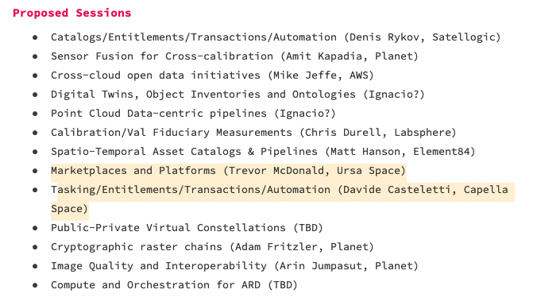
ARD23 Program

Slide 6
Questions + Discussion
Guidance received:
No program yet
Should look very similar to previous years (ARD21 Program)
Sessions of 1-2 hours, short talks followed by a panel discussion and Q&A. Usually 3-4 talks.
For the CEOS session Ignacio thinks: “it would be useful to address practical topics such as governance, intended use, current state, upcoming decisions and examples of implementation and/or compliance presented by providers”.
Approach for CEOS session
What are our main messages?
Questions?

Slide 7
Tentative topics
ISO/OGC ARD SWG (Josh)
CDSE (Sinergise/Grega)
S2 L2H/F, GRI (ESA, Enrico Cadau)

