Slide 1
The Committee on Earth Observation Satellites (CEOS) AFOLU Roadmap
Ben Poulter (NASA GSFC), Frank Martin Seifert (ESA), Osamu Ochiai (JAXA), Stephen Ward (JAXA), Stephen Briggs (ESA)
Credit: NASA

Slide 2
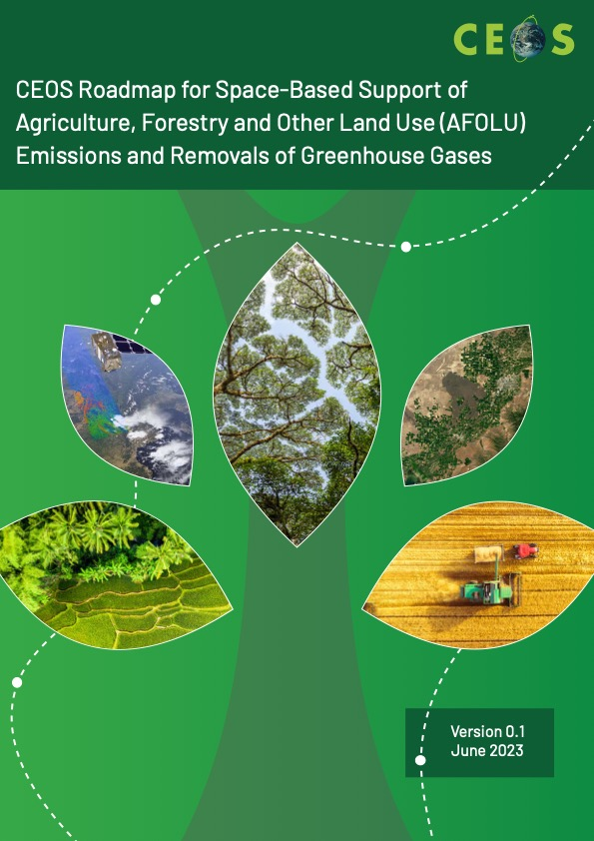
CEOS AFOLU Roadmap: Acknowledgements
Benjamin Poulter (NASA Goddard Space Flight Center), Osamu Ochiai (JAXA), Frank Martin Seifert (ESA), Clement Albergel (ESA), Stephen Briggs (ESA), Mark Dowell (EC-JRC), Laura Duncanson (University of Maryland), Sven Gilliams (VITO), Nancy Harris (WRI), Martin Herold (GFZ), Neha Hunka (University of Maryland), Heather Friendship-Kay (Aberystwyth University), Ian Jarvis (GeoGlam), Richard Lucas (Aberystwyth University), Yasjka Meijer (ESA), Joana Melo (EC-JRC), Shaun Quegan (University of Sheffield), Ake Rosenquist (JAXA), Lindsey Sloat (WRI), Terry Sohl (USGS), Daniela Requena Suarez (GFZ/WUR/GFOI), Stephen Ward (JAXA), Alyssa Whitcraft (University of Maryland), Silvia Wilson (USGS)

Slide 3
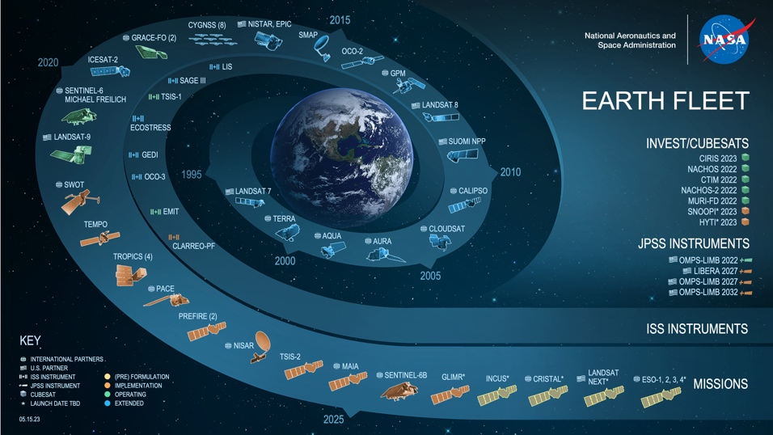
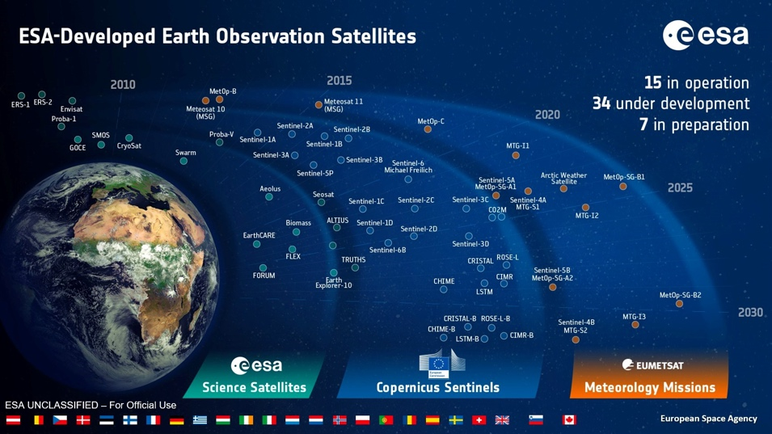
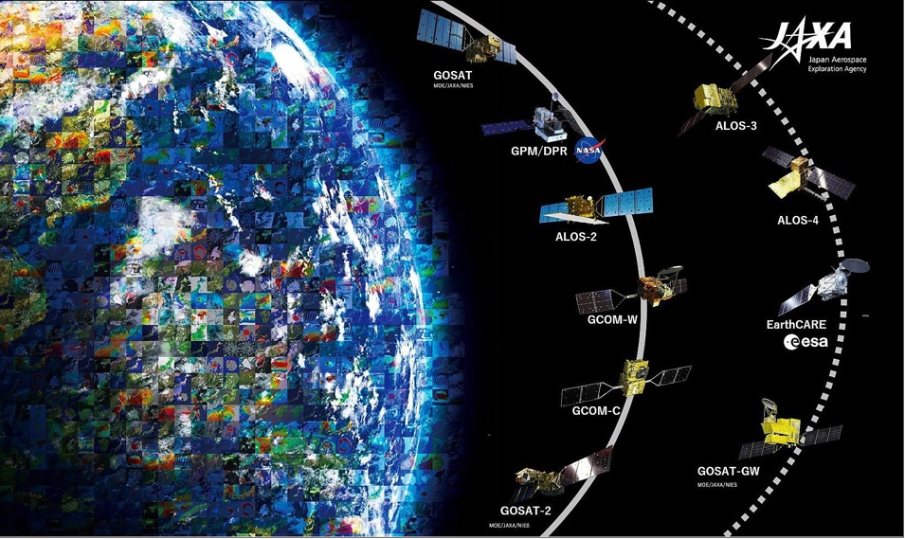
CEOS Strategy to Support the Global Stocktake
In 2021, the CEOS Strategy document to support the Global Stocktake was approved to:
Identify remote sensing observations related to atmospheric greenhouse gas (GHG) concentrations, land use and land cover change, and biomass emission factors
Work with the UNFCCC to identify areas where remote sensing data can be integrated within the IPCC Guidelines for National GHG Inventories
Enable ‘Measurement and Verification Systems (MVS)’ through top-down GHG approaches with bottom-up activity and emission data inventories

Slide 4
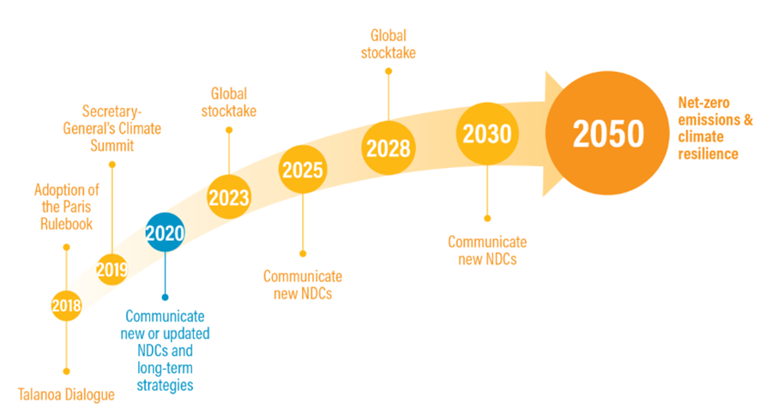
Earth Observations in support of Global Stocktake(s)
https://www.climate-chance.org/en/comprehend/blog-observatory-global-africa/cop28-first-global-stocktake-what-to-expect-paris-agreement/

Slide 5
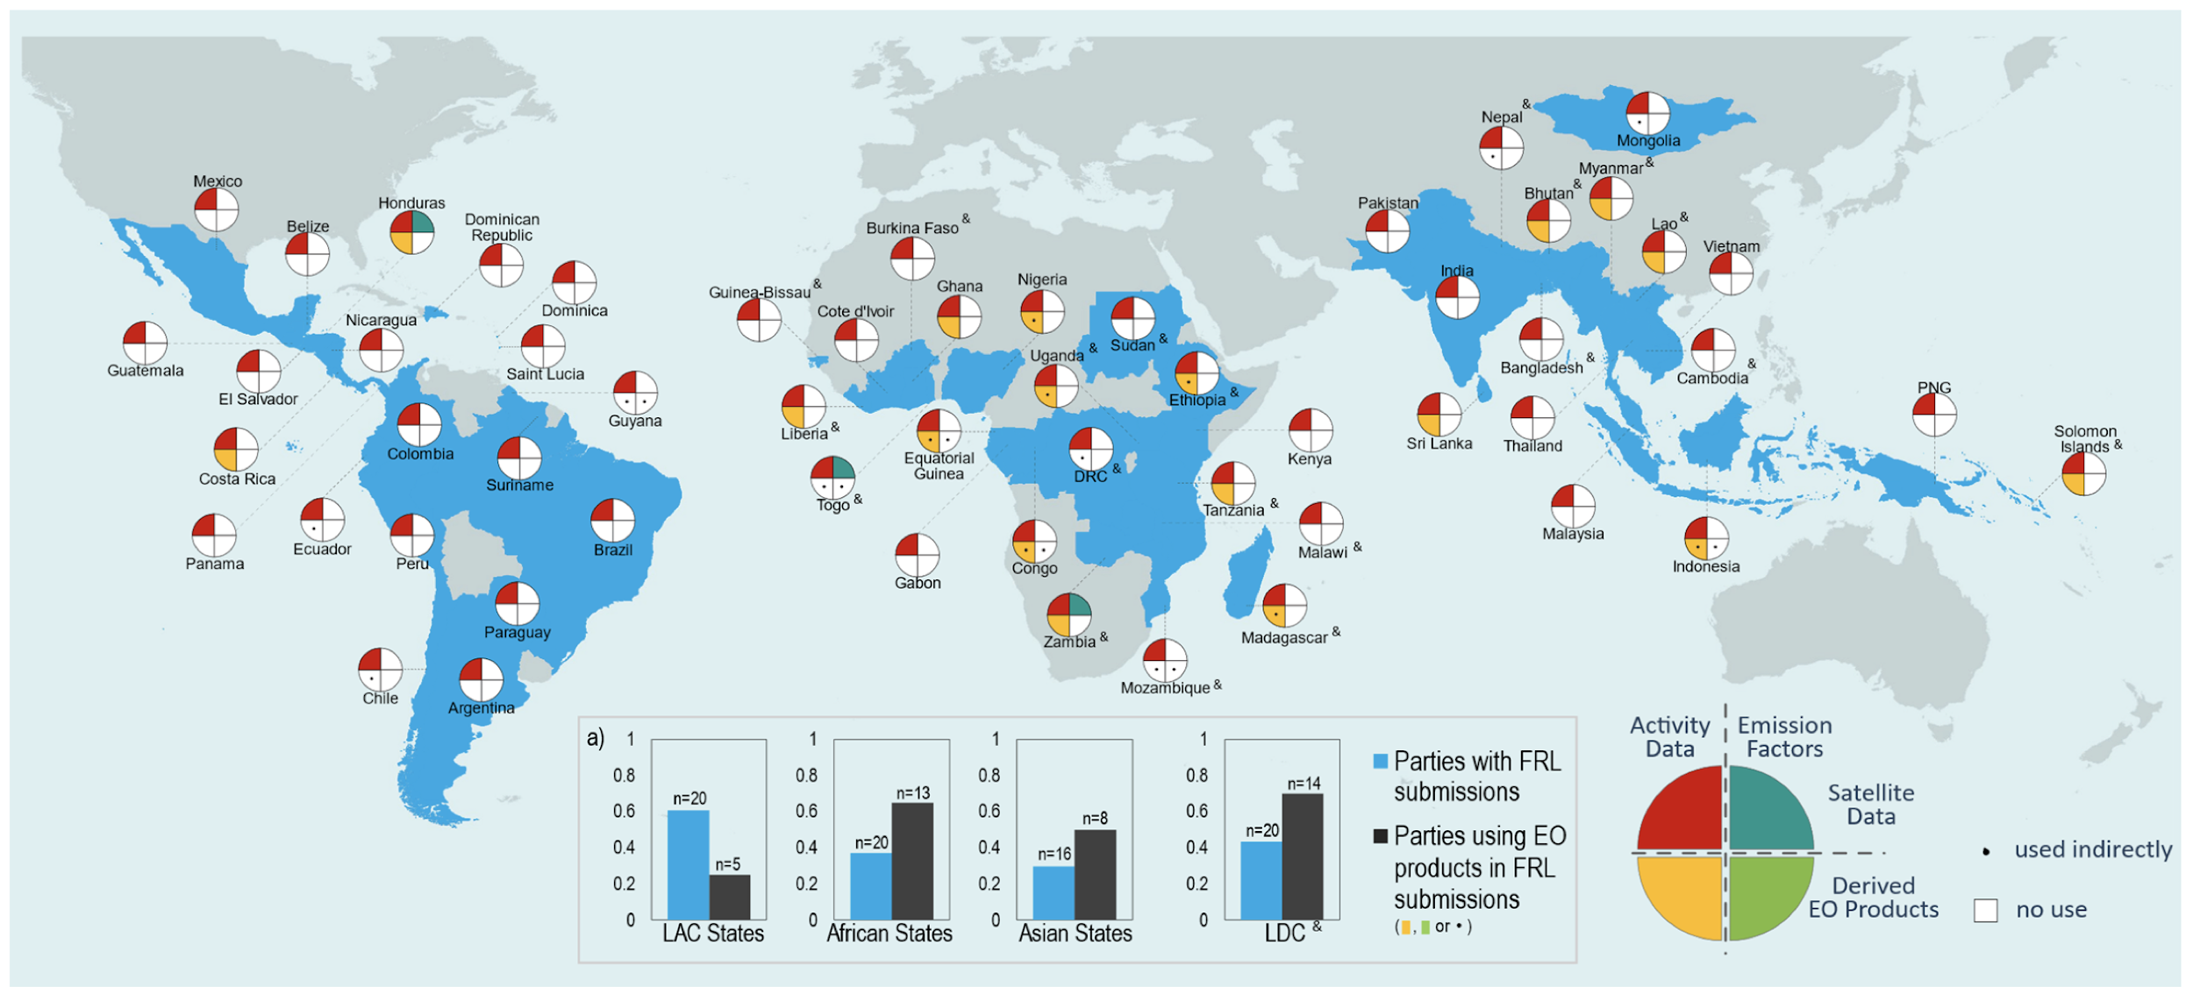
Opportunities for use of Earth Observations in NIR, BUR, REDD+, and ETF
Melo et al., 2023, ERL

Slide 6
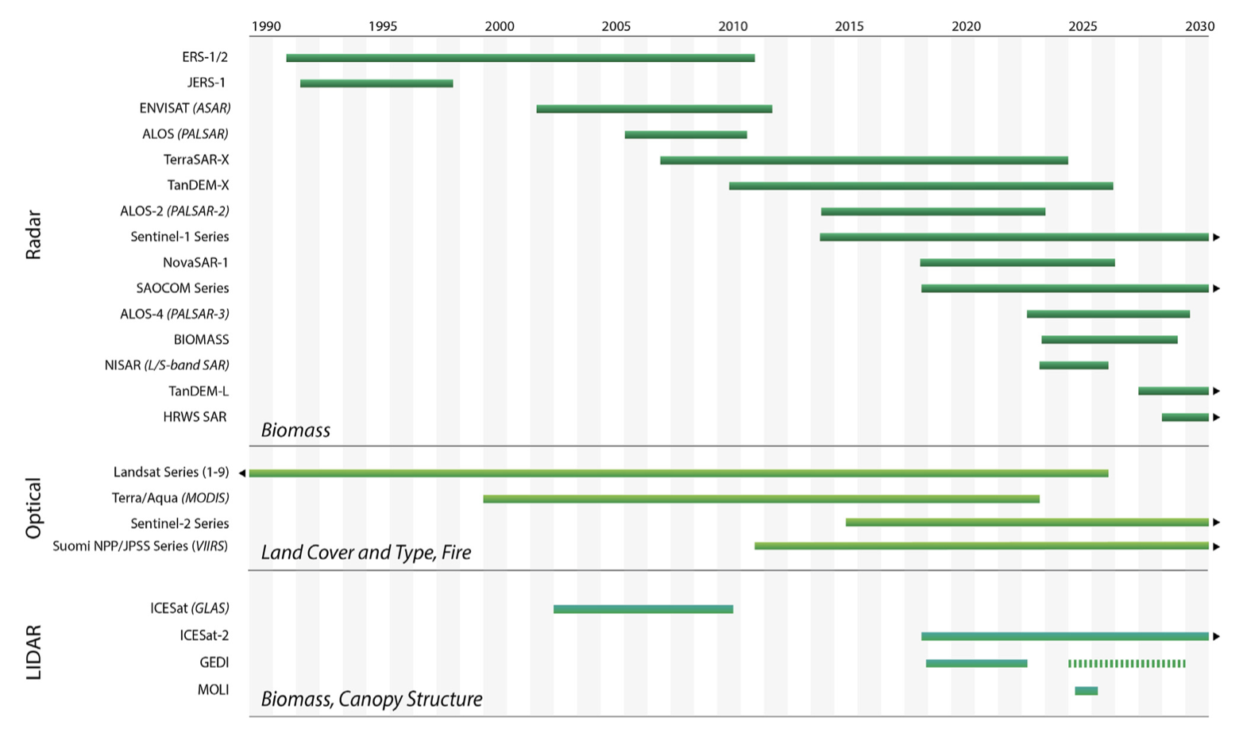
Role of Earth Observations in GST
Ochiai et al., 2023

Slide 7
The CEOS AFOLU Roadmap
Table of Contents
Overview of IPCC methodologies
Stock change
Gain loss
EO for Activity Data
Land cover change working group
EO for Emissions Factors
Biomass harmonization working group
Capacity Building and Stakeholder Engagement
Integrated Monitoring and Verification System
Recommendations

Slide 8
Key Recommendations (1/2)
Recommendation 1: Ensure long-term continuity for missions providing activity data and emission factors
Highlight where Research to Operations (R2O) of satellite missions is required
Recommendation 2: Coordination between CEOS and the IPCC and UNFCCC
Work with IPCC Taskforce on Inventories (TFI) on use of EO data in supporting GHG Inventories
Recommendation 3: Enable dialog between inventory practitioners and CEOS community
Identify and engage with stakeholders via capacity building programs, i.e., NASA SERVIR, USGS SilvaCarbon

Slide 9
Key Recommendations (2/2)
Recommendation 4: Support efforts to reconcile bottom-up, top-down, and inventory estimates of GHG emissions and removals
Harmonize approaches to meet standard definitions, i.e., managed vs unmanaged
Recommendation 5: Systematically target activities to support IPCC land cover classes
Land cover classification systems and cross-walking to IPCC classes vs other requirements
Recommendation 6: New Space partnerships
Integration of high-spatial resolution optical, radar and potentially lidar missions with shorter temporal coverage
Recommendation 7: GHG+
Enable integration of TD and BU methods for MVS

Slide 10
Next steps
AFOLU side event at CEOS SIT 39 to integrate agency comments on draft
Define set of ‘actions’ to implement the Roadmap recommendations
Present AFOLU Roadmap for endorsement of the CEOS Plenary (2023)

Slide 11
Thank you - & QR link to more information

Slide 12
Extra materials

Slide 13
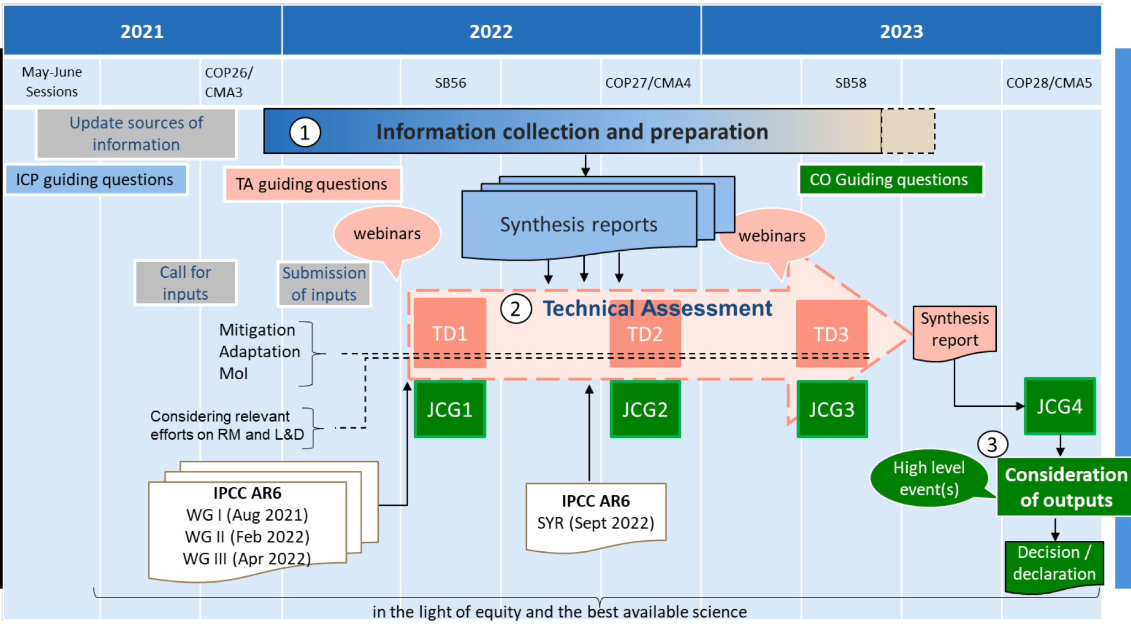

Slide 14
Land Cover Working Group
Forests
Agriculture
Mangroves and wetlands

Slide 15
Biomass Harmonization Working Group

Slide 16
Capacity Building Working Group

