Slide 1
CEOS-ARD Communications Activities
Libby Rose / Chris Barnes
Agenda Item 12.1
LSI-VC-14 2023, ESA/ESRIN
10th - 12th October 2023

Slide 2
CEOS-ARD Twitter
@CEOSARD
Following steadily growing!
102 followers - up from 55 in March
13 tweets March - Sept 2023
Averages
 | Mar-Sep 23 | Jun 22 - Mar 23 | % increase
Impressions | 855.38 | 334.13 | 156.00%
Engagements | 44.85 | 16.07 | 179.07%
Engagement rate | 6.13% | 4.81% | 27.45%
User Profile Clicks | 5.23 | 2.87 | 82.26%
* Statistics calculated as of 2 Oct
Notes:
Good growth since lsi-vc-13
Thanks to all for sharing and supporting
Who wants to be our 100th
Good growth across all metrics
Engagements especially important

Slide 3
Topics?
Always looking for things to share
Assessments
Data hosting, access
Applications, user stories
On our radar:
BiDS & VH-RODA
Landsat & DE Australia coastlines story
Landsat Collection 2 paper
Notes:
Email sent couple of weeks ago
Great response - thank you!
Now have a couple in the bank
Any topics relating to CEOS-ARD in general are relevant
Let me know

Slide 4
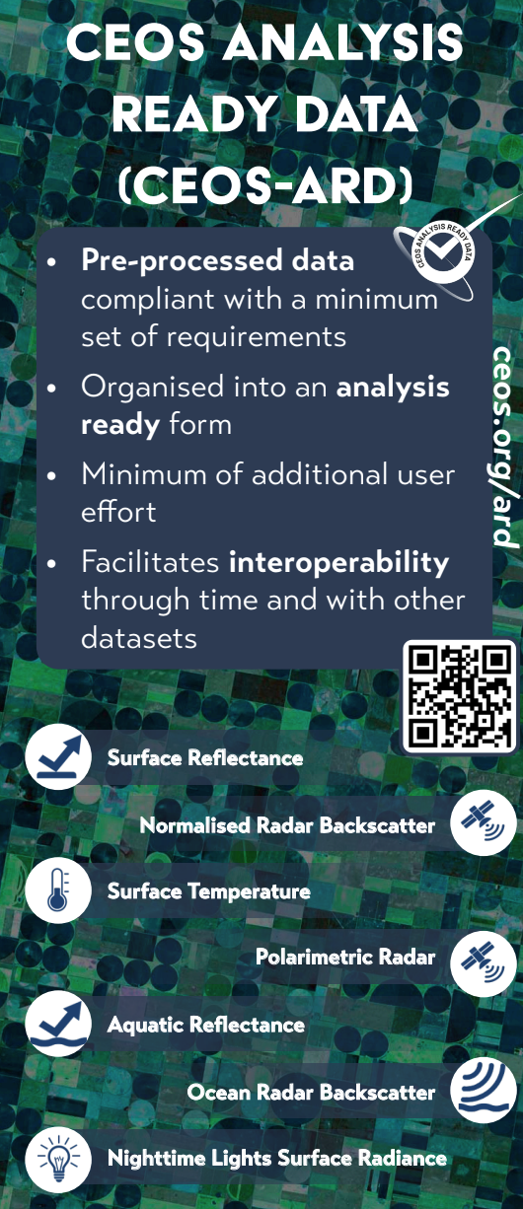
CEOS-ARD at IGARSS 2023
Poster (presented by Andreia)
Roll-up banner
Panel of CEOS Flyer
Notes:
Attended IGARSS in July with Dave, Brian and a couple from AMA team
Broad ceos booth
Two point where ARD was highlighted
Banner - in an ‘ask us about’ format
Have flyer on table
Poster a good visual summary of CEOS-ARD

Slide 5
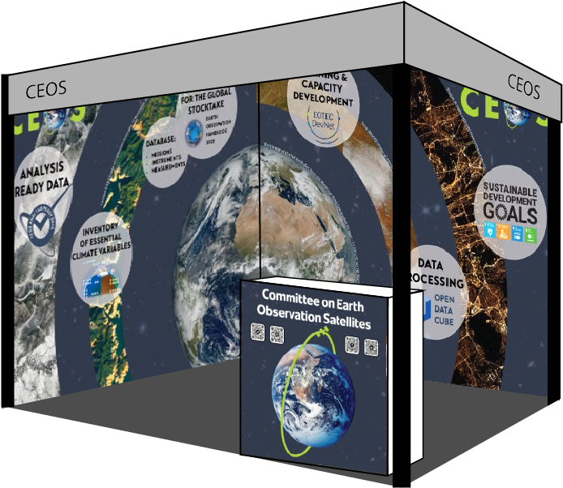
GEO Week 2023
Notes:
Can have full wall graphics
Similar format as the banner - ‘ask us about’
ARD featured on left wall
Centre image is MTG-I1 first light, fitting as the event is in SA

Slide 6
Branding Package
Now available online: https://ceos.org/ard/files/CEOS-ARD%20Logo.zip
Four colours, two file sizes
Includes design file + vector format
Notes:
Action from LSI-VC-13
Available in the header of ard website
Zip file, includes four colours
Blue is the preferred option
To be used by ARD datasets to show their certification
Or to promote CEOS-ARD broadly

