Slide 1
Aquatic Reflectance/Ocean Colour PFS Update
Chris Barnes, USGS/KBR
Agenda Item 5.3
LSI-VC-14 2023, ESA/ESRIN
10th - 12th October 2023

Slide 2
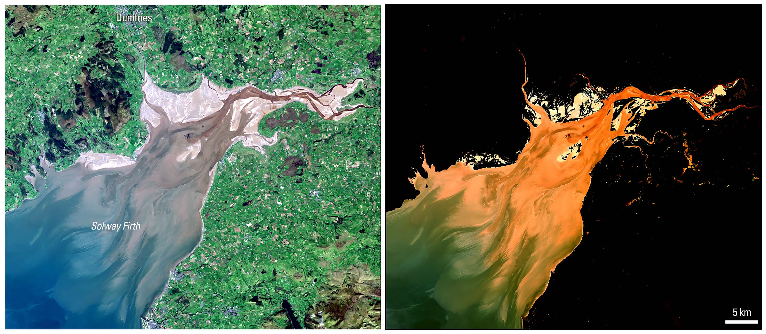
Agenda
CEOS Aquatic Reflectance (AR) Product Family Specification (PFS) History
- AR PFS v1.0 vs SR PFS v5.0
AR PFS Recent Activity
What’s Next?
Source: USGS Provisional Aquatic Reflectance

Slide 3
CEOS AR PFS History
Coordinated by: Andreia Siqueira (GA) & Chris Barnes (USGS/KBR)
Development began in March 2020 and finalized in February 2022
Applies to data collected by multispectral and hyperspectral sensors operating in the VIS/NIR/SWIR wavelengths over coastal and inland water bodies
Using the CEOS Surface Reflectance ARD PFS as a baseline, GEO-Aquawatch, Water-ForCE and subject matter experts around the world met virtually to review/modify and generate new Threshold and Target requirements
Special thanks to the technical lead: Arnold Dekker (SatDek)

Slide 4
AR PFS v1.0 vs SR PFS v5.0
Requirements Summary:
1.0 General Metadata (17/17)
No requirement changes
2.0 Per-Pixel Metadata (13/20)
1 requirement modified
Sea/Lake/River Ice Mask (Threshold)
10 new requirements identified (All required at Threshold)
Adjacency Effects
Altitude (ASL)
Bidirectional Reflectance Distribution Function
Deep/Shallow Water
Floating Vegetation/Surface Scum Mask
Optically Deep or Optically Shallow Assessment
Sky Glint Mask
Sun Glint
Turbid Water Flag
Whitecap/Foam Maskmont

Slide 5
Requirements Summary:
3.0 Radiometric and Atmospheric Corrections (6/14)
1 requirement modified
Atmospheric Reflectance Correction (Threshold)
8 new requirements identified (*5 required at Threshold)
Adjacency Effects Correction
Bidirectional Reflectance Distribution Function
*Floating Vegetation/Surface Scum Correction
*Other Trace Gaseous Absorption Corrections
*Sky Glint Correction
4.0 Geometric Corrections (1/1)
No requirement changes
~80% of the AR PFS requirements correspond with Surface Reflectance PFS requirements
Sun Glint Correction
*Turbid Water Correction
*Whitecap & Foam Correction

Slide 6
AR PFS Recent Activity
Reminder that current AR PFS v1.0 applies to data collected by multispectral/hyperspectral sensors operating in the VIS/NIR/SWIR wavelengths over coastal and inland water bodies
and… AR PFS v1.0 was only endorsed in February 2022
June 2022: CEOS-ARD Oversight Group learned NASA (Jeremy Werdell) and NOAA/Blue Planet (Emily Smail) were looking at the feasibility of adapting the AR PFS to include open oceans
November 2022: CEOS-ARD Oversight Group, including others from the ocean observing community, reaffirmed that a single consolidated AR PFS covering inland, coastal and oceanic waters is the preferred approach and should be developed in collaboration between CEOS, OCR-VC, GEO Aquawatch, and International Ocean Colour Coordinating Group IOCCG

Slide 7
AR PFS Recent Activity
March 2023: International Ocean Colour Coordinating Group (IOCCG) (Maycira Costa) led an effort to review the AR PFS and present their input at the 27th IOCCG Committee Meeting
Differences between Threshold and Target requirements, as Ocean Colour standardised processing is more mature
Pseudo-invariant reflectance features can be used on the land but not ocean
Are peer reviewed journal paper(s) published on algorithms required?
Differences in sun glint correction (in water bodies bounded by land)
Atmospheric adjacency correction for (heavily) land affected water pixels
Differences on how to deal with optically shallow water flags
…

Slide 8
AR PFS Recent Activity
July 2023: Small working group met to plan a strategy for coordinating feedback from the IOCCG/Aquatic Reflectance communities
Included: Maycira Costa (Univ. Victoria), Ewa Kwiatkowska (EUMETSAT), Arnold Dekker (SatDek), Claudia Giardino (NRC Italy), Sean Bailey (NASA), Matthew Steventon (Symbios), Chris Barnes (USGS/KBR)
August 2023: DLR experiences roadblocks in implementing an EnMAP AR product
Awaiting recommendations for inclusion in future AR PFS update via USGS/DLR bilateral engagement
October 2023: AR PFS v1.0 feedback and comments from IOCCG and aquatic reflectance communities shared with the working group from June 2023
November 2023: International Ocean Colour meeting will be used to finalize recommendations to CEOS ARD Oversight Group

Slide 9
What’s Next?
LSI-VC and ARD-Oversight Group facilitating the expansion of the current AR PFS to include oceanic waters, and ensure what is baselined for the land domain, does not break
Early 2024: IOCCG present recommendation to the ARD-Oversight Group to update the AR PFS v1.0 to include oceanic waters
Side note: USGS (Steve Labahn) is working to engage with CSIRO’s (Alex Held) AR ground validation site network to improve the USGS’s approach to measuring aquatic reflectance

Slide 10
Questions

