Slide 1
CEOS Interoperability Framework
Makoto Natsuisaka, WGISS
Tom Sohre, WGISS
Agenda Item 6.1
LSI-VC-14 2023, ESA/ESRIN
10th - 12th October 2023

Slide 2
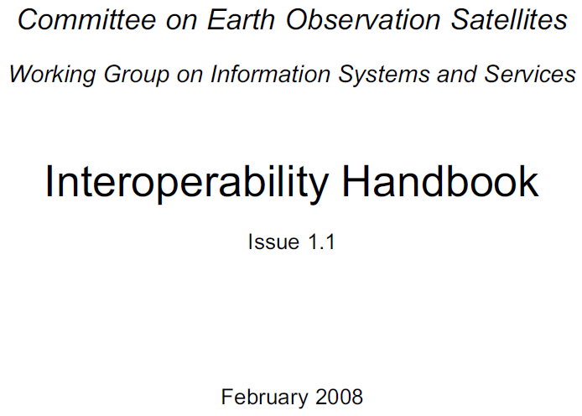
Interoperability Action
ACTION from 2022 CEOS Plenary
Goal to consider Data and Service Interoperability
Development of a CEOS Interoperability Framework and Roadmap
Reference Interoperability Definition(s):
Interoperability is the “ability of two or more systems or components to exchange information and to use the information that has been exchanged.”
ISO 25964 Thesauri and Interoperability with other Vocabularies (ISO 25964-2:2013)
F.A.I.R. Interoperability: Data is interoperable when it can be integrated with other data and systems to leverage open standards and specifications.
The FAIR Guiding Principles for scientific data management and stewardship | Scientific Data (nature.com)

Slide 3
Framework Development Team
CEOS WGCV
CEOS SEO
CEOS WGISS
CEOS ARD OG
Notes:
Lead: Makoto Natsuisaka
Participants
WGISS: Tom Sohre
WGCV: Philippe Gory
LSI-VC: Steve Labahn, Peter Strobl, Ake Rosenqvist
CEOS-ARD OG: Ferran Gascon, Paolo Castracane
SEO: Dave Borges

Slide 4
Framework Development
Meeting | Date | Topics
Kick off meeting | Feb. 15, 2023 | Discussed vision, teams, topics, membership and annual process. WGISS, LSI-VC, CEOS ARD OG, WGCV, SEO
#2 meeting | Mar. 1, 2023 | Discussed the components and the topics.
#3 meeting | Mar. 17, 2023 | Draft roadmap was proposed. Discussed the components and the topics based on the roadmap. Further discussions in each VC/WG were requested.
SIT-38 side meeting | Mar. 28, 2023 | Discussion on draft roadmap Initial identification of “Factors” critical for Interoperability
WGISS-55 | Apr. 20, 2023 | Reviewed SIT-38 recommendations Discussed history of WGISS Interoperability Handbook (2008)
#4 meeting | May 10, 2023 | Reviewed current Framework concept (7 factors) Assigned action to WG Leads to identify Factor Champions Set up recurring Interoperability IG meeting (2nd Wed. of month)
WGCV, CGMS | June 2023 | Presented Status of Framework
#6 meeting | June 14, 2023 | Reviewed Factors, Definitions, In/Out
#7 meeting | August 22, 2023 | Roadmap Factors consensus Data Call to ALL CEOS WG Chairs re: Interoperability Supporting Activities
#8 meeting | Sept. 27, 2023 | Reviewed CEOS Work Plan initial mapping
LSI-VC | October 2023 | Present Status of Framework / Roadmap
SIT-TW WGISS-56 Plenary | October October November | Present Status of Framework / Roadmap Discuss WGISS Interoperability Interest Group Goals Present Interoperability Framework / Roadmap

Slide 5
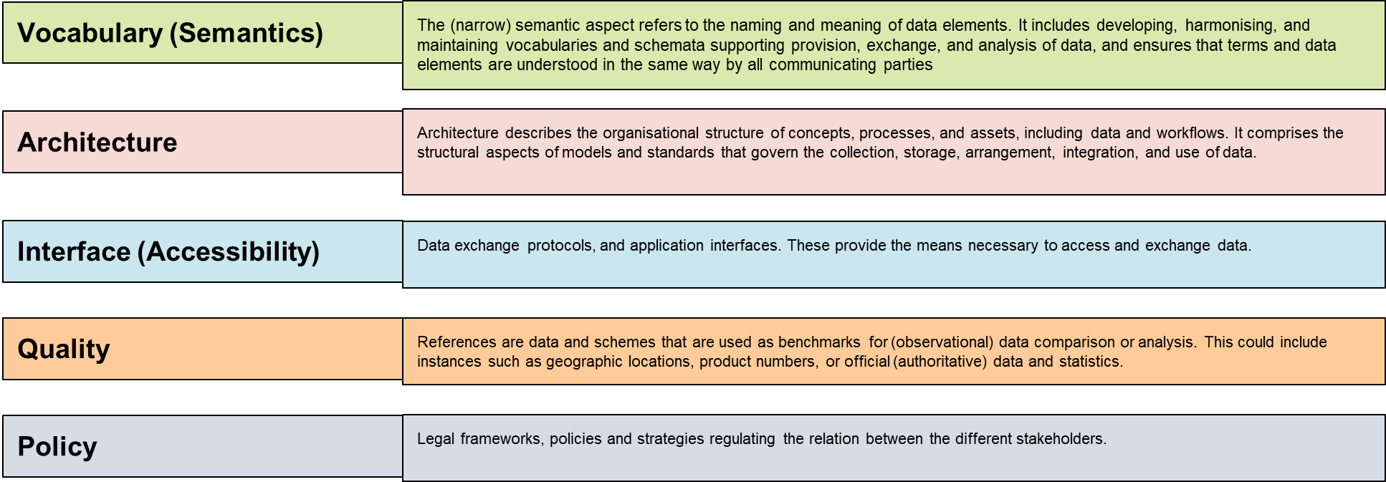
Interoperability Framework

Slide 6
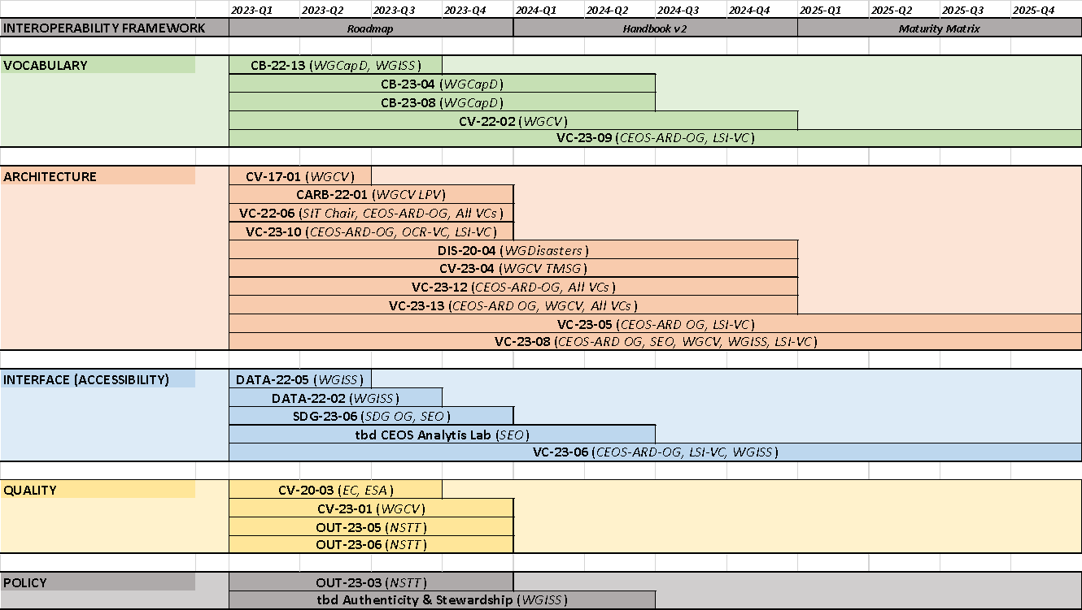
Interoperability Roadmap
Mapping of Interoperability Factors to CEOS Activities Identified in 2023-2025 Work Plan (March 2023 v1.1)

Slide 7
Notes re: Framework/Roadmap
Activities may (likely) support more than one Factor
TODO: Develop matrix of activities to Factor(s)
Activities benefit from the Factors as well as contribute to improving the overall Framework maturity
TODO: Identify Use Cases for Framework
TODO: Develop a Maturity Matrix (measure improvement)
Initial Roadmap identifies existing activities
TODO: Challenge WGs/VCs/etc to identify gaps and propose NEW supporting efforts

Slide 8
LSI-VC work plan items

Slide 9
Presenter Guidelines 1
Presenters should name their file using the following convention:
AgendaItemNumber_LastName_Subject_Version (e.g., 1.1_Labhan_Welcome_v1)
Documents and presentations should be uploaded to the shared folder to allow for streamlined self service
Shared Presentation Folder (default view only, ask for upload/edit permission as required)
For support contact matthew@symbioscomms.com
Presentations should be submitted by 3 October
Meeting website: https://ceos.org/meetings/lsi-vc-14/
Please explicitly highlight the decisions, outcomes, or actions you are seeking. The more explicit you are, the better. i.e., feel free to provide text for a proposed action – it may be revised later, but this approach will help with the efficient preparation of the actions record of the meeting.

