Slide 1
2.3: Product Family Specification Feedback and Updates
Discussion and Decisions
Agenda Item #2.3
LSI-VC-15, Tokyo
3rd - 5th April 2024

Slide 2
Firstly: GitHub Issue Tracker
https://github.com/libbyrose/ceos-ard
In time it will be merged into a CEOS 'organisational' GitHub run by CEOS SEO
Accessible from menu at ceos.org/ard
Open issues will be tracked here from now on replacing the old spreadsheet on GDocs
All open issues have been transferred and categorised
A number of issues flagged 'LSI-VC-15' to raise today and seek decisions to close them!
LSI-VC-15 Action!
Please sign up for GitHub and join the discussion threads!
And contact Libby if any issues with permissions libby@symbioscomms.com

Slide 3
CHIME Feedback on CEOS-ARD SR PFS
Ferran Gascon, ESA

Slide 4
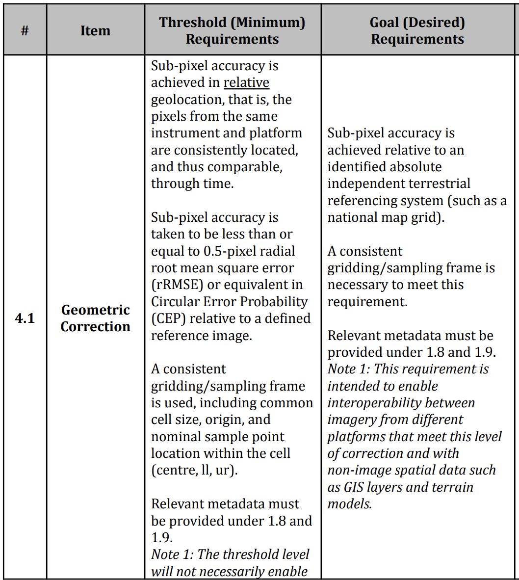
CHIME Feedback on CEOS-ARD
With respect to CEOS-ARD PFS Surface Reflectance v5.0.1 document.
CHIME team wonders if bottom-of-atmosphere reflectance products on sensor geometry that have been appended a per-pixel lat./long./altitude refined geometry information information are CEOS-ARD compliant.
PFS SR chapter 1.6 “Map Projection” indicate that non-projected products are still compliant.
However, in chapter 4.1 “Geometric Correction” Threshold requirements, the description is considered as not clear in particular regarding what can be considered as “consistent”.

Slide 5
CHIME Feedback on CEOS-ARD
“Sub-pixel accuracy is achieved in relative geolocation, that is, the pixels from the same instrument and platform are consistently located, and thus comparable, through time.”
In sensor geometry a near coincident ground location will appear on a different image locations within the products and the actual pixel footprint will be slightly different.
“A consistent gridding/sampling frame is used, including common cell size, origin, and nominal sample point location within the cell (centre, ll, ur).”
In sensor-geometry each image element corresponds to a given focal-plane element, but this does not translate to a fixed ground sampling distance (it will depend on the local DEM). Does this qualifiy as consistent sampling?
What does constitute a consistent gridding? Can a consistent gridding be achieved without a map projection?
Page 19: “These products would be resampled onto a common geometric grid (for a given product) and would provide baseline data for further interoperability both through time and with other datasets.”
This would not be satisfied by CHIME sensor geometry products.

Slide 6
GitHub Issues to be resolved at LSI-VC-15
– to aid STAC Extension Work

Slide 7
2.13 in SR / NLSR – Goal Requirement "to be determined"
Need to clarify or remove this
AOD is clearly important, and should feature at some point, but this null row is not helpful
Proposed LSI-VC-15 Decision: Change to ‘As Threshold’ or just ‘Not Required’
Discuss!
https://github.com/libbyrose/ceos-ard/issues/10

Slide 8
'No Data' Definition
AR
SR / ST / NLSR
The empty pixels terminology is problematic ?
Matthias' proposal for LSI-VC-15 decision: Replace “(‘empty pixels’)” with “(e.g., ‘empty pixels/invalid observation/below noise floor’)” in SR/ST/NLSR PFS
Also need to harmonise this terminology with SAR side?
https://github.com/libbyrose/ceos-ard/issues/4

Slide 9
No Data' Definition Contd.
Peter suggests differentiating four cases at threshold level:
Sensor-dependent:
'NoData': No sensor reading available (e.g., outside FOV).
'Invalid': Sensor acquired observation, but no valid result obtained (e.g., below noise floor).
Measurand-dependent (may change over the value chain):
'Falsified': Valid observation acquired, but not representing desired measurand (e.g., cloud/snow).
'Valid': Verifiable observations of the measurand (e.g., ToR, LST).
Note that this issue is not just 'optical'. Should be linked with issues #7 and #17 for a holistic discussion of flags regarding data quality. Many can be generalised and streamlined across all types of observations.

Slide 10
Spectral Bands & FWHM
Spectral bands (1.10) requires only central wavelength for SR/ST/NLSR PFS.
For AR it additionally requires FWHM.
Can this be aligned?
To promote interoperability between different datasets, we need more information than just the central wavelength of spectral bands.
Proposal for LSI-VC-15 Decision: Adjust the SR, ST, NLSR PFS to include at a minimum:
– FWHM at Threshold
– Full Spectral Response Function at Goal
https://github.com/libbyrose/ceos-ard/issues/3

Slide 11
Map projection (1.6) inconsistencies
ST
SR
NLSR
AR
Map projection is required at Threshold in all PFS except for ST. Can this be aligned?
Inconsistency affects STAC Extension work.
Recall v5.0.1 update to SR PFS also - another inconsistency
Is there a specific reason this is a Goal requirement for ST, rather than Threshold?
LSI-VC-15 Decision: Is it appropriate to simply take 1.6 from SR PFS and use that for ST PFS? (and AR, NLSR…)
https://github.com/libbyrose/ceos-ard/issues/1

Slide 12
Map projection (1.6) inconsistencies
Peter’s suggestion is distinguishing between two geometric requirements:
a) Geolocating: Determines the geographic location of an observation/pixel.
b) Georectification: Corrects sample locations to achieve a regular 2D geographic grid. Sharing the grid enhances interoperability.
In most cases this step requires resampling of original observations. It will only foster interoperability ('analysis readiness') if respective grid is shared with other datasets with which interoperability is desired. In this case the specific (harmonised) grid should become part of a threshold requirement. A rectification to a grid, arbitrarily chosen by the provider, is generally not desirable. In this case requirement a) is sufficient and should ideally be accompanied by:
c) Resampling method: Derives values for locations other than observed ones. This remains a goal due to various applicable methods.

