Slide 1
LSI-VC-15 Item 4.5
Wetlands:
JAXA update from the Ramsar Convention
Scientific and Technical Review Panel (STRP)
Ake Rosenqvist, JAXA/soloEO

Slide 2
The Ramsar Convention
The Ramsar Convention on Wetlands
Established 1971 in Ramsar, Iran
20 years before the UN Rio Conventions (UNFCCC, CBD, UNCCD)
172 Contracting Parties
Conference of the Parties (COP) every 3 years
Ramsar Convention Strategic Plan:
Goal 1 - Addressing the drivers of wetland loss and degradation
Goal 2 - Conservation and management of the Ramsar Site Network
Goal 3 - Wise use* of all wetlands
Goal 4 - Enhancing implementation of the Convention
* Wise use: conservation and sustainable use of wetlands and all the services they provide, for the benefit of people and nature.

Slide 3
The Ramsar Convention
Bodies of the Convention
The Conference of the Parties (the COP)
The Standing Committee
The Ramsar Secretariat (SG: Dr Musonda Mumba)
The Scientific and Technical Review Panel (STRP)
The STRP
The “Ramsar SBSTA”
Develops scientific and technical guidance to the COP
JAXA and ESA Observer Organisations to STRP

Slide 4
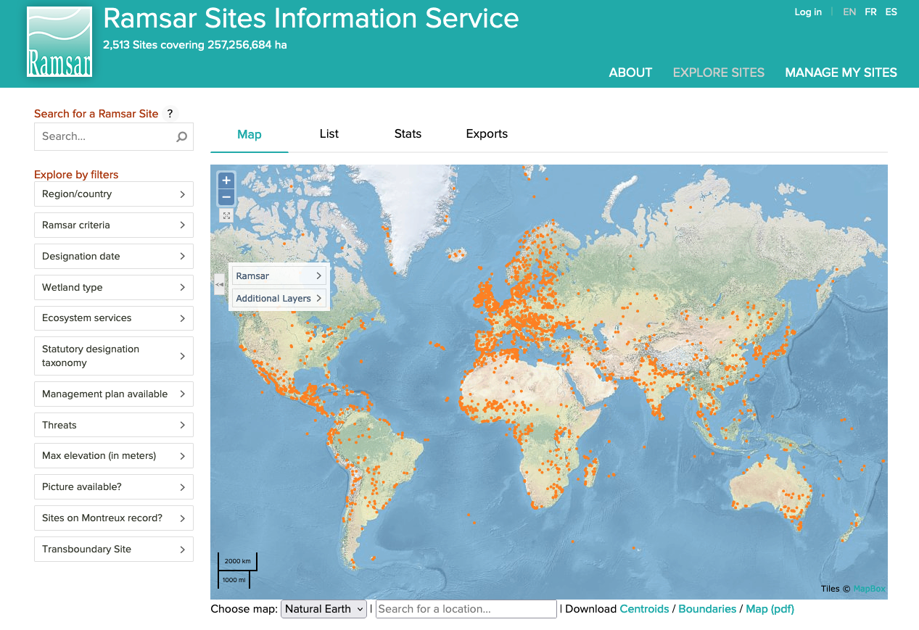
The Ramsar List
The Ramsar Database of Wetlands of International Importance
List of wetlands designated by the Contracting Parties
2400 Ramsar Sites in 172 countries
However:
Information lacking or outdated
Geospatial information on wetland extent lacking or inadequate (often lat/long centre point only)
No information on wetland loss/degradation over time
→ Not adequate for reporting or management
https://rsis.ramsar.org/

Slide 5
The Data Gap
STRP-25 (@RamsarSec, Switzerland, Feb 2024):
Only a fraction of Contracting Parties fulfil their reporting req.
“Critical need” for improved wetland mapping and inventory.
Gap of adequate and up-to-date data on wetlands – both for Ramsar Sites and wetlands globally recognised as the Elephant in the Room for effective implementation of the Convention both at country level and globally (Strategic Goal 4).
→ There is a clear role for Earth observation

Slide 6
CEOS and Wetlands
Links to ongoing CEOS/GEO activities:
UN SDGs: EO4SDG
SDG 6.6.1 (Change in wetlands extents over time)
CBD/GBF: GEO Global Ecosystems Atlas
Pilot demo: Global Mangrove Watch
UNFCCC: AFOLU Roadmap
Recommendation 5.d: improve mapping of wetlands
Action: support new wetlands mapping work (including Global Mangrove Watch) and ensure future missions take this into account - JAXA, ESA lead
Ramsar: GEO-Wetlands
Dormant…

Slide 7
CEOS and Wetlands
MORE is required
Wetlands are notoriously difficult to map due to their great diversity and variability in extent over time.
whole range of EO sensors required
Ongoing CEOS efforts cover only a fraction of the World’s wetlands
Requirements for wetlands related parameters expected to be formulated by the Ramsar STRP next triennium (2025/H2)
Is there a role for LSI-VC to support (forthcoming) Ramsar geospatial information needs ?

