Slide 1

SIT-39
2024
GEOGLAM
Alyssa Whitcraft | GEOGLAM
Agenda Item # 3.5
SIT-39 2024, Tokyo, Japan
10th - 11th April 2024

Slide 2
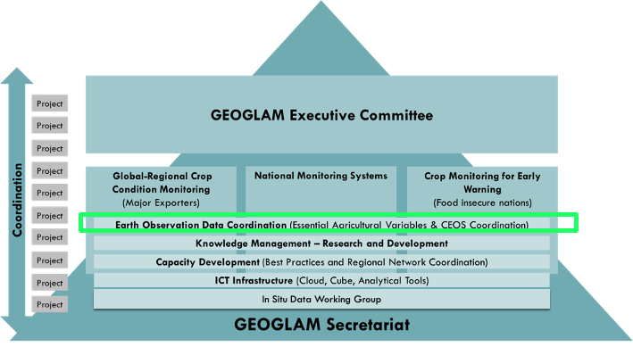
GEOGLAM’s Relationship with CEOS
GEOGLAM enjoys a long-term relationship with CEOS on coordination of EO data
GEOGLAM shares satellite data requirements:
  Acquisition:
    Spatial
    Spectral
    Temporal
    Radiometric
  Access & Compute
  Products??

Slide 3


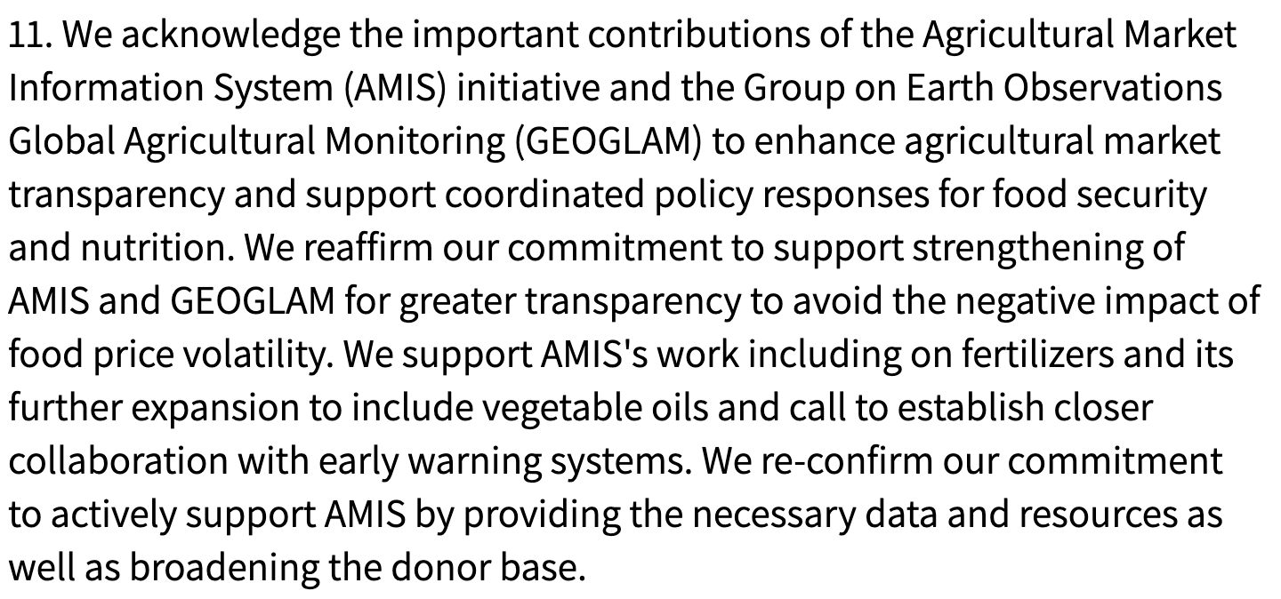
GEOGLAM General Update
New GEOGLAM Secretariat Director –
Sven Gilliams
  With thanks to Ian Jarvis for his 5 years as Director!
GEOGLAM Co-Chairs
  Wu Bingfang (Chinese Academy of Sciences)
  Chris Justice (University of Maryland)
  Bettina Baruth (European Commission)
  Jana Blogman (German Ministry of Ag)
GEOGLAM again endorsed
by the G20 →
GEOGLAM also supporting national statistics, AFOLU, Sendai, SDGs…

Slide 4
From a 2018 GEOGLAM community survey
(small sample, but representative)
From Ag Monitoring “End User” organizations:
All agreed that their organization would benefit from a greater use of EO data in their org’s decision making
Q: If your organization does not use satellite EO at any level of their decision making process, why is that the case?
“…org interested in EO, unsure how to incorporate”
“…org thinks EO data are too expensive or difficult to access…”
“…org thinks EO data are too unreliable to implement operationally…”
Other answers:
  Can’t keep up to date with which products are good
From EO-for-Ag practitioners:
<50% agreed that they had access to all of the EO they needed for their analyses
65% agreed they required additional technical support to download, process, or utilize EO (even seasoned EO practitioners!)
Strong indication of desire for standard products:
  Cloud-free, intercalibrated/harmonized time series (“ARD”)
  Essential Agriculture Variables like crop type map, crop calendar …
Most consistent boundary identified: lack of field data!
Whitcraft, et al. (2018)
Notes:
Recurring theme of difficulty in access/discovery as well as in perceived/actual unreliability.
New sensors, new methods → constant iteration
Need consensus voice → what’s real, what isn’t?

Slide 5
For a complex policy and operations environment, we need an integrator from EO to Impact
  GEOGLAM is a bridge between communities
    Policy & decisions drive the information needs
    Information needs drive the analytical needs
    Analyses run on data
    Data requirements inform space agencies
    Analytical needs identify capacity development and ICT needs
Policy / Use
Analysing & Adding Value
Products
Justifying and
Defining Needs
Data
Notes:
Reminding people of why GEOGLAM exists as a community… how we are this key linkage between policy/use and data. I have intentionaly greatly oversimplified.

Slide 6

Satellite Data Value Chain
“Data produced must be policy-relevant and not exist for its own sake.” (UN Statistics Division, 2017)
  Clear mandate to harmonize and synergize
“Essential Agriculture Variables” (EAVs) emerged as a unifying framework to maximize EO value and meet multiple information and decision needs

Slide 7
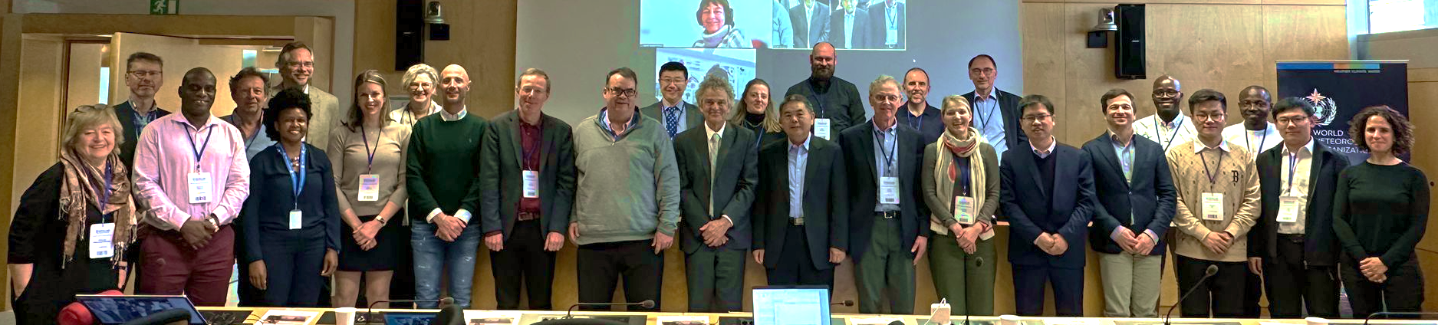
Essential Agriculture Variables
What:
  Satellite-based “building blocks” that in combination with one another and/or other non-EO information support actionable, policy-required information on the state, change, and forecast of agricultural land use and productivity.
  Learn from ECVs, seek to harmonize with other communities
Who:
  2 Co-leads (Whitcraft, Gilliams) + 27 ”EAV Stewards” from GEOGLAM operations or operational research Community
Timeline:
  2018: Socialized with GEOGLAM community
  2019: GEOGLAM Workshop
  2020: Virtual sprints
  2022: 1st version published
  ← 2023: Community priorities + supporting work areas ID’d

Slide 9
Ag Domain EAVs
Water Productivity
Irrigated Cropland Map
Reference Crop Calendars
Current Crop Stage
GDD
Crop condition assessment
Crop yield forecast
Crop Yield estimation
Rangeland Condition assessment
Land Management Calendar
Agriculture Mask
Cropland Mask
Rangeland Mask
Seasonal Fallow mask
Seasonal Cover Crop Mask
Non-Perennial Cropland Mask
Perennial Cropland Mask
Managed Grasslands Mask
Crop Type Masks
Field Boundaries
Crop Type Area Estimation
Agricultural Burned-Area Map
Met & Land Domain EAVs
Land surface temp (ECV)
Air temperature (ECV)
Surface Soil Moisture (ECV)
Root Zone Soil Moisture (ECV)
Wind Speed (ECV)
Precipitation (ECV)
LAI (ECV)
fAPAR (ECV)
Incoming radiation
Relative humidity
Reference Evapotranspiration
Actual Evapotranspiration
Seasonal Dynamics of Surface Water Availability
Aboveground Agricultural Biomass
Fractional Cover
Soil Carbon
Runoff
Residue Cover
Surface roughness
I think I missed flagging a few ECVs
+base multispectral data and simple Indices

Slide 10
Implementing the EAVs
Work Areas to ”Implement” EAVs
  Defining EAVs – complete
  Corresponding data requirements
    Satellite (partial)
    In Situ (partial; related to...)
  Initiative on Product Quality
    Validation and product documentation good-practices (1 workshop completed; 1 planning)
  Harmonization with other communities
    ID duplicate variables (complete with ECVs)
    Align land use typology for border classes
  Gap Analysis
    i.e. what is missing to produce + put into use?
  Production

Slide 11
GEOGLAM Activities Related to EAVs
(examples)
GEOGLAM has always been supported by community activities – bottom-up! - with ”cross-cuts” that address community needs and priorities
Multiple community projects / programs contributing →
GEOGLAM Crop Monitor → Crop Condition
ESA WorldCereal → Crop Type maps for Wheat, Corn; working on others
Asia-RiCE → many variables for rice
China CropWatch → Crop Condition
NASA Acres Consortium → designed around EAV concept, for US
  Yield
  Cropland and Crop Type Mapping
  Crop Calendar
  Field Boundaries and Sizes
  Multiple management EAVs
  Rangeland Condition / Quality
  Pest & Disease Mapping
  Soil Organic Carbon Stocks & Change
  ET
Copernicus Land Services

Slide 12
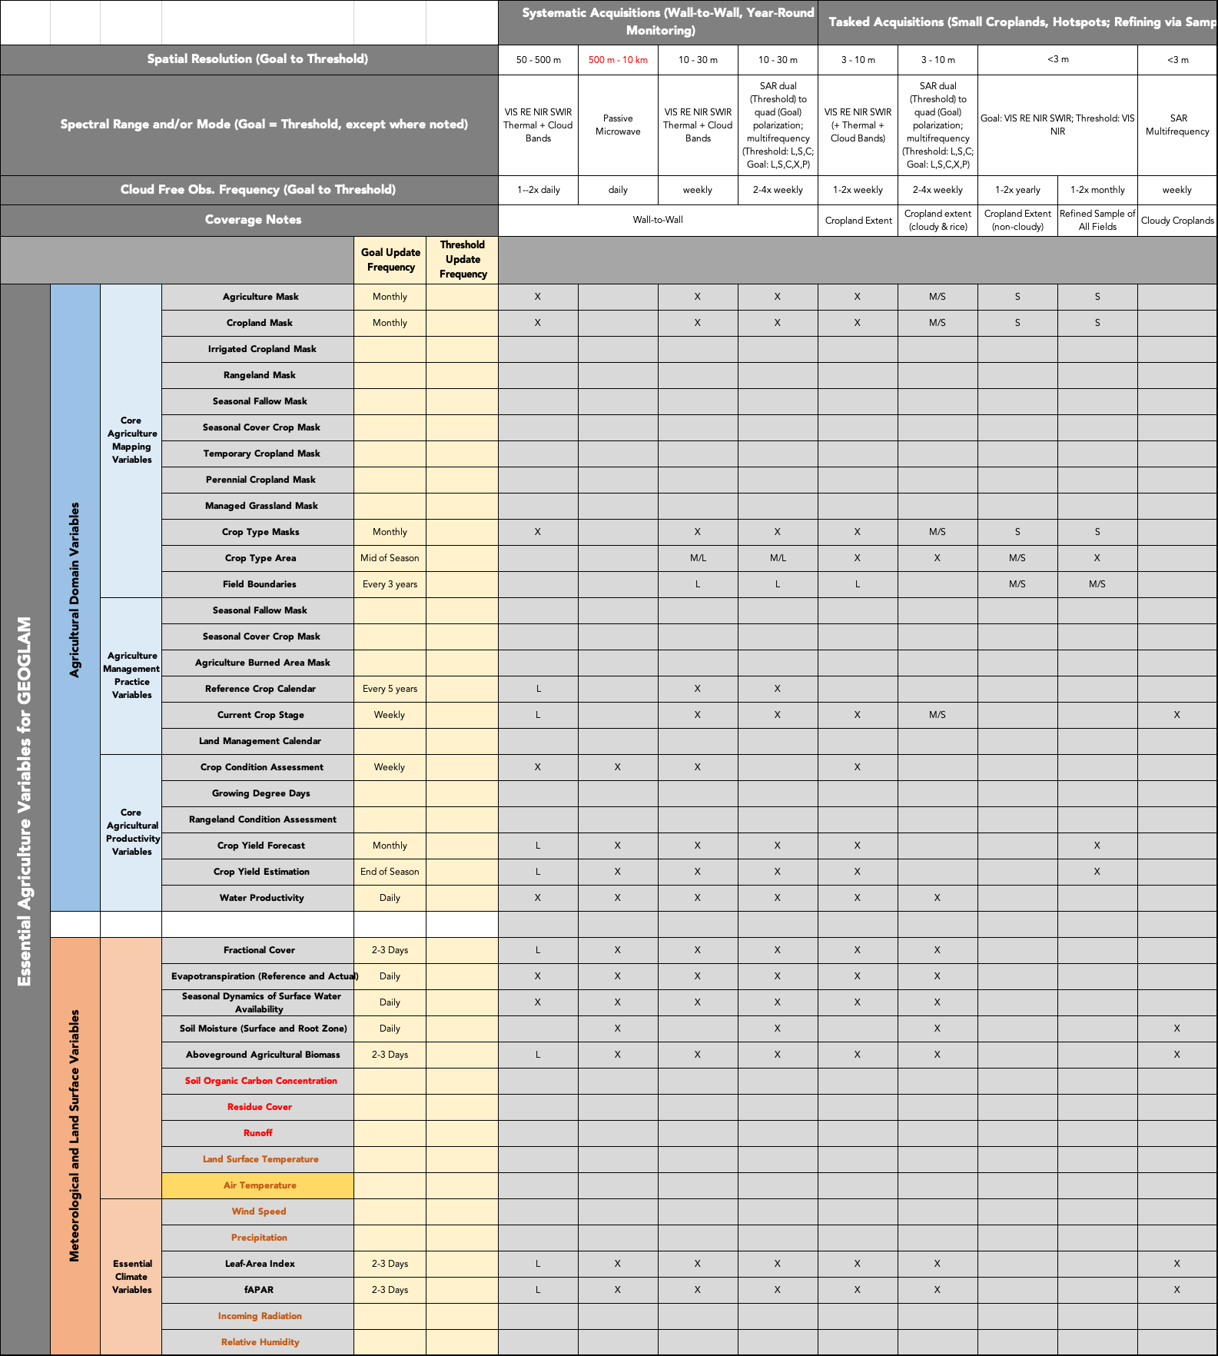

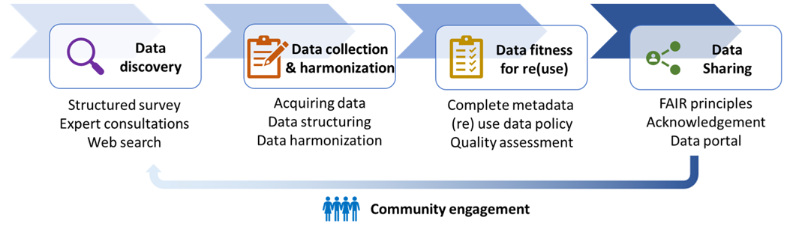
GEOGLAM Cross-Cut Activities Related to EAVs
(examples)
in progress revision of GEOGLAM Observation Requirements Table
Nelson, Teuben, Whitcraft et al. (2023)
Toward a global, extensive, open reference data repository
Notes:
Can add another figure here for the LPV meeting

Slide 13
Where we are
While the variables have been articulated,
And we have multiple contributions from the community in the form of projects & of cross-cuts…
there remain critical gaps in the production of the EAVs as either standard products or as “pipelines” to generate the products (e.g. open source tool-kits, user-friendly interfaces).

Slide 14
Gap Analysis Framework
“endorsed” by GEOGLAM ExCom March 2023
Conditions for EO adoption in producing Agriculture Information and Knowledge
Conditions for Production
of Ag Domain Variables
Conditions for Production of
Climate & Weather Variables

Slide 15
For a specified USE CASE…
Policy Conditions (Secretariat Summarizes all information and does engagement/advocacy around EO uses and pathways there)
Conditions for EO adoption in producing Agriculture Information and Knowledge
Organizational Conditions
Current status of EO usage
Mandate
Funding
Summarized Variable Conditions
EO data source
in situ data source
method source
operational product provision
Integrated Analysis System
Method for integrating EO data/products
Compute/IT
Technical capacity to use analysis system(s)
Operational transition
Ownership of initial system
Capability to manage changes (in variables, IT, sensors, new methods)
Ag Variable 1
Ag Variable 2
Ag Variable n
Conditions for Production
of Ag Domain Variables
  Summary of C&W variables
  In situ source (specific to this variable) → collected, accessible
  Method status → open or closed; scalable/transferable Y/N; validated Y/N; performance quality
    In which regions/systems do we have good methods, in which regions/systems do we not?
  Is there a standard product for this variable broadly accessible?
C&W Variable 1
C&W Variable 2
C&W Variable n
Conditions for Production of
Climate and Weather Variables
  EO data source → collected, accessible
  In situ source → collected, accessible
  Method status → open or closed; scalable/transferable Y/N; validated Y/N; performance quality
  Is there a standard product for this variable broadly accessible?
Notes:
Use Case
For each underpinning variable
EO data source → collected, accessible
In situ source → collected, accessible
Method status → open or closed; scalable/transferable Y/N; validated Y/N; performance quality
Is there a standard product for this variable broadly accessible?
For the use case – is the information needed being developed continuously and operationally?
Organizational conditions --> has the organization mandated someone to create EO-based information, and supporting them with sufficient resources?
Are the standard products for underpinning variables in place?
Technical capacity of individuals in organization
If not, are there resources to do the training/tech transfer/ongoing support?
Is there sufficient public documentation of related variables and tools (i.e. “Knowledge management”)

Slide 16
For a specified USE CASE…
Policy Conditions (Secretariat Summarizes all information and does engagement/advocacy around EO uses and pathways there)
Conditions for EO adoption in producing Agriculture Information and Knowledge
Organizational Conditions
Current status of EO usage
Mandate
Funding
Summarized Variable Conditions
EO data source
in situ data source
method source
operational product provision
Integrated Analysis System
Method for integrating EO data/products
Compute/IT
This informs:
CEOS observation,
In situ observations
analysis platforms
”science team” funding priorities
Technical capacity to use analysis system(s)
Operational transition
Ownership of initial system
Capability to manage changes (in variables, IT, sensors, new methods)
This informs:
CapDev Guidance and Priorities
IT working group priorities
Ag Variable 1
Ag Variable 2
Ag Variable n
Conditions for Production
of Ag Domain Variables
  Summary of C&W variables
  In situ source (specific to this variable) → collected, accessible
  Method status → open or closed; scalable/transferable Y/N; validated Y/N; performance quality
    In which regions/systems do we have good methods, in which regions/systems do we not?
  Is there a standard product for this variable broadly accessible?
C&W Variable 1
C&W Variable 2
C&W Variable n
Conditions for Production of
Climate and Weather Variables
  EO data source → collected, accessible
  In situ source → collected, accessible
  Method status → open or closed; scalable/transferable Y/N; validated Y/N; performance quality
  Is there a standard product for this variable broadly accessible?
Notes:
Use Case
For each underpinning variable
EO data source → collected, accessible
In situ source → collected, accessible
Method status → open or closed; scalable/transferable Y/N; validated Y/N; performance quality
Is there a standard product for this variable broadly accessible?
For the use case – is the information needed being developed continuously and operationally?
Organizational conditions --> has the organization mandated someone to create EO-based information, and supporting them with sufficient resources?
Are the standard products for underpinning variables in place?
Technical capacity of individuals in organization
If not, are there resources to do the training/tech transfer/ongoing support?
Is there sufficient public documentation of related variables and tools (i.e. “Knowledge management”)

Slide 17
Opportunities for Collaboration (1/2)
We know CEOS and the agencies are invaluable and indispensable partners in co-creating these variables and producing societal impact.
Broadly summarized, the proposed realms of collaboration with CEOS include:
Assess gaps in satellite Earth observation capabilities in collaboration with CEOS, e.g. SEO, MIM Database, USGS-RCA
Identify gaps and opportunities for easing access to and utilization of satellite data in the production of EAVs. e.g. WGISS
Assess method status
  Assess method quality, develop Validation Good Practices via the GEOGLAM Initiative on Product Quality, e.g. through Community Workshops with WG Cal-Val Land Product Validation Group
  Scalability & Transferability
Underpinning it: space agency membership on GEOGLAM Subgroup in LSI-VC

Slide 18
Opportunities for Collaboration (2/2)
Assess gaps in satellite Earth observation capabilities e.g. SEO, MIM Database, USGS-RCA
Identify gaps and opportunities for easing access to and utilization of satellite data e.g. WGISS
Assess method status:
  Assess method quality, develop Validation Good Practices via the GEOGLAM Initiative on Product Quality, e.g. through Community Workshops with WG Cal-Val Land Product Validation Group
  Scalability and transferability.

Slide 19
Meta-notes on Needed Effort
Confront above L2 product coordination – more than just EAVs
ID Synergies – perhaps via “retreat” workshop?
  Across EV’s
    ID/deconflict high-overlap needs
  Taking stock of what is already being done
ID points of contact
  Understand agency interest in the areas of effort (prior slide)
    Including cross-mission harmonization (e.g. HLS) and/or co-location hosting (i.e. in the same cloud region) to take the most advantage of sensor agnostic analyses?

Slide 20
Agency | Name - Observations Side | Name - Products / Operations Side | Contact Info
NASA
ESA
JAXA
CSA
INPE
ISRO
NOAA
USGS
CSIRO
GeoScience Australia
UKSA
CONAE
DLR
CMA
Others?

Slide 21
Draft discussion Questions (for SIT)
How do the agencies view their role with respect to above L2 products?
How do the agencies view product generation vs. pipeline support?
Does CEOS agree with proposed work areas, generally?
  What are the specifics?
  What is missing?
How can we populate the LSI-VC Subgroup on GEOGLAM?
  Terms of reference?
For refinement following LSI-VC discussion

Slide 22
Discussion Questions – for LSI-VC
Which agencies would produce EAVs in the medium to long-term, pending successful adoption?
  Is the supposition that demonstration of success would lead to sustained support from agencies (in one way or another) a good one?
    Or should we abandon that possibility (we don’t want to set up unrealistic expectations among users).
  Which agencies would fund the development / validation of EAV methods?
  Which agencies would be open to the idea of cross-mission harmonization (e.g. HLS) and/or co-location hosting (i.e. in the same cloud region) to take the most advantage of sensor agnostic analyses?
How do we start relationships with the CEOS working groups (or contributing agencies) on prior slide?
  How would we most successfully make that ask?
What is the best way to work any of this through CEOS?
  Would Sydney SIT-TW be the time/place to make the actual ask that would then go to Plenary?

Slide 23
Discussion Questions – for LSI-VC
Could CEOS LSI-VC could provide the platform for streamlining discussions with ECV, EBV – i.e. how do we harmonize between the requests?
  Finding overlap, promoting middle ground
  Interoperability discussion - creating efficiency
  Who are the ECV PoCs for this? - WG Climate?
  Who are the EBV PoCs for this? - GEOBON?
We need to identify agency points of contact for the CEOS LSI-VC sub-group on GEOGLAM
  This is a critical gap
  The process to get people engaged not clear – even when we know them
    CEOS seems the best channel to ID contacts (with ag interests ideally, if not with aligned vision) in different agencies

Slide 24
Discussion notes (from LSI-VC)
Approach could be ID’ing 2-3 priority variables
  Convo with Steve L. about dialog needed to mutually understand priorities and deconflict competing requirements/needs
    I mentioned GEOGLAM being the most complicated case due to the spatio-temporal domain being complex - could be a good model for collecting requirements
Matt recommends → ID’ing what is happening where
  Or just telling the principals directly that we don’t know what people are doing, and who is in charge of R&D decisions or engagement with different user communities – sowe don’t know what we are missing.
BUT, So maybe we need to ask the principals to ID people for a use-oriented “retreat” to identify missed opportunities that CEOS-type / VC-type gatherings can resolve

Slide 25
Presentation edits (from LSI-VC)
Make sure to flag all overlap with ECVs; revise discussion points for SIT
Share that all of ours are remote-sensible (vs. e.g. ECVs) – critical role of CEOS agencies
Prioritization could be presented – e.g. green = already happening; yellow = demonstrated but not operational; red = substantial limits
  Then present the framework for answering that
  Use soil moisture as an example – could even illustrate the point of missing things like CONAE’s work
    From existing USGS RCA analysis
Also, things hard to find for our user community (and even for experts like Sven and Alyssa) – e.g. where do I look to see what the best version of or status of ____ variable is?
  Indexing issue – semantics / typology
WRT to LSI-VC being the “coordinator” for meeting multiple EVs – how does GEOGLAM’s presentation complement LSI-VC’s message?

Slide 26
Thank you
Thanks to you all, we are no longer in an era of data scarcity – and now we can go further, together
Contact:
  Alyssa Whitcraft, GEOGLAM Programme Scientist
    akwhitcraft@geoglam.org
  Sven Gilliams, GEOGLAM Secretariat Director
    sgilliams@geosec.org

Slide 27
PoCs
Danilo Dadamia – CONAE – lots of soil moisture data and info

Slide 28
Presenter Guidelines 1
Presenters should name their file using the following convention:
  AgendaItemNumber_LastName_Subject_Version (e.g., 1.1_Hirabayashi_Welcome_v1)
Documents and presentations should be uploaded to the shared folder to allow for streamlined self service
  Shared Presentation Folder (default view only, ask for upload/edit permission as required)
  For support contact the SIT Chair Team: jaxa-sit-chair-2024-25@googlegroups.com
  Documents for decision should be submitted by 27 March
  Presentations and documents for information should be submitted by 3 April
Reporting to engage discussion or decision is encouraged, but detailed reporting should be provided as pre-meeting reading material or in background slides.
Meeting website: https://ceos.org/meetings/sit-39/

Slide 29
Presenter Guidelines 2
Please explicitly highlight the decisions, outcomes, or actions you are seeking. The more explicit you are, the better. i.e., feel free to provide text for a proposed action – it may be revised later, but this approach will help with the efficient preparation of the actions record of the CEOS Plenary.
Where relevant and possible, presenters are invited to highlight for the CEOS community, and especially for CEOS Principals and stakeholders, significant milestones and key accomplishments. Please reference the CEOS 2024-2026 Work Plan where relevant deliverables or other CEOS services and functions apply.

