Slide 1
Session 5: Beyond ‘Level 2’ (LSI-VC Scope Discussion)
Context
Matt Steventon
CEOS-ARD Oversight Group & LSI-VC Secretariat
LSI-VC-15
4 April 2024

Slide 2
We have groups asking for LSI support..
Request for CEOS support to the EAVs
But, confusion about role of CEOS / LSI-VC is blocking progress!
Essential Agriculture Variables
CEOS Chair Priority for 2024
Likely mostly ‘distributed’ home in CEOS for this topic
And likely to come back to us in future
Essential Biodiversity Variables
Essential Climate Variables
Role of LSI-VC not clear
Certainly lacking the membership to address current requests

Slide 3
Headline issues
Discussion catalysed by GEOGLAM
In fact there are various requests related to higher level products
EAVs/EBVs/ECVs
There are overlaps
There are EO applications related activities taking place in CEOS agencies that are not coordinated?
Is this the role of CEOS?
Or just ensuring the underlying observations
Fuzzy boundary
Frequently CEOS discussions go ‘beyond Level 2’
But to what extent can/should CEOS Agencies go?
We have intentionally restricted the scope of LSI-VC to be Level 2 products. All of these requests coming our way require a re-examination of this scoping?
The current lack of clarity is confusing to partners and stakeholders
If leadership agrees this is indeed the role of CEOS
Land related requests need a ‘home’ in CEOS. If not in LSI-VC Subgroups, where do these discussions happen in a coordinated manner? How do we avoid duplication of effort and interoperability / complementarity of the results.
But these Subgroups need to have clear mandates from CEOS leadership and appropriate staffing / resources
What role can agencies play within their existing mandates and resources..?

Slide 4
Ecosystem Extent Task Team:
“CEOS agencies should support research and development of value-added biodiversity products and release the corresponding open source software. While agencies routinely produce Level 2 products such as surface reflectance, biodiversity users generally need higher level products--none of the EBVs or GBF indicators are Level 2 products, for example.”
GEOGLAM:
“While the variables have been articulated, there remain critical gaps in the production of the EAVs as either standard products or as “pipelines” to generate the products (e.g. open source tool-kits, user-friendly interfaces).”

Slide 5
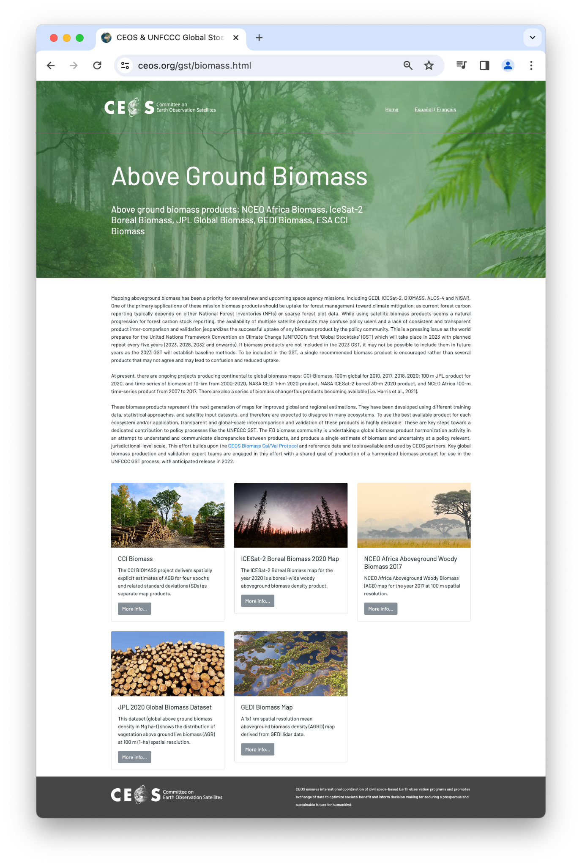
Biomass
“The EO biomass community is undertaking a global biomass product harmonization activity in an attempt to understand and communicate discrepancies between products, and produce a single estimate of biomass and uncertainty at a policy relevant, jurisdictional-level scale.”
ceos.org/gst
Notes:
With better coordination (in LSI?) can we help avoid the same for EBVs? How can we make sure agencies' efforts are complementary, interoperable, etc. And can LSI-VC serve as a forum to avoid duplication of work across EAVs/EBVs/ECVs
As Gary wrote:
"As you know Copernicus provides services for generating many higher level products. There is also the DIAS, several platforms that if I remember correctly are operated semi-commercially (something like that). And ESA has toolkits that are analogous to BON in a Box. Marc—correct/clarify any of the above as needed."
So we are all off doing our own things? Surely that is confusing for the end user? What is the definitive dataset? Can we better coordinate all this using an LSI subgroup perhaps?
Then the question is who do we need to bring together from CEOS agencies in LSI. And do we establish a biodiversity subgroup to work through these things together. Basically it's about providing a coordination mechanism for agencies' efforts.

Slide 6
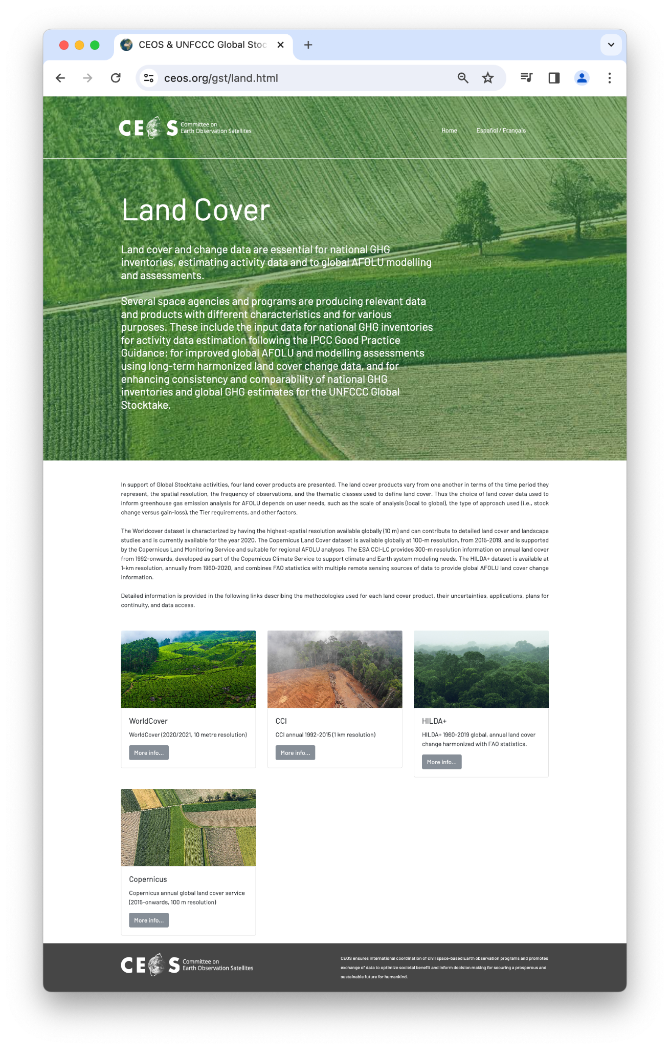
Plenty of agency activity - does it need more coordination in CEOS?
Seems to be the case for EAVs and EBVs
Variety of products are confusing for the end user?
Doesn’t need to mean operational production
Joint R&D / application development campaigns (note NASA Acres)
Open source tool-kits (NASA Open Science?)
Shared approaches and shared end goals / delivery points for these ‘pipelines’ (NASA-ESA MAAP? CAL? BON in a Box, etc.)
Methods / tools that could be hosted somewhere for others to pick up and run with.
Work within existing agency priorities and mandates
Providing forum for coordination
Generally increase complementarity of agency activities

Slide 7
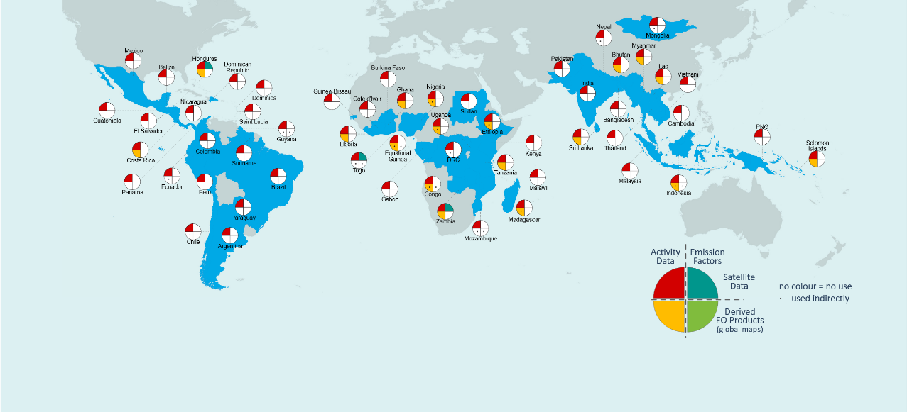
Satellite-based global maps in support of the GST Uptake in national GHG inventories – our baseline
Melo et al 2023 Environ. Res. Lett. 18 034021
Use of satellite-based global maps?
75 submissions to the UNFCCC
56 countries (a subset of the 153 developing countries included in the JRC database)
80% tropical forests
Global product | AD | EF | Indirectly
Global forest change (GFC) | 16 | - | 14
MODIS Fire (BA, AF) | 2 | - | 1
Saatchi et al (2011) | - | - | 3
Baccini et al (2012) | - | - | 2

Slide 8
So for today:
Noting recent requests for support on EAVs, EBVs, and ECVs, it is time that LSI-VC re-examine its loose boundary of ‘Level 2’ products.
If CEOS Principals agree that there is a role for CEOS in supporting higher level products such as these, LSI-VC will need to be the group to respond for land aspects.
We need to have clarity on our own scope, what it is we can feasibly do, what agency representation we need, and how our efforts fit into a broad, coherent hierarchy – to avoid overlaps, duplication, and to promote interoperability and complementarity of products."
Goals for LSI-VC-15:
Have a better idea if / how such a 'downstream product' component of LSI-VC would work, what it would seek to do, and what would be needed from Principals to have it function.
We can't have SIT agree that CEOS should respond to the EAVs / EBVs then fall back into the cycle of not having the appropriate mandate and representatives in LSI to be able to progress things.

Slide 9
So for today:
We’re being asked about CEOS support to EAVs
Likewise EBVs suggesting CEOS provide similar support for biodiversity
If CEOS leadership decides next week that CEOS should take action on EAVs – what is our response as LSI-VC?
1) OK – but we need appropriate staff and resourcing for LSI subgroup(s) and top-down strategic direction from CEOS leadership
2) No – we draw the line at Level 2 products, thanks.
The latter is fine! But we need a firm decision to give our partners clarity – we are fuzzy at the moment
Decision point for LSI-VC-15: Scope of LSI-VC Activity

Slide 10
Discussion Seed Questions

Slide 11
Discussion Seed Questions
What do we aim to achieve
Should LSI-VC seek to formally address higher level land product requirements that are being raised by partners
Is this an appropriate role for the LSI-VC or does this belong somewhere else in CEOS?
What is the role of the LSI-VC subgroups?
What role could LSI-VC feasibly play beyond Level 2 and what opportunities / risks exist?
What role can agencies play within their existing mandates and resources? What are LSI-VC agencies’ constraints?
Doesn’t need to mean operational production
Joint R&D / application development campaigns (note NASA Acres)
Open source tool-kits (NASA Open Science?)
Shared approaches and shared end goals / delivery points for these ‘pipelines’ (NASA-ESA MAAP? CAL? BON in a Box, etc.)
Methods / tools that could be hosted somewhere for others to pick up and run with.
Coordination regarding overlaps in EAVs, EBVs, ECVs
Is LSI-VC an appropriate forum for technical topics related to producing L3/L4 products or the tools for generating them?

Slide 12
Discussion Seed Questions
It was noted in the biodiversity discussions that agencies are distributing calls / funding for R&D but is there a mechanism for avoiding overlap, ensuring consistency, complementarity, etc.
Does it make sense to position LSI-VC as a forum where agencies that have active LSI application R&D programs come together to coordinate their activities related to EAVs, EBVs, ECVs, etc.?
Providing forum for coordination
Generally increase complementarity of agency activities
There are EO applications related activities taking place in CEOS agencies that are not coordinated?
Should there be a mechanism like the SDCG/GFOI R&D Component?

Slide 13
Discussion Seed Questions
If we agree this is a role for LSI-VC, what do we need from CEOS Principals to do it?
Active subgroups. Subgroups need to have clear mandates from CEOS leadership and appropriate staffing / resources
Opportunities for new Leads and energy from CEOS agencies that are more application focused?
What is the role of partnerships with the likes of GEOGLAM, SilvaCarbon, FAO, SEO – those that operate closer to the users.
What LSI-VC team membership, including representation of thematic experts, is necessary to be able to tackle these types of things?
Discussion: Shortlist a name of additional people we would like to see in LSI-VC?

