Slide 2
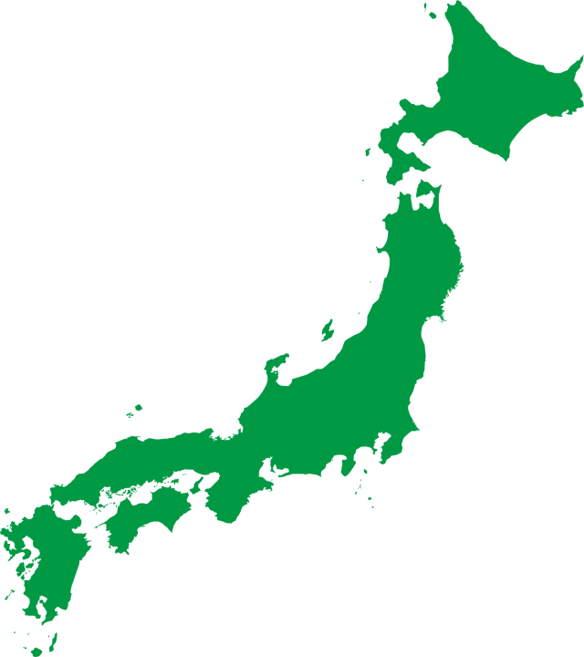
About us
Established in 2021
Startup company from Prof. Masahiko Nagai’s lab.
90 min.
Yamaguchi Ube Airport
Haneda Airport
Copyright © 2024 New Space Intelligence Inc. All rights reserved.
Slide #2
Notes:
2021年11月に山口県宇部市で5人のメンバーとスタートしました。
弊社は、タイにあるAsian Institute of Technology と山口大学の
長井正彦研究室発スタートアップです。

Slide 3
The Team
Research & Development team
Carcellar Bienvenido III Gromeo
RS Engineer
Prof. Dorj Ichikawa
Vise-President, CSO
Vaibhav Katiyar
Ph.D, CIO
Ei Matsui
RS Engineer
Gaku SAITO
RS Engineer
System Development team
Kritsana Suwankhajorn RS Engineer
Muhammad Daniel Iman bin Hussain RS Engineer
Yumiko Nagai
CEO
President
Chairath Sirirattanapol, Ph.D., CTO
Nopphawan Tamkuan
Ph.D, CAO
Prin Chaiboonrueng
Back-End Engineer
Prin Chaiboonrueng
RS Engineer
Business Development team
Back office team
Hiroshi Senzoku
CFO
2 Assignees
Natsumi Taguchi
Mai Yoshihara
Suteeporn Kraikan
Copyright © 2024 New Space Intelligence Inc. All rights reserved.
Slide #3
Notes:
現在は、日本人９名、外国人８名の計１７名で事業を行っています。
衛星データ解析やアルゴリズム開発、AI解析を非常に得意なメンバーが集まっています。

Slide 4
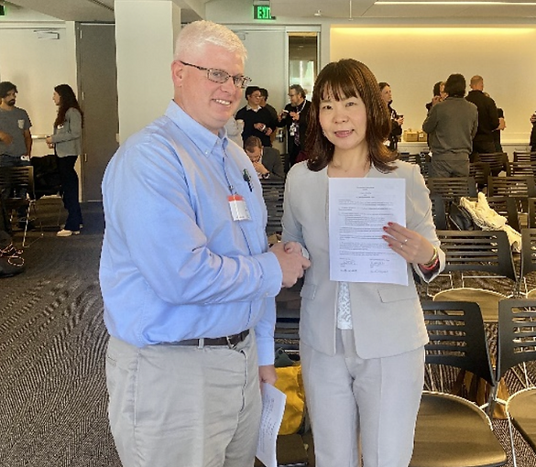
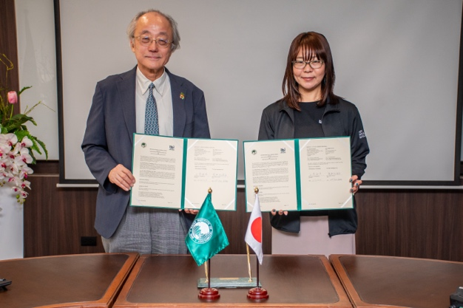
About us
2023.7
Partnership signed with Labsphere inc. to develop Analysis Ready Data products
2024.2
Signed a MOU with the Asian Institute of Technology to develop scientific research and educational cooperation and promote friendly relations between the two parties.
2023.1
Partnership concluded with Axelspace Co., Ltd. to expand the use of satellite images
Copyright © 2024 New Space Intelligence Inc. All rights reserved.
Slide #4

Slide 5
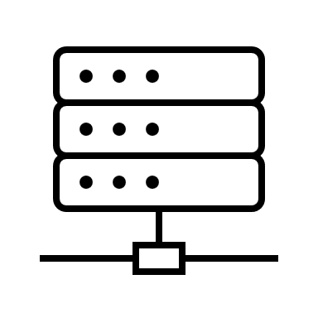
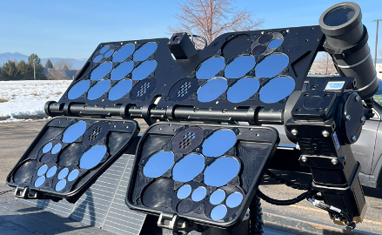
Satellite Data Pipeline
customer
Purpose, cost, frequency
Bloomberg
in satellite data version
Provision
Satellite Data Pipeline
non-financial
global index
Combination of latest satellite data
Use harmonize data
GRUS
Planet
JAXA
Analysis
Selection
Planet
GRUS
Sentinel-1
Planet
Planet
Sentinel-1
Integration
Automated system
JAXA
Planet
GRUS
Planet
Same satellite data
Combination of same observation date
Copyright © 2024 New Space Intelligence Inc. All rights reserved.
Slide #5

Slide 6
Monitoring （AOI by Points）
Regular monitor service at monitoring points of interest using satellites and notifies anomaly
Example
Sediment disaster monitoring
Infrastructure monitoring
Illegal dumping monitoring
Forest monitoring
Agriculture monitoring
remote island surveillance
Copyright © 2024 New Space Intelligence Inc. All rights reserved.
Slide #6

Slide 7
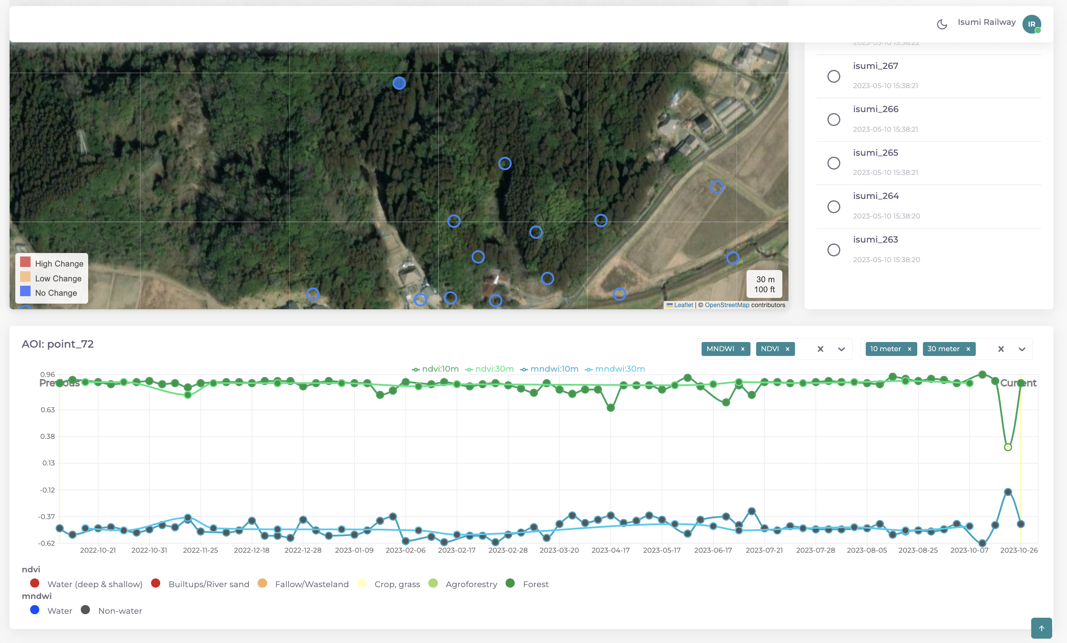
Satellite Data Pipeline
Copyright © 2024 New Space Intelligence Inc. All rights reserved.
Slide #7

Slide 8
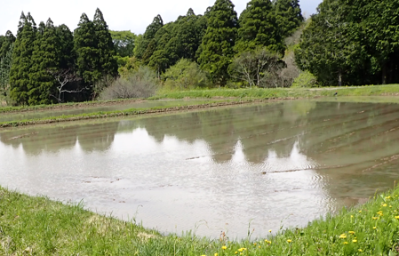
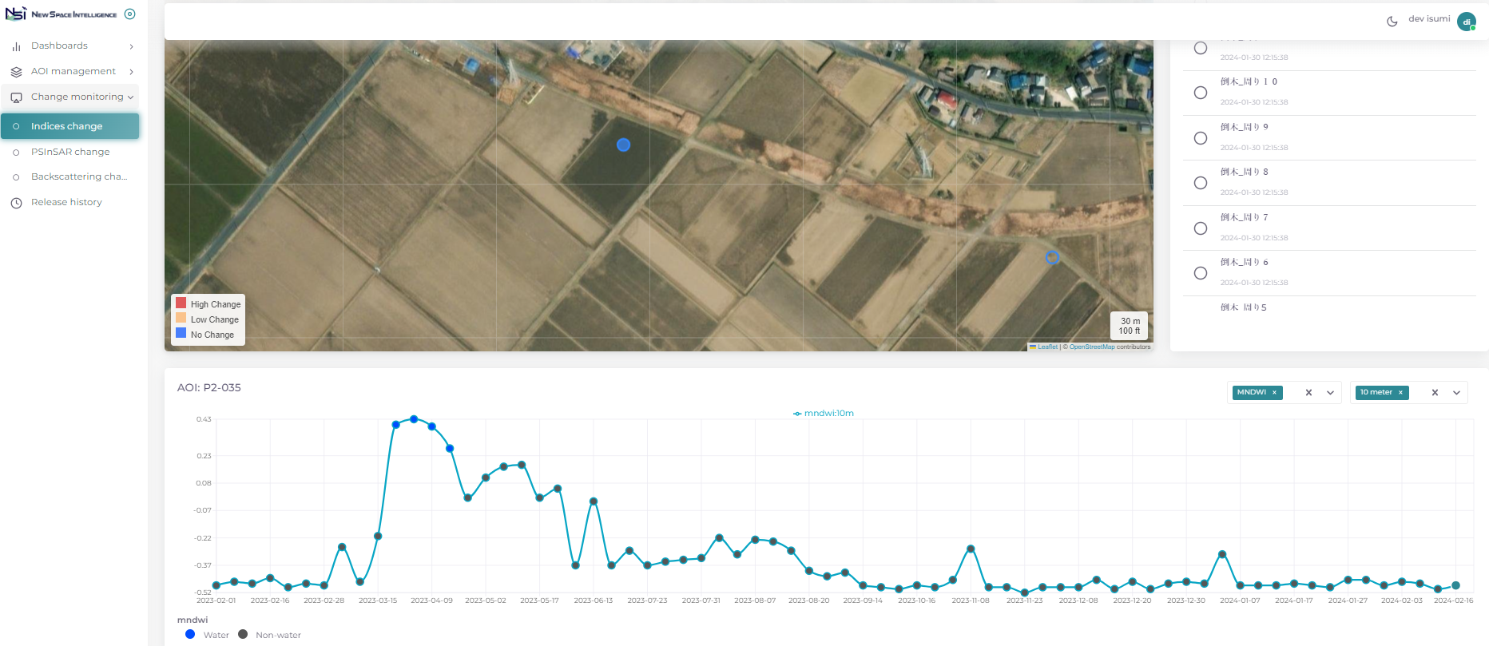
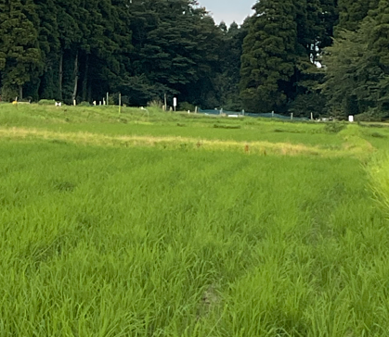
Satellite Data Pipeline
Systematization of change detection method using time-series optical images
rice field growth
水田
成長
Paddy Field
Time series change: mNDWI
Copyright © 2024 New Space Intelligence Inc. All rights reserved.
Slide #8

Slide 9
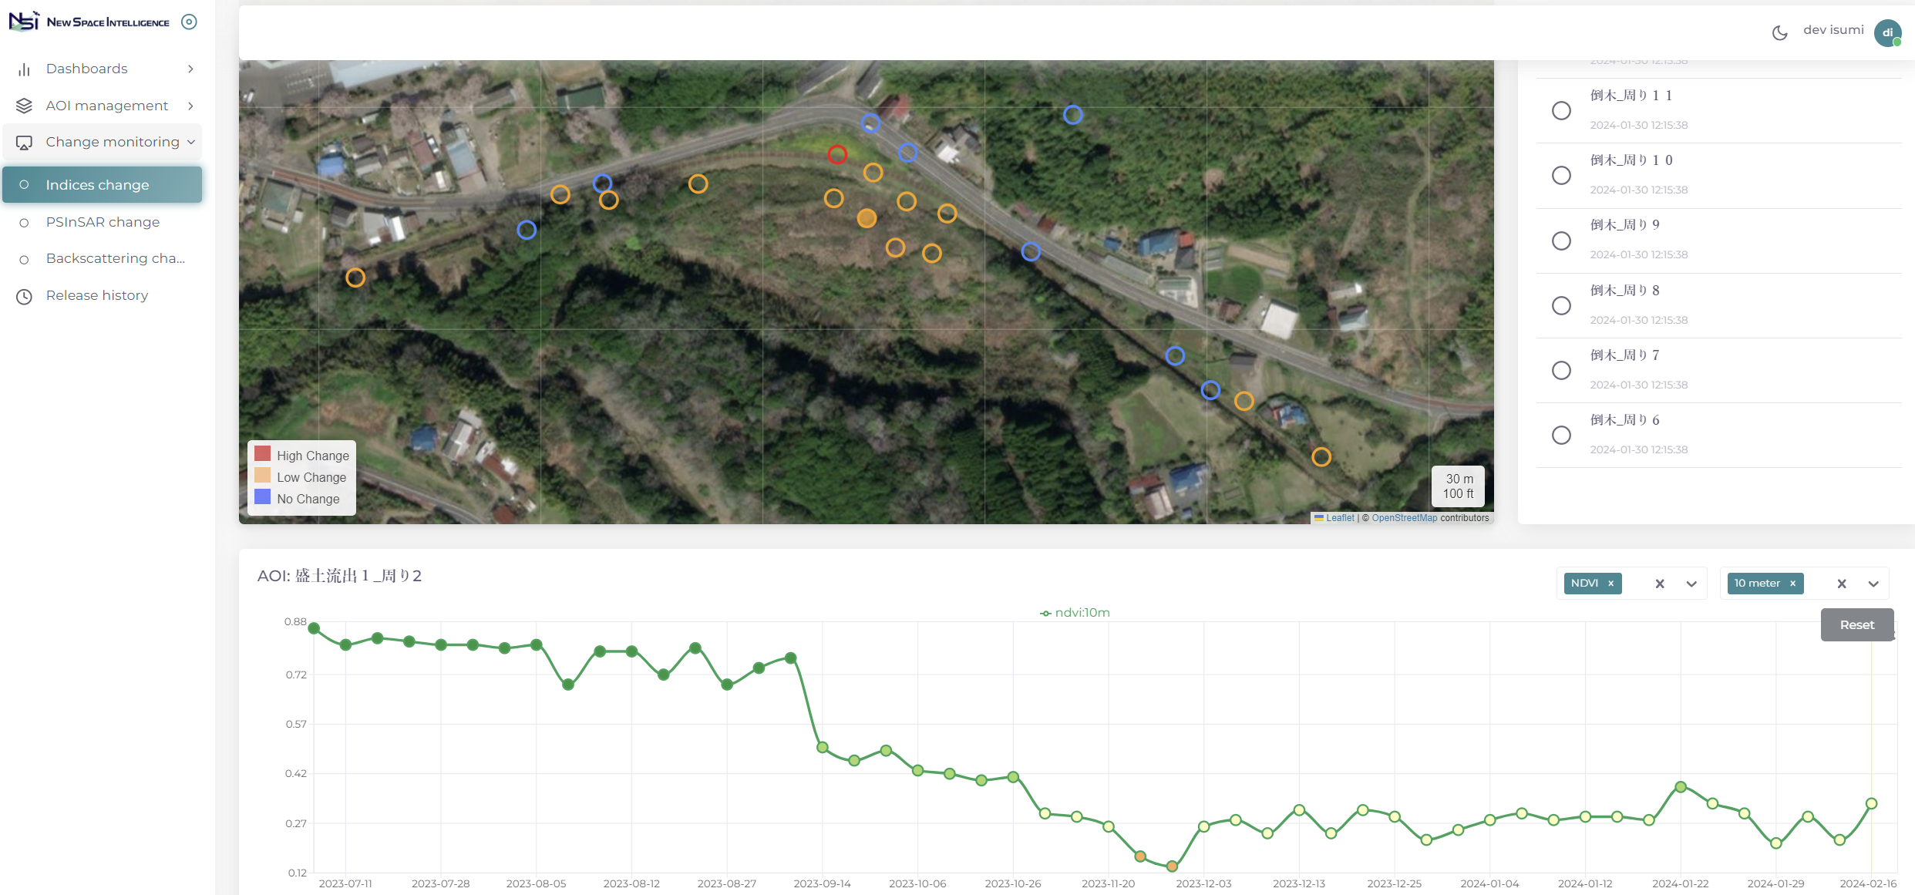
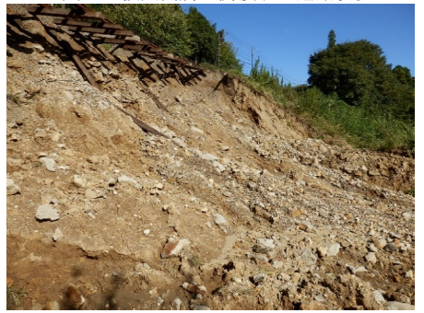
Satellite Data Pipeline
Selection of monitoring target area and implementation of ground measurements
Vegetation change(spot at heavy rain disaster occurred)
09-08 Heavy Rain
After disaster
Time series change: NDVI
Copyright © 2024 New Space Intelligence Inc. All rights reserved.
Slide #9

Slide 10
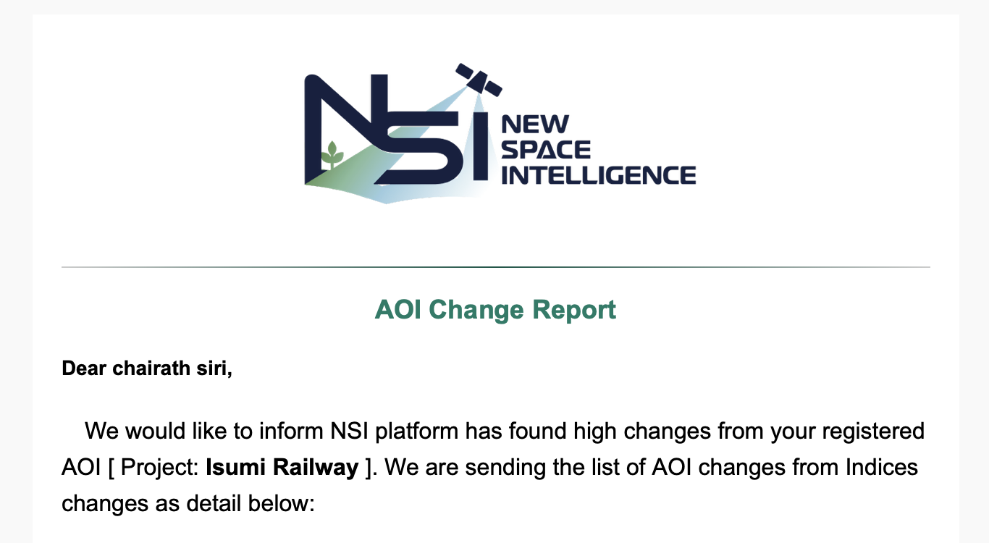
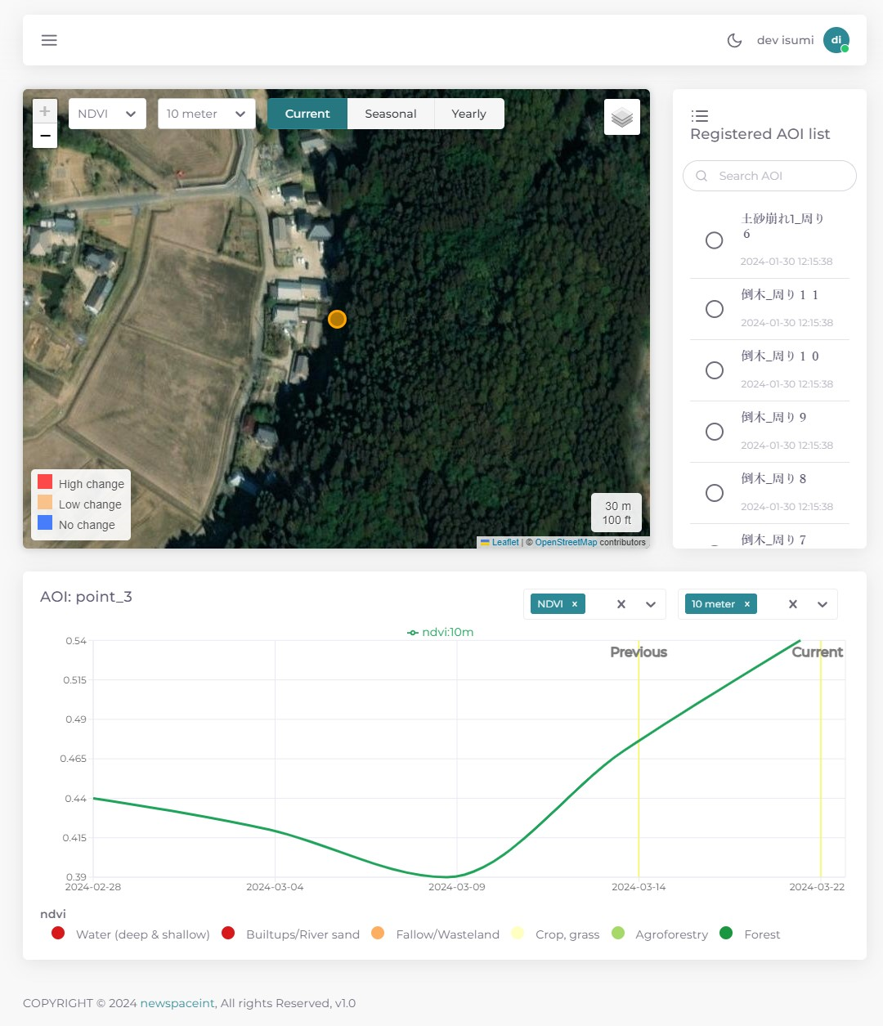
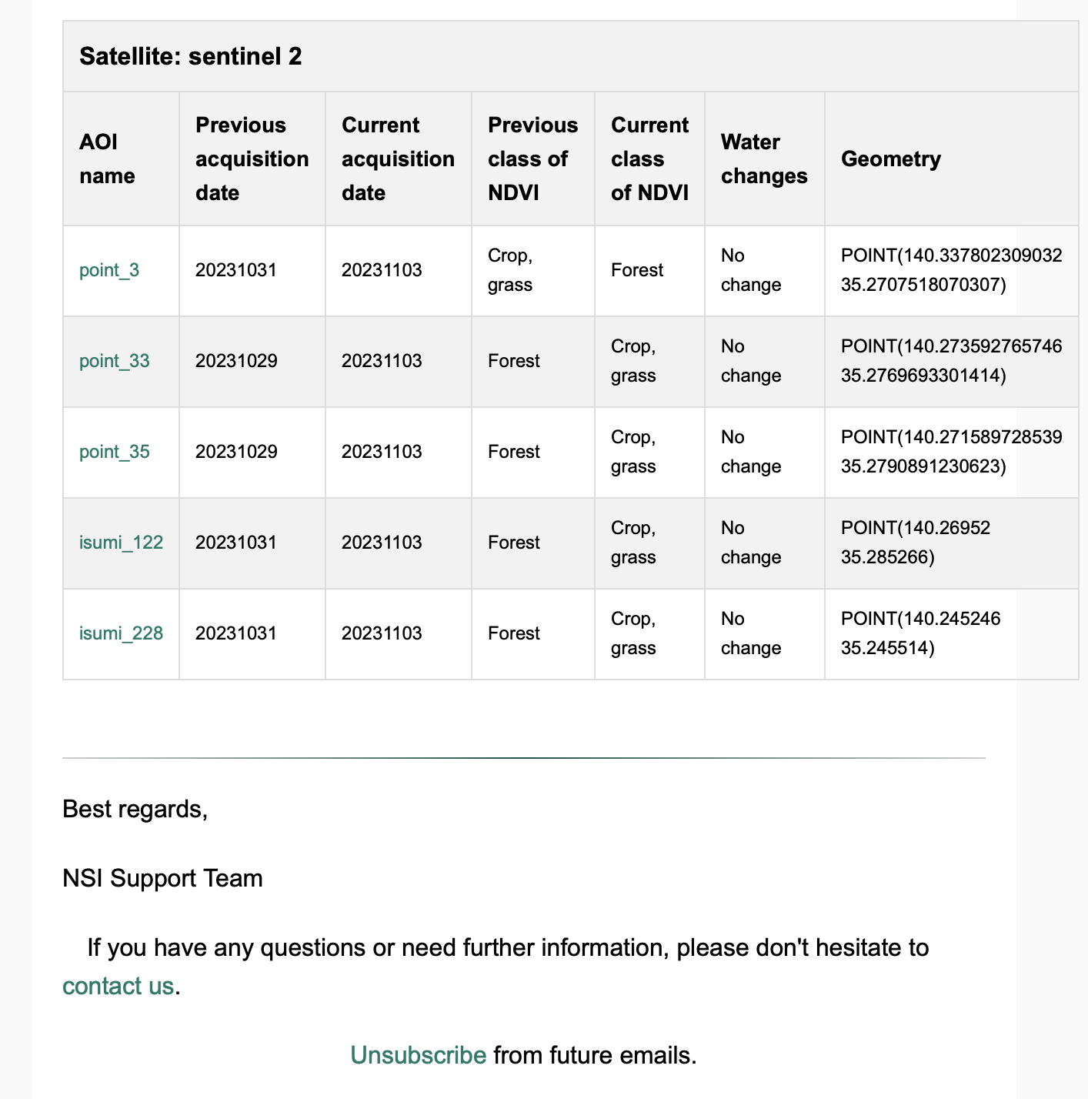
Satellite Data Pipeline
Send e-mail automatically when change was detected from e-mail, we can jump to the interface to check the point
Jump
Click
Anomaly point
Slide #10
Copyright © 2024 New Space Intelligence Inc. All rights reserved.

Slide 11
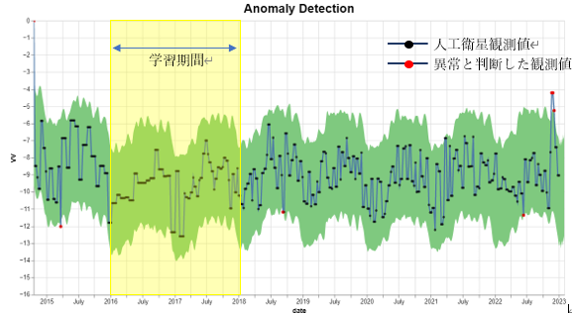
Illegal Dumping at Hiroshima Prefecture
Satellite observation values
Study period
Observed values judged to be abnormal values
Hiroshima Prefecture Industrial Waste Countermeasures Division: By using SAR satellite images, they start monitoring illegal dumping and improper storage by waste disposal companies using SAR satellites
Anomaly detection at satellite monitoring points
Collect observation data of monitored area
monitoring
Industrial Waste
Countermeasures Division,
Welfare and Environment Office, etc.
Sentinal-1
(SAR)
Every12 days observation
Receive alerts
On-site confirmation
Detect anomaly changes by analyzing time series observation data
Illegal dumping occurred
early detection
Improving detection accuracy by feeding back the results of on-site confirmation
SAR (Synthetic Aperture Radar)
By capturing reflected waves from the ground surface, it is possible to investigate the roughness of the ground surface and the presence or absence of objects.
Slide #11
Copyright © 2024 New Space Intelligence Inc. All rights reserved.

Slide 12
Monitoring Service B （AOI by Area）
Regular monitor service at monitoring Area of interest using satellites and notifies anomaly
お客様の監視したいエリアに対する地盤変動（地表面の変動）を面的に解析します。
Time series analysis
land subsidence
Sabo dam sediment detection
Embankment detection
Erosion (Coastal/ Soil)
Disaster response
Crustal deformation by earthquake/volcano
House collapse
liquefaction
Copyright © 2024 New Space Intelligence Inc. All rights reserved.
Slide #12
Notes:
And these are the services to monitor area of customer’s interest using satellite data and notifies anomaly,
Like not only time series analysis but also can use for disaster response,.

Slide 13
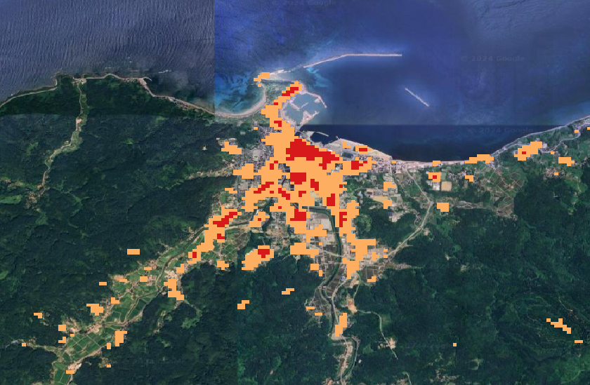
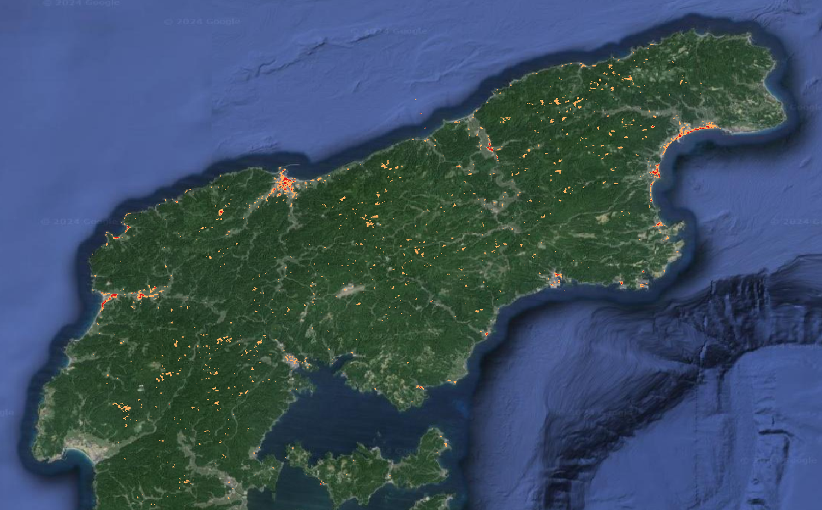
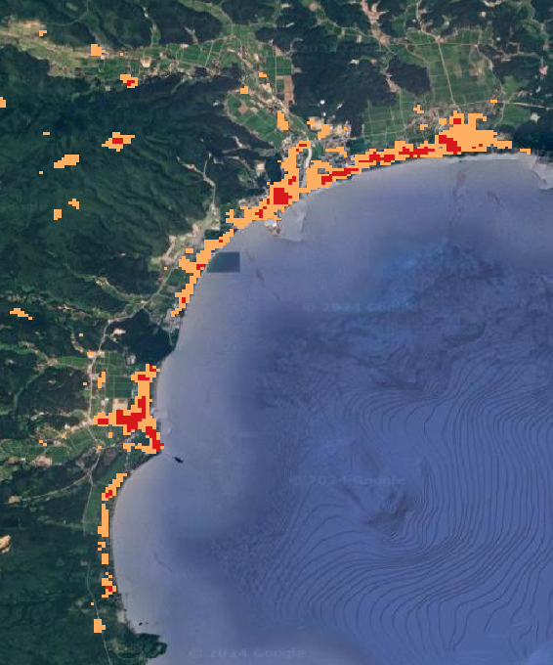
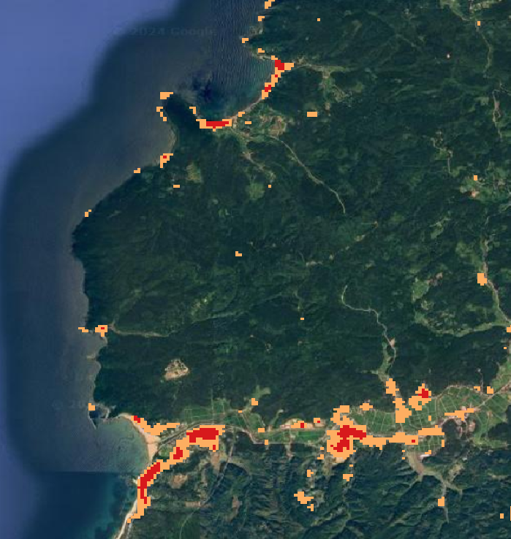
Coherence change result
High coherence change (damage)
Very high coherence change (severe damage)
Copyright © 2024 New Space Intelligence Inc. All rights reserved.
Slide #13

Slide 14
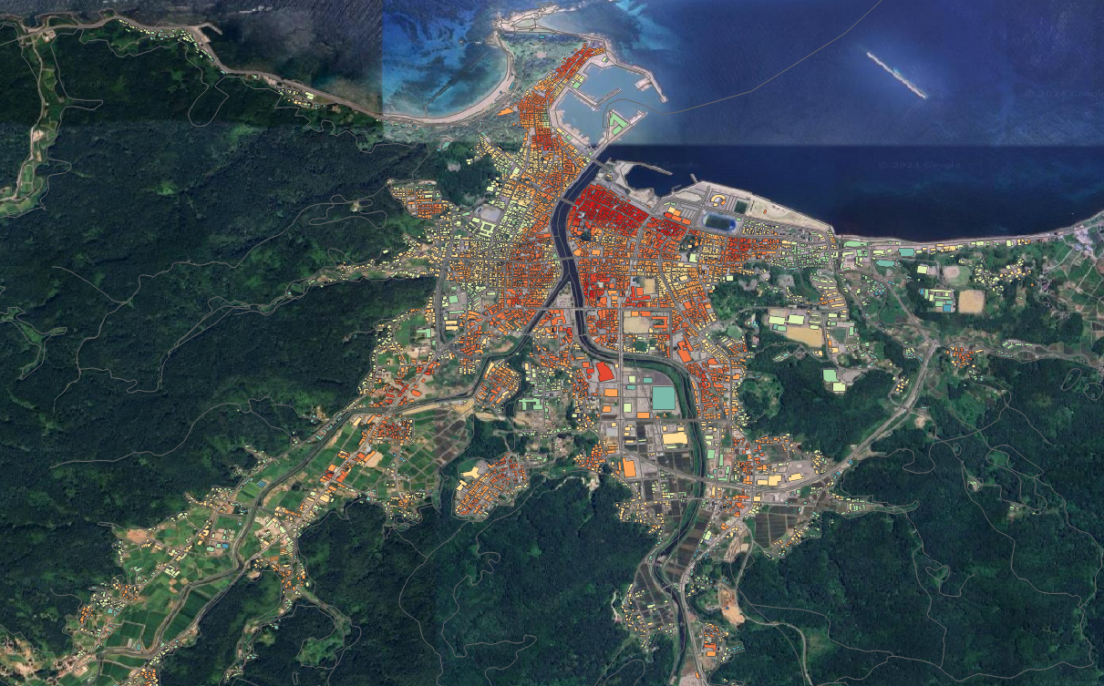
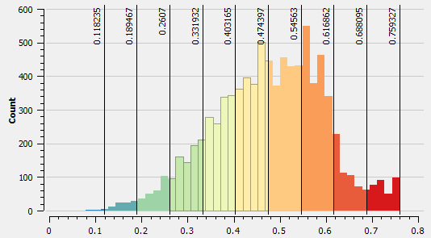
Earthquake at Wajima city
High
Very high
This is just preliminary analysis.
Information: 1st Jan 2024
The result has not been validated.
Copyright © 2024 New Space Intelligence Inc. All rights reserved.
Slide #14

Slide 15
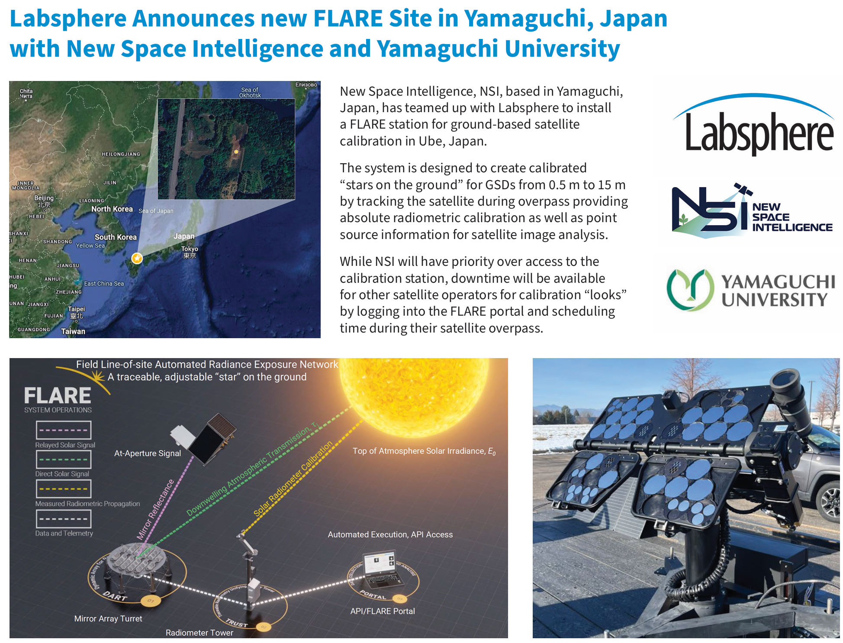
Collaborative Research and Development in Calibration
Copyright © 2024 New Space Intelligence Inc. All rights reserved.
Slide #15
Notes:
Until now, government-led large satellites have been launched.
Today, small satellites led by the private sector are being launched more and more.
Currently around 400 earth observation satellites has been lunched and will be more than 1,000 in 10 years (by Euroconsult)
Satellitia data democratization will be occurred. In near future, we CHOOSE our prefer satellite data, NOT given and used.

Slide 16
NSI-ARD
Why ARD for NSI-Satellite Data Pipeline ?
Developing Multi-Satellite Data Solutions which creates satellite data products that are easy accessible and usable to anyone, from anywhere
Developing Satellite Data Pipeline for Multi-Satellite Data Solutions creates
NSI-ARD
The Satellite data in NSI-Pipeline are pre-processed with radiometric, atmospheric, geo-registration and gridding of GRUS1, LandSat, Sentinel-2 and other satellite data products for user community to reduce time of image processing and analysis.
Copyright © 2024 New Space Intelligence Inc. All rights reserved.
Slide #16
Notes:
Until now, government-led large satellites have been launched.
Today, small satellites led by the private sector are being launched more and more.
Currently around 400 earth observation satellites has been lunched and will be more than 1,000 in 10 years (by Euroconsult)
Satellitia data democratization will be occurred. In near future, we CHOOSE our prefer satellite data, NOT given and used.

Slide 17
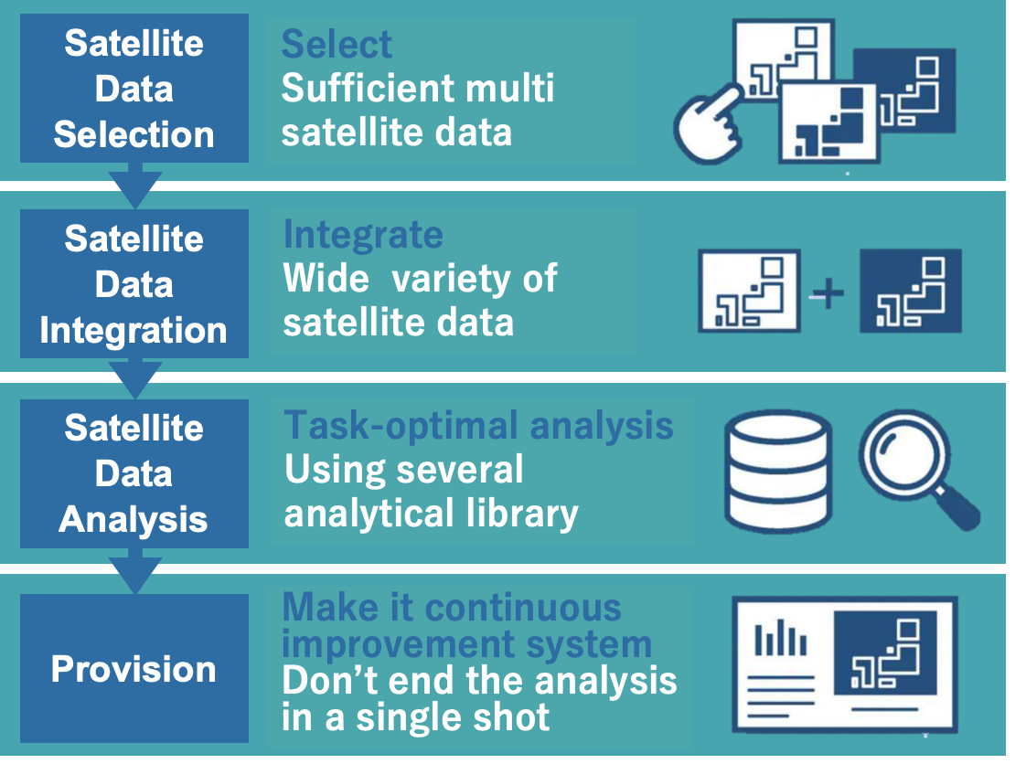
NSI-Satellite Data Pipeline
It is the platform that automates and systemizes a series of processes from
”Selection”, “Integration”, “Analysis”, and “Provision” of multiple satellite data.
Copyright © 2024 New Space Intelligence Inc. All rights reserved.
Slide #17
Notes:
Until now, government-led large satellites have been launched.
Today, small satellites led by the private sector are being launched more and more.
Currently around 400 earth observation satellites has been lunched and will be more than 1,000 in 10 years (by Euroconsult)
Satellitia data democratization will be occurred. In near future, we CHOOSE our prefer satellite data, NOT given and used.

Slide 18
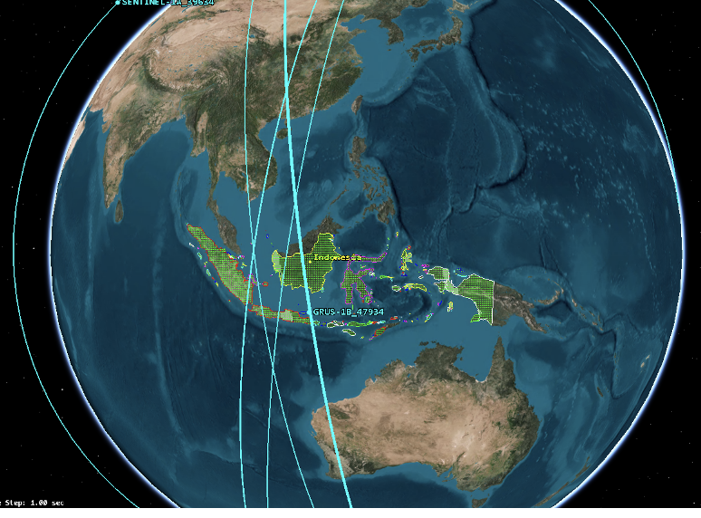
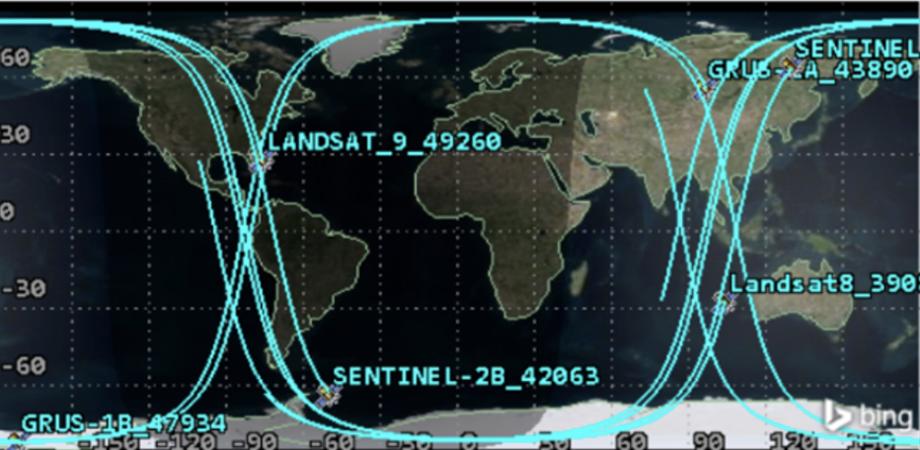
DEVELOPMENTAL STEPS | METHOD
Multi-satellite navigation and Selection using the Ansys Systems Tool Kit (STK), Specially for Virtual Constellation
SATELLITE DATA SELECTION
NSI-Calibration&Validation of multi-satellite data using:
SATELLITE DATA INTEGRATION
- CEOS RadCalNet sites
https://ceos.org/home-2/wgcv-radcalnet/
Copyright © 2024 New Space Intelligence Inc. All rights reserved.
Slide #18
Notes:
Until now, government-led large satellites have been launched.
Today, small satellites led by the private sector are being launched more and more.
Currently around 400 earth observation satellites has been lunched and will be more than 1,000 in 10 years (by Euroconsult)
Satellitia data democratization will be occurred. In near future, we CHOOSE our prefer satellite data, NOT given and used.

Slide 19
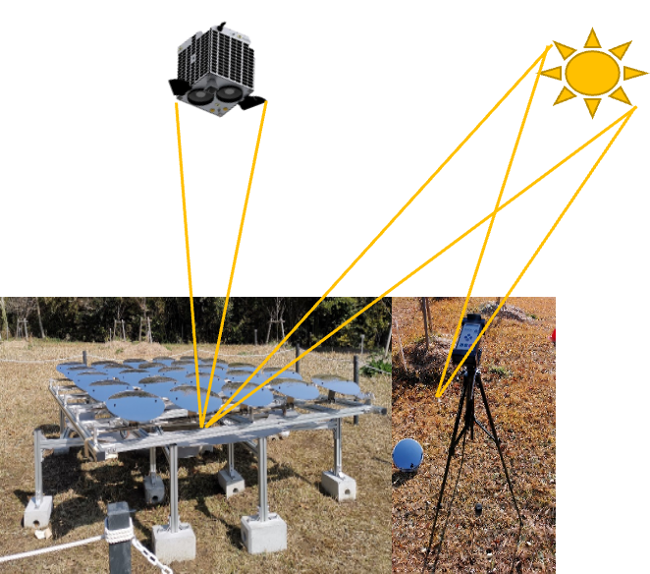
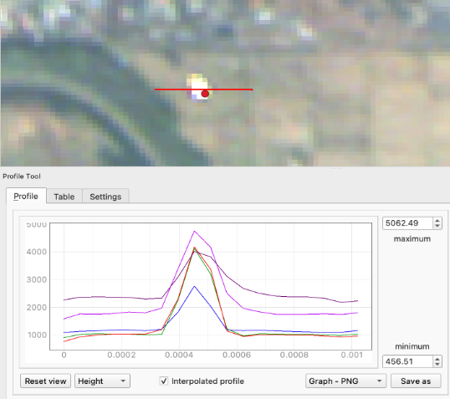
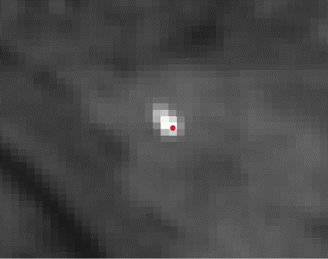
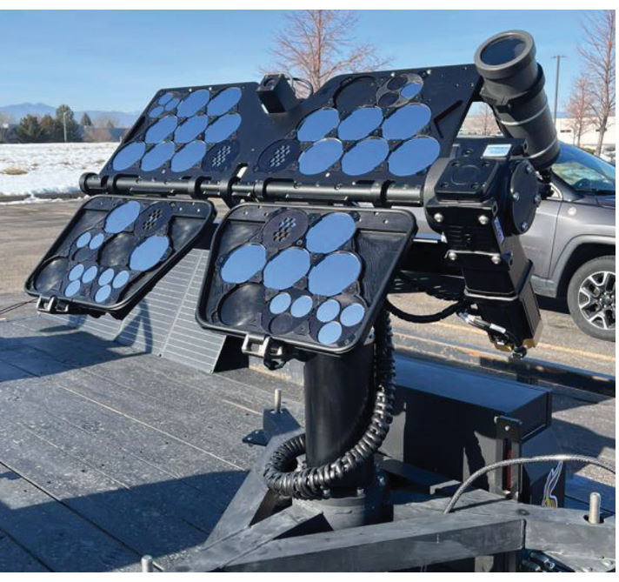
DEVELOPMENTAL STEPS | METHOD
NSI-Calibration&Validation of multi-satellite data using:
Satellite Data Integration
- The NSI-mirror reflector
NSI-Mirror Reflectors
S2 image pixel of the mirror
- The NSI-mirror reflector FLAIRE LANTENT
automated system at Ube, Yamaguchi, Japan
Copyright © 2024 New Space Intelligence Inc. All rights reserved.
https://www.labsphere.com/
Slide #19
Notes:
Until now, government-led large satellites have been launched.
Today, small satellites led by the private sector are being launched more and more.
Currently around 400 earth observation satellites has been lunched and will be more than 1,000 in 10 years (by Euroconsult)
Satellitia data democratization will be occurred. In near future, we CHOOSE our prefer satellite data, NOT given and used.

Slide 20
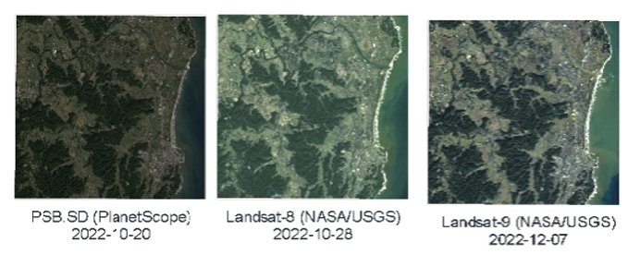
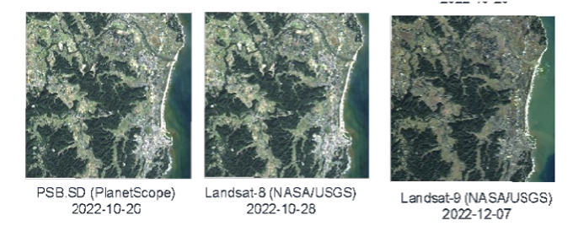
DEVELOPMENTAL STEPS | METHOD
Satellite Data Integration
Atmospheric correction: using LUT created by 6S
Geo-registration: AROP using S2 Global Reference Image (GRI)
Band Adjustment: SBAF created using SCIAMACHY Hyperspectral data
Gridding: Under development
Differences in S2, LS and GRUS1 ARD, the sensor-specific radiometric, spatial, spectral and geometric resolutions are adjusted and removed. It produces Interoperable data which can be combined from multiple sensors into a single seamless time series.
Copyright © 2024 New Space Intelligence Inc. All rights reserved.
Slide #20
Notes:
Until now, government-led large satellites have been launched.
Today, small satellites led by the private sector are being launched more and more.
Currently around 400 earth observation satellites has been lunched and will be more than 1,000 in 10 years (by Euroconsult)
Satellitia data democratization will be occurred. In near future, we CHOOSE our prefer satellite data, NOT given and used.

Slide 21
Ongoing projects using NSI satellite data pipeline
Application development for railway infrastructure monitoring
Monitoring illegal dumping using satellite data
Development of Smart Monitoring of Uninhabited Islands Using Virtual Satellite Constellations (NEDO-SBIR)
Demonstration of advanced satellite remote sensing business (METI-SBIR)
Multi-satellite observation for VDES monitoring in EEZ Japan area
Copyright © 2024 New Space Intelligence Inc. All rights reserved.
Copyright © 2024 New Space Intelligence Inc. All rights reserved.
Slide #21
Notes:
Until now, government-led large satellites have been launched.
Today, small satellites led by the private sector are being launched more and more.
Currently around 400 earth observation satellites has been lunched and will be more than 1,000 in 10 years (by Euroconsult)
Satellitia data democratization will be occurred. In near future, we CHOOSE our prefer satellite data, NOT given and used.

Slide 22
SUMMARY
Thank CEOS meeting and workshop in Tokyo has valuable importance for public, academic and commercial Earth Observation communities of Japan
We expect good collaboration and exchange information on future plan, methodology, methods, tools, publications, developments for ARD
Thank You !
Copyright © 2024 New Space Intelligence Inc. All rights reserved.
Slide #22
Notes:
Until now, government-led large satellites have been launched.
Today, small satellites led by the private sector are being launched more and more.
Currently around 400 earth observation satellites has been lunched and will be more than 1,000 in 10 years (by Euroconsult)
Satellitia data democratization will be occurred. In near future, we CHOOSE our prefer satellite data, NOT given and used.

