Slide 1
LSI-VC-16
Digital Earth Africa and CEOS ARD
Michael Wellington,
Geoscience Australia Digital Earth Africa
Agenda Item 2.1
LSI-VC-16, Canberra
23 - 25 September 2024

Slide 2
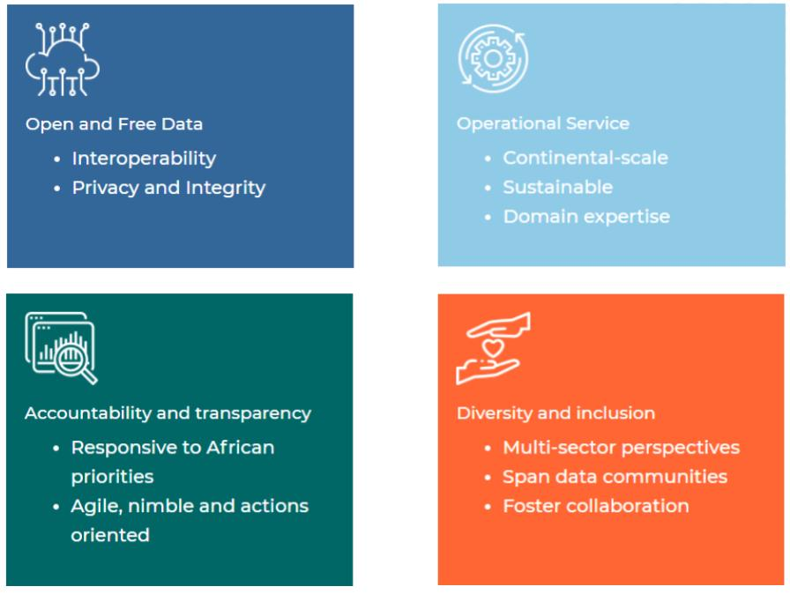
Digital Earth Africa
Our vision
Digital Earth Africa provides a routine, reliable and operational service, using Earth observations to deliver decision-ready products enabling policy makers, scientists, the private sector and civil society to address social, environmental and economic changes on the African continent.

Slide 3
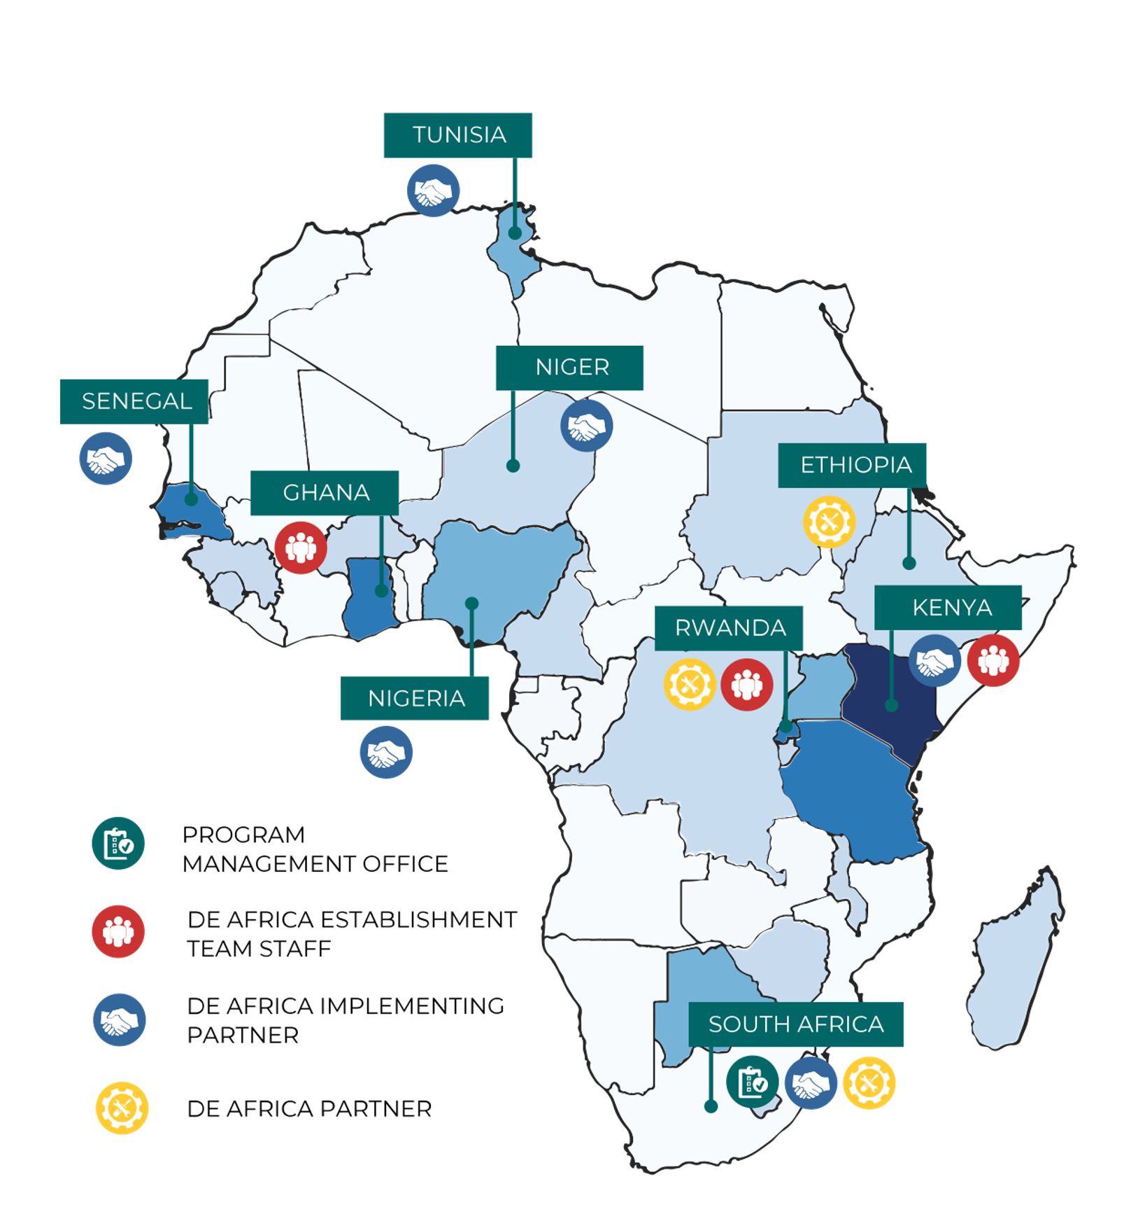
Digital Earth Africa
Digital Earth Africa program delivery
Program delivery, science, capacity development and user engagement, platform, and communications
Numerous long-term staff based in several African countries: Kenya, Ghana, Rwanda, South Africa
Funding host (Geoscience Australia) for major donor funds
Program oversight
Some science support - including for USGS collaboration
Currently providing platform support
‘Host’ organisation (currently Research Institute for Innovation and Sustainability - RIIS)
Houses and organises the program management office

Slide 4
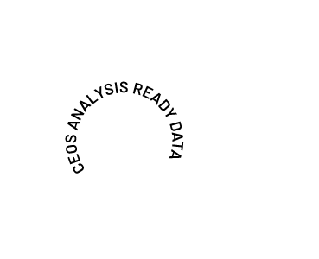
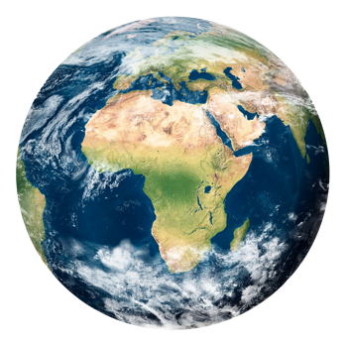
Products and Services
Space Agencies
Analysis Ready Data
p
COGS/STAC AWS S3 Cape Town
ODC supports numerous analysis environments where sensor-agnostic workflows and multi-sensor data fusion are demonstrated and encouraged.
Explorer
Jupyter Sandbox
Map

Slide 5
Surface Reflectance ARD
Analysis-ready surface reflectance data underpins DE Africa Products and Services
Landsat-5, 7, 8 & 9 Level-2 Surface Reflectance and Surface Temperature
Fractional Cover
Water Observations from Space
Annual Geomedian
NDVI Mean, Anomaly and Climatology
Sentinel-2 Level-2 Surface Reflectance
Annual, semiannual, and three-monthly rolling Geomedians
NDVI Mean and Anomaly

Slide 6
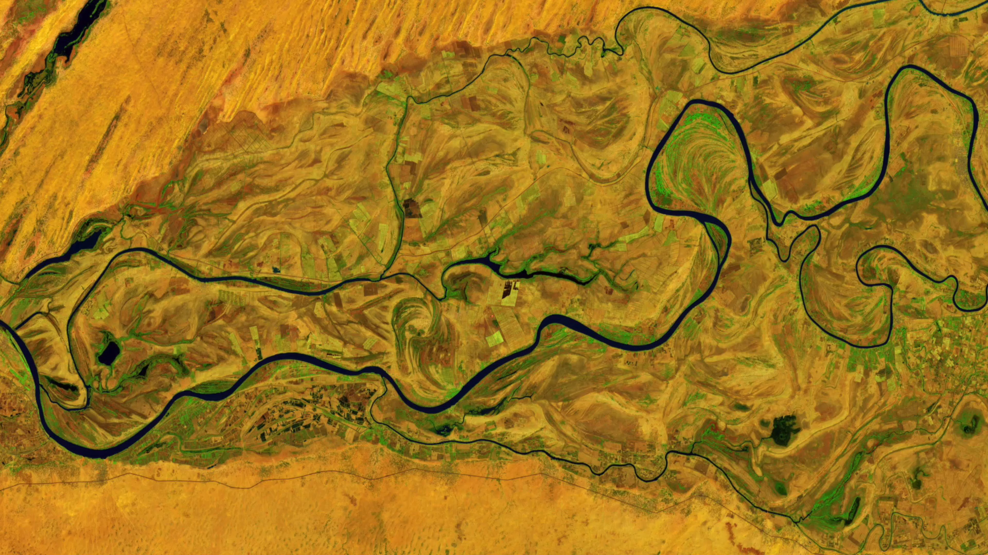
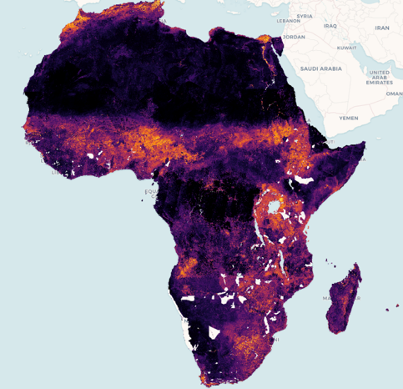
Surface Reflectance ARD
Geomedians (GeoMADs)
GeoMADs condense satellite imagery into a high-quality image, and provide ML-ready input data
Enable ML-based derivatives, e.g. cropland extent map

Slide 7
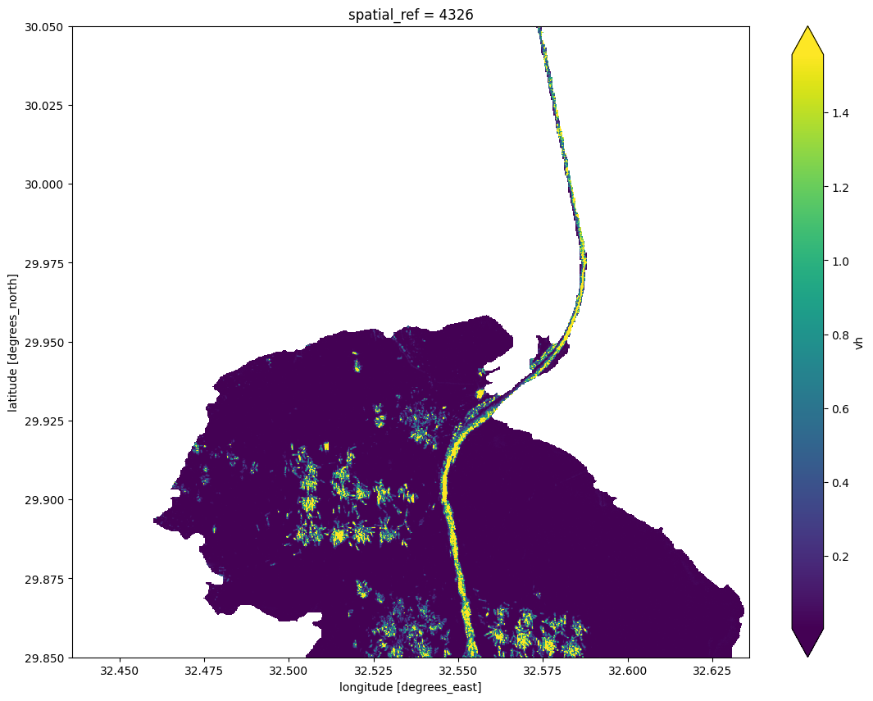
Sentinel-1 ARD
DE Africa worked with Sinergise to develop CEOS ARD for Sentinel-1 RTC ARD
The DE Africa platform is a novel interface for users to interact with and build and understanding of Sentinel-1 SAR
Jupyter Notebooks include loading ARD, integrating with WOfS to detect shipping lanes and activity (right)

Slide 8
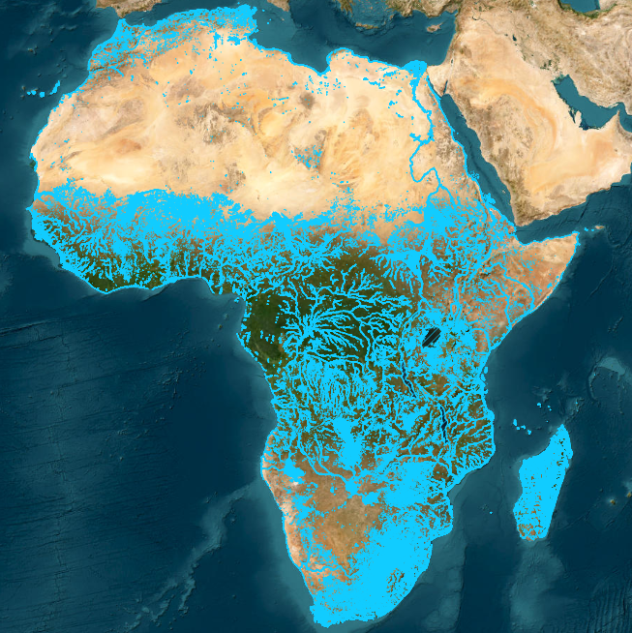
Aquatic Reflectance
Stated demand from industry and government in several African countries
SDG reporting
Aquaculture monitoring
A logical and natural extension of WOfS and waterbodies
Testing undertaken of USGS provisional AR
Known issues across all parties with negative reflectance values
All parties agree on a ‘provisional’ status
Differences in AR and DE Africa water masking
Emphasises the importance of ARD

Slide 9
On the horizon
Sentinel-1 monthly mosaic, Sentinel-3 and Sentinel-5P over the coming 12 months
Note that ARD specs for SYN are under development
We would welcome ARD guidance for Sentinel-3 OLCI & SLSTR with a focus on surface reflectance (water) temperature (land and water)
Where CEOS ARD is defined, it is built into our agreements with service providers
Pre-harmonised data - HLS?

Slide 10
Importance of ARD
Sensor-agnostic ARD clearly underpins DE Africa product and service offerings
Focus is on measurements and analytical outputs for reliability and interoperability (our vision and mission)
Legacy approach
Resolution
(e.g., “moderate”)
Platform
(e.g. “Landsat-7”)
Sensor
(e.g. ETM+)
Band
(e.g. “blue”)
Future / user: Measurement
(of type, at resolution,
from sensor,
on platform)

Slide 11
Importance of ARD
We need EO data of sufficient quality to allow harmonised EO products, data assimilation in workflows, and sensor-agnostic approaches
Statements of uncertainty are needed in the interoperability framework to communicate uncertainties in EO measurements across time and space
Statements and quantification of variation in uncertainty across geographies
Statements of known issues enable more informed use, enhancing overall reputation
Quantification and qualification of data quality support a collaborative approach to improvement and drive confidence in EO approaches

Slide 12
Thank you!
Michael Wellington,
Geoscience Australia Digital Earth Africa
Agenda Item 2.1
LSI-VC-16, Canberra
23 - 25 September 2024

