Slide 1
STAC Introduction
Matthias Mohr mohr.ws

Slide 2
Why STAC?

Slide 3
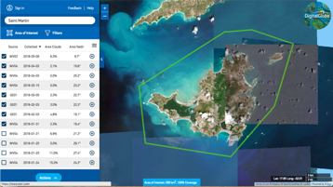
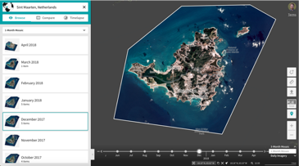
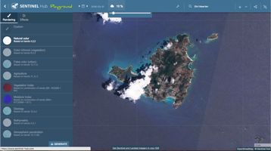
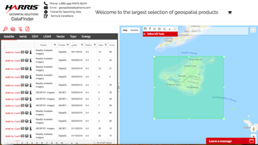
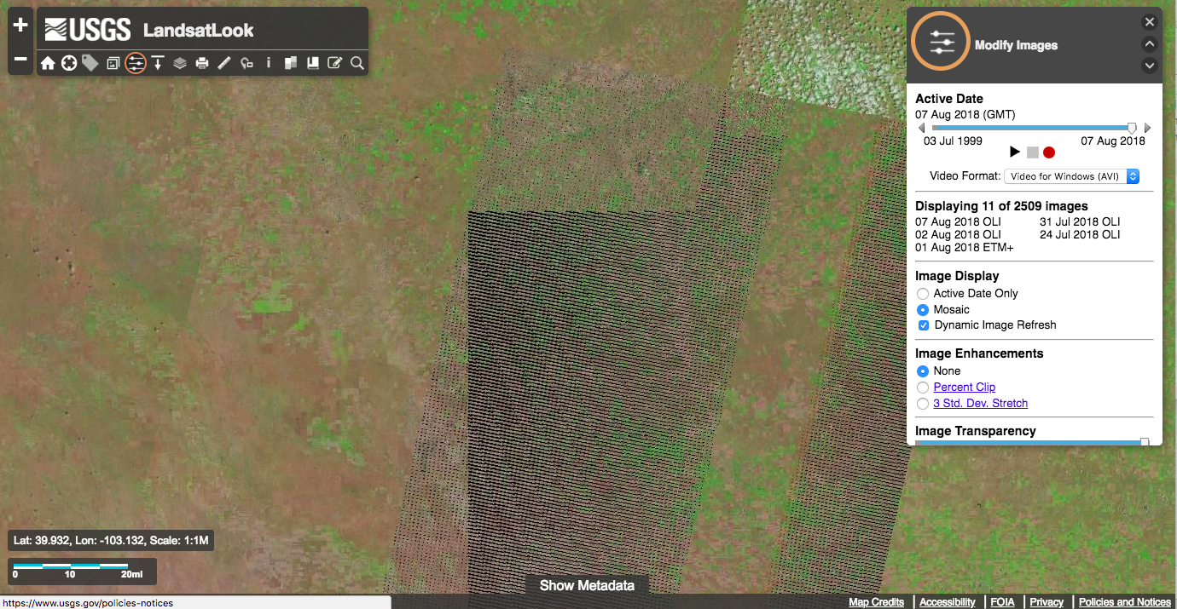
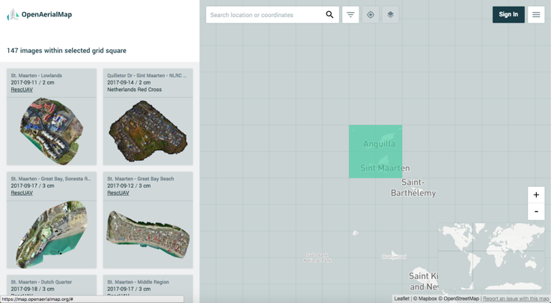
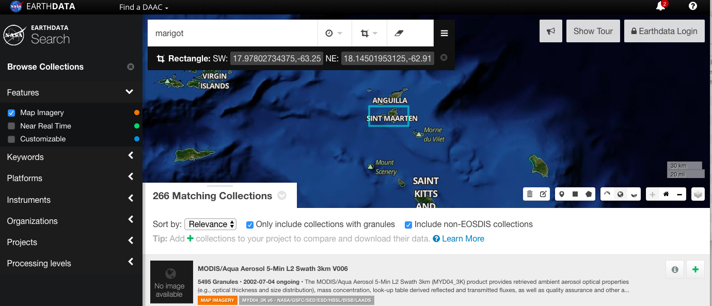
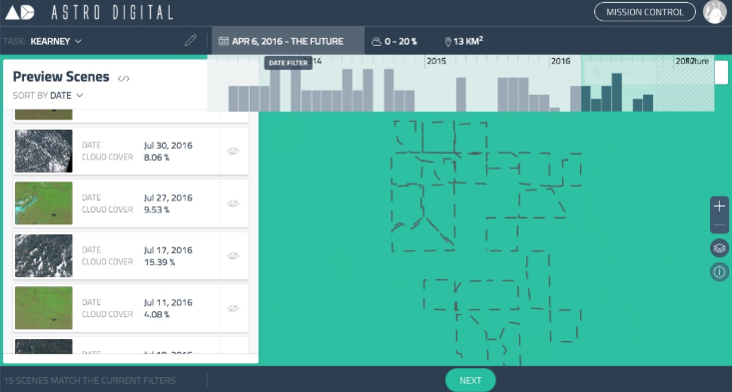
Notes:
The main motivation is that I have to got lots of different sites that to be sure that I am searching for all the available imagery in an area.

Slide 4
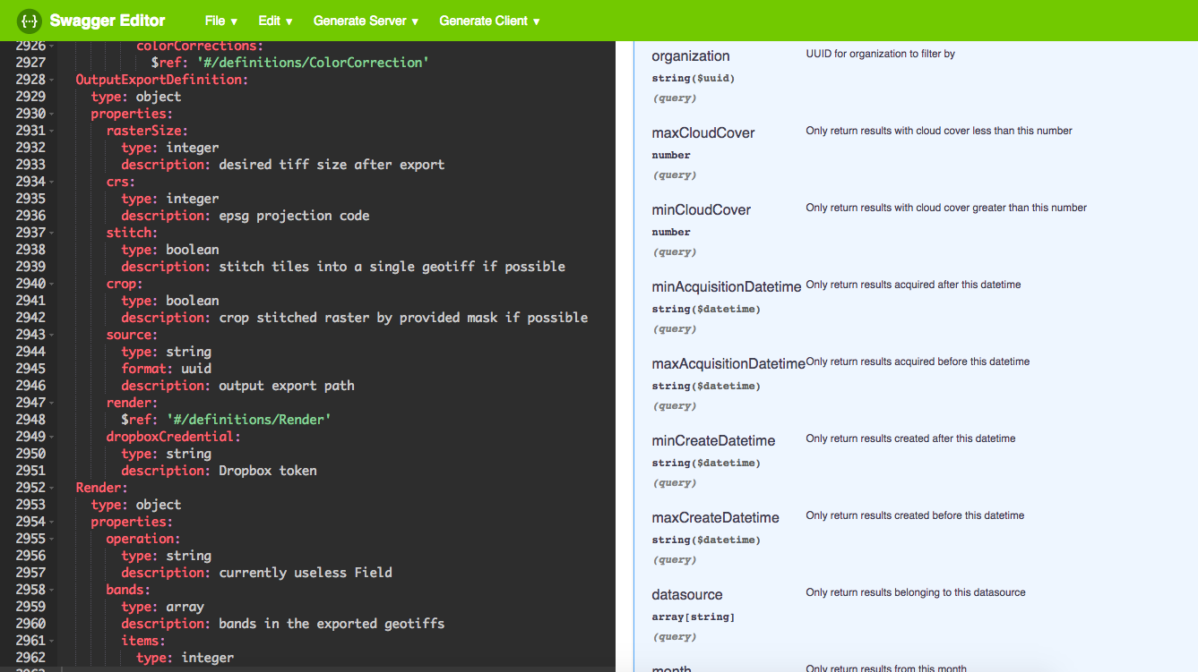
Notes:
And the situation is just as bad for API’s - every one of those visualizations shown is powered by a slightly different API.
They’re also JSON and RESTful, but each has a different way of organizing. One may do min and max cloud cover, another just a cloud percent that you do a comparison against. One may count cloud percentage from 0 to 1, another 0 to 100

Slide 5
What is STAC?

Slide 6
STAC is a suite of specifications and software

Slide 7
The STAC specification describes geospatial and/or temporal data (through interlinked static JSON files)

Slide 8
The STAC API specification adds search, aggregation, transactions and makes STAC dynamic

Slide 9
What is it?
STAC = SpatioTemporal Asset Catalog
Specifications
Search & Discovery
Simple & Extensible
STAC specification & Extensions
STAC API specification & Extensions
Ecosystem
Data(!)
Software
Tutorials
Community
Notes:
What we’ve ended up with at the core is pretty simple core JSON spec that focuses on a simple & extensible language for describing geospatial assets, with a clear target of ‘search’

Slide 10
What is not (necessarily)?
Full-fledged metadata standard
Single source of truth
Covering all kind of datasets
Replacement for ISO 19115, OGC CSW, …
Notes:
We are not trying to replace real metadata standards, or to be the only source of truth – we want to be a super easy translation into common fields that is trivial to implement.

Slide 11
STAC specification

Slide 12
Static STAC
Files on some data hosting platform (e.g. S3)
Easiest way to extend existing data archives with STAC
Defines: Catalogs, Collections, Items, Common Metadata
Extensible
Hard to filter/search through
Stable (1.0.0) since 2021
Version 1.1.0 released in September 2024

Slide 13
Important entities in STAC I
Catalog
Simple, mostly for static (virtual folders)
Basic grouping for Items, Catalogs and Collections (instead of pagination in an API)
Example: all Sentinel 2 L2A imagery for a specific day
Collection
Is basically a Catalog with rich metadata (extents, license, providers, keywords, …)
Example: Sentinel-2 L2A
Item
A set of data files for a specific location at a specific date and time (or interval)
Extended GeoJSON
Example: all bands of a single Sentinel-2 capture

Slide 14
Important entities in STAC II
Asset (in: Item, Collection)
A single data file for (machine) consumption
Example: green band of a Sentinel 2 capture as COG
Link (in: Catalog, Collection, Item)
A related resource for (human) consumption
Example: Sentinel-2 documentation, connection between STAC entities

Slide 15
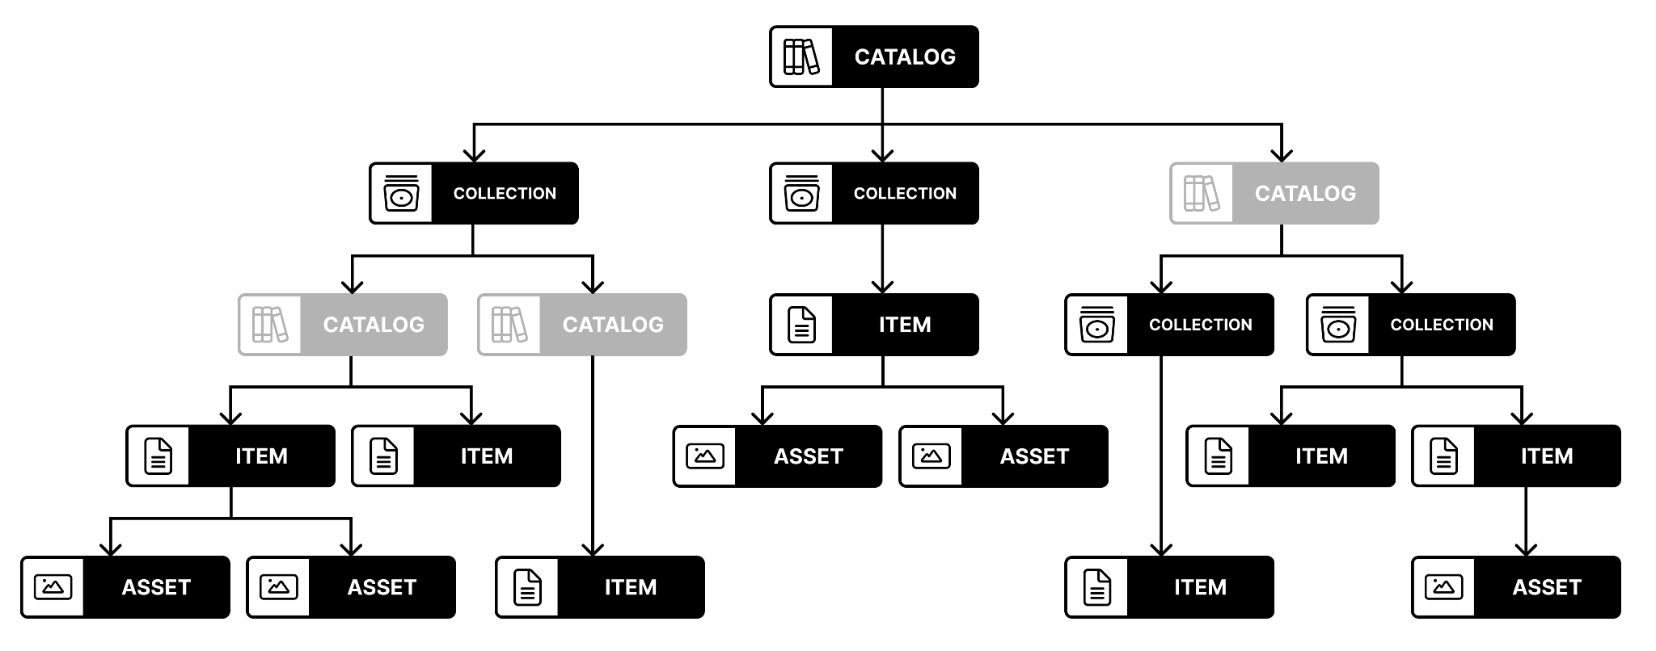

Slide 16
Extensions (non-API)
CEOS-ARD
Classification
Datacube
Electro-Optical
Forecast
Label
Point Cloud
Processing
Projection
Raster
SAR
Satellite
Scientific
Table
Version
View
…
60+ extensions (see stac-extensions.github.io)
Usually define new content fields and link relations
Markdown + JSON Schema + Examples

Slide 17
Metadata fields
Fields defined in
(specification per entity)
common metadata (confusingly part of the item-spec)
extensions
Fields added to
Catalog: top-level
Collection: top-level, assets
Item: properties, assets
Sometimes also links, providers, bands, …
Fields usually in a hierarchy (assets override top-level/properties)
Example: proj:epsg in properties -> set to null in thumbnail to override.
Some exceptions: updated, created, eo:bands, …

Slide 18
STAC API specification

Slide 19
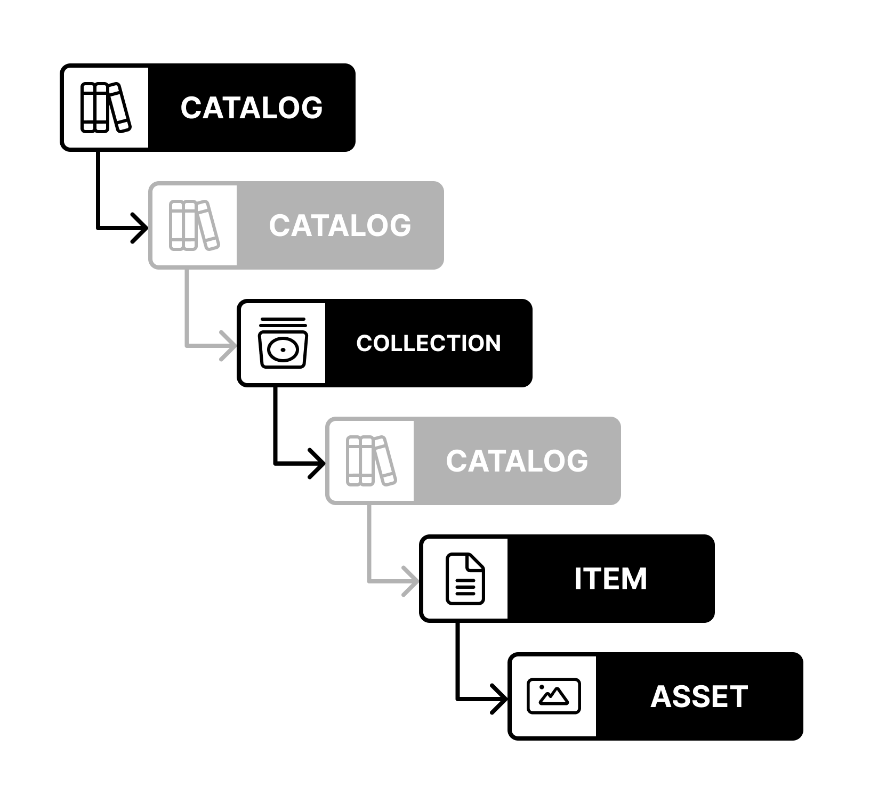
STAC API
HTTP(S) & JSON
Multiple “parts”:
Core
Item Search
Collections / Features based on OGC API (Features)
Extensible
Stable (1.0.0) since 2023

Slide 20
Extensions (API)
10+ extensions (see stac-api-extensions.github.io)
Usually define new API behavior (endpoints, parameters, …)
Markdown + OpenAPI + Examples
Aggregation
Browsable / Children
Collection Search
Fields
Filter / Query
Language
Sort
Transaction
…

Slide 21
Ecosystem

Slide 22
Notable clients / creators
DotNetStac (C#)
Simple STAC client (Java)
stac-js (JavaScript)
STAC.jl (Julia)
pystac / pystac-client (Python)
rstac (R)
stac-ruby / stac-client-ruby (Ruby)
stac-rs (Rust)
stac4s (Scala)
QGIS
STAC Browser
…

Slide 23
Notable servers
stac-fastapi (Python, PostgreSQL or Elasticsearch or SQLAlchemy)
stac-server (NodeJS, Elasticsearch)
resto (PHP)
pygeoapi & pycsw (Python, OGC API centric)

Slide 24
Other notable tools
CLI: stactools, stacterm
Jupyter: stac-nb, leafmap
HTML components: openEO Vue Components
Validation: stac-validator, stac-check, stac-node-validator, STAC API Validator
xarray integration: xstac, stackstac, intake-stac, odc-stac
Web mapping: TiTiler, stac-layer (Leaflet), OpenLayers (WIP)
GDAL/PDAL integration

Slide 25
Notable public STAC (APIs)
Earth Search (Sentinels, stac-server)
USGS Landsat (stac-server) & Astrogeology (Mars etc)
NASA Common Metadata Repository (CMR)
Microsoft Planetary Computer (stac-fastapi)
CBERS and Amazonia-1
Open Data from Capella, Maxar, Planet (static)
See STAC Index for more

Slide 26
What’s next?

Slide 27
STAC 1.1 is available!
Merge eo:bands and raster:bands into generic bands construct
Strengthen the common metadata model
Further alignment with OGC API - Records
many small improvements
API: Focus is to get extensions ready (dependencies on OGC APIs)

Slide 28
STAC + CEOS ARD

Slide 29
The Past: STAC CARD4L Extension
Complex
Only SR, ST, NRB, POL
Many card4l: fields that should live in separate STAC extensions
Outdated name

Slide 30
Tasks
Create new CEOS-ARD STAC extension
Create specific STAC extensions for missing fields
Work with CEOS on
Clarifications
Single template (see Radar)
“Profiles”
Make (example) data available
Deprecate STAC CARD4L extension
Align with ISO/OGC work?

Slide 31
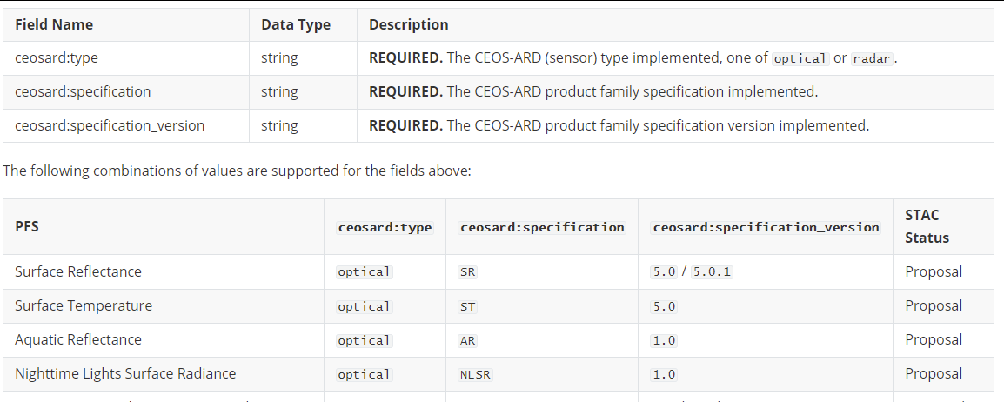
CEOS-ARD STAC Extension
Simplify (may not include all optional requirements)
Create “profiles” for Optical and Radar
Extend to cater for (1) AR, NLSR and (2) ORB, GLSC
Update naming scheme
Create JSON Schema
Create examples

Slide 32
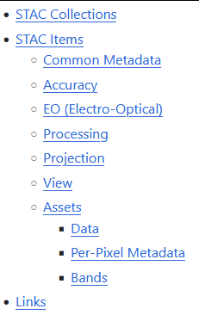
Optical
Draft is available
Needs final polish
May need updates if Optical PFS get merged
Wish for an official review by CEOS
Example dataset will be created

Slide 33
Radar
Work has started
planned for 20242025
needs a lot of discussions for new STAC extensions (~ 30 fields)

Slide 34
Building Blocks / Profiles
Similar to STAC extensions => work on small groups of related information
Seems to be foreseen in ISO/OGC (see UML diagram)
Potentially helpful for CEOS-ARD

Slide 35
Excursion: Cloud-Native Geospatial

Slide 36
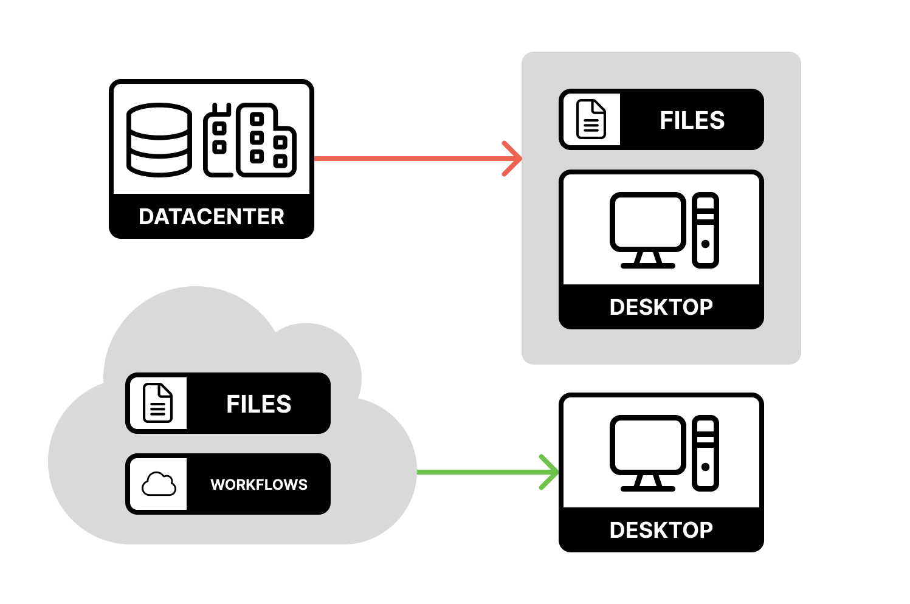
What is Cloud-Native Geospatial?
Complete workflows performed in the cloud
Data Discovery
Processing
Analytics
Visualization
Promotes
Scalability
Reproducibility
Online Publishing (Executable papers)
Examples
Google Earth Engine
Microsoft Planetary Computer

Slide 37
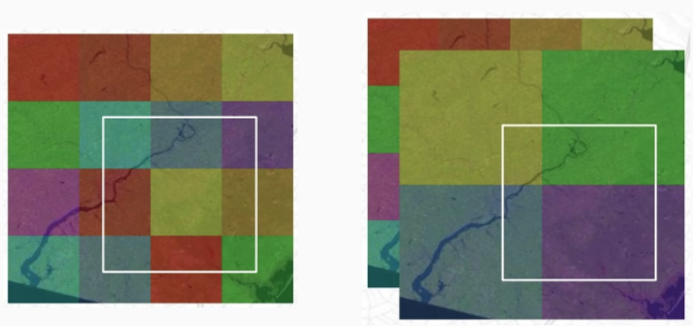
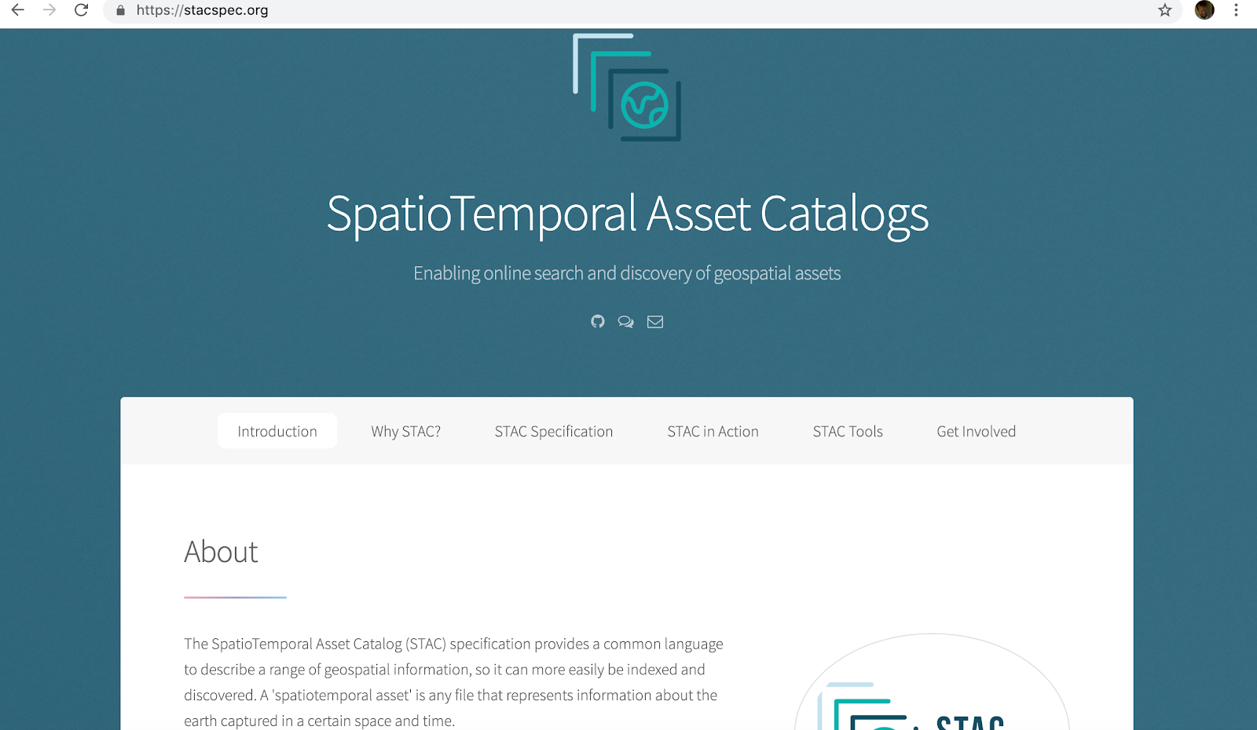
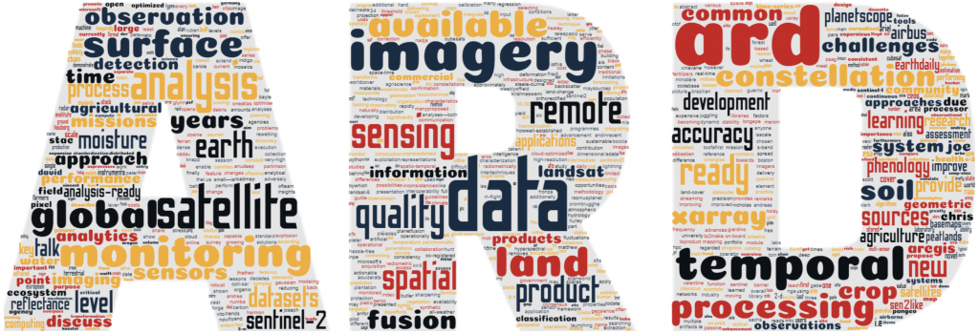
Cloud-optimized data formats
Standardized, searchable metadata
Well-characterized data

Slide 38
Cloud Native Data Formats
Format | Data Type
Cloud-Optimized GeoTIFF (COG) | Raster (good for EO data)
GeoZarr | Raster (good for modeled data)
Cloud-Optimized Point Cloud (COPC) | Point Clouds
GeoParquet | Vector
STAC | Discovery / Metadata
cotar / sozip 🤯 | Archives

Slide 39
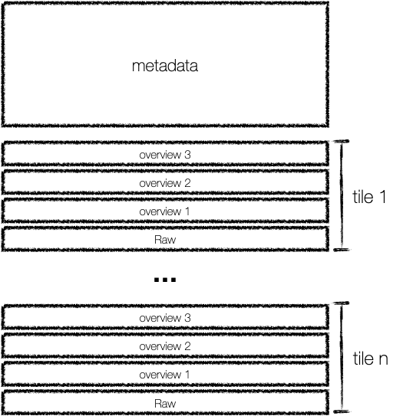
Cloud-Optimized GeoTIFF
Metadata at beginning of file
reduces data seek times
Uses Tiled Segments
decompress and load separately
Overviews in file
efficiently use the data at any resolution

Slide 40
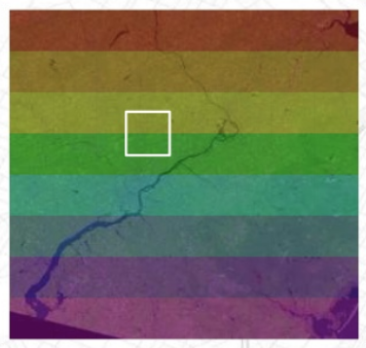
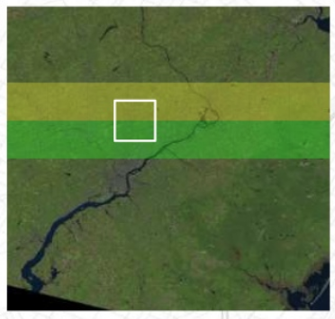
Striped Chunks

Slide 41
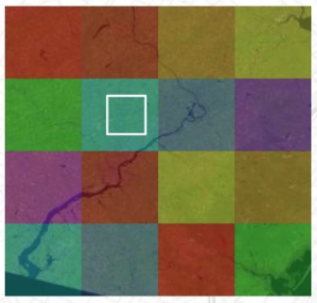
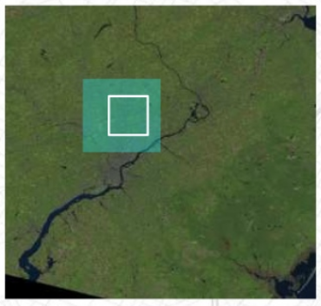
Tiled Chunks

Slide 42
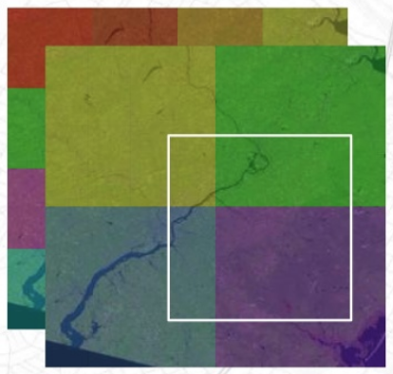
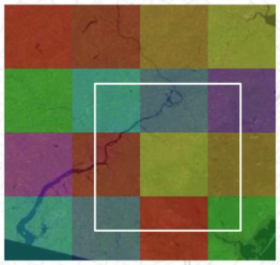
Overviews

Slide 43
A Cloud Native Dataset is one with small addressable chunks

Slide 44
Cloud-Native Geospatial is a collection of standards and technologies for programmatic discovery, access, and exploitation of geospatial data
in the cloud
Notes:
Quote Slide

Slide 45
Resources
Q&A
Official Website
STAC specification
STAC API specification
STAC Index: List of catalogs, tools and tutorials
STAC extensions
STAC API extensions
STAC CEOS-ARD Extension
Old STAC CARD4L Extension

