Slide 1
LSI-VC-17
2025
Agency Updates: ESA “Towards Improved Interoperability”
Ferran Gascon, ESA
Agenda Item 13.1
LSI-VC-17 2025, Tsukuba
14-16 April 2025

Slide 2
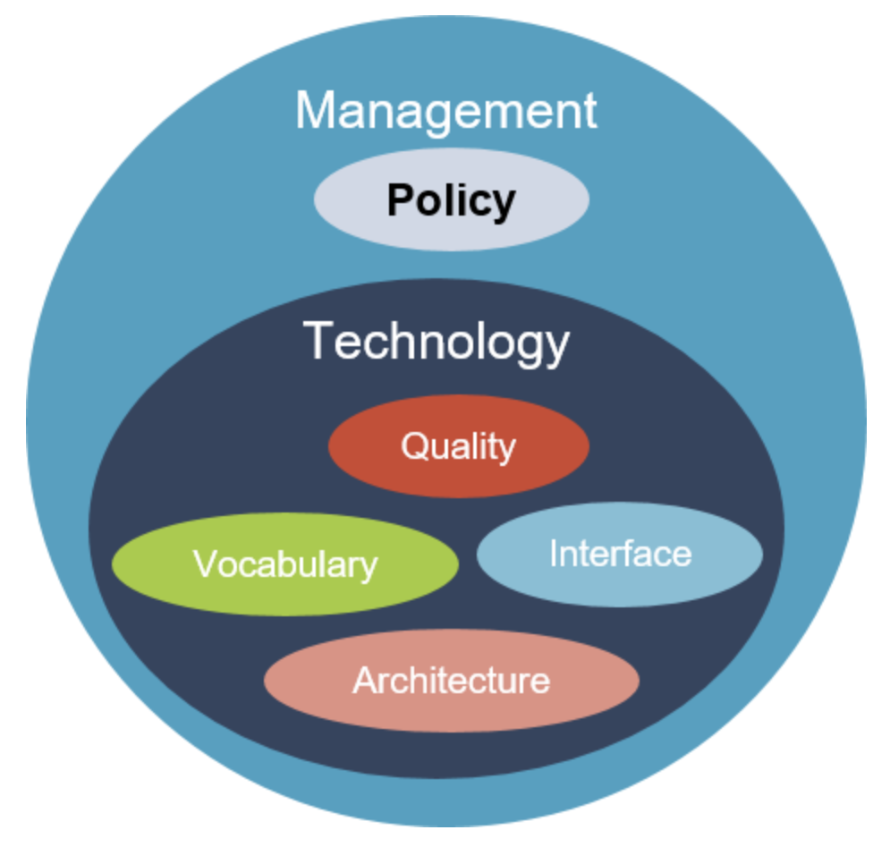
Overview
“Towards Improved Interoperability”
Interoperability Challenges
Interoperability Solutions
Open EO
STAC
Product Format Evolution (with Zarr)
DGGS
CEOS-ARD
Measurements Harmonisation
Free & Open Data Policy
CEOS Interoperability Factors

Slide 3
ESA UNCLASSIFIED – For Official Use
European Space Agency
Notes:
D/EOP has three main lines of activities: Earth Science, Copernicus and Meteorology

Slide 4
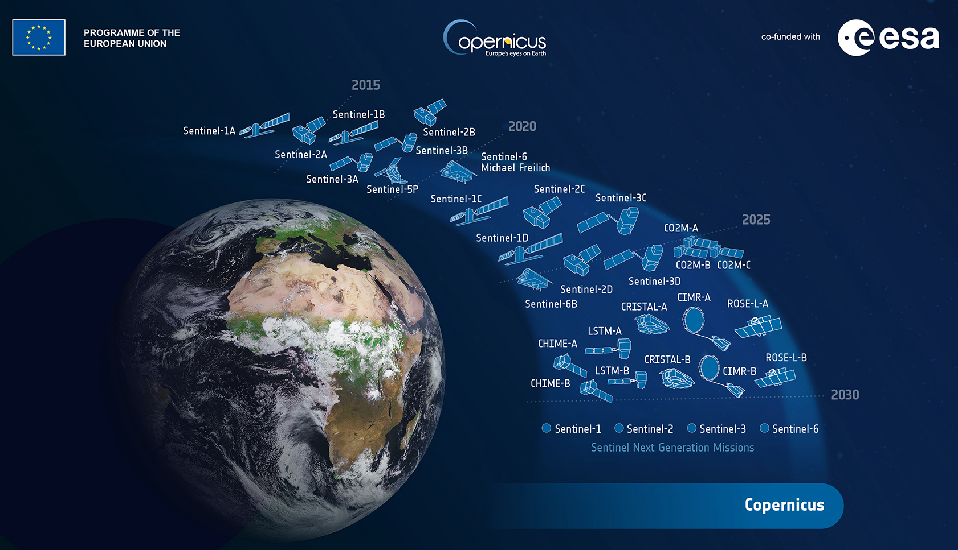
Tomorrow - 2030
Copernicus ESA operations will include 6 new Sentinel missions and more than double the number of satellites in operations.
Data volumes generated will become incompatible with a systematic data replication.
Efficient use of the data holdings will require innovative data management and access interfaces.
New technologies & capabilities (including massive use of AI).
At European level, Data Spaces architecture & implementation progressively becoming available.

Slide 5
Tomorrow - 2030
It’s time to prepare for the future
Evolutions foreseen in the framework of Copernicus operations to introduce innovations in data management and support efficient access to large volumes of data.
Evolutions also needed in the Collaborative scenario to adapt to the future challenges.
It’s time to:
- Address the “jungle of platforms” (CDSE, Data Cubes, GEE, AWS, MS, DestinE,…)
- Prepare for European interoperability “by design”.
- Prepare for the future evolution of Copernicus missions data volumes.

Slide 6
Challenges
How to build powerful and efficient distributed environment in which services, data and users can be managed without introducing mere duplication?
How to transition from unified access to data, towards an ecosystem of interoperable set of decentralised and collaborative services maintaining their own identity and control?
How to offer innovation, stability and security to users and services?
We are not alone! Some large and dense jungles exist out there
Profit from International and European solutions and context

Slide 7
Solutions
ESA managed operations for Copernicus / DestinE / Earth Explorers, are established following similar principles and architecture guidelines.
These generic principles and architecture are being consolidated in the form of an “ESA Observation Framework” (EOF), instantiated by each Programme in line with its specificities, benefiting from European interoperability “by design”.
EOF aligns with the best practices established by the European Commission to accelerate the formation of sovereign European Dataspaces.
European Dataspaces
“Interoperable framework, based on common governance principles, standards, practices and enabling services, that enables trusted data transactions between participants”.
Data Space Support Centre (DSSC): European Commission initiative to define common requirements and establish best practices to accelerate the formation of sovereign data spaces.
ESA Observation Framework (EOF)
Define guiding principles, architectural drivers and service integration strategies established for the European industry by ESA to manage the operations of space observations derived datasets and services.

Slide 8
Solutions / OpenEO
Simple data access & processing for multiple Earth observation datasets
Scalable and efficient processing capabilities.
A standardized system that works across different platforms.
Independence from underlying technologies and software libraries
Supporting principles of FAIR (Findable, Accessible, Interoperable and Reusable) data and Open Science, e.g. transparent workflows.

Slide 9
Solutions / OpenEO
https://dataspace.copernicus.eu

Slide 10
Solutions / STAC
STAC (SpatioTemporal Asset Catalogs) has very useful and powerful extension mechanisms to tailor the specification to support diverse data sets and use cases (well beyond legacy lowest common denominator interoperability approaches).
Rich set of Open-Source resources and libraries provides low barrier for implementations.
STAC goes beyond data discovery and matches well to providing interoperable data access for cloud native datasets.
There is an active community shaping the evolution of the standard, ready to contribute to the implementation.
Adopted across ESA projects as core element for facilitating interoperability.

Slide 11
Solutions / Data Format Evolution
Not a ‘nice-to-have,’ but a fundamental priority to:
Optimise access to the large data volume generated by Copernicus since the start of Sentinel-1 operations in 2014, and prepare for the access to the significantly larger volumes to be generated by the Copernicus Expansion missions as from 2028.
Facilitate combination of multi-Sentinel data, harmonising representation and access across missions.
Foster the evolution from individual product download to a streamlined data access, facilitating the access to the target data subset, across missions and along time.
Support the readiness of Sentinel data for AI analysis and applications.
Keep a leading Europe’s role in the advanced use of Sentinel data.
New EOPF (Earth Observation Product Format) developed

Slide 12
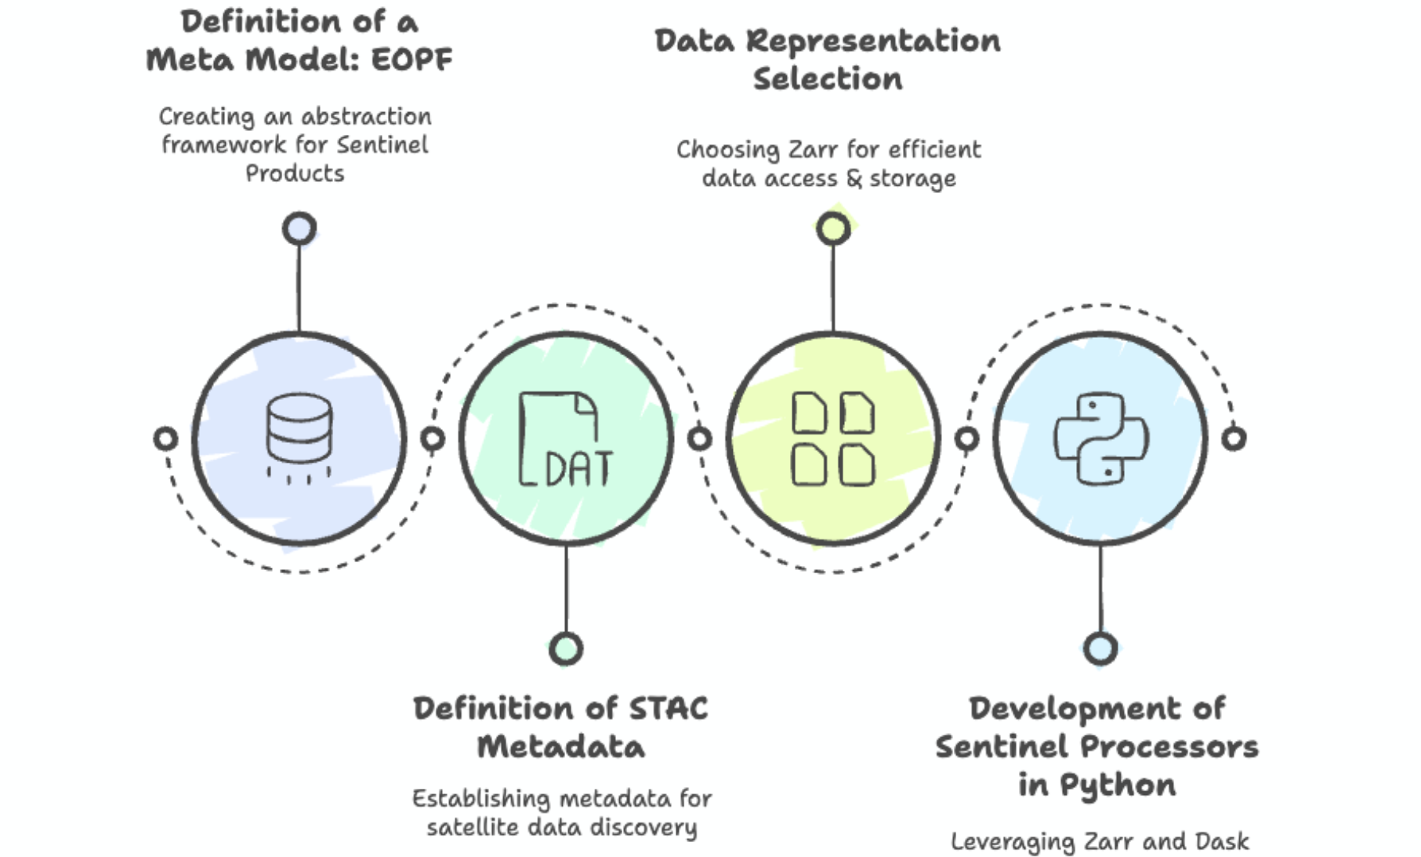
Solutions / Data Format Evolution

Slide 13
Solutions / Data Format Evolution

Slide 14
Solutions / Data Format Evolution

Slide 15
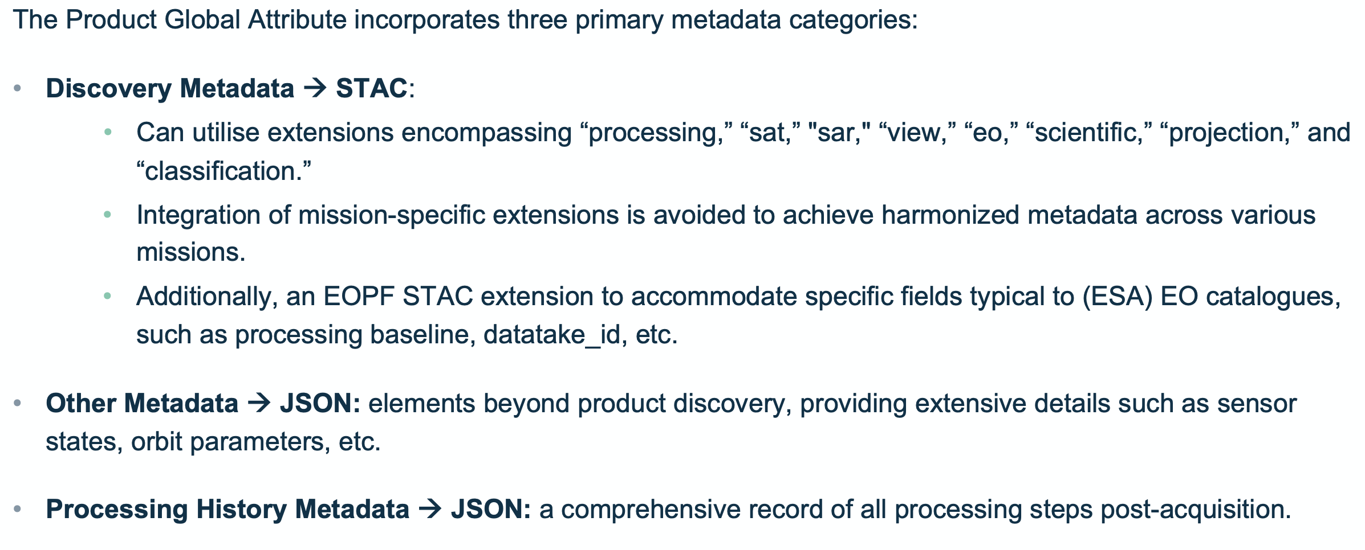
Solutions / Data Format Evolution

Slide 16
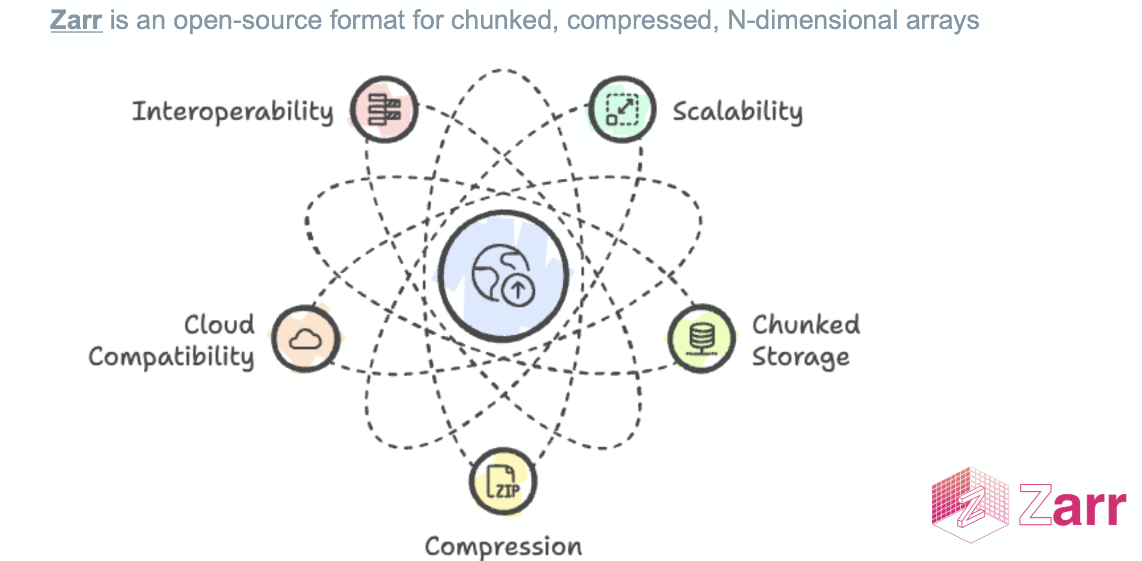
Solutions / Data Format Evolution
https://zarr.eopf.copernicus.eu

Slide 17
Solutions / Data Format Evolution
EOPF (Earth Observation Product Format) resources
All the resources can be found here:
https://eopf.copernicus.eu/
Product format currently available:
Common Product Spec: https://cpm.pages.eopf.copernicus.eu/eopf-cpm/main/PSFD/
Common ADF: https://cpm.pages.eopf.copernicus.eu/adf-auxiliary-data-file/main/adfs/index.html
Sentinel 1: https://s1.pages.eopf.copernicus.eu/s1-l12-rp/main/pfs/index.html
Sentinel 2: https://s2.pages.eopf.copernicus.eu/pdfs-adfs
Sentinel 3: https://s3.pages.eopf.copernicus.eu/pdfs-adfs
Source code for the CPM (Common Product Model) library:
https://gitlab.eopf.copernicus.eu/cpm/eopf-cpm

Slide 18
Solutions / DGGS
Context:
The Copernicus Space Component (CSC) and the Destination Earth (DestinE) initiative generate and make available vast amounts of Earth Observation (EO) and climate data.
Different data representation, structures, projections and formats complicate the synergetic use and analysis of large volumes of diverse data.
Need:
An interoperable data representation that streamlines the combination of large volumes of EO and climate data for easier processing, visualization and analysis.
Solution:
Adoption of Discrete Global Grid Systems (DGGS) in combination with the Zarr cloud-optimized format (EOPF for the Sentinels) to harmonise the data representation across diverse types of data, including different types of EO sensors and climate data.

Slide 19
Solutions / DGGS
Definition:
A DGGS partitions the Earth’s surface into a hierarchy of cells with discrete boundaries, enabling systematic storage, indexing, and analysis of geospatial data.
Key Features:
Multi-Resolution: Cells can be refined at finer levels while preserving relationships to coarser grids.
Spatial Indexing: Each cell has a unique identifier, supporting efficient queries and data retrieval.
Uniform Coverage: Ensures consistent global representation with minimal distortion.
Interoperability: Standardizes data representation across different sources and scales.
Why DGGS?
Facilitates seamless integration of large volumes of EO multi-mission and multi-domain data.
Enables fast, scalable analytics in cloud-based or big data environments.
Offers a common reference framework for diverse geospatial applications.

Slide 20
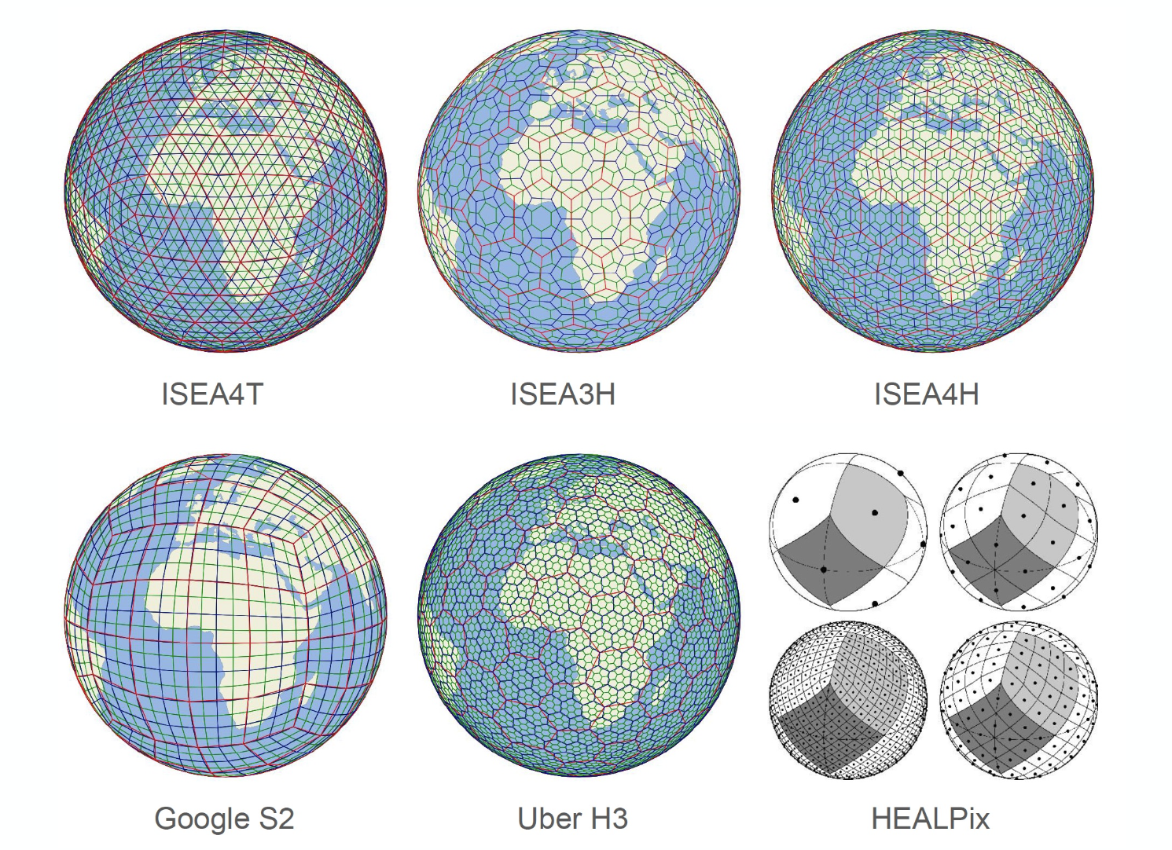
Solutions / DGGS

Slide 21
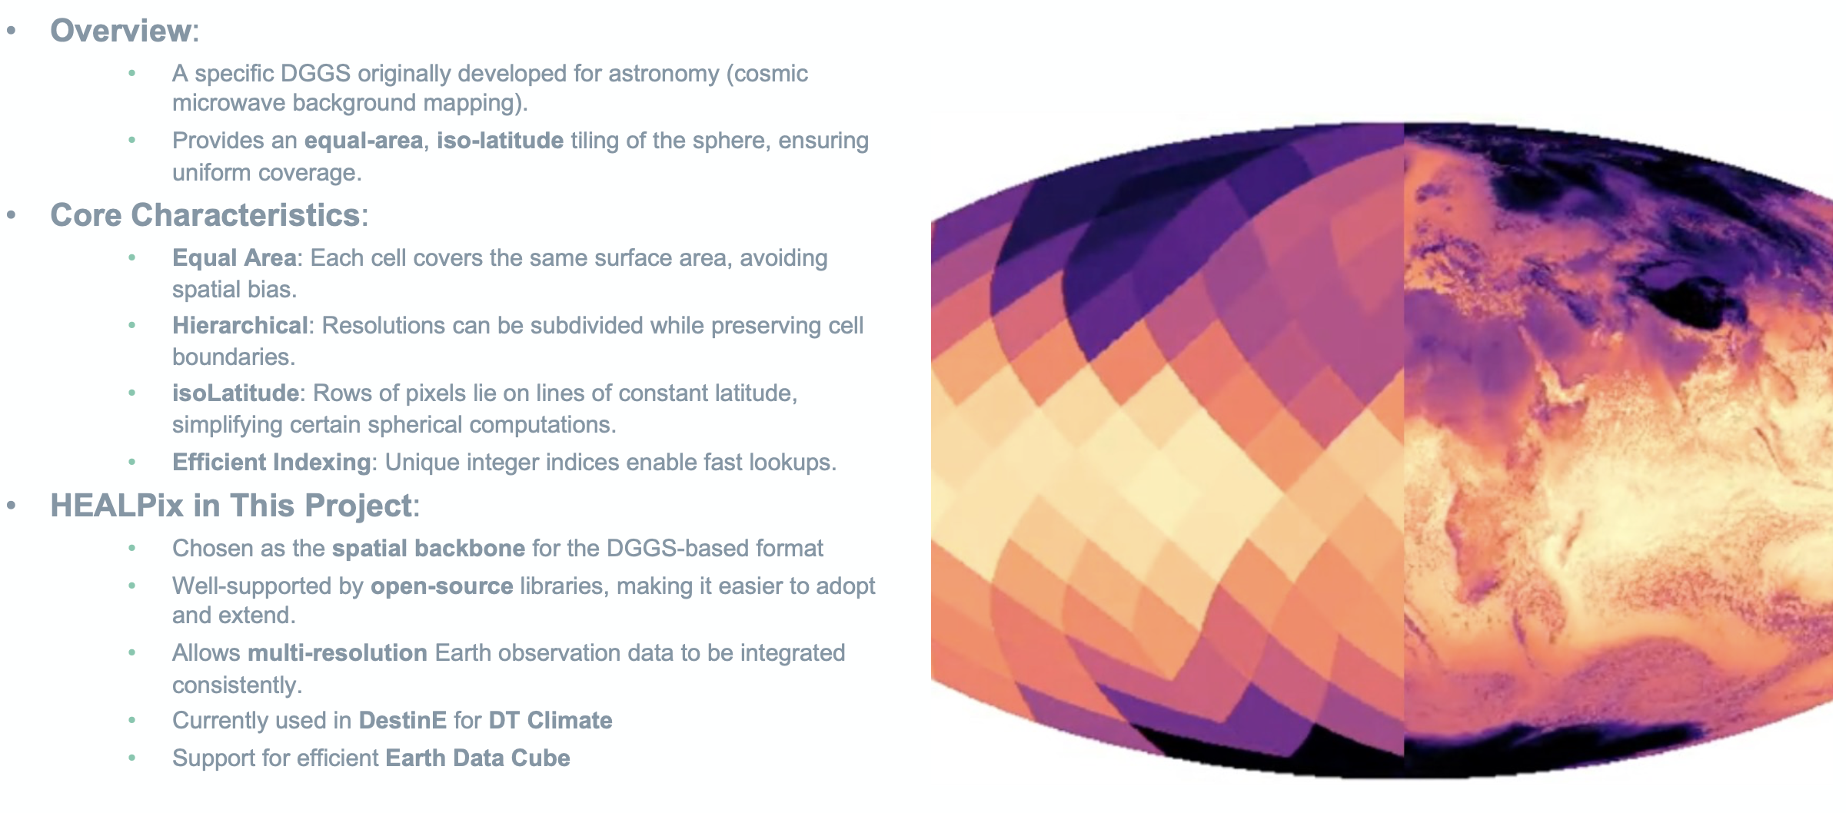
Solutions / DGGS / HEALPix

Slide 22
Solutions / DGGS / HEALPix

Slide 23
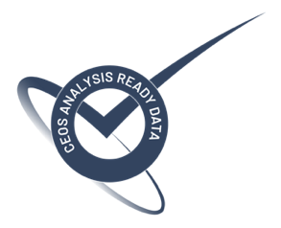
Solutions / CEOS-ARD
Mission | Product | PFS | Status | Availability Date
Sentinel-2 | L2A | SR | ✅ | January 2022
PROBA-V | Collection 2 | SR | ✅ | March 2023
Sentinel-2 | L2H | SR | Under Development | 2023 (pilot product), TBD (operational product)
Sentinel-2 | L2F | SR | Under Development | 2023 (pilot product), TBD (operational product)
Sentinel-2 | L2A | AR | Under Development | TBD
Sentinel-1 | NRB / ORB | NRB / ORB | Under Development | TBD
Sentinel-3 | SYN | SR | Under Development | TBD
ERS SAR | TBC | NRB | Under Development | TBD
ERS ATSR | TBC | LST | Under Development | 2024
Envisat ASAR | TBC | NRB | Under Development | TBD
Envisat MERIS | TBC | SR | Under Development | 2024
CHIME | L2A | SR | Under Development | 2029
CHIME | L2H/L2F | SR | Under Development | 2029 (pilot product), TBD (operational product)
LSTM | L2A | ST, SR | Under Development | 2029
LSTM | L2H/L2F | ST, SR | Under Development | TBD
ROSE-L | TBD | NRB…TBC | Under Development | TBD

Slide 24
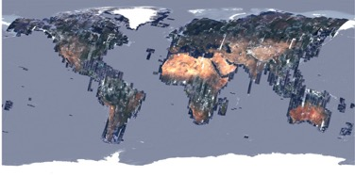
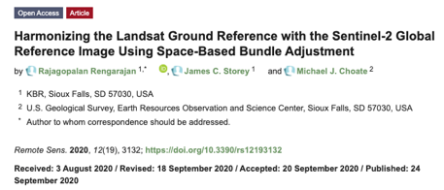
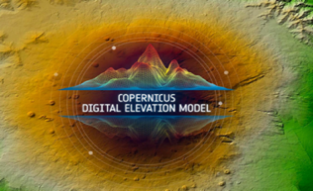
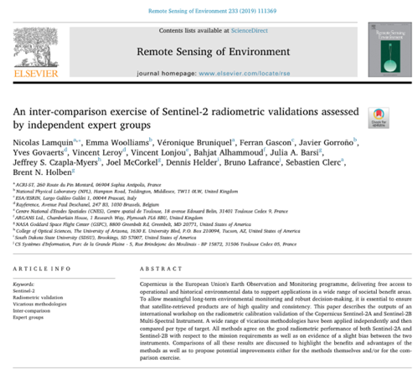
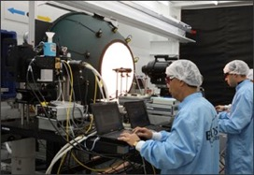
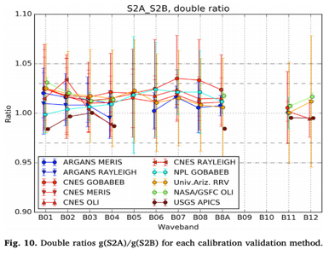
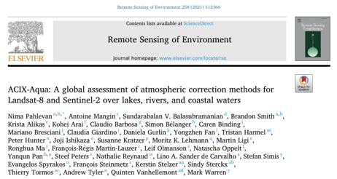
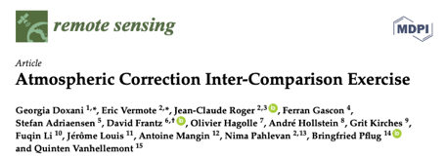
Solutions / Measurements Harmonisation
Example for Landsat - Sentinel-2 Measurements Harmonisation
Geometry :
S2 GRI (Global Reference Image)
Copernicus DEM (Digital Elevation Model)
CEOS DEMIX (DEMs Intercomparison eXercise)
Top-of-atmosphere Radiometry :
Pre-flight sensor comparison using an integrating sphere
S2 spectral responses close to Landsat-8/9
Absolute radiometry inter-comparison
Surface Reflectance and Cloud Masking :
CEOS ACIX (Atmospheric Correction Intercomparison eXercise)
CEOS CMIX (Cloud Mask Intercomparison eXercise)
Harmonized/Homogeneized/Fused Products :
Sen2Like & HLS

Slide 25
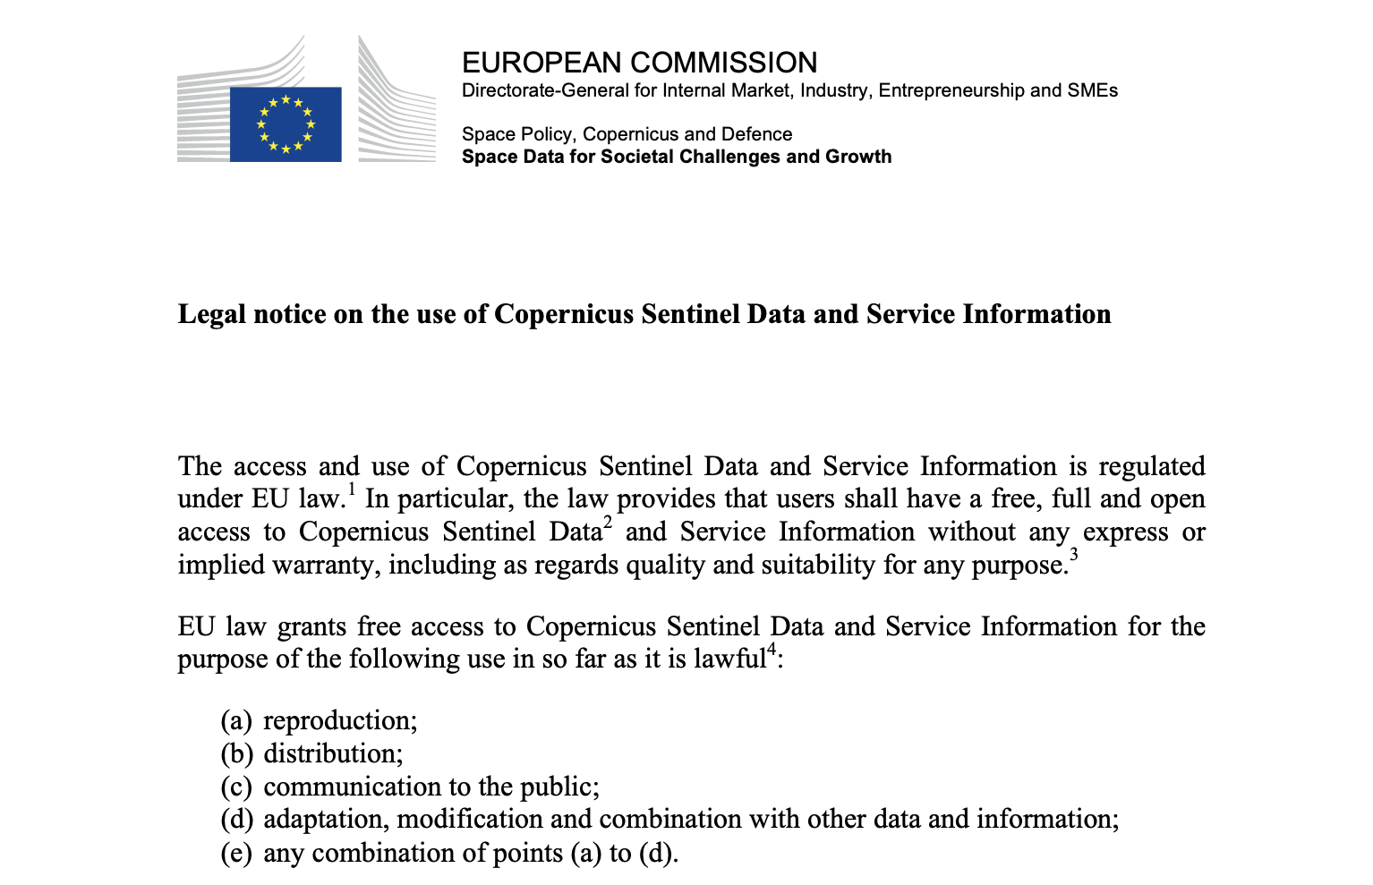
Solutions / Free & Open Data Policy
https://sentinel.esa.int/documents/247904/690755/Sentinel_Data_Legal_Notice

Slide 26
Conclusions and Outlook
Clear need to move quickly towards effective interoperability to face the growing EO data volumes coming very soon.
ESA is preparing interoperability ‘by design’ to face this challenge.
A set of solutions is being implemented across ESA-managed programmes, including Open EO, STAC, Product Format Evolution, DGGS, CEOS-ARD and Data Policy.
This improvement of interoperability is and will be performed considering similar efforts at European and International level.

Slide 27
Thank you!

