Slide 1
USGS Landsat
Collection 3 Status
Agenda Item 13.4
LSI-VC-17
Tsukuba, Japan
14-16 April, 2025

Slide 2

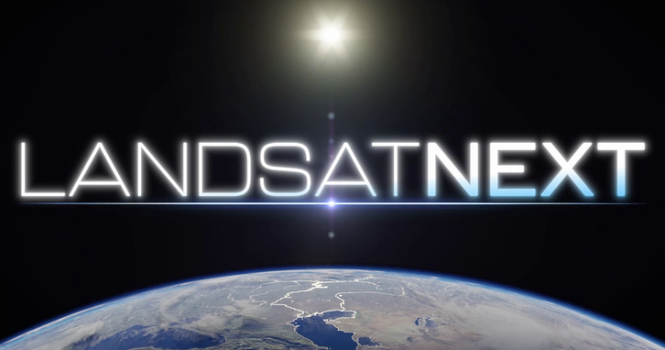
Context
Landsat Collection 3 in formulation!
Collection 3 will reprocess the 53+ yr record to implement improvements and enhancements:
  Level-1 radiometric calibration/geometric correction
  Level-2 atmospheric correction
  Global Aquatic Reflectance (New)
  Metadata and file naming structures to accommodate Landsat Next
    Allows opportunity to revisit the archive spatial structure/projection system
Target public release: 2028/2029
  “Landsat Next-ready”

Slide 3
Collection 3 Executive Vision
Resolve Collection 2 known issues that is currently CEOS-ARD complaint and geometrically interoperable/aligned with ESA’s Sentinel-2 Collection 1 data products.
Modernized USGS Landsat Data Processing and Archive System while improving and advancing Landsat 1-9 archive data quality, algorithms, products, capabilities, and services.
Prepare for integration of Landsat Next’s observations and data products in the early 2030s that maintains archive continuity and facilitates emerging applications e.g., surface water quality, cryospheric science, geology, and agricultural applications.

Slide 4
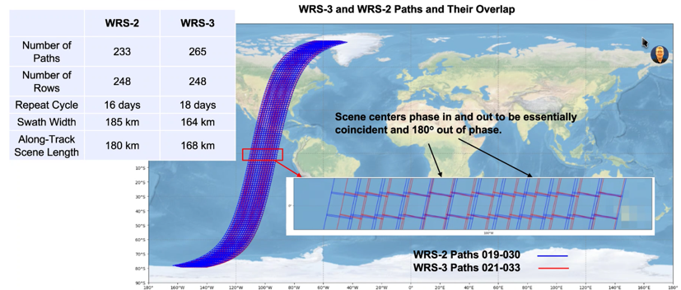
Discontinuities Exacerbated with Landsat Next on WRS-3

Slide 5
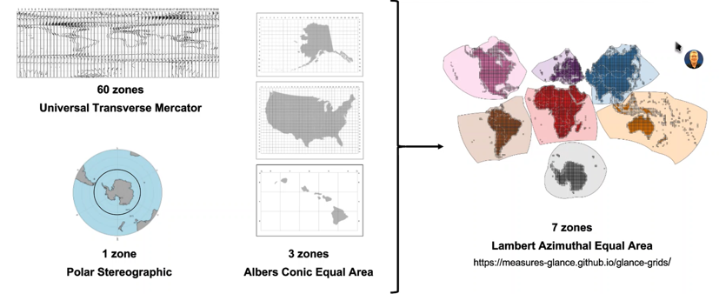
Proposing: Continental Equal Area Projection for Collection 3
Collection 2
Proposed Collection 3 Projection

Slide 6
Community Engagement & Feedback
Proposed Collection 3 projection has been presented ~15 times, reaching ~250 individuals.
  Overall feedback skews neutral to enthusiastic, with “no-change” a minority.
  Will Greenland suffer too much distortion? Pacific Islands?
  Europe already has a standard LAEA projection (i.e., EPSG:3035) – why not use that?
Next Steps
  Generate sample products.
  Continue user community engagement.
  Further characterization at CEOS WGGCV GRGIX.
  Landsat program decision prior to final Collection specification.

Slide 7
How will the USGS Achieve This?
NLI and EROS Landsat program/project civil service staff across the Landsat operations and development portfolio.
EROS Technical Support Services Contract.
NASA Landsat Science and Calibration/Validation joint agency project team.
2025-2030 Landsat Science Team comprised of competitively selected investigators from non-government and U.S. government entities (announcement soon!).
Through the 2030 Landsat International Partnerships Initiative to include GA, DLR, ESA, and EC.

Slide 8
Collection 3 Status – April 2025
USGS proposed to COM/ESA/NASA for establishment of a formal action to coordinate and align Landsat Collection 3 and Sentinel-2 Collection 2 archive processing where possible starting in 2025
USGS/EROS is nominally developing Collection 3 science/engineering requirements to guide Collection 3 development/archive processing
Collection 3 draft requirements prepared for partner sharing in Spring 2025
High-level priorities are to resolve Collection 2 Level-2 product known issues, improve and advance science data products that address interoperability targets (e.g., maintain geometric GCPs, adoption of COPDEM, continental equal area projection, re-baseline/quantify science algorithm uncertainties, product design according to CEOS-ARD compliance), and prepare for Landsat Next integration.

Slide 9
Collection 3 Status – April 2025 (cont.)
USGS/EROS is planning to formally adopt System Engineering Management Plan
  Plans are currently under consideration by USGS/EROS and LSDS portfolio leadership
March 2025 thru May 2026 is an important period for Collection 3 definition, algorithm maturation, and product design.
USGS plans to reach out to partners with interests participating as a formal Collection 3 review team member if endorsed by USGS/EROS and NLI program leadership

Slide 10
Questions

