Slide 1
LSI-VC-17
SAR topics for LSI-VC
Ake Rosenqvist, JAXA/soloEO
Agenda Item 12.1
Tsukuba, Japan, 14-16 April, 2025

Slide 2
LSI-VC-17 agenda item 12.1
SAR topics for LSI-VC:
LSI-VC PolSAR activity – Status update [for information]
Int’l Coordination Group for Spaceborne SAR missions (ICGS-SAR) potential new CEOS activity in 2026 – implications for LSI-VC? [for discussion]

Slide 3
LSI-VC Polarimetric SAR (PolSAR) Activity – Quick recap & status update
Ake Rosenqvist, JAXA
Francesco Sarti, ESA
Magdalena Fitrzyk RSAC c/o ESA
Agenda Item 12.2(1)
Tsukuba, Japan, 14-16 April, 2025

Slide 4
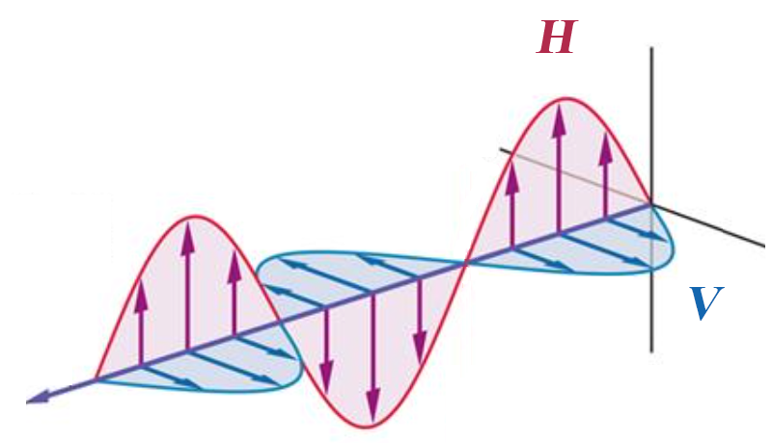
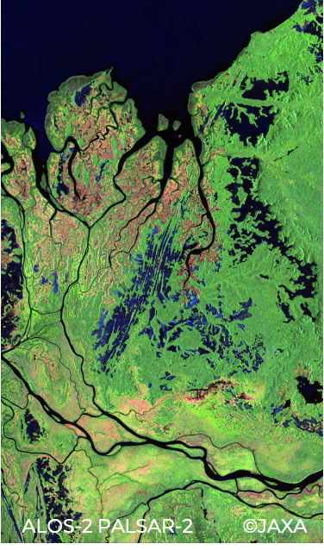

Quick PolSAR recap
Fully polarimetric, quad-polarisation (QP), data provides information about both backscatter amplitude and backscatter phase - for each polarisation combination (HH/HV/VH/VV)
Polarimetric phase varies depending on the ground target → enables enhanced retrieval of target structural parameters
Time-series of QP data enables interferometric analysis of changes in polarimetric phase (Pol-InSAR)
Radar wavelength (λ) directly correlated with target size → multi-frequency (multi-wavelength) data enables enhanced retrieval of target structural parameters
ALOS-2 PALSAR-2 (JAXA) Processing: Y. Yamaguchi (U. Niigata)

Slide 5
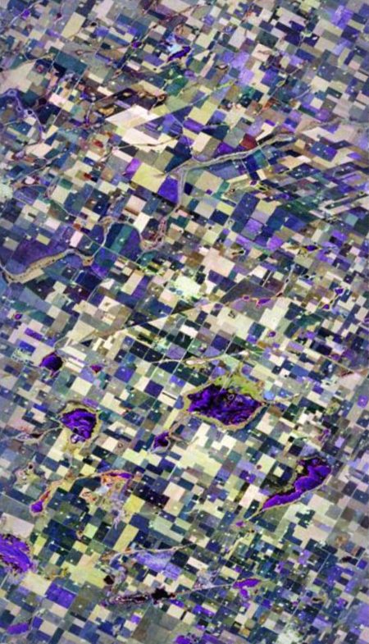
Quick PolSAR recap
Despite great potential – POLINSAR research and applications still under-developed
Scarcity of consistent time-series of polarimetric data for R&D
Lack of (near)coincident, multi-sensor, multi-frequency datasets for SAR-SAR interoperability analysis
Complexity of polarimetric processing 🡪 high entry level for new users
SAOCOM-1 (CONAE) Processing: CONAE

Slide 6







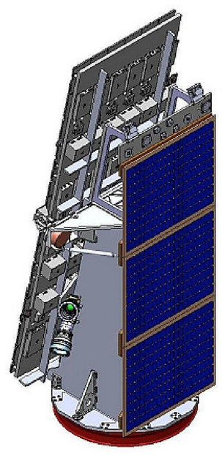



Quick PolSAR recap
CEOS capacity exists!
A large number of current and imminent CEOS missions with polarimetric (QP) capacity
Missions span all radar frequency bands (P, L, S, C, X)
Recent technology developments (wide observation swaths @ fine spatial resolution; high speed downlink)
– Significantly improved capacity for routine QP observations.
– Readiness to exploit the full potential of Synthetic Aperture . Radar
NovaSAR

Slide 7
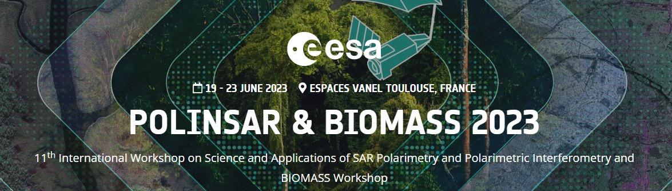
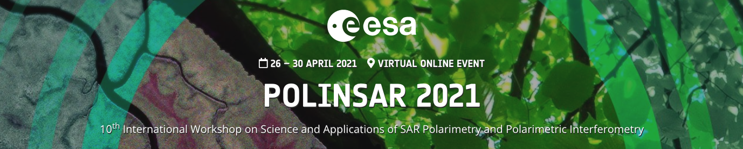
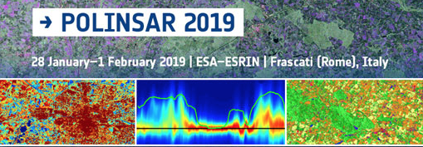

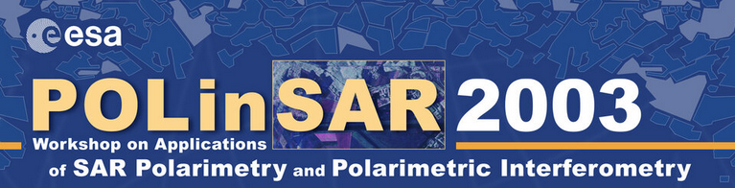
Quick PolSAR recap
Long-term engagement with PolSAR/Pol-InSAR community
ESA POLINSAR workshops for 20+ years.
JAXA K&C Initiative int’l R&D program with dedicated PolSAR theme.
CONAE, CSA, ISRO national PolSAR programs.
Users represent a range of applications, mostly related to land – e.g. agriculture, forestry, wetlands, cryosphere, soil moisture 🡪 close link to LSI-VC

Slide 8

Recommendations to SIT-39 (1/3)
1. Establishment of a POLINSAR Reference Site Network
Reference sites representing range of biomes and application areas
Established sites of on-going SAR/PolSAR/Pol-InSAR research by CEOS agencies (CONAE, CSA, DLR, ESA, ISRO, JAXA, NASA)
Access to in-situ, Lidar and/or airborne SAR data
Seek synergy with ongoing CEOS & GEO ground validation networks, e.g. GEO-TREES, AFOLU/Biomass Harmonisation.

Slide 9
Recommendations to SIT-39 (2/3)
2a. Dedicated Polarimetric observations over POLINSAR Reference Sites
Coordinated CEOS Agency effort under LSI-VC
Build time-series of QP data for PolSAR and Pol-InSAR
Multi-mission observations at multiple (P, L, S, C, X) frequencies
Best effort basis
2b. Long-term vision
As 2a above, but with regional/global-scale focus
Integration of Polarimetry in strategic background mission observation plans

Slide 10
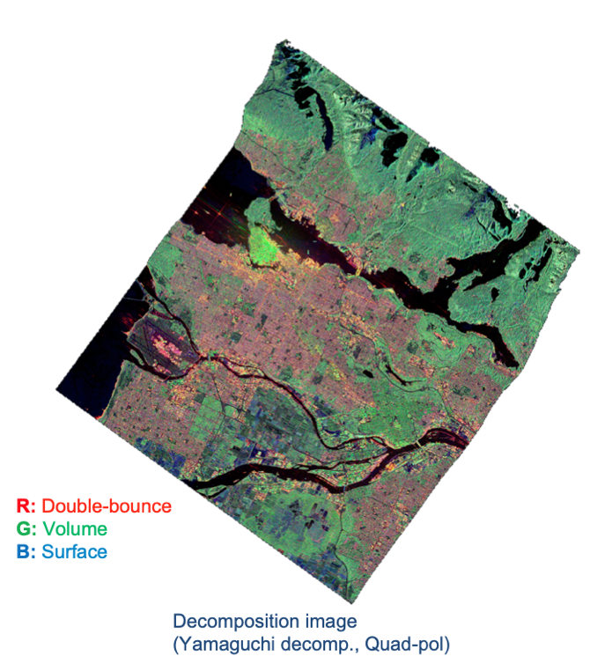

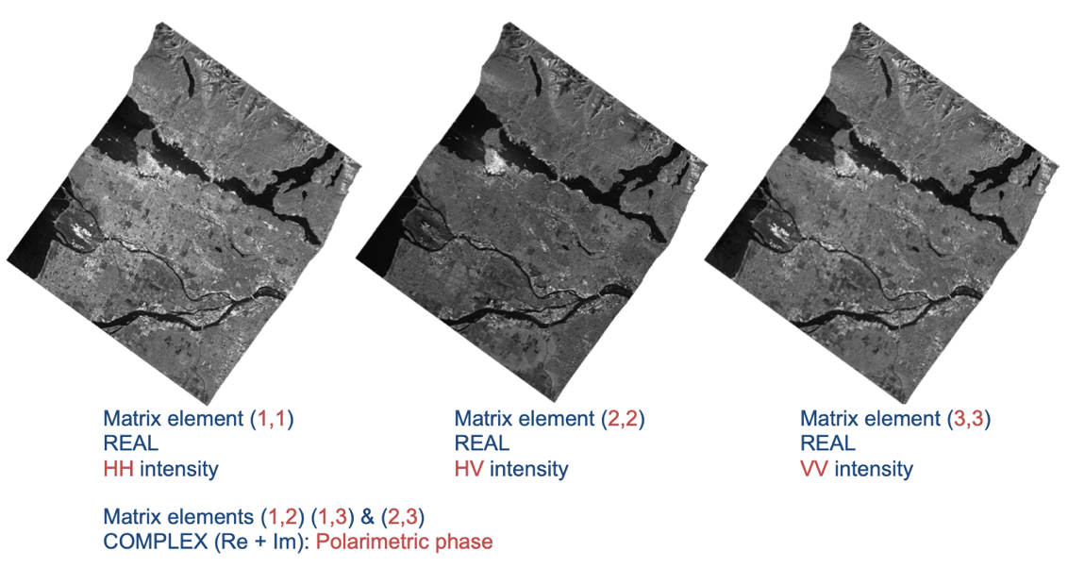
Recommendations to SIT-39 (3/3)
3. Simplified Data Access for R&D
Single data repository for QP datasets on the CEOS Analytics Lab (CAL) platform
Open access for R&D groups (data sharing model similar to that for WGDisasters?)
Use of user-friendly product standards → CEOS-ARD
POLINSAR software tools
Support further development of open software tools for POLINSAR processing and analysis (ESA PolSARPro, SNAP)
Toolboxes and Notebooks on the CEOS Analytics Lab (CAL)
CEOS-ARD
Polarimetric Radar

Slide 11
SIT-39 Action
SIT-39-09: Relevant CEOS Agencies asked to designate a PoC for engagement in the LSI-VC PolInSAR Team, which includes support for systematic observations over Reference Sites [on a best-effort basis].

Slide 12
Current status (April 2025)
SIT-39-09: Relevant CEOS Agencies asked to designate a PoC for engagement in the LSI-VC PolInSAR Team, which includes support for systematic observations over Reference Sites [on a best-effort basis].
PoC nominated:
  ESA: K. Scipal (BIOMASS, P-band)
  JAXA: T. Tadono (ALOS, L-band)
  CONAE: L. Frulla (SAOCOM, L-band)
  NASA: P. Rosen (NISAR, L-band)
  CSA: S. Chalifoux (RCM/R-2, C-band)
PoC nominations pending:
              ASI (COSMO-SkyMed, X-band)
          DLR (TerraSAR-X, X-band)
          ISRO (EOS-04, C-band, NISAR, S-band)
  Yet to be contacted (?):
  UKSA/CSIRO (NovaSAR, S-band)
NovaSAR

Slide 13




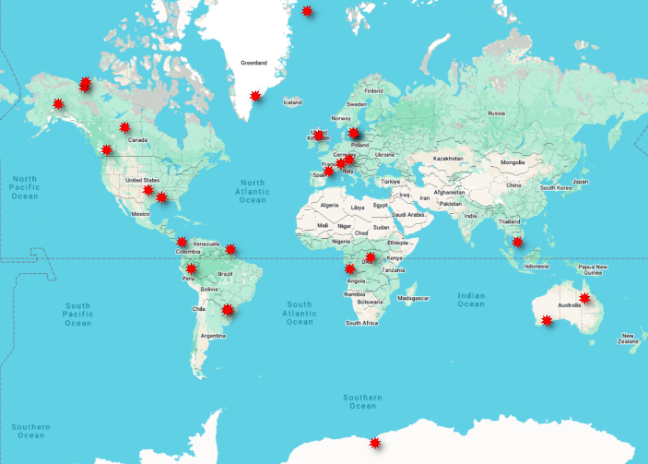
Current status (April 2025)
2025 Milestones
Define PolSAR Science Team & Reference Sites
Compile PolSAR observation requests for each contributing SAR mission
Coordinate observation tasking with nominated Agency PoCs
Start of PolSAR observations in time for NH summer
Set up data repository and toolboxes on the CAL
Interim reporting: SIT TW 2025, LSI-VC-18
ESA POLINSAR workshop (Feb 2026)

Slide 14
PolSAR Reference Sites
PolSAR Reference Site name | Location | Land cover
Alaska wetlands & CR site | Alaska/USA | Wetland & CR site (NISAR CV site)
Attsjö | Sweden | Temperate forest
Barro Colorado Island | Panama | Tropical forest (GEO-TREES)
Belgica Bank | Arctic Sea | Sea ice
Boorowa Research Farm | NSW/Australia | Agriculture
Flanders Moss | Scotland | Temperate peatland/bog
Great Aletsch glacier | Switzerland | Alpine Glacier
Great Western Woodlands | WA/Australia | Temperate woodland
Helheim Glacier | Greenland | Glaciers/ice sheets (PolInSAR)
Interior Douglas-Fir (IDF) zone | BC/Canada | Boreal forest - fire scars
King Baudouin Ice Shelf | Antarctica | Glaciers/ice sheets (PolInSAR)
Luki | DR Congo | Tropical forest (GEO-TREES)
Mekong delta | Vietnam | Irrigated rice (CH4 emissions)
Misiones | Misiones/Argentina | Managed forest & subtropical rainforest
Mississippi Yucatan Lake | Mississippi/USA | Wetland (NISAR CV site)
Oklahoma CR site | Oklahoma/USA | CR site (NISAR CV site)
Pacaya Samiria Reserve | Peru | Tropical peatland (NISAR CV site)
Paracou | French Guiana | Tropical forest (GEO-TREES)
Peace-Athabasca delta | Alberta/Canada | Inland river delta (NISAR CV site)
Robson Creek | QLD/Australia | Tropical forest
Toulouse | France | Urban
Traunstein | Germany | Temperate Forest
Tuktoyaktuk | NWT/Canada | Boreal peatlands
Yangambi | DR Congo | Tropical forest (GEO-TREES)
LSI-VC PolSAR Reference Sites

Slide 15
ICGS-SAR & LSI-VC
Ake Rosenqvist, JAXA
Agenda Item 12.2(2)
Tsukuba, Japan, 14-16 April, 2025

Slide 16
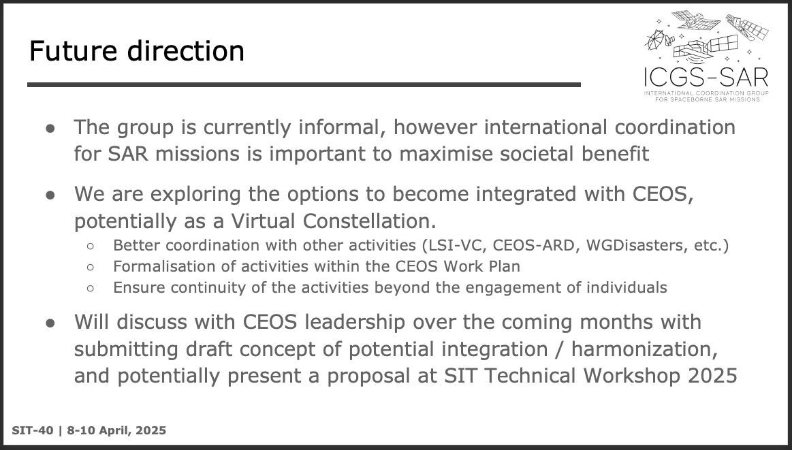
ICGS-SAR & LSI-VC
SIT-40: Int’l Coordination Group for Spaceborne SAR Missions (ICGS-SAR) flagged as potential new CEOS activity (SAR-VC?) in 2026

Slide 17
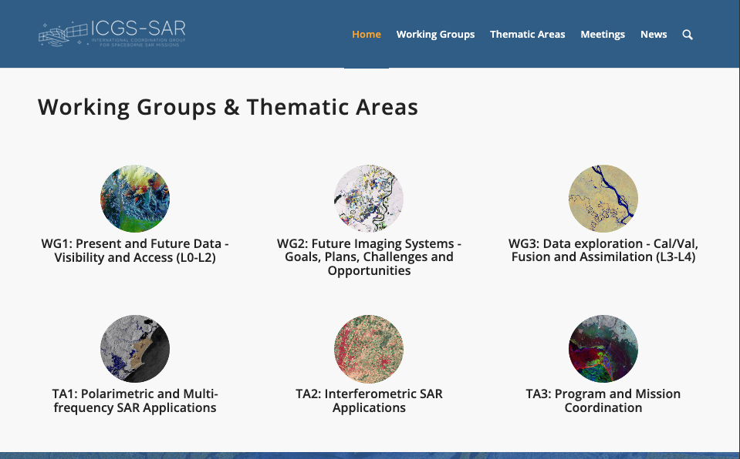
ICGS-SAR & LSI-VC
SAR-related activities in LSI-VC
LSI-VC PolSAR activity
        • Obvious commonality with TA-1
CEOS-ARD SAR PFS
• Core LSI-VC activity
• No present ICGS-SAR equivalent
Could be argued that one or more should fall under a SAR-VC.
– LSI-VC Leads thoughts?
– Should there be a common LSI-VC position?

