Slide 1
LSI-VC-17
EO for Wetlands
Ake Rosenqvist, JAXA/soloEO
Agenda Item 12.3
Tsukuba, Japan, 14-16 April, 2025

Slide 2
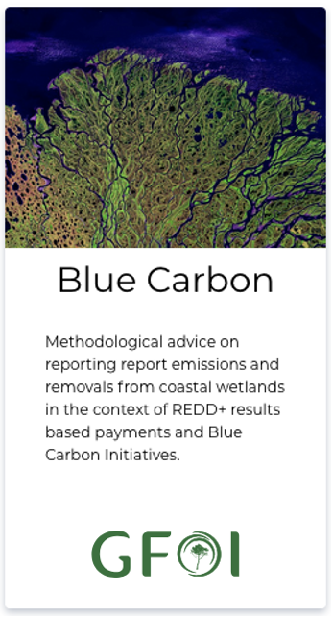
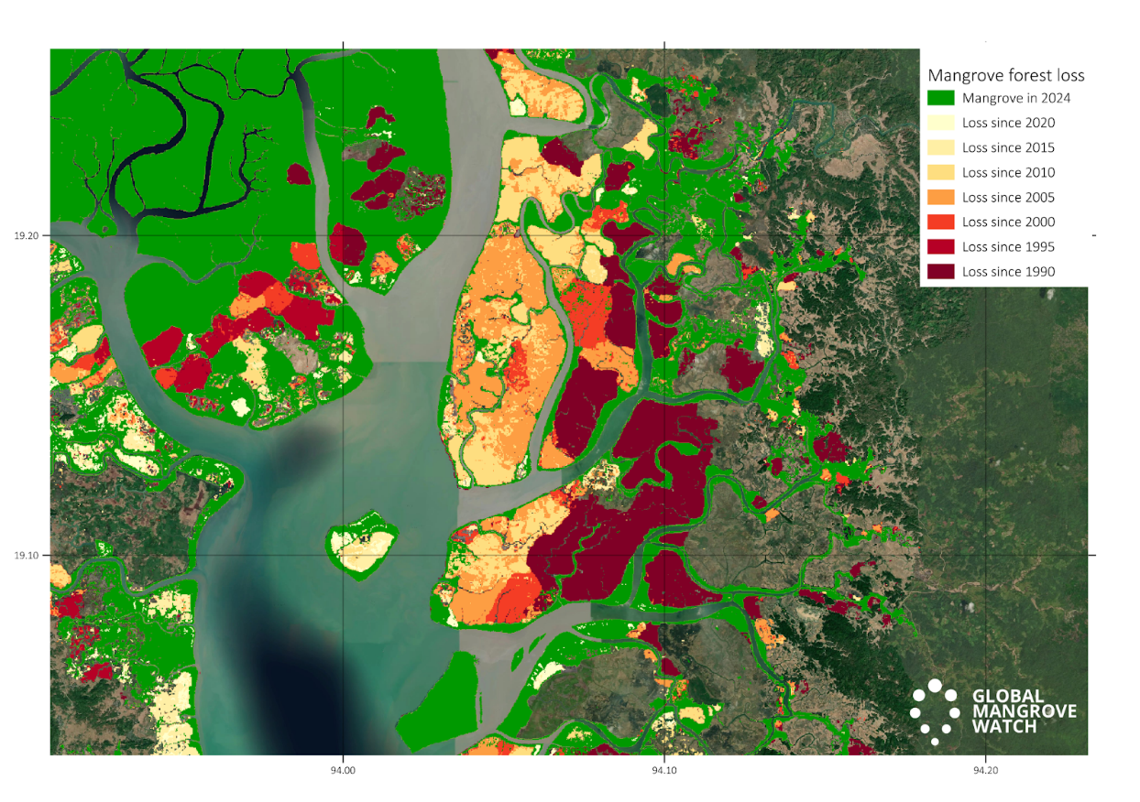
EO for Wetlands
Activities in the AFOLU Roadmap directly related to Wetlands:
Action 5.3: Consider best practice for including Blue Carbon Ecosystems (BCEs) in national inventories. GFOI MGD: Blue Carbon Guidance released Feb 2025
Action 5.4: (a) Explore the development of new CEOS initiatives on wetlands mapping and monitoring. GEO-Wetlands proposal for Post-2025 GEO WP; Global Mangrove Watch; ALOS ScanSAR Forested Wetlands Inundation Extent (b) Ensure that new CEOS missions consider wetlands amongst their mission goals. ALOS-4 – BOS & K&C Wetlands; NISAR – Wetlands science objective; ESA wetlands programmes
Action 5.5: Establish closer collaboration with the Ramsar Convention and Ramsar Science and Technology Review Panel (STRP)
Blue Carbon Guidance for national reporting
https://www.reddcompass.org/mgd
Activity Data. Global Mangrove Watch map showing mangrove extent 2024 [green] annual losses [yellow/orange/red] and annual gains [blue] for 1990-2024
JAXA & ESA long-term STRP Observer Organisations
Directive for STRP to develop initiative to foster knowledge exchange and guidance on EO for national wetlands inventory
Ramsar Earth Observation Day organised Dec 2024 in collaboration w CEOS agencies (JAXA/ESA/EC) and SEO
STRP considering EO as a Priority Task in the STRP Work Plan for the next triennium 2026-2028.

Slide 3
Ramsar Convention on Wetlands
Consultation on the use of Earth Observation
Organised by the Ramsar Secretariat
to investigate the options for working with Earth observation organizations, and to put EO data and monitoring tools at the disposal of Contracting Parties
to contribute to and strengthen the use of Earth Observation for National Wetland Inventories and in wetland assessment, monitoring and conservation
Ramsar Earth Observation Day (Dec 2024) organised in collaboration with CEOS agencies (JAXA/ESA/EC) and CEOS CEO
Keynote presentations by JAXA, ESA, EC, Digital Earth Africa, UNEP, MedWet
Recommendations¹ endorsed by the Ramsar Standing Committee. For presentation to the Ramsar COP15 (Zimbabwe, July 2025)
¹ “Draft report on the consultation on the use of Earth Observation for wetland inventory, assessment, monitoring and conservation” (SC64 Inf.2)
https://www.ramsar.org/sites/default/files/2025-01/SC64_inf2_earth_observation_consultation_e.pdf

Slide 4
EO Day – Key findings
Earth Observation data generation and data quality are increasing rapidly.
EO data is, for the most part, readily and freely available
EO data is a valuable but underused asset.
User-driven design is key to enhancing use of EO in wetland inventory.
Limitations to EO data remain but can increasingly be addressed.
Effective use of Earth Observation is dependent on ground-based data.
A common wetland classification system supports data interoperability and reporting.
Essential wetland variables can inform wetland conservation and wise use.
Enhanced use of EO in wetland inventory will strengthen national reporting
Global datasets of specific wetland types are crucial to support development of National Wetlands Inventories as well as global reporting.
Enhanced international coordination and cooperation, and identification of policy requirements and gaps, are essential to accelerate the uptake and maximize the impact of EO initiatives.

Slide 5
Recommendations to SC and COP
Recommendation 1:
Develop an initiative dedicated to supporting use of EO.
It is recommended that such a mechanism would:
Facilitate access to and utilization of Earth Observation technology.
Develop/strengthen global wetland datasets.
Develop Essential Wetland Variables.
Undertake capacity building. Strengthen capacity-building initiatives by developing
Provide Technical Advice and Support.

Slide 6
Recommendations to SC and COP
Recommendation 2:
Establish or strengthen bilateral cooperation with space agencies and Earth Observation initiatives.
Expanding the long-standing collaboration with individual space agencies contributing to the work of the STRP and the Convention’s programme
Strengthen the applicability of existing EO products and services (such as those of Copernicus, the Global Mangrove Watch ) in national wetland inventory,
Develop new tools and global wetland datasets to address current gaps.

Slide 7
Recommendations to SC and COP
Recommendation 3:
Identify technological development needs.
E.g. identification of wetland types for which require further technical development of EO based approaches, including dedicated systematic observation strategies for wetlands
May be pursued through the STRP work plan for the 2025-2027 triennium, with findings addressed through collaboration with space agencies or EO initiatives.
Encourage development of RS approaches and products for mapping e.g. forested inland wetlands, small wetlands, and human-made wetlands , peat soils and extent and condition of wetlands with high seasonal or inter-annual dynamics, through formal liaison with the Committee on Earth Observation Satellites (CEOS).

Slide 8
Recommendations to SC and COP
Recommendation 4:
Disseminate the findings of the Earth Observation consultation, identified needs and recommended actions.
This may include outreach to space agencies and Earth Observation initiatives; international and national funding agencies and philanthropies;

Slide 9
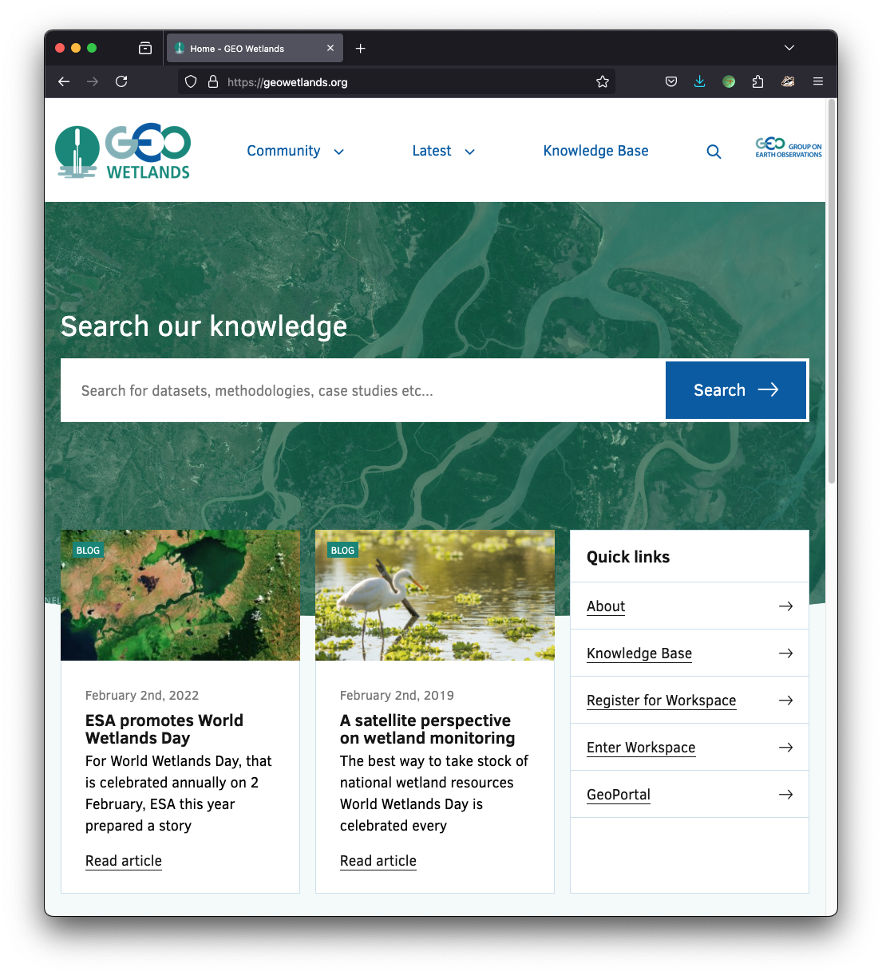
GEO Wetlands
Response to Recommendation 1:
Revived proposal for the Post-2025 GEO Work Programme with direct involvement of the Ramsar Convention
Leads:
Ramsar Secretariat/STRP and Wetlands International
Supporting CEOS agencies: ESA, JAXA
Objectives:
To advance approaches to effectively utilise EO to support wetland inventory, monitoring and assessment
Identify Essential Wetland Variables (EWVs) that capture the state and spatial/temporal dynamics of wetland ecosystems.
Capacity building for wetlands inventories, including the use of Earth observation tools.

Slide 10
Ramsar - Summary
Directive from the Standing Committee to undertake an New Ramsar initiative to foster knowledge exchange and guidance on EO.
Ramsar Earth Observation Day (Dec 2024) organised in collaboration with CEOS agencies
EO Priority Task in the next (2025-2027) STRP Work Plan
Ramsar STRP leading new GEO-Wetlands initiative.
Formal liaison with the Committee on Earth Observation Satellites (CEOS) explicit recommendation in STRP report to Ramsar Standing Committee¹.
Opportunity for closer CEOS/Ramsar engagement.
¹ “Draft report on the consultation on the use of Earth Observation for wetland inventory, assessment, monitoring and conservation” (SC64 Inf.2)
https://www.ramsar.org/sites/default/files/2025-01/SC64_inf2_earth_observation_consultation_e.pdf

