Slide 1
LSI-VC-17
JAXA Mission Updates and ALOS-4 Status
Takeo Tadono, JAXA
Agenda Item 13.2
LSI-VC-17
Tsukuba, Japan
14-16 April, 2025

Slide 2

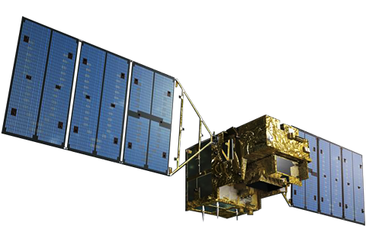

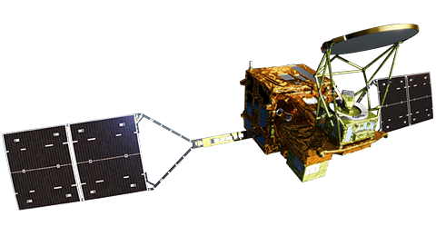
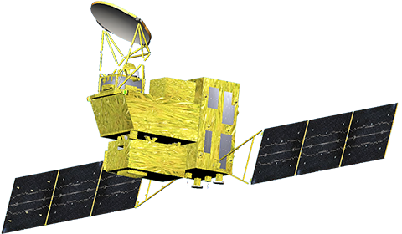
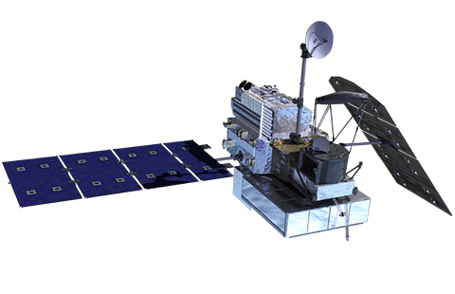

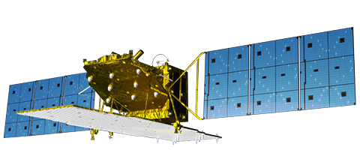
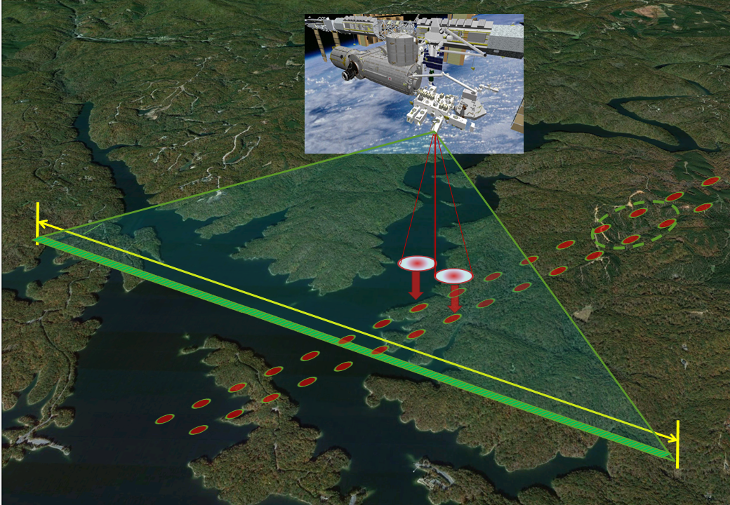
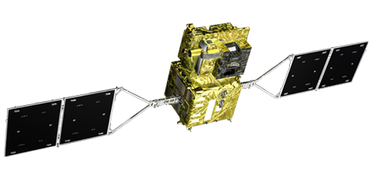
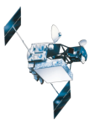
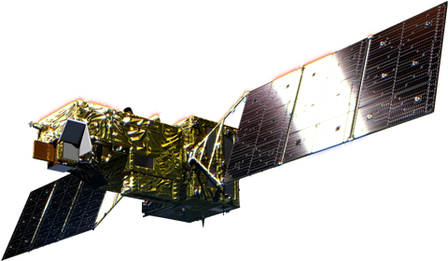
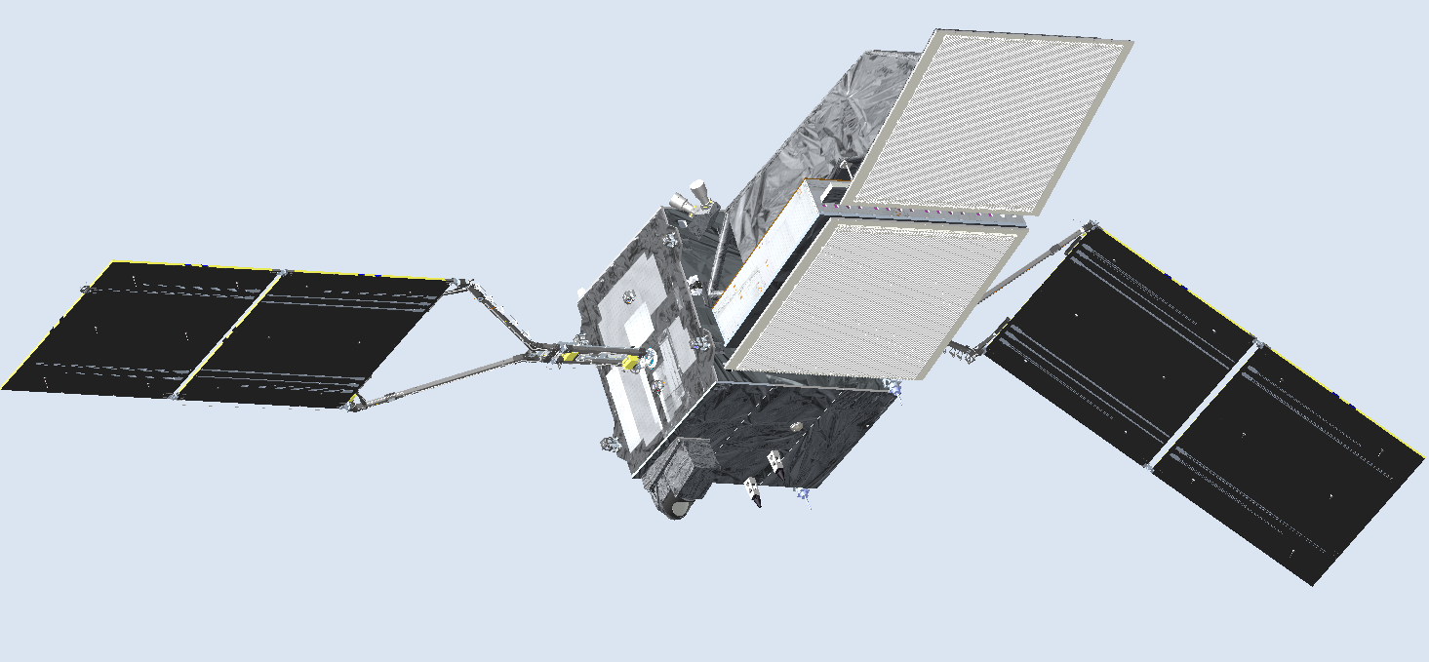
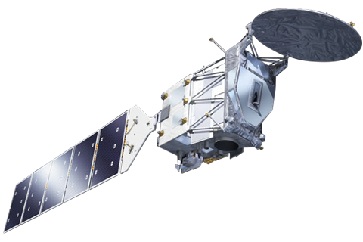
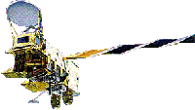
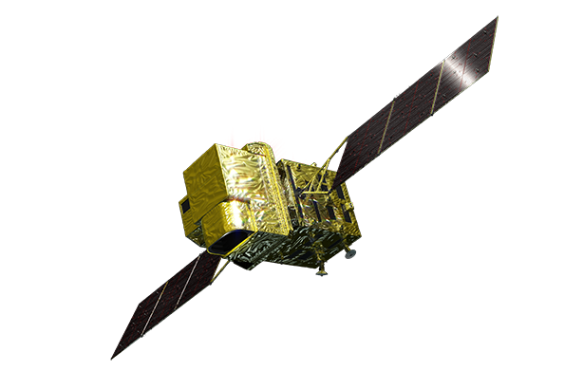
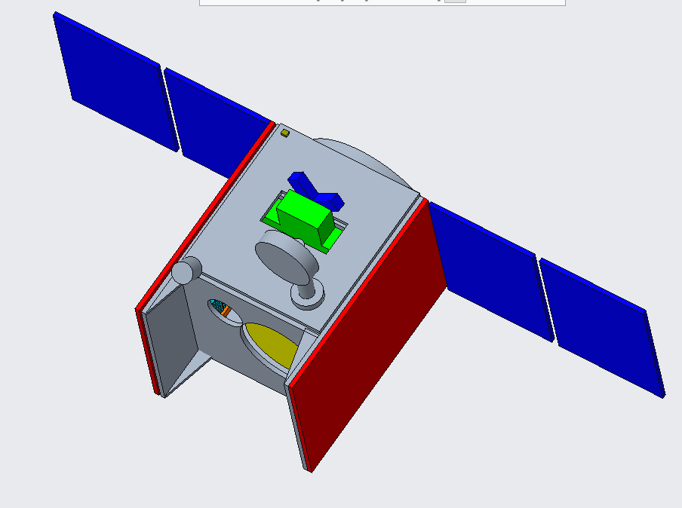


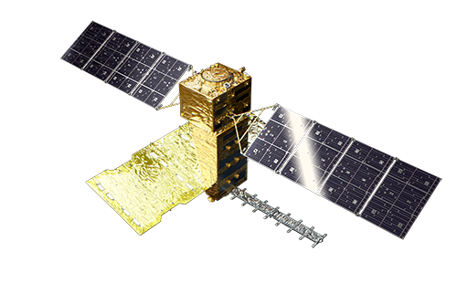
Completed
In Operation
To be Launched
MOS-1/MOS-1b
GOSAT
1987-1990/1995-1996
MOE/JAXA/NIES
2009-
GCOM-W
GOSAT-GW
JERS-1
2012-
MOE/JAXA/NIES
JFY2025
By H2AF50
1992-1998
GPM/DPR
2014-
ADEOS 1996-1997
ADEOS-II 2002-2003
ALOS-2
2014-
MOLI
JFY2027
TRMM/PR
GCOM-C
1997-2015
2017-
GOSAT-2
MOE/JAXA/NIES
PMM
2018-
JFY2028
Aqua/AMSR-E
May 29, 2024-
By US SpaceX Falcon 9
2002-2015
EarthCARE
Altimeter LiDAR
JFY2028 (TBD)
ALOS-3 (Optical)
* Lost due to launch failure on March 7, 2023
ALOS
July 1, 2024-
By H3F3
2006-2011
ALOS-4
2
Notes:
JAXA is currently operating six Earth observation satellites including ALOS-2.
These can be observed in various geophysical parameters and quantities.
And several satellites will be launched near the feature, which contains ALOS-3 and ALOS-4 that successor ALOS-2.
Such ALOS series was started by the first ALOS operated from 2006 to 2011.

Slide 3
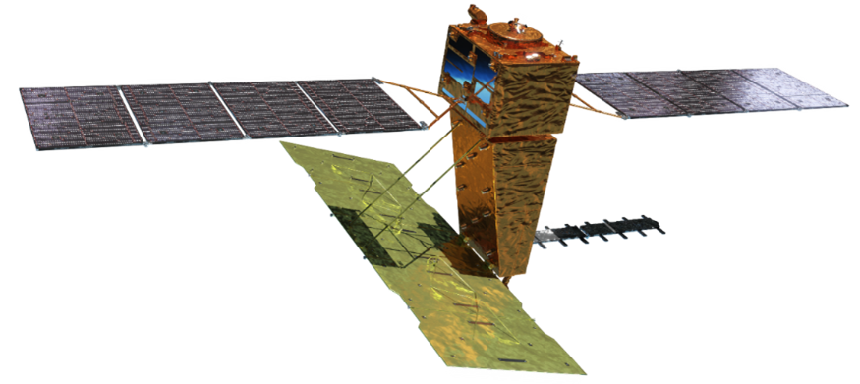
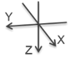
ALOS-4 Overview
Laser Communication
Terminal
Designed Life Time |  | 7 years
Mission Instruments |  | PALSAR-3, SPAISE3
Size (X, Y, Z) |  | 10.0m×20.0m×6.4m
Satellite Mass |  | Approx. 3,000 kg
Electricity | Solar Array | Approx. 7,200 W
 | Battery | 380 Ah
Data Recorder |  | Approx. 1 Tbyte
Data Transmission |  | Direct Trans. by Ka-band 3.6 Gbps
 |  | Via. Laser Utilizing Communication System (LUCAS) by 1.8 Gbps
Orbit | Type | Sun-synchronous
 | Altitude | 628 km
 | LSDN | 12:00
 | Revisit Cycle | 14 days
 | Inclination | 97.9 deg.
SPAISE3
PALSAR-3
Ka-band Antenna for DT
Same orbit as ALOS-2
↓
Enable analysis combining data from ALOS-2 and ALOS-4
SPAISE3：SPace based Automatic Identification System Experiment 3
PALSAR-3：Phased Array type L-band Synthetic Aperture Radar-3

Slide 4
ALOS-4 Mission Outcome Goals
Title |  | Descriptions
From post-event detection to early identification of anomalies (volcanoes, land subsidence, landslides, etc.) |  | ALOS-2 has conducted emergency observations to assess the situation after a natural disaster, and the use of ALOS-2 data has been positioned as one of the means of disaster monitoring (e.g., satellite observations were added as one of the means of information collection in the Basic Plan for Disaster Prevention). Since the frequency of ALOS-4 observations will be increased, ALOS-4 will be used not only to assess the situation after a disaster, but also to verify the early detection of anomalies caused by crustal and surface deformation (volcanoes, land subsidence, landslides, etc.), and will be used regularly by disaster management agencies to determine risks and to alert the public and society to reduce disasters.
Contributions by complementing and reinforcing the ground observation network | Contribution to national land resilience | Time-series analysis based on ALOS-4's high-frequency observations will complement and reinforce ground-based observations by local agencies, and contribute to national land resilience through measures against aging infrastructure (early detection of anomalies and more efficient inspection work) and utilization in public surveying (more efficient monitoring of land subsidence, etc.).
 | Contribution to the understanding of ocean conditions | Continuing the use of SAR and AIS observation information from ALOS-2 to monitor oceanographic conditions, ALOS-4's high-resolution and wide-area observations will enable analysis of ships at sea (distribution, shape, etc.) and contribute to efficient oceanographic information collection and enhancement of marine surveillance systems.
 | Contribution to addressing Global Issues | The goal is to achieve operational use of new or developed products (e.g., forests) during the mission period through comprehensive observation of priority observation areas around the world and utilization of polarimetric high-resolution observations.

Slide 5
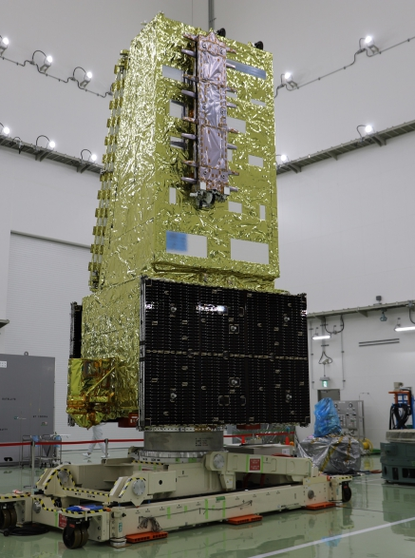
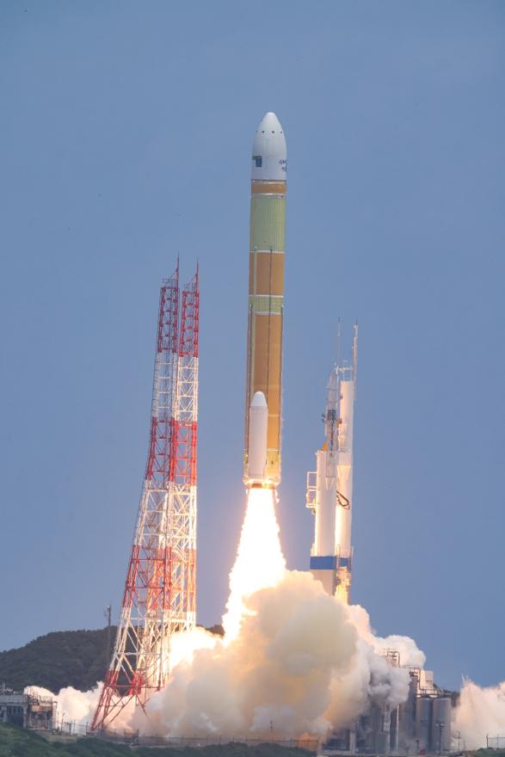
ALOS-4 Operation Status
Launched by H3 Launch Vehicle flight No. 3 on July 1, 2024.
The Initial Functional Verification operation was completed on October 18, 2024, and the satellite moved to the Initial Calibration and Validation (ICV) operation.
The ICV operation was scheduled to three months, but it was decided to continue until the end of March 2025 because it took more time than expected to adjust the image quality for the world's first on-orbit demonstration of digital beam forming (DBF).
The ICV was completed on March 31, 2025, and the Nominal Observation operation started from April 1, 2025.
ALOS-4
H3F3 launch
July-Sep. 2024 | Oct.-Dec. 2024 | Jan.-March 2025 | April 2025~
Initial Functional Verification
Initial Cal/Val (ICV) operation
Nominal Observation
operation
▲Launch
On July 1st 2024
▲Start of provision of PALSAR-3 standard product
▲Start of the Basic Observation Scenario (BOS) and emergency observation

Slide 6
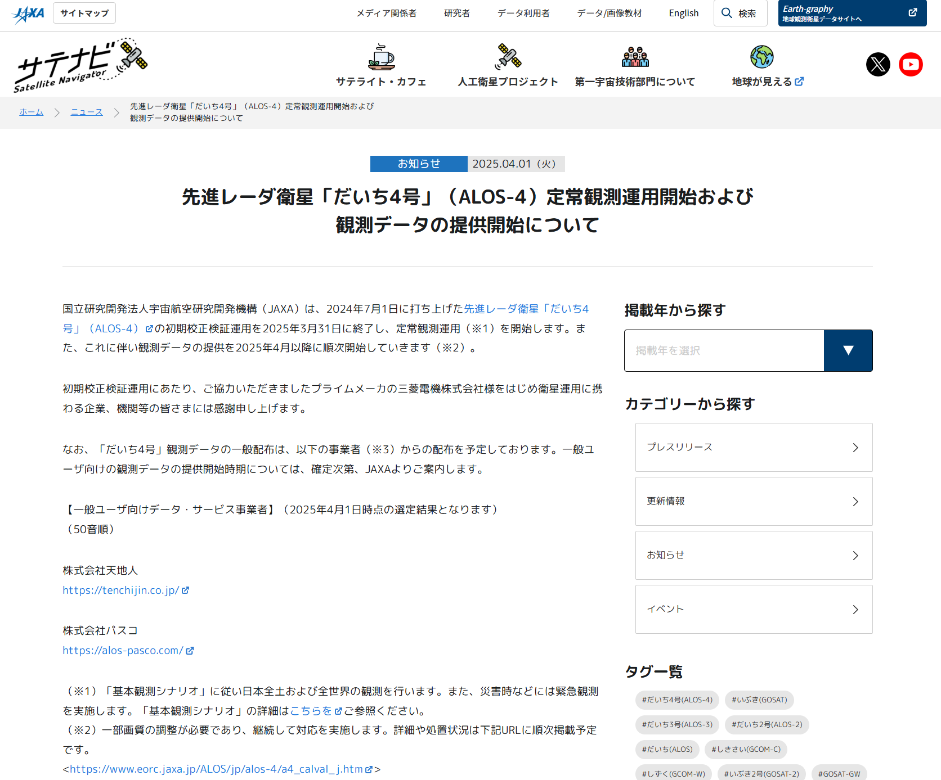
ALOS-4 Operation Status

Slide 7

ALOS-4 PALSAR-3 Overview
Expansion of Observation Swath and Improvement of Observation Frequency
  New technologies such as Digital Beamforming (DBF) enable observation of a 200 km swath in high resolution 3 m mode (50 km swath in ALOS-2) and observation of the entire Japan about 20 times a year (approx. 4 times in ALOS-2).
  Wide-area mode (25 m resolution) enables observation of 700 km width (standard 350 km for ALOS-2)
Satellite
flight direction
Observation swath width
200km
@30-56deg
Modes | ALOS-4 | ALOS-2
Stripmap (res. 3/6/10 m) | 100-200 km | 30-70 km
ScanSAR (res. 25 m*) | 700 km | 350-490 km
Spotlight (res. 1 x 3 m) | 35km ×35km | 25km ×25km
700km
100km
Stripmap
1160 km
8 deg
35km x 35km
ScanSAR
* Single look
1160 km
Spotlight
70 deg

Slide 8
ALOS-4 PALSAR-3 Overview
Observation Mode of PALSAR-3
SAR mode | Spotlight | Stripmap |  |  |  |  |  | ScanSAR
Code name | SB | UW | UB | HW | HB | FW | FB | XB
Resolution [m] | 3 x 1 (Rg x Az) | 3 |  | 6 |  | 10 |  | 25 (1 look)
Swath width [km] | 35 x 35 | 200 | 100 | 200 | 100 | 200 | 100 | 700 (4 scan)
Center freq. [MHz] | 1257.5 | 1257.5 |  | 1236.5 (or 1257.5/1278.5)
Bandwidth [MHz] | 84 | 84 |  | 42 |  | 28 |  | 28
Polarization* | S, D | S, D | S, D, Q | S, D | S, D, Q | S, D | S, D, Q | S, D
Incidence angle range [deg.] | 8-70 | 30-56 | 8-70 | 30-56 | 8-70 | 29-56 | 8-70 | 8-70
Number of Beam | - | 3 | 23 | 3 | 23 | 3 | 21 | 3
NESZ | < -20 dB | < -20 dB |  | < -24 dB |  | < -28 dB |  | < -20 dB
Rg. S/A | > 15 dB | > 15 dB |  | > 15 dB |  | > 20 dB |  | > 15 dB
Az. S/A | > 15 dB | > 15 dB |  | > 15 dB |  | > 20 dB |  | > 15 dB
Pol. X-talk | > 30 dB
Split-band option | N/A | N/A | N/A | N/A | N/A | 28+10 MHz | N/A | N/A
* Polarization: S = HH or HV or VV or VH, D = HH+HV or VV+VH, Q = HH+HV+VH+VV

Slide 9
PALSAR-3 Initial Cal/Val Operation Results
In the Initial Calibration and Validation (ICV) operation (Oct. 2024 – Mar. 2025), the following evaluations and calibrations were conducted for the observation modes / beams used in the Basic Observation Scenario (BOS), and the performance of the standard products was confirmed to be satisfactory (examples of evaluation results are shown later).
  Geometric calibration
  Antenna pattern calibration
  Radiometric calibration
  Polarimetric calibration
  Image quality evaluation (point target performance, NESZ, S/A, etc.)
  L2.1 ortho-rectification evaluation
  High-level product (interferometric SAR performance evaluation, global mosaic and forest/non-forest classification)
For other potentially available observation modes and beams of PALSAR-3, the above calibration and evaluation will be performed during the Nominal Observation operation after April 2025.
The following restrictions have occurred at several observatories and are being considered and implemented.
  Azimuth ambiguity (false images) in some areas
  Ionosphere correction mode (onboard) is not available (restrictions occur due to setting adjustments during ICV operation)

Slide 10
PALSAR-3 Initial Cal/Val Operation Results
Progress of calibration and validation of each observation mode and beam
Cal/Val Plan | Observation Mode | Incidence angle / Beam / Pol. | Purpose of Use
Initial Cal/Val operation [Completed] | Spotlight (SB) | SBD （Incidence angle set arbitrarily) | Emergency obs. / Individual obs.
 | Stripmap 3 m / 200 km (UW) | UWD01～03 | BOS, Emergency obs. / Individual obs.
 | Stripmap 6 m / 100 km (HB) （Quad-Pol.） | HBQ06, 08 | BOS, Emergency obs. / Individual obs.
 | Stripmap 10 m / 200 km (FW) | FWD01 | BOS, Emergency obs. / Individual obs.
 | ScanSAR (XB) | XBD02 | BOS, Emergency obs. / Individual obs.
Nominal Observation operation [To be calibrated] | Stripmap 3 m / 100 km (UB) | UBD01～05、UBD14～23 | Emergency obs. / Individual obs.
 | Stripmap 3 m / 100 km (UB) （Quad-Pol.) | UBQ05～09
 | Stripmap 6 m / 100 km (HB) （Quad-Pol.） | HBQ05, 07, 09
 | Stripmap 10 m / 200 km (FW) | FWD02～03
 | ScanSAR (XB) | XBD01, 03
Currently unavailable (restriction) | Stripmap 10 m / 200 km (FW) (Ionosphere correction mode) | FWD01 | BOS, Emergency obs. / Individual obs.
No plan | Other than above | Other than above | Not expected to be used
* BOS: Basic Observation Sicario

Slide 11
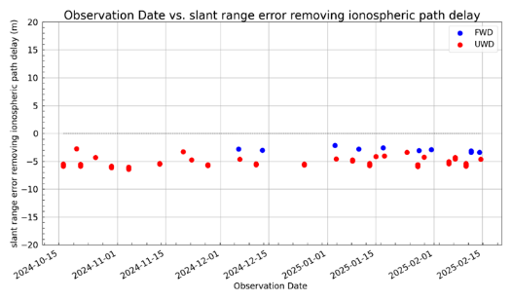
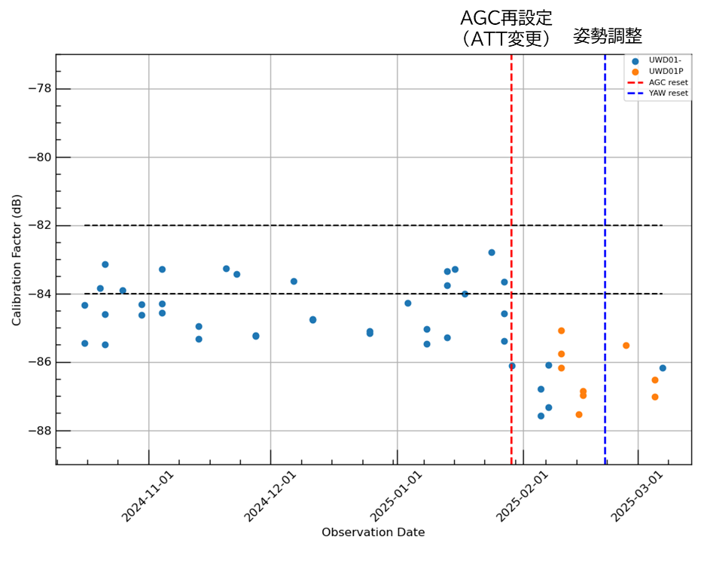
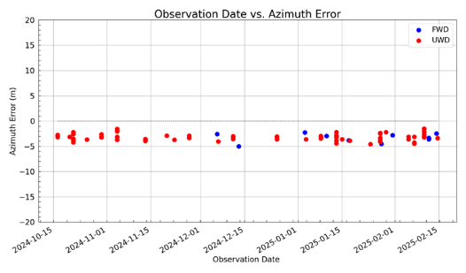
PALSAR-3 Initial Cal/Val Operation Results
Geometric Accuracy (Requirement within 10 m RMSE)
Radiometric Accuracy (Requirement within 1 dB, STDEV)
 | Ave. (m) | STDEV (m) | RMSE (m) | Points
Error in azimuth | -3.220 | 0.713 | 3.317 | 84
Error in slant range (after ionospheric delay correction) | -5.086 | 1.054 | 5.224
 | Before AGC resetting | After AGC resetting
Ave. (dB) | -84.393 | -86.505
STDEV (dB) | 0.805 | 0.740
Points | 35 | 15
In slant range
(After ionospheric delay correction)
AGC resetting
(Changed ATT)
Satellite Attitude
resetting
In azimuth direction
(After ionospheric delay correction)

Slide 12
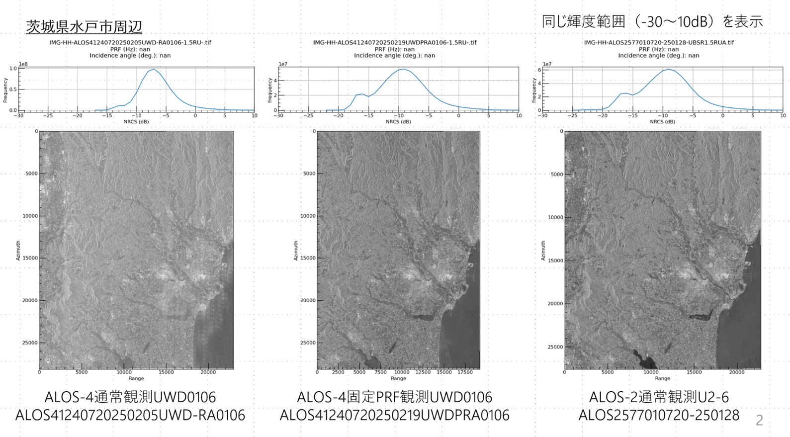
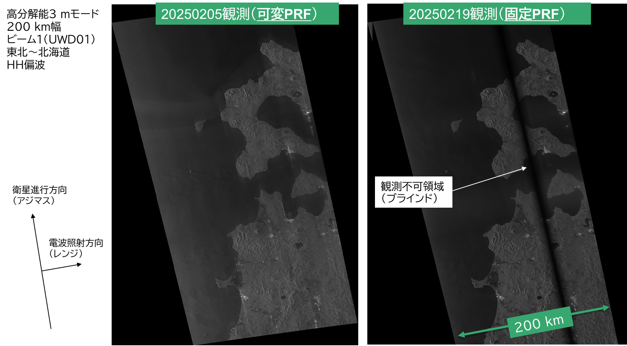
PALSAR-3 Initial Cal/Val Operation Results
Azimuth ambiguity (false images) in some areas
In the DBF-SAR technology, which will be newly developed in ALOS-4, it has been confirmed that many false images occur in the satellite flight direction (i.e., azimuth direction) in some areas when operating with the “Variable PRF (pulse repetition frequency)” setting, a function to create seamless images. Image quality adjustment is necessary continuously and is scheduled to be taken care of during FY2025.
To avoid the influence of this phenomenon, the “Fixed PRF” setting may be used in some cases. In this case, an unobservable area (called “blind”) of approx. 10-20 % will occur in the observation width, but the image quality is equivalent to ALOS-2.
“Variable PRF”
Feb. 5, 2025
“Fixed PRF”
Feb. 19, 2025
ALOS-2 PALSAR-2
Jan. 28, 2025
“Variable PRF”
Feb. 5, 2025
“Fixed PRF”
Feb. 19, 2025

Slide 13
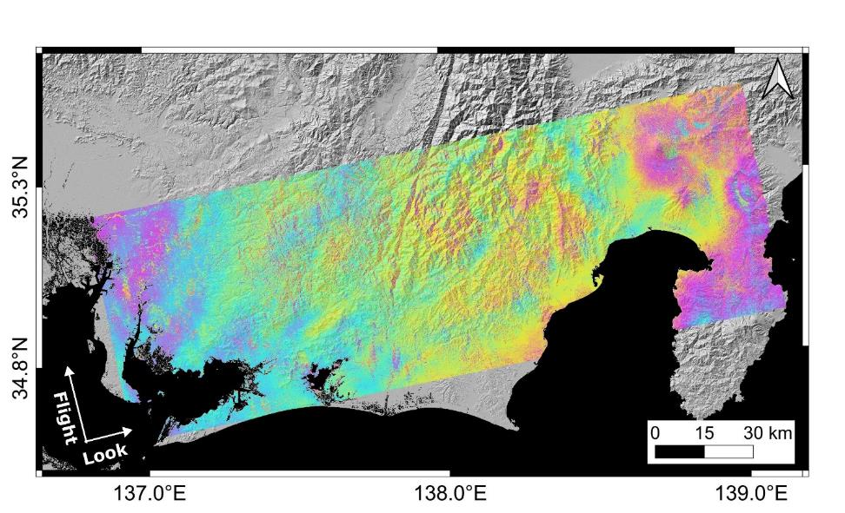
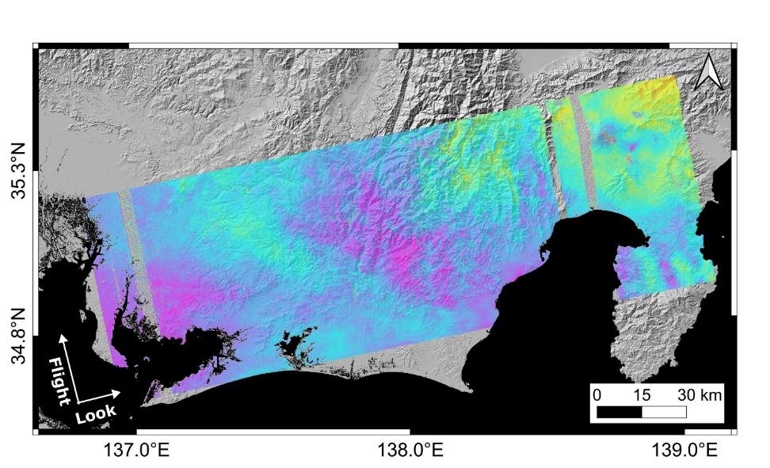

PALSAR-3 Initial Cal/Val Operation Results
Interferometric SAR (InSAR) performance of ALOS-4
“Variable PRF” pair: InSAR analysis is possible over a 200 km width without interruption. But its performance is reduced due to residual ambiguity.
“Fixed PRF” pair: No-data in blind areas. Other areas can be processed with the same level of InSAR analysis as ALOS-2.
Mt. Fuji
Blind areas have no data
Suruga Bay
Mikawa Bay
InSAR processed image by “Variable PRF pair” of ALOS-4
2024/12/21 – 2025/01/04 (Perpendicular baseline = -16 m)
InSAR processed image by “Fixed PRF pair” of ALOS-4
2025/02/15 – 2025/03/01 (Perpendicular baseline = 86 m)
衛星に近づく変位
衛星から遠ざかる変位

Slide 14
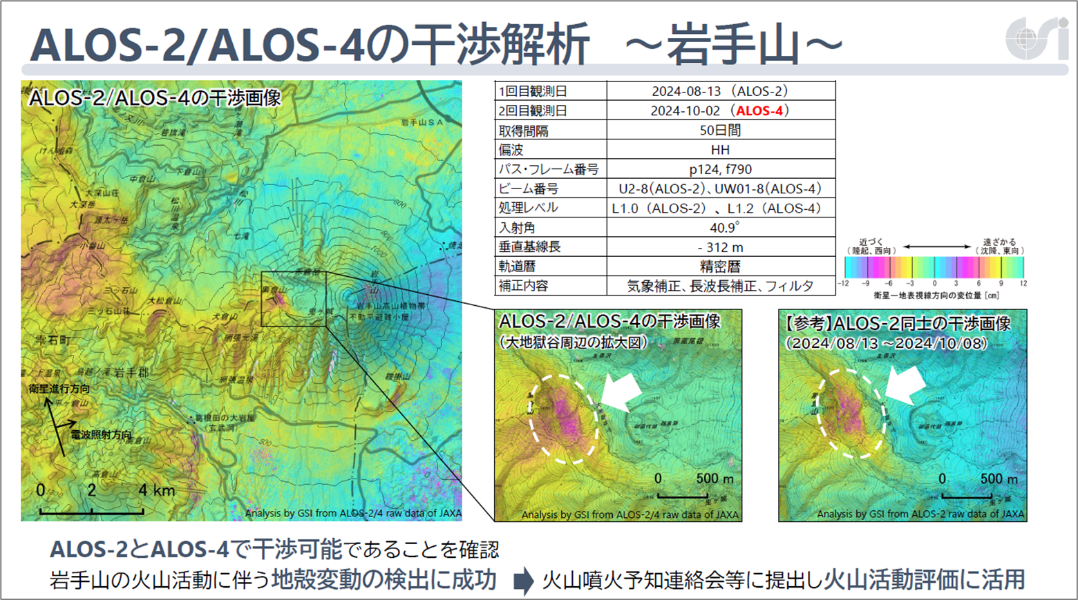
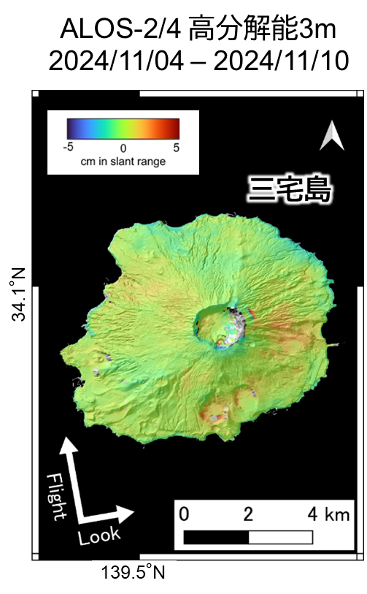
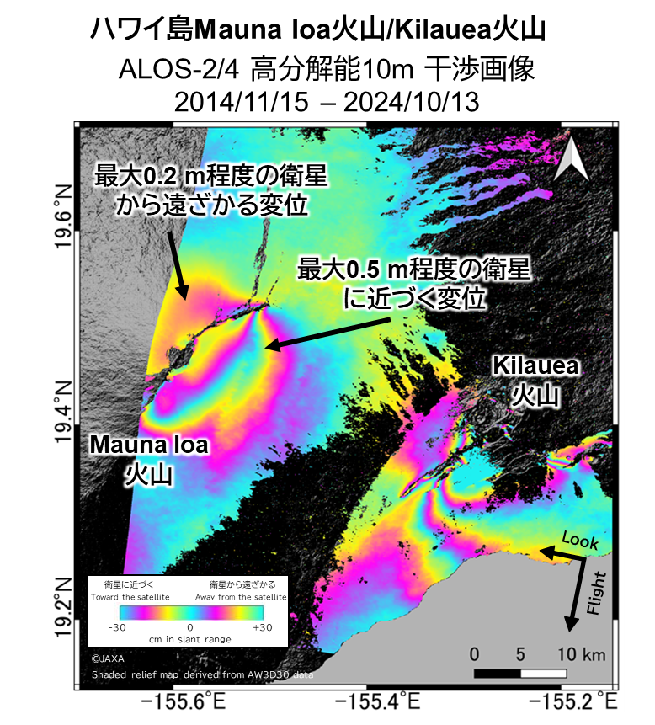
PALSAR-3 Initial Cal/Val Operation Results
Interferometric SAR (InSAR) performance by ALOS-2 and ALOS-4
Results of analysis by Geospatial Information Authority (GSI) of Japan
Results by JAXA EORC

Slide 15
PALSAR-3 Future Observation Operation Plan
ALOS-4 PALSAR-3 Basic Observation Scenario (Rev. B, Feb. 2024)
https://www.eorc.jaxa.jp/ALOS/en/alos-4/a4_observation_e.htm
Area | Item | Purposes | Mode | Polarization | Direction | Frequency
Japan | Disaster Response Basemap | Maintain pre-disaster archives needed for disaster detection and InSAR analysis | UWD 3 m XBD 25 m | HH, HV | L and R | Left angle of incidence 30-44 degrees once a year. Others are renewed once every 3 years.
 | Time-series observation | Observation of the entire national territory at the same angle of incidence over time. It is prepared in parallel with the base map of the disaster. | UWD 3 m | HH, HV | R | About 20 times a year. However, a decrease in frequency is allowed for the year in which the disaster basemap is acquired.
World | Global Basemap | Observation of terrestrial and coastal zones | Asc.: FWD 10m Desc.: HWQ 6 m | Asc.: Dual Desc.: Quad | R | Annual observation of ascending/descending orbits, respectively.
 | Disaster Response Basemap | Maintain pre-disaster archives for tectonic zones and Asia | XBD 25 m FWD 10 m | HH, HV | R | Updated every three years. 10 m resolution is global basemap and different incidence angles.
 | Thematic Observation | Requirements for each theme ( deforestation detection, forestry, snow and ice, crustal movement, agriculture, feasibility demonstration, cooperation with international organizations, etc.) | Depends on the theme | Depends on the theme | R | Depends on the theme

Slide 16
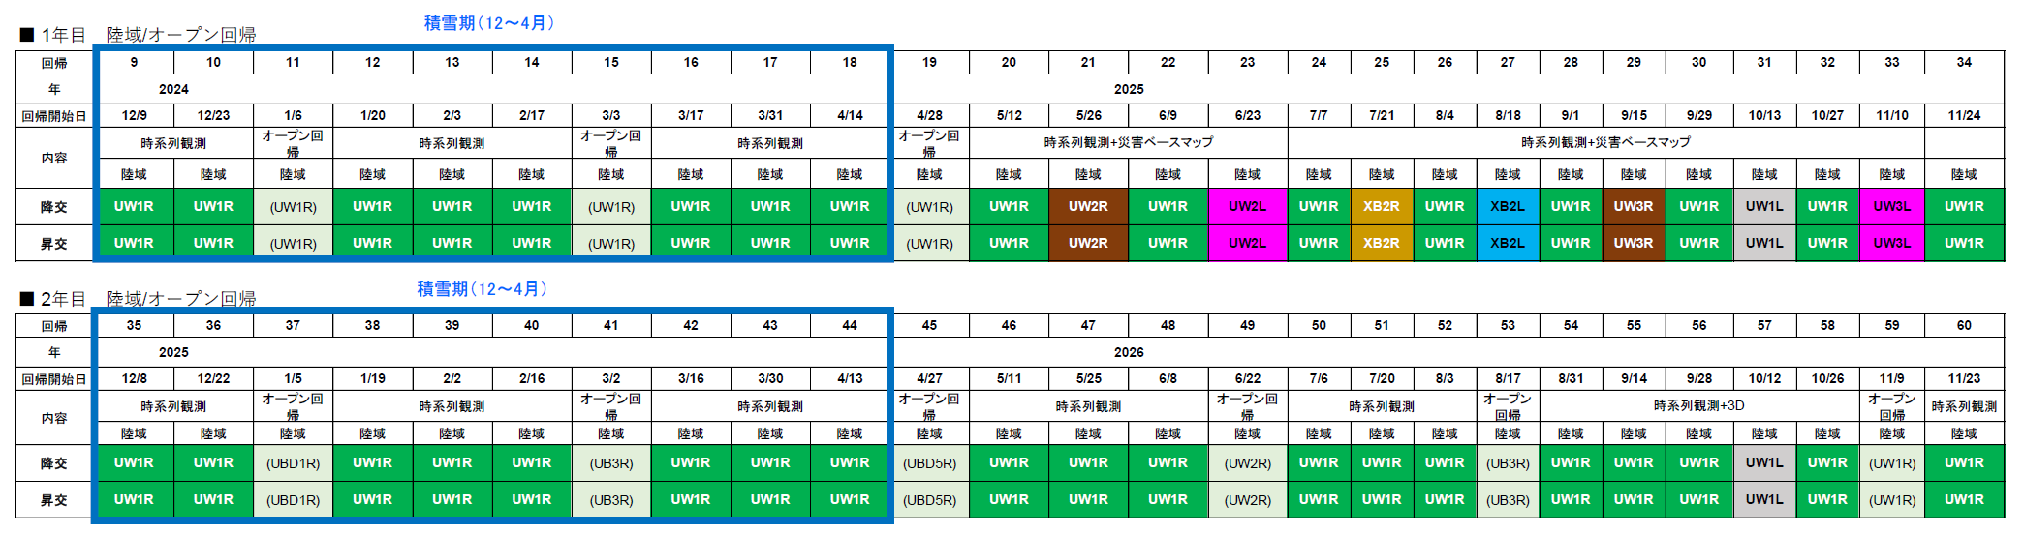
PALSAR-3 Future Observation Operation Plan
Basic Observation Scenario (BOS) in Japan
  The “Variable PRF” will be used as the basic method. Some regressions will be changed to “Fixed PRF” observations for pre-disaster archiving.
  Based on the evaluation results from the future accumulation of regular observation data, changes to the observation plan will be discussed at the Observation Operation Coordination Meeting, etc. as necessary.
UWD1R
Fixed PRF
(PRF 1)
UWD1R
Fixed PRF
(PRF 2)
UWD1R
Fixed PRF
(PRF 1)

Slide 17
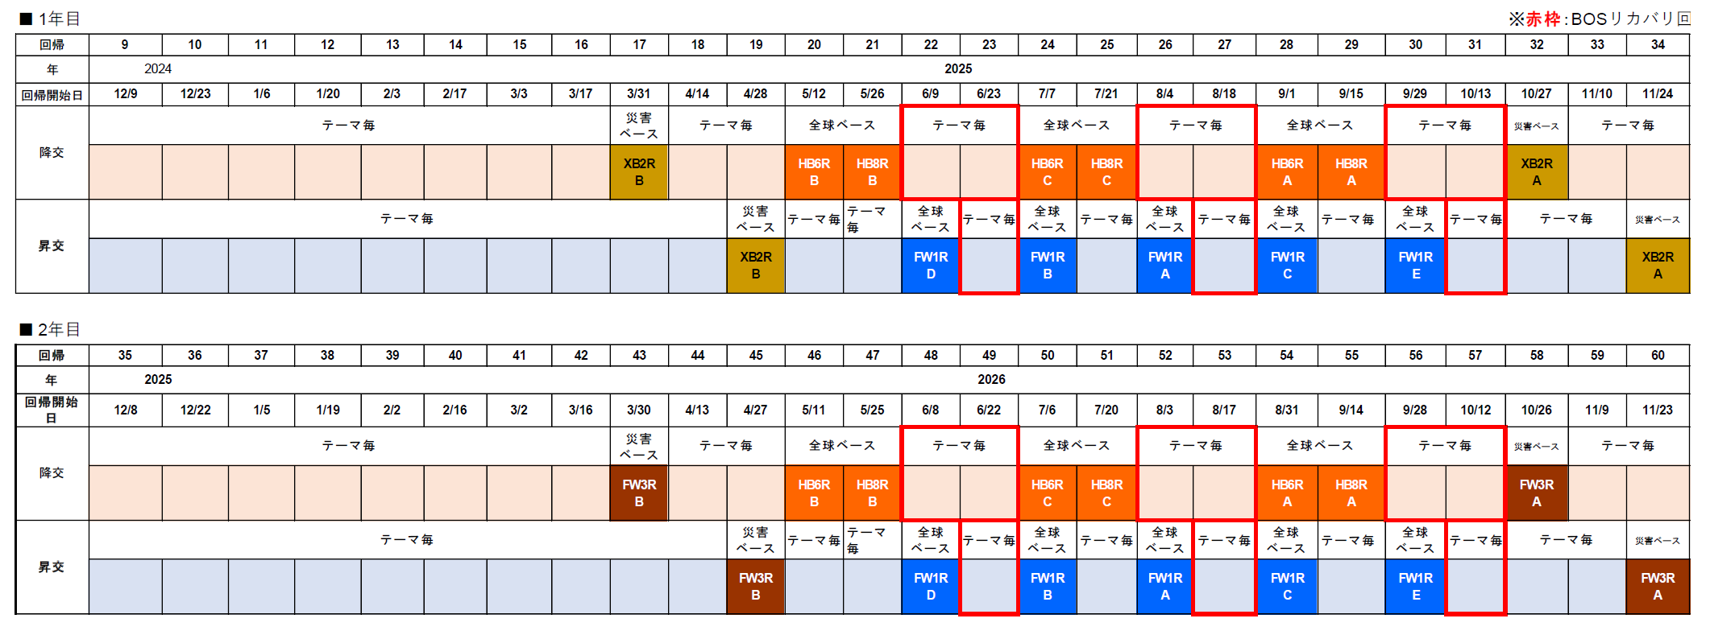
PALSAR-3 Future Observation Operation Plan
Basic Observation Scenario (BOS) in the World
Variable PRF
Variable PRF / Fixed PRF is switched according to the observation

Slide 18
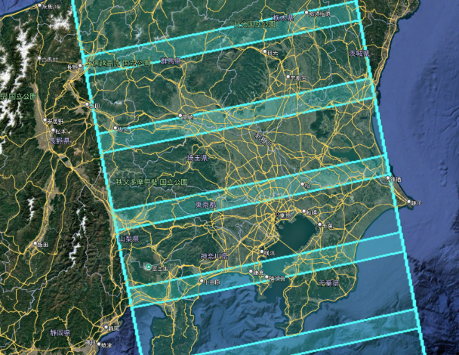
PALSAR-3 Future Observation Operation Plan
Emergency observation (in case of disaster) and individual observation requests based on agreements, etc.
For the time being, “Fixed PRF” is the basic method to ensure image quality. “Variable PRF” is also possible for interferometric SAR use only.
In order to respond to requests for “Fixed PRF” observations, a means of confirming the location of blinds will be provided to avoid overlapping of blinds in the requested observation area in advance. The blinds will be set in two ways, with different positions for each other for one scene.
Operational procedures for requesting “Fixed PRF” settings from the disaster prevention interface system will be developed.
Pattern A
Pattern B
Example of Fixed PRF observation.

Slide 19
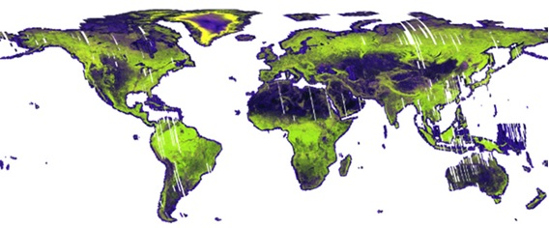
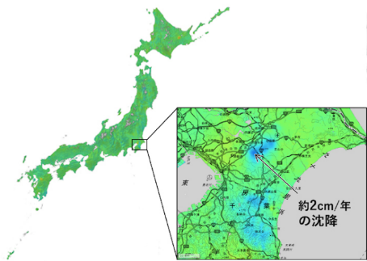
ALOS-4 Products
Standard Products
    Compatible definition with ALOS-2
    Product documentation and sample products are in preparation
    Data policy is under discussion
Higher-level Products
Global mosaic compliant CEOS-ARD SAR NRB
Global forest/non-forest map (FNF)
Disaster response map and information
Time-series InSAR over entire Japan by GSI, etc.
https://ceos.org/ard/
Processing level | Content | Format
L1.1 | Single look complex image | CEOS
L1.2 | Signal data processed to a single-beam observation equivalent and uniform PRF | CEOS
L1.5 | Ground-range multi-look amplitude image | CEOS, GeoTIFF
L2.1 | Ground-range multi-look amplitude image with ortho correction to L1.5 | CEOS, GeoTIFF
© GSI

Slide 20
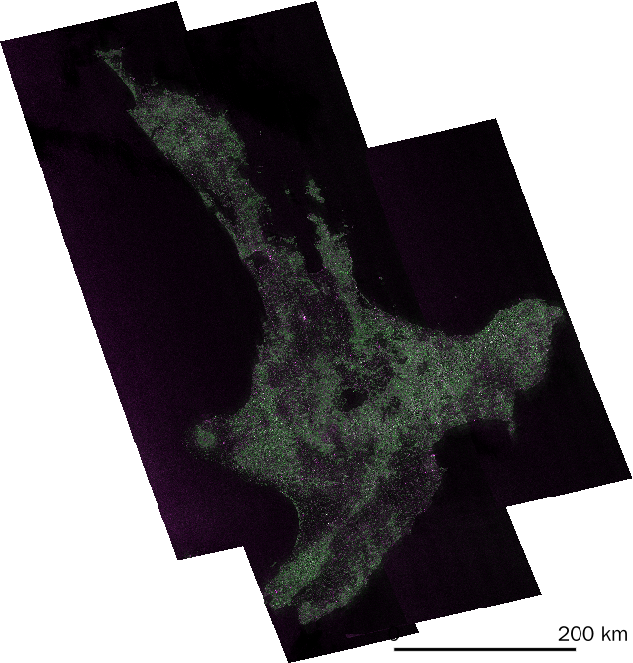
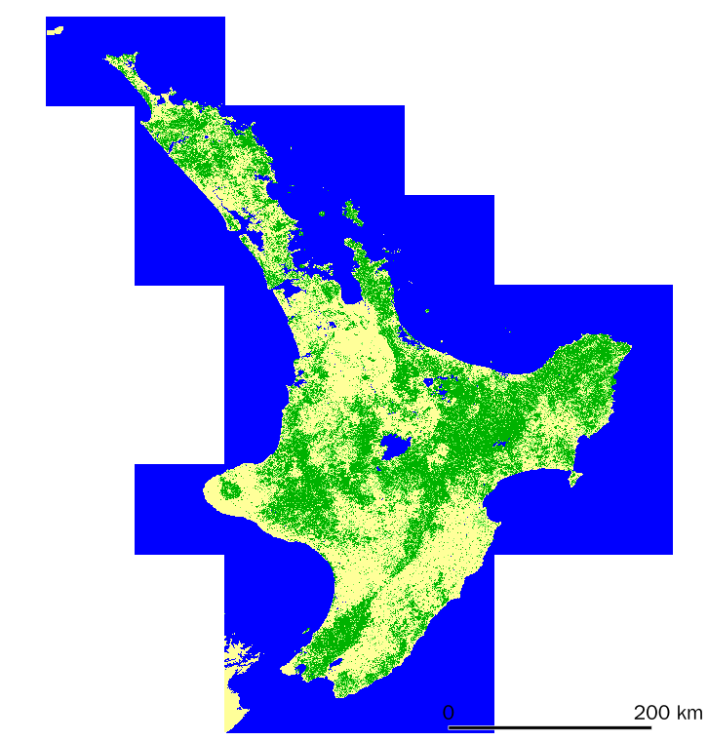
ALOS-4 Products
Test processing SAR Mosaic in New Zealand
CEOS-ARD SAR PFS compliance format
Forest/Non-Forest Classification Map
RSP100
2025/02/25
■ 森林
■ 非森林
■ 水域
RSP101
2025/03/02
RSP99
2025/02/20

Slide 21
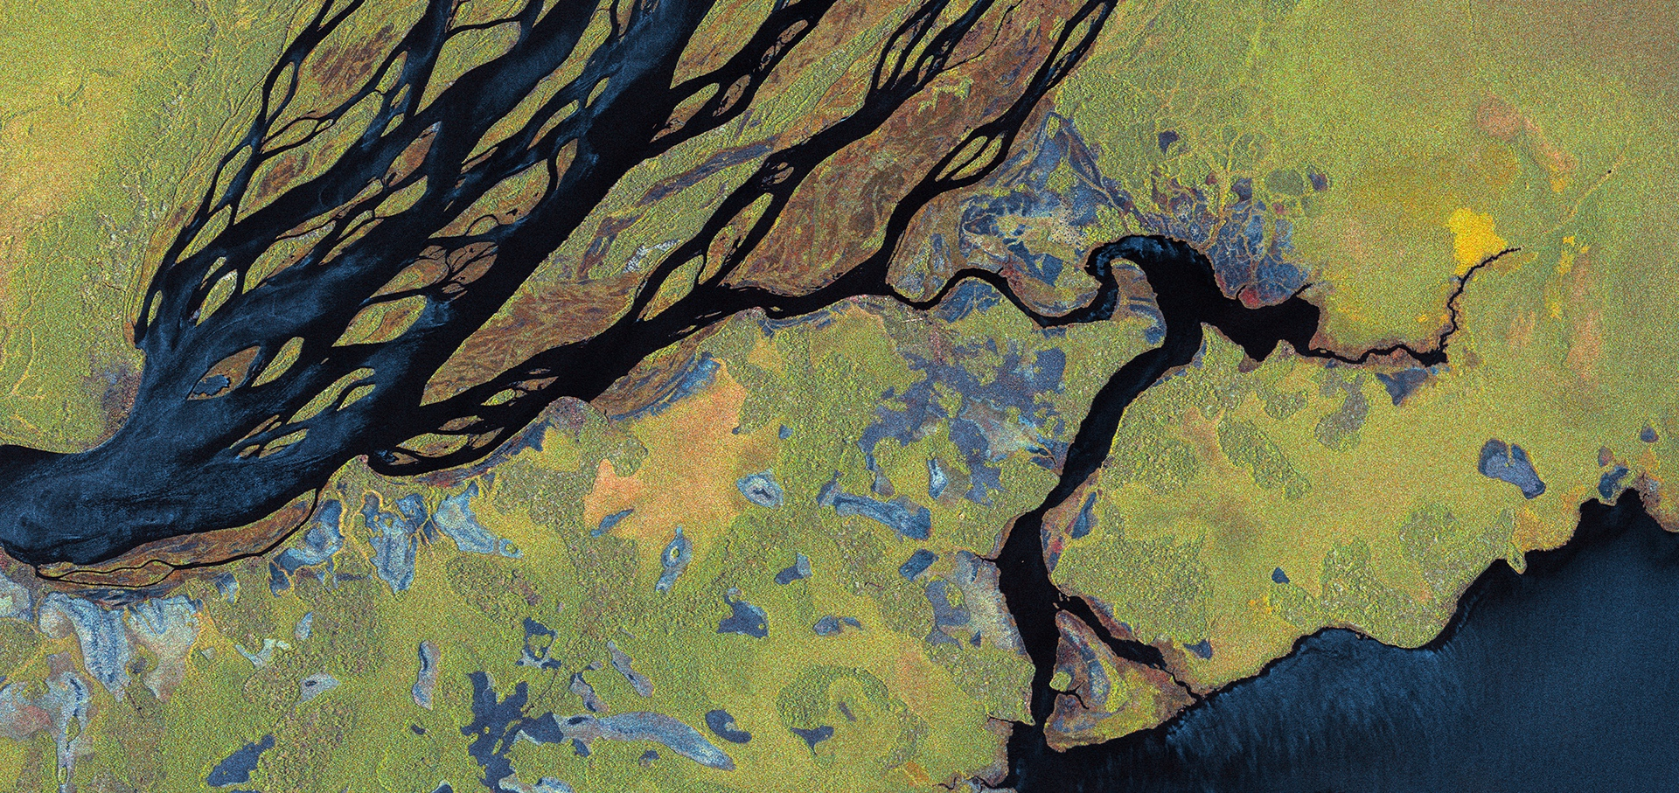
Thanks for your attention.
Any questions or comments?
Polarimetric backscatter
ALOS-2 © JAXA
21

