Slide 1
CEOS-ARD for Synthetic Aperture Radar (v1.2) – Interferometric Radar [InSAR] for endorsement
A. Rosenqvist^{1,3}, F. Charbonneau², T. Tadono³, C. Albinet⁴, B. Chapman⁵, D. Small⁶ , J. Truckenbrodt⁷, Z. Zhou⁸ T. Logan⁹, M. Garthwaite⁸, D. Bekaert⁵, V. Brancato⁵, D. Dadamia¹⁰, G. Hajdush¹¹, J. Kellndorfer¹², M. Lavalle⁵, F. Meyer⁹, N. Miranda⁴, Jayasri P.V¹³, P. Pasquali¹⁴; M. Repse¹⁵, Hari Priya S.¹³, G. Shiroma⁵, A. Siqueira¹⁶; S. Staniewicz⁵, M. Thankappan¹⁶, F. Yuan¹⁷, H. Zebker¹⁸, F. De Zan¹⁹ 1 – soloEO; 2 – NRCan; 3 – JAXA; 4 – ESA; 5 – NASA JPL; 6 – 6 – U.. Zürich; 7 – DLR; 8 – CSIRO; 9 – ASF; 10 – CONAE; 11 – CLS; 12 – EBD; 13 – ISRO; 14 – sarmap; 15 – Sinergise;
16 – Geoscience Australia; 16 – Digital Earth Africa;
17 – Stanford Univ; 18 – CSIRO; 19 – Delta-Phi
LSI-VC-17
Agenda Item 2.2
Tsukuba, Japan
April 14-16, 2025

Slide 2
LSI-VC-17 – Agenda Item 2.2
SAR & Lidar PFS status
PFS for consideration @ LSI-VC-17
Interferometric Radar [InSAR]
Discussion and potential endorsement.

Slide 3
LSI-VC-17 – Agenda Item 2.2
SAR and Lidar PFS status

Slide 4
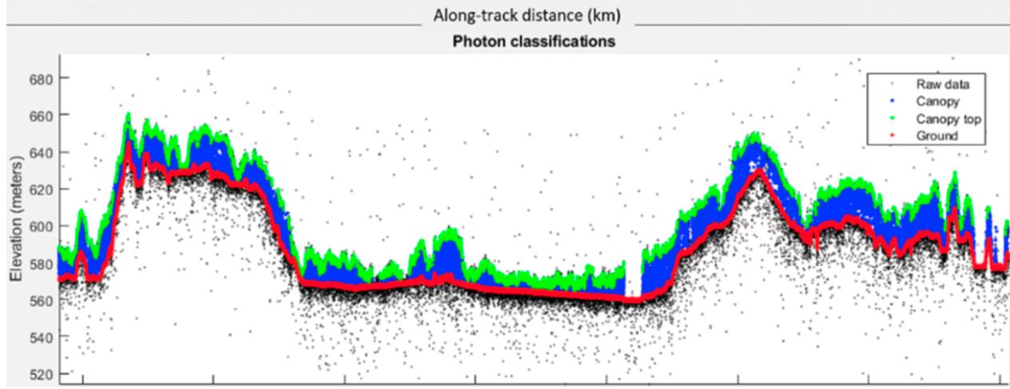
CEOS-ARD for Spaceborne Lidar
PFS: Lidar Terrain & Canopy Height
CEOS-ARD Lidar team members
Lidar mission teams:
GEDI, MOLI, ICESat-2
Data Providers:
NASA LP-DAAC; NSIDC;
Science community
Limited progress since 2019
Lidar PFS team membership – below critical mass
Lack of Lidar Agency champion
Limited incentive for broad uptake
→ Propose to discontinue CEOS-ARD Lidar activity
Terrain & canopy top height from ICESat-2
(Neuenschwander et al, 2019)

Slide 5
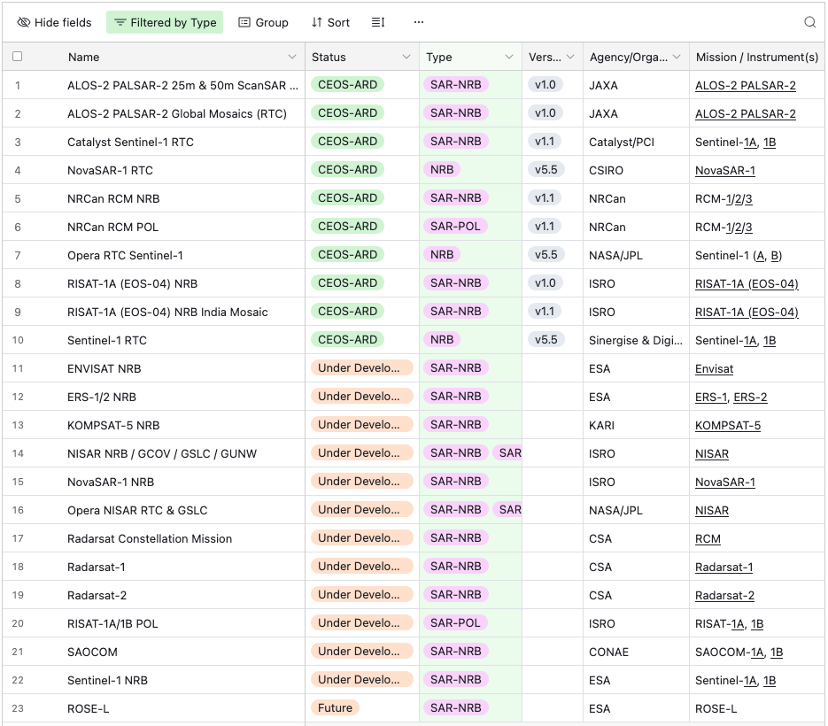
CEOS-ARD for Synthetic Aperture Radar
Endorsed:
CEOS-ARD for Synthetic Aperture Radar (v1.1)
Normalised Radar Backscatter (NRB)
Polarimetric Radar (POL)
Ocean Radar Backscatter (ORB)
Geocoded SLC (GSLC)
Up for endorsement today (LSI-VC-17): CEOS-ARD for Synthetic Aperture Radar (v1.2)
Interferometric Radar (InSAR)
Community uptake:
Approved compliant:
NRB: 7 data providers
POL: 1 data provider
Under development:
12 data providers

Slide 6
LSI-VC-17 – Agenda Item 2.2
CEOS-ARD for Synthetic Aperture Radar v1.2
Addition of Interferometric Radar [InSAR]

Slide 7
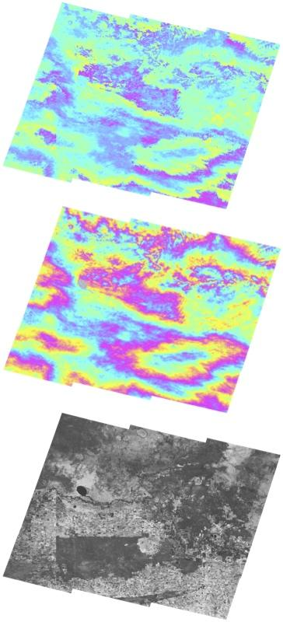
Interferometric Radar [InSAR]
The CEOS-ARD Interferometric Radar [InSAR] PFS supports two levels of InSAR product categories:
1. InSAR products generated from an InSAR pair, or a stack:
- Wrapped interferogram: Image of differential phase signals between
two SLC or GSLC images
- Unwrapped interferogram: Image of differential phase signals where the fringes
are summed (“unwrapped”) to give a continuous phase signal across the image.
- Interferometric coherence: Image of phase coherence between the two images.
2. InSAR Displacement products – interferometric displacement (change)
from a pair – or time-series – of SAR acquisitions, as a displacement and/or
as displacement rate products over a time period.
Wrapped phase
Unwrapped phase
Interferometric coherence
Sentinel 1 interferometric products (Geoscience Australia team)

Slide 8
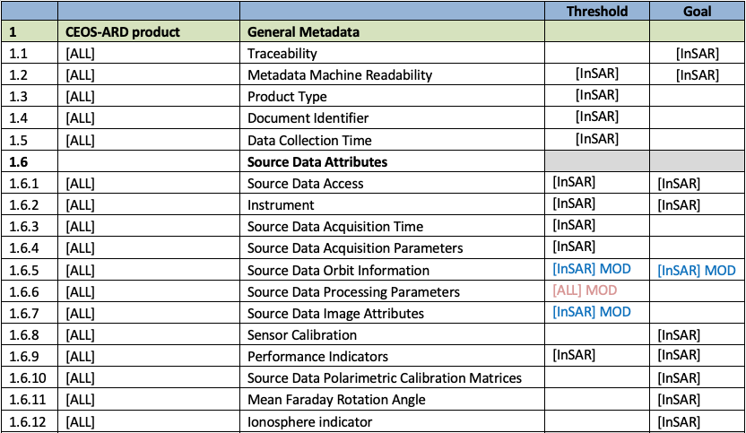
General Metadata (Source metadata)
[InSAR]
Requirement same as for other CEOS-ARD SAR products
[InSAR] MOD
Requirement modified for InSAR only
ALL] MOD
Requirement modified for all products

Slide 9
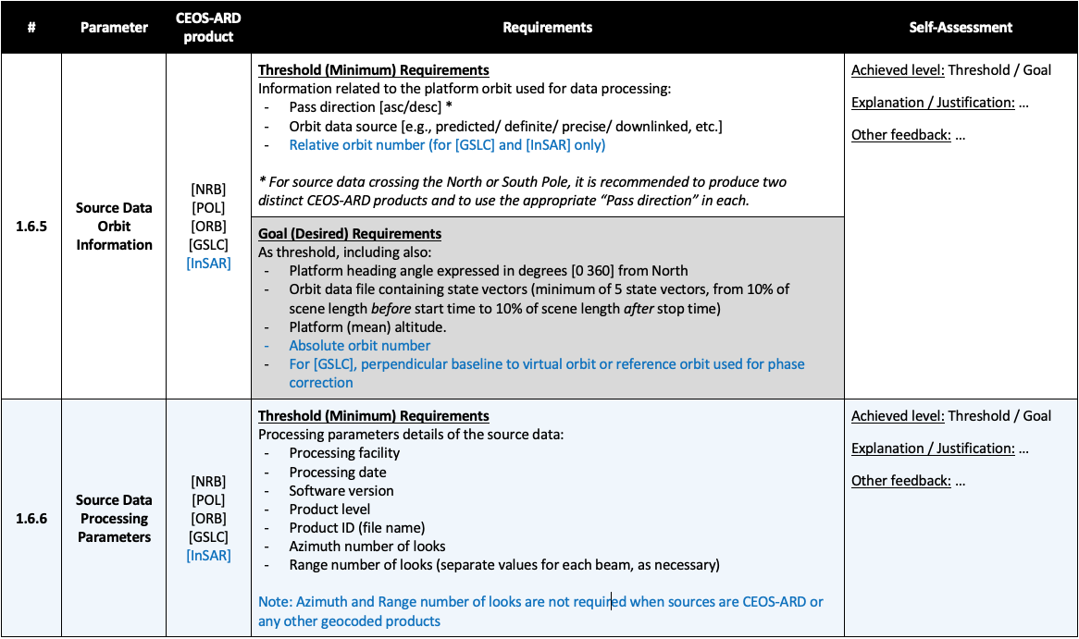
General Metadata (Source metadata)

Slide 10
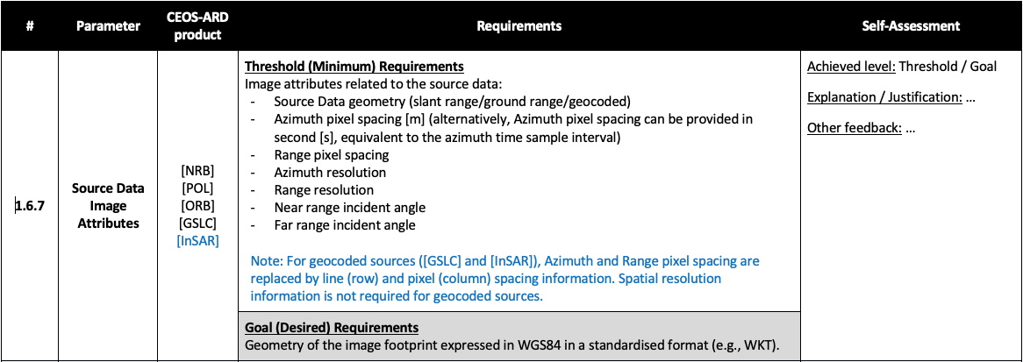
General Metadata (Source metadata)

Slide 11
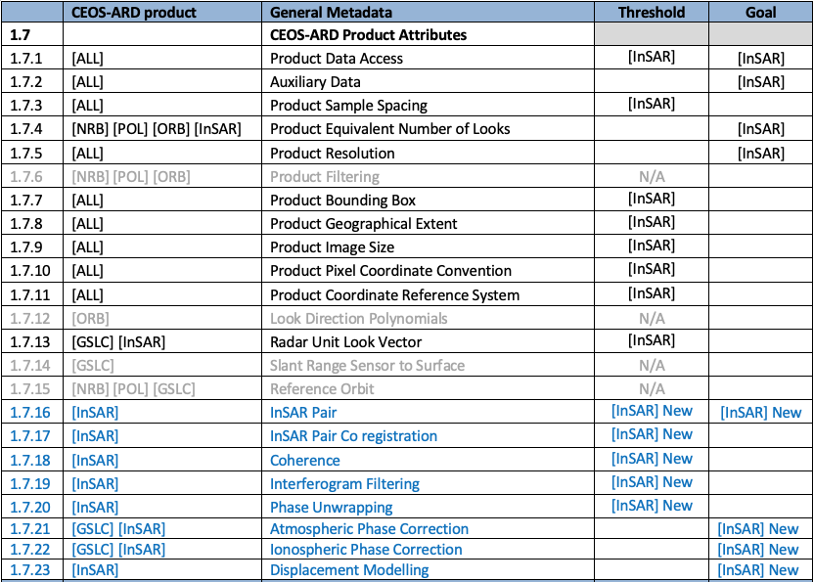
General Metadata (Product metadata)
[InSAR]
Requirement same as for other CEOS-ARD SAR products
[InSAR] NEW
New requirement for InSAR only

Slide 12
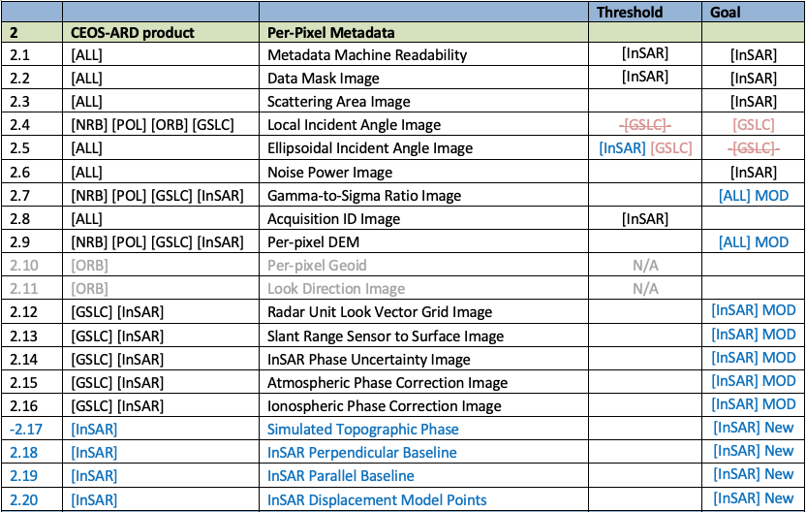
Per-pixel Metadata
[InSAR]
Requirement same as for other CEOS-ARD SAR products
[InSAR] MOD
Requirement modified for InSAR only
[InSAR] NEW
New requirement for InSAR only
[GSLC] –[GSLC]–
Requirement modified for GSLC product

Slide 13
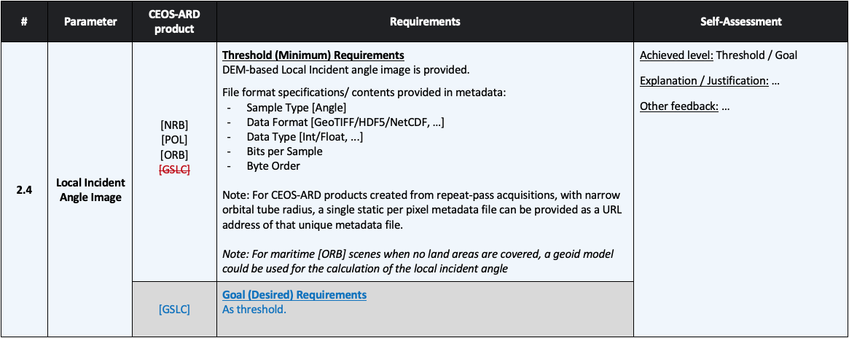
Per-pixel Metadata

Slide 14
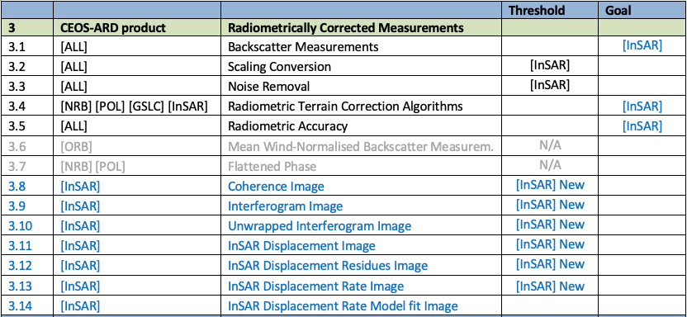
Radiometric & Geometric Corrections
[InSAR]
Requirement same as for other CEOS-ARD SAR products
[InSAR] MOD
Requirement modified for InSAR only
[InSAR] NEW
New requirement for InSAR only

Slide 15
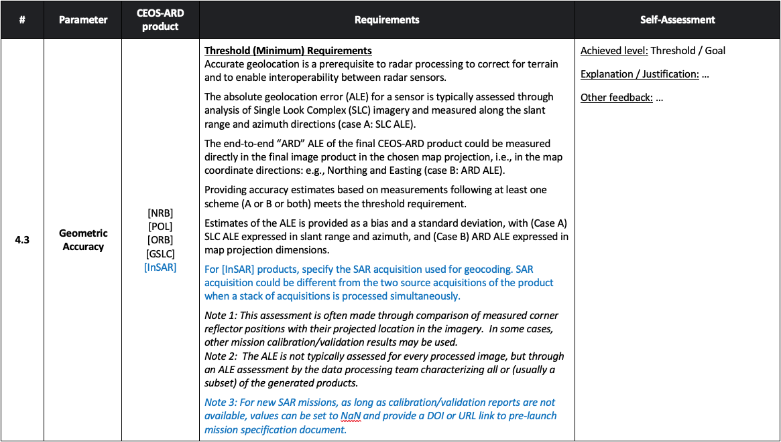
Radiometric & Geometric Corrections

Slide 16
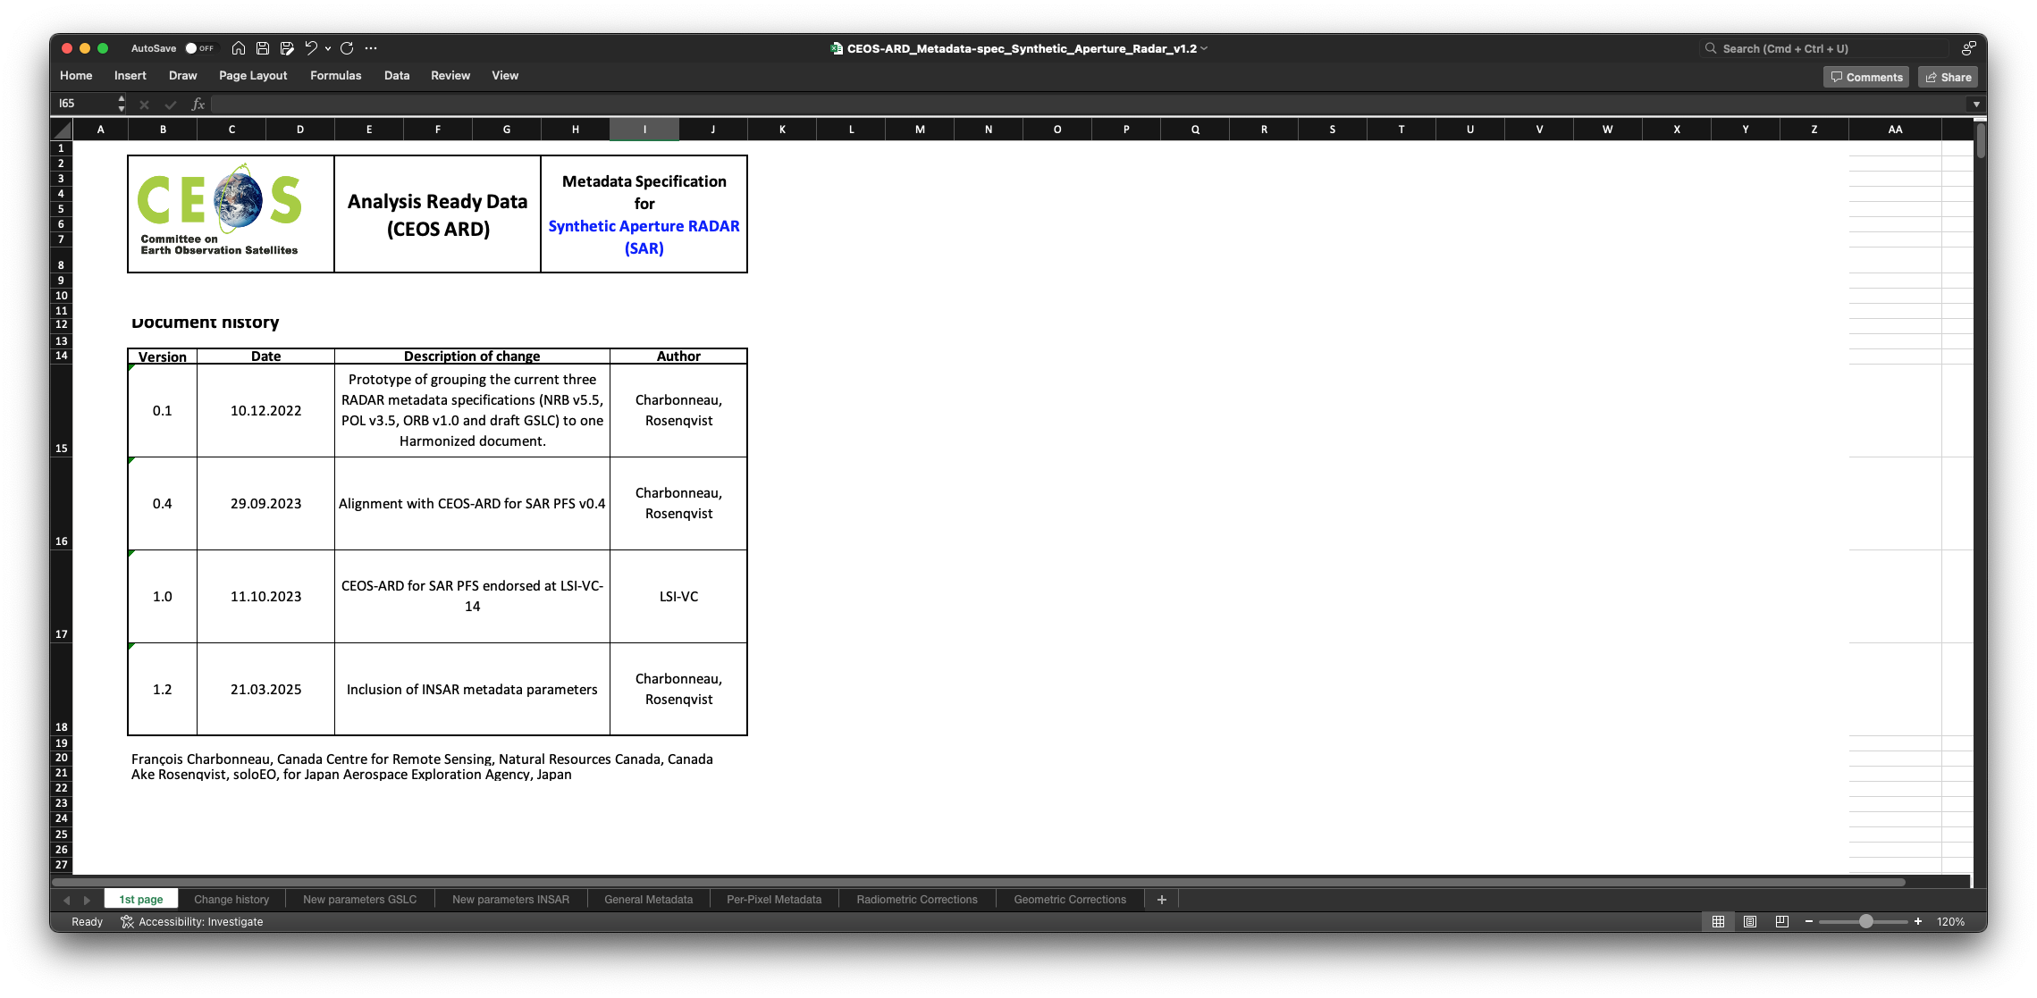
XML metadata specifications
1st page

Slide 17
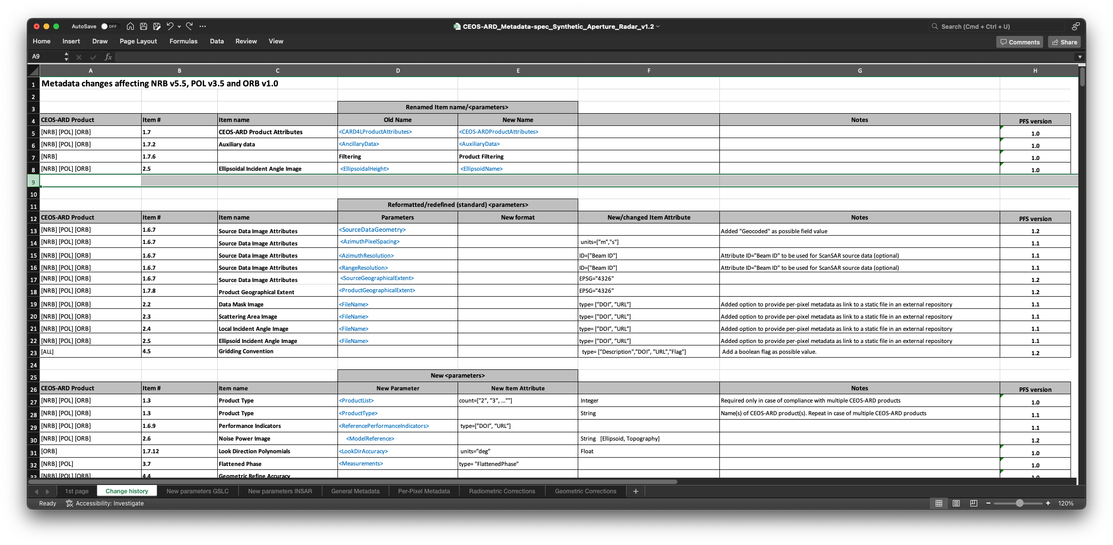
XML metadata specifications
Change history

Slide 18
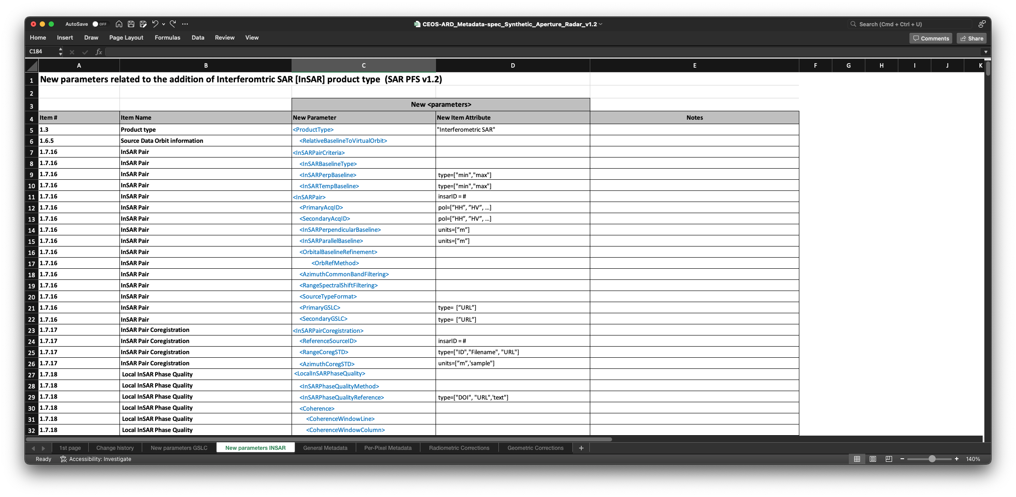
XML metadata specifications
New parameters [InSAR]

Slide 19
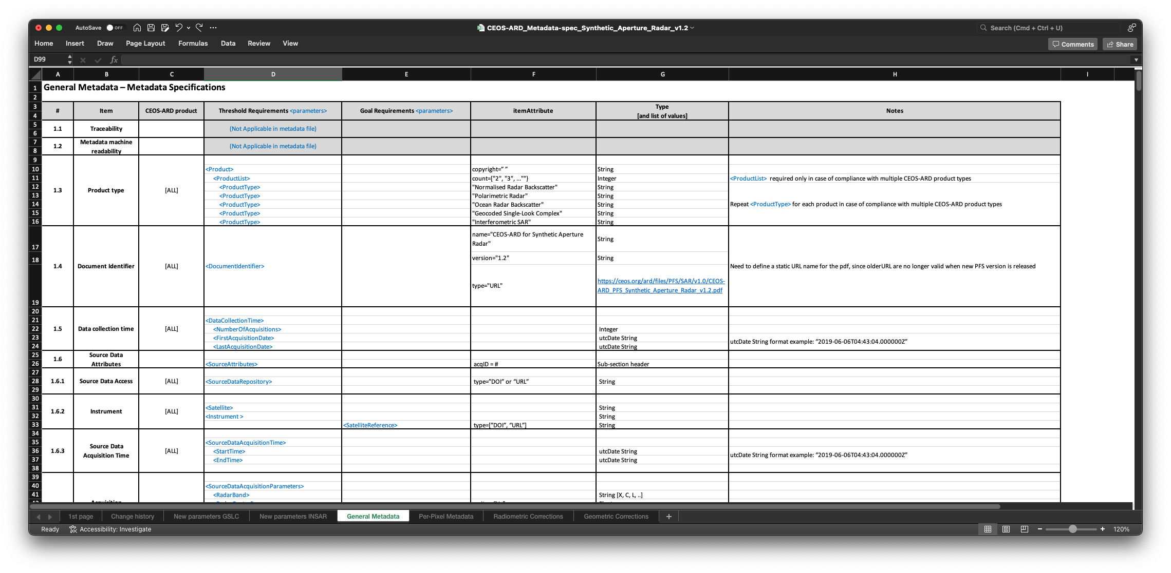
XML metadata specifications
1. General metadata

Slide 20
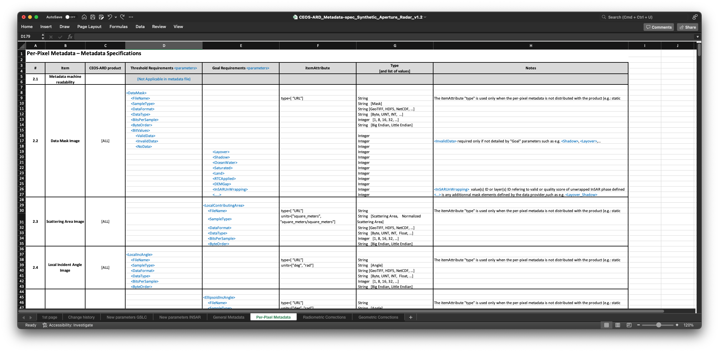
XML metadata specifications
2. Per-pixel metadata

Slide 21
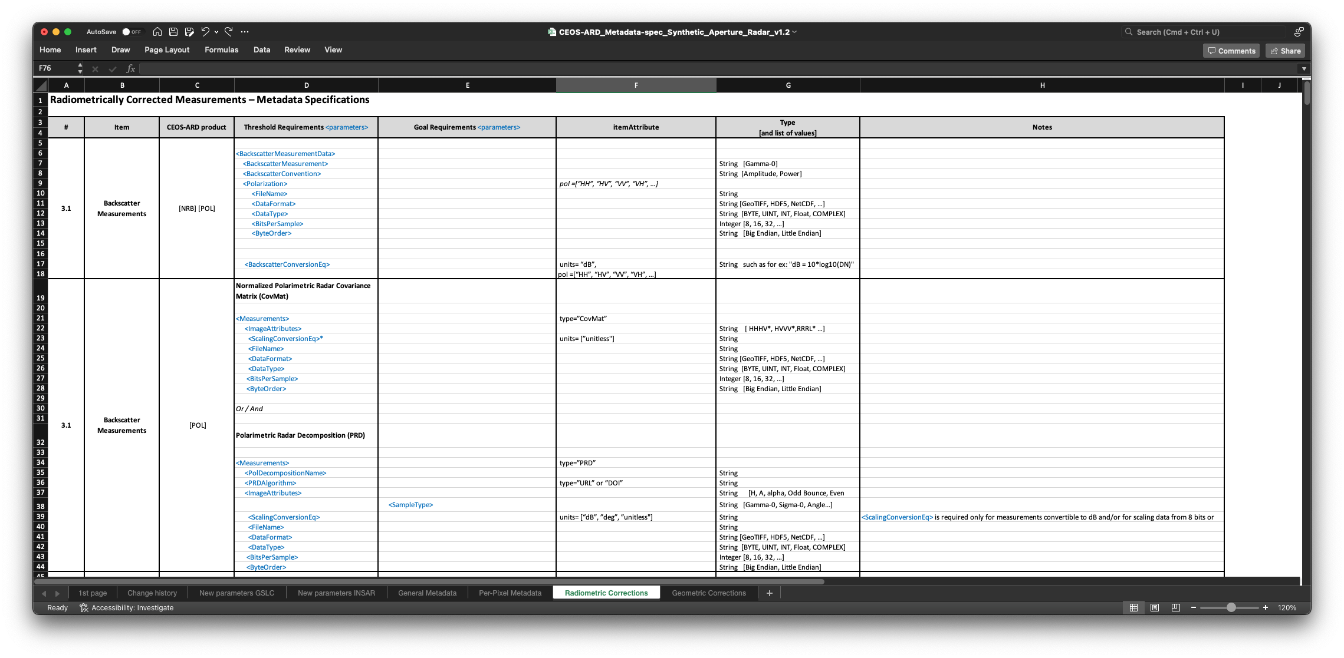
XML metadata specifications
3. Radiometric corrections

Slide 22
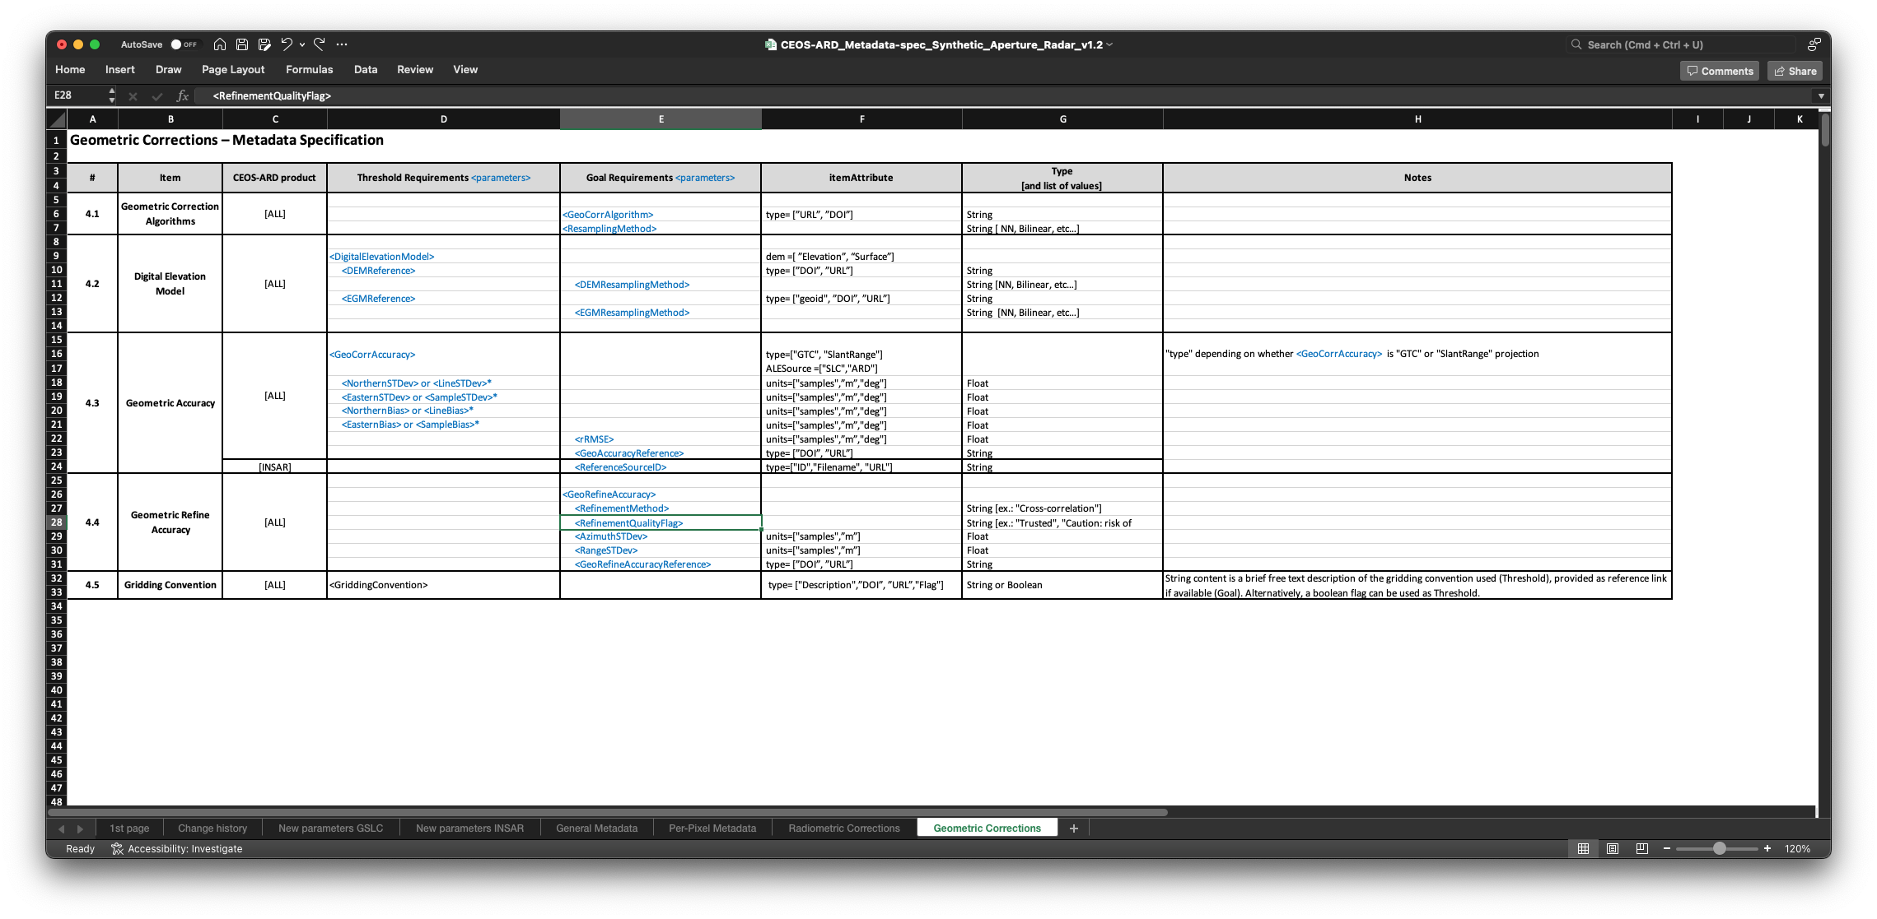
XML metadata specifications
4. Geometric corrections

Slide 23
LSI-VC-14 – Agenda Item 5.2
Discussion and potential endorsement

