Slide 1
CEOS-ARD
Aquatic Reflectance PFS v2.0
Review and Endorsement
Matt Steventon
CEOS-ARD & LSI-VC Secretariat
Arnold Dekker
CSIRO, CEOS-ARD AR PFS Lead
CEOS LSI-VC-17 (14 April 2025)
IOCCG-29 Committee Meeting (15 April 2025)

Slide 2
Motivations

Slide 3
CEOS-ARD Origins & Motivations
2016: Define something – address ‘ARD’ ambiguity
Open Data Cube – Digital Earth programmes around the world
Easing the use of satellite EO data to reach new, non-expert users and increase data uptake and use
Reduce pre-processing burden for users
Facilitate analysis in the cloud
Reduce egress and processing
Provision of analysis-ready geophysical measurements
Define key parameters and corrections for different types of geophysical products
Provide a first step for data interoperability
Open and transparent
Common starting point; consistency
Promote clear documentation of processing steps – not prescribing methods/approaches
Capitalise on space agency expertise and experience and best available science and high quality processes

Slide 4
Aquatic Reflectance PFS sections
1. General Metadata
2. Per-Pixel Metadata
3. Radiometric and Atmospheric Corrections Metadata
4. Geometric Corrections Metadata
Product Family Specifications (PFS)
Specifications for each geophysical measurement
Detail ‘Threshold’ and ‘Target’ / ‘Goal’ requirements for a variety of parameters

Slide 5
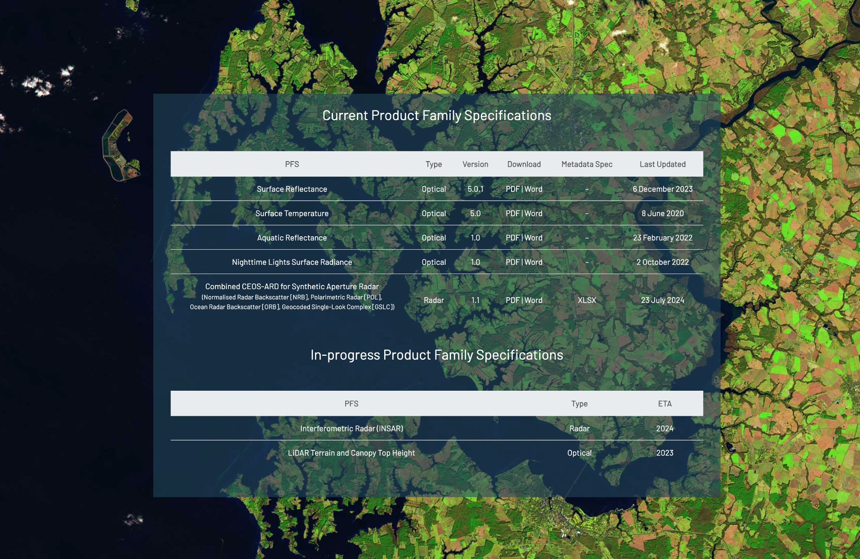
GHG flux products? Precipitation? TBD..

Slide 6
CEOS-ARD AR PFS v1.0 (Feb 2022)
The CEOS-ARD Aquatic Reflectance PFS, which focused on inland, nearshore coastal, and optically shallow waters, was first published in 2022.
Emphasis on higher resolution inland and coastal water products

Slide 7
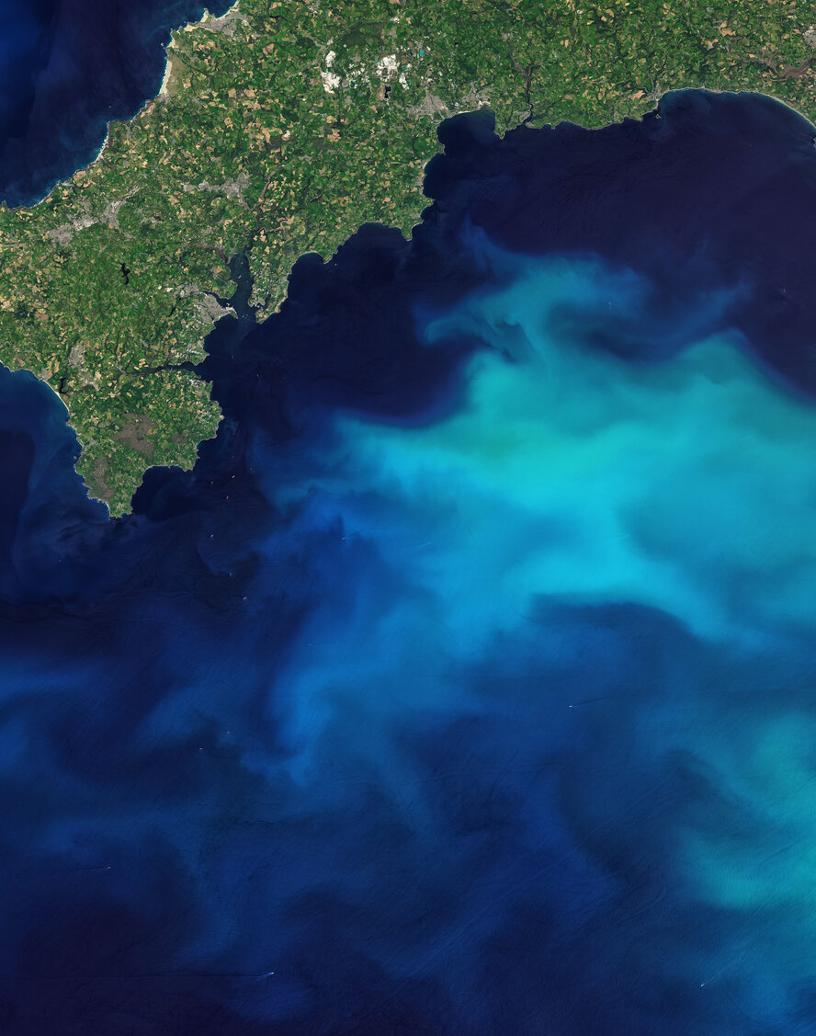
CEOS-ARD AR PFS v2.0 (March 2025)
Extended approach began in May 2024 to define a single AR PFS that covers all aquatic domains (inland, coastal, sea, and oceanic waters).
Bi-weekly meetings of an expert group of agency, service provider, research, and commercial representatives.
Metadata Threshold and Goal requirements carefully updated
Some updates apply to the CEOS-ARD PFS more broadly, serving as a useful reference for consolidation of optical PFS requirements (in development)
Version 2.0 AR PFS shared March 14, with a few weeks for final review – now presented for formal endorsement:
April 14: LSI-VC-17
April 15: IOCCG-29

Slide 8
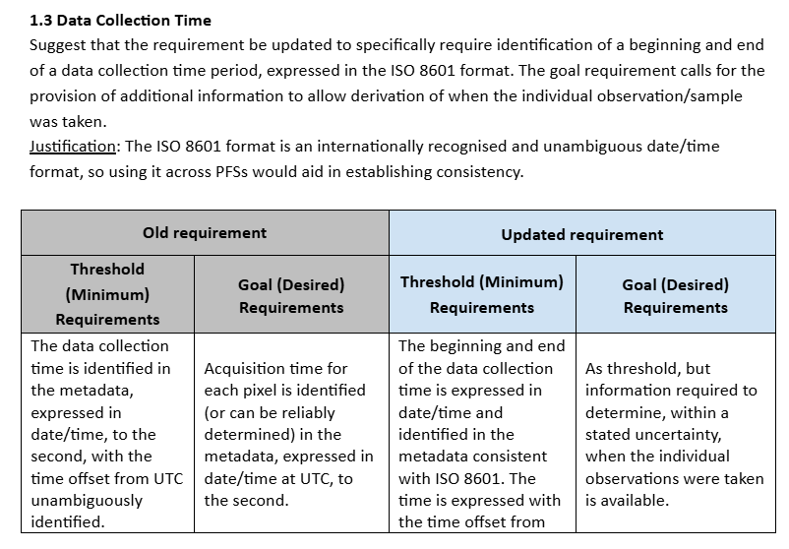
Update to PFS metadata requirements
Each metadata requirement was updated and documented after expert discussion and agreement
Description of edits made
Justification of update
Comparison of old vs new requirement
See the full summary of changes and decisions here

Slide 9
Main Metadata Updates
Requirements made more stringent and less prescriptive about methods
Threshold and Goal metadata requirements carefully considered in the context of CEOS-ARD
SI Traceability -> Goal
Some requirements broadened
E.g. Cloud and cloud shadow defined by ‘cloud or cloud-affected pixels’.
Requirement descriptions made less ambiguous
No more ‘if possible’ statements
Binary statement of ‘corrected’ / ‘not corrected’
Providers can use any algorithm, as long as it is compliant and documented (not necessarily peer reviewed publication)

Slide 10
Editorial PFS Updates
Requirement descriptions updated for clarity and conciseness
Requirements made more explicit
Removal of ambiguous and superfluous terminology
‘The metadata indicates’ -> ‘specification of’
‘if/where possible,’ ‘when available’
‘Accuracy’ -> ‘Uncertainty’
‘Target’ -> ‘Goal’
Took redundant terms outside of each parameter for readability
e.g. ‘metadata,’ ‘Information should be available in the metadata as a single DOI landing page’

Slide 11
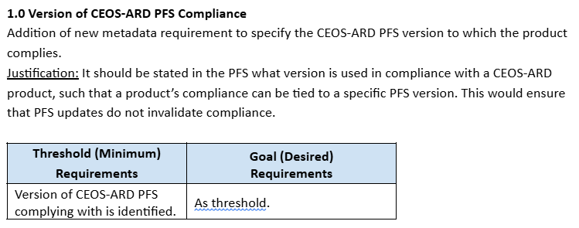
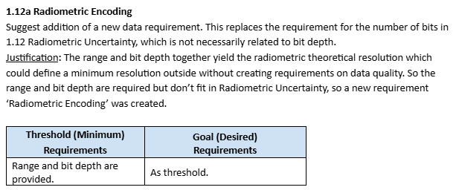
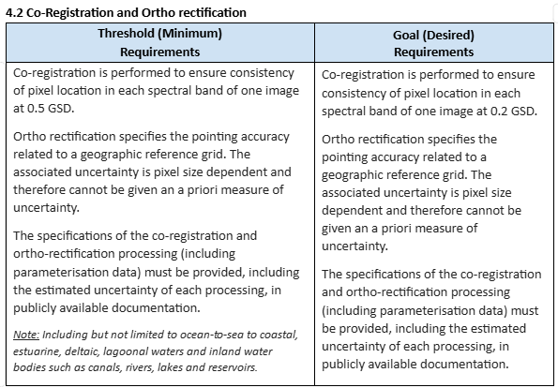
New Metadata requirements

Slide 12
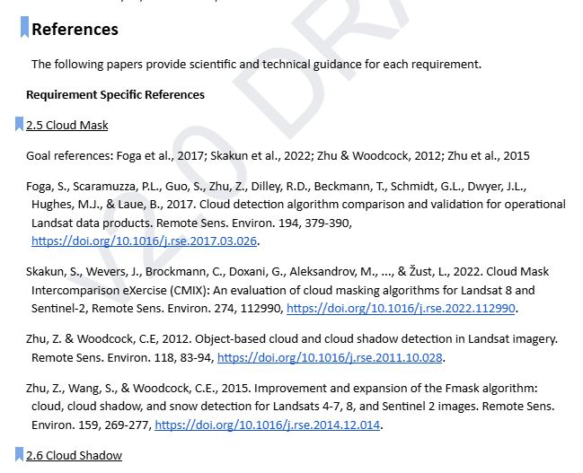
References update
References updated and organised by metadata requirement

Slide 13
Endorsement
Requested Decision: Formal endorsement of the CEOS-ARD AR PFS v2.0 (March 2025)
Document here

Slide 14
CEOS-ARD Assessment
Completed Self-assessment Table
Blank table in the specification
Includes references to metadata, DOIs, methods, etc.
CEOS Working Group on Cal/Val
Peer review
For Threshold – simplified checks
For Target/Goal – Review Panel
Iterative
CEOS-ARD Secretariat
Initial checks
CEOS-ARD
Sample Products
Incl. metadata
More Details
Guide to CEOS-ARD Self-Assessments
ceos.org/ard
CEOS-ARD Framework

Slide 15
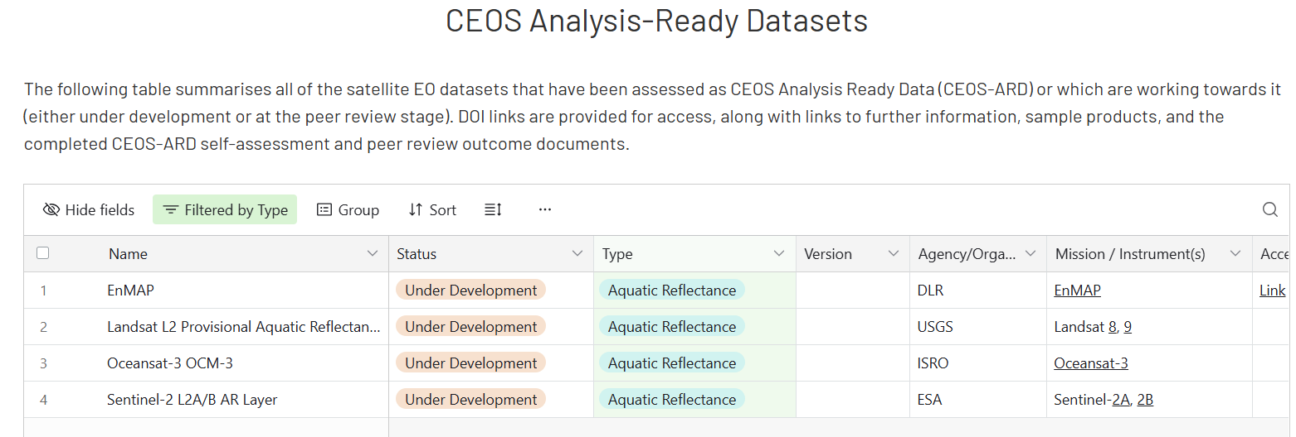
Current CEOS-ARD Products
Four datasets under assessment for a while
Should now use the new PFS
All data providers encouraged to self-assess against the AR PFS V2

Slide 16
CEOS-ARD GitHub
Aims:
Increase community involvement, transparency, and version control, tracking of issues, etc.
Modularisation of CEOS-ARD Specs
‘Building blocks’
Consolidation, commonality, consistency, terminology.
Ease PFS development
Alignment with SpatioTemporal Asset Catalogs (STAC) (Discovery, Access)
Various other technical topics
Continued evolution of the specs to meet community expectations
https://github.com/ceos-org/ceos-ard/

Slide 17
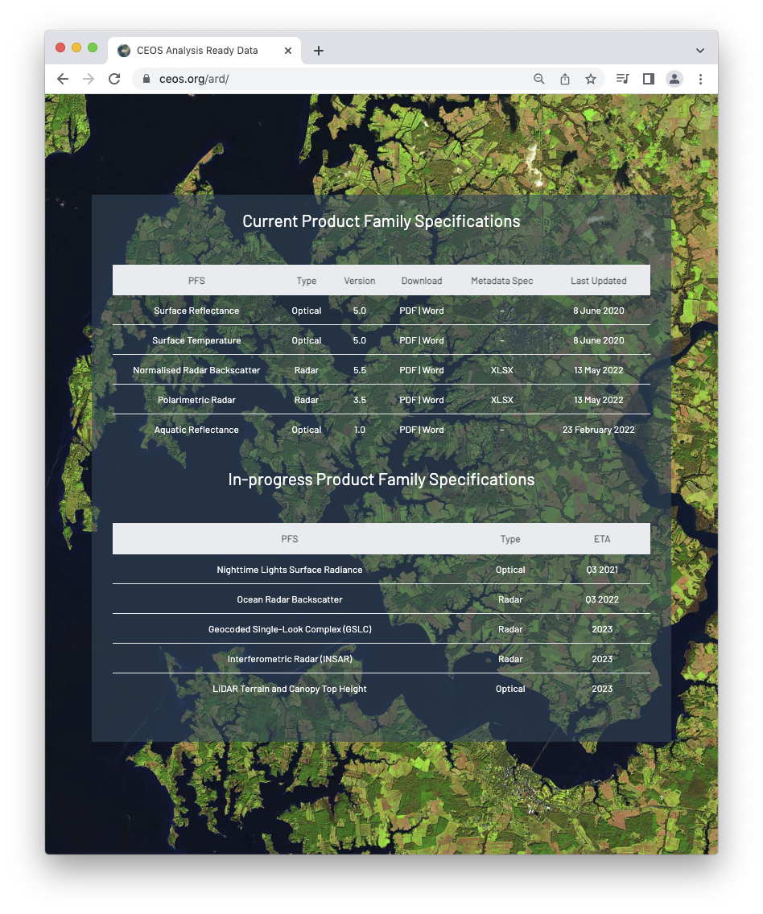
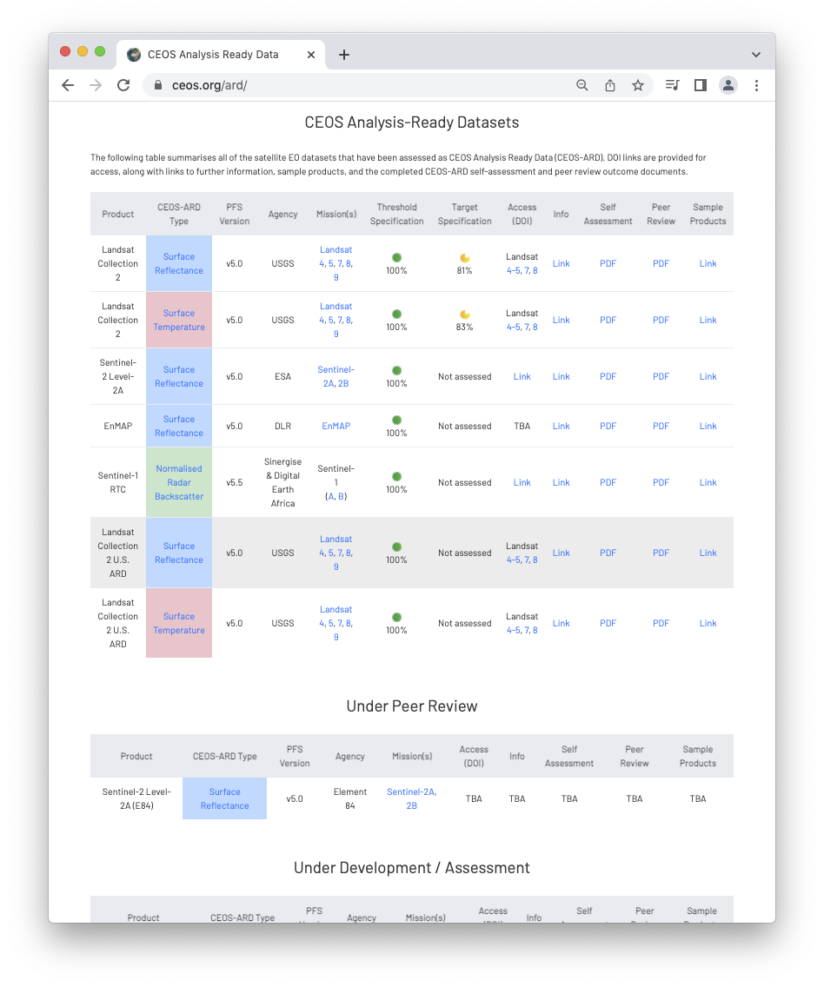
More information
CEOS-ARD www: https://ceos.org/ard
CEOS-ARD GitHub: https://github.com/ceos-org/ceos-ard
CEOS-ARD Newsletter Sign-up
Past new issues: https://ceos.org/ceos-ard-newsletter/
Twitter/X: https://x.com/CEOSARD
Contacts:
Ferran.Gascon@esa.int
matthew@symbioscomms.com
ard-contact@lists.ceos.org

