Slide 1
WGISS Analysis of AIML readiness of CEOS-ARD and Suggestions for the COES-ARD PFS and Framework
Yousuke Ikehata/JAXA
Agenda Item #3.2
LSI-VC-17
Tsukuba, Japan
14 April, 2025

Slide 2
Background
WGISS and its subgroup, the Technology Exploration Interest Group (TEIG), are considering publishing a white paper about AI/ML for EO.
There is a “jargon” term “AI/ML ready data” regarding the dataset for AI/ML.
We can't find a clear definition about it, but it is discussed in ESIP (Earth Science Information Partners) and they have developed a checklist.
https://github.com/ESIPFed/data-readiness/tree/main

Slide 3
ESIP’s checklist
Since July 2021, the ESIP Data Readiness Cluster has focused on creating tools like the AI-ready checklist for new data managers and other researchers who are learning to prep data for new uses. The checklist continues to evolve alongside the technologies it supports and its current draft covers key questions needed to ensure data preparation, data quality, data documentation and data access. Cluster participants offer their insights along with explanations of the checklist content.
(from https://www.esipfed.org/checklist-ai-ready-data/)
ESIP invent a check list, and it involves 4 categories.
Data Preparation
Data Quality
Data Documentation
Data Access

Slide 4
CEOS ARD
We evaluate PSFs(Product Family Specifications).
Aquatic Reflectance (Optical)
Nighttime Lights Surface Radiance (Optical)
Surface Reflectance (Optical)
Surface Temperature (Optical)
Synthetic Aperture Radar

Slide 5
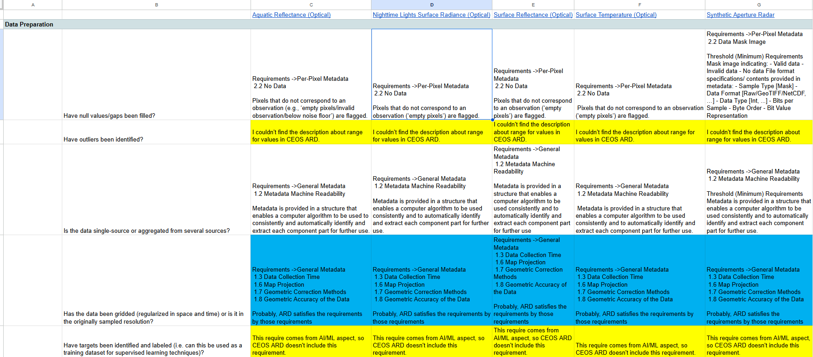
Compliance matrix
We evaluate “CEOS ARD” by ESIP’s checklist as compliance matrix.
https://docs.google.com/spreadsheets/d/1fRwTgZ_vKHZybef4iLFY6Gv-nb5T0zUtCjVQRU--0aU/edit?usp=sharing

Slide 6
Legends
I wrote compatibility to intersection cells and colored.
white cell: I can find compatibility with CEOS ARD requirement.
blue cell : I can’t find definite requirement, but I think compatible by other condition and background.
green cell: I can find compatibility, but it is “desired”(not minimum requirement).
violet cell: I can’t find requirement, but I think data provider might show related information to support users can estimate.
yellow cell: I can’t find descriptions from CEOS ARD requirements.
Blue cells
Green cells
Violet cells
Yellow cells

Slide 7
Incompatible requirement 1/2
ESIP’s checklist includes AI oriented requirement.
Have targets been identified and labeled (i.e. can this be used as a training dataset for supervised learning techniques)?
Have measures been taken to reduce bias?

Slide 8
Incompatible requirement 2/2
CEOS ARD is definition about data but ESIP’s checklist asks various aspects: data access, data documentation.
Do the parameters follow a defined standard?
Are parameters crosswalked in an ontology or common vocabulary (e.g. NIEM)?
Are there example codes / notebooks / toolkits available showing how the data can be used?

Slide 9
Result
CEOS ARD + landing page(doi) ~= AI ready data
AI/ML ready data
CEOS ARD
meta
doc
Data requirement
Metadata requirement
Documentation
Access
almost equal?
Landing page

Slide 10
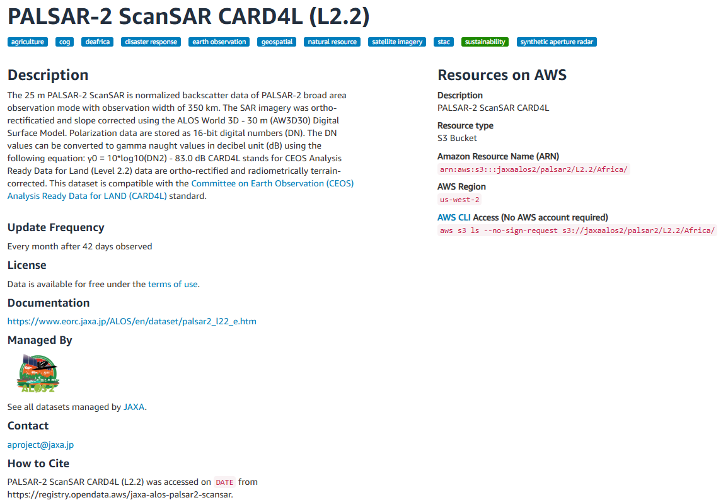
Example
AWS/CARD4L
User can download products with metadata.
JAXA also provides CSW(metadata), but it’s now unavailable for replacement.
https://registry.opendata.aws/jaxa-alos-palsar2-scansar/
Data Access
Related documents

Slide 11
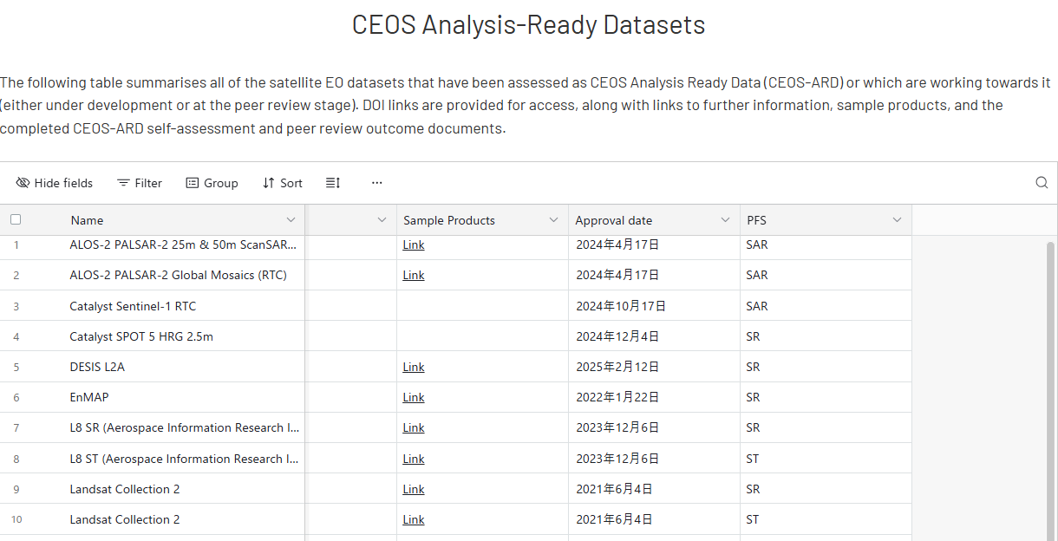
Suggestions
AI readiness
XX/XX
XX/XX
XX/XX
XX/XX
XX/XX
XX/XX
XX/XX
XX/XX
XX/XX
XX/XX

Slide 12
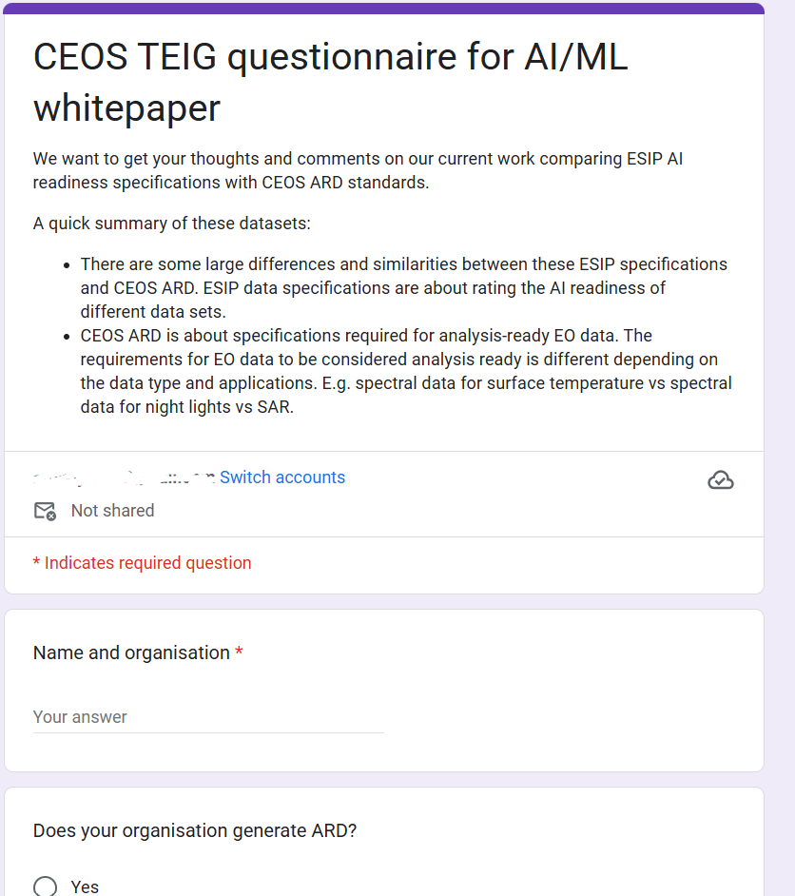
Questionnaire for TEIG.
https://docs.google.com/forms/d/e/1FAIpQLSfhhjfW_tA7RDr71Y-ErRRu9_sVvZBCZu-KH03jOTtcbHjvDw/viewform
We need volunteer who can answer our survey.
This survey will figure out awareness about ESIP’s checklist and needs about CEOS ARD’s readiness for AI.
Due date:
We plans to publish our white paper before WGISS-60 so could you please answer it till end of May.

