Slide 1
LSI-VC-17
Some WGCV Data QA initiatives
Nigel Fox, NPL
CEOS WGCV IVOS
Agenda Item: 4.3
LSI-VC-17
Tsukuba, Japan
14-16 April, 2025

Slide 2


Quality Assurance and Data Useability Assessment Frameworks for Earth Observation Data Products
QA MM (EDAP)
Sam Hunt¹, Jaime Nickeson², Leonardo De Laurentiis³, Sébastien Saunier⁴, Clément Albinet³,
Batuhan Osmanoglu², Alfreda Hall², Philippe Goryl³, Paolo Castracane⁵, Valentina Boccia³ , John Swinton^{6,} , Amy Beaton⁶+ others
(1( NPL, (2) NASA, (3) ESA, (4) Telespazio, (5) RHEA/ESA,
(6) TPZ UK,
https://www.youtube.com/watch?v=IRjR_611-ao

Slide 3
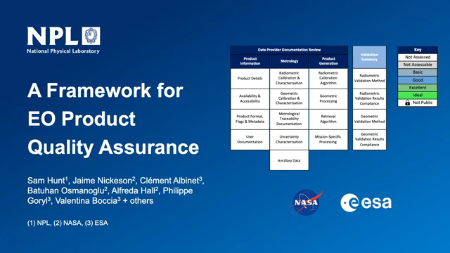
QA MM (EDAP)

Slide 4
Commercial Satellite Sector Growth
In 2030, it is projected that there will be over 8000, with the most explosive growth in the hyperspectral and hybrid sensor domains.
The need was identified by Space Agencies for systematic evaluation of commercial satellite data to understand how it may be integrated into their programmes.
NASA launched the CSDA Project and ESA the EDAP project to meet this need.
(source: the US National Geospatial-Intelligency Agency)

Slide 5
The Value of QA
Mission success is dependent upon quality assurance. Evidencing data quality adds significantly to the value of datasets.
Gives potential customers the confidence data is fit for their purpose.
Many aspects of data quality are aimed at facilitating communication to users → required for e.g. to interoperability.

Slide 6
QA Standards
Developing increasingly comprehensive definition of mission quality:
Analysis ready data & interoperability – e.g. CEOS ARD
Fiducial reference measurements
Uncertainty evaluation e.g. Sentinel-2, Sentinel-3, Landsat 9
Traceability – CLARREO, TRUTHS, Libra missions
Framework brings together this work to define a
combined QA standard

Slide 7
Assessment Philosophy
The assessment framework is aimed at verifying claimed mission performance and adheres, where applicable, to community best practices to an extent that is “fit for purpose”.
Assessment divided into two parts
  Review of mission quality as evidenced by its documentation
  Validation analysis performed by mission quality assessor

Slide 8
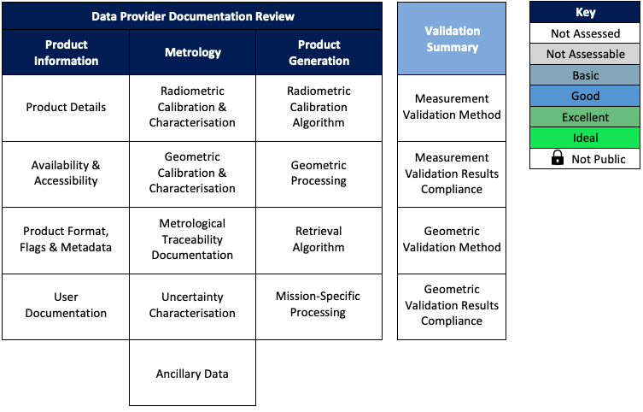
Framework Structure

Slide 9
Framework Structure
Validation Summary
Summarises validation activity undertaken by assessor

Slide 10

Framework Structure
Validation Summary
Summarises validation activity undertaken by assessor
Data Provider Documentation Review
Review of mission quality as evidenced by its documentation
Product Information
Review of descriptive information accompanying products
Metrology
Review of underpinning evidence for observation quality
Product Generation
Review of “fitness for purpose” of product generation

Slide 11
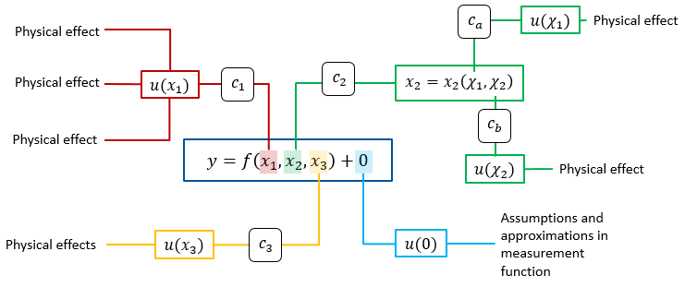

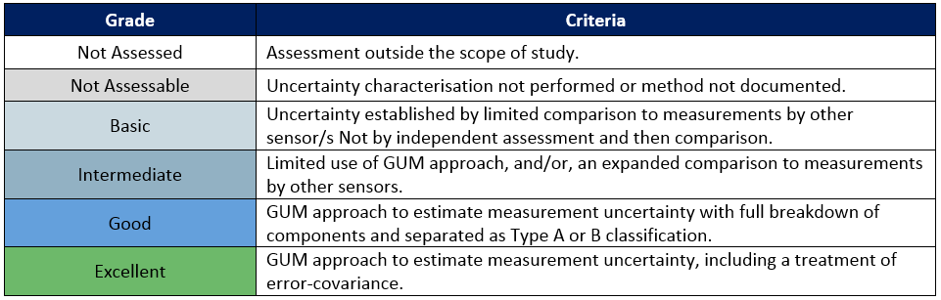
Example: Uncertainty Characterisation
Description of Best Practice
Earth observation metrology techniques developed within the H2020 FIDUCEO project.
www.fiduceo.eu
Grading Criteria
Based on the extent to which application of the Guide to the Expression of Uncertainty is applied, wrt fitness for purpose in the context of the assessed mission

Slide 12
Approach to Assessments
This framework is something data producers can refer to as they define products and evidence themselves.
Common framework between ESA and NASA simplifies process for vendors, and makes results more comparable
Assessment process is an interactive activity between assessors and missions

Slide 13
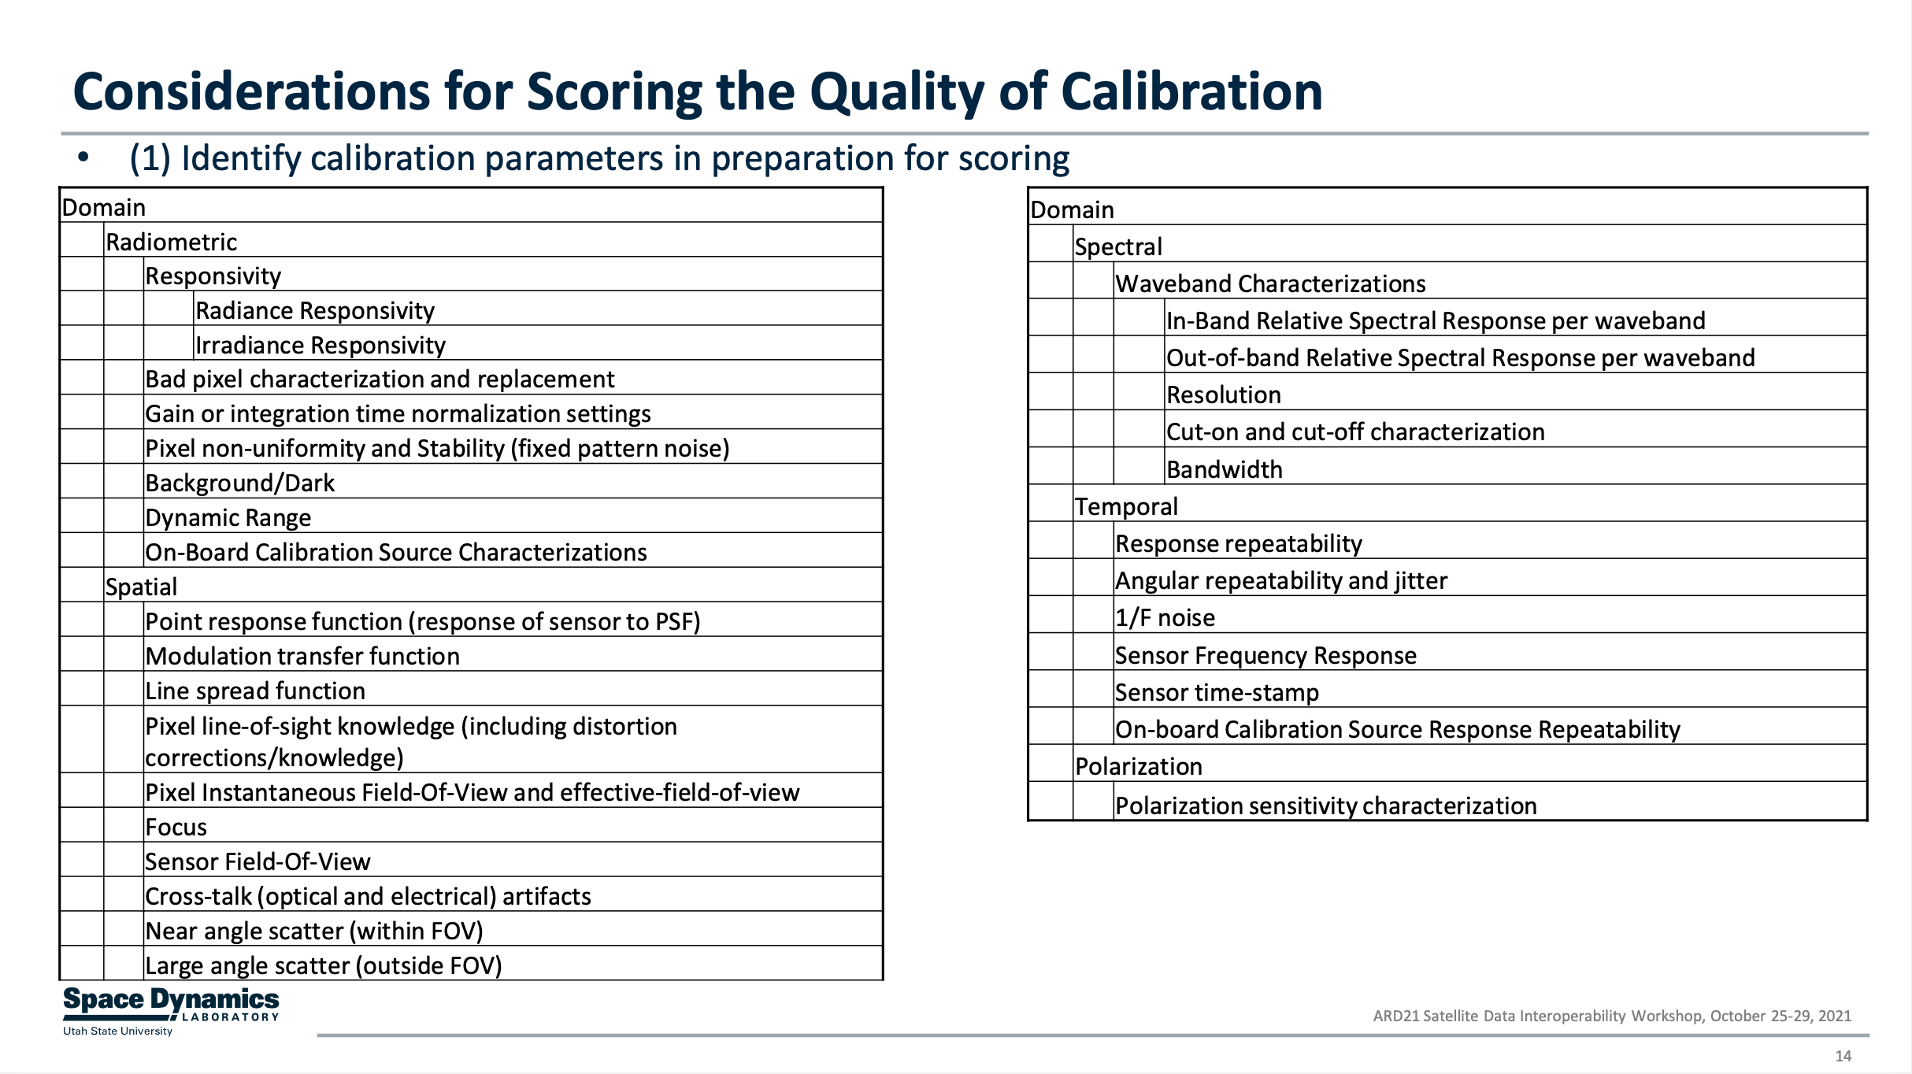
Calibration Assessment
MM underpinned by available best practice
Assessing compliance at times requires assessor expert judgement
Recommendation
Where missing, develop best practice material that is objectively testable
CEOS-PVP (Product Validation Platform)- a new aid
Tansock, ARD21

Slide 14


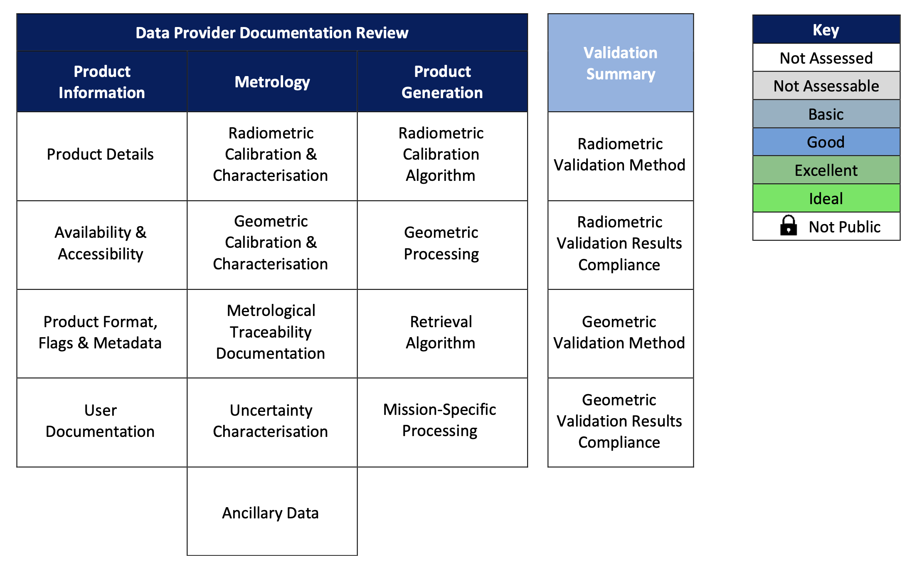
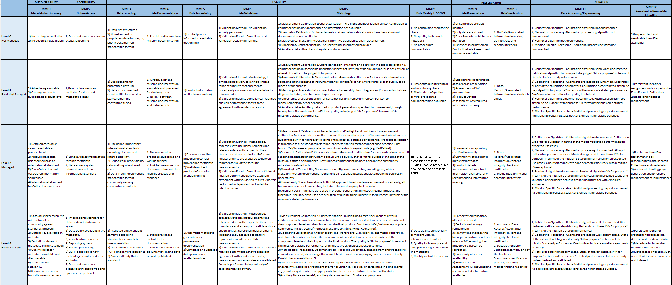
CEOS WGCV and WGISS Context
ESA Earthnet
NASA Commercial Smallsat Data Acquisition (CSDA) Program
NASA and ESA are working toward a comprehensive ESA-NASA Evaluation Framework. EDAP is intended to perform quality assessment for various EO missions in the QA4EO, Earthnet and New Space context.
EDAP approach aims to define a mission quality Cal/Val Maturity Matrix
CEOS WGISS Data Management & Stewardship Maturity Matrix
Reference: WGISS DMSMM
EDAP Cal/Val Maturity Matrix
EDAP Cal/Val Maturity Matrix provides input for quality aspects to the CEOS WGISS Data Management & Stewardship Maturity Matrix that includes information on all aspects of the data records, including discoverability, accessibility, usability, preservation and curation

Slide 15
Required Information from data provider
Product name
Sensor Name
Sensor Type
Product version number
Product ID
Processing level of product
Measured quantity name
Measured quantity units
Stated measurement quality
Spatial Resolution
Spatial Coverage
Temporal Resolution
Temporal Coverage
Mission coverage

Slide 16
Recommended
Point of contact (Responsible organisation, including email address)
Product locator (e.g. URL, DOI if applicable)
Conditions for access and use
Limitation on public access
Product abstract (summary of resource)

Slide 17

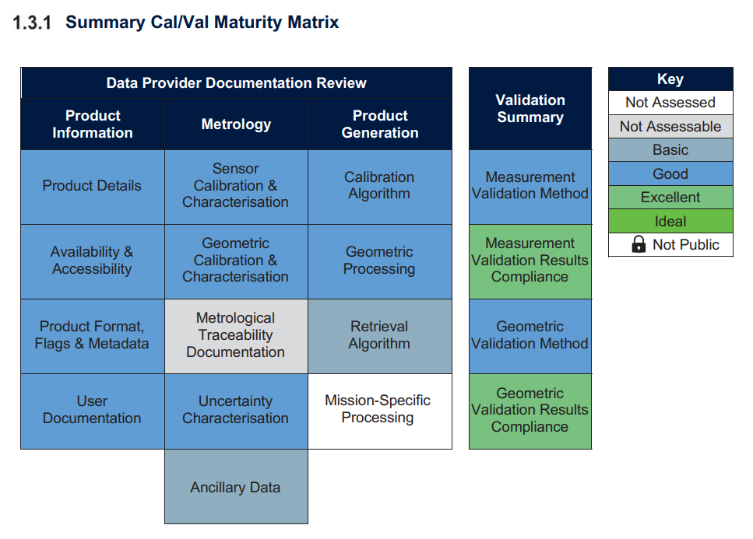
EDAP analysis SuperDove Apr 2024
VHR, HR and MR Optical Missions - Earth Online

Slide 18
Report
Comprehensive
Detailed
Evidence of Validation results
Discussed and iterated with sensor data provider
Significant effort by agency experts – but needed to ensure rigour and consistent QA knowledge as with own sensors
Report publicly available

Slide 19
MM reporting format now increasing in use and utility
CEOS-FRM example
  FRM (Fiducial Reference Measurements) provide independent means to validate satellite sensor data product performance
  Potentially all types of products but mainly L1, L2
  Need to evidence FRM meets criteria needed to do validation
Satellite Methane detection validation

Slide 20
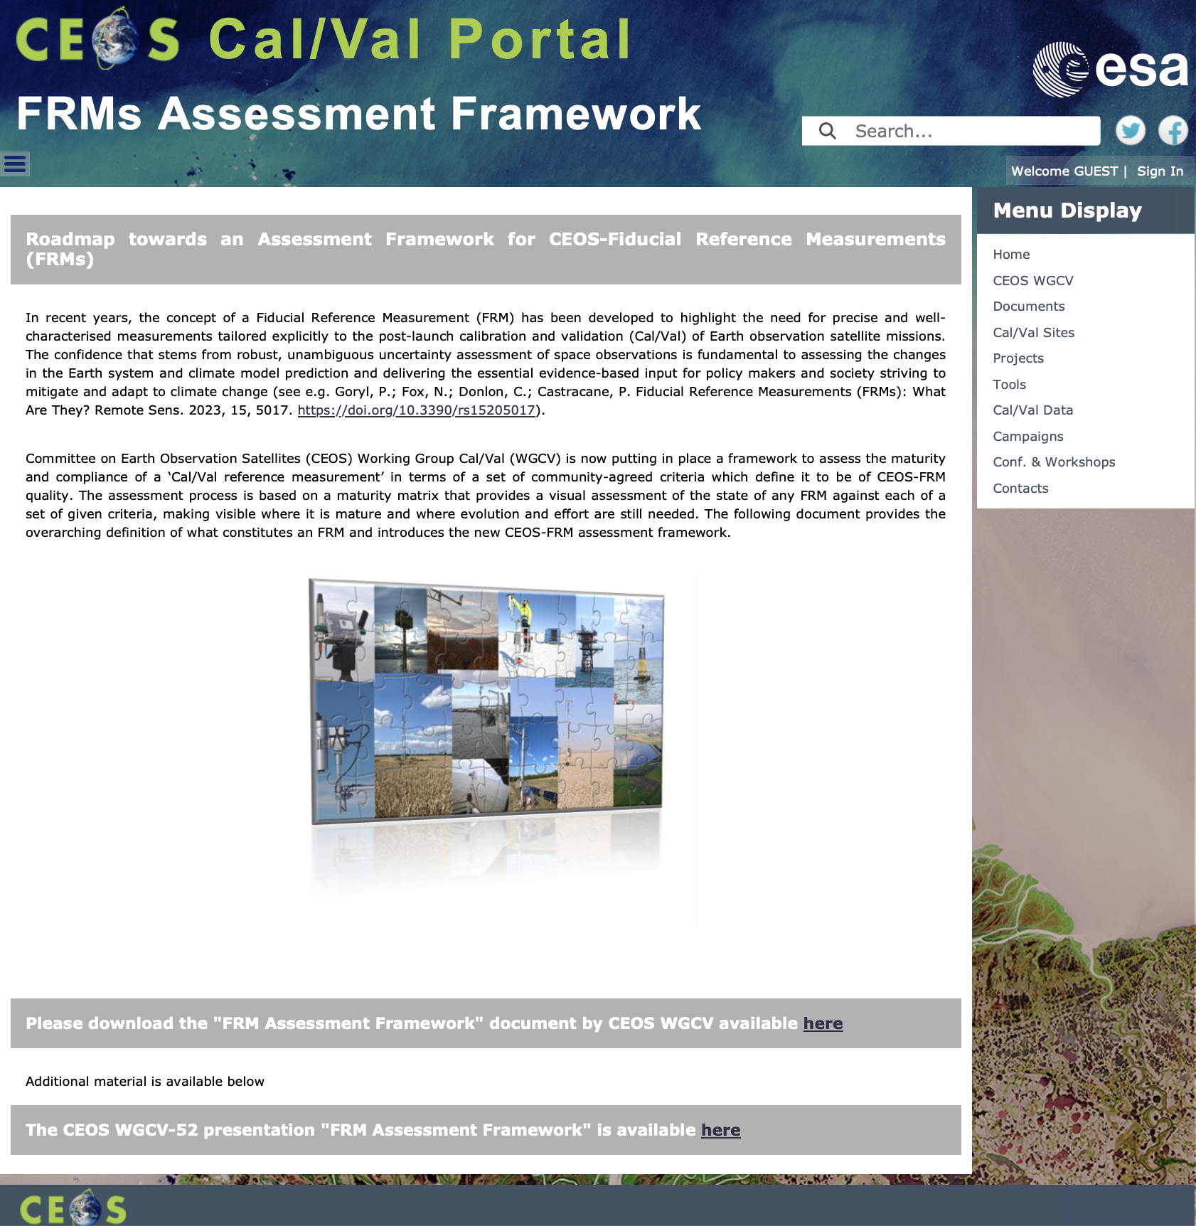
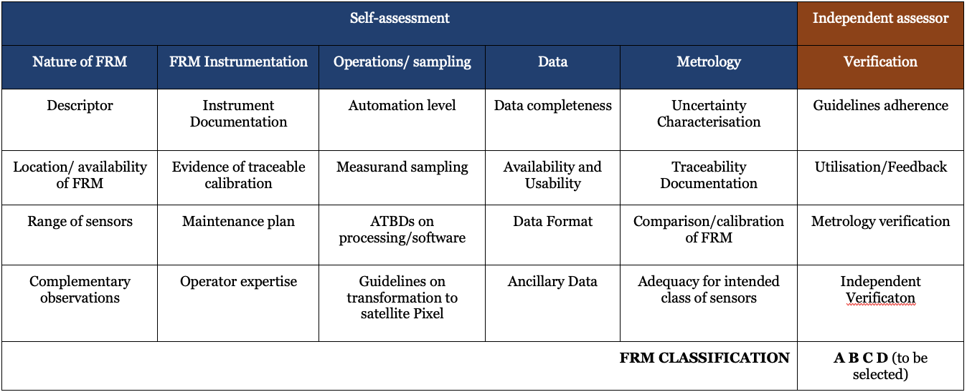
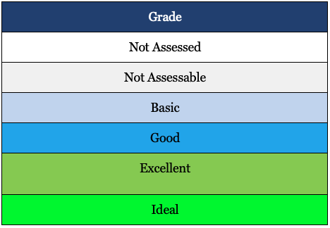
CEOS FRMs Assessment Framework
Roadmap towards an Assessment Framework for Fiducial Reference Measurements (FRM)
https://calvalportal.ceos.org/web/guest/frms-assessment-framework
The purpose of the document is to propose a roadmap towards an assessment framework to endorse a specific class of measurements as a Fiducial Reference Measurement (FRM).
Background and Objectives
FRM Definition and Principles
FRM Endorsement Process
FRM Maturity Matrix
FRM Overall Classification
Goryl, P.; Fox, N.; Donlon, C.; Castracane, P. Fiducial Reference Measurements (FRMs): What Are They? Remote Sens. 2023, 15, 5017. https://doi.org/10.3390/rs15205017.

Slide 21
CEOS-FRM Maturity Matrix V2
Self-Assessment |  |  |  |  |  | Independent Assessor
Nature of FRM | FRM Instrumentation | Operations/ Sampling (single instrument) | Data | Metrology | Network/ multi-location | Verification
Descriptor | Instrument documentation | Automation level | Data completeness | Uncertainty characterisation | Spatial coverage | Guidelines adherence
Location/ availability of FRM | Evidence of traceable calibration | Measurand sampling/representativeness | Availability and Usability | Traceability documentation | Temporal Sampling | Utilisation/Feedback
Range of instruments | Maintenance plan | ATBDs on processing/ software | Data format | Comparison/calibration of FRM | Centralized data, processing and standards | Metrology verification
Complementary observations | Operator expertise | Guidelines on transformation to satellite Pixel | Ancillary data | Adequacy for intended class of instrument/ measurand | Timeliness | Independent verification
FRM CLASSIFICATION |  |  |  |  |  | A B C D (to be selected)

Slide 22
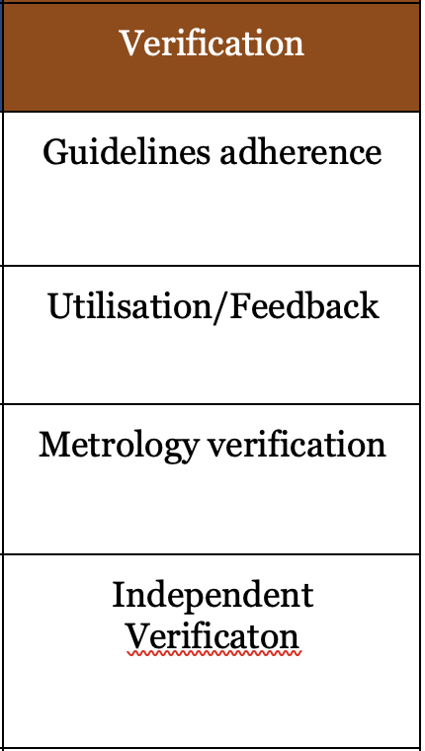
Independent assessor FRM MM
Verification
The overall goal is to verify that the FRM is consistent with self-assessed criteria and that the evidence provided fully supports the assessment. This column is again subdivided into categories to provide some granularity to the verification process.
The degree of utilisation/impact in terms of citations, website visit, feedback provided etc is an important aspect
The relevant classifications of these categories leads to an overall compliance Class for the particular application the FRM is specified for. The user can then choose what class of FRM is needed to meet their needs

Slide 23
Critical verification categories
GUIDELINES
Independent Verification
Grade | Criteria
Not Assessed | Assessment outside of the scope of study.
No Assesable | Relevant information not made available.
Basic | All categories should be at least basic and if not there should be a clear strategy to progress within a short (<3 month) timescale. Those categories in basic should have a strategy to progress towards greater compliance.
Good | More than 80% must meet the good category and those in basic should indicate a strategy to progress. >30 % should be in the green classification. There should be no basic classifications in the metrology or Instrument columns and any in these columns indicating good should indicate a strategy to progress
Excellent | All categories are good or above with > than 80% in the green classification and those in the Metrology or instrument columns must meet excellent or above.
Ideal | All categories in the matrix fully meet the green classification i.e. Excellent or Ideal with at least half reaching the ideal category and of these half must include those in the metrology and FRM instrument column
Grade | Criteria
Not Assessed | Assessment outside of the scope of study.
Not Assessable | Relevant information not made available.
Basic | Some comparison evidence but limited ability to confirm or otherwise the declared FRM uncertainty
Good | Full compliance of declared FRM uncertainties through comparison to a reference of good but higher uncertainty than the FRM or near but not full compliance against a reference of comparable or lower uncertainty.
Excellent | Full compliance of declared FRM uncertainties through comparison to a reference with comparable uncertainties.
Ideal | Full compliance of declared FRM uncertainties through independent comparison to a reference of lower overall uncertainty
Class A & B must achieve some form of Green for all categories,

Slide 24
FRM Overall Classification
To provide overall summary guidance to a user we have created the following four classes.
Class A – Where the FRM fully meets all the criteria necessary to be considered an FRM for a particular class of sensor.
It should achieve a class of Ideal in the ‘guidance criteria’ in the ‘independent verification’ section of the MM and green (at least excellent) for all other verification categories where these have been carried out.
Class B – Where the FRM meets many of the key criteria and has a path towards meeting the Class A status in the near term. It should achieve at least Excellent in the guidance criteria in the independent verification section of the MM and green (at least excellent) for all other verification categories where these have been carried out. Ideally it should indicate a path towards achieving the high class.
Class C – Meets or has some clear path towards achieving the criteria needed to reach a higher class and provides some clear value to the validation of a class of satellite sensors.
It should achieve at least Good in the guidance criteria in the independent verification section of the MM and at least good for all other verification categories where these have been carried out. Ideally it should indicate a path towards achieving the high class.
Class D - Is a relatively basic adherence to the FRM criteria but where this is a strategy and aspiration to progress towards a higher class. This can be considered an entry level class for those starting out on developing an FRM. It should achieve at least Basic in the guidance criteria in the independent verification section of the MM and at least Good for all other verification categories where these have been carried out. FRM owners/developers must indicate a path towards achieving the high class.

Slide 25
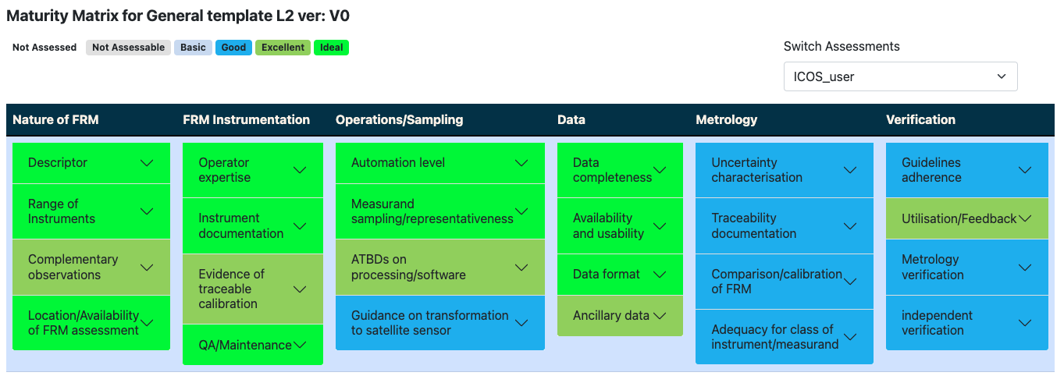
CEOS FRM – ICOS (Ecosystem Component) Assessment
CEOS FRM
Class C
General considerations about ICOS
ICOS is an environmental monitoring network, whose main objective is to monitor ecosystem responses to natural and human-induced changes. The main infrastructure at the ICOS sites are the eddy-covariance flux towers, for measuring GHG and energy fluxes at ecosystem scale.
ICOS is divided in three main components: atmosphere, marine and ecosystem. Within this exercise, I focused on the Ecosystem component.
ICOS was not originally designed for satellite validation. However, ICOS measurements include a number of variables, which are of interest for satellite validation. In this assessment I focused on radiation and vegetation variables, mainly FAPAR and LAI. For those variables, there are no existing validation networks, while the common approach (e.g., GBOV) is to build on existing infrastructure (ICOS, NEON, TERN) to perform satellite validation at global scale.
Overall, ICOS appears to be a good/excellent source of reliable validation data. Yet, the issue of upscaling to satellite pixel is not addressed. The main gap at the moment is the compliancy to metrological guidelines, with no use of rigorous uncertainty tree diagrams and little information about traceability. This gap mainly impact the Ecosystem component, while stricter requirements for traceability exist for the Atmospheric component, with tight links to WMO standards.
There is a strong willingness and a clear path towards fostering the use of ICOS data for satellite validation. As part of this endeavor, best practices are being refined with stronger attention to uncertainty and traceability requirements. One example, is the prototyping of an automated SI-traceable network of PAR sensors for FAPAR/LAI validation. This set-up is now being considered as the reference and the intention is to deploy it in all ICOS Ecosystem sites.
As a result of the above mentioned and other on-going R&D projects, the compliancy of ICOS Ecosystem component to FRM criteria is expected to improve in the coming 2-3 years. The CEOS-WGCV-LPV is closely following this evolution and will facilitate those improvements.

Slide 26

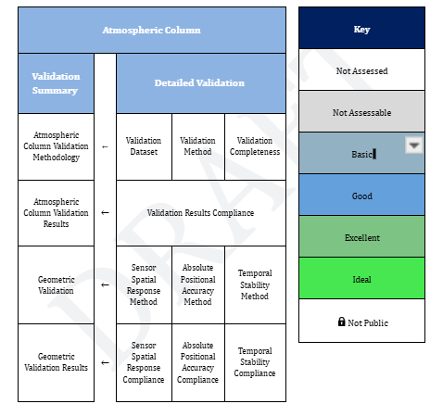
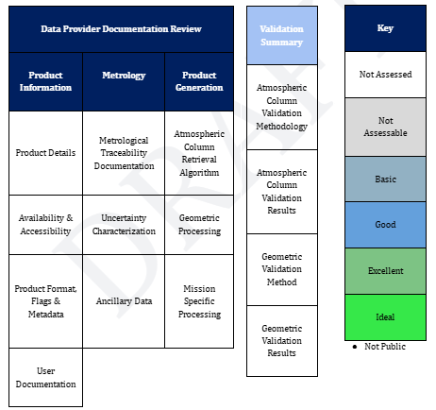
MM for GHGs

Slide 27
Conclusion
QA/Cal/Val MM is comprehensive standard for mission quality defined by ESA & NASA
Currently in use in ESA/NASA commercial missions QA evaluation
The results are summarised in the Cal/Val maturity matrix (MM)
The assessment opened a “communication channel” between Agencies and commercial companies but formal validation process is labour intensive
Cal/Val Maturity Matrix integrated in the CEOS WGISS Maturity Matrix
MM reporting style, readily allows graded assessment (not just binary) identifying and encouraging progression & easy visibility of what matters for specific users
  Can, as done for CEOS-FRM, still enable overall summary classifications for particular applications (e.g. schema based on number and nature (criticality) of green boxes for particular specs/use
  A MM could be created to report CEOS ARD PFS compliance- enabling a more progressive, less ‘binary’ (Fail, Threshold, Target) framework

Slide 28
Evolution / Next Steps
Work in progress to establish the means to evidence ‘fitness for purpose’ or ‘useability’. i.e. classes of MM outcomes / what colour does each box need to be?
Impossible to truly achieve – too many different applications! So!
  Limited number of broad application types
  Critical criteria for the application e.g temporal, spatial, radiometric
  Establish quantitative distinguishing metrics for these
  Represent in an additional matrix or columns of matrix and a ‘classification’ based on achieving critical criteria

Slide 29
Usability Summary:
Framework Components
Defining the input product performance
Evaluation of target application requirements
Evaluation of suitability of input product to target application
Reporting to user (e.g., website mock-up)

Slide 30

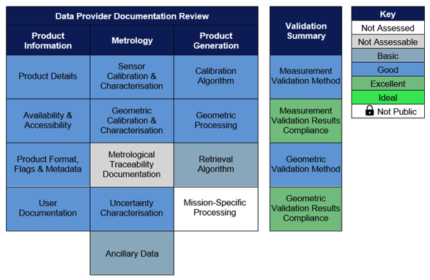
Usability Summary:
Framework Components
Defining the input product performance
Evaluation of target application requirements
Evaluation of suitability of input product to target application
Reporting to user (e.g., website mock-up)
Existing framework:

Slide 31

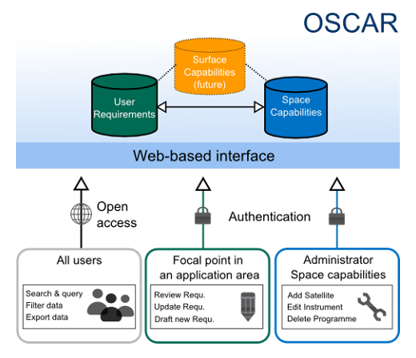
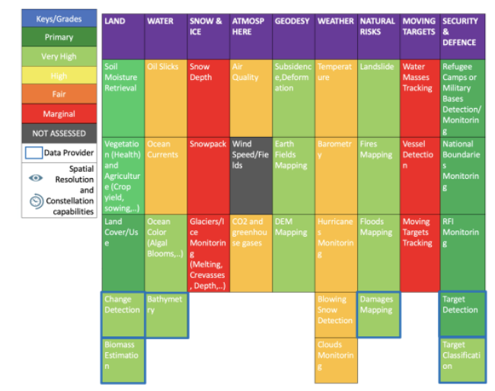

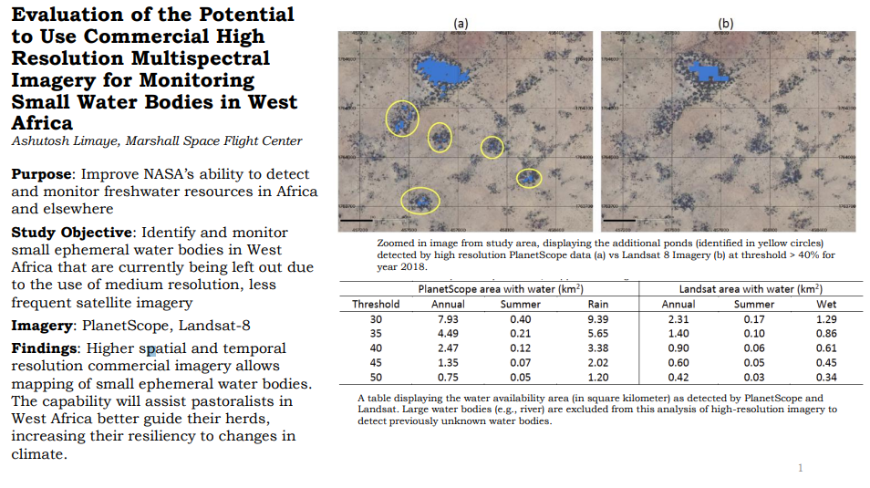

Usability Summary:
Framework Components
Defining the input product performance
Evaluation of target application requirements
Evaluation of suitability of input product to target application
Reporting to user (e.g., website mock-up)
Existing frameworks:

Slide 32

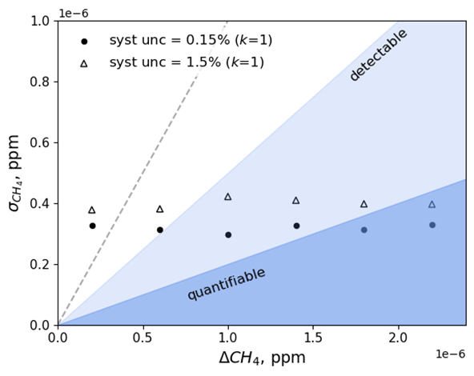
Requirements Definition:
Simulation Studies
Common to support product requirements with simulation studies – more quantitative than previous
Discussion at VH-RODA 2023 about how such simulation tools could support application developers (I. Zuleta suggestion)
  Similar discussion at CEOS-WGCV-IVOS
  Evidence from sensitivity studies provides justification to commercial providers as to why information/characterization is needed
    Helps their internal cal teams justify what often they would like to do
Target particular applications of interest for case study.
Example from TRUTHS Mission: Simulated retrieval uncertainty vs methane enhancement of the simulated methane enhancement. Circular markers show the results for a TRUTHS-like sensor, triangular markers show the results for a typical sensor

Slide 33

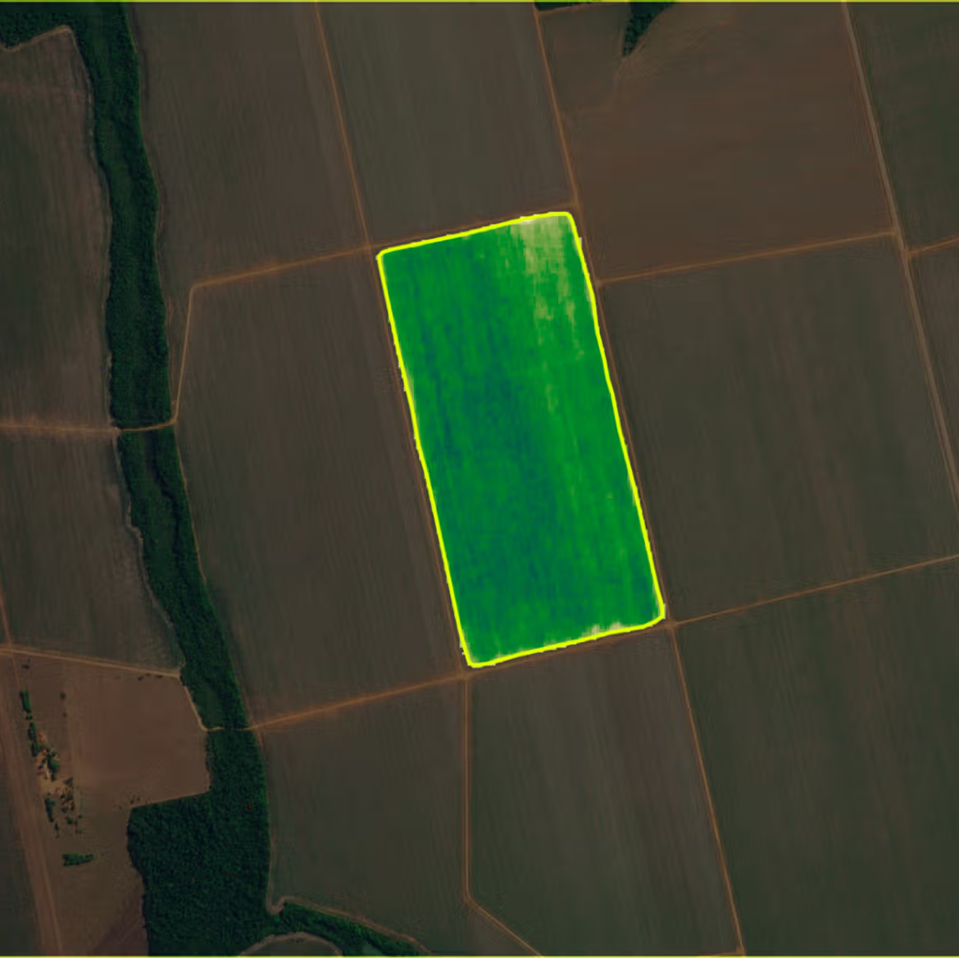
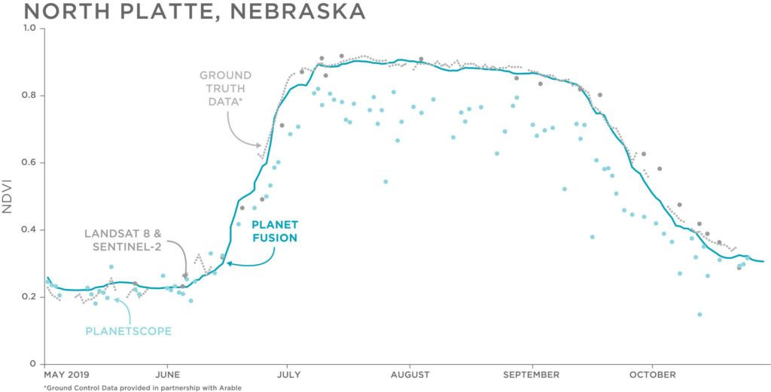
Case Study:
Agricultural Monitoring
Simple case – agricultural monitoring from high-resolution optical sensors
Typically performed using time series of NDVI to identify e.g., season start/end
Define which sensor performance drivers and investigate tradeoffs, e.g.:
  SNR
  Abs Cal (and constellation intercal)
    Cal drift
  Temporal coverage
  SRF
  ….
Planet NDVI data used for agricultural monitoring

Slide 34
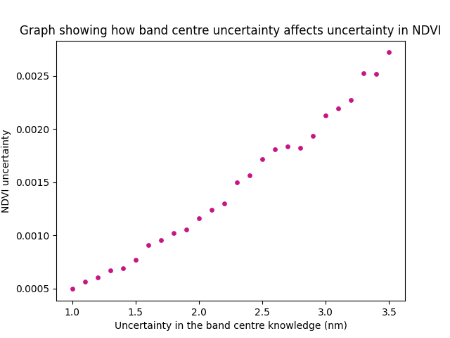
Case Study:
Agricultural Monitoring
Define simulation model
  Simulate TOA agricultural scene
  Simulate sensor observation
  Evaluate NDVI retrieval
Propagate uncertainties through simulator modelling using Monte Carlo
Explore trade off space for sensor performance vs. application performance
Example for NDVI sensitivity to spectral uncertainty

Slide 35
Next Steps
Now simulating individual spectra – extend to simulating time series of NDVI observations taking in range of uncertainty sources
Evaluate sensitivity of agricultural parameters to uncertainties – e.g., Start of season / End of season

Slide 36


CEOS WGCV
CEOS-PVP incorporating CID & RadVAL
Product Validation Platform
(previously known as 'matchup Database’)
(CEOS.org/PVP)
(Comparison Image Database) &
(Radiometric Validation & AnaLytics tool)
Nigel Fox, NPL
WGCV IVOS Chair
Agenda Item 5.1
SIT-40
Fukuoka, Japan
8-10 April, 2025
Notes:
Full overarching name

Slide 37
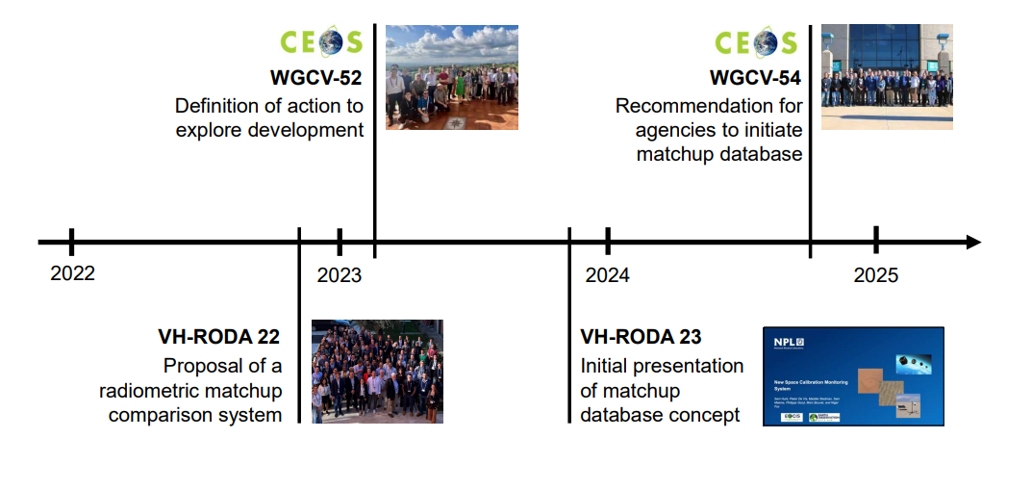
Background
Supporting the CEOS New Space Task Team white paper generally, including recommendations (R3) and deliverables (D4)
VH-RODA 2023 slides here
Noting recent CEOS Commercial Engagement guidance

Slide 38
WGCV’s recommendation
(CEOS plenary 2024)
CEOS WGCV’s recommendation to facilitate interoperable global satellite imagery for both public and commercial agencies
CEOS Agencies should regularly collect and provide free access to Level 1 satellite imagery and metadata against a common ‘CEOS reference’ (representing radiometric and spatial properties)
  A combination of CEOS calibration sites will be integrated together into a virtual reference
Commercial data providers are encouraged to also provide similar imagery
Imagery should be made available through an API or a dedicated CEOS archive offered to be hosted by the UK Earth Observation Data Hub (EODH).
CEOS will provide QA feedback to support satellite operators and data users via an NPL developed web app

Slide 39

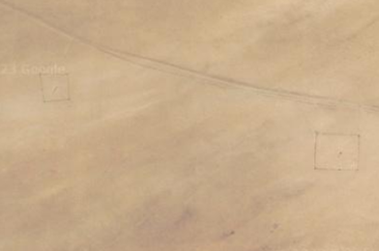
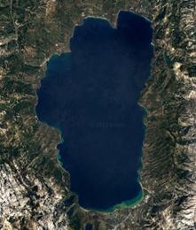

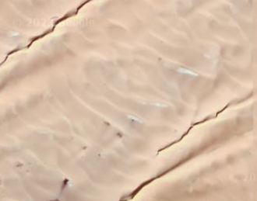

Selected: Radiometric Sites
Instrumented Sites
Railroad Valley, USA
Gobabeb, Namibia
Lake Tahoe, USA
Natural (Pseudo-Invariant Calibration Sites)
Libya 4
Libya 1
Algeria 3

Slide 40
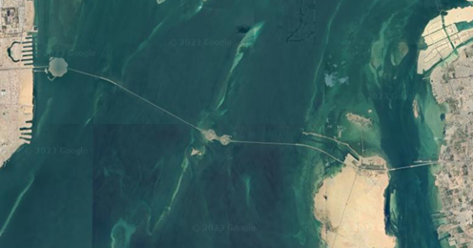
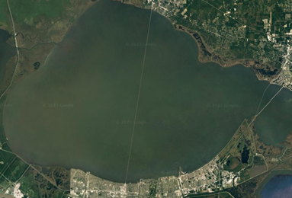

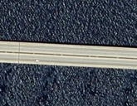
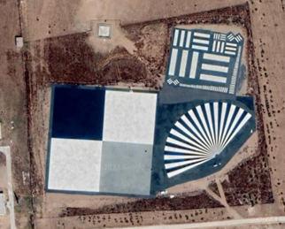
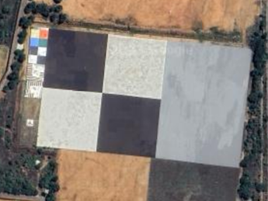
Selected: Spatial Sites
High resolution sensors
King Fahd Causeway, Saudi Arabia-Bahrain
Lake Pontchartrain Causeway, USA
Medium resolution sensors
Baotou Target, China
ISRO NRSC target, India

Slide 41
Current Progress
Creation of an overarching Product Validation Platform (PVP) new name for matchup database
Database of radiometric and spatial imagery data has been developed: (Comparison Image Database (CID)
Combination of CEOS-developed references - integrated together to form “virtual reference”
  Gobabeb, RadCalNet
  Railroad Valley, RadCalNet
  PICS
“Virtual reference” concept to be refined in future to reduce reference uncertainty
Initial implementation built into a Radiometric Validation AnaLytics tool (RadVAL) within UK EODH, including:
  Sensors: Sentinel-2, Landsat and commercial high-res: Planet SuperDove and Airbus Pléiades (as a demo)
  CEOS references: Radiometric sites defined. More may be added, but aim to maintain a minimum core set of sites
Comparison Image Database (CID) to hold mission imagery over the sites now ready for inputs
  Sentinel-2
  Landsat 8

Slide 42
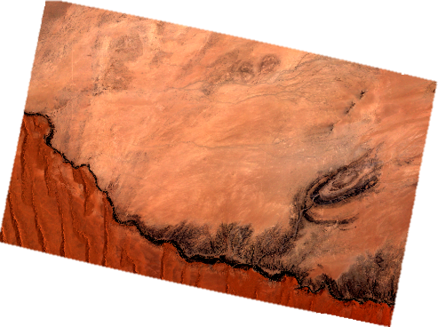
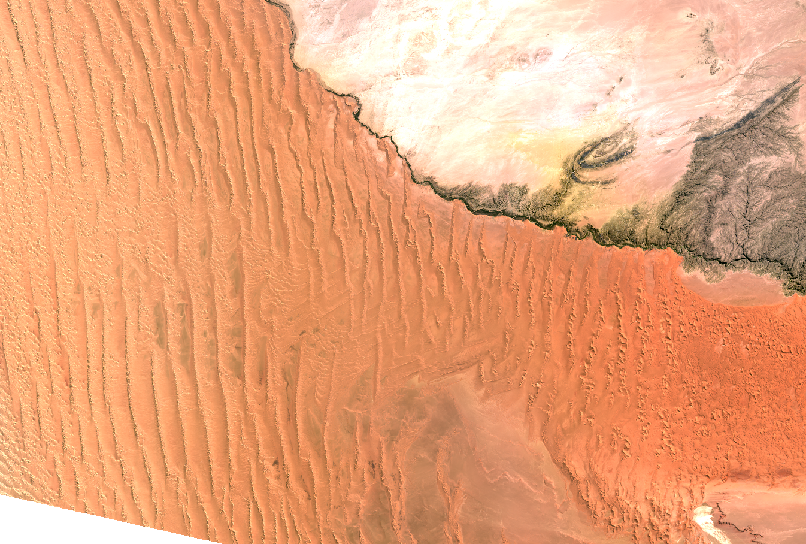
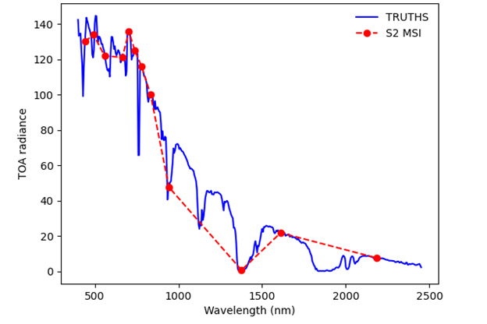
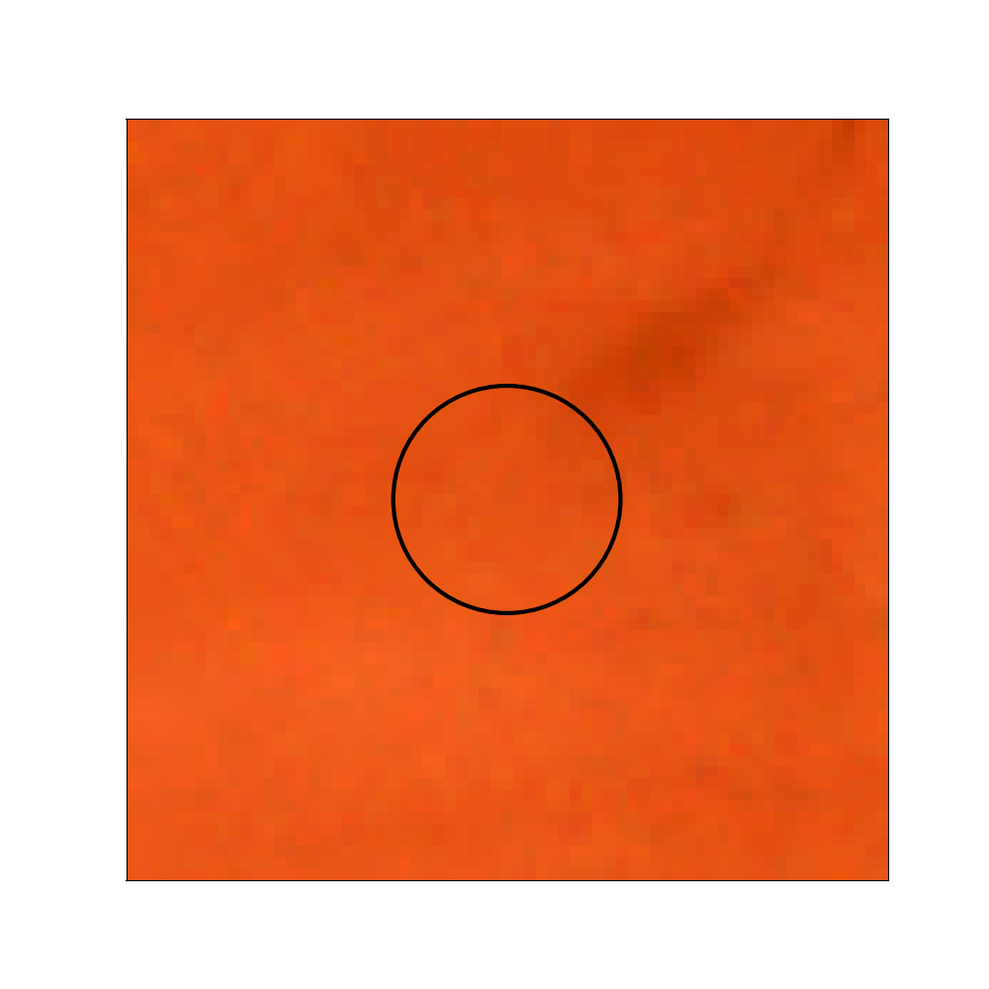



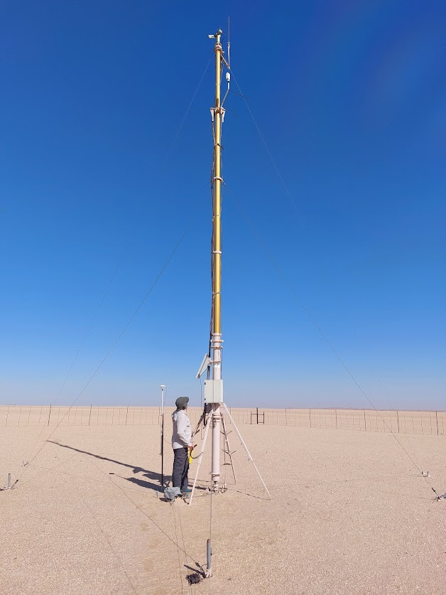








Product Validation Platform: PVP
PVP: Product Validation Platform
Data Collection
Comparison
Visualisation
Comparison Image Database (CID)
RadVAL Comparison
Database
RadVAL
Comparison
Dashboard
& future contributing missions…
Radiometric sites
Spatial
sites
RadVAL: Radiometric Validation AnaLytics Tool

Slide 43


Comparison Image Database (CID)
The UK’s Earth Observation Data Hub (EODH) infrastructure hosts the archive of satellite imagery over CEOS references:
  Intended to be open access
Initial mechanism of data transfer via direct contact with NPL and completing a form with the required information: Samantha.Malone@npl.co.uk
  Mission/sensor details (product description/reader) and performance specification
  SRFs for sensors will be needed (not necessarily publicly accessible)

Slide 44

RadVAL Comparison Dashboard
Radiometric Validation AnaLytics Tool
Built from NPL’s Cal/Val toolkit (to be open source)
Beta version, live in staging environment, including:
  Sensors – Sentinel-2, Landsat, Planet SuperDove* and Airbus Pléiades* (* via EODH)
  CEOS References – RCN GONA, RCN RRV, with PICS coming soon & 'virtual'
  Landing page describing the activity and how to contribute
  Find at: ceos.org/pvp – live by end of April 2025 (URL to be agreed at SIT 40)
Allows Satellite operator to demonstrate radiometric performance and stability in a consistent manner via a range of independent references
  'Virtual reference' an approximation of truth and aid to harmonisation
  Can provide feedback to sensor operators

Slide 45
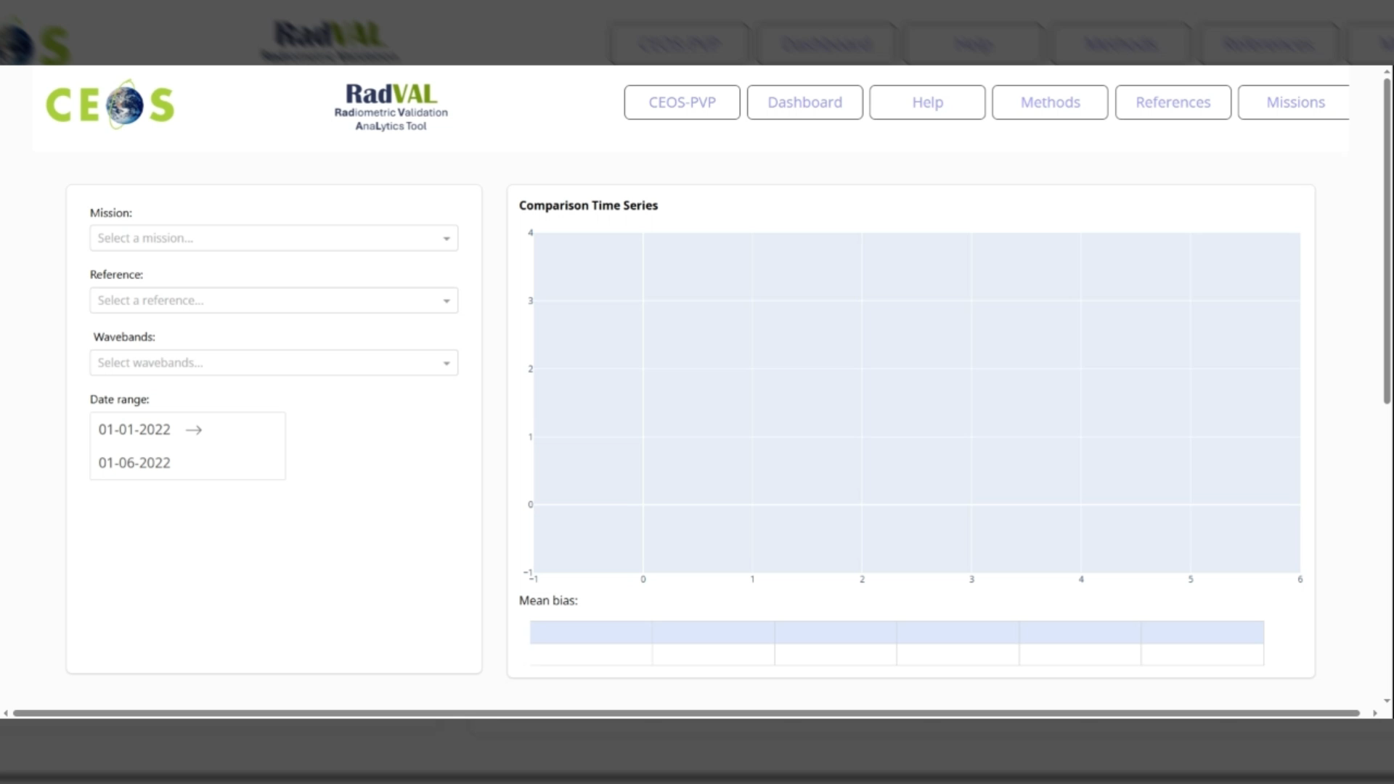
RadVAL tool demo

Slide 46
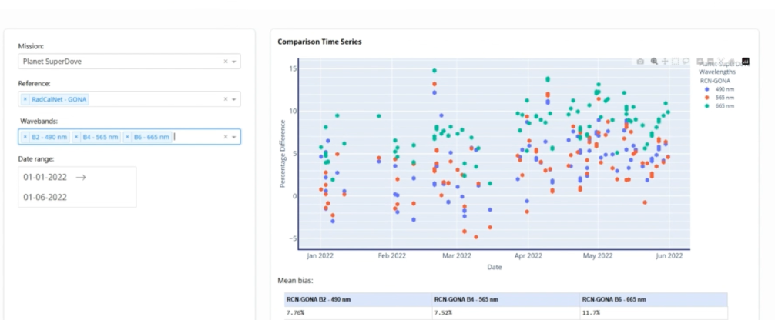
Planet superDove screen shot

Slide 47
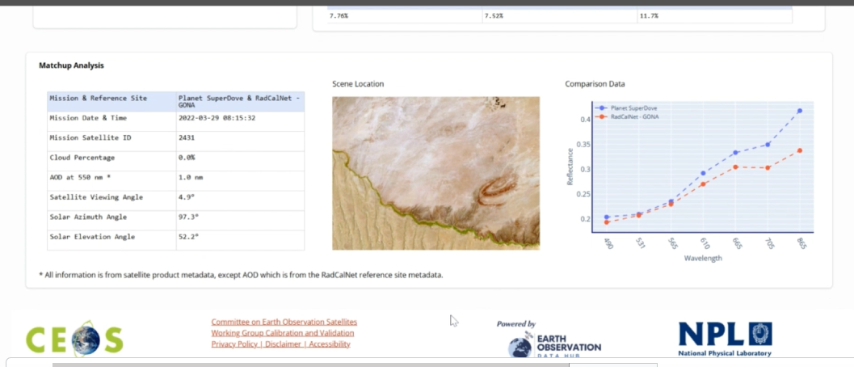
Screenshot summary page example

Slide 48
Next Steps
Interaction with commercial missions to encourage delivery of imagery over reference sites
  Release of submission form for missions to provide their data
RadVAL beta launch end of April 2025
  Launch CEOS Comparison Image Database (CID) on EODH
  Deployment of beta RadVAL Comparison Dashboard site
Refinement of the CEOS ‘virtual reference’ concept
Populate CEOS-PVP with agency and commercial satellite imagery data.

Slide 49
Overall Summary
WGCV and member agencies are actively engaging (particularly through JACIE and VH-RODA) in encouraging and facilitating Commercial Sat data providers data to be used in fair and equitable manner
  Providing means and processes to assess and evidence quality
    RadCalNet (and other test sites), Cal/Val Maturity Matrix, PVP (RadVAL, CID), FRM …
  Guidance as to what is needed and how to provide evidence
  Free resources and tools to help self-demonstration of capabilities
Maturity Matrix is an agile, readily assessable reporting mechanism (ARD?)
Commercial sector are ready to engage and comply with QA informational requests when it is clear the why?
  Need to be flexible on what must be public
  CEOS can be accepted as an authority but be more responsive
CEOS-ARD is a powerful valuable framework & WGCV continues to want to help!.

