Slide 1
Commercial Sector Uptake of CEOS-ARD
Agenda Item #8.2
LSI-VC-17
Tsukuba, Japan
14-16 April, 2025

Slide 2
Why does it matter?
Supporting the mainstreaming of satellite EO data in society
Expanding the user base
More and easier to use EO sources for all users - including major global development agendas (i.e. priorities of CEOS)
  Richness and diversity of data sources
Gap filling of CEOS agency datasets; redundancy of critical observations; resilience
Consistency with CEOS agency requirements
Likewise making CEOS agency data easier for industry to use
Supporting data procurement
Broad uptake and legitimacy of CEOS-ARD specs
Maintaining high standards for EO data
Enhancing quality and traceability of EO products and awareness of users to the importance of these factors
Foundation of broadly adopted future standards

Slide 3
So…
Who are we talking about?
What engagement have we seen so far and to what extent?
What are the issues with the current CEOS-ARD PFS and Framework that limit applicability and uptake by the commercial sector?
The role of military specs (e.g. SAR experience) and the potential complementary role of CEOS-ARD (i.e. providing another target / user community perspective)
Profit is the bottom line – building the business case and appeal of CEOS-ARD
Forward strategies for engagement – coordinated, coherent, multi-pronged approach
Prioritisation of engagement

Slide 4
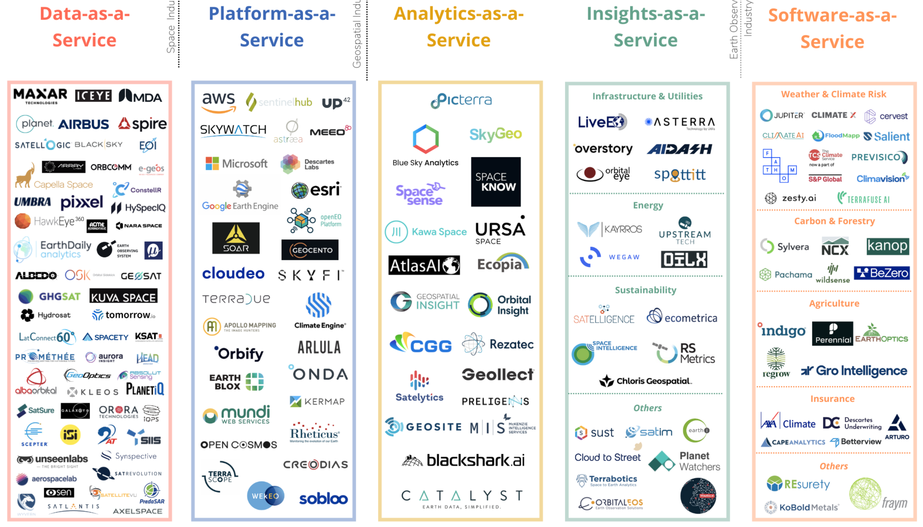

Slide 5
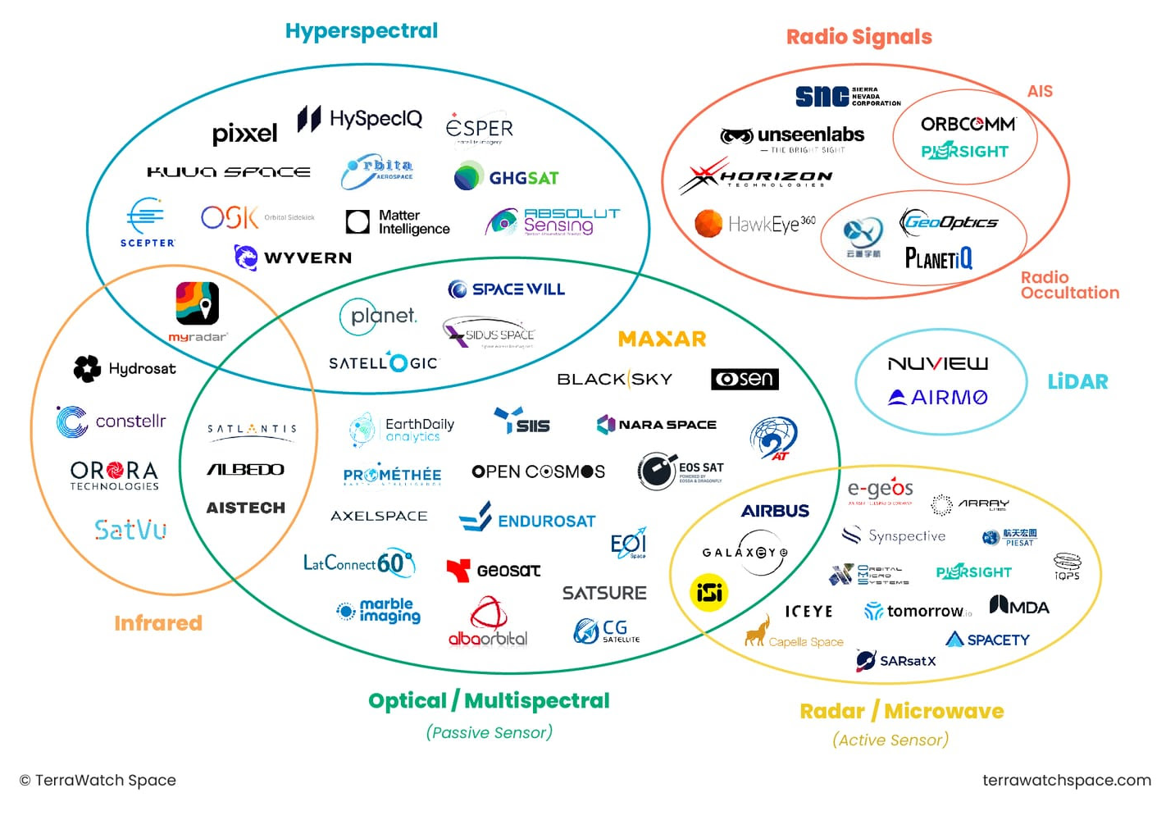
Primary Data Producers
Explosion in companies in recent years – now plateauing / consolidation phase?
Who are the main players?
The thought leaders?
The trend setters?
Who is likely to stick around?
Who do we know already?
Where to start
Prioritisation and criteria

Slide 6
Existing engagements
CEOS-ARD Commercial Contact Tracker
Primary data producers:
  AxelGlobe/AxelSpace, Capella, EarthDaily, Esper, ICEYE, iQPS, Planet, Satellogic, SatSure(?), SkyServe, Synspective, Umbra, Maxar

Slide 7
What are the issues with the current CEOS-ARD PFS and Framework that limit applicability and uptake by the commercial sector?
High resolution data
  incl. RTC SAR products and DEM availability
Optical mosaic products
  Planet ARPS feedback
Financial -> Need to make a strong business case for CEOS-ARD
  CSDA and EDAP are key value propositions – others? JAXA?
Standards?
Decision: Plans to resolve known issues hindering commercial sector uptake

Slide 8
Notes from SEO’s Preliminary SAR Assessment
Products delivered commonly reference Geospatial Intelligence (GEOINT) Standards
Compensated Phase History Data (CPHD)
Sensor Independent Complex Data (SICD)
Sensor Independent Derived Data (SIDD)
https://nsgreg.nga.mil/
Not openly stated what DEMs these providers use for their further processing
Copernicus 30m
Custom DEMs
…?
DEM resolution is the limiting factor for RTC product resolution?
Current suite of PFSs are unsuitable for VHR SAR data, so even commercial data providers keen to adopt CEOS-ARD cannot do so before we have produced "VHR-adapted" PFSs. (a next target for the SAR team this year)

Slide 9
Building the CEOS-ARD business case
$$$ is the bottom line
Building appeal
Incentivization
Getting users calling for CEOS-ARD
Making it easier to bring third party data onto their platforms
AI/ML and training data?
CEOS Agency data procurement (CSDA, EDAP)
Archive data buyout mechanism - giving old data value
  Can we also encourage strategic background observation plans ?
Pilots? Demonstrations? Demonstrating benefit of CEOS-ARD and interoperability
Action: Gathering commercial sector community feedback on the current state of CEOS-ARD, what they value in the current iteration of CEOS-ARD and what is needed in future evolutions
Discussion: other aspects to capture?
Decision: Communicating all of the benefits

Slide 10
Amplifying & coordinating our message
Private sector engagement is a big job and needs sustained representation
We need to leverage everyone’s networks to amplify our message
  Assembling a team of CEOS advocates / champions
  Consistent messaging - coordinated, coherent comms
Enabling partners and advocates
  Cloud-Native Geospatial Forum (CNG) / Radiant Earth
  OGC?
  ARD2x community
Team of commercial sector allies
Events: JACIE, VH-RODA, LPS, IAC, IGARSS,
  Note: plans for LPS, IGARSS and IAC consultation workshops

