Slide 1
CEOS-ARD Building Blocks
Matthias Mohr
for LSI-VC 17

Slide 2
Important Note
Building Blocks ≠ GitHub
The building blocks are independent of GitHub.
(We propose to combine them though.)
‘We could choose other platforms over Github.
We could
ditch GitHub and keep the building block approach
or
keep GitHub and ditch the building block approach
or
do both
or
…

Slide 3
Status (completed since LSI-VC 16)
Continue work on combined Optical PFS (Chris Barnes)
Check tech options for building block framework
  Programming language: Python
  Building blocks:
    YAML (StrictYAML)
    Markdown (Pandoc flavor)
  Document generation:
    Pandoc (Word, HTML)
    Chrome headless (PDF)
Implement application that validates and generates PFS documents
  https://github.com/ceos-org/ceos-ard-cli
  PDF and HTML (for reading)
  Word (for self-assessment)

Slide 4
Status (completed since LSI-VC 16)
Establish basic structure for building blocks
Textual identifiers
Basic documentation
Textual approach instead of tabular
Converted SAR PFS document(s)
(ready for Optical conversion, too)
  Initial attempt to

Slide 5
New functionality
Consistent and reusable building blocks (PFS requirements, other texts)
  Changes reflected in all relevant PFS within seconds
New identifiers (technical necessity, draft version)
  Textual, unique identifiers (format to be discussed)
  Numeric identifiers are not unique, only usable as chapter numbers per PFS!
Glossary items and citations
  Can be grouped (as proposed by AR)
  Only added to document when in use
Citations BibTex-based
(Partial) Validation

Slide 6
New functionality
New HTML version (short)
  great for search engines, ease of access, …
PDF version (short)
Only Word version (long) contains self-assessment parts
Page headers
(Clickable) references in text (citations, chapters, requirements)

Slide 7
Structure / Building Blocks
assets -> images and other media content
glossary -> abbreviations and definitions
pfs -> PFS details (title, authors, requirement mapping, etc.)
references -> citation information (BibTex)
requirements -> individual requirements (e.g. Traceability is one req.)
  grouped into metadata, per-pixel, corrections, measurements
  this should probably be categorized differently (see agenda item 3.1)
sections -> editorial content
  annexes -> individual annexes
  introduction -> general introductory texts (what is ceos-ard, etc)
  requirement-categories -> headers for requirements (e.g. General Metadata)
templates and .github -> technical internals

Slide 8
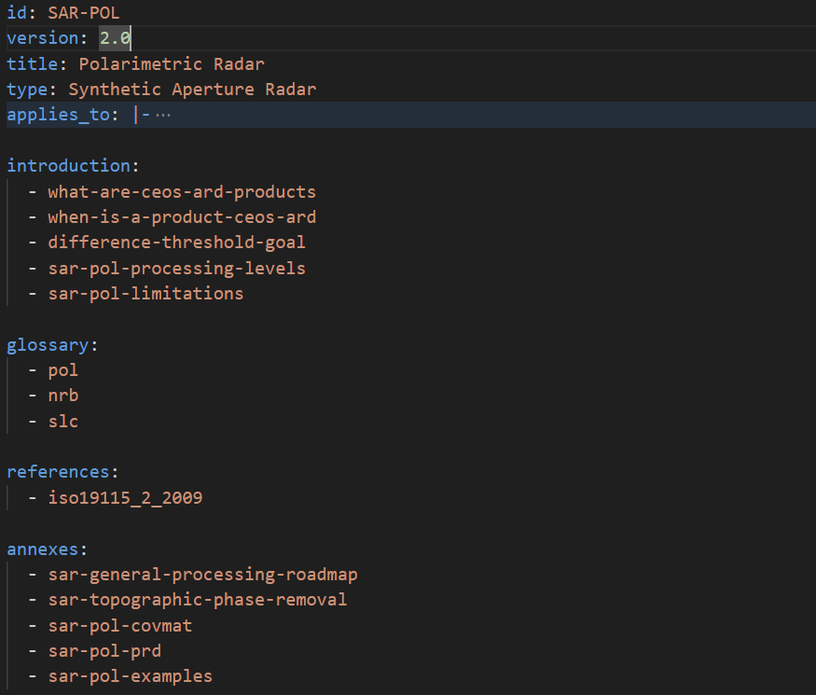
PFS
Details

Slide 9
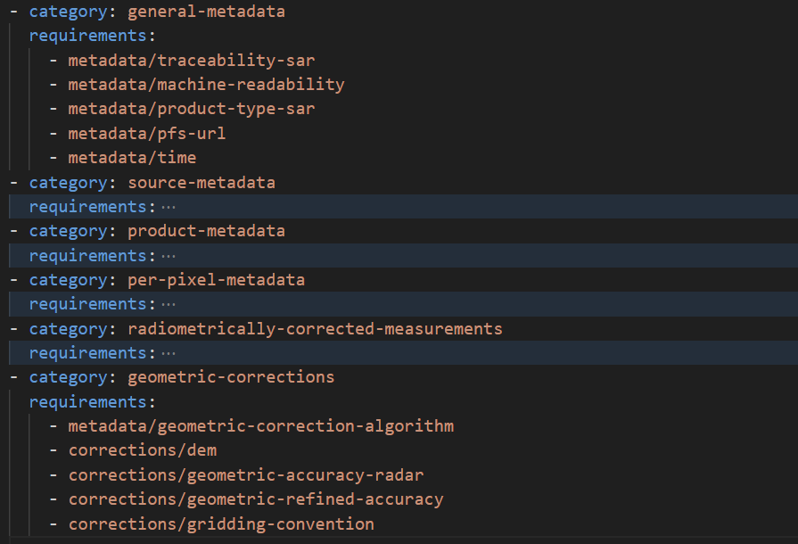
PFS
Req.
mapping
collapsed for readability

Slide 10
PFS
Req.
mapping
requirements/metadata/time.yaml

Slide 11
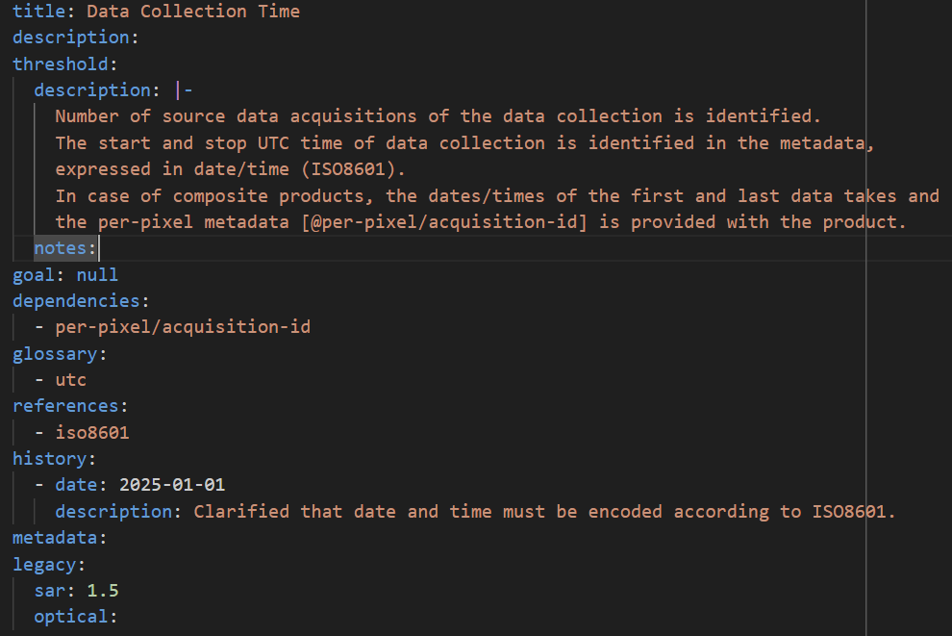
Require-
ments

Slide 12
Require-
ments
Title / Section heading

Slide 13
Require-
ments
Sets context

Slide 14
Require-
ments
Threshold requirements and notes
Goal requirements and notes
=> Will likely be split soon

Slide 15
Require-
ments
Reference to other requirement
Requirement depends on…
(warns if missing)

Slide 16
Require-
ments
Relevant glossary items

Slide 17
Require-
ments
Citations to add to reference section

Slide 18
Require-
ments
Idea: Justifications for changes
(or use GitHub?)

Slide 19
Require-
ments
Idea: Metadata mapping (XML, STAC, …)

Slide 20
Require-
ments
Requirement numbers in last release before building blocks

Slide 21
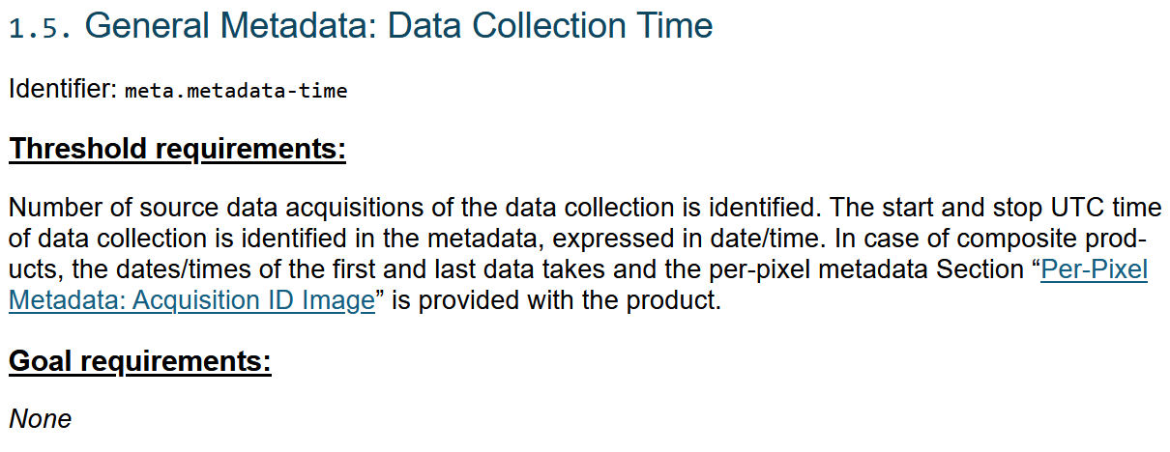
Requirements (draft HTML version)

Slide 22
Examples
SAR-POL:
HTML
PDF
Word (docx) => for self-assessment
More: https://github.com/ceos-org/ceos-ard#product-family-specifications
Note: Optical is largely incomplete!

Slide 23
Roadmap (planned for LSI-VC 18)
Document history and justifications for changes (see AR)
Convert InSAR PFS and Optical PFSes
Update SAR XML specification (identifiers only)
Better granularity of requirements (freely usable in threshold and goal)
Create web tool to look up requirement dependencies
Extend documentation
Training

Slide 24
Roadmap (planned for LSI-VC 18)
Maybe:
Metadata mapping (basic framework for XML and STAC)
Better categorization of requirements (see agenda item 3.1)
Integrate external glossary (see agenda item 3.1)
Create web tool to edit documents and preview changes quickly
Define release workflow
Notes:
Roadmap/work items: https://docs.google.com/document/d/13Jt-UKdag-WGVzniUjKtcfqqTVFCjQobAivuHBTUc14/edit?usp=sharing

Slide 25
Long-term vision
Optical and SAR share building blocks where feasible
  for consistency
  for same metadata language (XML and/or STAC)
  Focus:
    likely: general metadata (incl. source, product metadata)
      e.g. metadata machine-readability, traceability, acquisition time, instrument, …
    maybe: some per-pixel metadata
      e.g. no-data image
    less likely: corrections and measurements
Build a framework that can be standardized within OGC and/or ISO
  other standard organizations may create ARD specifications that are not in scope for CEOS (yet)

Slide 26
General observations / recommendations
Optical and SAR metadata requirements diverge significantly
  Problematic for a potential common metadata specification (see item x.x)
Terminology: Threshold and Goal (Target)
  RFC 2119: Requirement (“required”) and Recommendation (“[not] recommended” / “optional”)
Restructure needed?
  Requirements are mixed throughout the document.
  Metadata requirements in measurements category etc.
  Requirements in category descriptions (cloud-optimized formats)
  SAR separates source and product metadata, Optical does not

Slide 27
Q&A
Thanks to NASA SEO for funding this initiative
Thanks to Ake, Chris, Dave and Matt for initial feedback
(during weird work times)

