Slide 1
Notional WGCV-56/ LSI-VC-19 Meeting Format
Christopher Barnes, KBR/ USGS
Agenda Item 10.2
LSI-VC-18
Ispra, Italy
2-5 September 2025

Slide 2
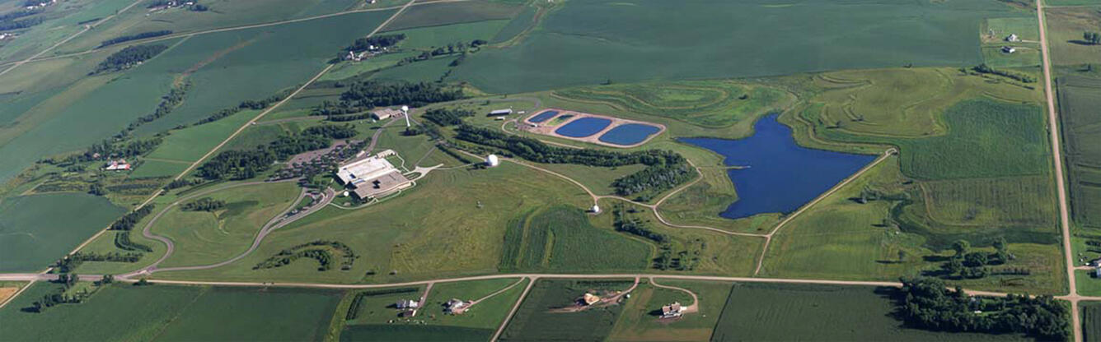
Location: USGS EROS Center
When: week of 20 April 2026!

Slide 3

Perception of South Dakota

Slide 4



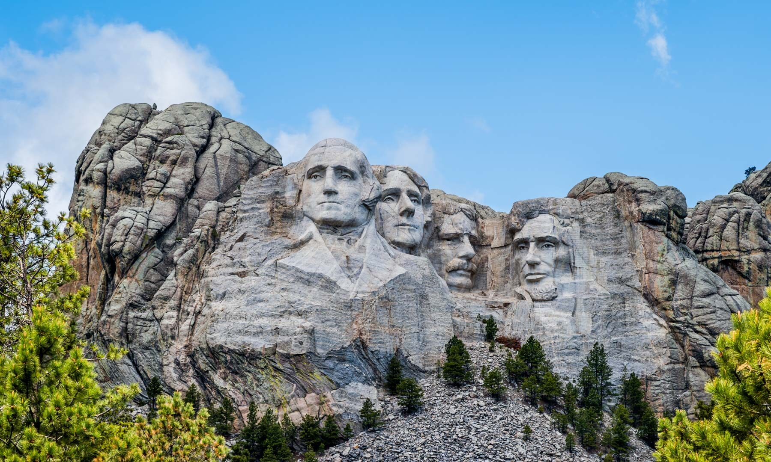
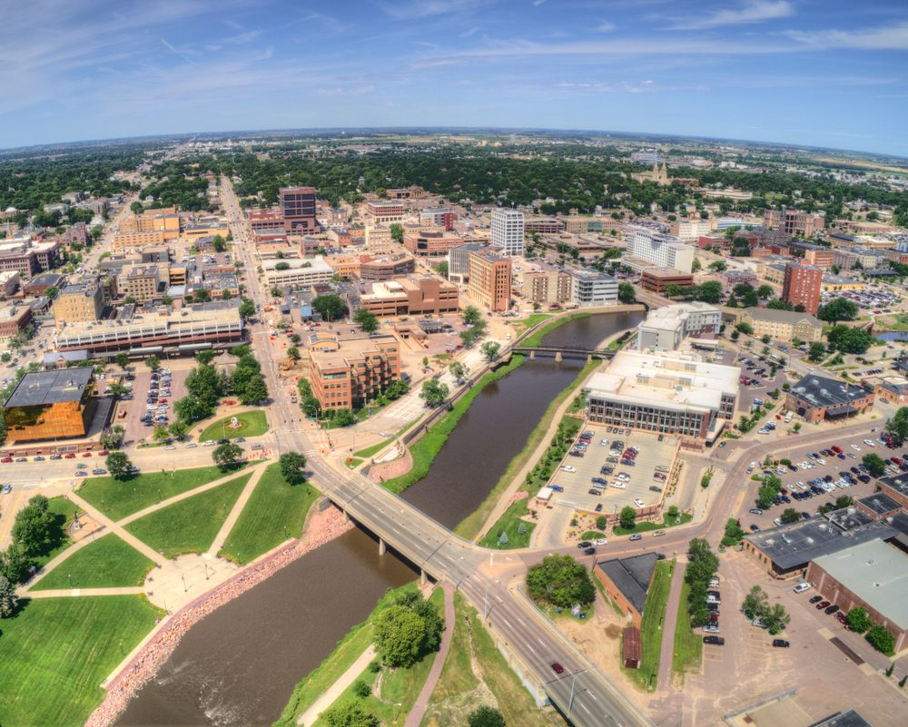

Just joking… actual South Dakota!

Slide 5
Notional Agenda
Delegates arrive: 19/20 April 2026
Day #1: Half day joint WGCV-56/ LSI-VC-18
Day #2 & #3: WGCV-56 and LSI-VC-18 individual focused days
Day #4: Joint WGCV-56/ LSI-VC-18 special topics
Day #5: CEOS-ARD Oversight Group
Agenda input is welcomed!

Slide 6
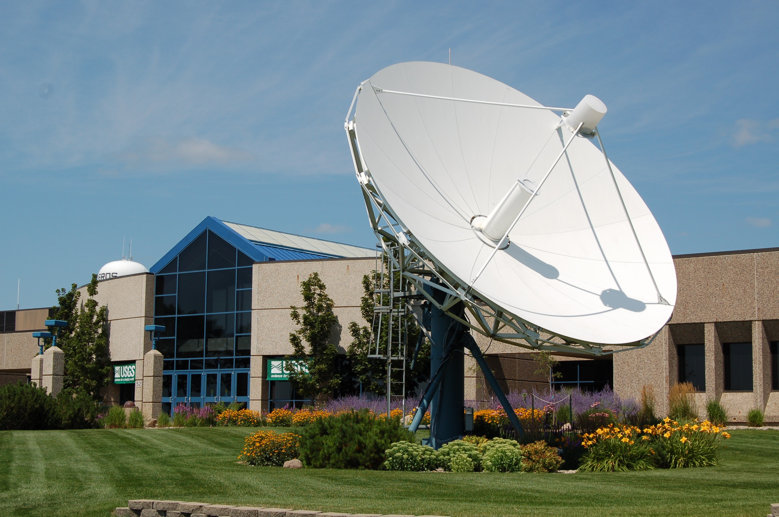
But in all seriousness…
… we look forward to giving CEOS delegates a warm welcome with fully pre-processed smiles, harmonized hospitality, and no cloud cover (or snow) in sight!

