Slide 1
LSI-VC-18
EO for Wetlands & the Ramsar Convention
Ake Rosenqvist, JAXA/soloEO
Agenda Item 2.2
Ispra, Italy, 2-5 Sept, 2025

Slide 2

The Ramsar Convention
The Ramsar Convention on Wetlands
Established 1971 in Ramsar, Iran
20 years before the UN Rio Conventions (UNFCCC, CBD, UNCCD)
172 Contracting Parties
Conference of the Parties (COP) every 3 years
Ramsar Convention Strategic Plan:
          Goal 1 - Addressing the drivers of wetland loss and degradation
          Goal 2 - Conservation and management of the Ramsar Site Network
          Goal 3 - Wise use* of all wetlands
          Goal 4 - Enhancing implementation of the Convention
          * Wise use: conservation and sustainable use of wetlands and all the services they provide, for the benefit of people and nature.

Slide 3
The Data Gap
Only a fraction of Contracting Parties fulfil their reporting req.
“Critical need” for improved wetland mapping and inventory.
Gap of adequate and up-to-date data on wetlands – both for Ramsar Sites and wetlands globally – major impediment to effective implementation of the Convention (Strategic Goal 4).
→ “Consultation with the Earth Observation community” and Earth Observation Day organised by SRTP in Dec 2024 to kick-start new activity on EO in the next triennium

Slide 4
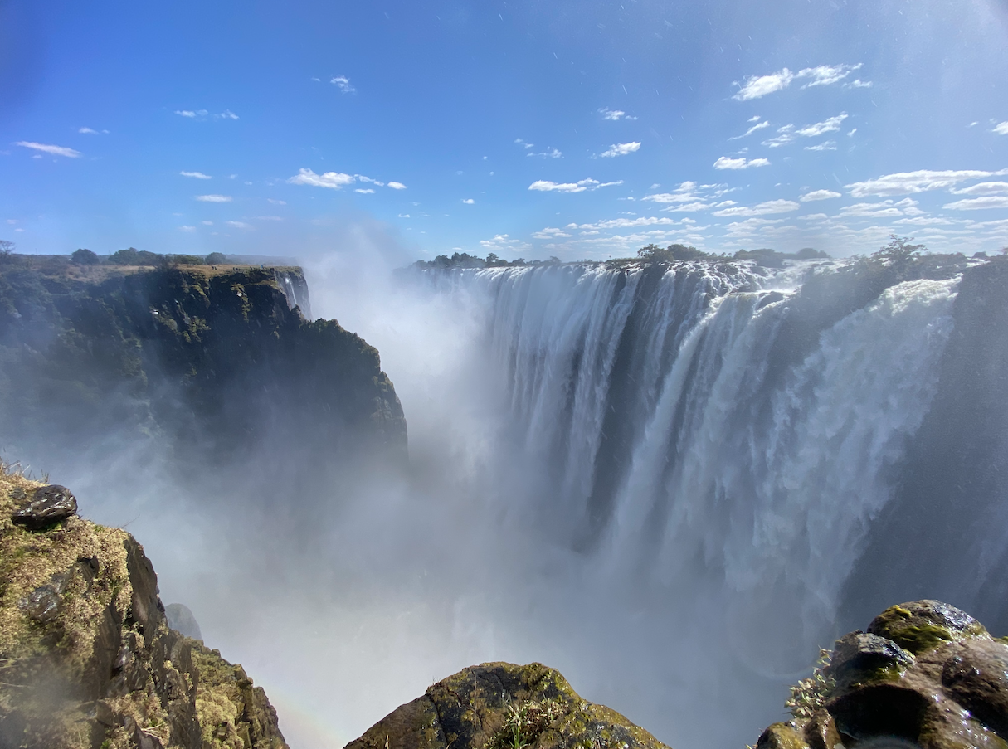

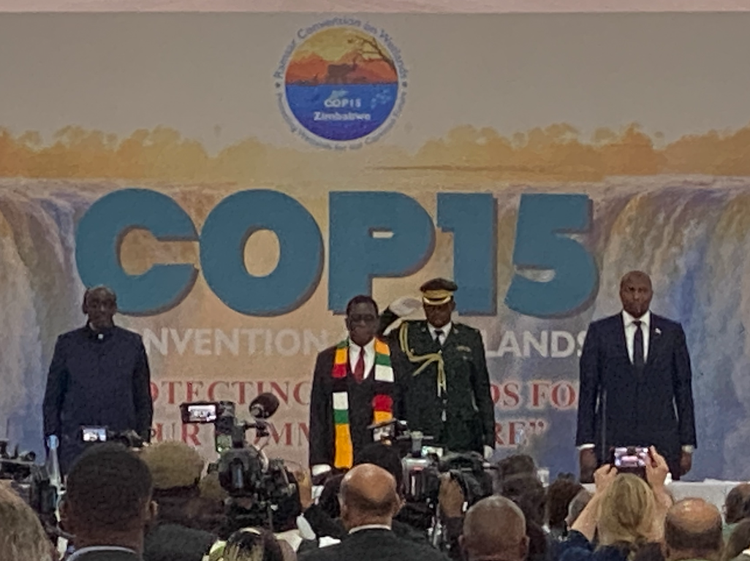

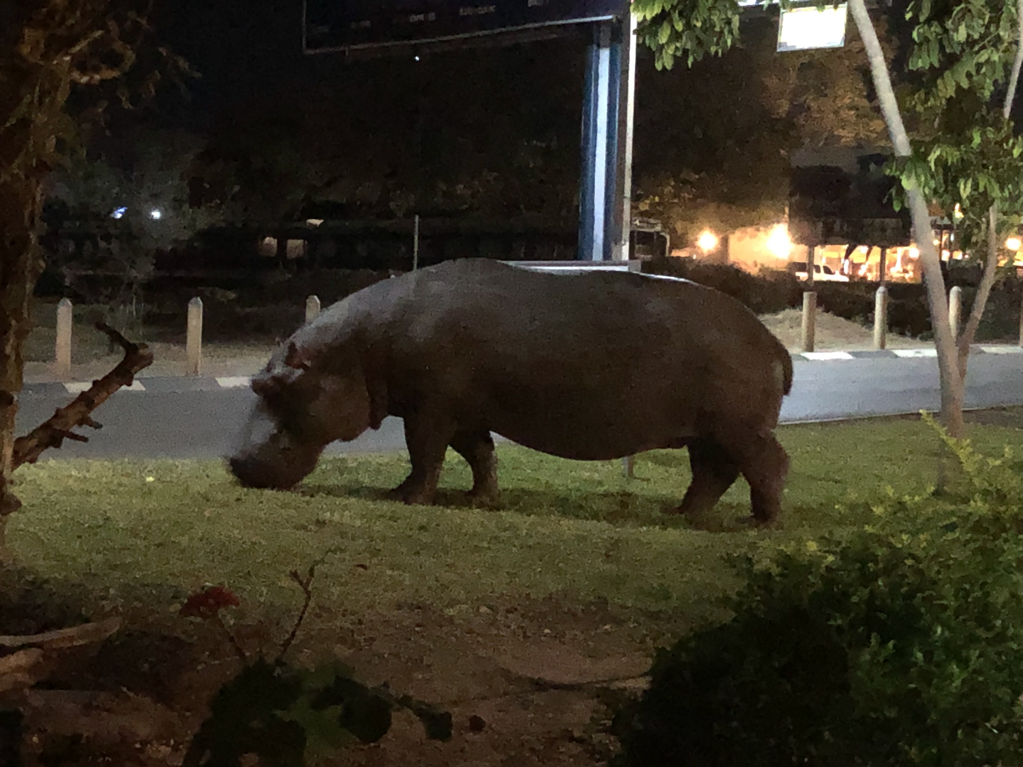
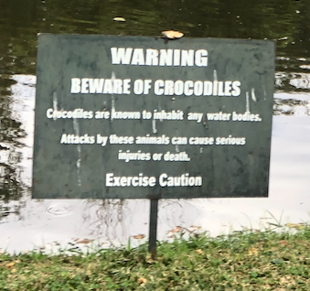
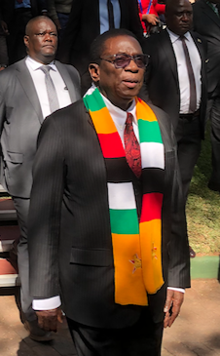
Ramsar COP15
Ramsar COP15
Victoria Falls, Zimbabwe July 24-31, 2025
Opening by Zimbabwe President Emmerson Mnangagwa

Slide 5
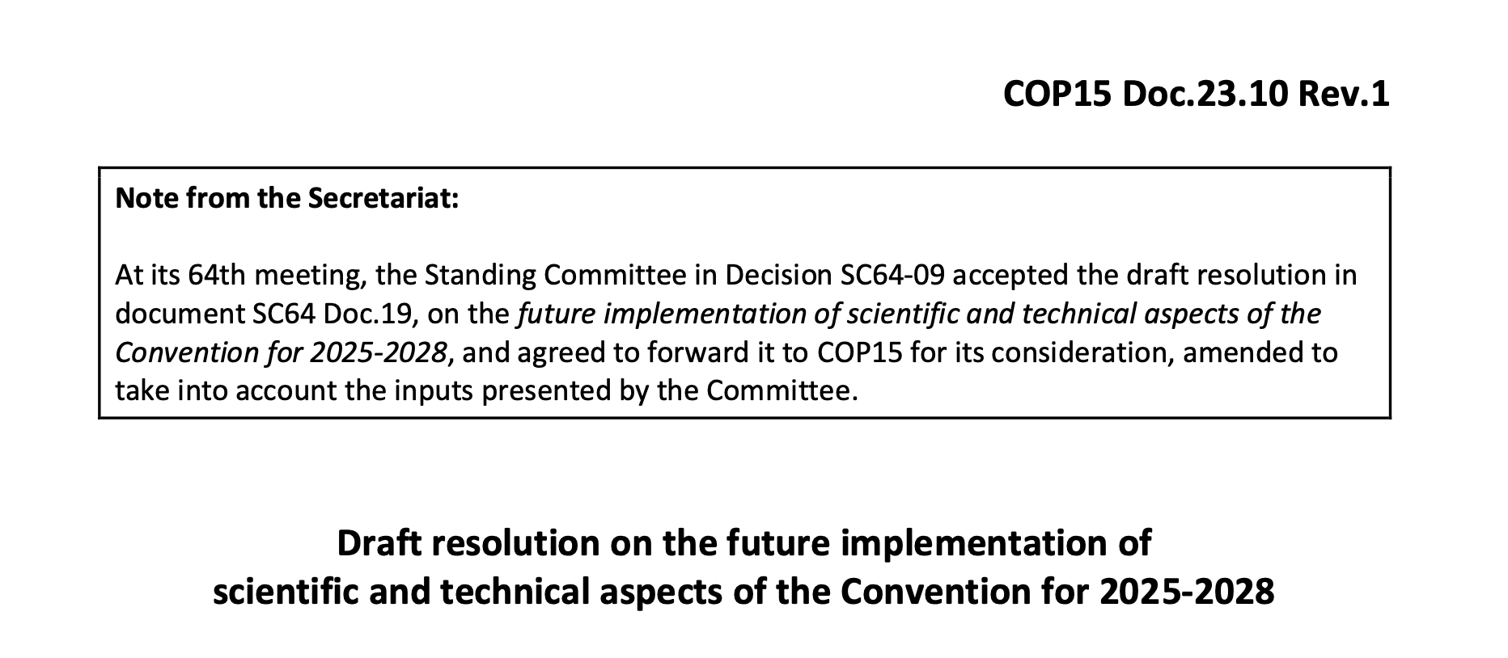
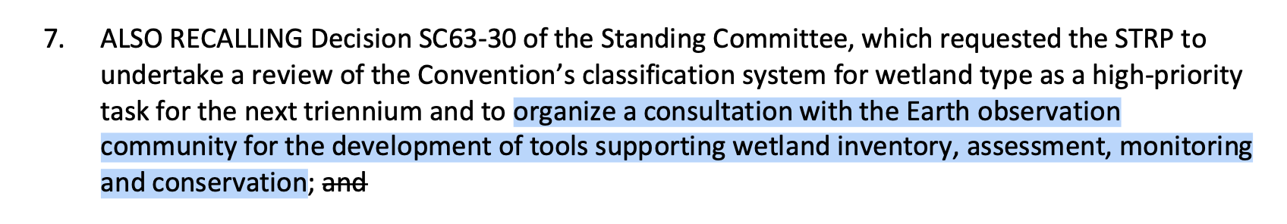
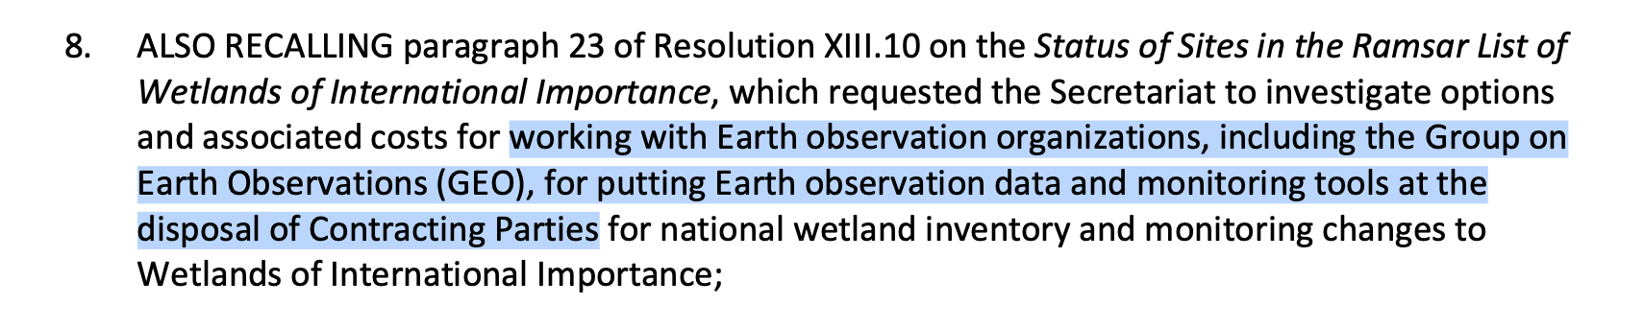
Resolution COP15 23.10

Slide 6
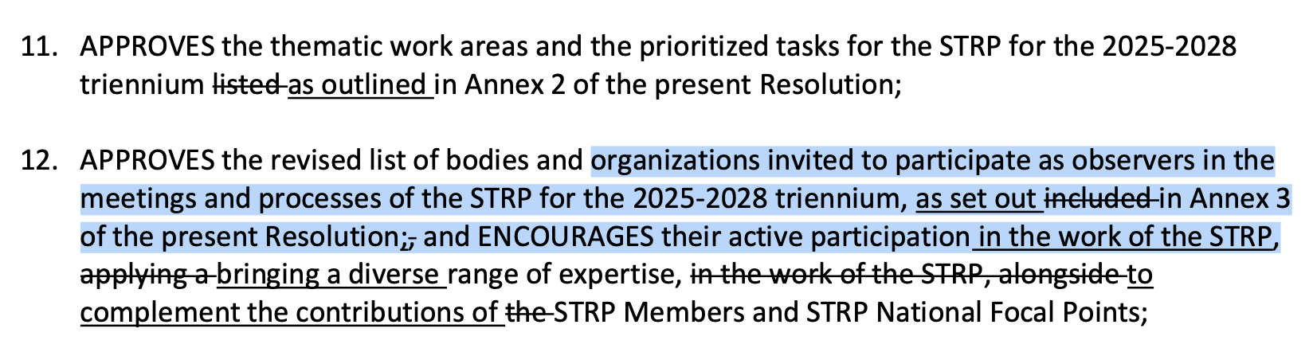
Resolution COP15 23.10

Slide 7
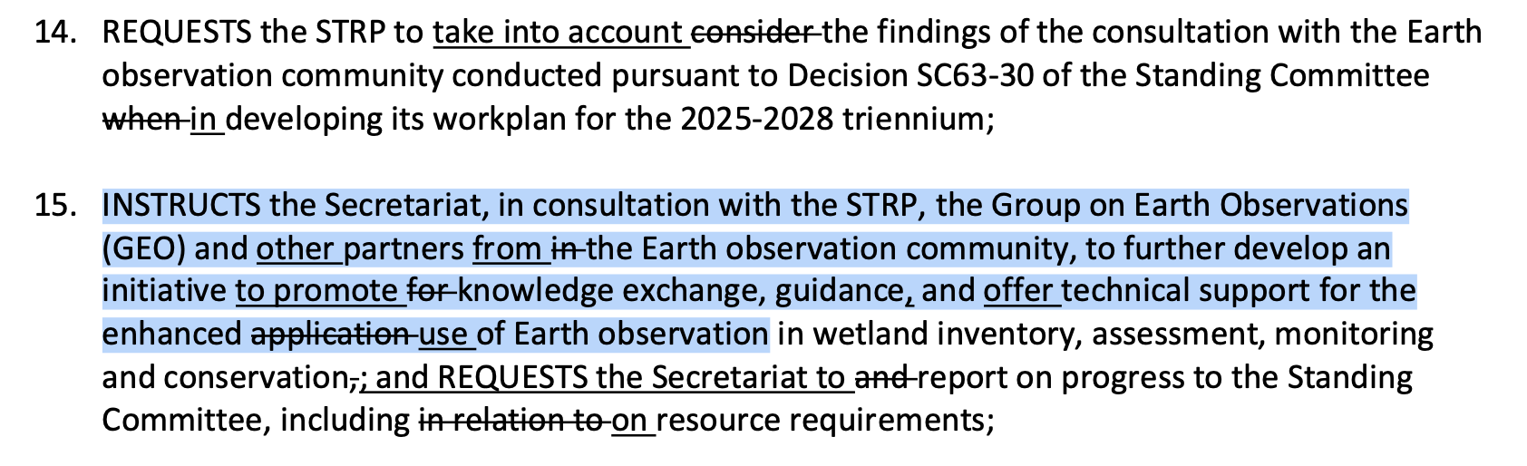
Resolution COP15 23.10

Slide 8

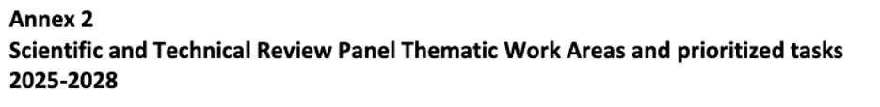
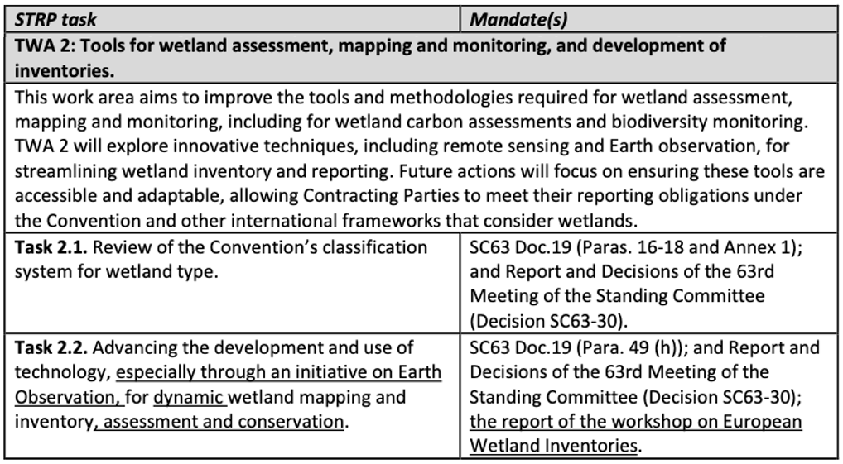
STRP work programme 2025-2028

Slide 9
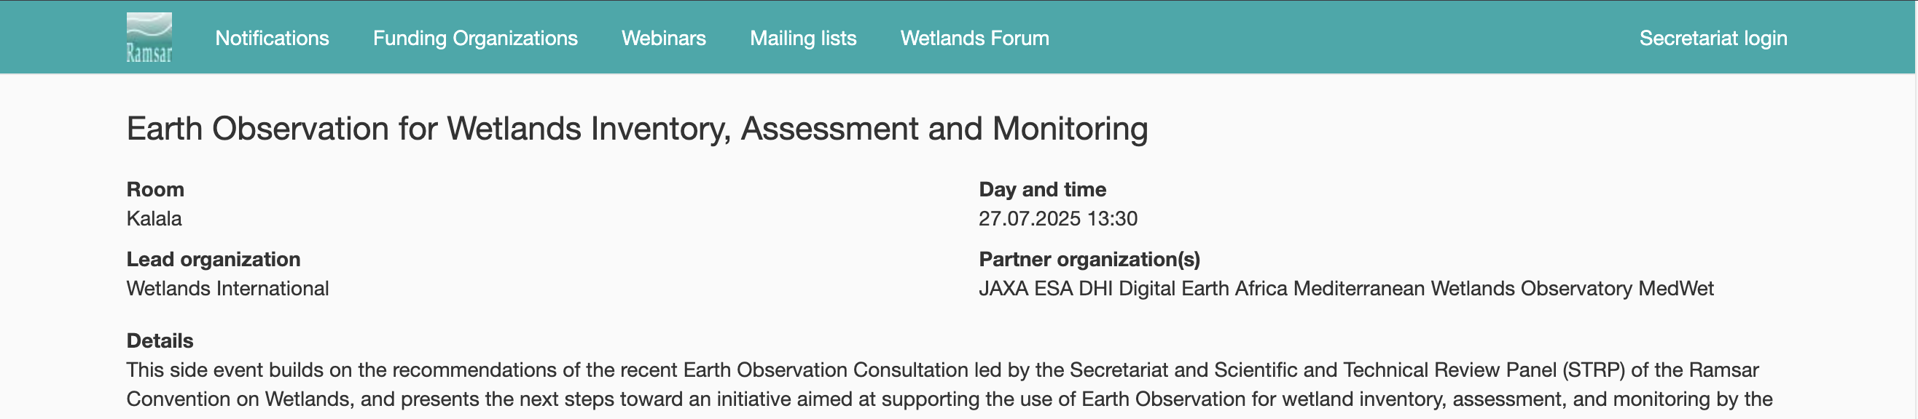
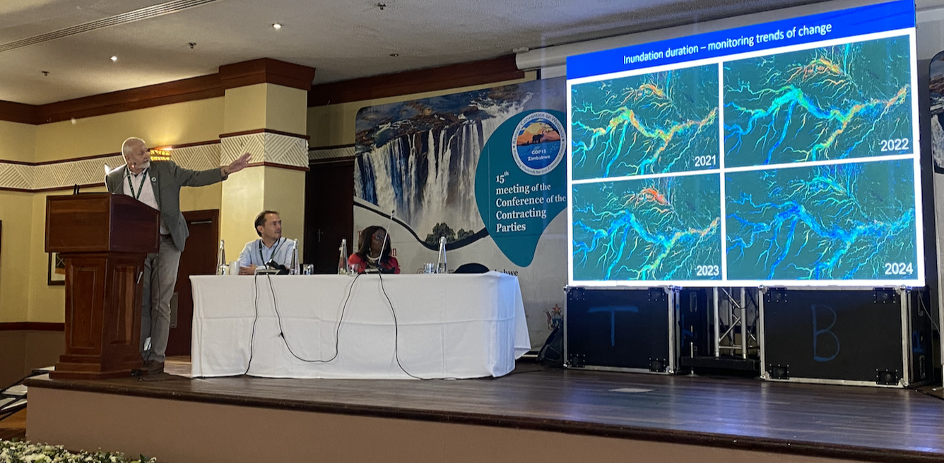
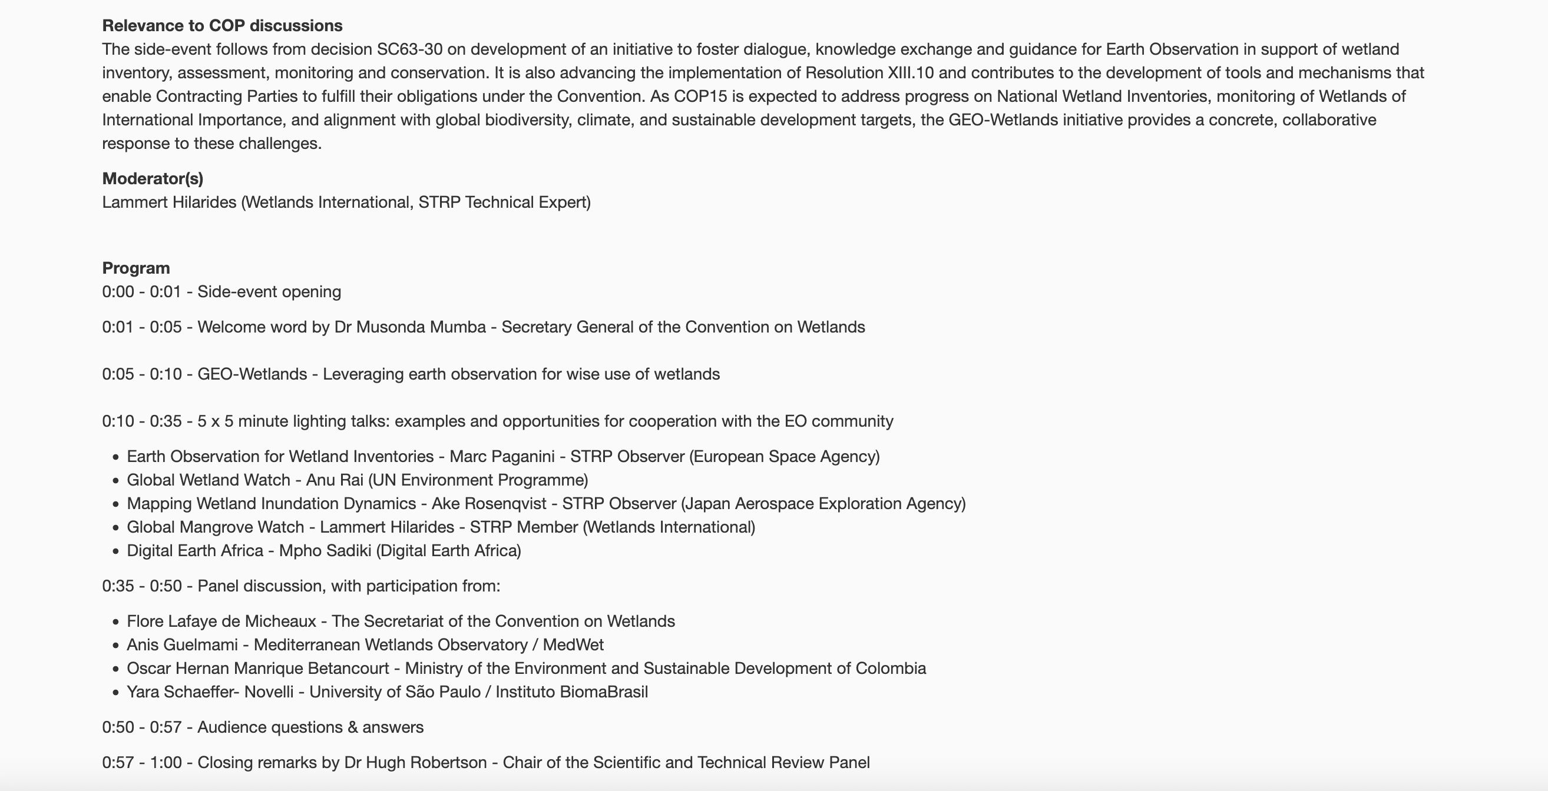
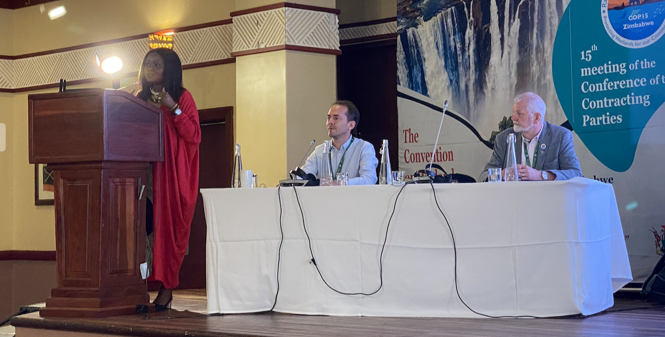
Ramsar COP15 – EO Side Event
ALOS-2 Forested Wetlands Mapping
Presentations:
Ramsar SG
GEO Wetlands
Wetlands Int’l
ESA
JAXA
UNEP
Digital Earth Africa
Keynote by Ramsar Secretary General Musonda Mumba

Slide 10
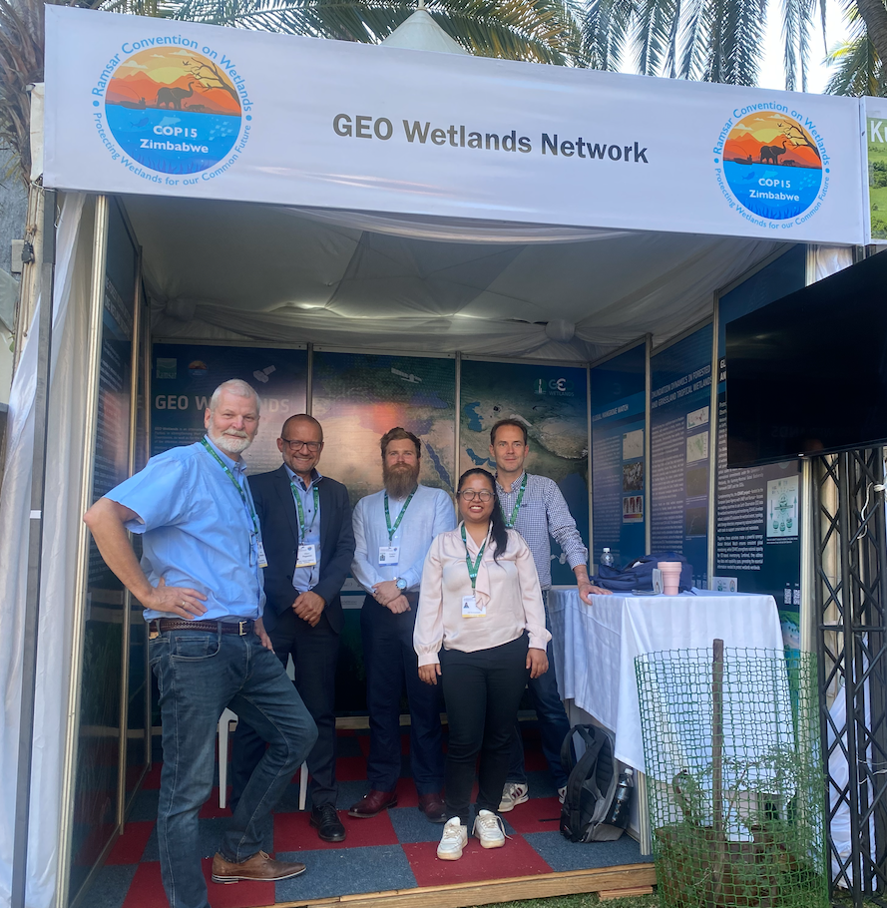
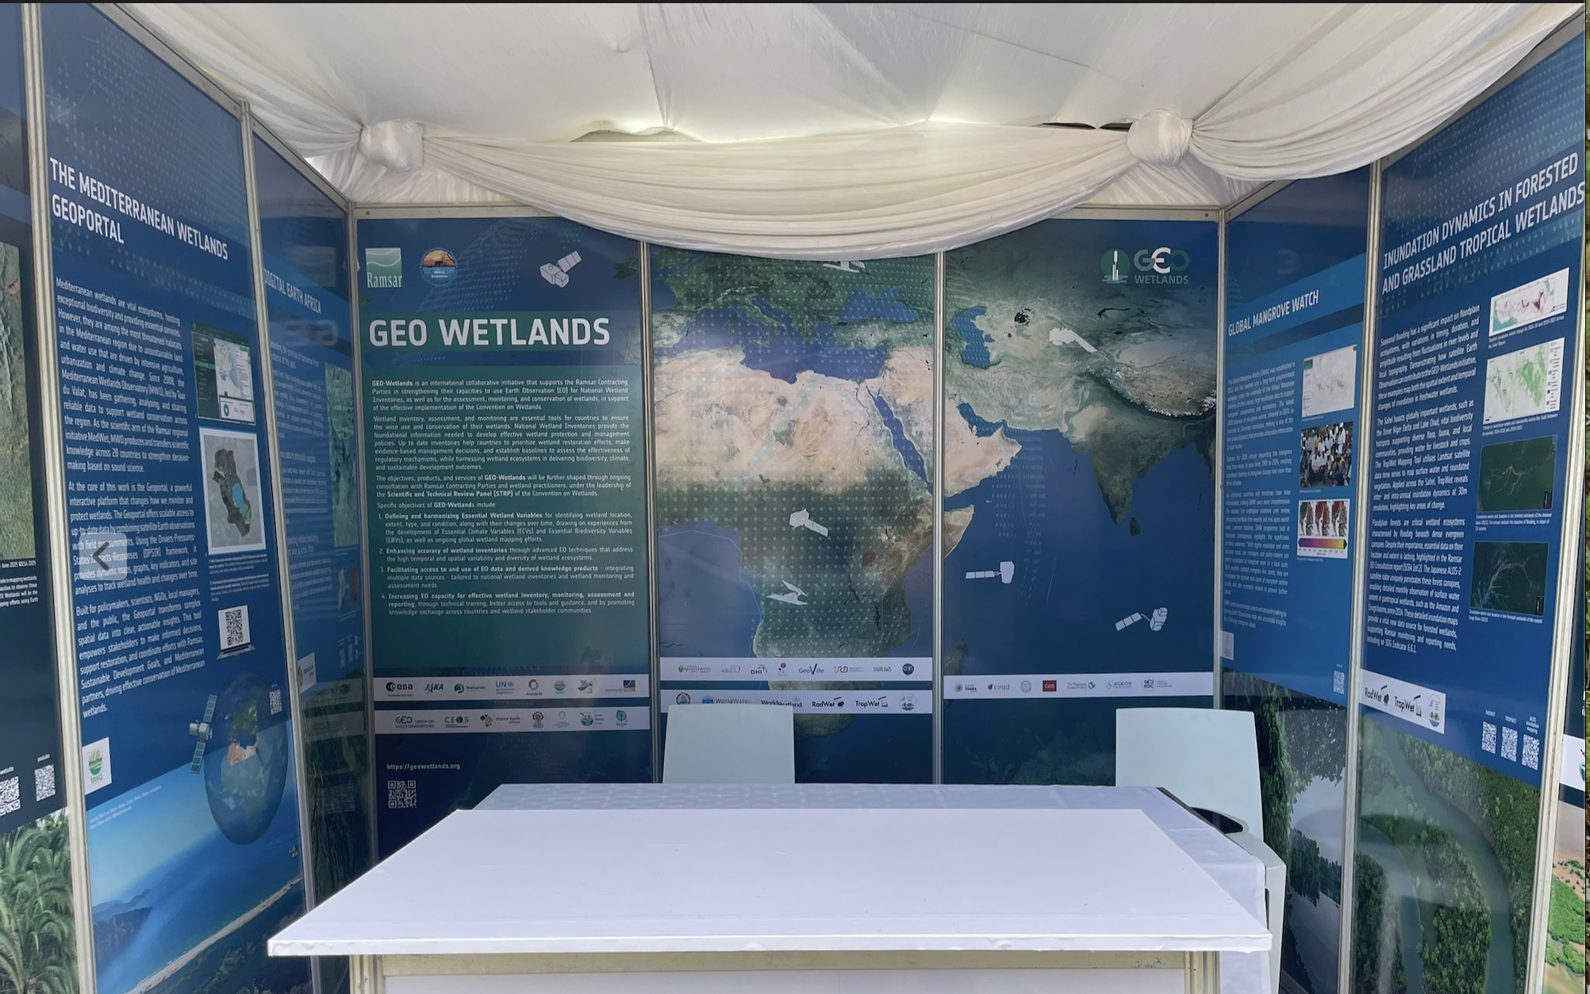

GEO-Wetlands Exhibition
JAXA
Digital Earth Africa
ESA
Aberystw Uni.
Wetlands Int’l
Exhibition booth by GEO-Wetlands partners to promote the initiative and inform about ongoing EO initiatives relevant to wetlands.
Global Mangrove Watch
ESA EO4WI
ALOS-2 Forested Mapping project
Digital Earth Africa
Mediterranian Wetlands Portal
UNEP Global Wetland Watch
One Wetland Initiative
UNEP

Slide 11
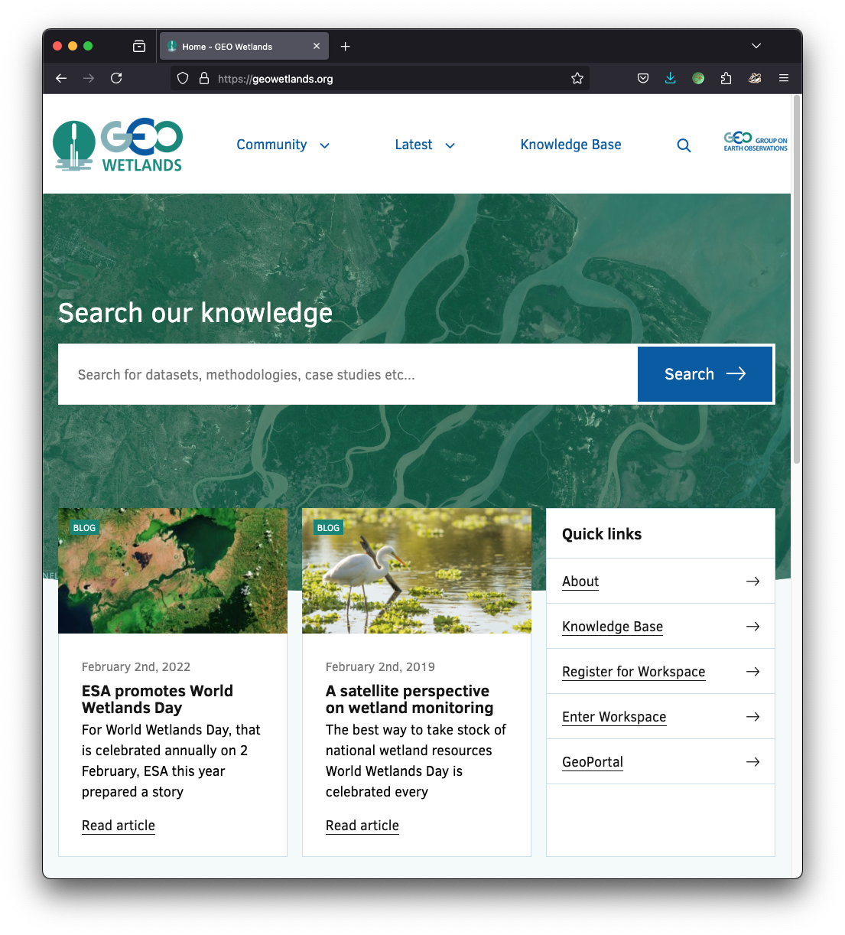
GEO Wetlands
GEO-Wetlands in the Post-2025 GEO Work Programme with direct involvement of the Ramsar Convention
Leads:
  Ramsar Secretariat/STRP and Wetlands International
  Supporting CEOS agencies: ESA, JAXA
Objectives:
  To advance approaches to effectively utilise EO to support wetland inventory, monitoring and assessment
  Identify Essential Wetland Variables (EWVs) that capture the state and spatial/temporal dynamics of wetland ecosystems.
  Capacity building for wetlands inventories, including the use of Earth observation tools.

Slide 12
GEO Wetlands
Essential Wetland Variables (EWVs):
  EO technologies play a crucial role in monitoring and managing wetlands by providing consistent, large-scale, and long-term data. To effectively utilize EO for wetland inventory, monitoring and assessment, it is essential to identify key variables that capture the state and dynamics of these ecosystems.
  Drawing on experiences from e.g. Essential Climate Variables and Essential Biodiversity Variables a well as ongoing work on wetland inventory, these EWVs can strengthen interoperability of data, enable the utilization of a variety of data sources in national wetland inventory, and strengthen its utility for monitoring and reporting at multiple scales.
  Example of foreseen EWVs: wetland MAX and MIN extent, wetland changes over time (conf. SDG 6.6.1)

Slide 13
GEO-Wetlands
GEO-Wetlands – Leveraging EO as a tool for wise use of wetlands:
[Use EO based techniques, data and products to] support National Wetland Inventory as a key tool towards effective implementation of the Convention on Wetlands, and harnessing wetlands in delivering biodiversity, climate and sustainable development outcomes.
Specific objectives to address:
Essential Wetland Variables (EWVs): Define core variables [measurable in EO data] for identifying wetland location, delineation/extent, type, and condition, and their changes over time…. drawing on experiences from e.g. the development of Essential Climate Variables and Essential Biodiversity Variables.
Enhancing data accuracy through advanced EO techniques and new technologies, to address the high temporal and spatial variability and diversity of wetland ecosystems.
Facilitating access to and use of EO data from a variety of sources and associated knowledge products customized to specific user requirements, with a focus on national wetland inventory.
Increasing capacity for effective wetland inventory and its application in monitoring and assessment, planning and reporting, through technical training, providing access to [EO] tools and guidance and promoting knowledge sharing.

Slide 14
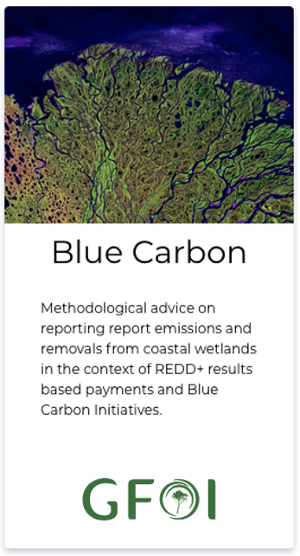
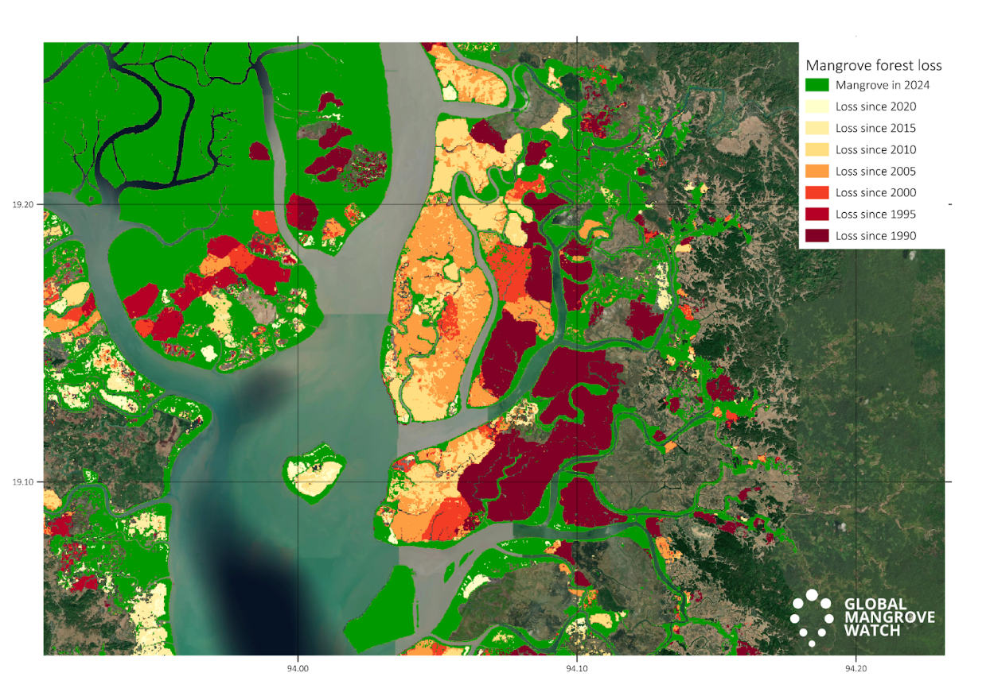
AFOLU Roadmap & GEO-Wetlands
        Action 5.3: Consider best practice for including Blue Carbon Ecosystems (BCEs) in national inventories. GFOI MGD: Blue Carbon Guidance
        Action 5.4: (a) Explore the development of new CEOS initiatives on wetlands mapping and monitoring. Global Mangrove Watch; ALOS-2 Forested Wetlands Inundation Mapping, GEO-Wetlands
        (b) Ensure that new CEOS missions consider wetlands amongst their mission goals. ALOS-4 – BOS & K&C Wetlands; ESA wetlands programmes; NISAR – Wetlands science objective
        Action 5.5: Establish closer collaboration with the Ramsar Convention and Ramsar Science and Technology Review Panel (STRP)
Blue Carbon Guidance for national reporting
https://www.reddcompass.org/mgd
Activity Data. Global Mangrove Watch map showing mangrove extent 2024 [green] annual losses [yellow/orange/red] and annual gains [blue] for 1990-2024
JAXA & ESA long-term STRP Observer Organisations
Earth Observation Side Event and GEO-Wetlands exhibition organised at Ramsar COP15
EO in the STRP Work Plan for the next triennium 2025-2028.

Slide 15
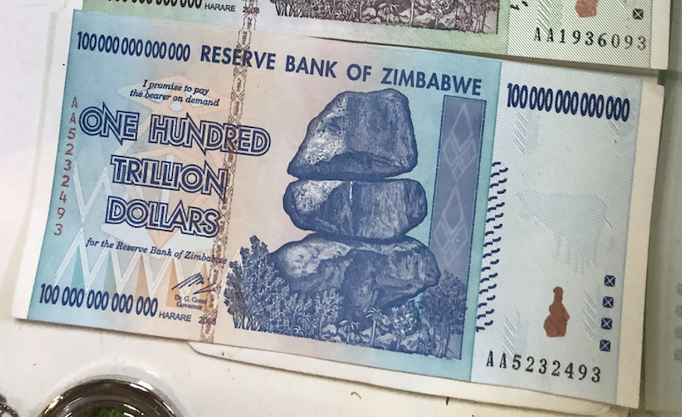
Thank you

