Slide 1
AFOLU Roadmap Status and Outlook
Takeo Tadono (JAXA)
Neha Hunka & Clement Albergel (ESA)
Agenda Item 2.2
SIT TW 2025
Darmstadt, Germany
9-11 September, 2025

Slide 2
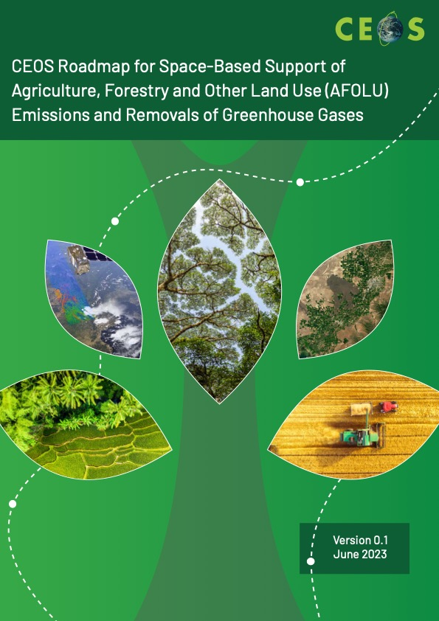
Purpose
Update for community on status
Way forward on key actions
Seeking engagement from relevant agencies
Ensuring continuity and progress

Slide 3
AFOLU Roadmap - Status
AFOLU Roadmap approved by CEOS Plenary Nov 2023
Draft actions presented at SIT 39 in April 2024 and finalised at SIT 40 in April 2025
Co-leads:
JAXA: Takeo Tadono
ESA: Neha Hunka
NASA: vacant

Slide 4
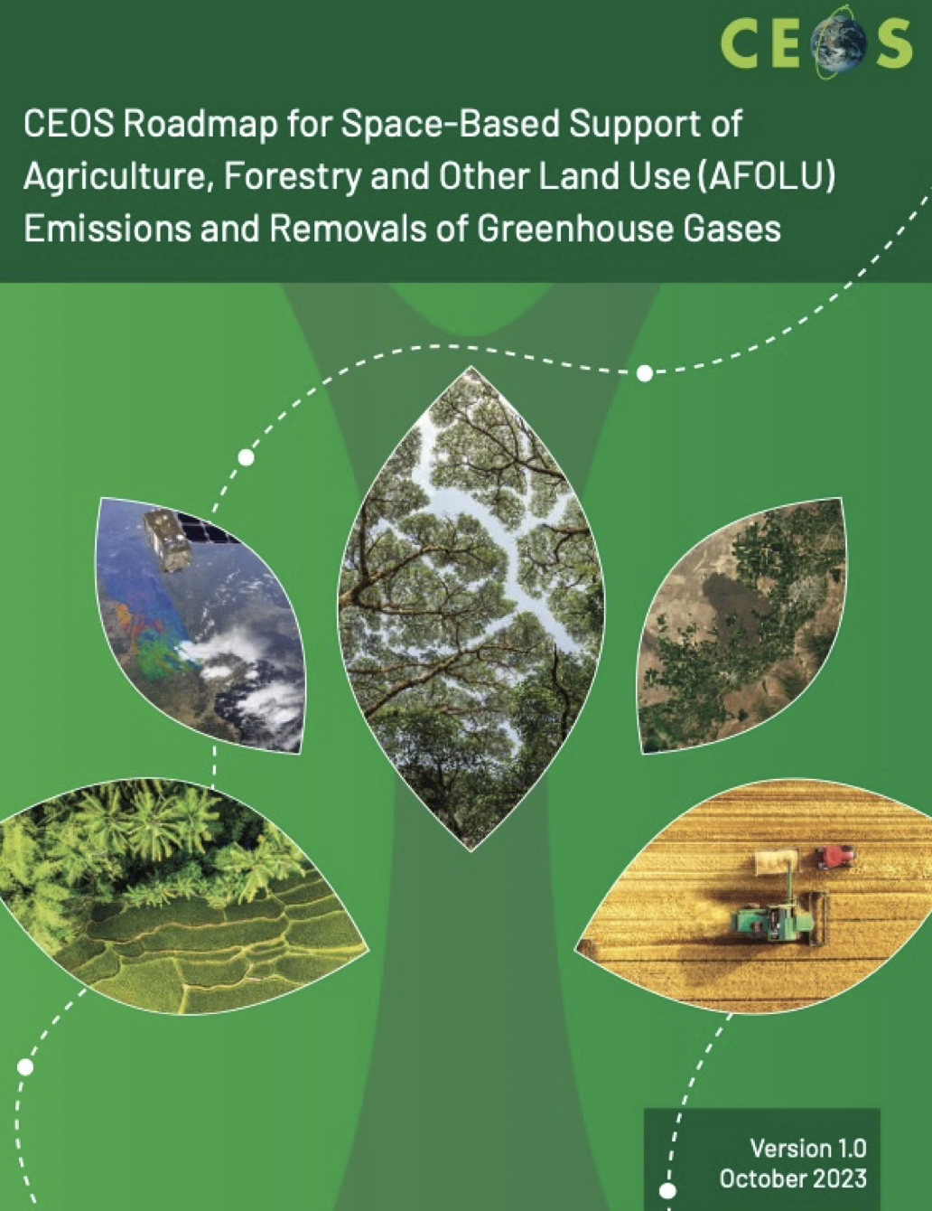
AFOLU Roadmap
A framework for long-term coordination of agency programmes in support of the needs of society for Agriculture, Forestry and Other Land Use (AFOLU)-related information, with a particular focus on the needs and ambition cycle of the Global Stocktake of the 2015 Paris Climate Agreement.
A guiding vision for long-term space agency coordination around AFOLU.
An effective means for communicating the intentions of CEOS
Address basic observation continuity and necessary agency coordination to achieve goals of sustained land-imaging of land-use and land cover change and biomass estimates

Slide 5
Recommendations
Recommendations from AFOLU Roadmap:
Universal access to satellite data needed for national reporting
Continuity and backward compatibility for missions providing activity data and emission factors
Improve data use in UNFCCC reporting and IPCC Guidelines
Enable dialogue between inventory practitioners and CEOS community
Reconcile bottom-up, top-down, and inventory estimates of GHG emissions and removals
Systematically target activities to support IPCC Land Cover classes
Work with New Space to provide comprehensive coverage for national GHG inventories
Consistency of AFOLU and GHG Roadmaps for integrated national GHG inventory system, GHG+.

Slide 6
Three Classes of actions
Actions across all Recommendations broadly fall into three categories:
Those pertaining to presently available data to support AFOLU procedures as in the 2006 IPCC Guidelines for National GHG Inventories vol.4, and their 2019 Refinement.
Actions to develop new or improved products that would allow more accurate and/or easier implementation of the Guidelines
Actions to facilitate greater interaction with the GHG Roadmap and hence improve characterisation of land management emissions through MVS based on satellite-based atmospheric inversions.
Notes:
- focus at this stage on two action classes above for technical reasons on MVS integration)

Slide 7
Governance
LSI-VC is the formal home for AFOLU in CEOS, within the Forests and Biomass team
LSI-VC is also home to our thematic work in ag (GEOGLAM) and forests (GFOI)
LSI-VC Leads recognise the need to ensure suitable ownership and tracking of these threads and arranging agenda time on their meetings and calls for at least virtual representation and reporting
Notes:
- focus at this stage on two action classes above for technical reasons on MVS integration)

Slide 8
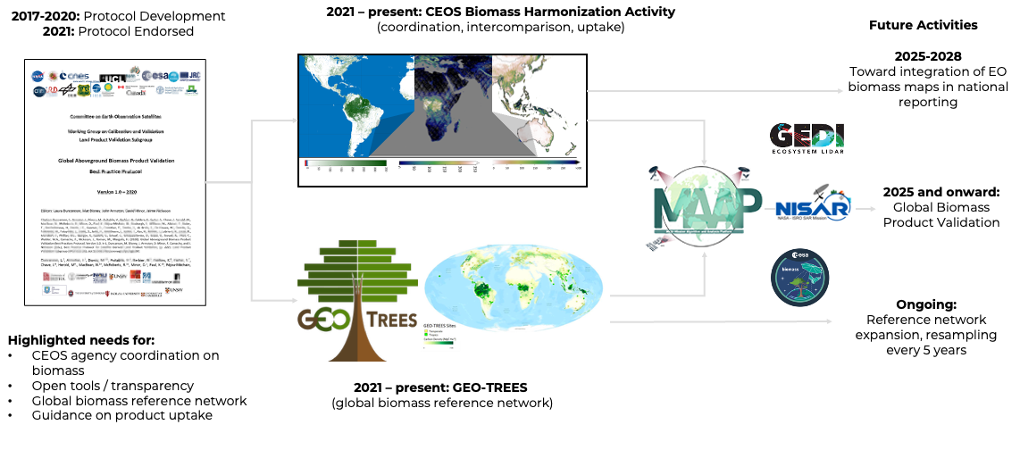



Action 0.3: Support biomass harmonization efforts
Notes:
The biomass harmonization activity is transitioning to a new phase (Phase 2) in recognition of the recent launches of the ESA BIOMASS and NISAR missions, and advances in reference data availability from GEOTREES. Phase 2 will rekindle communication between NASA, ISRO, ESA, and JAXA mission teams focused on intercomparison of new datasets from these new missions, as well as independent validation using available biomass reference maps from GEOTREES. Both ESA and NASA are supporting the development of a biomass validation tool via the MAAP platform to link new mission datasets to GEOTREES.

Slide 9
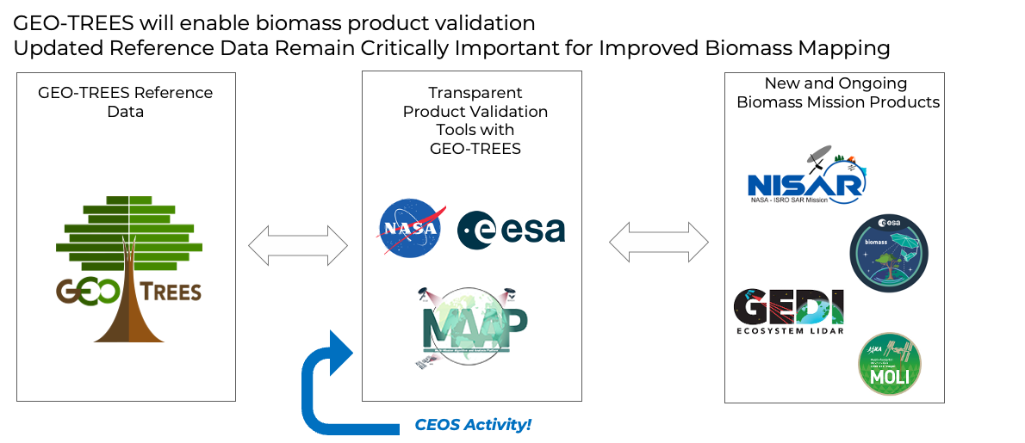
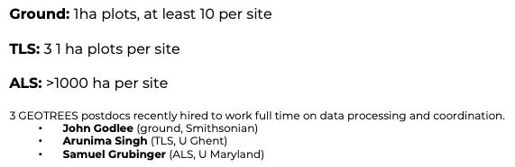
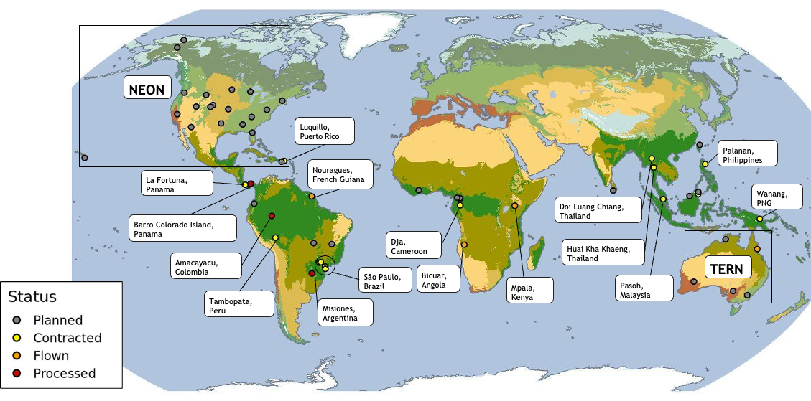
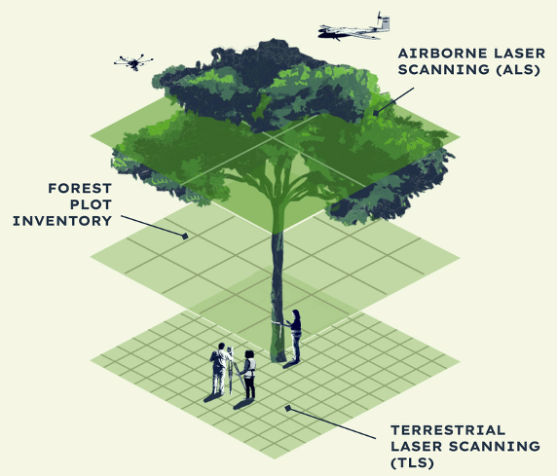
Action 2.5: Support GEO-TREES efforts
GEOTREES ALS Sites (Status August 2025)
Notes:
‘partner networks are being engaged to join, for example TERN in Australia is already a GEOTREES partner, and there are plans to collaborate with NEON in the US to expand beyond the tropics.’
ISRO being a key partner
We have right now 42 sites in the doing. Data should be available starting end of this year and throughout 2026.
Other points of interest for SIT:
Data from the first sites should become available in the next weeks. There is still some technical issues pending (agreeing on formats, versioning numbers etc) but nothing critical.
Complementing observation
All sites are covered with high priority by Tandem-X
All sites are covered by EnMAP though with low priority and cloud cover is an issue (usually we have ~10 acquisitions per site of which 80% are cloud covered). I agreed with them to select ~20 sites for which we will get higher priority to improve the coverage.
CSA RCM, and ALOS cover all sites but I have no visibility about the status.
Engagement of Agencies is still weak. So far ISRO, ESA, CNES and CSIRO (I assume they co-fund TERN activities) are the only ones providing funding for ground data collection. DLR, JAXA, CSA providing EO capacities. Maybe the expansion to the North can be a hook for other Agencies.
I believe we have a unique multi source EO data set. Agencies could support GT by supporting the analysis of this data. CEOS could coordinate these efforts?

Slide 10
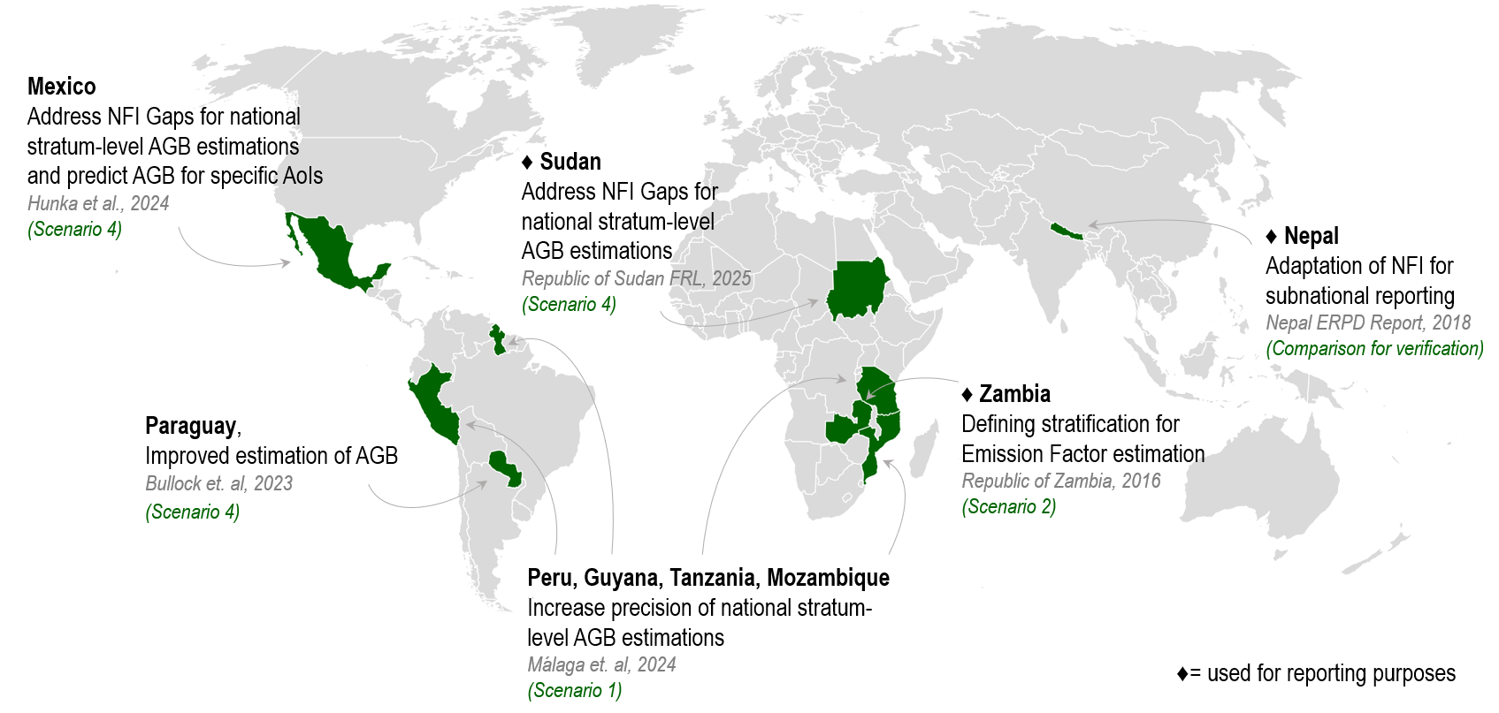
Action 2.6/2.8/3.1: GFOI R&D efforts on informed uptake of space-based biomass products
GFOI Plenary 2025
21–23 October 2025 in Bali, Indonesia, and online
Theme: ”Forests and the marvel of monitoring”
Information: https://www.fao.org/gfoi/plenaries/plenary-2025
Review of Biomass Rapid Response Module (to be launched at GFOI Plenary)
Possible applications of EO-based biomass data (in combination with existing ground data), and their current level of maturity
Key operational and research examples for the use of space-based forest biomass-related data as auxiliary information for reporting purposes
Notes:
Facilitates international efforts to bring EO data and research towards operational uptake by countries in the tropics
Identifying gaps and needs to advance research and data provision
Foster a scientific community knowledgeable of country uptake needs
Contribute to the GFOI process, organization of expert meetings, support in capacity building workshops, assessment of maturity of methods and datasets…
Involvement in international forums (UNFCCC, GCOS/TOPC, GEO-TREES, CEOS cal/val efforts, UN-SDGs…)
Advocate for the use of remote sensing coupled with in-situ observations
Global gathering for countries, donors, development partners and practitioners in the forest monitoring sector

Slide 11
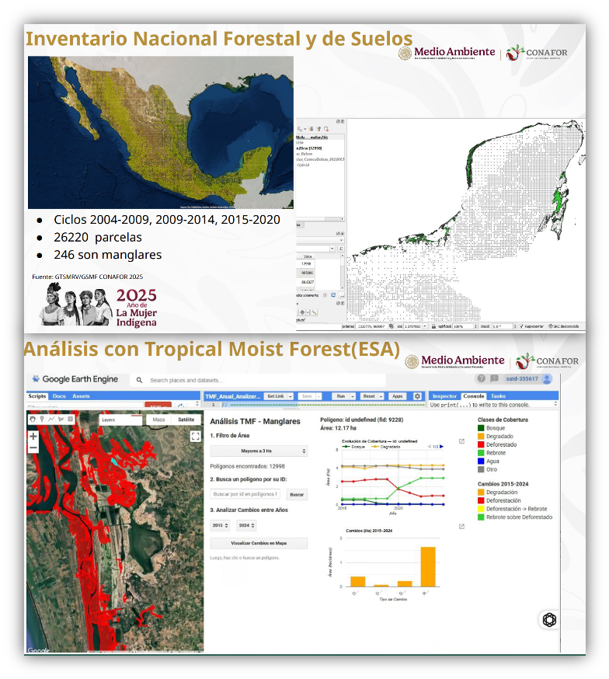
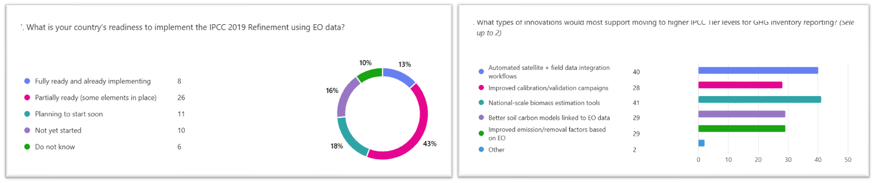
Action 2.8: Scaling from global to national inventory needs
GFOI R&D Broad Assessment of satellite data needs and integration into reporting systems
Survey deployed to 34 countries, and currently collecting results
Analysis and presentation at the GFOI summit in Bali
Results to inform R&D and Capacity Building efforts
Success stories using EO for AFOLU - Central American case study (Guatemala, Mexico, Belize) – ongoing and will be publish December 2025
EO supporting emission reductions and reporting CO₂ in mangroves ecosystems
Analysis with multiple datasets, including Tropical Moist Forest (ESA)
Two more case studies (Africa, and Asia) for 2026

Slide 12
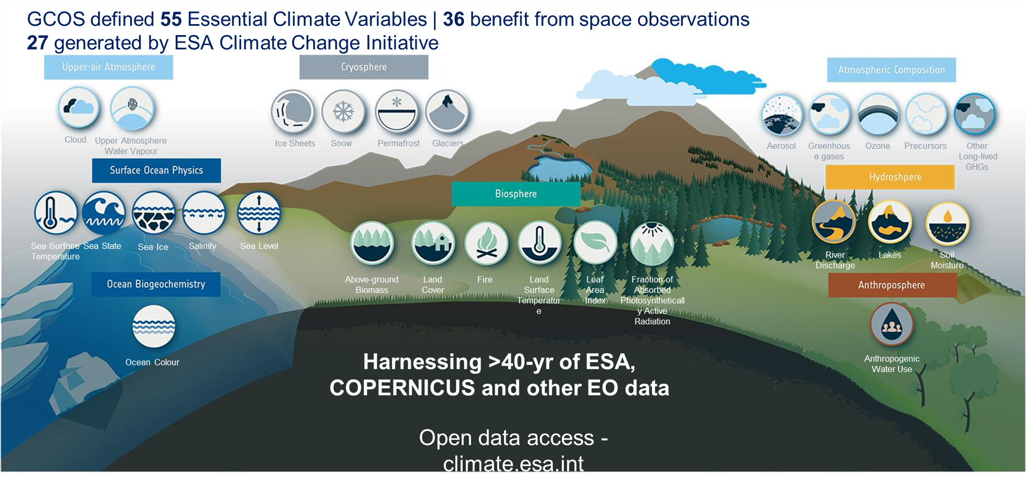
Action 2.9: Supporting GCOS for NRT and low latency variables
Notes:
4 new ECV projects:
Land evaporation
Ocean Surface Heat Flux, Phytoplankton biomass and diversity, Sea Ice Age and Drift

Slide 13
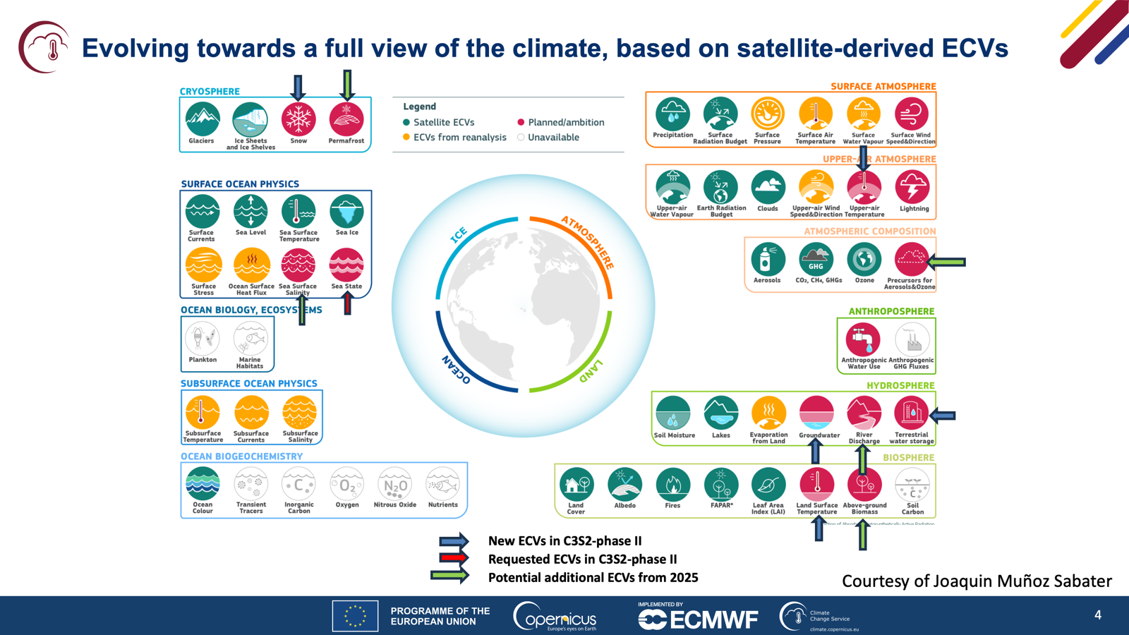
Action 2.9: Supporting GCOS for NRT and low latency variables

Slide 14
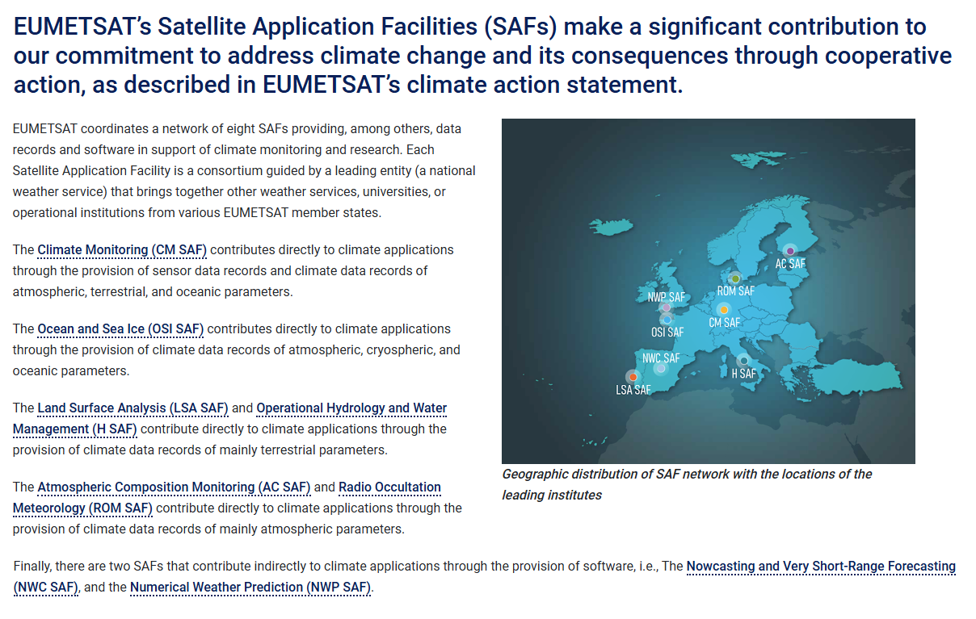
Action 2.9: Supporting GCOS for NRT and low latency variables

Slide 15
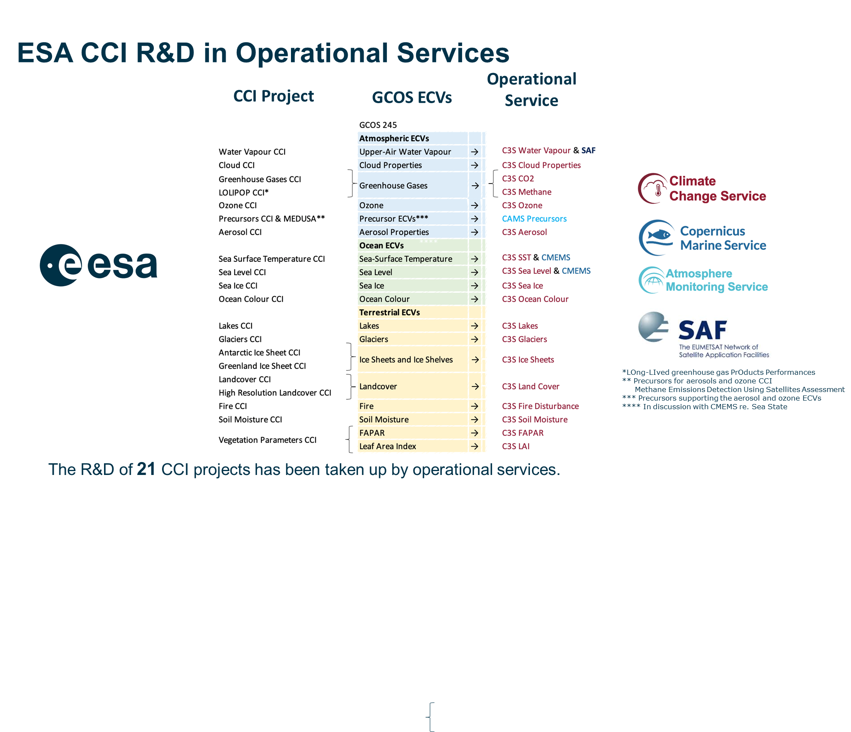
Action 2.9: Supporting GCOS for NRT and low latency variables

Slide 16
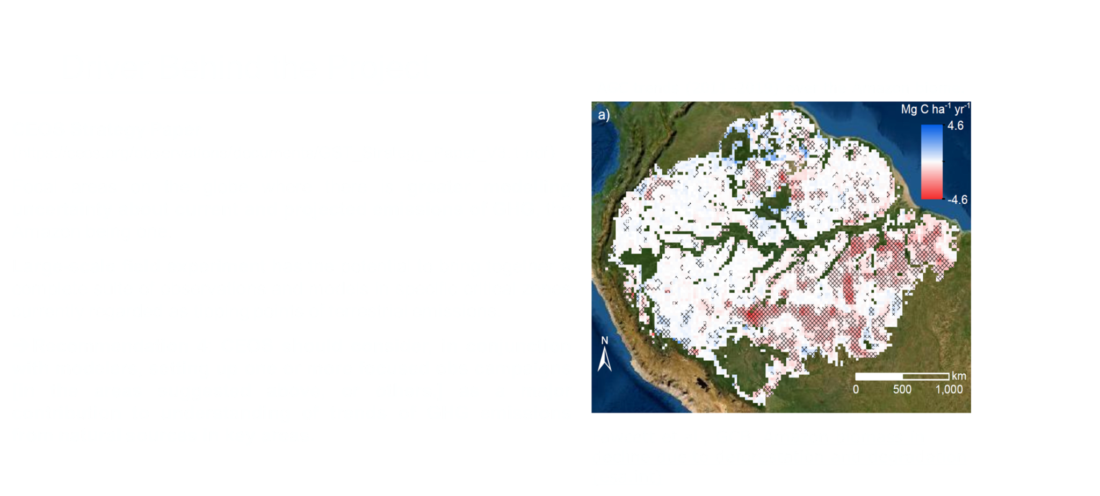
Action 3.2/6.1: ESA-INPE Campaign

Slide 17
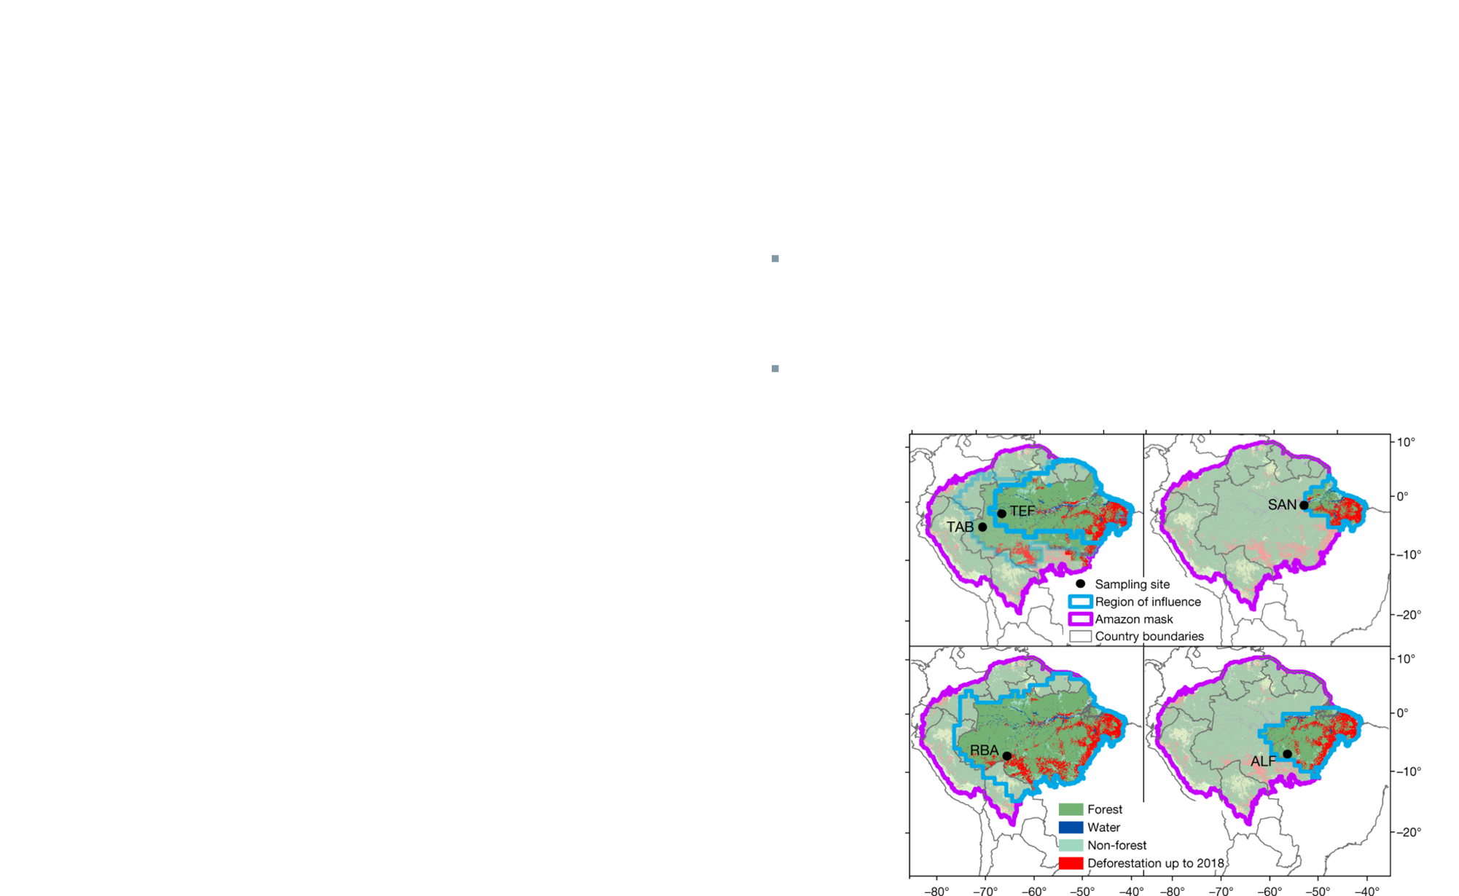
Action 3.2/6.1: ESA-INPE Campaign

Slide 18

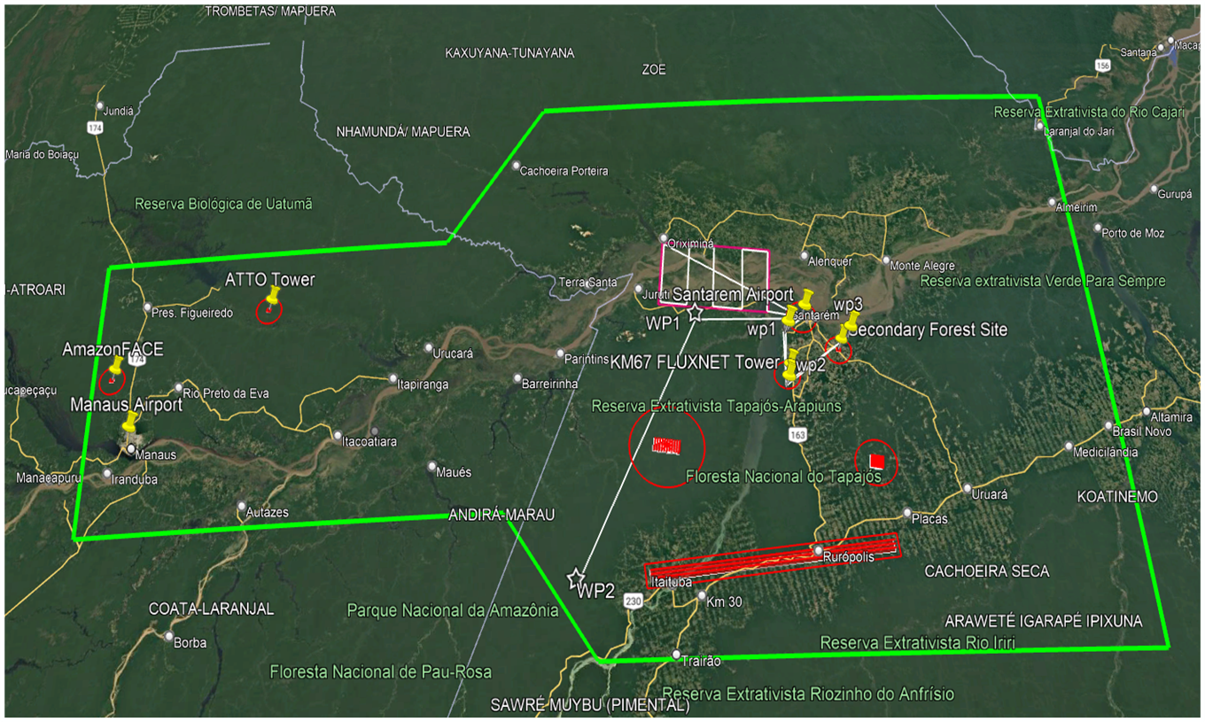
Action 3.2/6.1: ESA-INPE Campaign

Slide 19
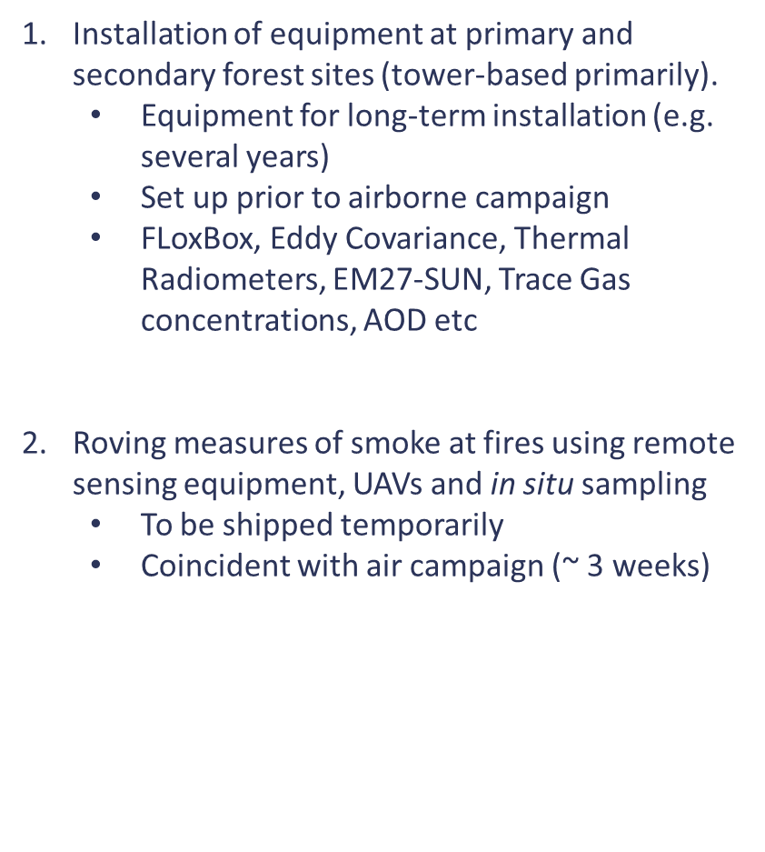
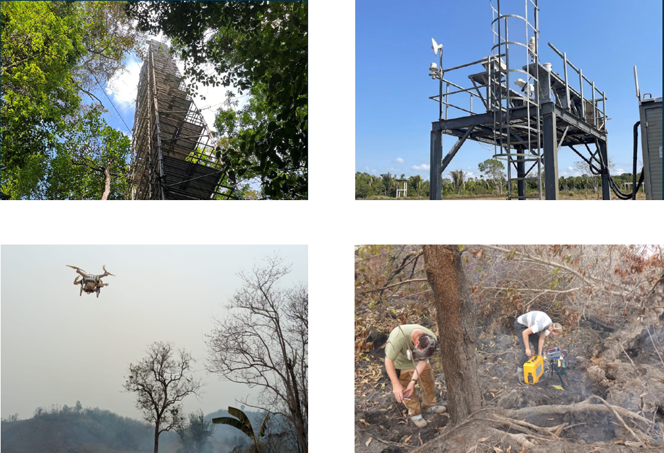
Action 3.2/6.1: ESA-INPE Campaign
Notes:
The airborne component is the UKRI BAS Twin Otter aircraft
the shippment of a large part - two tonnes and more - of the equipment has arrived in Santarem and is now at UFOPA.
(aircraft instruments, ground equipment).
First science flight at the moment is expected (fingers crossed) around 27th Sept.

Slide 20
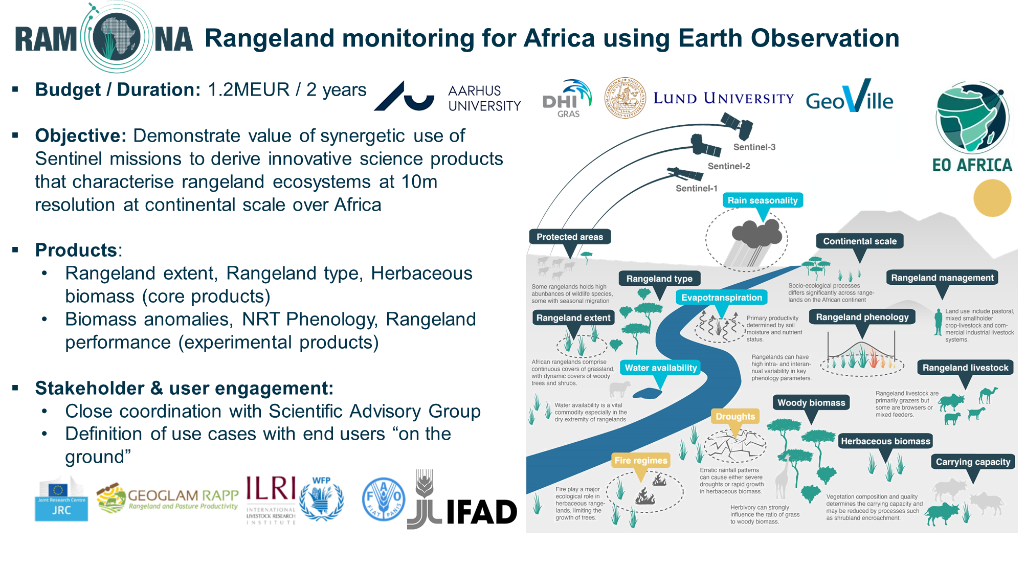
Action 5.6: Improve grassland and rangeland mapping

Slide 21
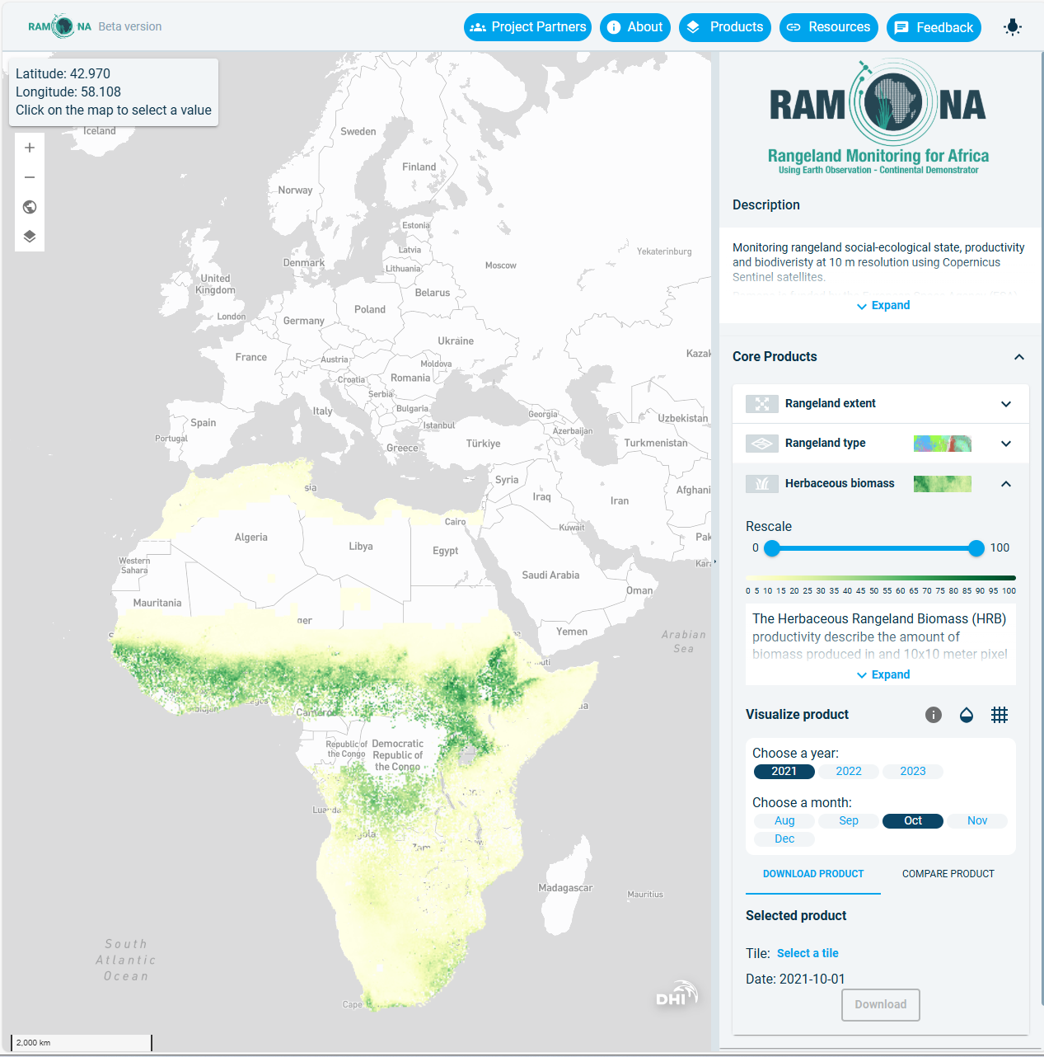

Action 5.6: Improve grassland and rangeland mapping
ESA plans to operationalise the RAMONA production system to enable on-demand generation of rangeland products in the near future
Currently validation and quality control is ongoing:
•Ground data collection at selected sites in 2022 (Senegal, Sudan, Kenya, South Africa);
•Limited flux tower in-situ measurements;
•Intercomparison with other products
•Eyes on the ground from partners
The RAMONA project would greatly appreciate additional (qualitative/quantitative) investigations into product quality by local/regional experts – national/regional scale product mosaic can be made available

Slide 22
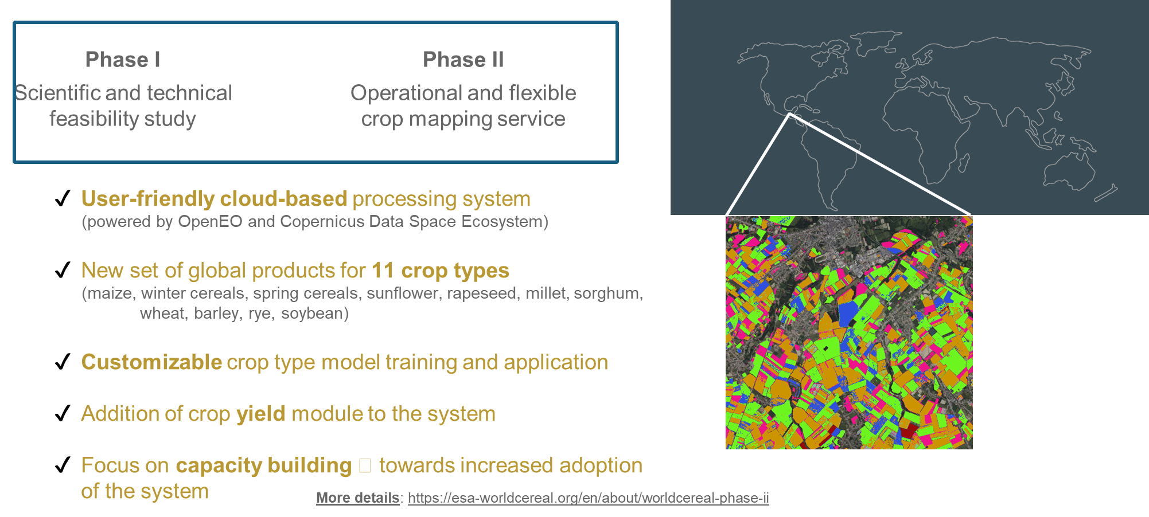

Action 5.7 & 5.8: WorldCereal products
Notes:
Currently under discussion the new year to be processed 2024 vs. 2025 with all the crops present
The cloud based system is basically ready and it will be deployed in the NoR asap (people can call the functions and run the system independently, pay only for the processing)
The local/hpc based system (mirroring the cloud based system) is almost done, and it will be ready to be deployed anywhere by anyone who has the computing capabilities
Both 2 and 3 systems will be capable to run global, regional, national etc levels.

Slide 23
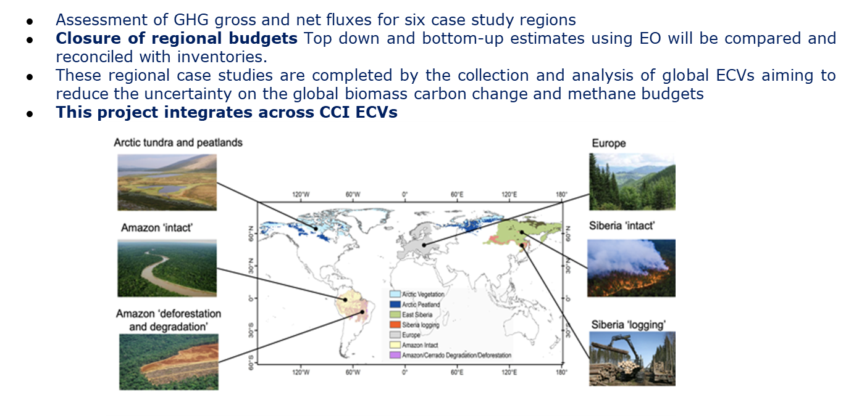
Action 7.1: REgional Carbon Cycle Assessment & Processes study (ESA & RECCAP 2)
Notes:
Northern hemisphere forests have shifted from carbon sinks to carbon emitters
Europe’s forests losing their carbon sink power
Human influence on Amazon’s aboveground carbon dynamics intensified over the last decade | Nature Communications

Slide 24

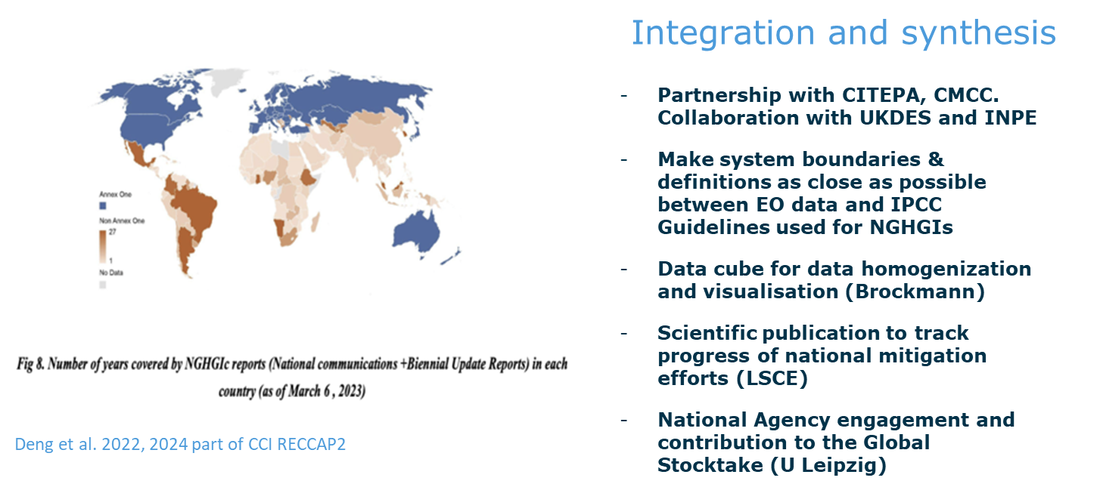
Action 7.1: REgional Carbon Cycle Assessment & Processes study (ESA & RECCAP 2)
Notes:
Northern hemisphere forests have shifted from carbon sinks to carbon emitters
Europe’s forests losing their carbon sink power
Human influence on Amazon’s aboveground carbon dynamics intensified over the last decade | Nature Communications

Slide 25
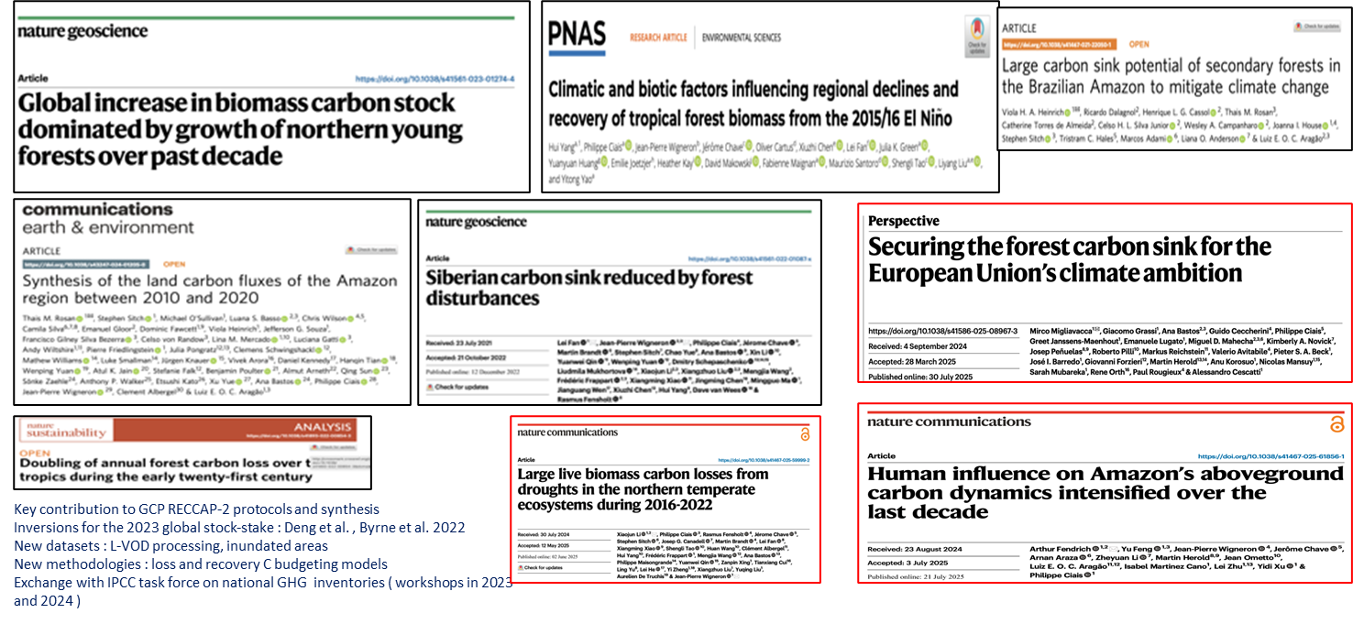
Action 7.1: REgional Carbon Cycle Assessment & Processes study (ESA & RECCAP 2)
Notes:
Northern hemisphere forests have shifted from carbon sinks to carbon emitters
Europe’s forests losing their carbon sink power
Human influence on Amazon’s aboveground carbon dynamics intensified over the last decade | Nature Communications

