Slide 1
LSI-VC-18
GEOGLAM
Alyssa Whitcraft GEOGLAM Secretariat
Agenda Item #2.4
LSI-VC-18
Ispra, Italy
2-5 September, 2025

Slide 2
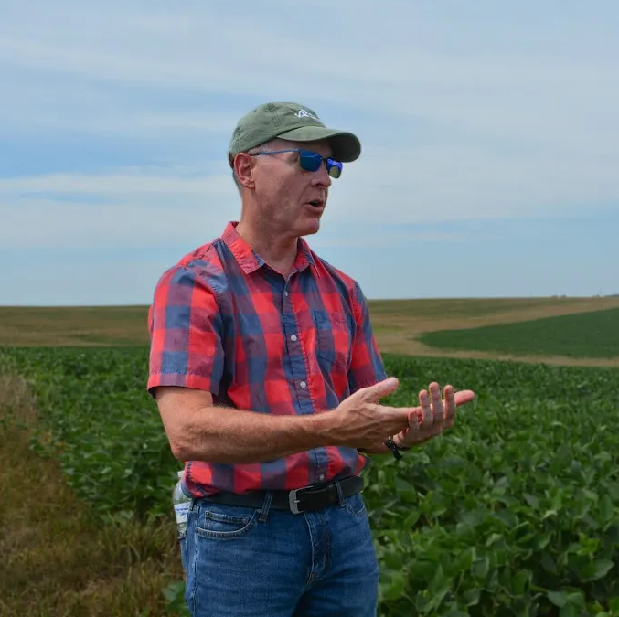

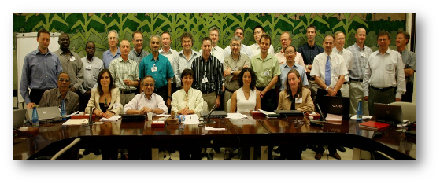
With Gratitude to Dr. Bradley Doorn
Brad Doorn retired from NASA in July 2025 after 40 years of government service
Highlights:
He started NASA’s Agriculture Applied Sciences Program in 2017, managed Water Resources 2008-2023
He served as (co-)lead of GEOGLAM Subgroup / AHWG from 2012 (far right, 2012)
He was one of GEOGLAM’s largest supporters (even when it was GEO Ag Task 07-03) (bottom, 2007)
What’s next? → he will continue teaching at Penn State University

Slide 3
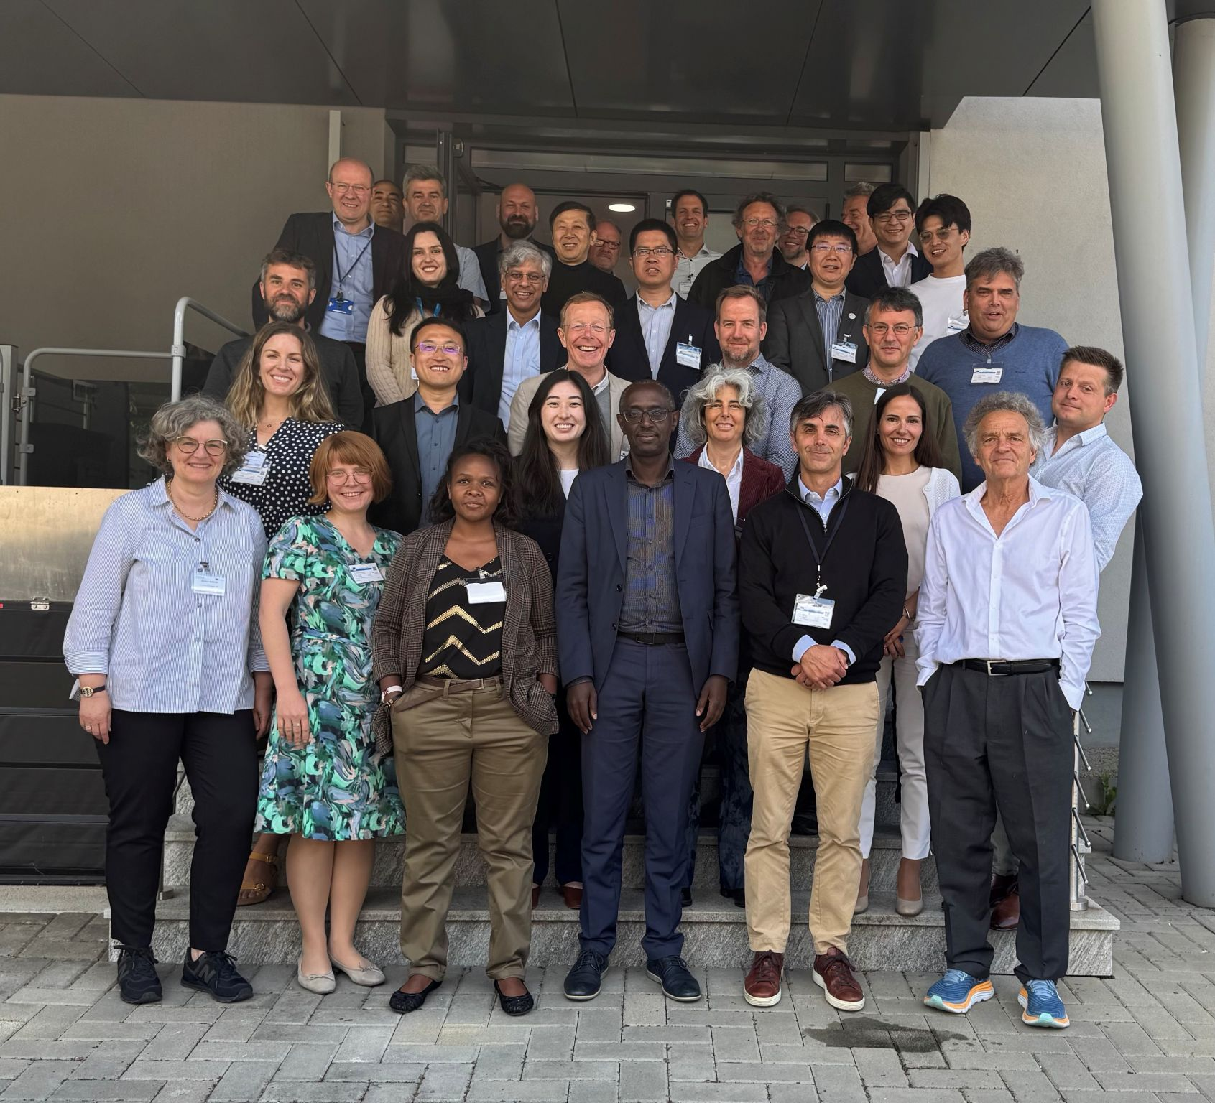
Progress on EAVs since SIT-40
GEOGLAM EAV Workshop 13-15 May 2025, EC JRC
34 in-person attendees, inc:
UKSA, NASA, ESA, EC
18 virtual attendees, inc:
JAXA, SANSA, Geoscience Australia, ISRO
2 new EAV Co-Leads
Laurent Tits (VITO)
Michael Marshall (U Twente)
Alyssa and Sven still co-leads

Slide 4
Key Outcomes: GEOGLAM EAV Workshop
Agreements:
The scope and objectives of GEOGLAM’s work on EAVs →
Present a unified and authoritative approach to defining and implementing systematic agricultural assessments.
Provide consensus, use-agnostic definitions for measurements and quality assessments of agriculture state, change, and forecast.
Create a path to concretely embed satellite observations within agriculture decisions.
Provide a communication tool for bridging gaps with non-satellite communities so that they adopt satellite data for their applications.
Set requirements tightly linked to use for space agencies to consider in current data provision and future missions and data systems.

Slide 5
Key Outcomes: GEOGLAM EAV Workshop
Agreements:
The list of “types of uses” of satellite-based EAVs that are within GEOGLAM’s scope
AMIS
Early warning
Quantitative production forecasting
Tracking agriculture-related SDGs / UNFCCC (AFOLU) / UNCCD (LDN) etc.
National statistics
Compliance / regulatory applications
Disaster response
Water district management and conservation planning
Insurance
Voluntary markets (GHG)
Supply chain traceability
Risk mitigation
Precision management
Land management
Now “on the record” as within scope of GEOGLAM EAVs

Slide 6
Key Outcomes: GEOGLAM EAV Workshop
Agreements:
The framework for thinking about and documenting EAVs
“Steps” in the GEOGLAM’s EAV Effort →
Plus timeline May 2025 - April 2026 (next slide)
Audiences for the EAV Effort (and what to show them (in appendix)
CEOS / agencies
Agriculture decision makers
Agriculture information product generators
Input variable product generators
Funders/donors
6 Initial Variables to “Pressure Test” Framework:
Crop type; crop yield; field boundaries; cover crop; ET; irrigated cropland; cover crop
Agree upon a list and single set of definitions & descriptions
Should be consistent regardless of scale
Descriptions also include guidelines for typologies, hierarchies, good practices for validation etc.; cross-cut with ECVs/EWVs/EBVs
2. Articulate EAV product requirements by use
Temporal, spatial, latency, accuracy by use
3. As they correspond with use, take stock of past, current, and planned:
Methods, projects, systems, and satellite instruments satellite instruments
State of use/uptake where relevant
4. As they correspond with use, analyse gaps...
Simply, this "stocktake - requirements = gaps" ...
But not all gaps are equally important, closeable, etc.
5. Prioritise what to do next...
6. Do it!

Slide 7
Example: Field Boundaries
(still in progress)
Definition: Field boundaries are the borders of an agricultural field, which are contiguous area of land used for specific agricultural purposes, such as one crop with common phenology for one season (sub-field) that may be contained within a larger field block (primary field) that is defined by land ownership or permanent or natural boundary features such as trees, roads, water courses, etc.
Observability Comments:
Commonly relies upon object-oriented classification.
Permanent and natural boundaries are easier to distinguish.
Sub-field boundaries are meaningful but can be more difficult to distinguish using EO unless very different management (e.g. different crops)
Product quality contingent upon reference data quality and desired objective (e.g. exact boundary location vs. area within boundaries)
Measurement Unit: Unitless Vector
Overlap with Other EVs: None
Recommended Typology: Land Use Typology
Accuracy Assessment Guidelines:
Object-based accuracy metrics (over segmentation, under-segmentation, intersection over union, commission/omission errors)
Good practices guidelines needed
Lead Steward: Catherine Champagne, AAFC
Participants: Bahram Daneshfar, Yuval Sadeh, Lin Yan, Rakhesh Devadas, Mykola Lavreniuk, Miao Zhang, Alyssa Whitcraft
Uses Identified (means 4 potetnail sets of reqs, inventory, gap analysis):
Production forecast or estimation (combine with yield)
Landscape monitoring
Parcel identification (e.g. reporting)
Current-season monitoring / rapid analysis

Slide 8
Example: Field Boundaries
(still in progress)
Use: Production forecast or estimation (combine with yield)
Product Requirements | Temporal |  | Spatial |  | Accuracy |  | Latency
 | Threshold | Goal | Threshold | Goal | Threshold | Goal | Threshold | Goal
 | Annual | Seasonal | Unit = Field Highly-variable globally. Corresponding spatial resolution would be 1-30m with precise geometric registration between images. |  | Above 80% overlap with each reference field | Above 90% overlap with each reference field | End of year | Early/mid season prior to harvest
Relevant Satellite Instruments
List | Specs & Performance (Red = Full Gap; Yellow = Goal not met; Green = Goal Met)
 | Temporal |  | Spatial |  | Accuracy -> interpreted as limiting factors |  | Latency |  | Availability
 | Spec | Performance | Spec | Performance | Spec | Performance | Spec | Performance | Spec | Performance
Sentinel-2 | 5 days | Goal | 10m | Threshold | issues with geometric registration with default processing - particular issues for small fields | Threshold / not adequate for small fields | 3-4h | Goal | free | Goal
Planet | Daily | Goal | 5m | Threshold to Goal (TBC) | georeferencing issues, limited spectral bands, limited time series, radiometric mosaics not consistent | Not Met | n/a | Goal | commercial | Not Met
Landsat | 8 days | Goal | 30 m | Threshold | spatial resolution suitable for large fields (North America) | Threshold |  | Not Yet Analyzed | free | Goal
There is MUCH more information… but take home messages are:
1) the satellite observation component are pretty good except for small fields, where geometric accuracy + insufficiently fine spatial resolution leads to many fields being missed.
2) We are definitely not documenting all satellites and products - and need agency input to do that…

Slide 9
May 2025
Sep 2025
Nov 2025
Spring 2026
April 2026
Agencies Do SIT-TW-41 Actions
CEOS Does Plenary-39 Action #2-3
SIT-TW-40
Report:
Progress on EAVs
Discuss:
“Roadmap” for EAVs over next 6 months
Actions:
Agencies provide ToR feedback and appoint PoCs to LSI-VC or stocktake
Scoping of Joint ET Workshop with Cal-Val
Plenary-39
Report:
1st Set of EAVs
Proposed Cal-Val Workshop for ET
Decision:
LSI-VC GEOGLAM Subgroup ToR approved
Actions:
Agencies Work on Stocktake for 1st 6 Variables
CEOS MIM Ag Component Database Design Scoping
WG Cal-Val Workshop “Green-Light”
SIT-41
Report:
EAV Requirements
Agency Priorities for next phase of EAV Stocktake
Action:
Agencies continues Stocktake based on their priorities
13-15 May 2025
GEOGLAM EAV Workshop
Spring 2026
GEOGLAM LSI-VC Subgroup Prioritization Workshop
Workshop Results
Agencies Do Action #1
Legend
Boxes = Events
Arrows = Work
Asynchronous work on Phase 1 EAVs
Completes + Submits Phase 1 EAV Report
Asynchronous Work on Phase 2 Def’s + Req’s for Other Variables
GEOGLAM
CEOS/Agencies
Shared
Notes:
By Plenary-39 → Review SIT-41 action - and set some deadline after which the ToR simply is assumed endorsed (?)
By Plenary-39 → Agencies to fill in the blanks on LSI-VC group
Beginning in the context of the stocktake support for the 6 actions
We could name the individual agencies who have been active in the past (see right pane)
April 14-16, 2026 - NASEM Beckman Center in Irvine, CA - https://www.nationalacademies.org/beckman-center
→ Agencies work on prioritized stocktake for 2 months (?)
→ More MIM
→ June-July period… GEOGLAM Prioritisation workshop (because full req’s + stocktake (as much as agencies want) + gap analysis can be complete) … outcome of this = prioritisation plan
Sept. 8-10, 2026 - NASEM in Washington, D.C. → review prioritisation plan
→ Plenary 2026… present final stocktake and operationalised MIM
April 20-22, 2027 - NASEM in Washington, D.C.
Sept. 7-9, 2027 – NASEM Beckman Center in Irvine, CA

Slide 10


SIT-TW-40 → 2 Requested Actions
1. By Plenary-39, CEOS agencies are asked to:
Review the submitted “LSI-VC Subgroup on GEOGLAM Terms of Reference” and provide suggested revisions or additions to GEOGLAM points of contact (from SIT-40-12) (from SIT-40-12)
Formally appoint a PoC to the GEOGLAM LSI-VC Subgroup (from Plenary-38-08)
Confirmed: ESA, ISRO, CSIRO, SANSA, Geoscience Australia, CONAE
Historically-engaged agencies without formal PoC: NASA, DLR, CSA, JAXA, UKSA, USGS, NOAA, CNES
All other agencies very much welcome!
Effort can be incremental → short-term commitment to support for first 6 variables of the stocktake (from SIT-39-05)
2. WG Cal-Val asked to work with GEOGLAM PoCs to scope “Joint Workshop on Good Practices for ET Validation”
UN FAO (ET-EAV Lead Steward) is able to host
Next step → Report workshop proposal at Plenary-39
View ToR here: https://go.umd.edu/GEOGLAM-LSIVC_ToR
View PoC List here: https://go.umd.edu/GEOGLAM-LSIVC-LIST

Slide 11
GEOGLAM Priorities for CEOS LSI-VC Subgroup on GEOGLAM ToR Excerpt
SIT-TW-40 + Plenary-39 Ask → Scoping the breadth of activities, roles, and responsibilities between GEOGLAM and CEOS (SIT-39-06)
Confirming ToR for LSI-VC Subgroup on GEOGLAM (SIT-40-12)
Identifying communication modalities and procedures for GEOGLAM collaboration with other CEOS Working Groups and activities, including the AFOLU initiative, where EAVs already feature.
This was an objective of the GEOGLAM EAV Workshop that did not get resolved
SIT-TW-40 Ask → Identifying engaged/active points of contact for each agency to serve on the LSI-VC Subgroup on GEOGLAM (SIT-39-05)
Embedded within GEOGLAM EAV Stocktake, Gap Analysis, and Prioritisation (SIT-39 + Plenary-38) → Undertaking a “stocktake” of (and formally documenting) past, current, and future EAV-related projects, activities, and missions/instruments, with CEOS agency participation.
Embedded within GEOGLAM EAV Stocktake, Gap Analysis, and Prioritisation (Plenary-38) → Reflect on the stocktake to create a robust gap analysis related to the EAVs toward identifying 2-3 of the highest-priority gaps, their source (e.g. observation, method, product…), and opportunities to address them.
SIT-TW-40 Ask → Progressing the work already initiated with CEOS WG Cal/Val Land Product Validation.

Slide 12
Look ahead → Plenary-39
Sep 2025
Agencies Do SIT-TW-41 Actions
Nov 2025
Crop type
Crop Yield
ET
Irrigated Cropland
Cover Crop
Field Boundaries
What will have been completed for 1st 6 Variables:
Definition + Descriptions
Product Requirements
GEOGLAM community’s “accounting” of current and past products and related satellites
GEOGLAM community’s assessment of gaps and prioritisation
SIT-TW-40
Report:
Progress on EAVs
Discussing: Way Forward
Actions:
Agencies Complete SIT-40 Action, including filling empty LSI-VC appointments
Scoping of Joint ET Workshop with Cal-Val
Plenary-39
Report:
1st Set of EAVs
Proposed Cal-Val Workshop for ET
Decision:
LSI-VC GEOGLAM Subgroup ToR approved
Actions:
Agencies Work on Stocktake for 1st 6 Variables
CEOS MIM Ag Component Database Design Scoping
WG Cal-Val Workshop “Green-light”
Legend
Boxes = Events
Arrows = Work
Completes + Submits Phase 1 EAV Report
Asynchronous Work on Phase 2 Def’s + Req’s for Other Variables
GEOGLAM
CEOS/Agencies
Shared

Slide 13
Look ahead → Plenary-39
Sep 2025
Agencies Do SIT-TW-41 Actions
Nov 2025
Crop type
Crop Yield
ET
Irrigated Cropland
Cover Crop
Field Boundaries
What will have been completed for 1st 6 Variables:
Definition + Descriptions
Product Requirements
GEOGLAM community’s “accounting” of current and past products and related satellites
GEOGLAM community’s assessment of gaps and prioritisation
Planned Decisions & Actions, Plenary-39:
Decision → ToR endorsed
Action → Agency participants on LSI-VC GEOGLAM Subgroup work on stocktake for 6 variables
Action → CEOS SEO / Symbios (?) + GEOGLAM → scoping of ag component of MIM
Action → Green-light / commitment to WG Cal-Val Workshop
SIT-TW-40
Report:
Progress on EAVs
Discussing: Way Forward
Actions:
Agencies Complete SIT-40 Action, including filling empty LSI-VC appointments
Scoping of Joint ET Workshop with Cal-Val
Plenary-39
Report:
1st Set of EAVs
Proposed Cal-Val Workshop for ET
Decision:
LSI-VC GEOGLAM Subgroup ToR approved
Actions:
Agencies Work on Stocktake for 1st 6 Variables
CEOS MIM Ag Component Database Design Scoping
WG Cal-Val Workshop “Green-light”
Missing = Agency’s accounting
Legend
Boxes = Events
Arrows = Work
Completes + Submits Phase 1 EAV Report
Asynchronous Work on Phase 2 Def’s + Req’s for Other Variables
GEOGLAM
CEOS/Agencies
Shared

Slide 14
Between Plenary-39 and SIT-41…
Actions from Plenary:
Agencies Work on Stocktake for 1st 6 Variables
In parallel, GEOGLAM EAV Working Group continues undertaking EAV Framework for other EAVs.
After ^^^, a joint CEOS-GEOGLAM “Prioritisation Workshop” to distill the EAV gaps into the most important areas of intervention for CEOS (observations, products, data systems, cal/val…), funding, etc.
CEOS MIM Ag Component Database Design Scoping
Eventual home for the EAV Framework
Continued planning, possible execution of WG Cal-Val Workshop
There are many dependencies in this plan, so SIT-41’s report could become SIT-TW-41’s:
Finding engaged EAV Stewards for next tranche of variables
Adequate agency engagement and buy-in
Green-light of Cal-Val Workshop + travel availability of participants
Spring 2026
April 2026
CEOS Does Plenary-39 Action #2-3
SIT-41
Report:
EAV Requirements
Agency Priorities for next phase of EAV Stocktake
Action:
Agencies continues Stocktake based on their priorities
Spring 2026
GEOGLAM LSI-VC Subgroup Prioritization Workshop
Workshop Results
Agencies Do Action #1
Asynchronous Work on Phase 2 Def’s + Req’s for Other Variables
Legend
Boxes = Events
Arrows = Work
GEOGLAM
CEOS/Agencies
Shared

Slide 15
SIT-TW-40 → 2 Requested Actions
1. By Plenary-39, CEOS agencies are asked to:
Review the submitted “LSI-VC Subgroup on GEOGLAM Terms of Reference” and provide suggested revisions or additions to GEOGLAM points of contact (from SIT-40-12) (from SIT-40-12)
Formally appoint a PoC to the GEOGLAM LSI-VC Subgroup (from Plenary-38-08)
Confirmed: ESA, ISRO, CSIRO, SANSA, Geoscience Australia, CONAE
Historically-engaged agencies without formal PoC: NASA, DLR, CSA, JAXA, UKSA, USGS, NOAA, CNES
All other agencies very much welcome!
Effort can be incremental → short-term commitment to support for first 6 variables of the stocktake (from SIT-39-05)
2. WG Cal-Val asked to work with GEOGLAM PoCs to scope “Joint Workshop on Good Practices for ET Validation”
UN FAO (ET-EAV Lead Steward) is able to host
Next step → Report workshop proposal at Plenary-39
View ToR here: https://go.umd.edu/GEOGLAM-LSIVC_ToR
View PoC List here: https://go.umd.edu/GEOGLAM-LSIVC-LIST

Slide 16
Recap & LSI-VC Internal Discussion Questions
We are making good progress toward EAV Objectives, despite the challenges for international collaboration
Is it acceptable to just call the ToR “official” without endorsement? Just set a deadline and say, “this is what it is?”
How should we conceptualize the other “logical” relationships? (next slide)
There was solid agency participation in the EAV Workshop, but we are lacking ongoing communication and effort from several key agency collaborators that will be critical for successful implementation of the EAVs, not just completion of the stocktake
What is the best way to make this happen? Concerted but incremental asks? (this is our SIT-TW-41 + Plenary-39 plan)
Any comments/feedback to pass to Sven for the SIT presentation?

Slide 17
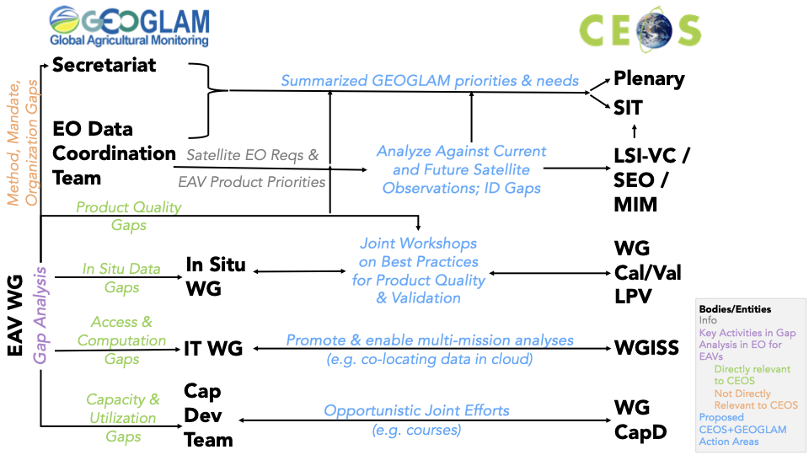
A sketch of logical GEOGLAM-CEOS interactions

Slide 18
Thanks
With Gratitude to Dr. Bradley Doorn
Brad Doorn retired from NASA in July 2025 after 40 years of government service
Highlights:
He started NASA’s Agriculture Applied Sciences Program in 2017, managed Water Resources 2008-2023
He served as (co-)lead of GEOGLAM Subgroup / AHWG from 2012 (far right, 2012)
He was one of GEOGLAM’s largest supporters (even when it was GEO Ag Task 07-03) (bottom, 2007)
What’s next? → he will continue teaching at Penn State University

Slide 19
Presenter Guidelines
Presenters should name their file using the following convention:
Agenda item number_Last name_Subject (e.g., 1.1 Strobl Welcome)
Documents and presentations should be uploaded to the shared folder to allow for streamlined self service
Shared Presentation Folder (default view only, ask for edit permission as required)
For support contact harvey@symbios.space
Please explicitly highlight the decisions, outcomes, or actions you are seeking. The more explicit you are, the better. i.e., feel free to provide text for a proposed action – it may be revised later, but this approach will help with the efficient preparation of the actions record of the meeting.

Slide 20
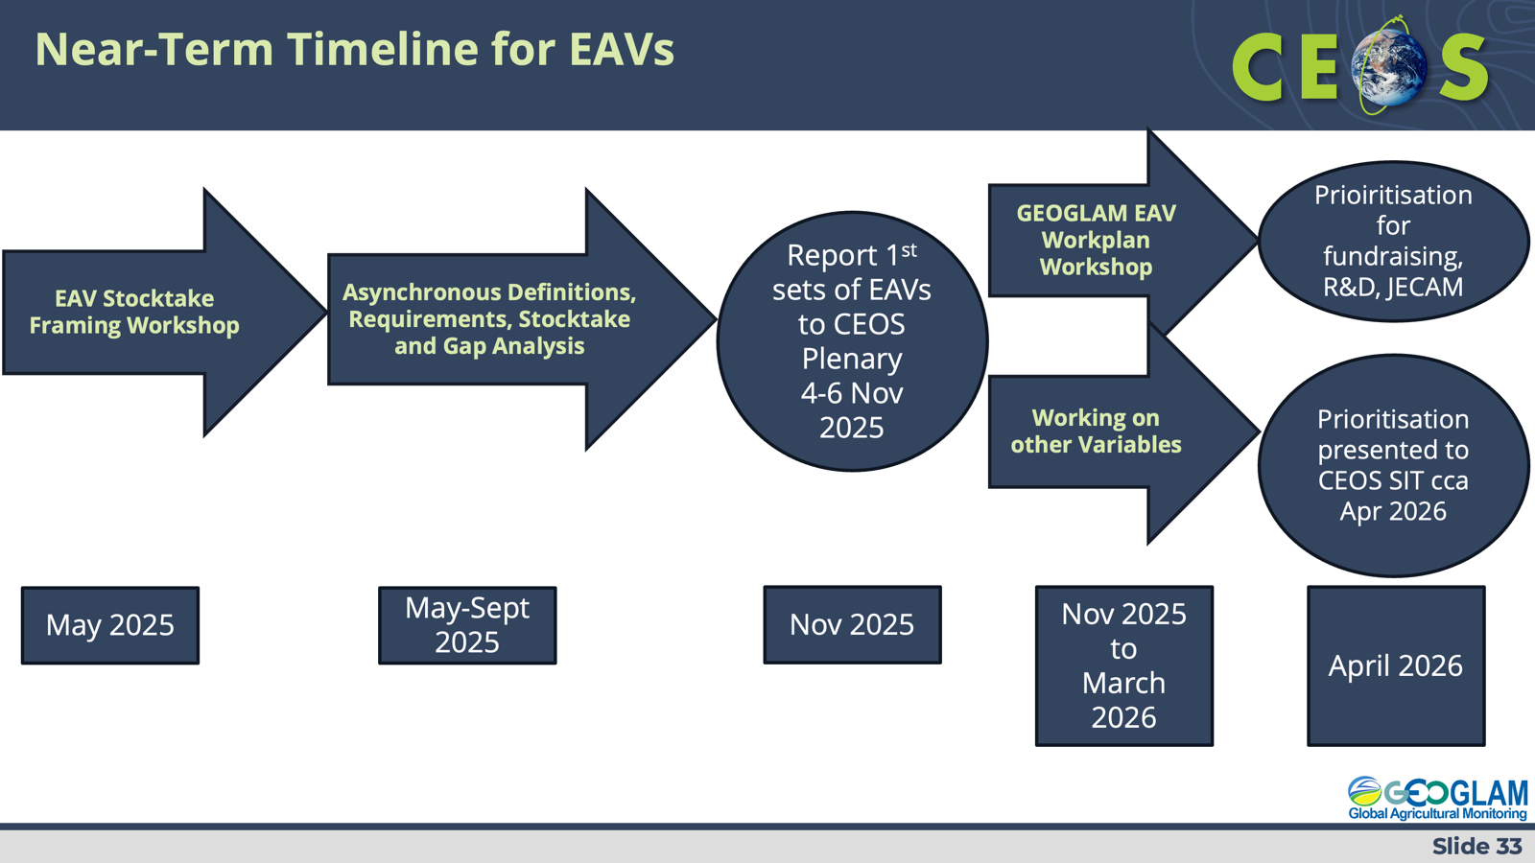
Brainstorm Outline
1 slide → Program updates with New co-chairs
2-3 slide → May 2025 workshop big picture
1 slide → Example
1 slide → Near-term timeline
1 slide → referring back to SIT-40 Action
Alongside show GEOGLAM priorities for CEOS
1 slide → supporting LSI-VC activities for near-term timeline
1 slide → Subgroup participation
CEOS LSI-VC Subgroup on GEOGLAM - Participant List ← clean this up
1 slide → Targeted asks
This is important
1 slide → proposed action next to timeline inset
Notes:
Please explicitly highlight the decisions, outcomes, or actions you are seeking. The more explicit you are, the better. i.e., feel free to provide text for a proposed action – it may be revised later, but this approach will help with the efficient preparation of the actions record of the meeting.
Desired Actions coming from SIT TW?
Matt suggests that we make agency-targeted requests
“We need this information from you” - coach them
What are the questions we have of agencies that we wish we knew, related to EAVs?

Slide 21
Proposed Actions
By Plenary-39 → Review SIT-40 action - and set some deadline after which the ToR simply is assumed endorsed (?)
By Plenary-39 → Agencies to fill in the blanks on LSI-VC group
Beginning in the context of the stocktake support for the 6 actions
We could name the individual agencies who have been active in the past (see right pane)
UKSA
NASA
USGS
NOAA
EC/JRC
JAXA
Canadian Space Agency
DLR

