Slide 1
LSI-VC-18
2025 KARI’s Works on ARD
Taeheon KIM, KARI
Agenda Item 3.1
LSI-VC-18
Ispra, Italy
2-5 September, 2025

Slide 2
Overview: Current Activities
KARI’s Global Collaboration Efforts:
Contributing to CEOS ARD standardization through active participation in CEOS LSI-VC WGCV, VH-RODA, JACIE, and other key international workshops
Developing K-ARD(Analysis Ready Data for KOMPSATs or Korea) to meet the specific requirements of KARI’s high-resolution satellite imagery
Development of Prototype Software
Research initiated in 2023 to develop a K-ARD prototype aligned with CEOS ARD standards
Now under development based on the completed design, focusing on KARI-operated optical satellites KOMPSAT-3/3A and SAR satellite KOMPSAT-5
Focused ARD study on EO SR product and SAR products (NRB, POL, ORB, GSLC; excluding InSAR)
※ SR (Surface Reflectance), NRB (Normalised Radar Backscatter), POL (Polarimetric Radar), ORB (Ocean Radar Backscatter), and GSLC (Geocoded Single-Look Complex)

Slide 3
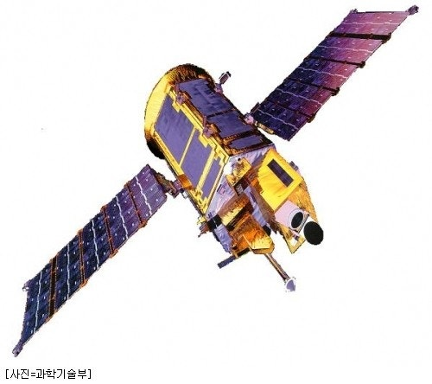
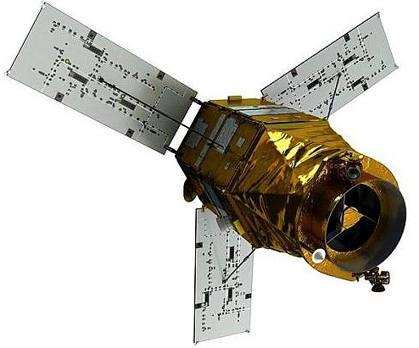
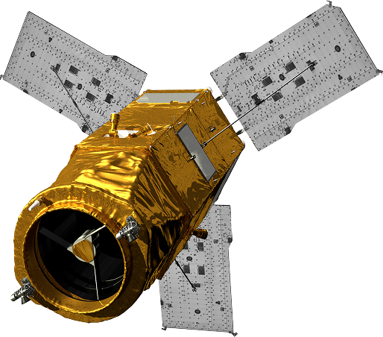
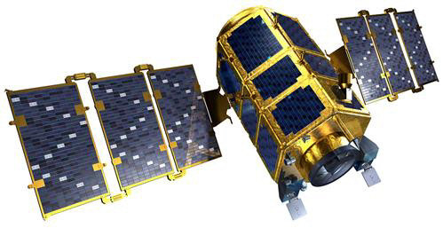
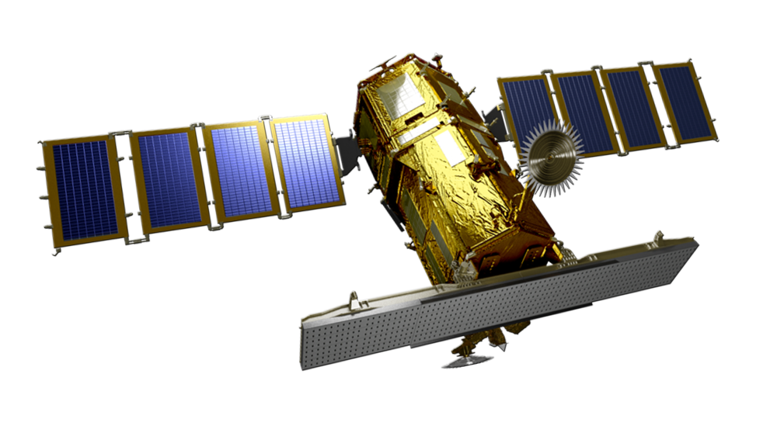
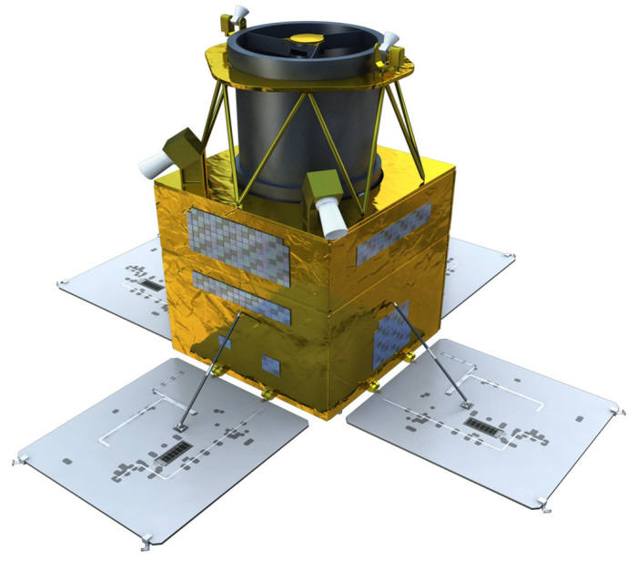
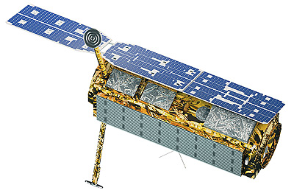
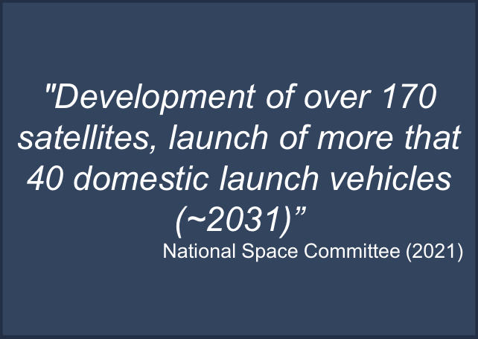
Overview: KARI’s LEO Mission
LEO
Not Working
Working
Under Development
KOMPSAT-1
1999
EO 6.6m
KOMPSAT-2
2006
EO 1m
KOMPSAT-3
2012
EO 0.7m
KOMPSAT-3A
2015
EO 0.55m
KOMPSAT-7
Q4 2025
EO 0.3m
KOMPSAT-7A
2026
EO 0.3m
KOMPSAT-5
2013
SAR 1m
CAS-1
2019
EO 0.5m
KOMPSAT-6
Q1 2026
SAR 0.5m
CAS-2
2026
EO 0.5m

Slide 4
Background
Growing Demand for Efficient Data Utilization
Increasing number of domestic satellites and wide use of EO/IR/SAR sensor
Rising need for efficient data processing and standardization
Introduction of CEOS ARD
CEOS introduced the concept of Analysis Ready Data (ARD)
Provides standardized satellite imagery usable without additional preprocessing
The Need for K-ARD
CEOS ARD mainly focuses on medium- to low-resolution imagery
High-resolution satellites like KOMPSAT series require a tailored ARD framework
Development of advanced image correction modules is also necessary to address these requirements
KARI’s Initiative
Developing prototype software for high-resolution satellite imagery (K-ARD)

Slide 5
Goal & Application
Goal of K-ARD
Establish ARD specification tailored to Korea’s environment while aligning with international standards
Verify the application of ARD to domestic satellite imagery through software development
Provide ARD-processed satellite imagery to the public within the next few years
Application Area of K-ARD
K-ARD provides standardized imagery with geometric, radiometric, and atmospheric corrections and is expected to support the following application areas:
Application Area | Example Applications
Time-series analysis | Monitoring agricultural field changes, Tracking urban expansion
Land cover and land use mapping | Observing forest area changes, Classifying agricultural zones
Climate change monitoring | Monitoring vegetation index changes, Detecting land degradation
Hydrological studies | Monitoring river level changes, Mapping flood-prone areas
Disaster detection (floods, droughts, wildfires) | Detecting inundated areas, Early warning for droughts, Assessing wildfire damage

Slide 6
Methodology
It analyzes the sensor characteristics and specifications of satellites operated by KARI and prepares K-ARD product specifications based on international standards.

Slide 7
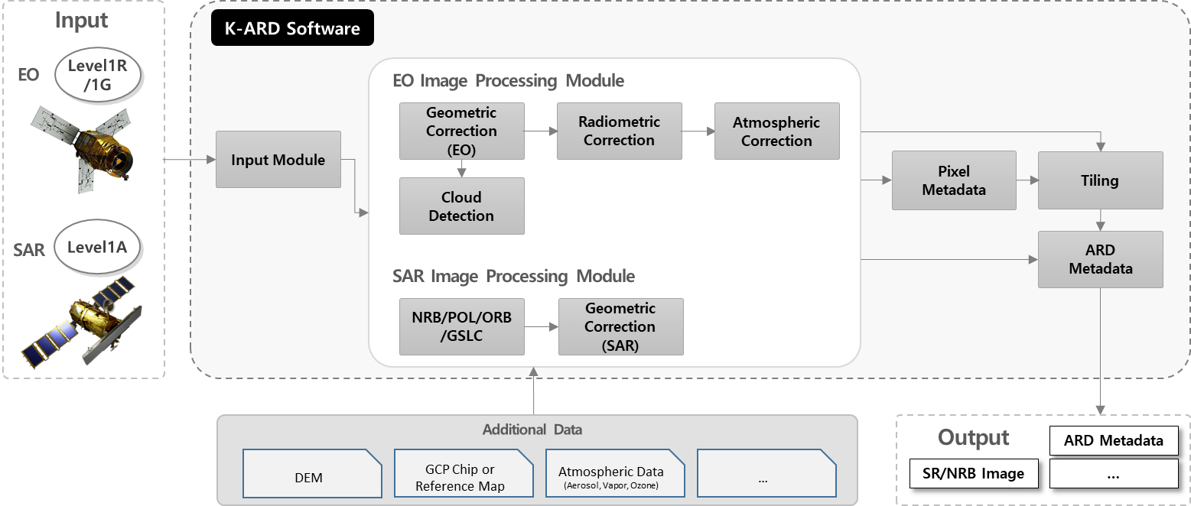
Methodology
Software is being developed to generate and verify satellite imagery products in accordance with the K-ARD specification

Slide 8
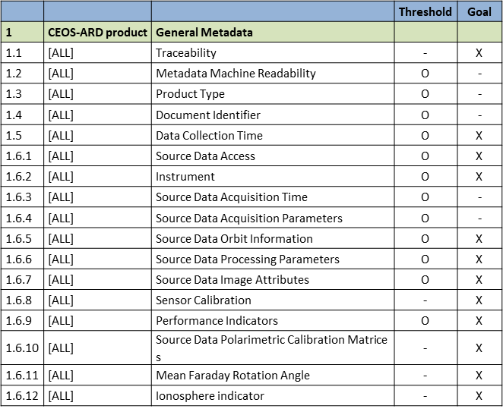
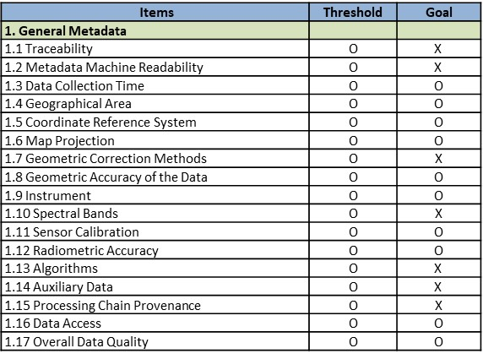
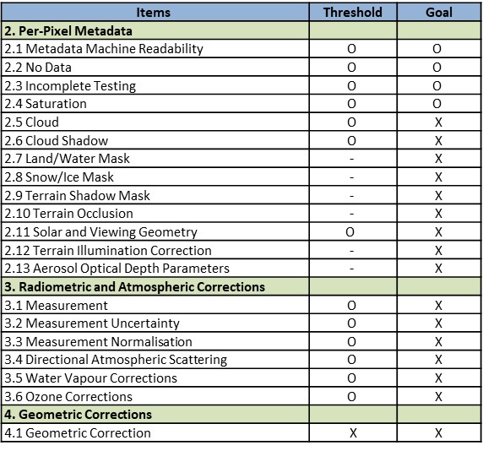
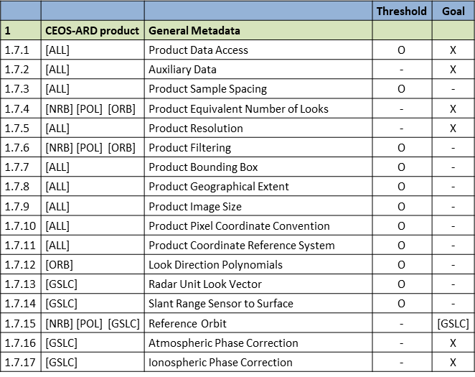
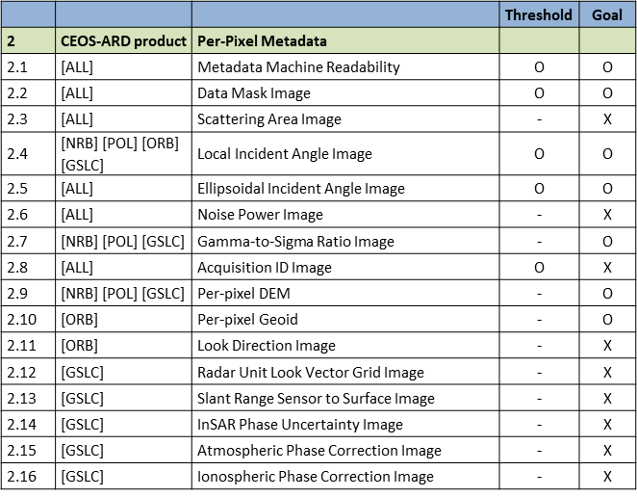
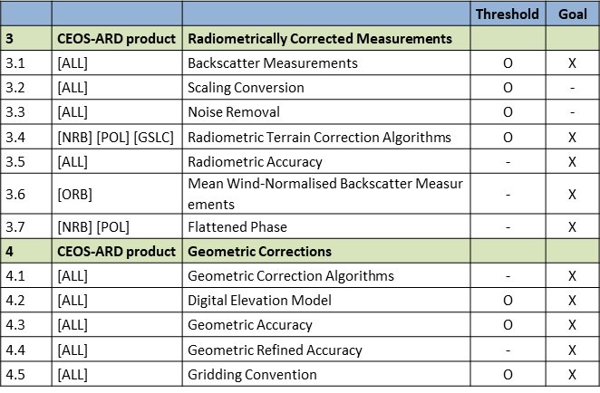
ARD Compliance Assessment
Compliance review conducted for KARI’s LEO satellites based on CEOS ARD
SAR (KOMPSAT-5 or 6): Four products (NRB, POL, ORB, GSLC) reviewed → all Thresholds confirmed satisfiable via tailored ARD module development
EO (KOMPSAT-3/3A or 7): Target Product SR reviewed → all Thresholds confirmed satisfiable (except 4.1 Geometric Correction requirement) → Identification of issue in High-resolution imagery
SAR Products Self Assessment table
EO SR Product Self Assessment table

Slide 9
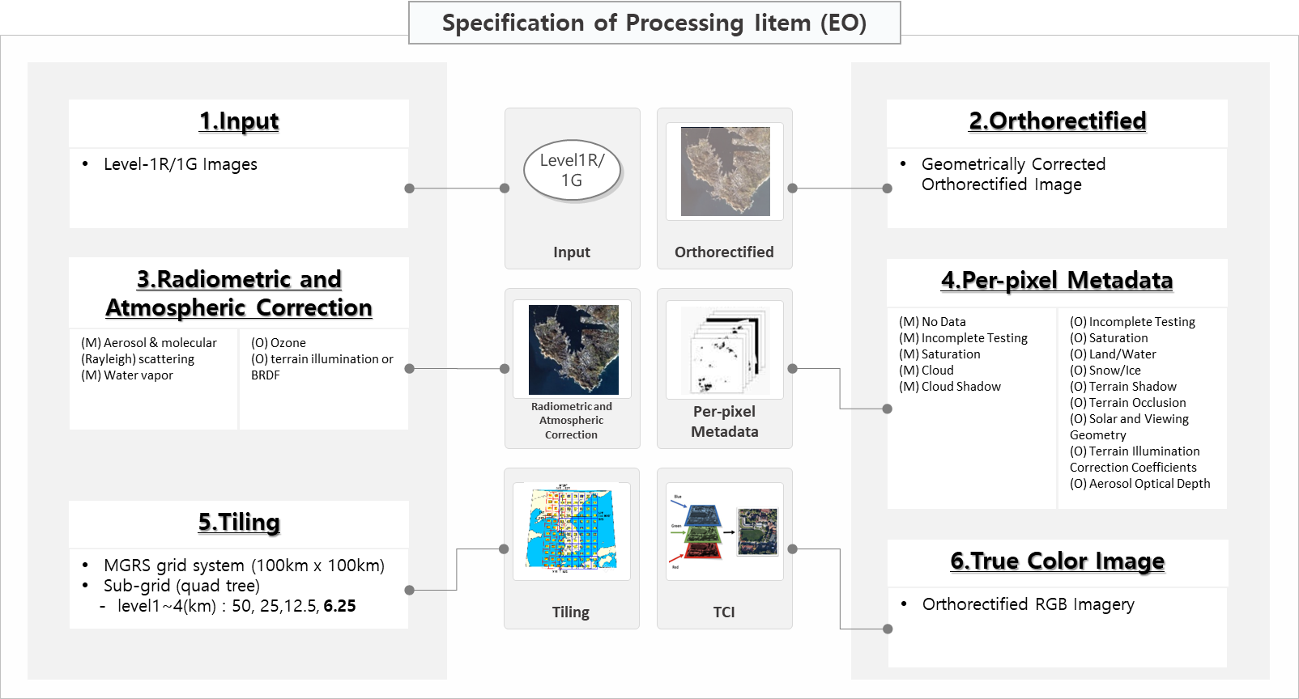
K-ARD for EO Imagery

Slide 10
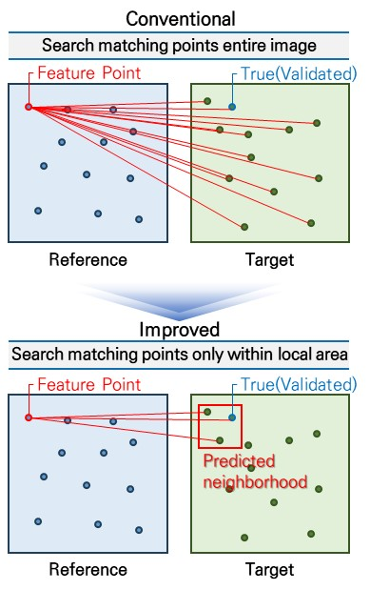
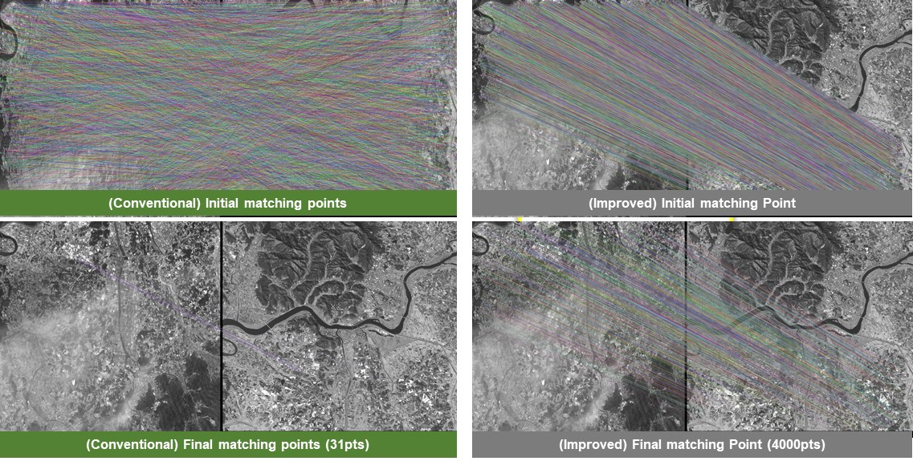
K-ARD for EO Imagery
Sensor model-based improved relative geometric correction
Conventional: matching points searched across entire target image → higher chance of mismatches
Improved (Sensor model-based): matching points searched only within predicted local neighborhood → more accurate and efficient matching

Slide 11
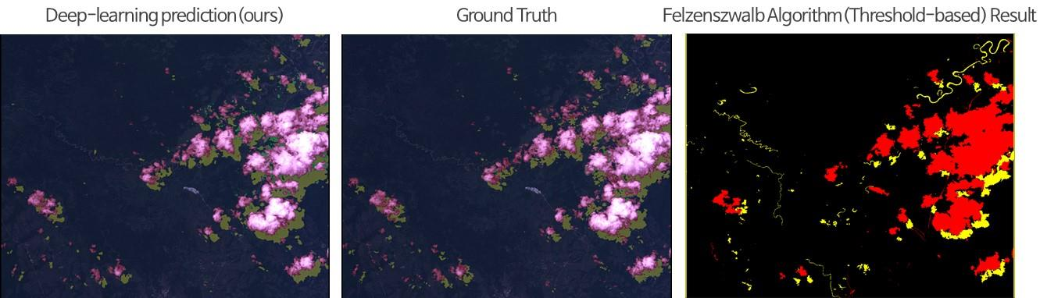
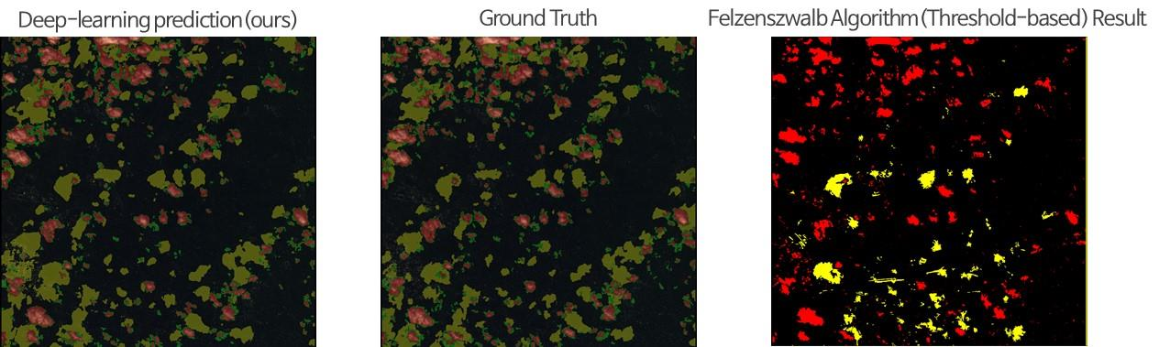
K-ARD for EO Imagery
Deep learning-based cloud detection
Adopted a Deeplabv3+ architecture with a ResNet-50 backbone for cloud segmentation in KOMPSAT-3/3A imagery
Generate ~4,000 augmented patches (1024 x 1024) from 162 original images to enhance training diversity
Achieved significant improvement compared to traditional cloud detection method (Threshold-based)
 | Thick Cloud | Thin Cloud | Cloud Shadow
Ground Truth | 12.49% | 0.11% | 4.30%
Deep-learning (ours) | 11.77% | 0.78% | 4.30%
Threshold-based | 9.69% |  | 3.50%
 | Thick Cloud | Thin Cloud | Cloud Shadow
Ground Truth | 9.35% | 6.09% | 12.12%
Deep-learning (ours) | 8.97% | 5.26% | 13.26%
Threshold-based | 6.44% |  | 3.20%

Slide 12
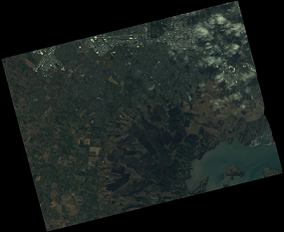
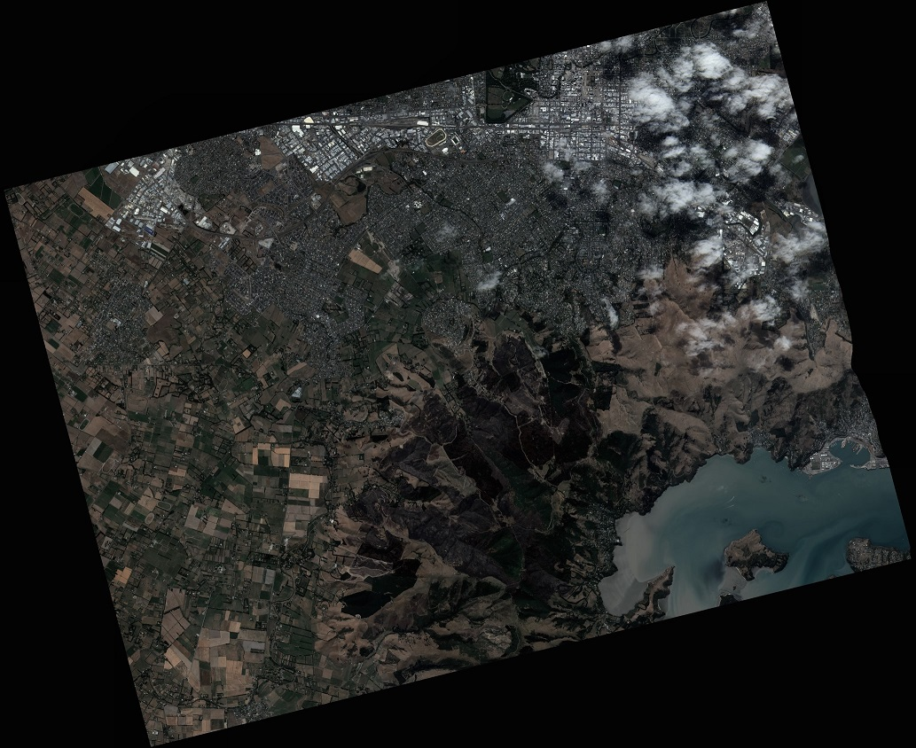
K-ARD for EO Imagery
Radiometric and atmospheric correction
6S model(LUT-based algorithm): radiative transfer model simulating solar radiation through the atmosphere
Removes atmospheric scattering/absorption from TOA signal to derive SR
Atmospheric correction converts DN values → SR (provided as GeoTIFF)
Uncorrected
Corrected
※ 6S (Second Simulation of the Satellite Signal in the Solar Spectrum)

Slide 13
K-ARD for SAR Imagery

Slide 14
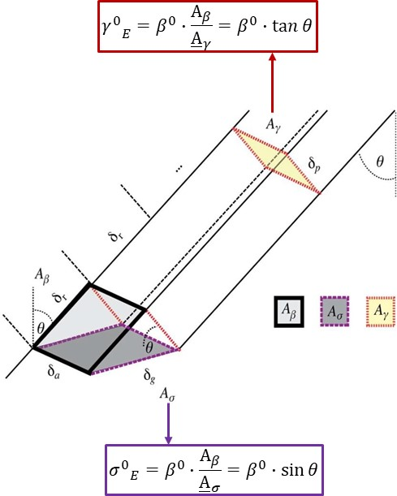
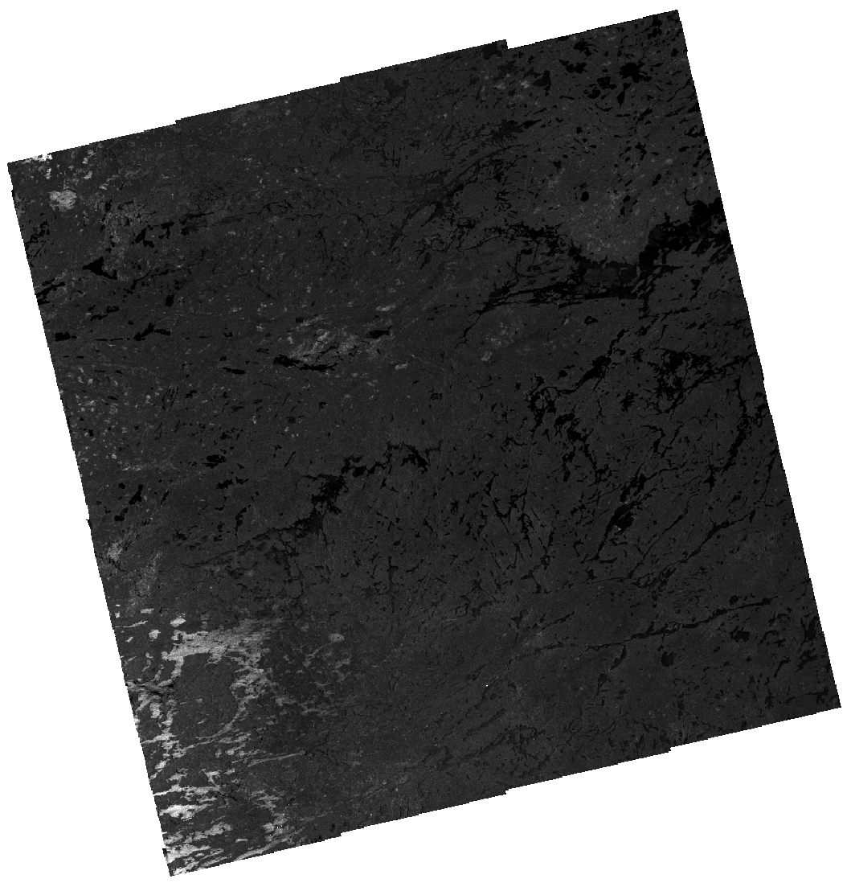

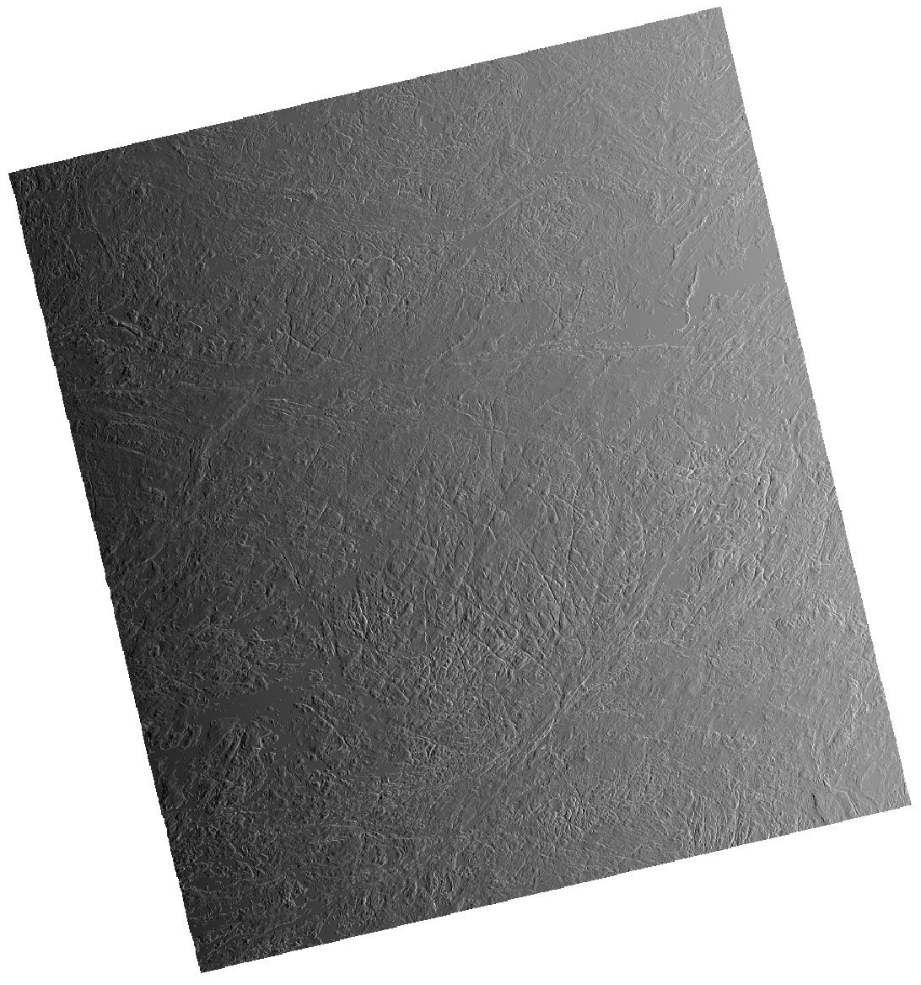
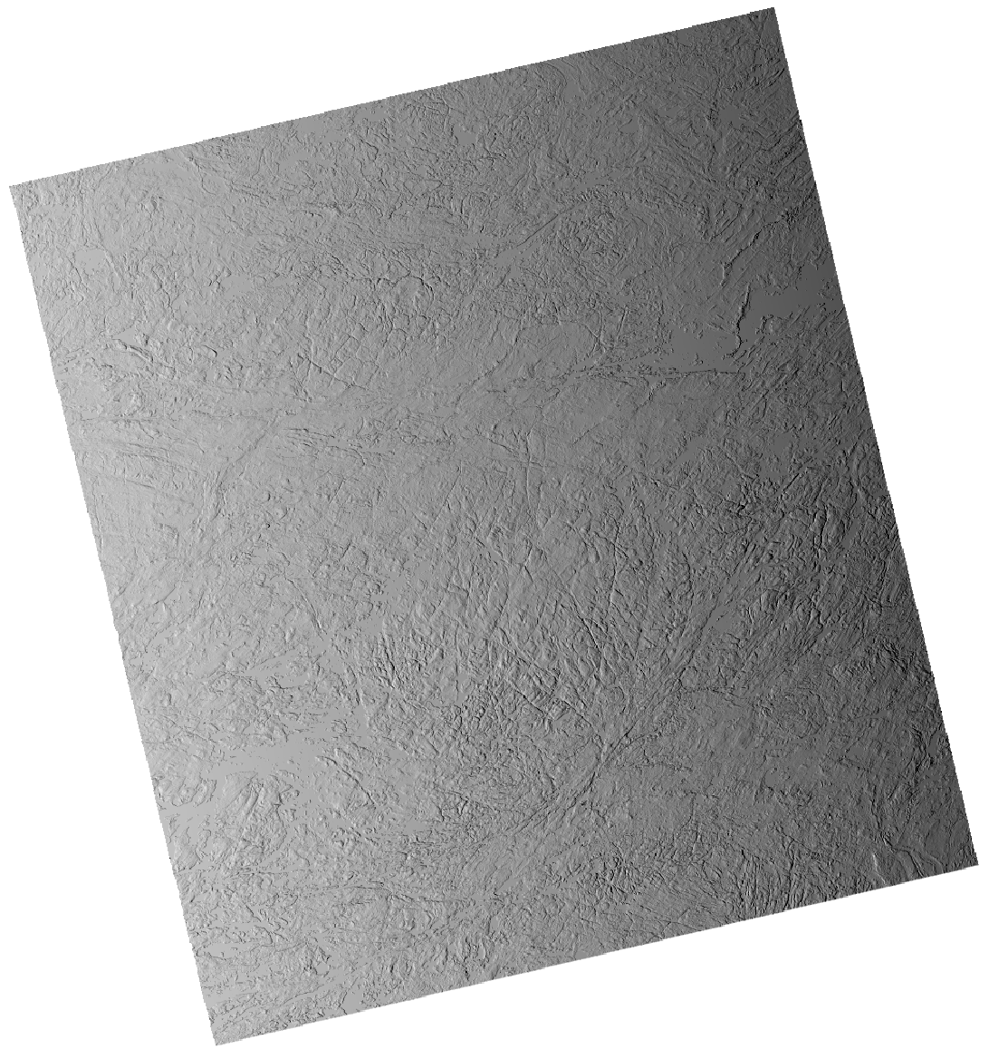

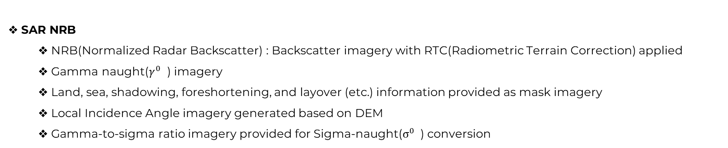

K-ARD for SAR Imagery
SAR NRB
NRB(Normalized Radar Backscatter) : Backscatter imagery with RTC(Radiometric Terrain Correction) applied
Gamma naught($γ^{0}$ ) imagery
Land, sea, shadowing, foreshortening, and layover (etc.) information provided as mask imagery
Local Incidence Angle imagery generated based on DEM
Gamma-to-sigma ratio imagery provided for Sigma-naught($σ^{0}$ ) conversion
SAR NRB $γ^{0}$Image
SAR NRB Mask
SAR NRB LIA
SAR NRB $γ^{0}$to $σ^{0}$ratio

Slide 15
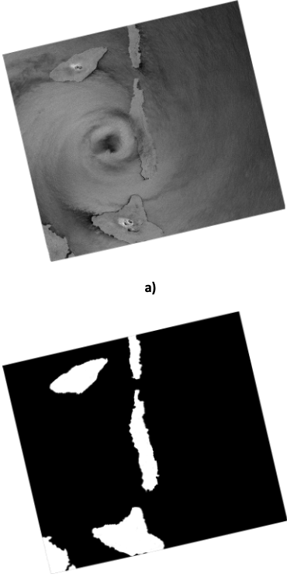
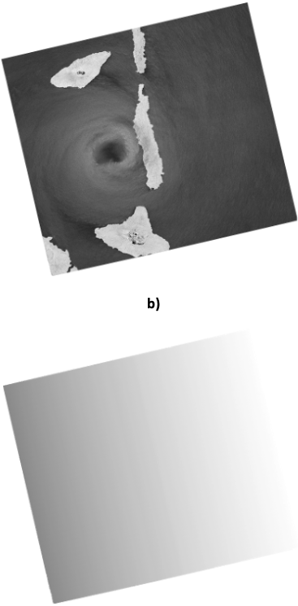
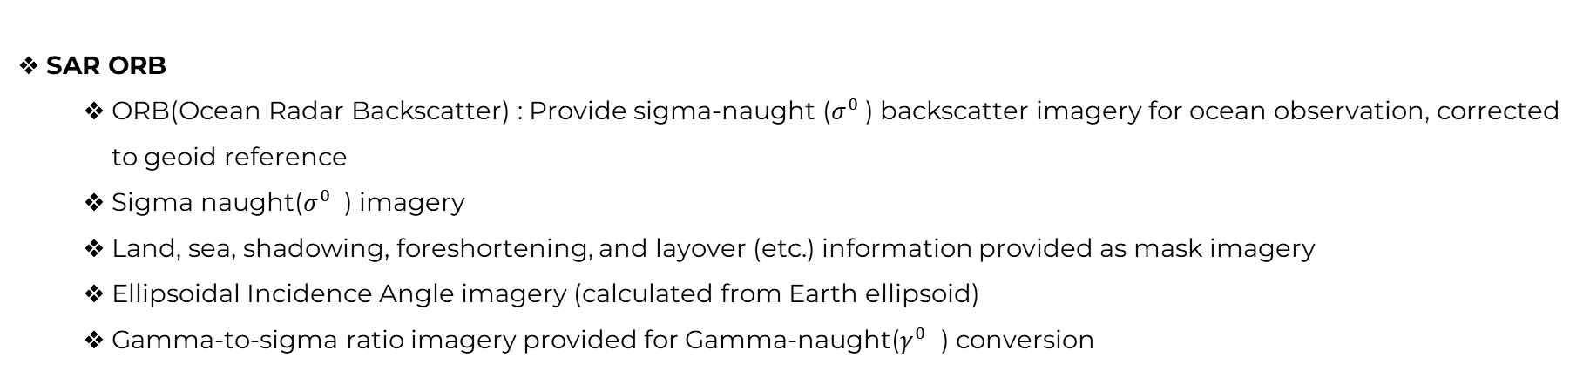


K-ARD for SAR Imagery
SAR ORB
ORB(Ocean Radar Backscatter) : Provide sigma-naught ($σ^{0}$) backscatter imagery for ocean observation, corrected to geoid reference
Sigma naught($σ^{0}$ ) imagery
Land, sea, shadowing, foreshortening, and layover (etc.) information provided as mask imagery
Ellipsoidal Incidence Angle imagery (calculated from Earth ellipsoid)
Gamma-to-sigma ratio imagery provided for Gamma-naught($γ^{0}$ ) conversion
SAR ORB $σ^{0}$VV
SAR ORB $σ^{0}$VH
SAR ORB Mask
SAR ORB EIA

Slide 16
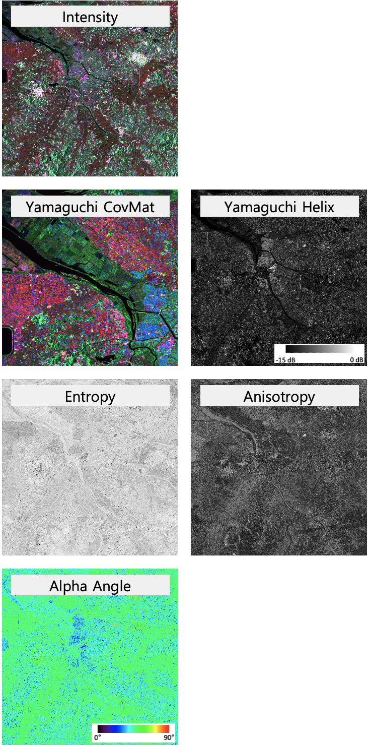
K-ARD for SAR Imagery
SAR POL
Polarimetric Decomposition | Product | Band | Description
CovMat | HH | Red | High backscatter observed over horizontally aligned surface
 | HV(VH) | Green | High return due to volume scattering
 | VV | Blue | High reflection from urban areas and man-made structure
Yamaguchi CovMat | Ps | Blue | Single-bounce backscatter from smooth ground surface
 | Pd | Red | Double-bound backscatter observed in dense building regions
 | Pv | Green | Volume scattering generated within vegetation
 | Helix | Gray scale | Scattering signal from multiple/asymmetric reflection patterns
Cloude-Pottier (H-A-Alpha) | Entropy | Gray scale | Signal representing scattering entropy
 | Anisotropy | Gray scale | Signal indicating the degree of directional scattering
 | Alpha | Gray scale | Signal representing the mean scattering angle

Slide 17
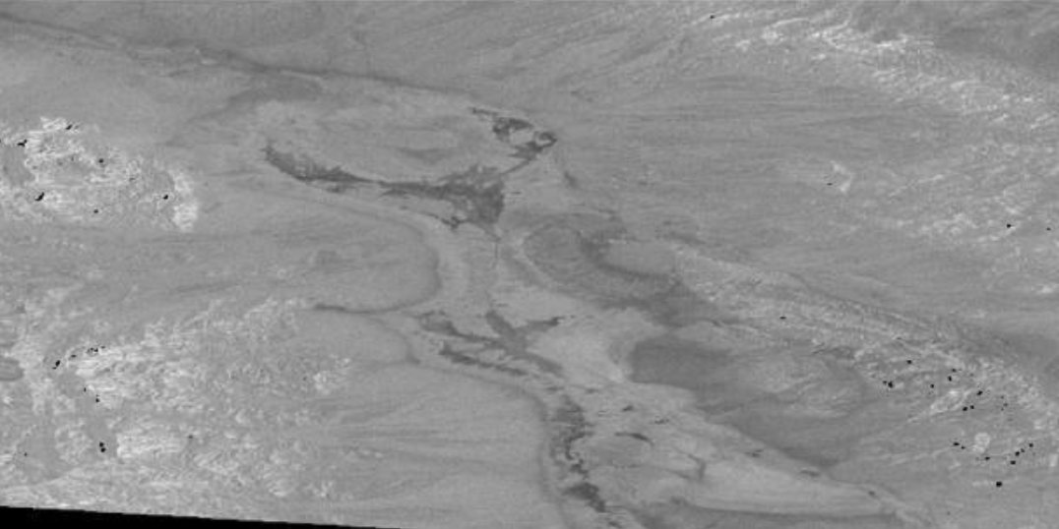
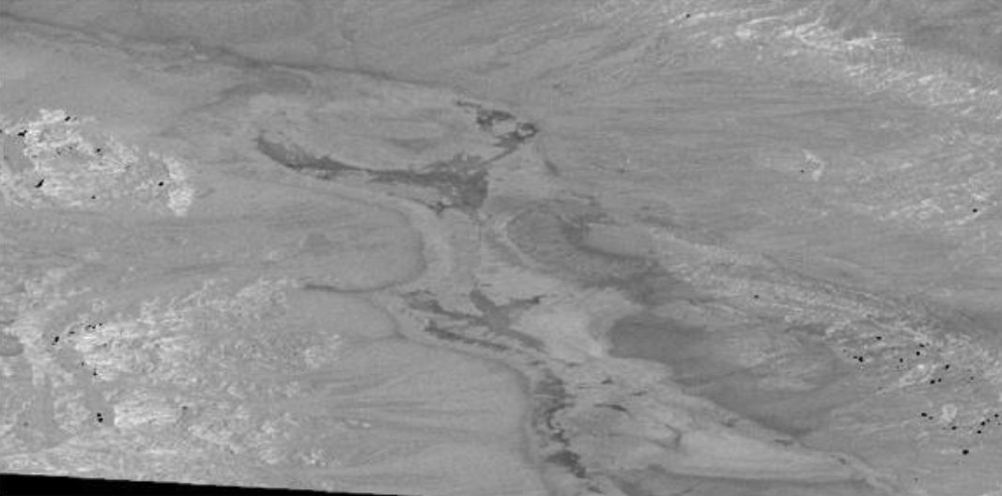
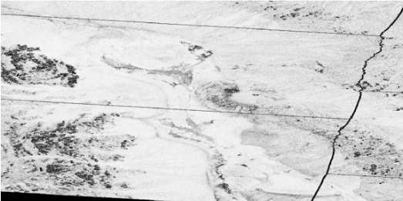

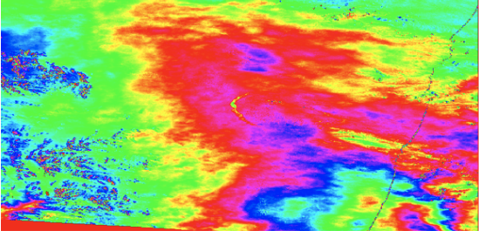

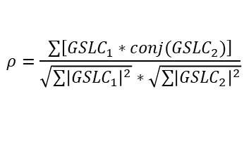
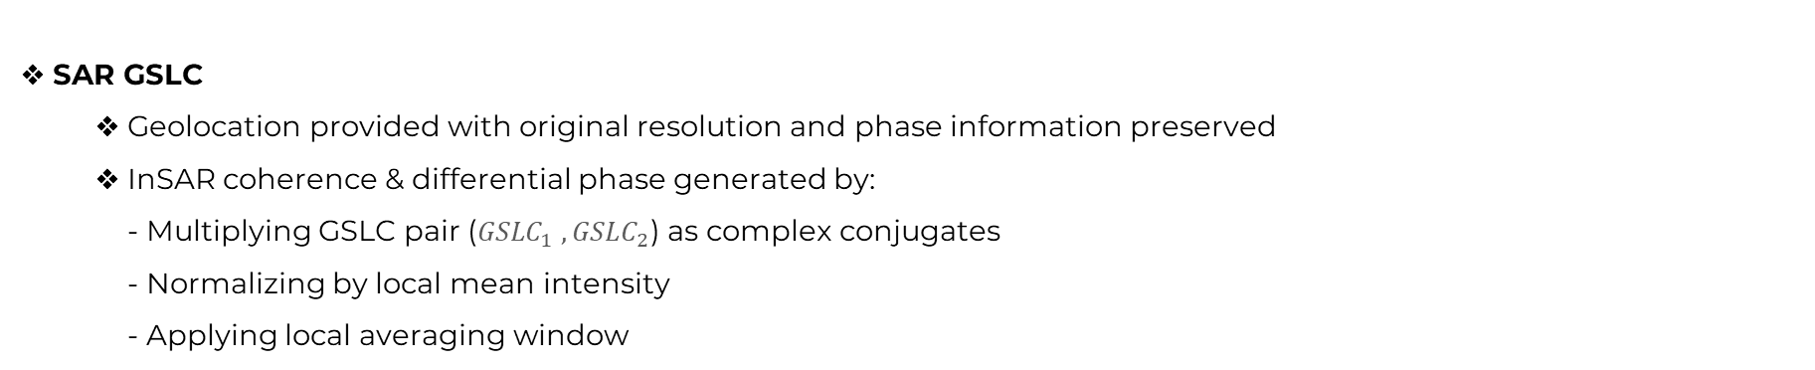

K-ARD for SAR Imagery
SAR GSLC
Geolocation provided with original resolution and phase information preserved
InSAR coherence & differential phase generated by: - Multiplying GSLC pair (${GSLC}_{1} ,{GSLC}_{2}$) as complex conjugates - Normalizing by local mean intensity - Applying local averaging window
Complex coherence
InSAR differential phase
GSLC Intensity(Complex image)
$$ρ=\frac{\sum{\left[{GSLC}_{1}∗conj({GSLC}_{2})\right]}}{\sqrt{\sum{{\left|{GSLC}_{1}\right|}^{2}}}∗\sqrt{\sum{{\left|{GSLC}_{2}\right|}^{2}}}}$$
$$φ=arg⁡(ρ)$$
GSLC₁ Intensity
GSLC₂ Intensity

Slide 18

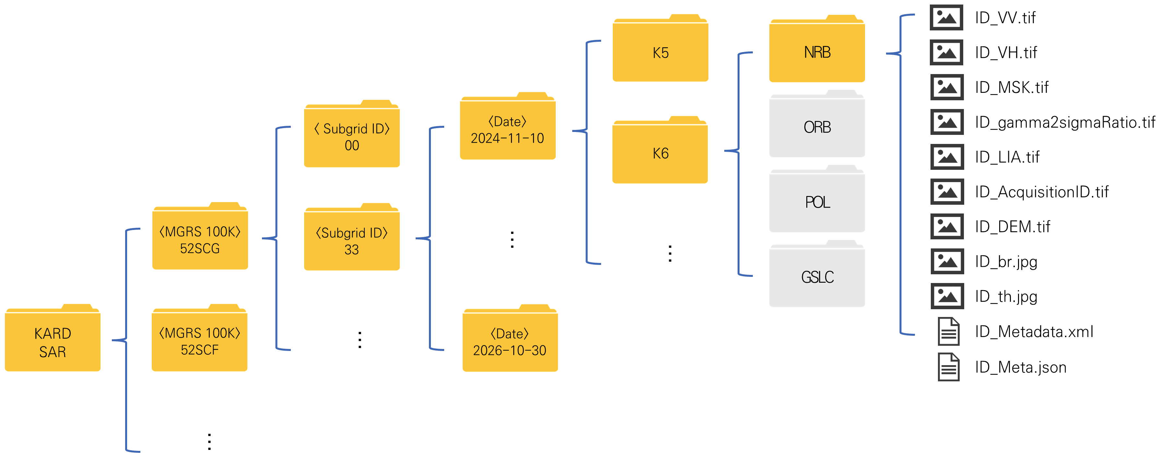
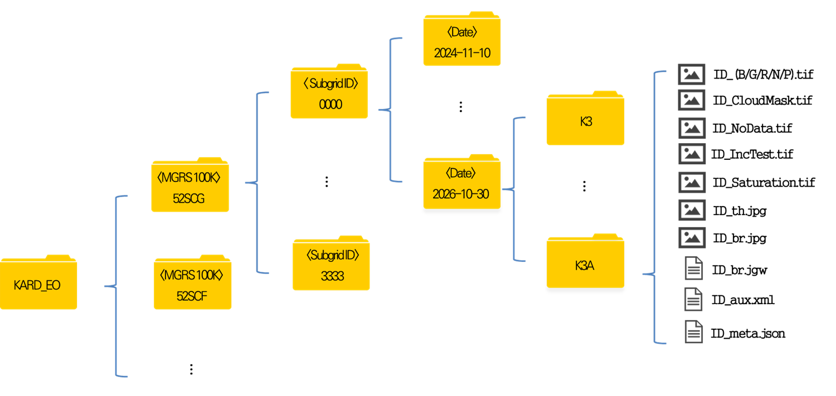
K-ARD Product Structure
SAR/EO product file and folder structure
K-ARD product folder structure defined as intuitive from user perspective
Structure advantageous for tile-based time-series visualization; designed as distribution folder structure
Folder structure aligned with image naming sequence of K-ARD products
SAR Folder Hierarchical Structure
EO Folder Hierarchical Structure
KARD
SAR
Tile Num.
Subgrid ID
Imaging Date
Satellite
Name
SAR
Product
KARD
EO
Tile Num.
Subgrid ID
Imaging Date
Satellite
Name

Slide 19
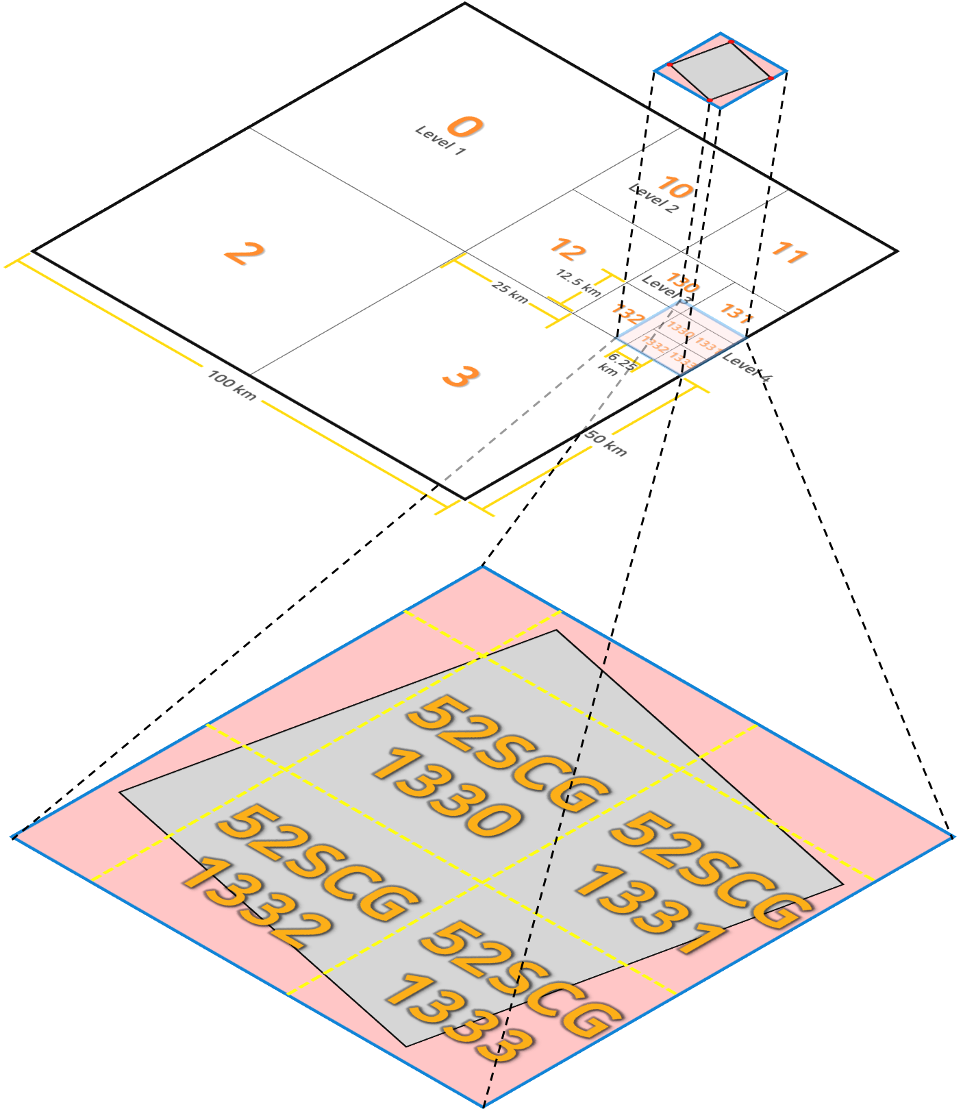
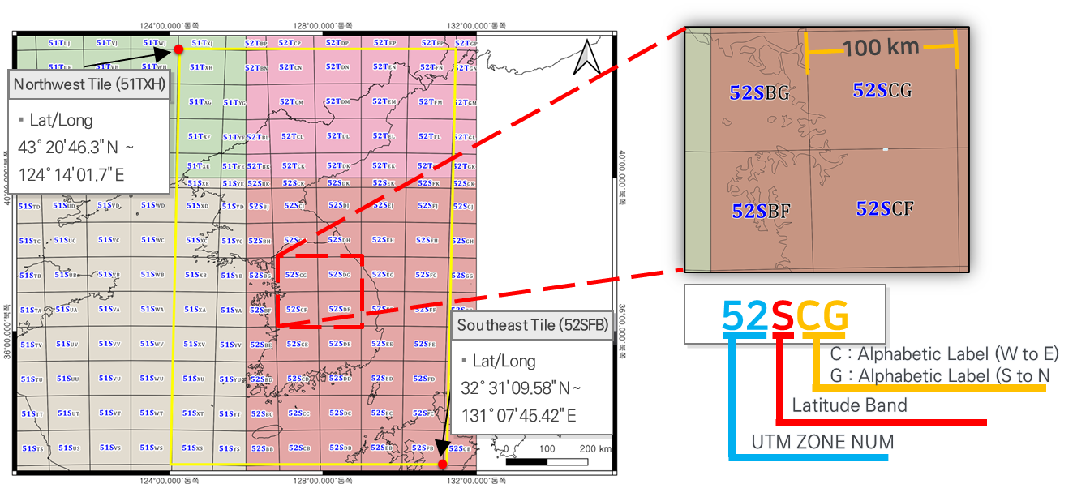
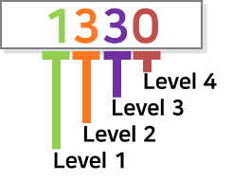
K-ARD Tiling Design
K-ARD tiling scheme defined on the basis of the MGRS tile system
Sub-grid tile size adjusted to EO and SAR swaths, following MGRS-based tile indexing rules
Tile sub-grid divided four times by quadtree method (equal-interval quartering)
Tile naming: MGRS tile index + sub-grid level (e.g., 52SCG1330)

Slide 20
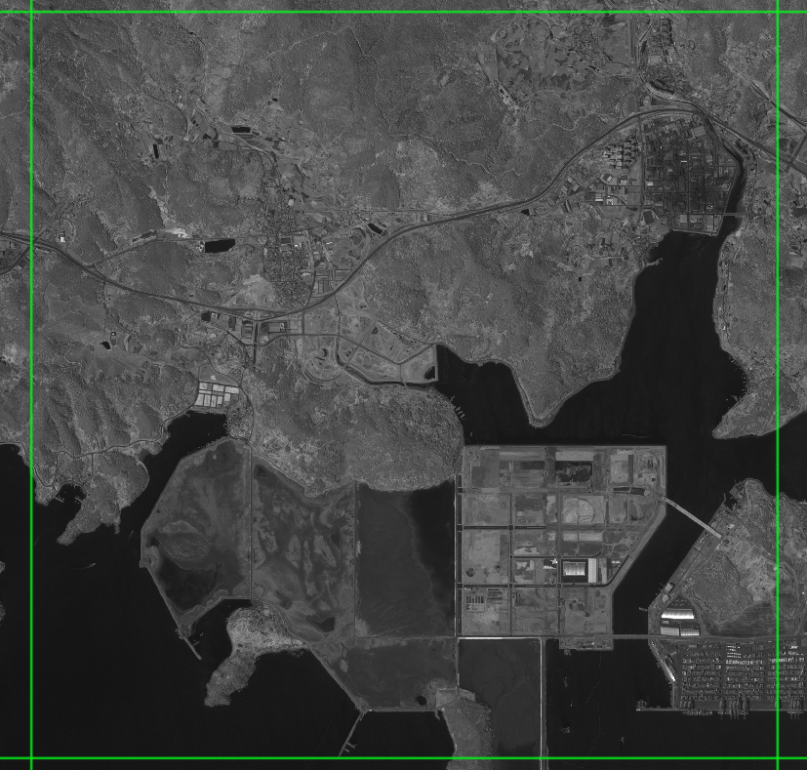
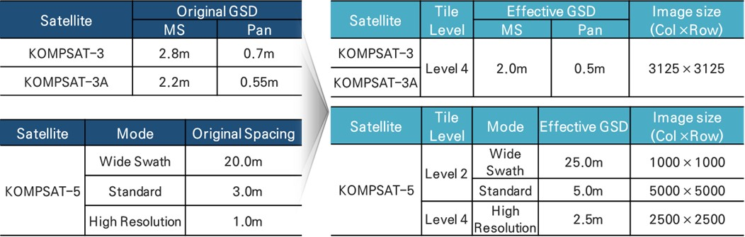
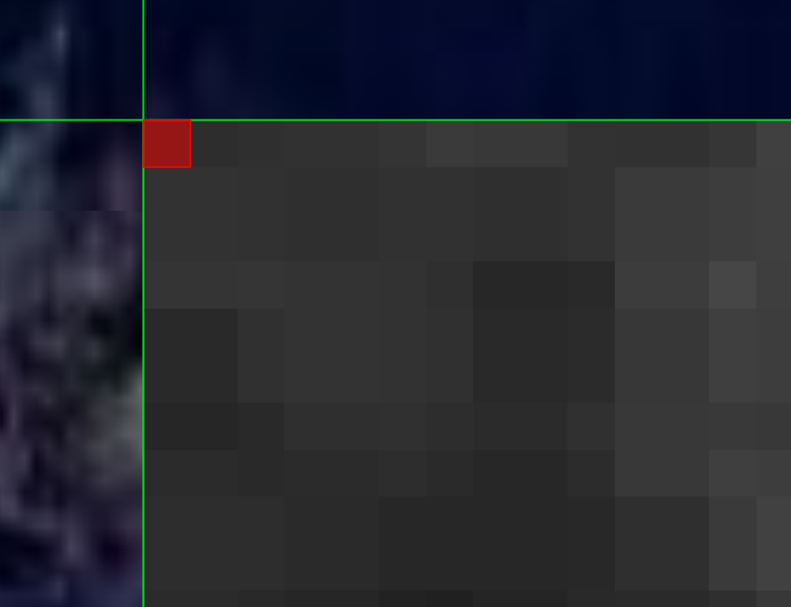
K-ARD Tiling Design
Determination of product GSD based on tile size
GSD defined as an integer multiple of the grid size
EO GSD set according to Level-4(6.25km) specification
SAR GSD set depending on acquisition mode (Level-4 and Level-2 combined)
Upper-left coordinate of the orthorectified image set to an integer multiple of the GSD for exact pixel alignment with grid boundaries

Slide 21
Near Term Activities
Near Term Activities
Software Integration and Development for ARD processing: ~ ’26/04
Software Testing and Verification for ARD processing: ~ ‘26/10

Slide 22
Thank you for your attention!

