Slide 1
U.S. Geological Survey – Agency Report
Timothy Stryker, USGS
Agenda Item #3.3
LSI-VC-18
Ispra, Italy
2-5 September, 2025

Slide 2
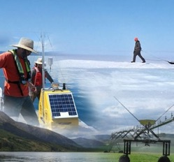
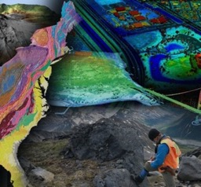
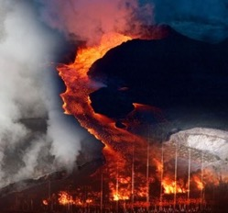
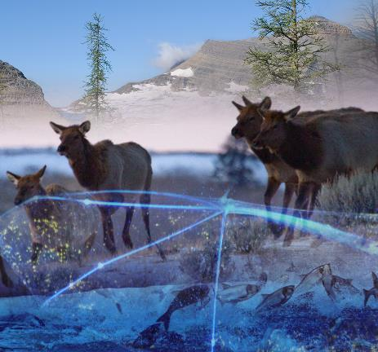
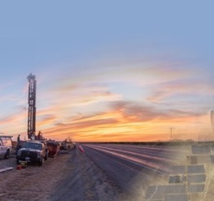
USGS Mission and Vision
Water Resources
The USGS mission is to monitor, analyze and predict current and evolving dynamics of complex human and natural Earth system interactions and to deliver actionable information at scales and timeframes relevant to decision makers.
Vision Statement: Lead the Nation in 21st-century integrated research, assessments, and prediction of natural resources and processes to meet society’s needs.
Core Science Systems
USGS Mission Areas
Natural Hazards
Energy and Minerals
Ecosystems

Slide 3
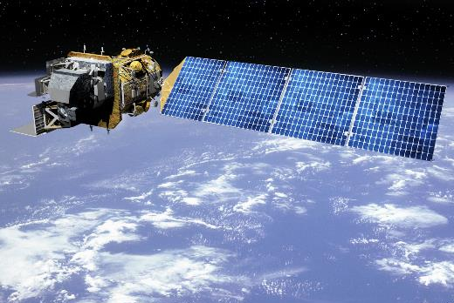
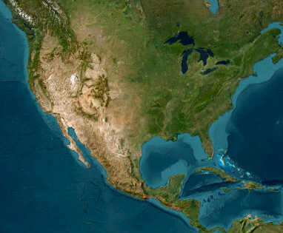
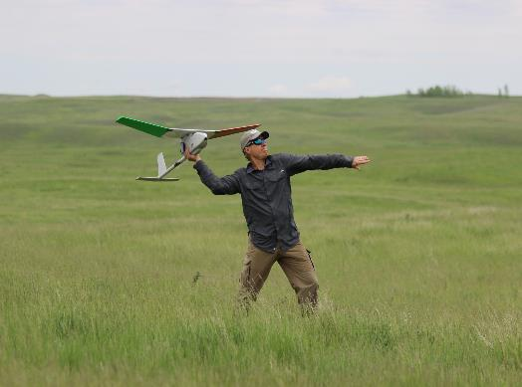
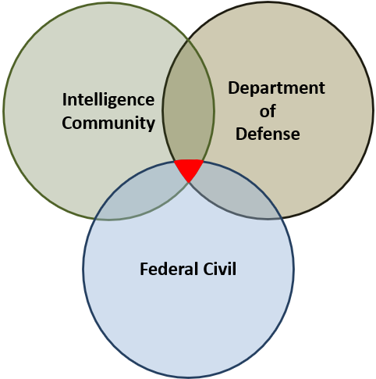
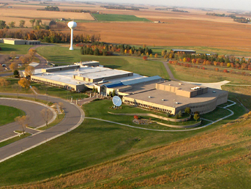

National Land Imaging (NLI) Program Overview and Objectives
NLI delivers a national and global capability to ensure broad public and scientific availability of observations of the Earth’s land surface.
The National Land Imaging Program includes:
Landsat Development & Operations
Applied Science and Applications
Remote Sensing Research & Development
National Civil Applications Center activities
National Land Remote Sensing Education, Outreach & Research Grant
Landsat 8, 9, and Landsat Next
USGS Earth Explorer
Uncrewed Aircraft Systems (UAS)
National Civil Applications Center (NCAC)
Earth Resources Observation and Science (EROS) Center
Education & Outreach Grant
Notes:
I would like to start with an overview of NLI and key components.
The National Land Imaging Program (NLI) is USGS’s lead program for satellite Earth observation.
NLI ensures that the US has continuous, reliable access to land imaging data, and it delivers this through a coordinated system of platforms, partnerships, and tools.
NLI has historically included a wide variety of programs, projects, and grants, as you see on the screen - including the AmericaView RS education and outreach consortium
USGS Earth Resources Observation and Science (EROS) Center is the operational hub for land imaging, located in Sioux Falls South Dakota. It processes, archives, and distributes millions of satellite images, supporting scientists, policymakers, and disaster response teams worldwide.
EarthExplorer is USGS’ public web portal that provides easy access to a massive archive of remote sensing data. Users can download Landsat, commercial imagery, aerial photos, and other geospatial datasets at no cost—supporting decision-makers, educators, and the public.
Landsat is the longest-running satellite imagery program in the world—capturing continuous images of Earth since 1972, and supporting national and commercial satellite imagery calibration and validation worldwide.
The National Civil Applications Center (NCAC) is funded by, and reports to NLI. Its role is advancing the the civil applications of dual-use (defense/intel systems) Earth observations technology. It is also USGS’s primary mechanism for accessing and using a wide range of commercial EO data and products.

Slide 4


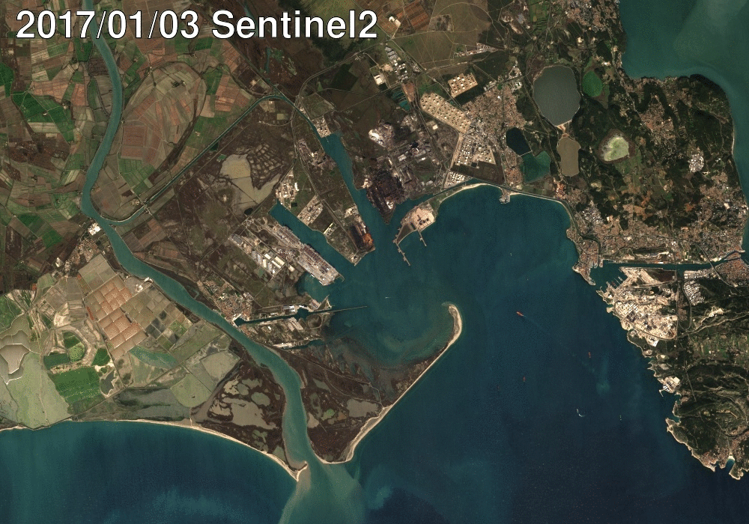

USGS VISION A comprehensive, worldwide, operational environmental monitoring system supported through international partnerships
USGS OBJECTIVE To partner with international agencies and organizations to advance U.S., Interior Department, and USGS Earth science objectives.
DESIRED OUTCOMES
Enhanced Mission Capabilities
Complementary EO Data Formats
Reciprocal Data Access
Cost Savings
Harmonized Landsat and Sentinel data over La Crue, France
Sentinel Data provided courtesy of the EC/ESA

Slide 5














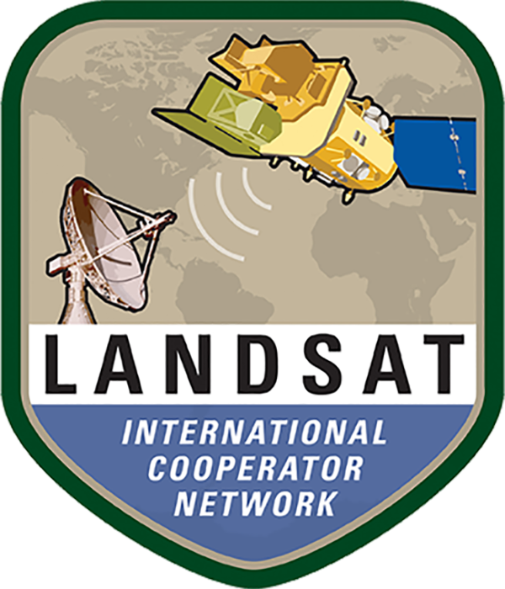













USGS Space-Based Earth Observation
Collaboration & Partnerships
Western
States
Water
Council

Slide 6
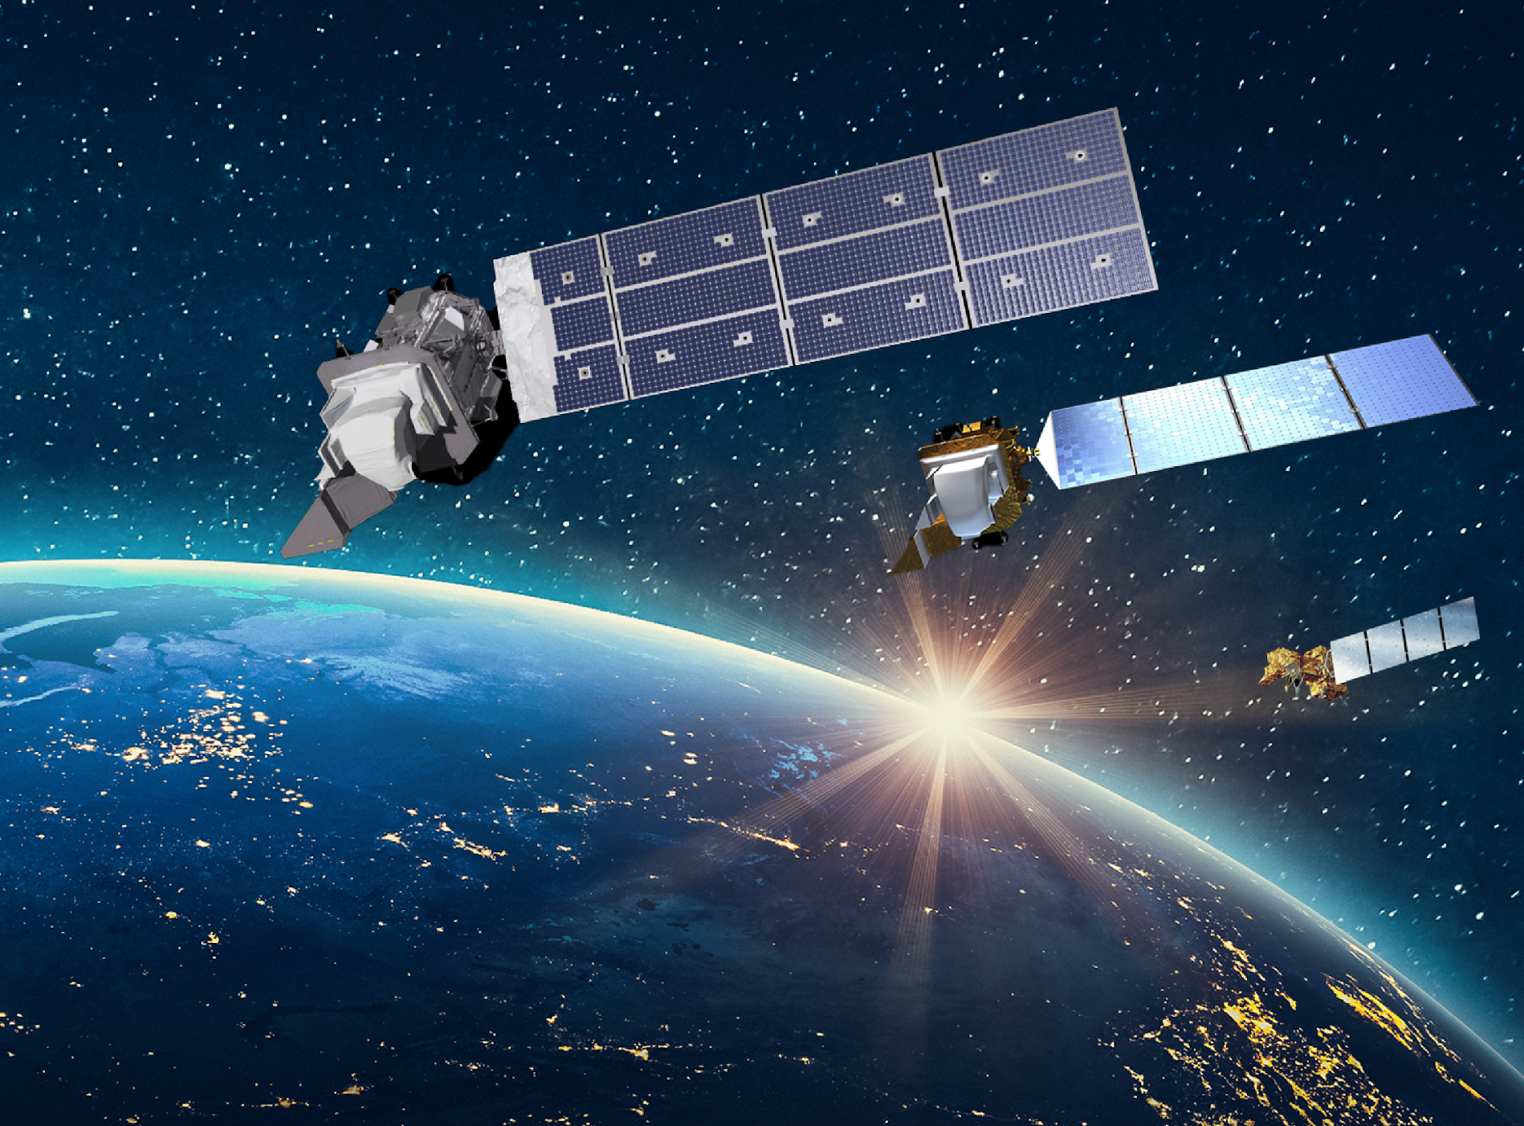


Landsat Operations Status
Landsat 9 (2021 - )
Collecting 750 new scenes (10 million square miles) per day; full mission transitioned to USGS in 2022
Landsat
Archive
Operations
FY 2024 Statistics:
~18 billion accesses via Commercial Cloud;
~100 million product downloads; and
~50 thousand terabytes managed.
Landsat 8 (2013 - )
Collecting 750 new scenes (10 million square miles) per day; will fall below 50% availability in 2030
Landsat 7 (1999 - 2025)
Lowered into storage orbit; decommissioning process complete—final commands sent June 4th

Slide 7






















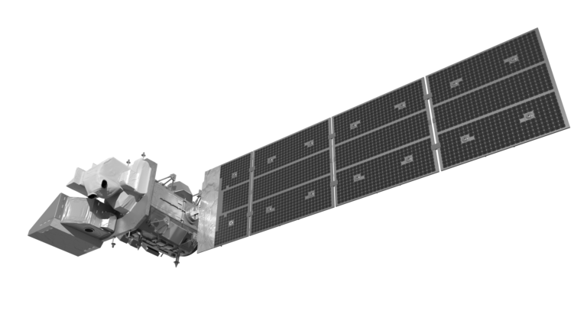






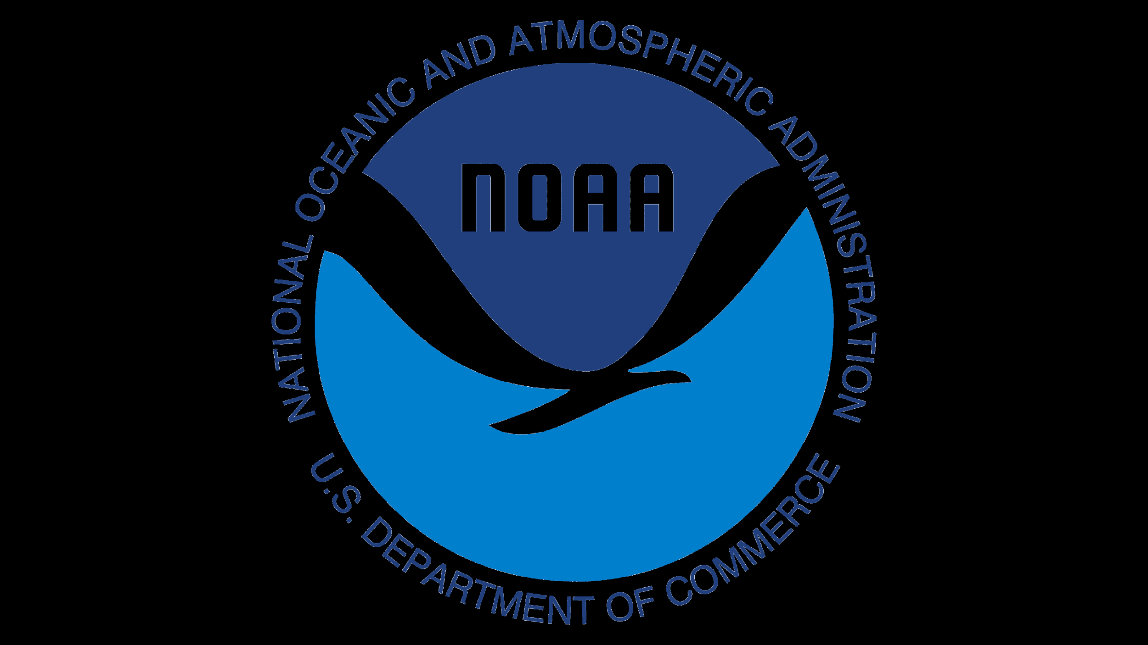












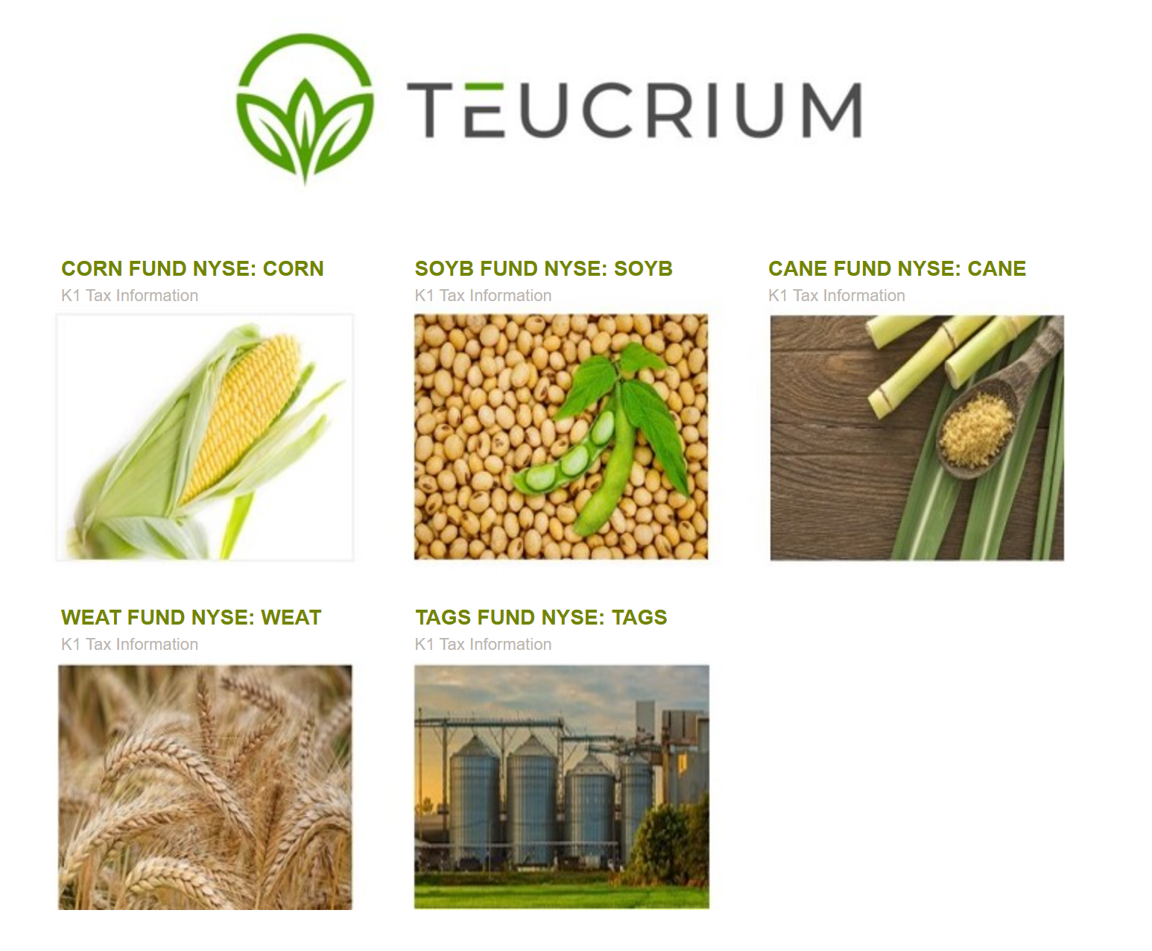





Data Acquisition,
Storage, & Delivery
Data Applications/
Products
U.S. Government and Corporate Direct
Data Consumers
Corporate Derivative
Information Consumers
Landsat is used everywhere!
Education Training
Teachers & Academic
Research
Energy Development
Cloud to User
Technology Innovators
Mineral Exploration
Commercial Real Estate
Developers
Cloud Compute, Storage
& Provider Services
Resource Management
Wetland, Water & Wildlife
Resource Managers
Landsat Satellites
(Raw Data)
Real-Time Data
Hazard Monitoring
Wildfire/Volcano
Flood Monitoring
Data Direct to User
Fire Fighters &
Emergency Services
1st Responders
Landsat Data used for
Calibration/Validation
EROS Data Center
Sioux Falls, SD
Disaster Response
Land Use/Land Cover
Change Detection
Tribal Partners
State & Local Planners
Decision Makers
Cropland Data Layer (CDL)
National Reports
Commodities Reports
Wheat
Corn
Soy
Sorgum
Coffee
Land Management
Agriculture
Forestry & Timber
Production
Commodity
Brokers
Notes:
Partly due to Landsat's longevity (more than 50 years of data) and partly due to its incredible impact (think Swiss Army Knife in Space), Landsat data and products have become integrated into the very fabric of our nation's economy.
This graphic conveys how Landsat data provided by our orbiting satellites is transferred to our primary science and data center—the Earth Resources Observation & Science (EROS) Center in Sioux Falls, SD—and then distributed in multiple ways to a myriad of users across the U.S. federal, commercial and academic sectors.
Users identified in this graphic and many more are able to access data and Landsat-derived products (like our National Land Cover Dataset) directly from EROS via mechanisms like USGS EarthExplorer or via commercial cloud providers like Amazon, and indirectly through Landsat's use in products that incorporate it into reports like agriculture forecasts, mining forecasts and wildfire predictions.
Much like GPS and weather information, Landsat data is an essential public service that returns billions in annual economic benefit to Americans and to the world, resulting in an incredible 100 X return on investment by the American taxpayer.

Slide 8
Landsat Next
NOTE
The President’s Fiscal Year 2026 Budget Proposal, announced by the White House
Office of Management and Budget on 2 May, directs the restructure of Landsat Next
"...while NASA studies more affordable ways to maintain the continuity of Landsat imagery,
which is used by natural resource managers, States, and industry."
Details of this restructure, including impacts to users, are yet to be determined.

Slide 9
Thank You!
Timothy Stryker
Chief, Outreach and Collaboration Branch
National Land Imaging Program
U.S. Geological Survey
U.S. Department of the Interior
tstryker@usgs.gov

Slide 10
Backup Slides

Slide 11
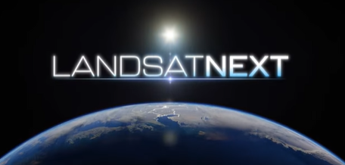

Current Landsat Next "Superspectral Triplets" Architecture
Designed to provide more frequent and finer-resolution science-quality Earth observation data of the changing surface of the Earth, complementing commercial and international datasets and meeting user needs of the 2030s
Based directly on user needs collected from across the U.S. Federal civil agencies community
3 smaller satellites, launched together, delivering combined 6-day revisit time supporting more frequent coverage of changing processes such as crop growth and coastal change and hazards.
“Super-spectral” with 15 new bands (5 thermal infrared bands in all) supporting water use/quality, soil conservation, and mineral mapping.
Improved spatial resolution (from 30 to 10-20 meters multispectral and from 100 to 60 meters thermal infrared) for finer targets of farm fields, forest disturbance, urbanization, inland lakes and streams.
Sustained radiometric quality supporting science and commercial users.
The current Landsat Next mission design would result in the largest collection of new Landsat data in the history of the program, estimated at 15 times the data volume of Landsat 9.
Eventual Details of the Landsat Next mission architecture are subject to
U.S. Fiscal Year 2026 Appropriations and any Related Administration and Congressional Guidance

Slide 12
Driving Applications for Current Landsat Next Architecture
Societal Benefit Area | Application | Benefits
Agriculture | U.S and global agricultural monitoring | Landsat Next would allow U.S. Federal agencies more precise observation of crop emergence.
 | Crop residue monitoring/soil conservation | Landsat Next observations in the early growing season could allow U.S. Federal agencies to detect cover crop and crop residue for soil conservation at the field-scale.
Forestry | Forest health monitoring | Landsat Next would aid U.S. agencies in their detection and identification of insect/disease agents for forest health monitoring, since symptoms are often seasonal and transient.
Water Resources | Evapotranspiration and water use | Landsat Next frequent observations of evapotranspiration (ET) are needed for field-scale ET estimates and continuous operational water use monitoring by U.S. Federal and Western State agencies.
Water Quality | Harmful Algal Bloom detection and monitoring | The new targeted spectral bands for water quality provided by Landsat Next would enable detection of specific organisms that cause harmful blooms.
Cryosphere | Snow/water availability | Higher temporal frequency and new targeted spectral measurement capabilities of Landsat Next would reduce cloud cover contamination while increasing detection.
Energy & Minerals | Mineral exploration and energy resource management | Landsat Next would enhance mineral exploration and energy resource management by providing richer spectral data and greater spatial resolution, improving the detection of minerals, helping companies locate fuel sources and geological deposits more efficiently, reducing cost and risk while maximizing investment returns.
Wildfire | Pre- and post-fire assessment | Landsat Next higher temporal revisit is needed to capture the onset of more frequent wildfires and support immediate post-fire response.
Slide ‹#›

Slide 13
Landsat Continuity Evolves
Since 1972, Landsat satellites have continuously acquired images of the Earth’s land surface, providing uninterrupted
data to help land managers and policymakers make informed decisions about natural resources and the environment.
Landsat Continuity has always been central to the program’s success. This includes:
(1) maintaining historic sensor compatibility to support long-term time series analyses
(2) ensuring consistent image quality to reduce uncertainties in land surface measurements
(3) evolving satellite observations and data products to meet changing priorities and national needs
The NASA/Interior Sustainable Land Imaging (SLI) program initiated in 2015 ensures a multi-tiered “sustainable” program
with on-ramps for new technology refresh designed to meet evolving observational requirements and emerging applications.
The world of the 2030s will be different, requiring improved Earth observations. Landsat Next would maintain Landsat’s
historic radiometric quality while supporting the monitoring of smaller agricultural fields and forests; more rapid clear
views of crop health and productivity, water quality, snow/ice state and wildfire; and support emerging applications in
water quality, snow hydrology and soil mapping.
Landsat history has shown that “continuity evolves”. Each new mission is enhanced with
improved yet mature technology to meet evolving user needs and emerging applications.

