Slide 1
LSI-VC-18
ISRO’s Updates on SAR CEOS-ARD products
P.V. Jayasri, Raghav Mehra
V.M. Ramanujam, H.S.V Usha Sundari
Indian Space Research Organization(ISRO)
Agenda Item # 3.4, LSI-VC-18, Ispra VA, Italy
3-5 September, 2025

Slide 2

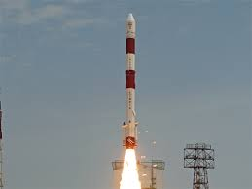
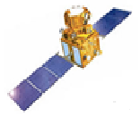
Indian Space Research Organization (ISRO)’s
Earth Observation Programme
ISRO’s EO Verticals:
- Remote Sensing
- Communication
- Weather
Planetary Missions
SAR Based Remote Sensing:
- Capability: Multi-Frequency and Multi-Polarization
- Spatial Resolution: 1m to 50m
- Swath: 10Km to 225Km
- Platforms: Airborne to Spaceborne
(Optical, SAR, Thermal, Hyper Spectral Sensors)
Calibration, Performance & Quality Reviews
Maintenance of Spacecraft
and Payload Quality
Design, Implementation
Reviews, Testing, Approvals
Launch
Commissioning/
In-Orbit Testing Phase
Operational Phase
End Of Life
Satellite
Conceptualization
Mission Performance Analysis and Data product Quality Evaluation
Calibration & Validation
Acquisition Planning
Acquisition Planning as per user demand
Data Products Generation
Quality Control & Assurance
Product Dissemination
Assimilation of user feedback/ requirements
Global Scenario
Studies for Satellite Configuration finalization
Payload Acquisition Planning

Slide 3
ISRO CEOS-Compliant SAR - ARD Product Generation – A Road Map
SNO | ARD Product | Sensor | Product Type | Timeline | CEOS Endorsement Status
1 | Normalised Radar Backscatter | EOS-04 / EOS-09* (RISAT-1A / RISAT-1B) | Level2B[NRB] | 2024 / 2025* | Completed
 |  | EOS04/ EOS-09* | India Mosaic[NRB] (Tiled Product) | 2024 / 2025* | Completed.
2 | Polarimetric Radar | EOS04/ EOS-09* | Geocoded Polarimetric Decomposition Products (Level-3B) [PRD] | 2025 | Final Designer level product package validation is in progress at ISRO
 |  | EOS04/ EOS-09* | GCOV (Geocoded Covariance Product) [CovMAT] | 2024 / 2025* | Final Designer level product package validation is in progress at ISRO
 |  | NISAR | GCOV (Level-2) [CovMAT] | 2025 | Launched successfully on 30th July, 2025 at SHAR/ISRO – India. S-SAR Data Acquisition and Data products validation is in progress as per NISAR Reference Observation Plan and Pan India Corner Reflector Network.
3 | Geocoded Single Look Complex | NISAR | GSLC (Level-2) | 2025
4 | Interferometric Products | NISAR | GUNW (Geocoded – Unwrapped Interferogram) | 2025/26
* -EOS-09 - Launch unaccomplished.
CEOS LSI-VC-18, 3-5 September 2025

Slide 4
CEOS Endorsement for ISRO’s Products
Following EOS-04 Data products are presently CEOS ARD Compliant NRB products for SAR PFS:
EOS04–Level-2B NRB data products for ScanSAR are CEOS ARD compliant NRB products.
EOS-04 Tile based India Mosaic product is compliant to CEOS NRB ARD specifications.
Date of Endorsement: 2nd April 2024.
Date of Endorsement: 6th January 2025
SAR Product Family Specification: v 1.0
SAR Product Family Specification: v 1.1
Evaluation : at Threshold Level
Evaluation : at Threshold Level
EOS-04 CEOS - ARD NRB ScanSAR Imaging mode .
Medium Resolution ScanSAR (MRS):18 meters spacing, scene-base (Level-2B ARD) Single, Dual, Circular and Full -polarization single-date products.
Coarse Resolution ScanSAR (CRS):36 meters spacing, scene-based (Level-2B ARD) Single, Dual, Circular and Full -polarization single-date products.
Medium Resolution ScanSAR (MRS) India Mosaic –
18 meters spacing, 1 deg X 1 deg tile-based NRB-ARD Dual HH-HV -polarization multiple-date products.
EOS-04 India Mosaic ARD product from MRS systematic coverage acquisitions is available as set of 809 1 deg. X 1 deg. tiles every 17 days.
https://doi.org/10.46693/NRSC/10/E04_SAR_MRS_STUC00ZTD
https://doi.org/10.46693/NRSC/10/E04_SAR_MRS_FIGC00ZTD

Slide 5
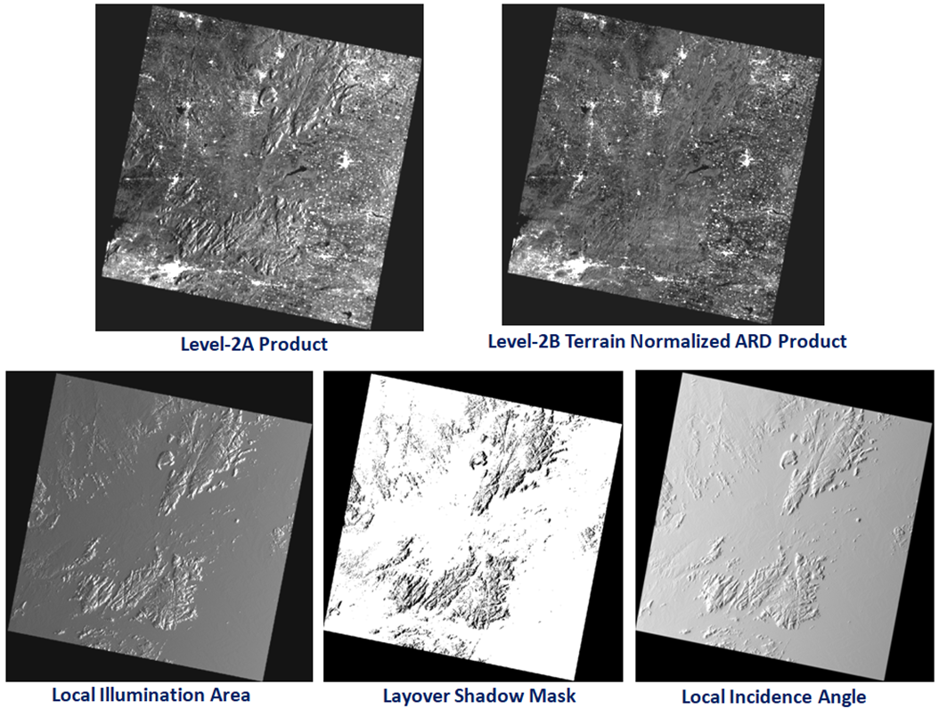
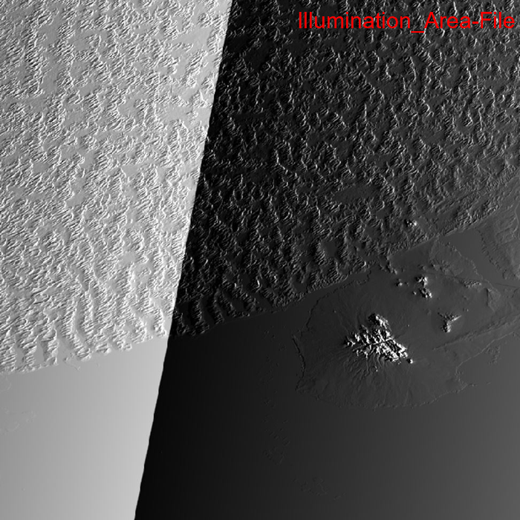
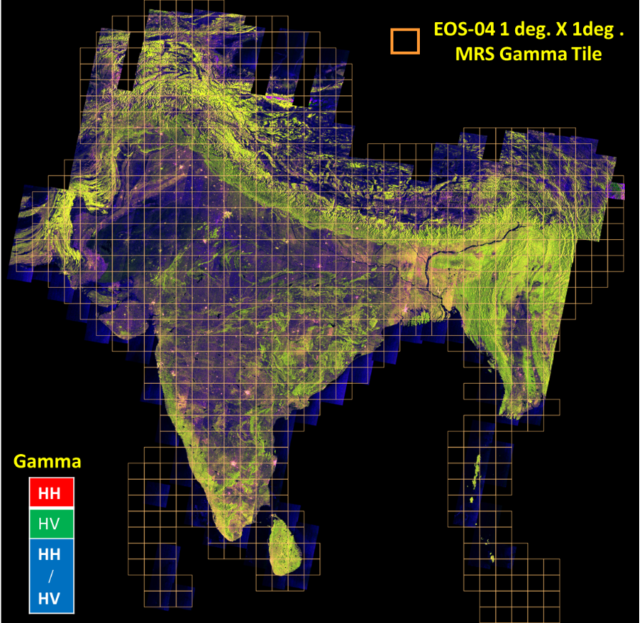
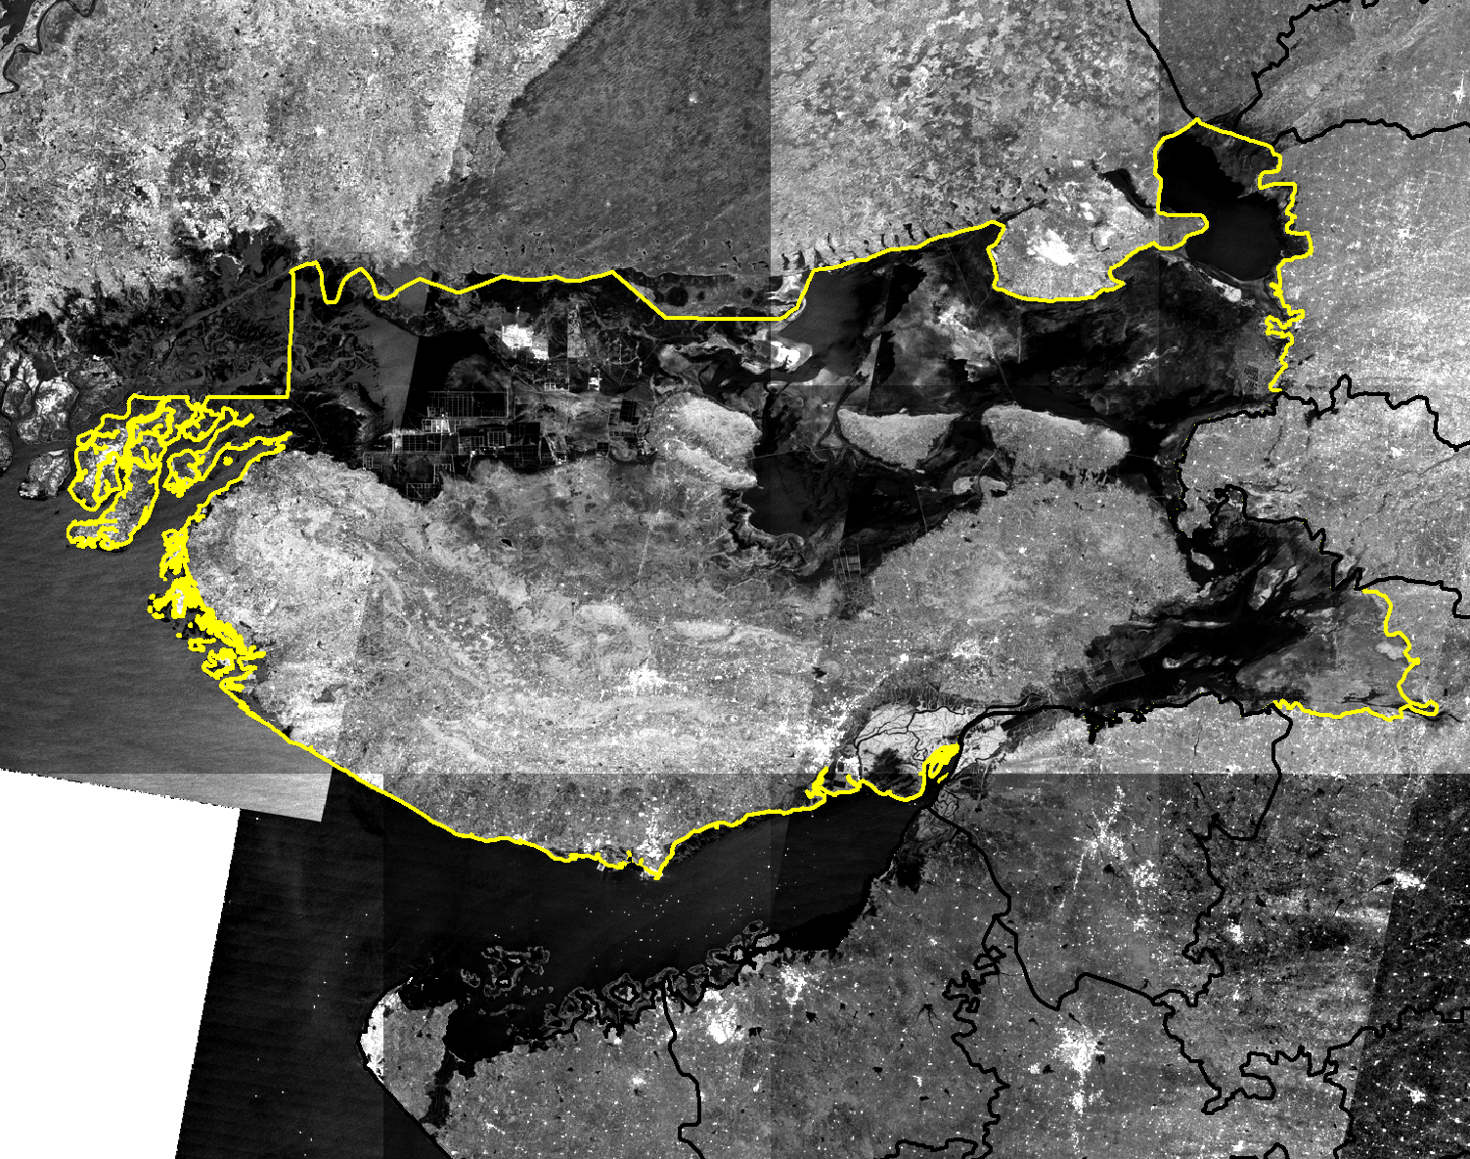
Sample data of EOS-04 ARD Products
Level-2B NRB data products (CEOS-ARD Endorsed)
EOS04 – Tiled based India Mosaic Product (CEOS-ARD Compliant)
Sample 1 deg x 1 deg tile
Medium Resolution ScanSAR(MRS) – 18m
BACK
Sample India Mosaic Product for a particular District in Gujarat State, India.

Slide 6
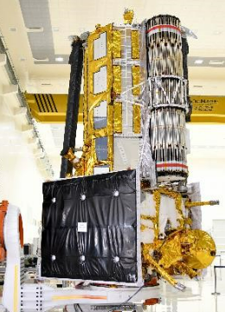
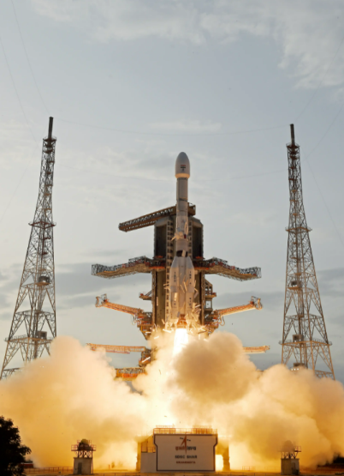
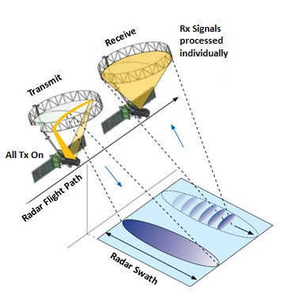
NISAR Mission
The NASA-ISRO Synthetic Aperture Radar (NISAR) mission, jointly developed by ISRO and NASA, was successfully launched aboard GSLV-F16 on 30 July 2025 from SHAR-ISRO, India
World’s first mission with dual frequency SAR—NASA’s L-band and ISRO’s S-band—using the advanced SweepSAR technique,
Capable to capture high-resolution polarimetric and interferometric data over a wide swath.
Designed for Global Earth system monitoring - Land, Cryosphere and Ocean surfaces.
Reptivity: Every 12 days during mission life providing exceptional insights into our planet’s dynamics.
NISAR Characteristic | Enables...
L-band (24 cm wavelength) | Low temporal decorrelation and foliage penetration
S-band (9 cm wavelength) | Sensitivity to light vegetation
SweepSAR technique with Imaging Swath > 240 Km | Global data collection
Polarimetry (Single/Dual/Quad) | Surface characterization and biomass estimation
12-day exact repeat | Rapid Sampling
3-10 m mode-dépendent SAR resolution | Small-scale observations
3 years science operations (5 years consumables) | Time-series analysis
Pointing control <273 arcseconds | Deformation interferometry (D-InSAR)
Orbit control < 500 meters | Short baseline D-InSAR
> 10% (S) / 50% (L) observation duty cycle | Complete land/ice coverage
Left-only pointing (Left/Right capability | Uninterrupted time-series Rely on Sentinel-1 for Arctic
SwweepSAR Technique
NISAR Spacecraft
Launched successfully on
30th July, 2025

Slide 7
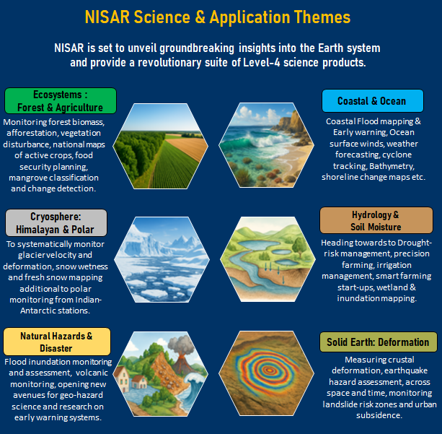
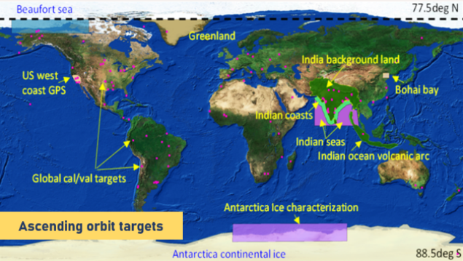
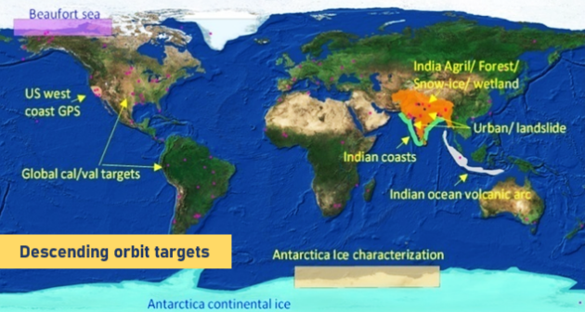
NISAR – Science Applications
ISRO identified Targets

Slide 8
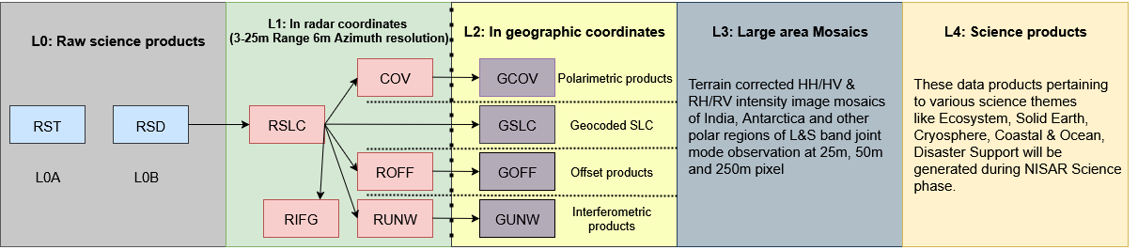
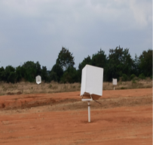
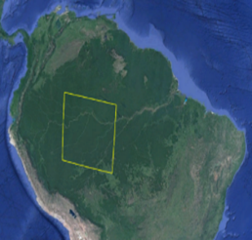
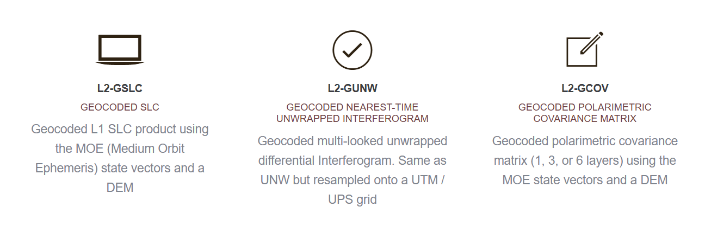
NISAR Data Products
RST –Raw Science Telemetry (Level 0A)
RSD-Radar Signal data (Level 0B)
RSLC- Range Doppler Single Look Complex
COV–Polarimetric Covariance Matrix
RIFG - Nearest-Time Interferogram
RUNW- Nearest-Time Unwrapped Interferogram
ROFF – Range Doppler Pixel Offsets
GSLC – Geocoded Single Look Complex
GNUW – Geocoded nearest –time unwrapped interferogram
GCOV – Geocoded Polarimetric Covariance Matrix
GOFF – Geocoded pixel offset
Data Product harmonization between ISRO and NASA have been implemented to ensure interoperability and consistency in data exploitation across diverse scientific disciplines and thematic applications.
Proposed for CEOS Endorsement
NISAR S-SAR Data Products will be well calibrated using PAN India Corner Reflector Network and Distributed Homogenous targets.
Level 0B, Level 1 & Level 2 Product in HDF-5 Format

Slide 9
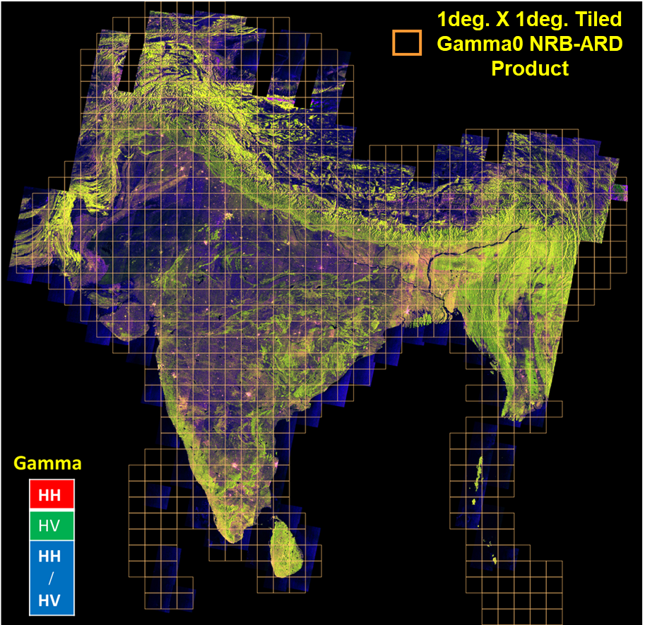
L, S (NISAR), C (EOS-04) Band India Mosaic ARD Product
Specifications 1⁰ X 1⁰ Tiles for India Mosaic ARD Product
Total No. of Tiles (India Mosaic Product) per cycle (17 days for EOS-04 ; 12 days for NISAR) | 809
Layers per Tile Product | 6 : HH-HV RTC Gamma0, LIA, Area, Mask, Date
Node/Look | Descending/Right (EOS-04) C-Band Ascending/Left (NISAR) L+S -Band
Tile Spacing (Geographic Lat-Lon) | =0.0001636125⁰ (for 18 m pixel size)
Volume per Tile Product | 314 MB
Format of tile Product | Cloud Optimized GeoTIFF (COG)
Gamma0, Mask, Date | Unsigned Short Int 16
Area , LIA | Float32
Products Repository
https://bhoonidhi.nrsc.gov.in

Slide 10


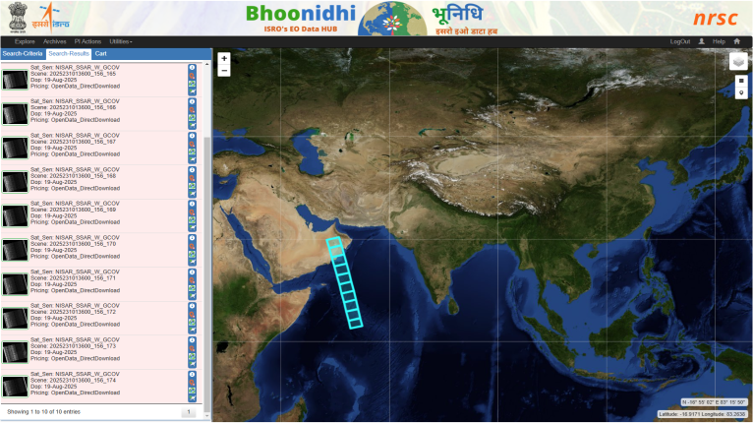


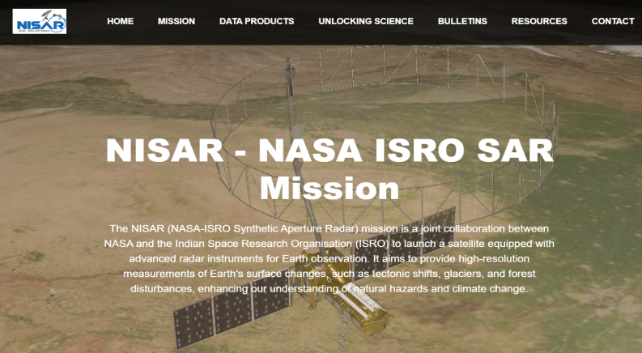

BHOONIDHI
ISRO’s Earth Observation Data Hub
NISAR Data Dissemination @Bhoonidhi
NISAR data available under the Open Data category on Bhoonidhi.
The platform provides easy access to data collected over ISRO-targeted areas in S-band, L-band, and Joint (L+S) modes.
NISAR: https://bhoonidhi.nrsc.gov.in/NISAR
Advanced search filters - including track/frame, polarization, etc., are enabled for efficient browsing and downloading of NISAR data.
Spatio Temporal Asset Catalogue (STAC)
STAC data catalogue for increased data interoperability
API based data access
API for machine-to-machine data access
Bhoonidhi Browse&Order
Search, select and download NISAR data products
Bhoonidhi VISTA
Online NISAR data visualization at native resolution
NISAR – Web Page
Bhoonidhi CodeLab
Cloud-based custom compute environment as a service
API Specification: https://bhoonidhi.nrsc.gov.in/bhoonidhi-api
Reference Operation Plan (ROP) Visualization: https://bhoonidhi.nrsc.gov.in/NISAR/ROP.html
Bhoonidhi ODP
(On Demand Processing)
On demand Information Product Generation and Exploitation

Slide 11
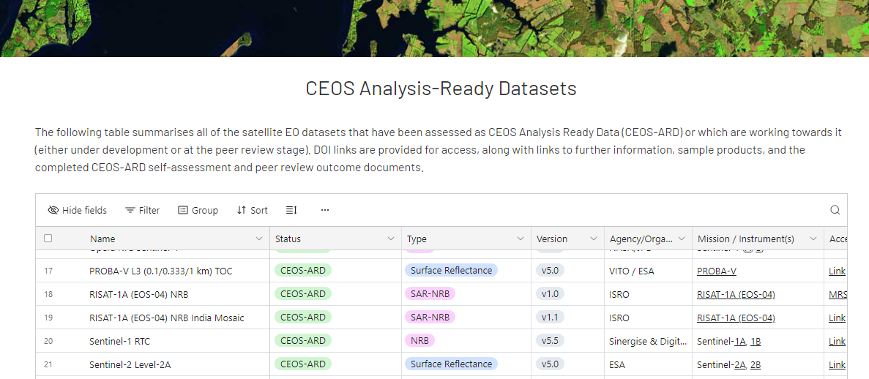
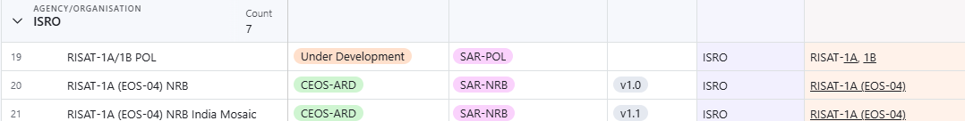
ISRO’s CEOS SAR-ARD Status:

Slide 12
Thank You…

