Slide 1
LSI-VC-18
Unlocking Commercial EO Archives for Public Good
Maggie Arnold, GA
Agenda Item 4.1
LSI-VC-18
Ispra, Italy
2-5 September, 2025

Slide 2
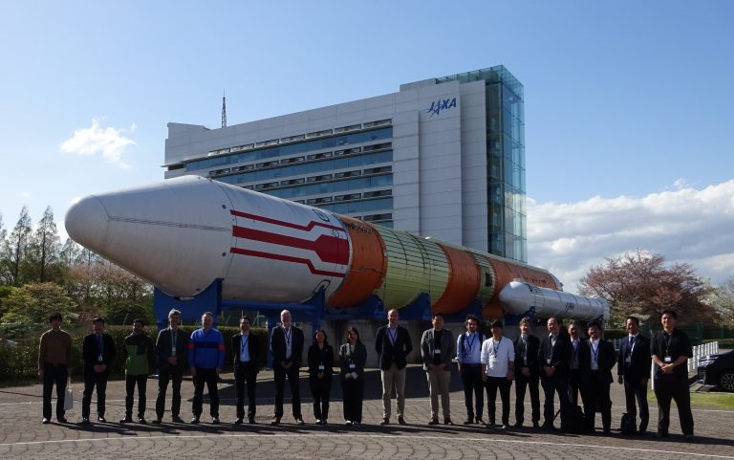
Background - Context
LSI-VC-17 (April 2025) Catalogue of archive buy out opportunities of land surface EO data to help CEOS identify what is available
Central record of prior acquisitions
Value in archived data

Slide 3
Why it’s important
CEOS can facilitate access to these archives
Maximising scientific and societal impact
Proposal:
Establish a catalogue of opportunities, including prior acquisitions, licensing terms, assessment outcomes
Why Now?
Long term archives critical for understanding Earth system changes, risk of data loss if commercial providers cease operations

Slide 4
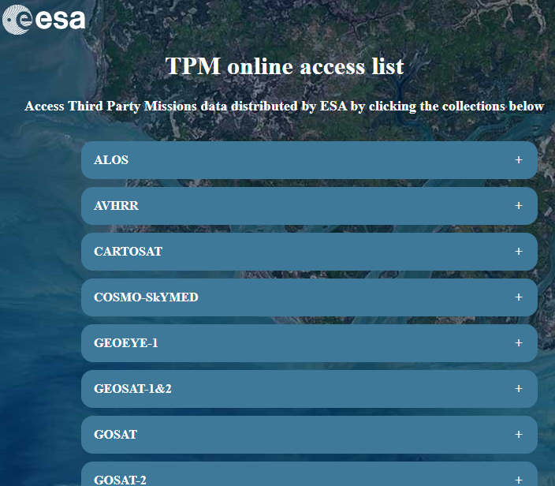
Since April 2024:
What’s been done so far
WGISS - EO Data collection appraisal procedure
ESA Third Party Missions
Open and Restrained
https://tpm-ds.eo.esa.int/collections/

Slide 5
Role
Facilitate, not purchase - up to individual agencies to purchase
Agreed approaches for negotiation
Encourage consistency, collaboration and transparency
Raise awareness of opportunities
Alignment with CEOS’s vision for free and open data

Slide 6
Risks
Industry may not see the value in the buy once for all model
Subscription models may limit access
Risk of acquiring data with limited scientific/operational value
Licensing and provider willingness may vary

Slide 7
How it could work?
Annual or bi-annual compilation of opportunities and acquisitions
Report at LSI-VC meetings
Exposure of archives as open licensed data (shapefile?)
Leverage existing frameworks (ESA EDAP, NASA CSDA)
Draw upon quality assessment standards (e.g CEOS ARD)
Potentially using CEOS ARD as a ‘gate’ on adding data
Ongoing effort to populate examples
Engagement at WGISS and VH-RODA

Slide 8
Questions
How to combine/compare what ESA (T&C for Third Party Missions) and NASA (CSDA) - potential for CSDA as lead purchaser on behalf of CEOS consortium?
Who will be responsible for making these datasets “ARD” compliant?
Buy-out? Financial arrangement, low cost or free access to images?
EO datasets? All types or primarily land surface?
How to incentivise the commercial sector or address their business concerns?
Does this imply that this project will be hosting the data itself, so it won't be lost if a data provider disappears?
Notes:
Invite feedback and participation from CEOS agencies.
Outline immediate actions and opportunities for engagement.

