Slide 1
LSI-VC-18
Land Degradation Neutrality
Neil Sims, GEO-LDN
Agenda Item 5.1
LSI-VC-18
Ispra, Italy
2-5 September, 2025

Slide 2
Today
SDG Indicator 15.3.1 and LDN
Calculation & data needs
Data challenges, gaps and needs
Data, Geographical
Collaboration opportunities

Slide 3

UN Sustainable Development Goals
Goal 15: Life on land
Target 15.3: By 2030, combat desertification, restore degraded land and soil, including land affected by desertification, drought and floods, and strive to achieve a land degradation-neutral world
Indicator 15.3.1: the proportion of land that is degraded over total land area (ha)

Slide 4
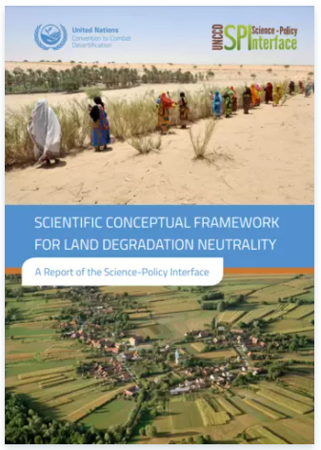

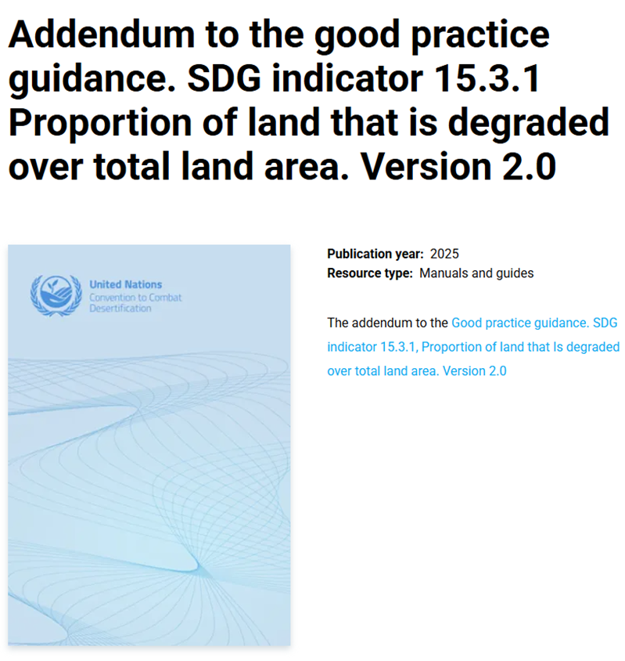
Methods guidance documents
2017
2017, 2021*
2025
Notes:
LDN Framework first document published. Relates to Target 15.3.
GPG – first engaged in 2016 to develop EO methods and elevate Tier level of the Indicator. GPG v1 published in 2017, Revised in 2021.
GEO LDN – sponsored by the UNCCD provides information, guidance and resources to help countries achieve LDN. I have co led this since its inception. Received significant funding from German Government. Only GEO activity ever to have been elevated from an Initiative to a Flagship (Ghana 2023).
Australians all over this. Federally this engagement is finally starting to be recognised. Some exciting new opportunities emerging in dryland countries.

Slide 5
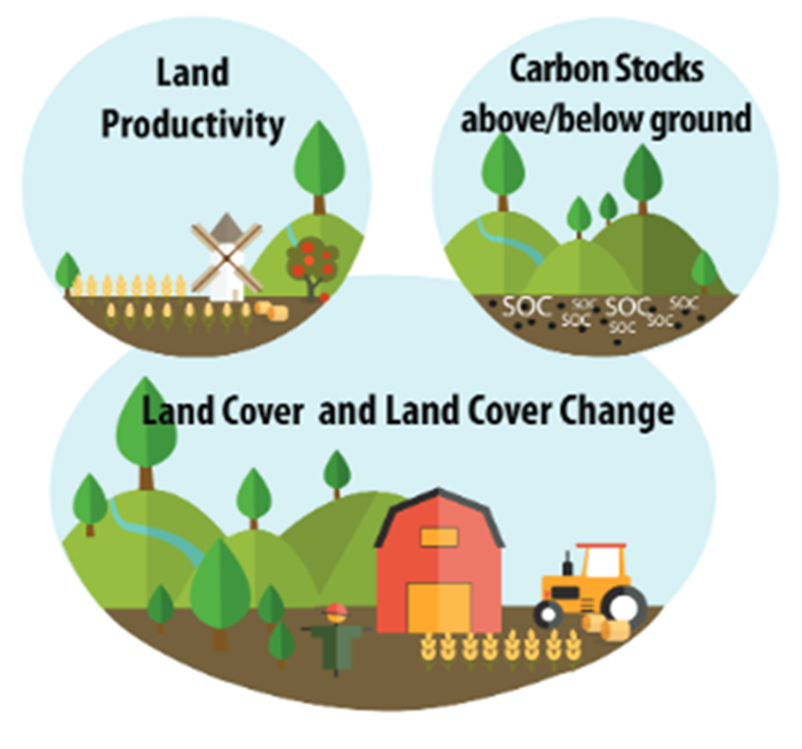
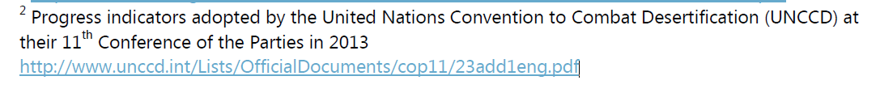
Indicator 15.3.1, sub-indicators & metrics (GPG)
Indicator 15.3.1: the proportion of land that is degraded over total land area (ha)
Sub-Indicators:
Land cover and land cover change
Land productivity
Carbon stocks, above and below ground*
Productivity metrics
Trend (long term)
State (recent change)
Performance (local v regional level)
*Binary indicator

Slide 6
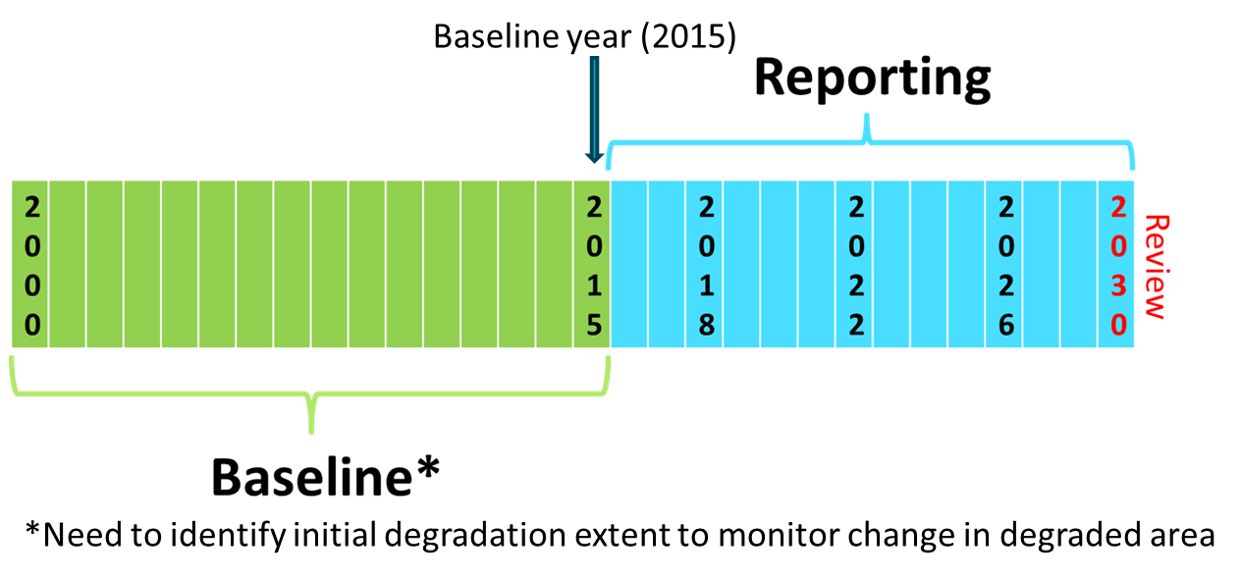
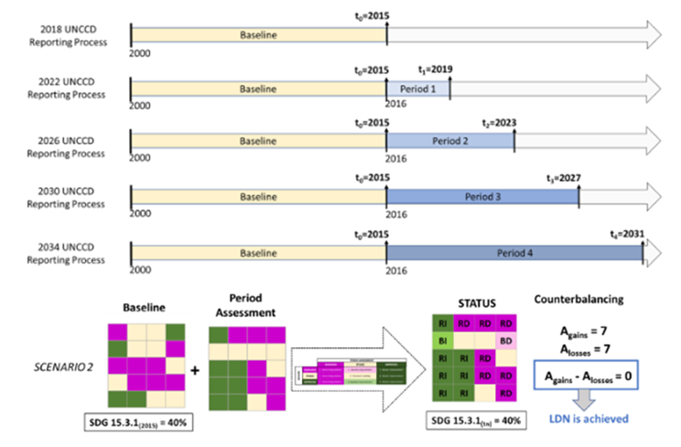
Change over time

Slide 7
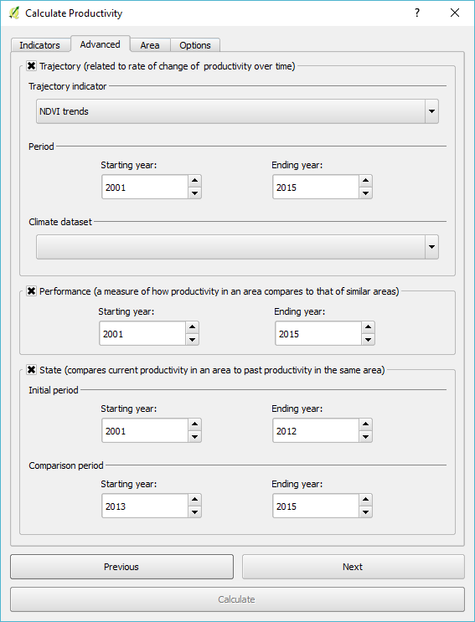
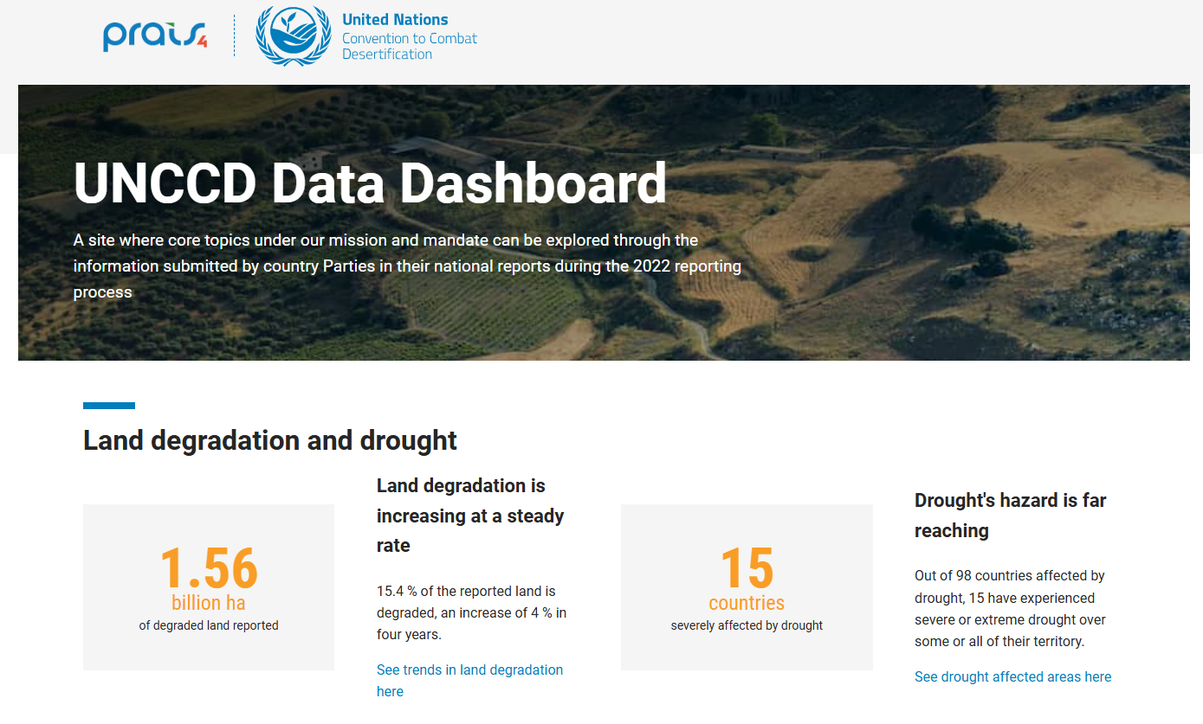
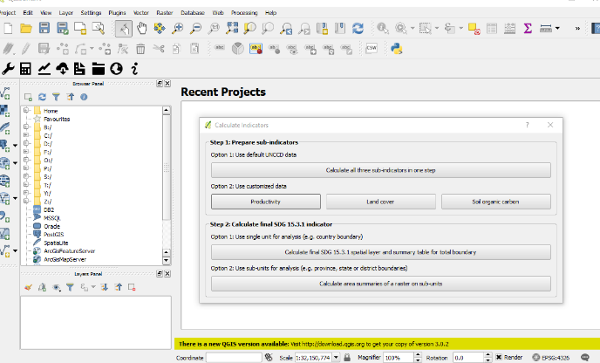
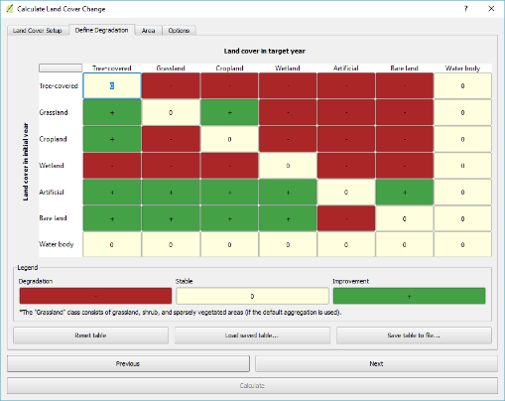
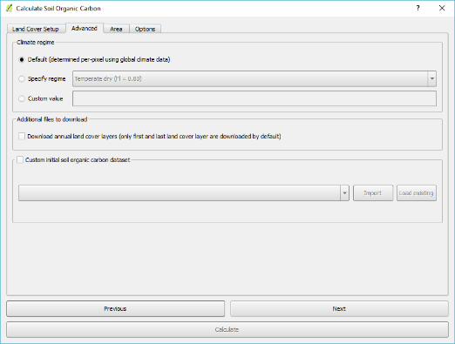
Analytics and Reporting
Analytics and Reporting
UNCCD Data portal (https://data.unccd.int/
Trends.Earth
Notes:
GPG AND TRENDS.EARTH MADE AT SAME TIME
GOOD ITERATIVE PROCESS
ADD-ON FOR QGIS
EXCELLENT INTERFACE FOR CALCULATING 15.3.1
BEING EXPLORED FOR OTHER SDGs

Slide 8
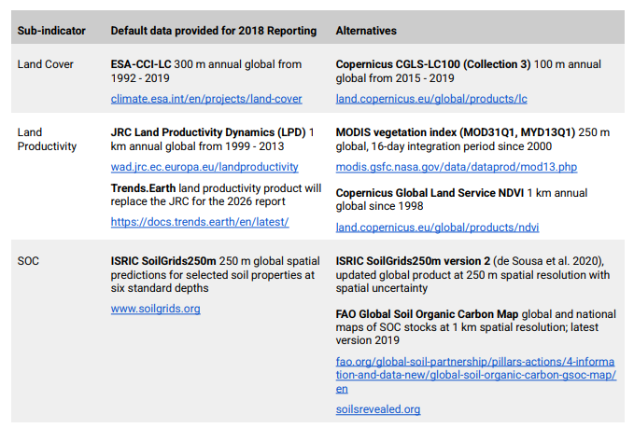
Default datasets

Slide 9
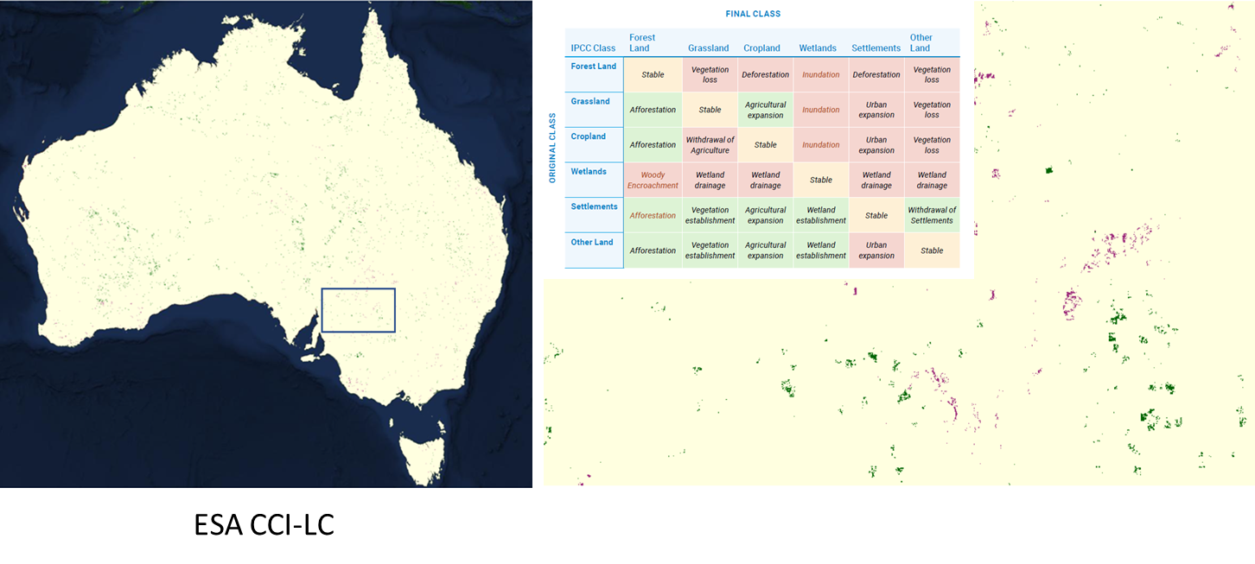
Australia 2022 - Land cover
Notes:
Crop rotation at end of season impacts apparent extent of degradation
This restricts appeal of indicator to agricultural land managers – case in Australia currently considering implementation

Slide 10
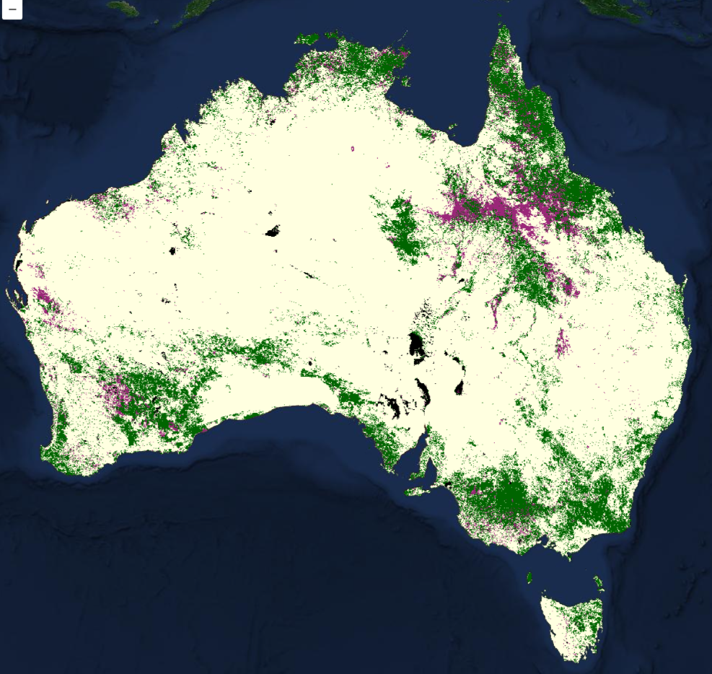
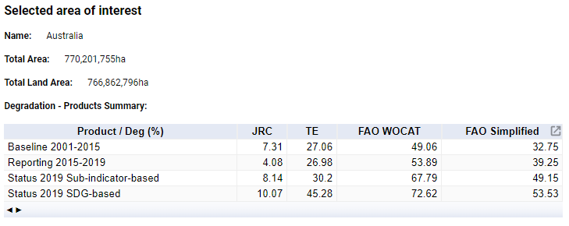
Land productivity

Slide 11
Australia 2022 – Land productivity
Figure 6. Trends.Earth land productivity degradation in the reporting period calibrated to account for changes in Water Use Efficiency (WUE). WUE calibration theoretically reduces the impact of climate variables in the apparent extent of land productivity degradation.
Figure 5. NDVI-based Trends.Earth land productivity degradation in the reporting period.

Slide 12
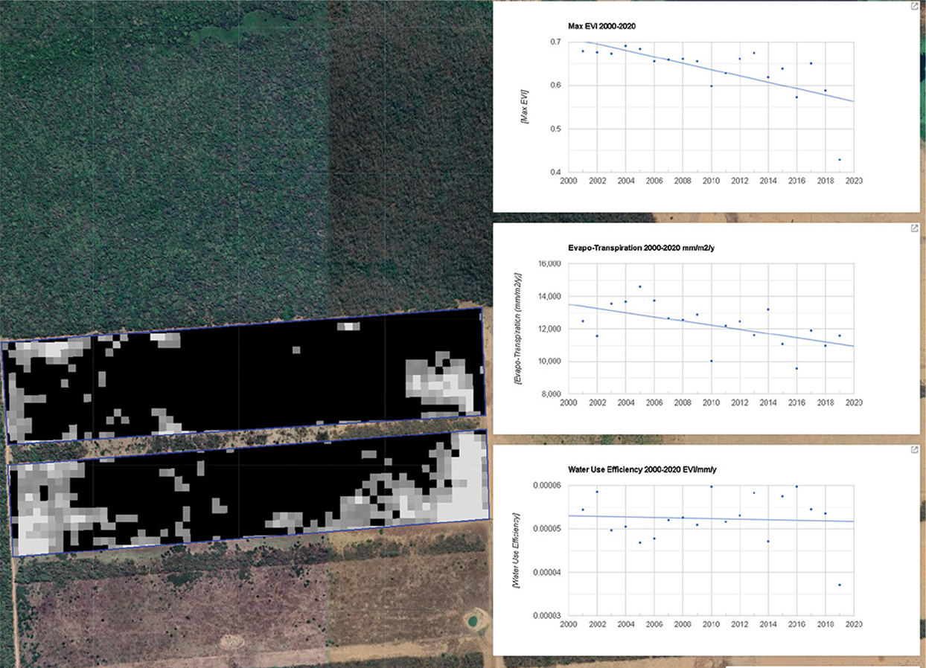
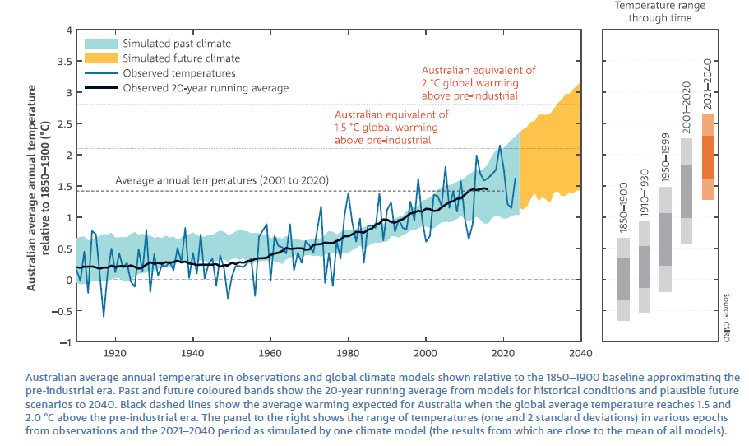
Climate attribution and forecasting
Markos, A., Sims, N., & Giuliani, G. (2023). Beyond the SDG 15.3. 1 Good Practice Guidance 1.0 using the Google Earth Engine platform: developing a self-adjusting algorithm to detect significant changes in water use efficiency and net primary production. Big Earth Data, 7(1), 59-80.
https://www.csiro.au/en/research/environmental-impacts/climate-change/state-of-the-climate

Slide 13
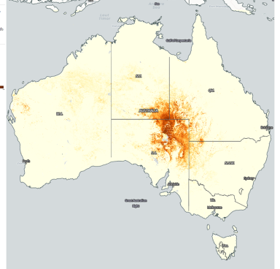
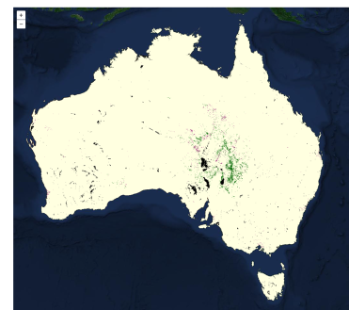

Soil Organic Carbon
Notes:
Left panel shows the location of SOC degradation in Australia. Areas of degradation and improvement are located near the cooper creek and lake eyre basins in central Australia.
Right panel shows areas of lowest persistent vegetation cover in orange. These areas coincide and (and see the location of highest uncertainty on the previous panel). One explanation is that where stocks are low, a small proportional change represents a very small quantity of SOC. If these levels approach the sensitivity of the models/ methods, then confidence in this assessment may be low.
It may be useful to reconsider the thresholds of change.

Slide 14
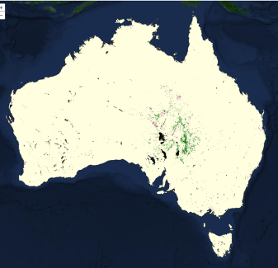
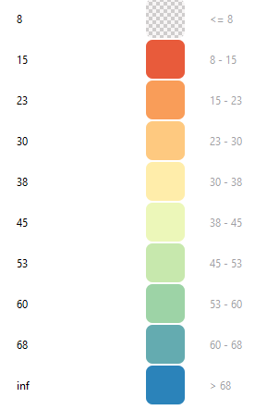
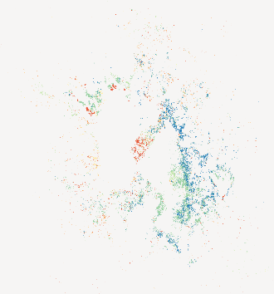
SOC thresholds
Notes:
Left panel shows the location of SOC degradation in Australia. Areas of degradation and improvement are located near the cooper creek and lake eyre basins in central Australia.
Right panel shows areas of lowest persistent vegetation cover in orange. These areas coincide and (and see the location of highest uncertainty on the previous panel). One explanation is that where stocks are low, a small proportional change represents a very small quantity of SOC. If these levels approach the sensitivity of the models/ methods, then confidence in this assessment may be low.
It may be useful to reconsider the thresholds of change.

Slide 15
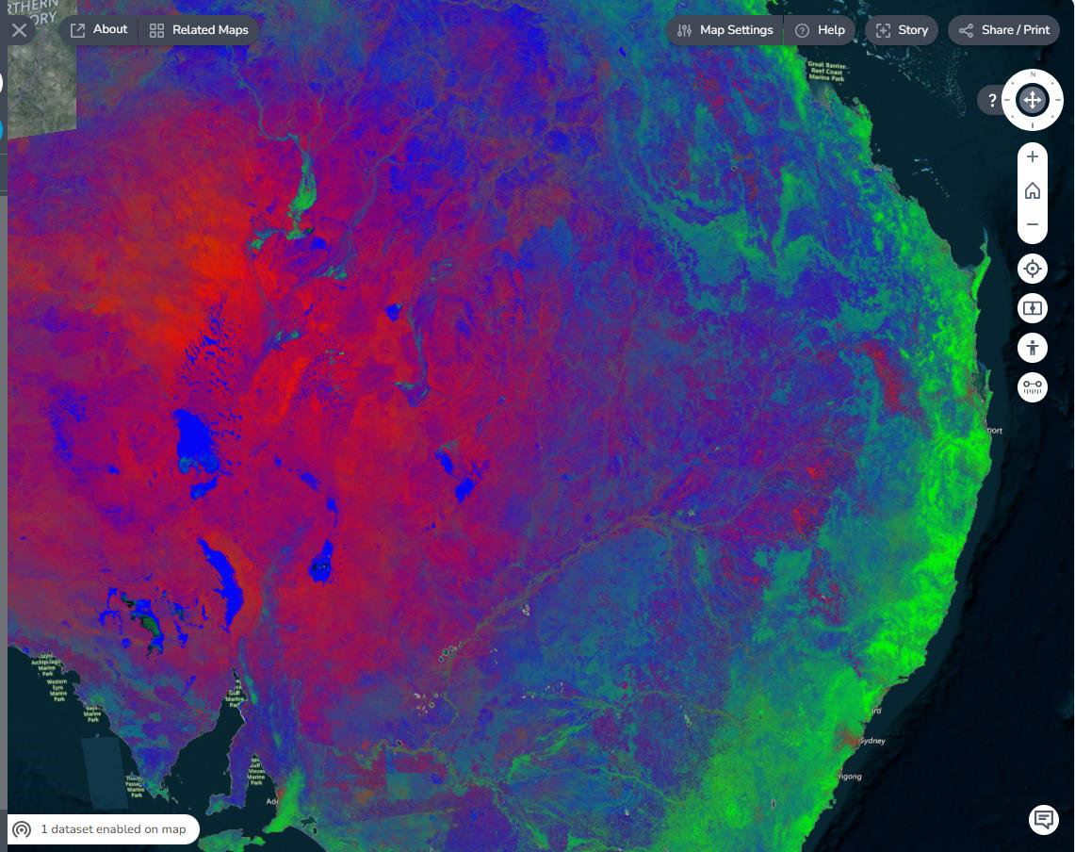
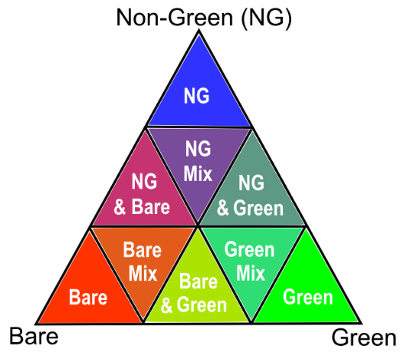
Vegetation Index for low plant cover

Slide 16
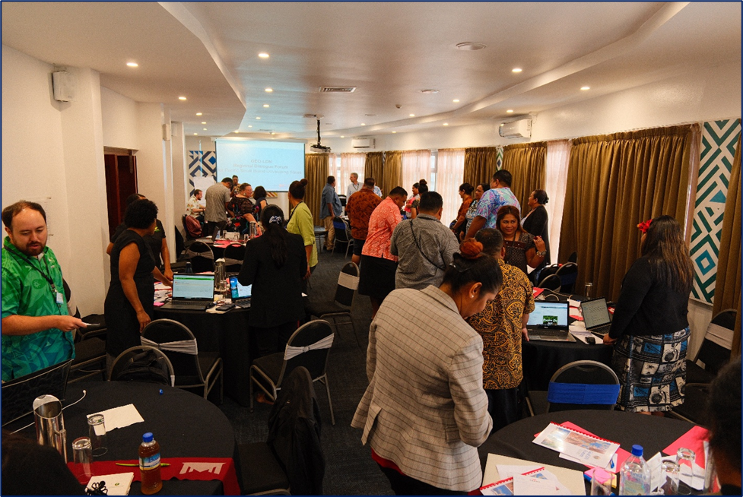
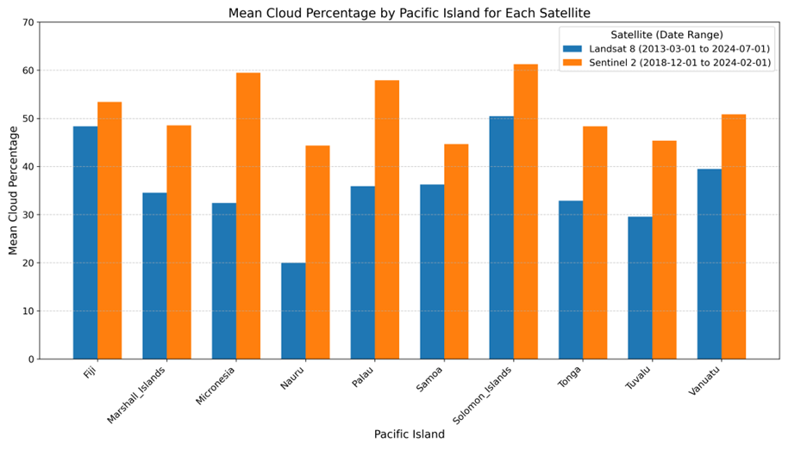
Pacific islands (and other SIDS)
Small land area
High resolution data (?)
Persistent could cover
CEOS SDG Coord Group, Killough, Borges et al, August 2024.
Capacity building needs
GEO-LDN Dialogue forum
Fiji, July 2025

Slide 17
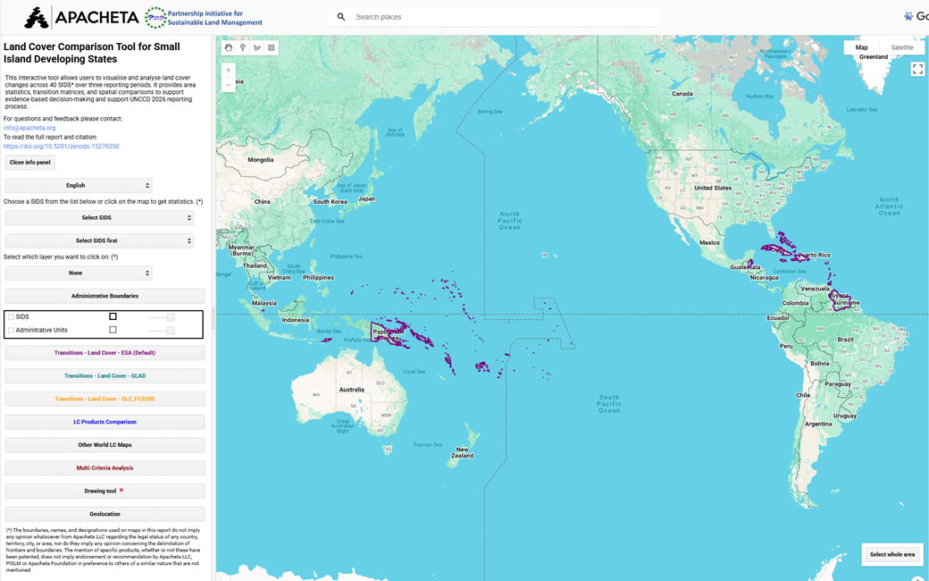
Pacific islands
GEO-LDN Partners

Slide 18

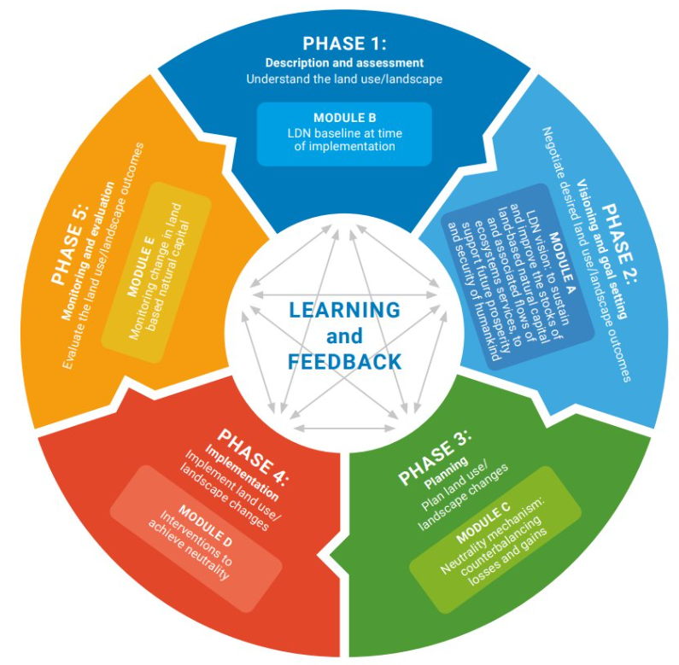
GEO-LDN (& Toolbox)
Two(ish) Working Groups
Data, Standards & Analytics
Capacity Development & Decision Support
Translate science and data into planning and action
Toolbox provides curated suite of datasets and tools
https://geo-ldn.org/ldn-toolbox/
Under review
Strong CEOS collaboration

Slide 19
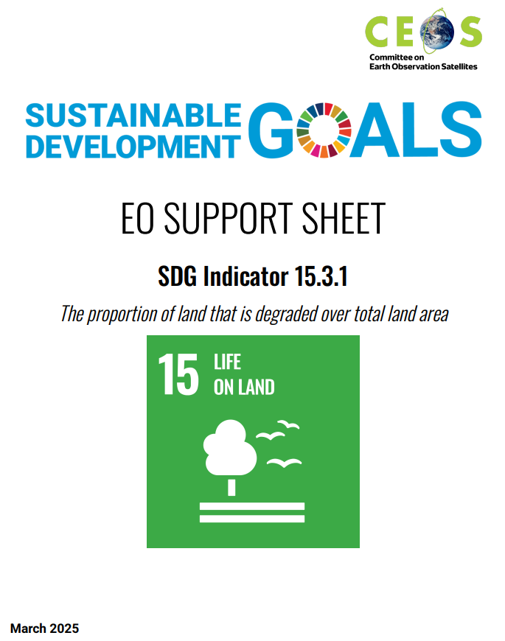
CEOS - Data Challenges
Long time series to identify degradation
2000 to present
Coarse resolution of default datasets
SIDS
Methods best suited to temperate regions
Hyper-arid, tropics
Lack of consistent global land cover data
Diversity of NPP methods
Difficulty assessing SOC, absence of full C dataset
Combining datasets of different frequency, resolution and duration
Climate calibration (degradation attribution)
https://ceos.org/document_management/Ad_Hoc_Teams/SDG-AHT/Support%20Sheets/SDG_15.3.1_EO_Support_Sheet_v2025_1.pdf

Slide 20
UNCCD/CEOS partnership letter – May 2024
High-Resolution EO Data
Prioritise SIDS, mountainous, and hyper-arid regions for improved land monitoring
Data Integration Guidance
Link coarse/fine datasets, cross-calibrate EO sensors, and assess new default datasets
Standards Development
Contribute to OGC standards and GEO-LDN’s minimum data quality benchmarks
Biodiversity Synergies
Align LDN and CBD targets; map overlapping degradation and biodiversity hotspots
Capacity Building
Engage in GEO-LDN training, governance, and joint outreach
Support 2026 reporting

Slide 21
New datasets
High spatial resolution
Pros and cons
Hyperspectral (EnMap, EMIT…)
More definitively define land cover conditions
High frequency
Commercial smallsat EO constellations
GNSS-R, Starlink?
Improved characterisation of productivity dynamics and response
Thermal
New element to degradation assessment. Urban?
Productivity calibration
Synthetic Aperture Radar*
Coverage of SIDS
Biomass
Land cover structure
disturbance
Moisture – aridity
Vertical profile (band integration)

Slide 22
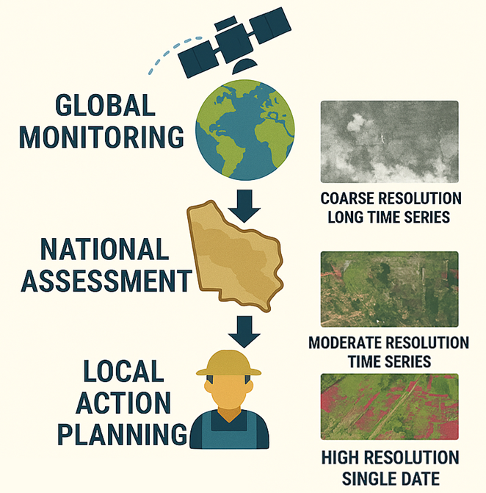
Data integration & harmonisation
Different phases have different data needs
How to intercompare datasets over different epochs?
spectral and spatial characteristics
Not necessarily quantitative

Slide 23
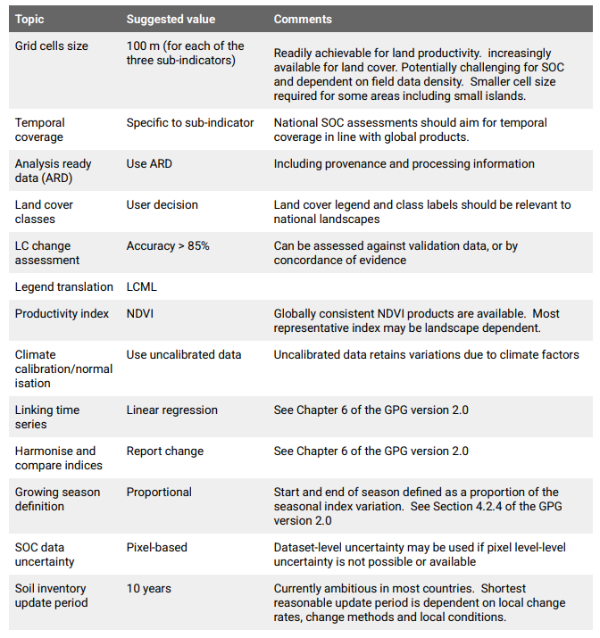
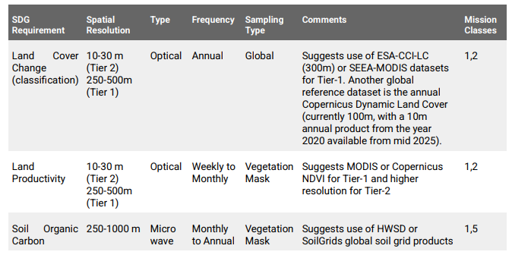
Data requirements

Slide 24
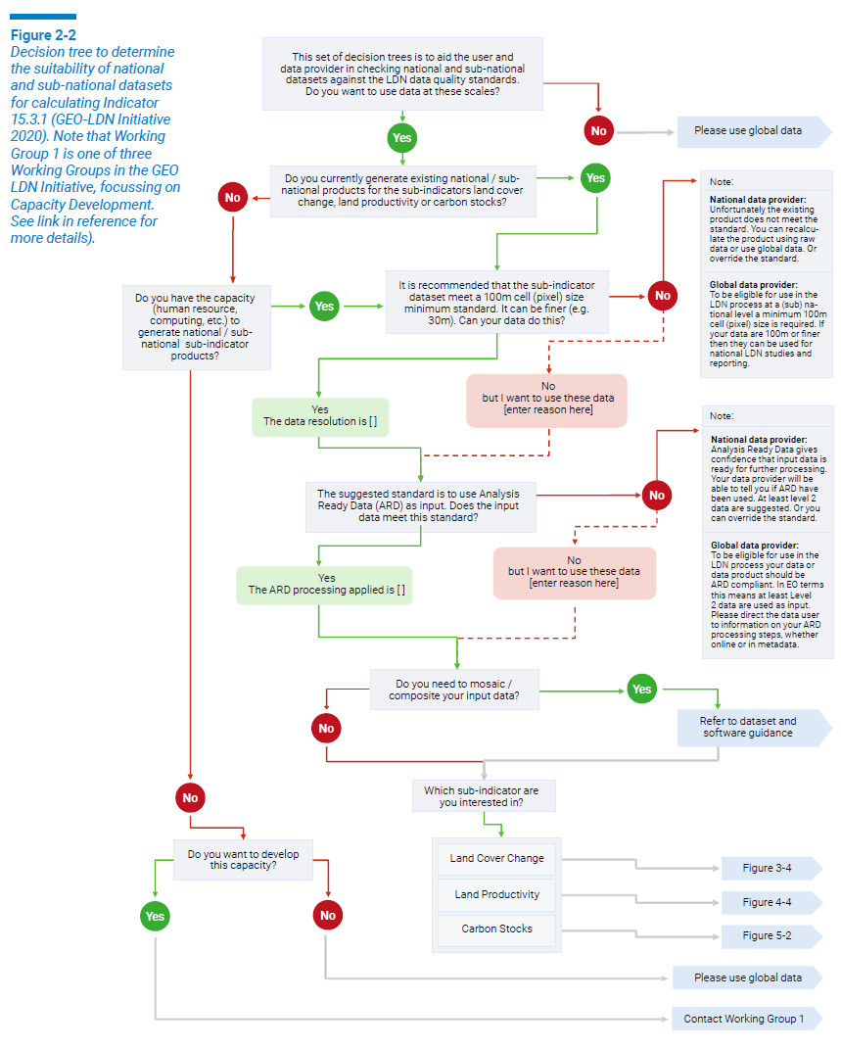
Decision trees
GPG for Indicator and sub-indicators
Support countries to identify their best datasets, rather than prescribe datasets
OGC Geospatial Reporting Indicators Standards Working Group
Develop portfolio of open standards
Accelerate development and adoption of standards-based geospatial technologies
Initial focus on LDN

Slide 25
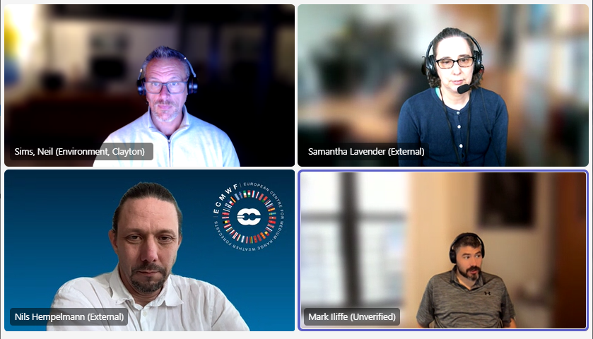
Standards – OGC Working Group (Feb 2024)
Mission: Standardize geospatial reporting for sustainability and climate frameworks.
Initial Focus: Land Degradation Neutrality (LDN) and SDG 15.3.1 reporting.
Value: Enable trusted, transparent ESG and SDG reporting.
Scope: Define standards using OGC/ISO frameworks and FAIR, TRUST, CARE principles.
Deliverables: Multi-part OGC standard, national guides, and interoperability pilots.
Considering development of standards, guidelines etc. Support data entry into UNCCD reporting portal
https://portal.ogc.org/files/107038

Slide 26
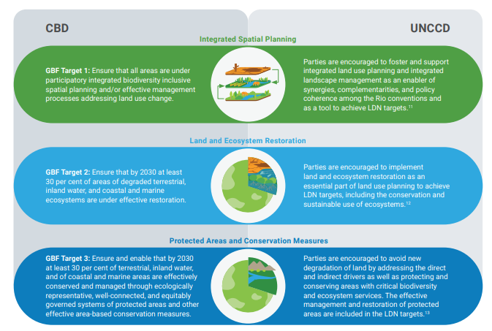
LDN/Biodiversity links
Indicator 15.3.1 endorsed as a component under Target 2 of the GBF
Ensure that by 2030, at least 30% of degraded terrestrial, inland water, marine, and coastal ecosystems are under effective restoration.
Baseline for tracking progress
LDN engaged with CEOS Biodiversity Science Team VC

Slide 27
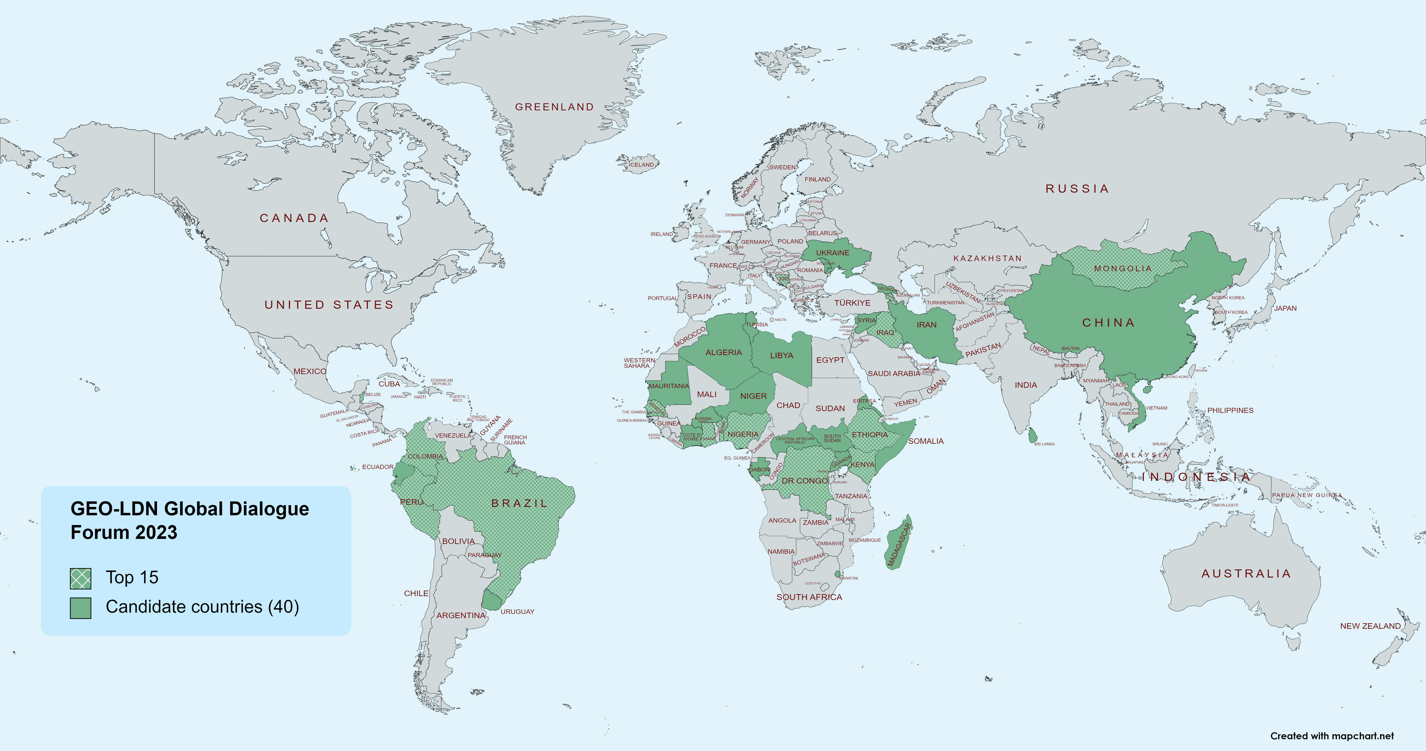

Capacity building
Post graduate program
University of Natural Resources and Mining, Ghana – others.
Decision support
One-on-one help for country teams
Dialogue Forums
40 country teams apply for Cape Town (GEO, 2023)
~100 attendees at Story-telling event, UNCCD CoP, Dec 2024
16 Countries in Fiji, July 2025

Slide 28
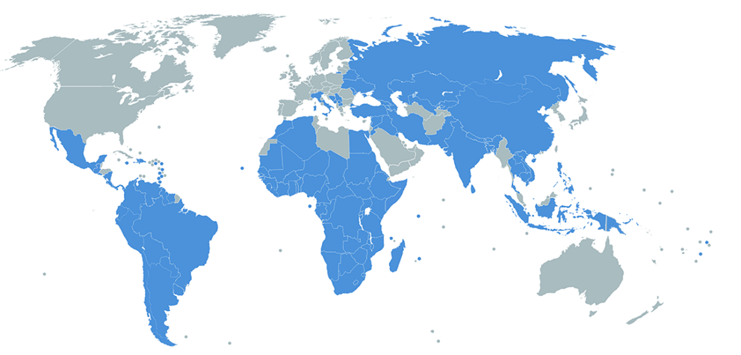
To wrap up….
~130 countries setting LDN Targets
~120 countries reporting on Indicator 15.3.1
Great opportunity for impact through SDG Custodian Agency (UNCCD) and GEO Flagship (LDN)
Reporting, Planning, Monitoring, Post 2030
UNCCD & GEO-LDN very grateful for existing CEOS support and keen to collaborate more
Partnership being formalised
Neil’s recommended priorities (completely unendorsed)
Data harmonisation
Methods for assessing degradation in areas of low vegetation cover
SAR for LDN

Slide 29
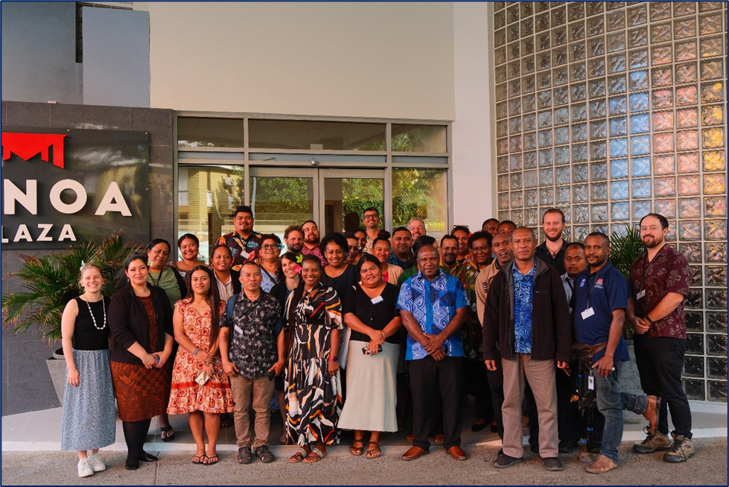
Thank You
Neil Sims,
GEO-LDN & CSIRO
Neil.Sims@csiro.au
info@geo-ldn.org

