Slide 1
LSI-VC-18
CEOS-ARD &
Standards Bodies
Dave Borges, SEO
Maggie Arnold, GA
Agenda Item 6.1
LSI-VC-18
Ispra, Italy
4 September 2025

Slide 2
Agenda
Open Geospatial Consortium (OGC)
  OGC ARD Maturity Report
  OGC ARD SWG → DWG Decision / Vote
  OGC 133rd Member Meeting, Boulder CO USA, 28-31 October
International Organization for Standardization (ISO)
  ISO 19176-1 WG 6 Imagery ARD Project, Stage 0
  CEOS representation in WG6 / ARD Project - Country-level
  Voting Implications

Slide 3
Agenda, cont.
Confirming an official CEOS-ARD position on OGC and ISO ARD standards efforts
Develop a brief regarding the ISO ARD standards development that can be shared with national standards body contacts

Slide 4

OGC: ARD Maturity Report
Link

Slide 5
OGC: ARD Maturity Report
Intent to release as OGC Engineering Report in October
GA/CEOS Intervention at 132nd Member Meeting (June):
“Geoscience Australia welcomes the presentation to this group for information. The adoption of Analysis Ready Data concepts has significant potential to support Earth observation exploitation.
We note that the CEOS-ARD Framework has been considered as a 'maturity matrix'. It was not developed to be one, unlike the other frameworks considered. So we would suggest before the matter goes further that this is clarified so that the OGC community is not confused. The CEOS-ARD Oversight Group would be happy to work through this matter to ensure the CEOS-ARD Framework is appropriately reflected.
We also note existence of OGC's ARD SWG. This SWG was explicitly formed to consider these types of matters as part of its deliberations. While the SWG is currently strategically paused, we note the importance of utilising the most appropriate OGC structures to consider business items, as it is the best way to ensure due attention is given and interested stakeholders engaged.
As such, we suggest that an alternative motion be adopted:
The EOXP DWG approves the recommendation that document 25-007 “Analysis Ready Data (ARD) Maturity Report” be amended to clarify the status of the CEOS-ARD Framework, and that the paper is put up for discussion in the ARD SWG once the strategic pause concludes, with that group considering whether it is sent for approval by the OGC Technical Committee as an OGC Engineering Report.
We are unable to support the motion as proposed.”

Slide 6
OGC: ARD Maturity Report
Next steps
  Have a close look at the Report super-matrix and prepare an official CEOS-ARD OG response
  Start thinking what we want CEOS-ARD to be or become, and what not. Some elements have been discussed in Tsukuba, but it's not a clear picture yet and I'm not sure we have consensus even internally. Both will weaken our position in discussions with OGC.
  Find out who else has stakes in ARD and what they want. We need to understand whom we are competing with and where we have developable consensus or critical dissent

Slide 7
OGC: ARD SWG
Joint OGC/ISO ARD Standards Working Group (May 2023)
Strategic Pause / Inactivation Motion (August 2024)
Joint OGC-ISO ARD SWG: Rationale for SWG Inactivation Motion
Based on observations and participation in over a year of Joint OGC-ISO ARD SWG teleconferences, the pace of progress of developing a standard for geospatial ARD is incompatible with the expectations, deadlines, and processes imposed upon it. Though the SWG is requesting a 6 month extension to the ISO effort, this extension would not provide sufficient time to work through the numerous foundational issues in both content and SWG dynamics, evidenced by the SWG’s limited progress over the past 12 months.
Specifically, the SWG has experienced multiple core challenges that include a lack of distinct progress on a geospatial ARD standard, insufficient diversity in contributors, and inadequate consensus among active contributors.
While this motion to inactivate seeks to strategically pause the Joint OGC-ISO activities, it does not question the importance and relevance of the ARD concept broadly. The CEOS-ARD Framework, which the SWG was largely based upon, is itself actively evolving to account for relevant technology developments, such as the evolution of STAC. Because of this rapid technological development, current efforts to define ARD broadly would benefit greatly by shifting from a standards approach to a more open source specification approach. This would allow agile development on an unrestricted timeline which can be reintroduced to OGC and ISO standards processes after it has been iteratively improved, implemented, and has seen adoption by real-world user communities and data providers.
To ensure that diverging, and conflicting, standards development efforts do not proceed prematurely, both the OGC and ISO aspects of the Joint SWG should be suspended for now, allowing this agile and open source specification effort to mature, as detailed in this blog post, authored by the Cloud Native Geospatial Foundation and Committee on Earth Observation Satellites (CEOS).

Slide 8
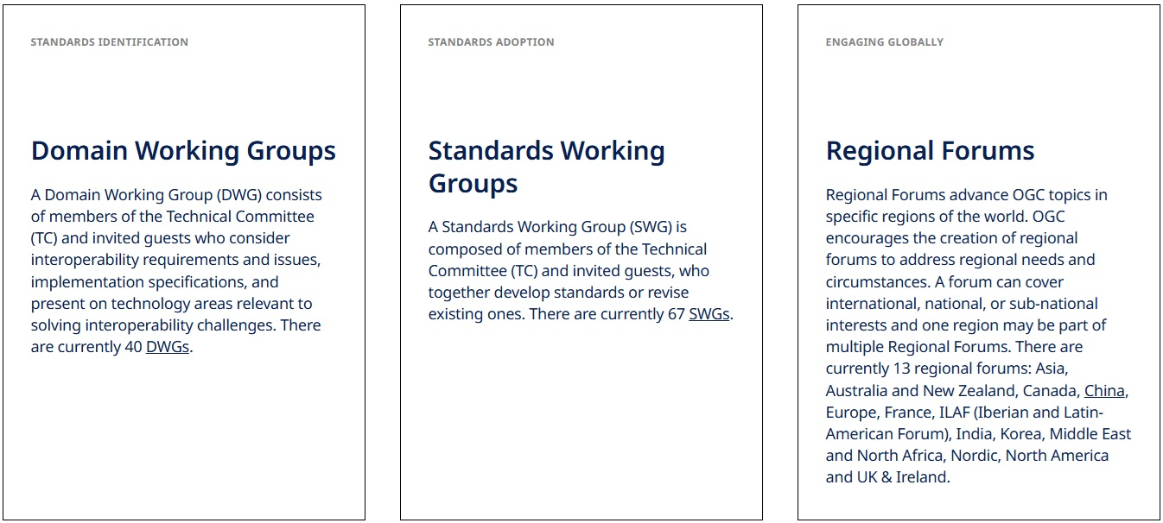
OGC: ARD SWG → DWG
Multiple parties (including OGC leadership) support the conversion from SWG → DWG
CEOS Preference - Opportunities vs Risks

Slide 9

OGC: Deadline 133rd Meeting
Any CEOS
planned attendance?

Slide 10
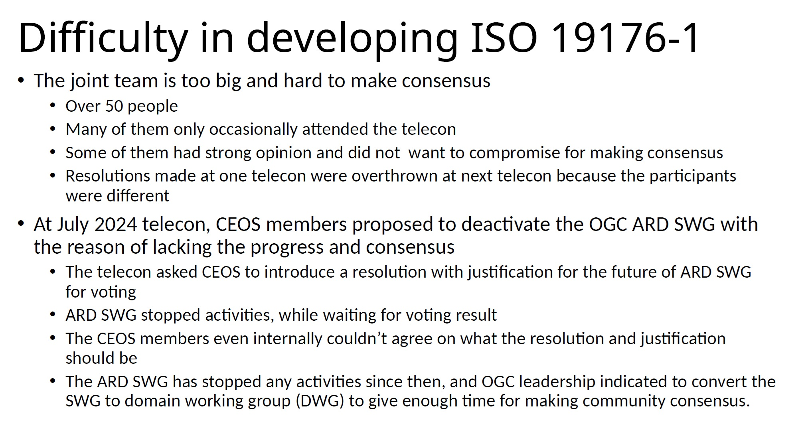
ISO: WG 6 ARD Project
Was Stage 1 under Joint OGC/ISO WG, strategically paused
Renewed as Stage 0 PWI at last ISO Meeting 2025 (Wuhan)
Vote towards Stage 1 planned for May 2026

Slide 11
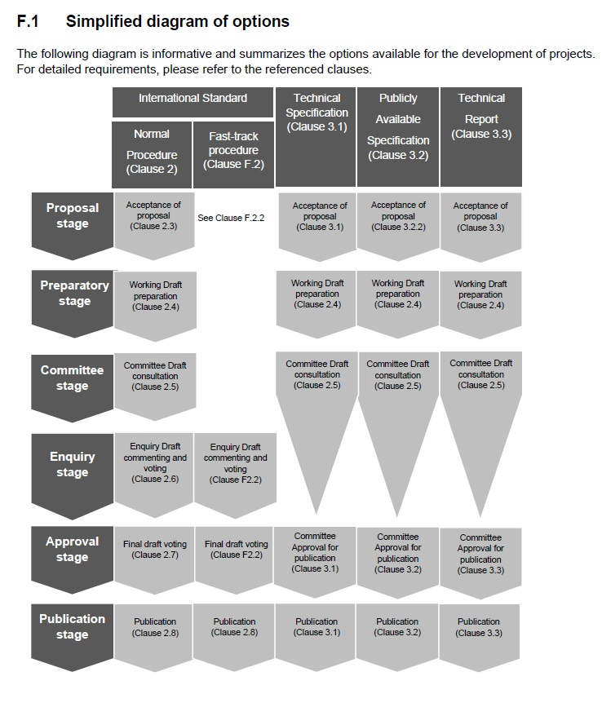
ISO Intl Standards Process

Slide 12
ISO: ARD Project Paths Forward
The diagram shows the steps for a stage-1 standard development project. ISO 19176-1 project (stage 1) was on technical specification track. We submitted a proposal which was approved by ISO TC 211 member countries. The project was converted to a stage 0 project by the TC211 plenary resolution in November 2024 when the project was at preparatory stage of Stage 1 (to develop a working draft).
Since now this project is on stage 0, it does not fit this diagram. Stage 0 is basically a research project to form the consensus on ARD. During stage 0, we can draft an outline or even an entire standard document. There is no strict time limit on stage 0, and once we (the project team) form the consensus, we can ask TC211 plenary to reinstate the project as a stage 1 project (in either international standard or technical specification track) through a plenary resolution. Depending on the results of stage 0, we can re-enter as working draft or the committee draft (e.g., if we have a complete standard draft). After the reinstatement, the standard development clock is kicked in and we have to move forward the standard development based on timeline defined by ISO rule.

Slide 13
ISO: WG 6 ARD Project
ARD Project, Stage 0, membership requires ISO WG 6 formal membership
WG 6 formal membership is dependent on formal membership in your national-level ISO / Standards body. Ex:
  USA, INCITS→ANSI→ISO
  Australia, Standards Australia→ISO
  Japan, Japanese Industrial Standards Committee→ISO
  Italy, UNI - Ente Italiano di Normazione→ISO
  Etc
How many known linkages does CEOS currently have in this context?

Slide 14
ISO: Australian Experience
Geoscience Australia - OGC Member, as well as member of ISO TC/211
  Interest in data standards across multiple domains (geospatial, geodetic infrastructures (ISO 19161-2) etc.)
  Virtual attendance at 132nd OGC Members Meeting in DWG Earth Exploration
  Not freely available (GA pays for annual membership to both OGC, ISO)
    Access to all standards
Standards Australia
  Responsible for voting via our delegate from Geoscience Australia (whom which we inform)

Slide 15
ISO: Australian Experience
Standards Australia (SA) (cont..)
  Membership nomination through GA to Standards Australia
    From GA - Matt Adams and Maggie Arnold have applied to formally attend meetings and vote on ISO PWI 19176-1 to
    Multiple members on WG, but 1 vote for Australia.
  Join subcommittee of IT-004 (only voting on standard(s) of interest)
    SA aggregates individual IT-004 member votes into 1 for Australia.
Supportive of developing an official position on CEOS ARD
  Risk misalignment with CEOS-ARD and could be detrimental if ISO 19176-1 is formalized prematurely.
Notes:
(Voting on the standards we care about

Slide 16
Required Decisions / Actions
How to address OGC ARD Maturity Report endorsement at OGC meeting in October?
Formal CEOS position on OGC ARD SWG → DWG conversion?
Who will volunteer to help draft formal Brief document that will provide CEOS-ARD background, describe current ISO situation, and request national level ISO representative vote in specific ways?
Who will commit to determining your individual, national-level, ISO engagement organization and establish relationship and awareness of the ARD Project?

