Slide 1
LSI-VC-18
Background on the Surface Temperature CEOS-ARD Product Family Specification
Harvey Jones, LSI-VC Sec
Darren Ghent, Uni of Leicester
Agenda Item 7.1
LSI-VC-18
Ispra, Italy
2-5 September, 2025

Slide 2
Session Overview
7.1: Background on the Surface Temperature CEOS-ARD Product Family Specification (PFS)
  Development and uptake
  Removal of Surface Brightness Temperature
  Agency & Commercial sector developments
  LST ECV requirements
Agency Presentations
  Copernicus LSTM
Commercial presentations
  SatVu
  Constellr
  Ororatech
7.7: Discussion
  Revival of the Surface Brightness Temperature specification
  ECV stability parameter
  Who are the users and what do they want?
  Inclusion of Sea Surface Temperature
  Updates for consistency with AR PFS V2.0

Slide 3
History of the ST PFS
The ST PFS was first initiated in 2017 led by GeoScience Australia
Feedback provided by US (Landsat community), ESA, UK (D. Ghent), and others
Version 3.2 removed Surface Brightness Temperature (SBT)
  It was concluded there was no clear user base at the time
  Therefore, ST became the minimum requirement (threshold) ST PFS
Feedback from ESA and USGS self-assessment included
Version 4.0 endorsed at LSI-VC-7
Currently a version 5.0 which contains a few further minor edits

Slide 4
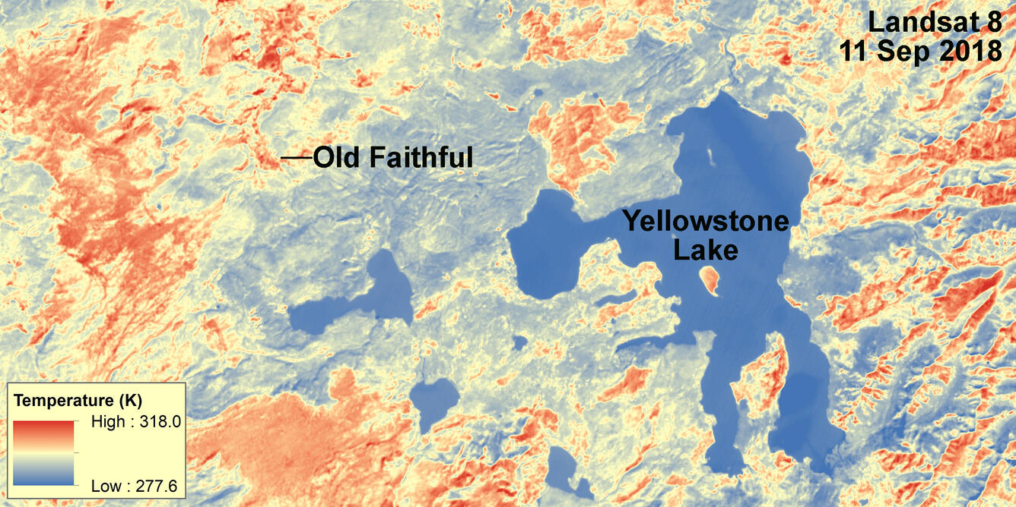
Development and Uptake
Compliant
Landsat Collection 2 U.S. ARD
Landsat 8 ST (AIR-CAS)
Under Development
AVHRR LST
ERS ATSR
Future
LSTM L2A ST
LSTM L2H/L2F ST
Others?

Slide 5
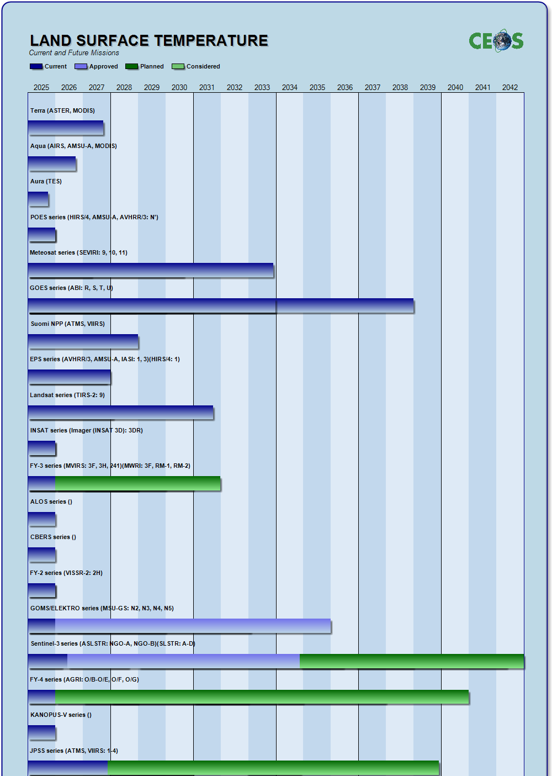
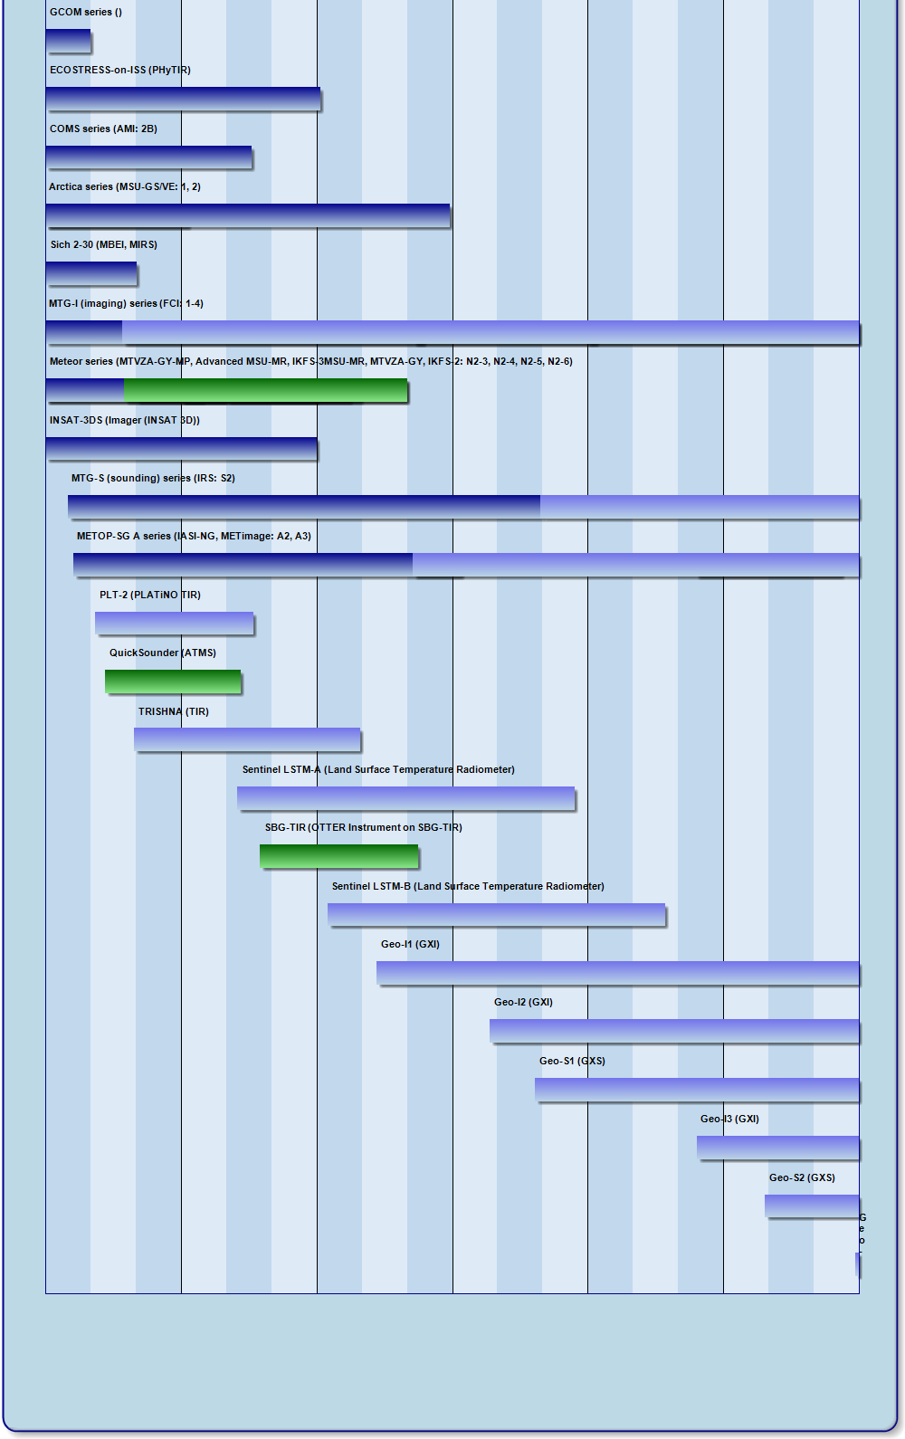
LST Mission Timeline
MODIS
VIIRS
INSAT
TRISHNA
SBG
LSTM
Has CEOS-ARD considered GEO sensors? (MSG, GOES, Himawari for LST e.g.)
S3 SLSTR

Slide 6
ST Mission Landscape
Commercial companies developing missions for land surface temperature or surface brightness temperature:
Ororatech (2025)
Constellr (2025)
SatVu (2023)
EarthDaily (2025)
Aistech Space (2022)
Hydrosat (2024)
Albedo Space (2025)
Planet (derived from AMSR-2 & Sentinel-2)
Satlantis (SuperSharp)

Slide 7
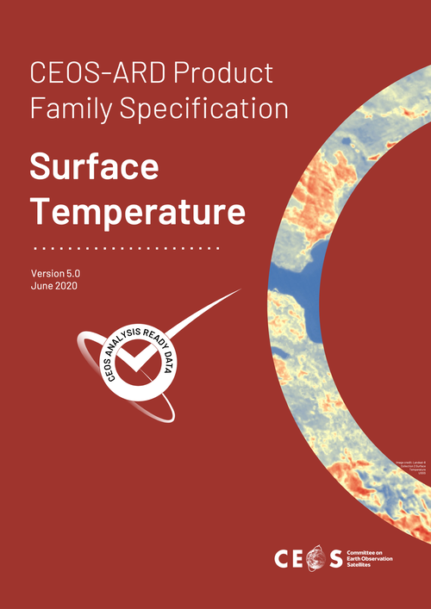
Who does the ST PFS apply to (currently)?
The current version of the ST PFS (V5.0, June 2020) applies to:
  Data collected with multispectral sensors operating in the thermal infrared (TIR) wavelengths. These typically operate with ground sample distance and resolution in the order of 10-100m; however, the Specification is not inherently limited to this resolution.
  At present, surface temperature measurements tend to be provided as either surface brightness temperature (SBT) or as land surface temperatures (LST) requiring the SBT to be modified according to the emissivity of the target. This specification identifies the Surface Temperature (ST) as being the minimum or Threshold requirement for analysis ready land surface data. Nevertheless, both SBT and LST are land measurements, requiring atmospheric corrections.

Slide 8
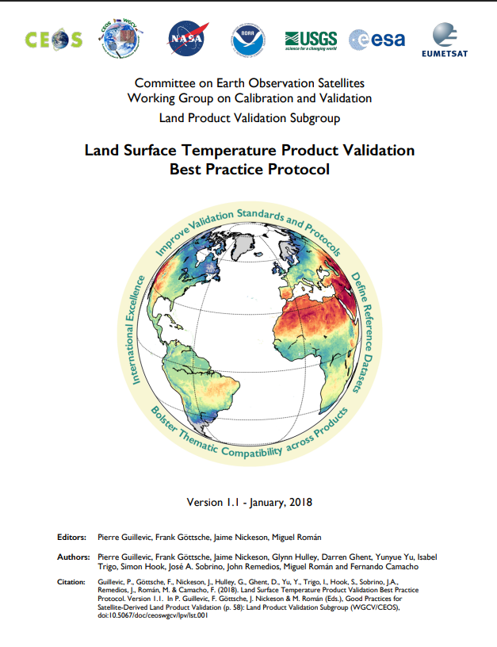
SBT vs LST?
The CEOS WGCV Land Surface Temperature Best Practice Protocol (2018) defines:
  Brightness temperature “is the temperature of a black body that would have the same radiance as the radiance actually observed with the radiometer. This requires specification of wavelength interval, direction and whether the observation is above the atmosphere from a satellite or immediately above the surface.” (Norman and Becker, 1995)
  Land Surface Temperature “is the aggregated radiometric surface temperature, i.e. based on a measure of radiance, of the ensemble of components within the sensor field of view. It represents the thermodynamic temperature of the skin layer of a given surface” (i.e. how hot or cold Earth’s surface would feel to the touch). (Norman and Becker, 1995).
Guillevic et al (2018). Land Surface Temperature Product Validation Best Practice Protocol. Version 1.1. Land Product Validation Subgroup (WGCV/CEOS), doi: 10.5067/doc/ceoswgcv/lpv/lst.001

Slide 9
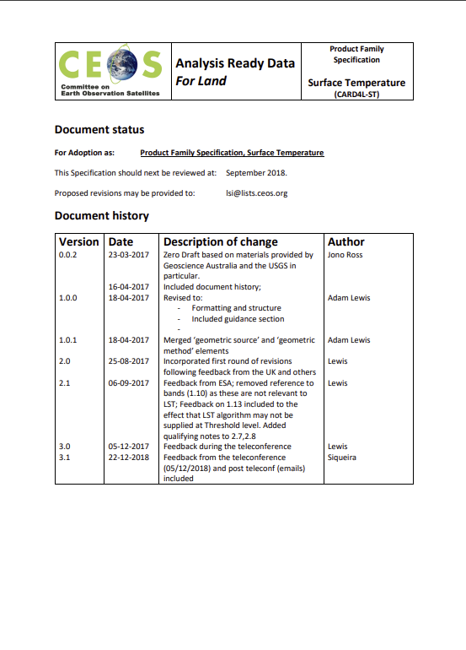
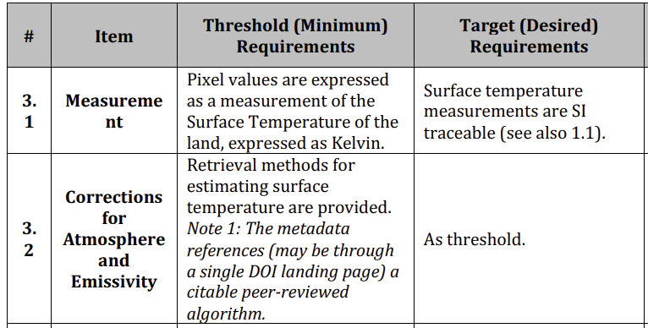
The Current ST PFS (V5.0)
Why was SBT removed? No user base at the time.
Discussed at LSI-VC-6 (September 2018 at JRC Ispra)
  SBT is not needed as a CEOS-ARD product – there is no clear user base. References to SBT were removed in following next update cycle. TOA brightness temperature was agreed as a useful product, already supplied by Sentinel-3 L1 product, but was deemed outside CEOS-ARD (CARD4L) scope at the time.
V5.0 has no requirements for atmospheric correction, terrain effects, land/water mask, or measurement normalisation.
Unique requirements for LST are captured in metadata Section 3.

Slide 10
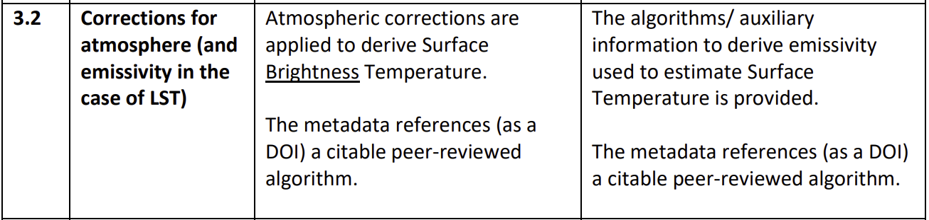
SBT in the ST PFS (v3.1)
Version 3.1
Version 5.0

Slide 11
ECV requirements
ECV | Product | Horizontal resolution | Temporal resolution | Timeliness | Temporal extent | Required measurement uncertainty | Stability
Land Surface Temperature | Land Surface Temperature | G: < 1 km B: < 1 km T: 1 km | G: < 1 hour B: 1 hour T: 6 hours (Very nearly met by day/night temporal resolution from polar orbiting satellite, which satisfies 70% of climate users in survey) | G: - B: 2 days T: 30 days | - | G: < 1 K B: < 1 K T: < 1 K (total uncertainty per pixel combining the four groups of uncertainty components) | G: 0.1 K B: 0.2 K T: 0.3 K

Slide 12
Questions for discussion
Do we re-introduce a CEOS-ARD compliance for SBT
  As a threshold requirement in the existing ST PFS?
  Or as a new SBT PFS, similar to the SAR PFS approach?
New requirement for ECV stability parameter?
What types of users do we foresee?
Are LST and SBT the preferred measurands? Are there others better suited?
Inclusion of Sea Surface Temperature?
Updates for consistency with AR PFS V2.0
How do we update the PFS, and where do we start?

Slide 13
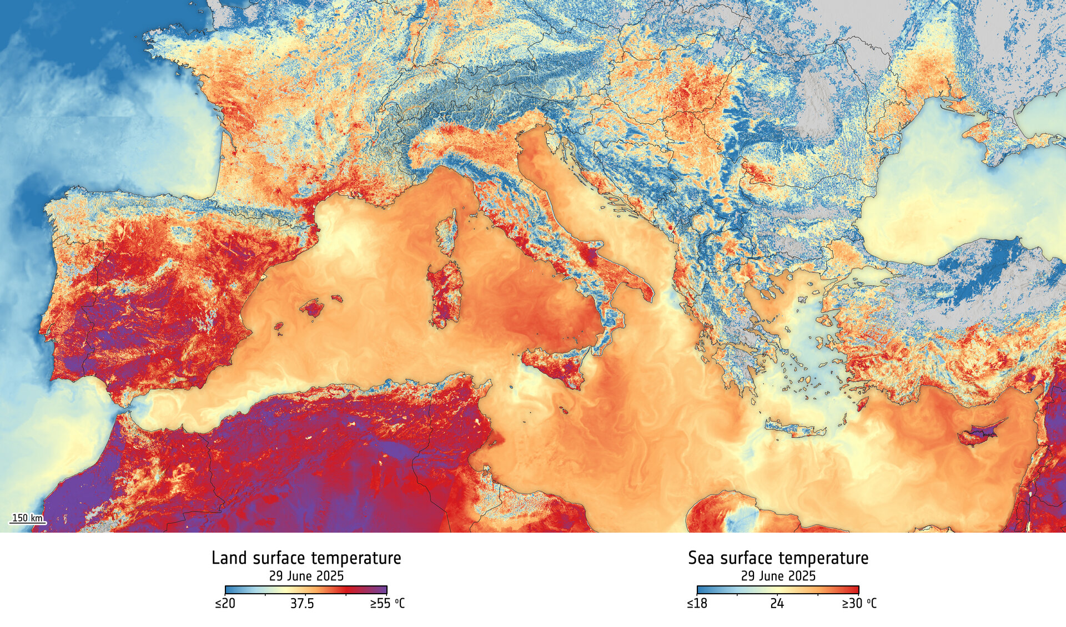
Thanks! Any questions?
ESA Sentinel-3/SLSTR, 29 June 2025

