Slide 1

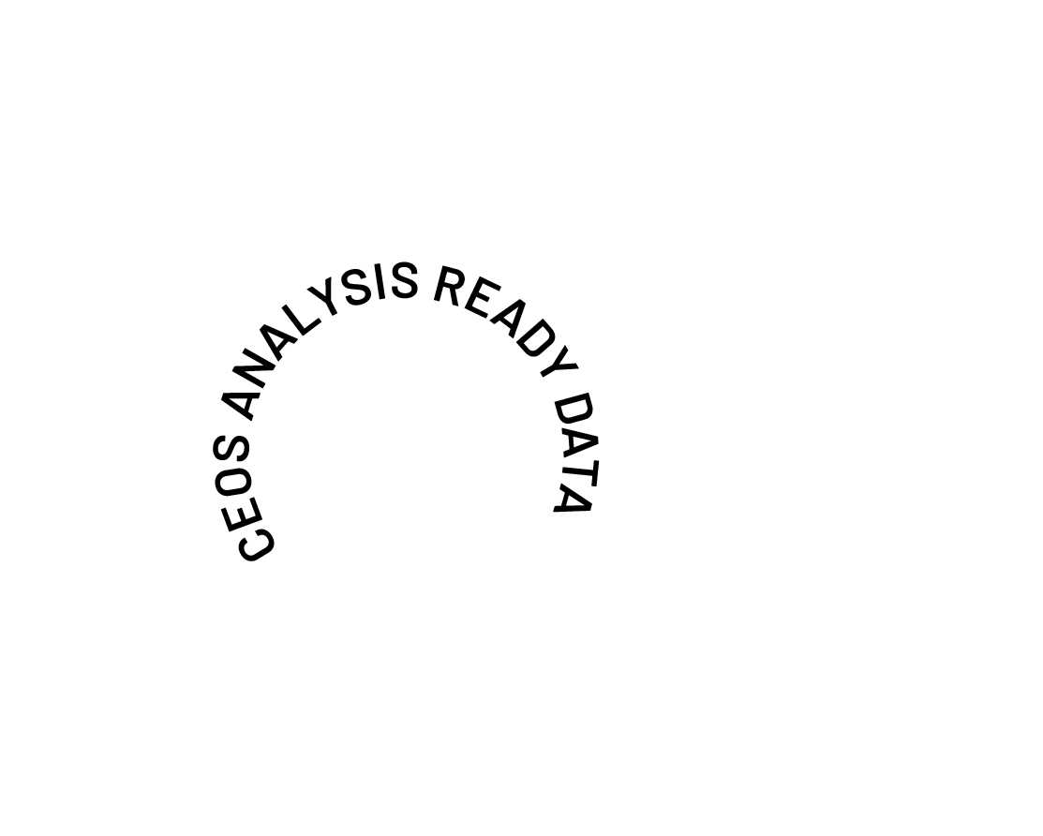
The Future of CEOS Analysis Ready Data
Ferran Gascon
CEOS-ARD Oversight Group Lead
Shaping the future of CEOS-ARD
LSI-VC-18

Slide 2



Future of CEOS-ARD
Goals for 2025:
Gather community feedback on the current state of CEOS-ARD
Understand priorities for future development
Present concept note for CEOS-ARD Strategy 2026 at CEOS Plenary 2025
Overall Aim: Ensure CEOS-ARD is working for the broadest group of stakeholders
LSI-VC-18

Slide 3

Background
CEOS Analysis Ready Data (CEOS-ARD) caused a significant and positive paradigm shift in the Earth observation community
Making data more transparent and easy to use
Basis for improved interoperability.
Critical benchmark for non-CEOS data providers
Encouraged a more thoughtful approach to data provision
Ensuring non-experts can benefit alongside the scientific community
Democratising EO
LSI-VC-18

Slide 4
Can we do more?
The Earth observation sector has come a long way since CEOS-ARD was first conceptualised:
Changing technology, including AI/ML, cloud-native
Evolving user base and expectations
Increasing demands for interoperability
Need CEOS-ARD to continue evolving
Ensure CEOS-ARD remains consistent with and relevant to the evolving user base and their expectations
Where are the opportunities to make CEOS-ARD better?
LSI-VC-18

Slide 5

Approach
CEOS-ARD Oversight Group tasked with maintaining CEOS-ARD Strategy
Updated every two years
In 2025 we have undertaken a community engagement campaign to understand needs
Particular focus on those outside of CEOS
Understand exactly how CEOS-ARD needs to evolve
Presence at key events such as ESA’s LPS, IGARSS, IAC, WGCV-55
Survey to gather feedback to “Help Shape the Future of CEOS-ARD”
Social media campaign
LinkedIn particularly valuable
LSI-VC-18

Slide 6
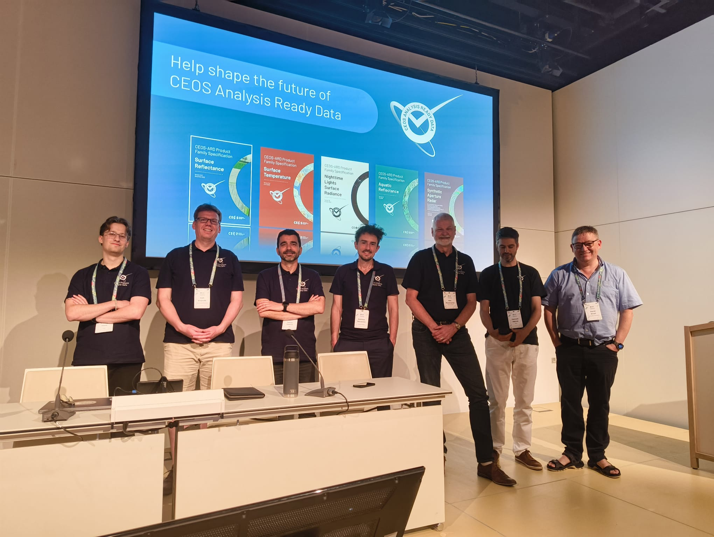

Slide 7

Timeline
Findings will be presented at the CEOS SIT TW (next week) and 2025 CEOS Plenary to:
Present a clear statement of what a future CEOS-ARD needs to look like according to the community.
Provide evidence as to why this is beneficial and necessary by presenting perspectives from across the community
Support request for CEOS Principal decision to develop the CEOS-ARD Strategy 2026 (for endorsement at CEOS Plenary 2026) that would delve deeper into what is needed to address these findings and resource the specific tasks needed to achieve this step change in ambition.
CEOS-ARD Strategy 2026 would be developed throughout 2026 by the CEOS-ARD Oversight Group in collaboration with various CEOS entities and in consultation with external stakeholders.
An initial outline would be presented at SIT-41 (April 2026), with a near complete draft then prepared for discussion at SIT Technical Workshop 2026, ahead of presentation for endorsement at CEOS Plenary 2026 (hosted by Australia, Hobart)
Joint WGCV-56 and LSI-VC-19 meeting a critical and timely milestone for data quality topics
LSI-VC-18

Slide 8
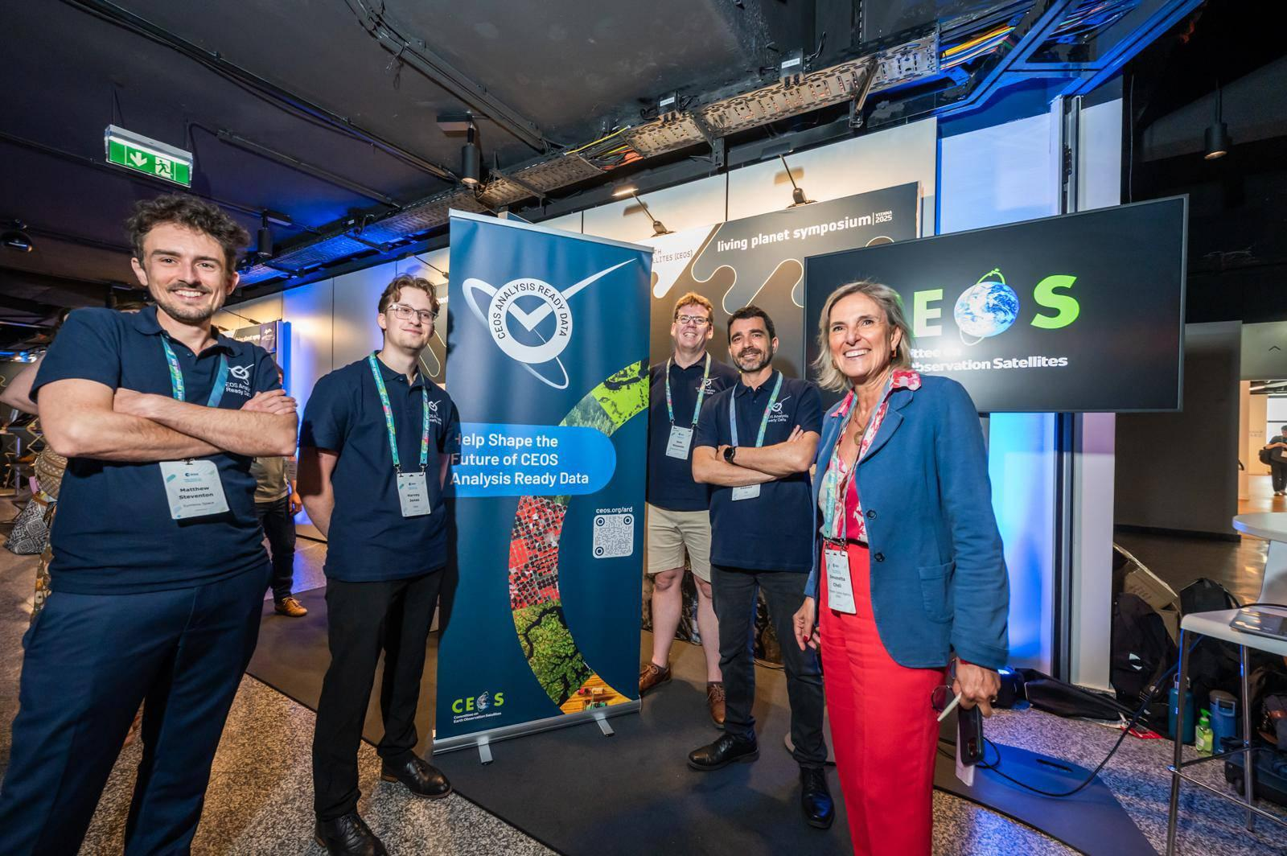

Slide 9
Closing
Thank you to everyone for supporting this effort!
Community reception has been extremely positive and encouraging
98 survey responses and counting
High-level overview of results in next presentation
Numerous valuable inputs through interaction at events
2025 has been pivotal for CEOS-ARD community engagement
Sustaining this outreach effort will lead to great things – keep it up!
VH-RODA, JACIE, BiDS
ARD workshop alongside SIT-41?
Webinar revival
LSI-VC-18

Slide 10





Shaping the future of CEOS Analysis Ready Data

