Slide 1

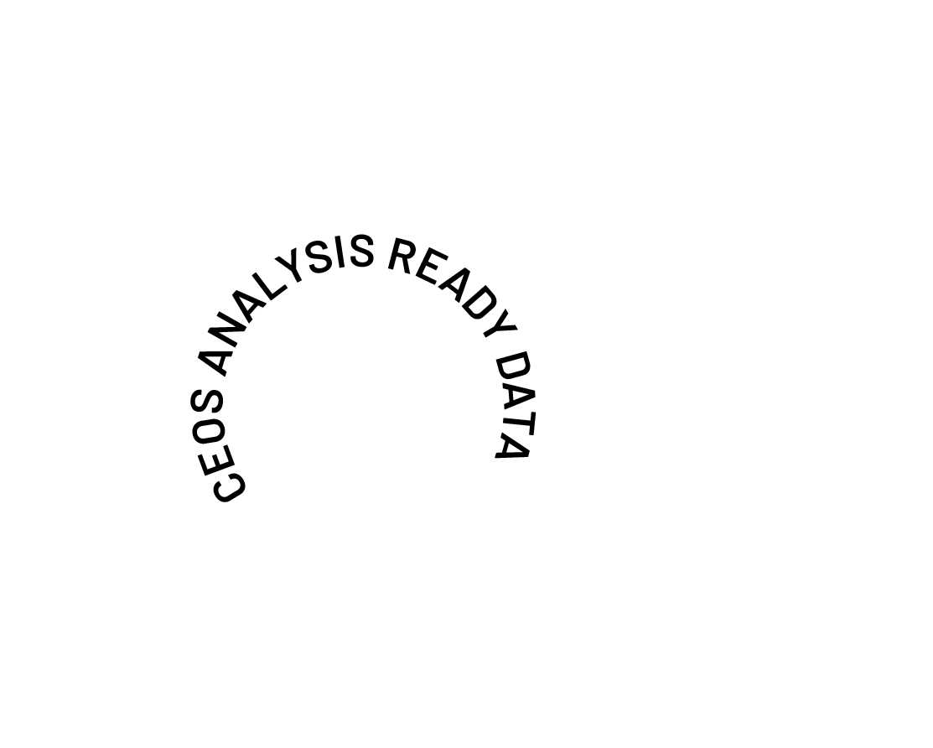
Future of CEOS-ARD Survey
Preliminary Results
Matt Steventon
CEOS-ARD Oversight Group
Shaping the future of CEOS-ARD
LSI-VC-18

Slide 2



Future of CEOS-ARD Survey
ceos.org/ard/survey
Core questions + tailored questions for data producers, users, distributors, etc.
Characteristics needed to make an EO dataset 'Analysis Ready'
What do you value most in the CEOS-ARD Framework
What should be prioritised for future development?
Do you see a need for formal EO ARD standards or is a ‘community standard’ approach like CEOS-ARD sufficient?
Characteristics needed to make an EO dataset 'AI/ML ready'
Barriers to use of the CEOS-ARD Framework / products
Specific datasets you would like to see assessed and endorsed as CEOS-ARD
Opportunities to accelerate the uptake and impact of CEOS-ARD
CEOS-ARD self-assessment plans
LSI-VC-18

Slide 3
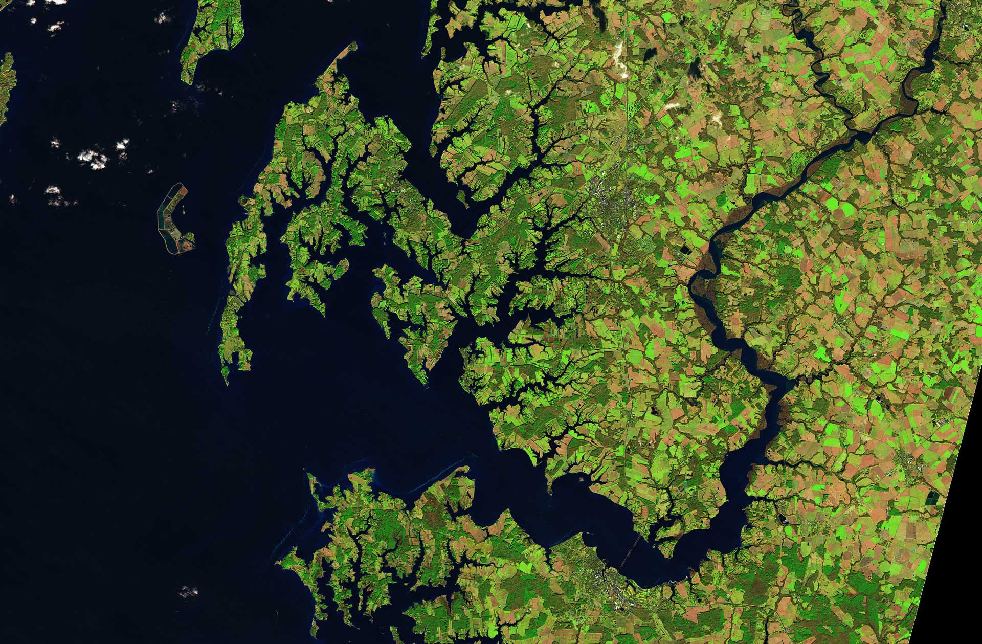
Some Food for Thought
Could we be more ambitious?
Is the value proposition of CEOS-ARD clear and could it be better communicated?
The potential role of CEOS-ARD as a common benchmark for space agency / governmental data procurement processes.
Do we need to introduce minimum requirements for data quality? And what is the correct approach?
Can we better support users to find products that are fit for a specific purpose?
Supporting application resilience by increasing consistency and equivalence of CEOS-ARD products?
How might CEOS-ARD be made more interoperable and interchangeable? Do we need to be stricter in certain areas to drive practical interoperability?
IGARSS 2025

Slide 4
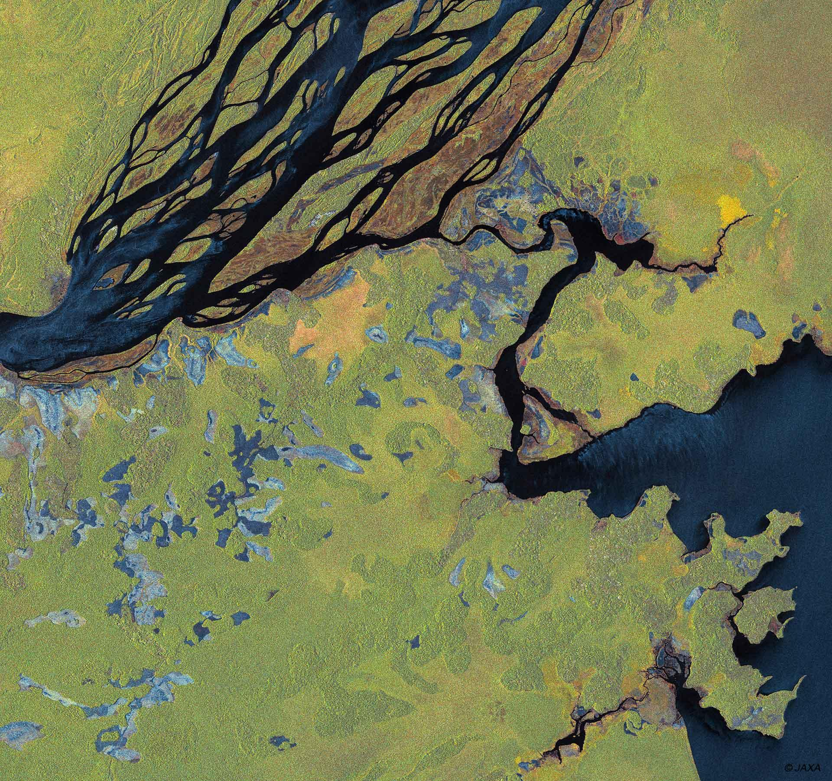
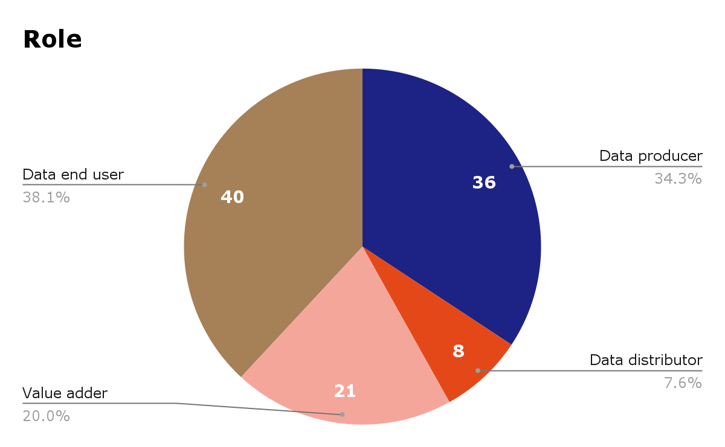
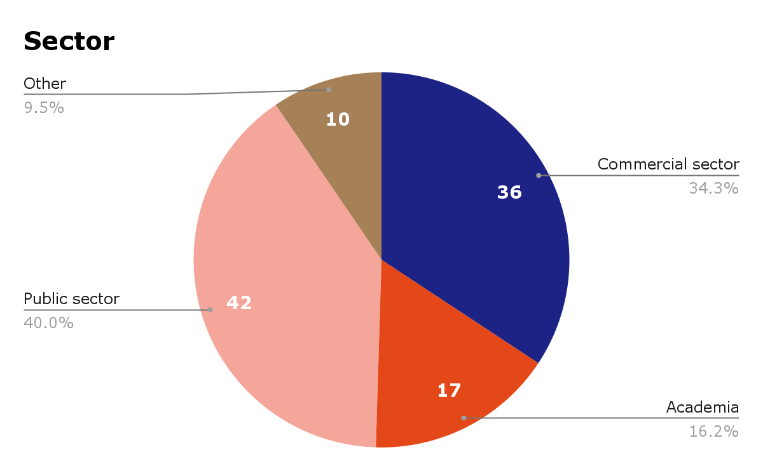
Respondents
106 responses! 🎉
IGARSS 2025

Slide 5
Representation
CEOS / Space Agency | Commercial | Other
Australian Bureau of Meteorology CONAE CSIRO DLR ESA Geoscience Australia GISTDA ISRO NASA NOAA SANSA UNOOSA | Airbus Defence and Space GmbH AISTECH SPACE, S.L. Arlula Pty Ltd Auspatious CATALYST (PCI Geomatics) Common Space Constellr EarthDaily ENVEO IT GmbH EOIntelligence Esri First Street GeoInsight GRASP Earth Marble Imaging AG Pixalytics Ltd Pixxel Planet Labs Sarmap SA SatSure India Analytics Pvt Ltd SatVu Sparkgeo SpectralEO Telespazio UK USACE-AGC World from Space | Aberystwyth University Anna University Conicet Curtin University Kasetsart University KTH Royal Institute of Technology Landgate Natural Resources Canada OGC STFC Trier University UK Met Office UK Ordnance Survey Univ. Colorado, Boulder University of Maryland University of Tartu University of the Free State University of Venda
LSI-VC-18

Slide 6
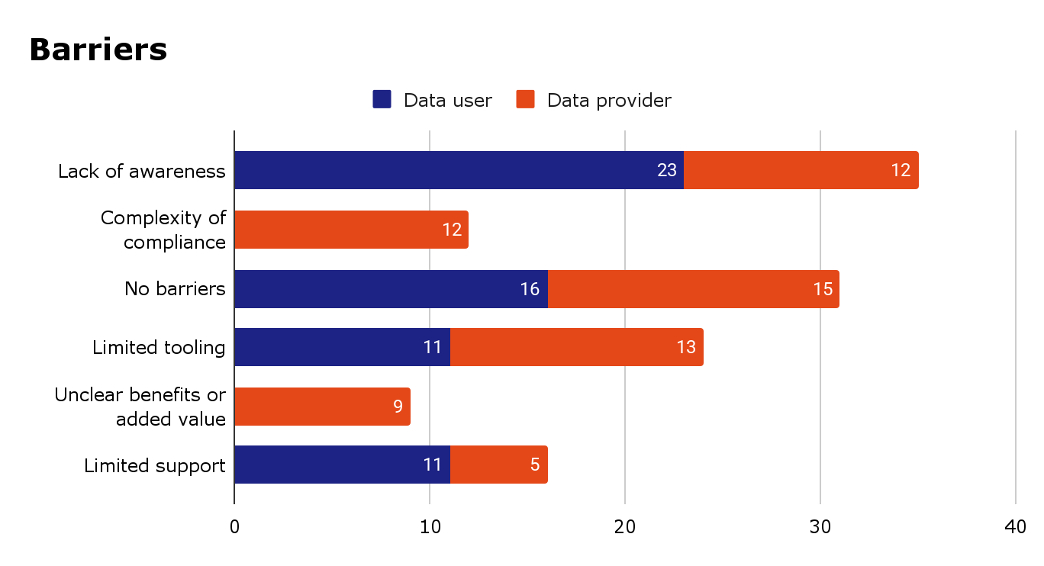
Future of CEOS-ARD
…
LSI-VC-18

Slide 7
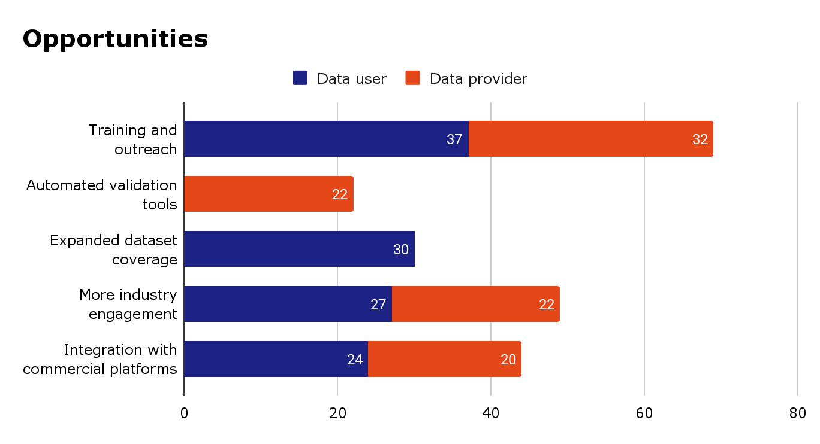
…
LSI-VC-18

Slide 8
Top 10 Characteristics for Analysis Ready Data (multiple choice)
Rank | Characteristics sorted by ranking
1 | Consistent metadata specifications
2 | Machine-readability
3 | Interoperability through time (relative geolocation)
4 | Findable, Accessible, Interoperable, Reusable (FAIR) compliance
5 | Consistency (data has temporal and spatial consistency)
6 | Consistent terminology
7 | Accessibility
8 | Interoperability with other datasets
9 | Geometric correction using DEM (ortho-rectified)
10 | Fitness for purpose indicators (that the product fulfills the requirements of a specific application, e.g., land cover mapping, precision agriculture, etc.)
Respondents were also asked to provide additional characteristics and comments in a free text field. Feedback has been integrated into concept note.
Notably, quality characteristics were mentioned six times.
LSI-VC-18

Slide 9
Top 10 Characteristics for AI/ML Ready Data (multiple choice)
Rank | Characteristics Sorted by Ranking
1 | Machine-readable formats
2 | Rich, consistent, useful and interpretable metadata
3 | Easy access via APIs or cloud providers
4 | Rigorous definition of data values/content (no ambiguities)
5 | High-quality data and continuous QA/QC
6 | Large-scale accessibility
7 | Temporal consistency
8 | Supply of training datasets that are consistently and accurately labelled
9 | Automated pre-processing
10 | Standardised acquisition parameters
Respondents were also asked to provide additional characteristics and comments in a free text field. Feedback has been integrated into concept note.
LSI-VC-18

Slide 10
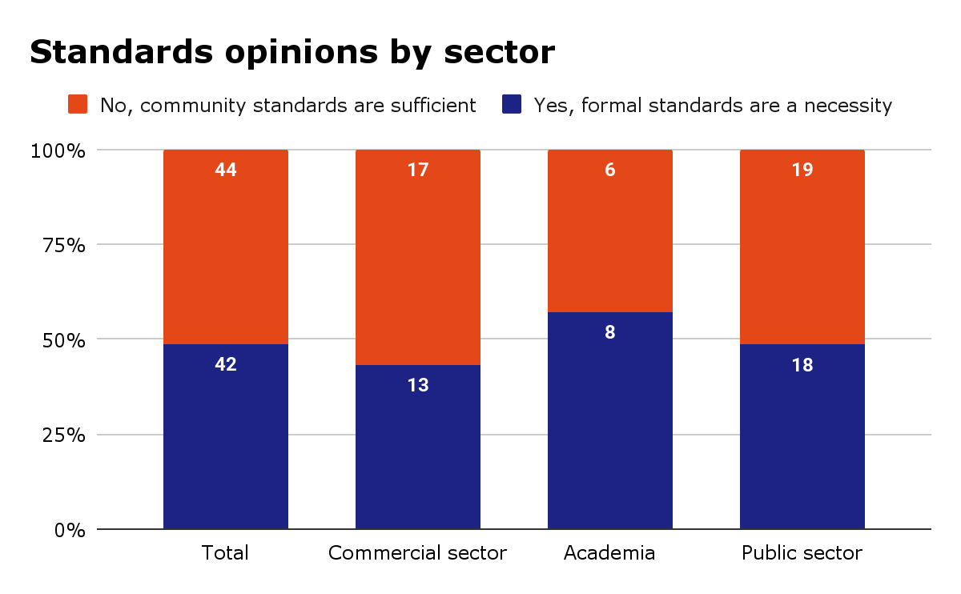
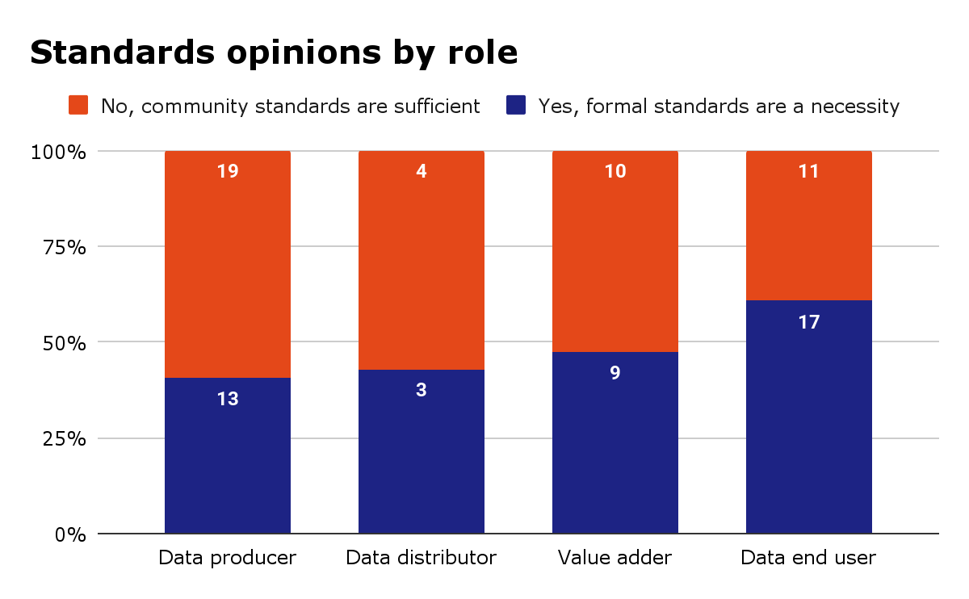
Opinions on ARD Standards
Respondents were divided on the topic of formal vs community standards
In the additional comments box, respondents advocated for free and open community – noting the need to be flexible
LSI-VC-18

Slide 11
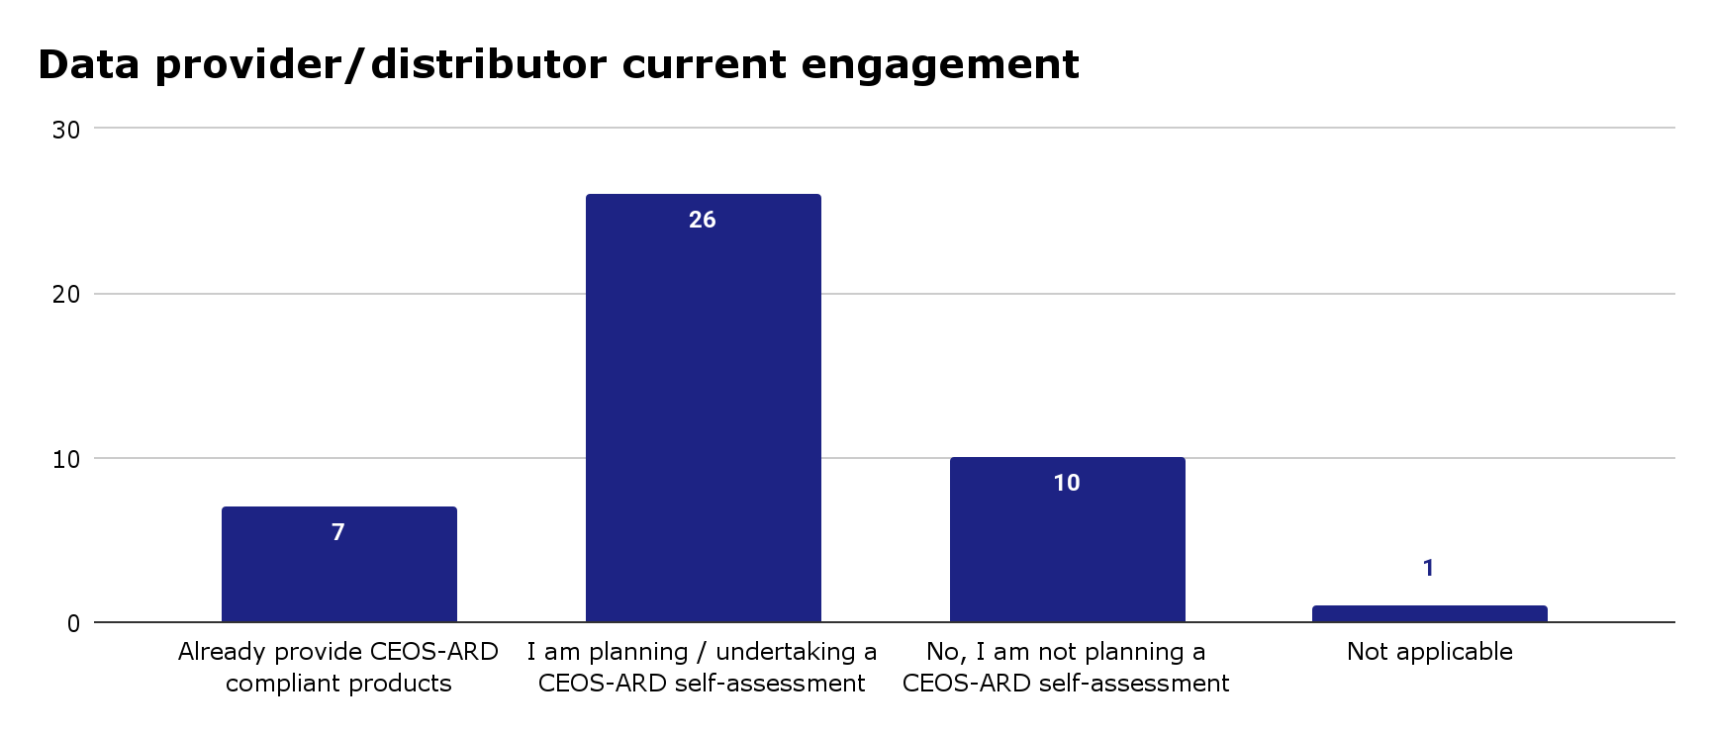
Approach
…
LSI-VC-18

