Slide 1
From Specs to Success:
The Next Phase of CEOS-ARD PFSs
Christopher Barnes, KBR/ USGS
Agenda Item 9.2
LSI-VC-18
Ispra, Italy
2-5 September 2025

Slide 2




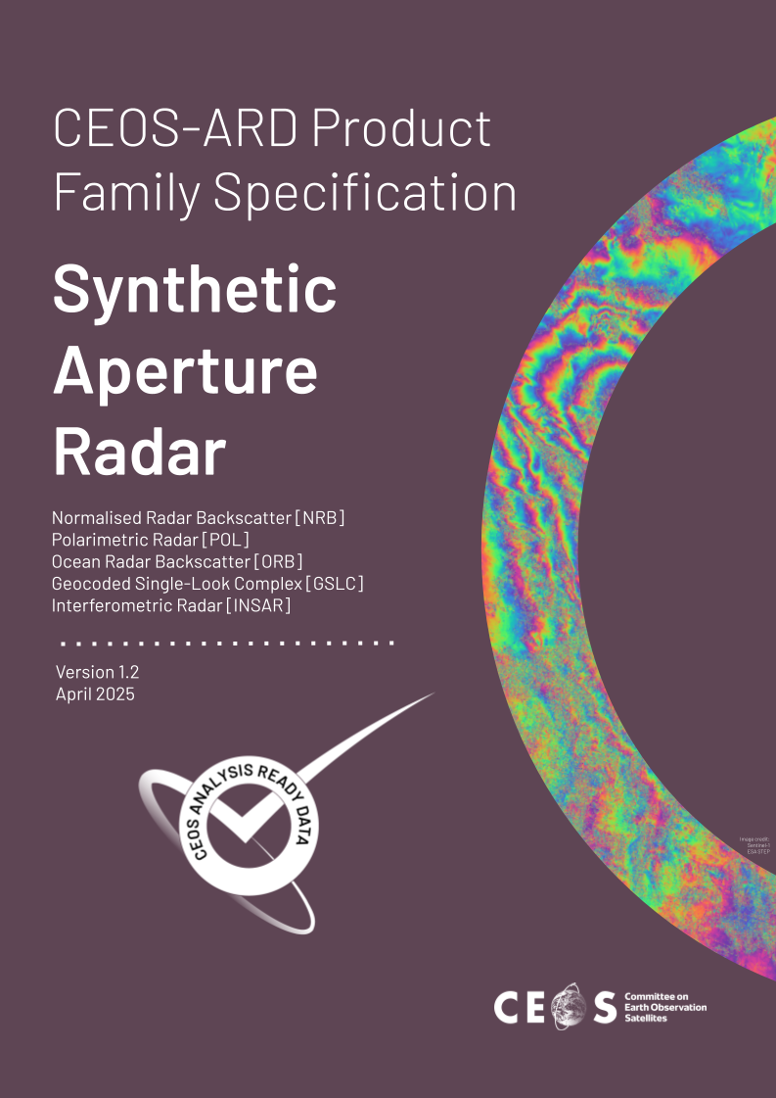
Agreed at LSI-VC-18 to…
Migrate all endorsed PFSs (single) to GitHub:
USGS will co-lead an effort to confirm equivalence in conformity between the optical PFS in GitHub and endorsed PFSs documents (*need to address how to deconstruct SAR PFS versioning)
PFSs will be re-generated and issued a minor increment in version numbering and announced to the CEOS-ARD community
v5.0.1
v5.0
v1.0
v2.0
V1.2*

Slide 3
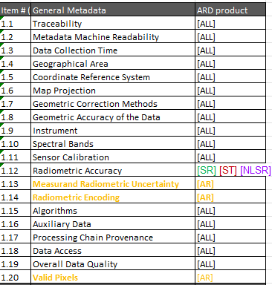
Then we need to…
Address consistency across optical PFSs with similar requirements
General
- 16 (All PFSs)

Slide 4
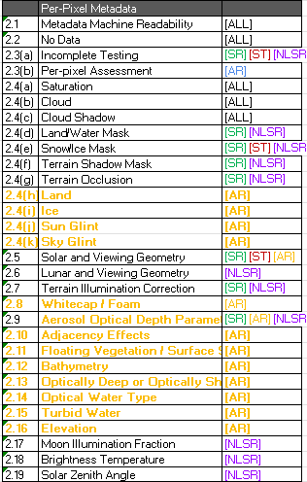
Then we need to…
Address consistency across optical PFSs with similar requirements
Per-Pixel
- 6 (All PFSs)
- 8 (multiple PFSs)

Slide 5
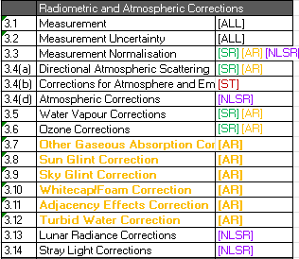
Then we need to…
Address consistency across optical PFSs with similar requirements
Radiometric and Atmospheric Corrections
- 2 (All PFSs)
- 4 (multiple PFSs)

Slide 6

Then we need to…
Address consistency across optical PFSs with similar requirements
Geometric Corrections
- 1 (All PFSs)

Slide 7
Reminder! We also need to…
Assemble SMEs from CEOS/ LSI-VC to address PFS GitHub issues*:
  All Optical PFSs: – To do: 50; Done: 3
    Surface Reflectance – To do: 15; Done: 1
    Surface Temperature – To do: 3
    Aquatic Reflectance – To do: 13
    Nighttime Lights Surface Radiance – To do: 3
  Synthetic Aperture Radar - To do: 20; In progess: 1; Done: 1
* GitHub issues submitted as of September 2025

Slide 8
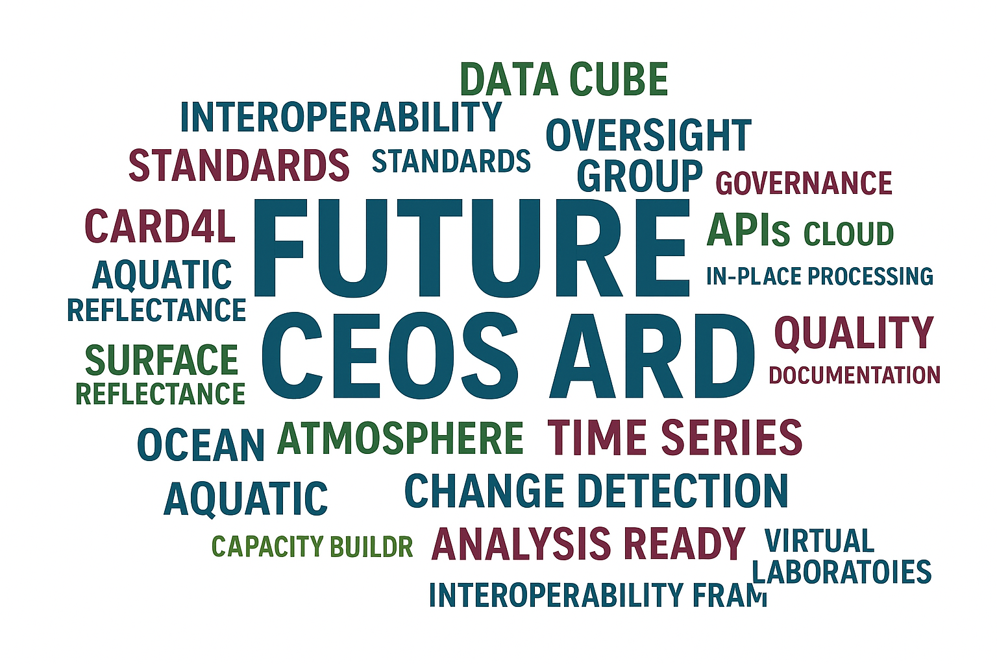

… and we're not done yet.
COMMERCIAL
CAPACITY BUILDER
INTEROPERABILITY FRAMEWORK

