Slide 1
LSI-VC-18
Discrete Global Grid System (DGGS)
Ferran Gascon (ESA)
Agenda Item 9.3
LSI-VC-18
Ispra, Italy
2-5 September 2025

Slide 2
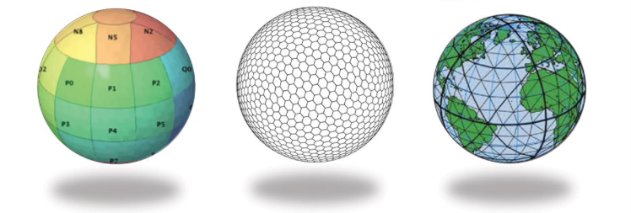
WHAT ?
“Discrete Global Grid System is a spatial reference system that uses a hierarchical sequence of equal area discrete global grids to model, partition and address the globe.” [OGC definition (Purss, 2015)]
Examples of DGGS tessellations based on platonic solids: (1) cube – cube, (2) hexagon – dodecahedron, and (3) triangle – icosahedron (Peterson, 2016)

Slide 3
WHY ?
Globally consistent framework | Combination of raster, vector and point cloud data into a common, globally consistent framework / Combination of multiscale EO data
Big data | DGGS cells an efficient type of granularity for big data analysis, i.e. cloud computing and parallelisation to visualization and data sharing
Common spatial reference | Integration and analysis of multiple data sources in one workflow, no need to convert/change spatial reference systems
Less distortions | While the data obtained by projection have serious deformation problems, especially in polar or high latitudes, DGGS cells are multiple, continuous, and have the same geometry and the “same area”

Slide 4
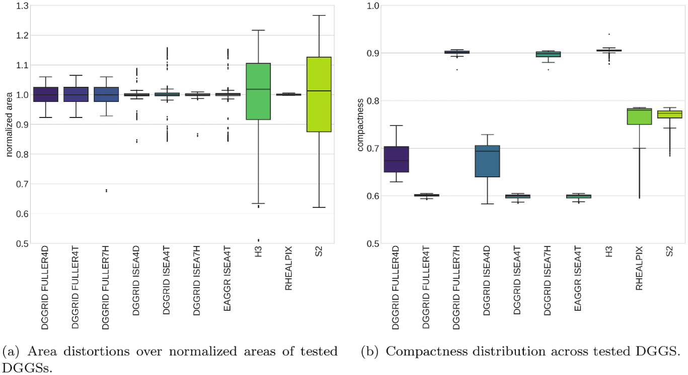
DGGS comparison
 | H3 | rHealPix | ISEA7H | ISEA4T/D
Cell | Hexagon | Multiple | Hexagon | Triangle/Diamond
Aperture | 7 | 9 | 7 | 4
Projection | Gnomonic | Custom (EA) | ISEA | ISEA
Shape/Area preservation | Great shape preservation High area distortions | Good shape preservation by shape group Very low area distortion | Great shape preservation Great area preservation | Low shape preservation (lower than ISEA7H) Great area preservation
indexing | Dual indexing: Axis and hierarchical | Z space filling curves | Sequential id | Sequential id
Children extend fully contained in Parent | No | Yes | No | Yes
Software support | Excellent (Multi-language support, DBs support, Cloud extensions, …) | Limited (implemented in the Proj.4 Cartographic Library) | Good (DGGRID + bindings) | Good (DGGRID + bindings)
Kmoch, A., Vasilyev, I., Virro, H., Uuemaa, E., 2022. Area and shape distortions in open-source discrete global grid systems. Big Earth Data 1–20. https://doi.org/10.1080/20964471.2022.2094926

Slide 5
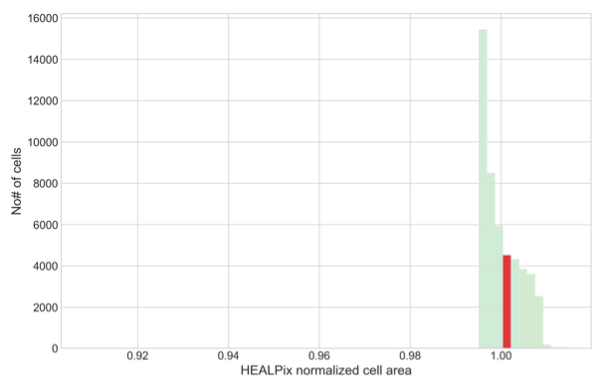
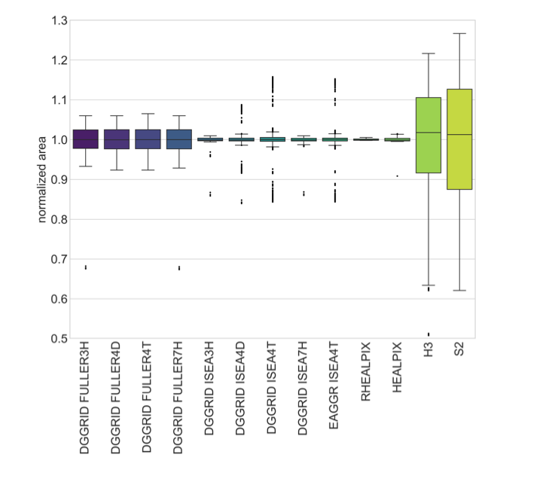
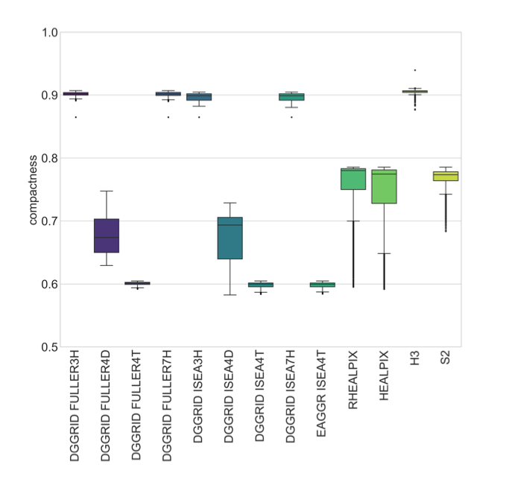
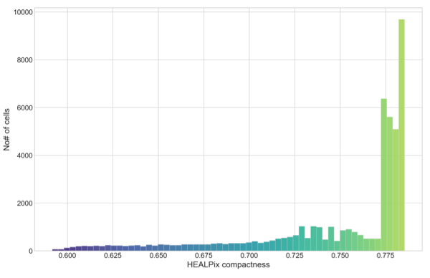
DGGS comparison (Including HEALPix)
Histogram of normalized area values for HEALPix cells.
Including HEALPix
Histogram of compactness values for HEALPix cells
Kmoch et al. (2024). XDGGS: A community-developed Xarray package to support planetary DGGS data cube computations. doi:10.5194/isprs-archives-XLVIII-4-W12-2024-75-2024
Good shape and area preservation

Slide 6

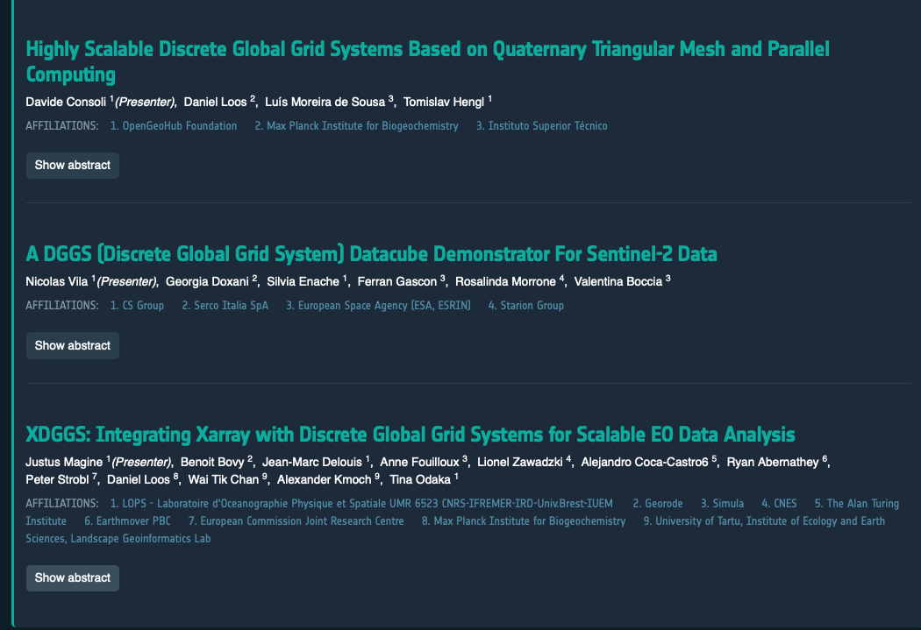
LIVING PLANET SYMPOSIUM
C.01.07 Discrete Global Grid Systems (DGGS)

Slide 7

LIVING PLANET SYMPOSIUM
C.01.07 Discrete Global Grid Systems (DGGS)
DGGS / Approach (Abstract) | Features | Teams
ISEA Projection & Indexing (ISEA3H / ISEA9R) | - Need for properly mapping geodetic latitude to authalic latitude ->ISEA grids to be truly equal-area. - Hexagonal indexing still complex: long identifiers and mapping issues at deep refinements -> A relatively simple approach proposed leverages the dual relationship between ISEA3H and ISEA9R (aperture 9 rhombic) DGGHs -> compact indexing scheme with 64-bit IDs.- Deterministic sub-zone ordering enables efficient storage & transmission. | Jérôme Jacovella-St-Louis, Ecere Marta Padilla Ruiz, University of Calgary Luís Moreira de Sousa, University of Lisbon Perry Peterson, University of Calgary Emmanuel Stefanakis, University of Calgary
Triangular DGGS with Parallel I/O (Aperture-4, MPI) | - Built from geodesic subdivision of an icosahedron → produces 20 quad-trees.- High parallelism & scalability: creates a nested-sphere topology for processing data at multiple spatial resolutions simultaneously. - Supports exponential parallel efficiency + logarithmic queries.- Compatible with chunked formats (e.g., Zarr). - Elevation information directly in the meshed structure-> DGGS for applications like hydrology, electromagnetic scattering and Earth digital twins. | https://opengeohub.org

Slide 8
DGGS comparison & LPS suggestions
Features | H3 | rHealPix | ISEA7H | ISEA4T/D | ISEA3H / ISEA9R | Triangular DGGS
Cell | Hexagon | Multiple | Hexagon | Triangle/Diamond | Hexagon and rhombs in dual relationship | Triangle
Aperture | 7 | 9 | 7 | 4 | 3 hexagonal tessellation and 9 for rhombic | 4
Projection | Gnomonic | Custom (EA) | ISEA | ISEA | ISEA with a proposed interoperable orientation (0.05° W shift) for consistency | Icosahedral geodesic subdivision
Shape/Area preservation | Great shape preservation High area distortions | Good shape preservation by shape group Very low area distortion | Great shape preservation Great area preservation | Low shape preservation (lower than ISEA7H) Great area preservation | - | -
indexing | Dual indexing: Axis and hierarchical | Z space filling curves | Sequential id | Sequential id | Compact, hierarchical indexing scheme with deterministic ordering | Dual indexing: Sequential and Hierarchical
Children extend fully contained in Parent | No | Yes | No | Yes
Software support | Excellent (Multi-language support, DBs support, Cloud extensions, …) | Limited (implemented in the Proj.4 Cartographic Library) | Good (DGGRID + bindings) | Good (DGGRID + bindings) | Ongoing work | Ongoing work

Slide 9
LIVING PLANET SYMPOSIUM
C.01.07 Discrete Global Grid Systems (DGGS)
DGGS as a Paradigm Shift Overcome distortions and redundancy in traditional projections (e.g., UTM, WGS84). / Enable hierarchical, multiresolution indexing for scalable queries and analysis. Criteria based assessment is needed for objective ranking of solutions.
Standardisation for Interoperability The OGC API – DGGS Core Standard defines uniform access, querying, and encoding of DGGS data / provides a foundation for interoperable geospatial infrastructures.
Technical Innovations Hexahedral and ISEA projections improve grid accuracy, equal-area properties, and indexing. New hierarchical and parallelized I/O strategies allow handling of petabyte-scale EO archives efficiently.
Ecosystem and Tools XDGGS library integrates DGGS with xarray, Dask, and the pangeo ecosystem, embedding DGGS in mainstream scientific workflows. Simplifies adoption, supports cloud-native scalability, and promotes cross-domain applications.
Key Insights

Slide 10
LIVING PLANET SYMPOSIUM
C.01.07 Discrete Global Grid Systems (DGGS)
DGGS are moving from research to operational reality through refined methods, standards, demonstrators, and tools.
They deliver efficiency, scalability, and interoperability for next-generation EO infrastructures.
Main Takeaways
Adoption will require continued tool development and community engagement.
DGGS will be a cornerstone for global-scale EO data analysis.

Slide 11
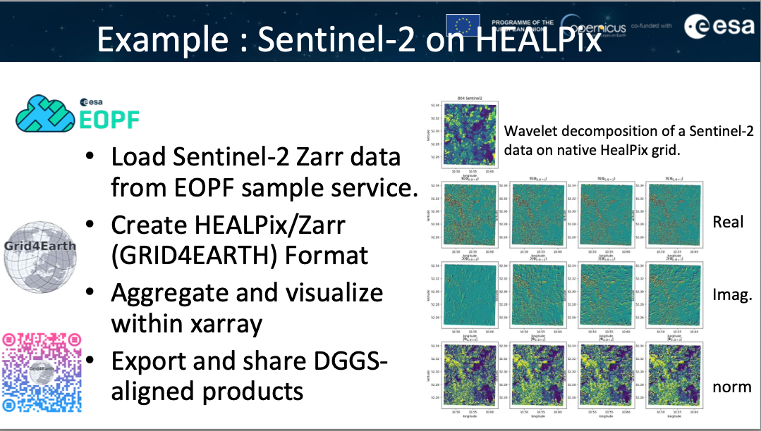
DGGS within DestinE
The HEALPix (Hierarchical, Equal Area, and isoLatitude Pixelisation) representation of the sphere offers a hierarchical tree structure for multi-resolution applications and has been adopted by DestinE for the Climate Digital Twin representation.

Slide 12
LIVING PLANET SYMPOSIUM
C.01.07 Discrete Global Grid Systems (DGGS)
DGGS / Approach (Abstract) | Pros | Cons / Challenges
Hexahedral Projections for Global Grids | - Flexible, versatile for EO needs.- Quadrilateral (“raster-like”) geometry = least disruptive transition from current EO workflows.- Many variants developed over decades → rich variety of approaches for various applications.- Can optimize distortions via graticule rotation.- Bridges 2D rasters with DGGS concepts. | - Trade-offs in distortion, accuracy, efficiency.- Requires careful evaluation and optimization per use case -> Global Reference Grid Intercomparison eXercise (GRGIX)
OGC API – DGGS | - Standardized API for querying, indexing, and retrieval.- Supports hierarchical DGGRS for precise multiscale analysis.- JSON/UBJSON/Zarr encodings enable interoperability & efficiency.- Facilitates integration across systems, lowering technical barriers.- Provides schema & examples for developers. | - Requires uptake by geospatial software tools.- Transition from legacy formats/systems may be slow.
ISEA Projection & Indexing (ISEA3H / ISEA9R) | - Need for properly mapping geodetic latitude to authalic latitude ->ISEA grids to be truly equal-area. - Hexagonal indexing still complex: long identifiers and mapping issues at deep refinements -> A relatively simple approach proposed leverages the dual relationship between ISEA3H and ISEA9R (aperture 9 rhombic) DGGHs -> compact indexing scheme with 64-bit IDs.- Deterministic sub-zone ordering enables efficient storage & transmission. | - Geospatial software tools still under development.
Triangular DGGS with Parallel I/O (Aperture-4, MPI) | - Built from geodesic subdivision of an icosahedron → produces 20 quad-trees.- High parallelism & scalability: creates a nested-sphere topology for processing data at multiple spatial resolutions simultaneously. - Supports exponential parallel efficiency + logarithmic queries.- Compatible with chunked formats (e.g., Zarr). - Elevation information directly in the meshed structure-> DGGS for applications like hydrology, electromagnetic scattering and Earth digital twins. | - Limited adoption in EO community; compatibility with existing tools an issue
Sentinel-2 Demonstrator with H3 DGGS | - Demonstrates real-world EO use case (Belgium ARD).-Supports multisource integration (Sentinel-2, Landsat, DEM).- Efficient cloud mask storage & querying.- Cloud-native design integrates with visualization and storage tools. | - H3 chosen only based on tools availability. -Requires adaptation of existing tools or development of new for applicability to other DGSSs.
XDGGS Library (DGGS + Xarray) | - Embeds DGGS into familiar xarray framework.- Scales with Dask for cloud-native EO analysis.- Easy access to DGGS workflows (lower adoption barrier).- Interoperability via pangeo ecosystem.- Supports visualization, reproducibility, cross-domain use. | - Ecosystem still young, limited maturity.- Not all EO workflows yet covered.- Researchers must adapt to DGGS-specific thinking (non-regular grids).

