Slide 1
L7.5
CEOS-ARD Discoverability and Accessibility
– Progress Report
Yves Coene (Spacebel for ESA)
WGCV-56 / LSI-VC-19 Joint Meeting, Sioux Falls, South Dakota (United States)
Session L7: Standards and Interoperability, 22/04/2026

Slide 2
Outline
Introduction
Guide to Enable Discoverability of Datasets
Proof of Concept (Improved discoverability and accessibility)
Conclusion

Slide 3
Introduction
Significant effort from member agencies to make CEOS-ARD compliant datasets available.
Member agencies make available many datasets via the WGISS Connected Data Assets (CDA), i.e. IDN and FedEO. Number of collections/granules grows continuously. However:
  No support to filter/find CEOS-ARD compliant datasets
  No consistent identification/description of CEOS-ARD compliant datasets.
Collaboration WGISS DAIG, CEOS Working Group on Cal/Val (WGCV) / CEOS-ARD Oversight group and SEO Team aiming to:
  Leverage WGISS Connected Data Assets (CDA) to improve discoverability and accessibility of CEOS-ARD datasets
  Discuss relation between CDA (STAC) collections and CEOS-ARD products and specifications
  Ensure that the CEOS-ARD access points are consistent and interconnected (e.g. IDN, FedEO, MIM DB, ceos.org/ard datasets table)
Notes:
https://docs.google.com/spreadsheets/d/1uCgp_XvMsl_B71-wSQY3zBV2lY8lF30cXiw3mdU8oZk/edit?gid=1265398649#gid=1265398649

Slide 4
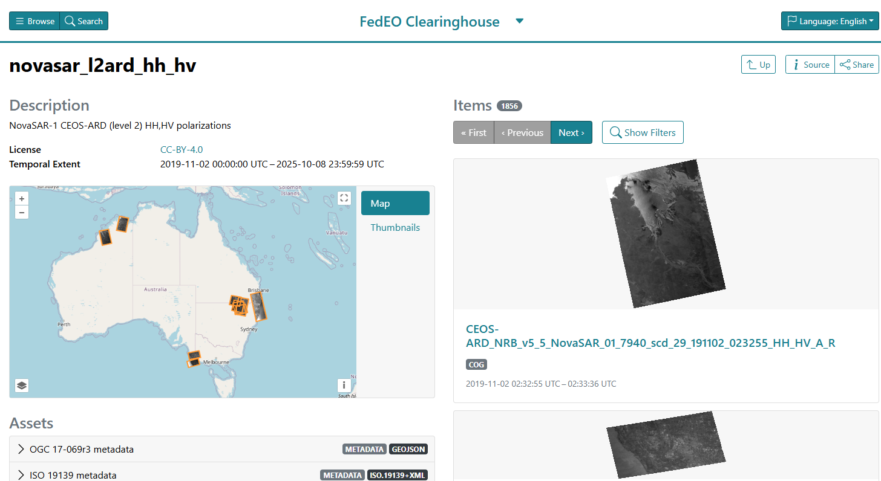
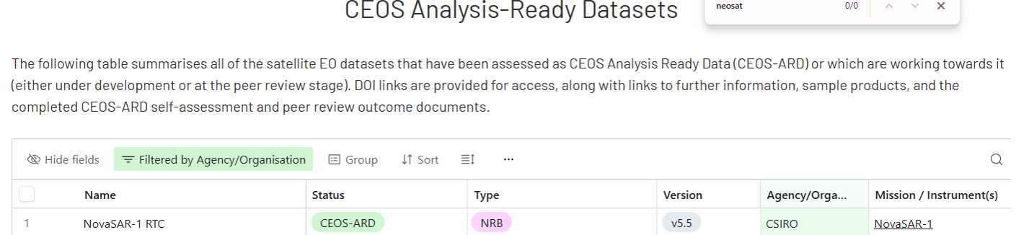
Example CEOS-ARD datasets in FedEO (1/3)
Example 1 – CSIRO:
  https://radiantearth.github.io/stac-browser/#/external/geo.spacebel.be/collections/novasar_l2ard_hh_hv
Notes:
See https://ceos.org/ard/index.html#datasets

Slide 5
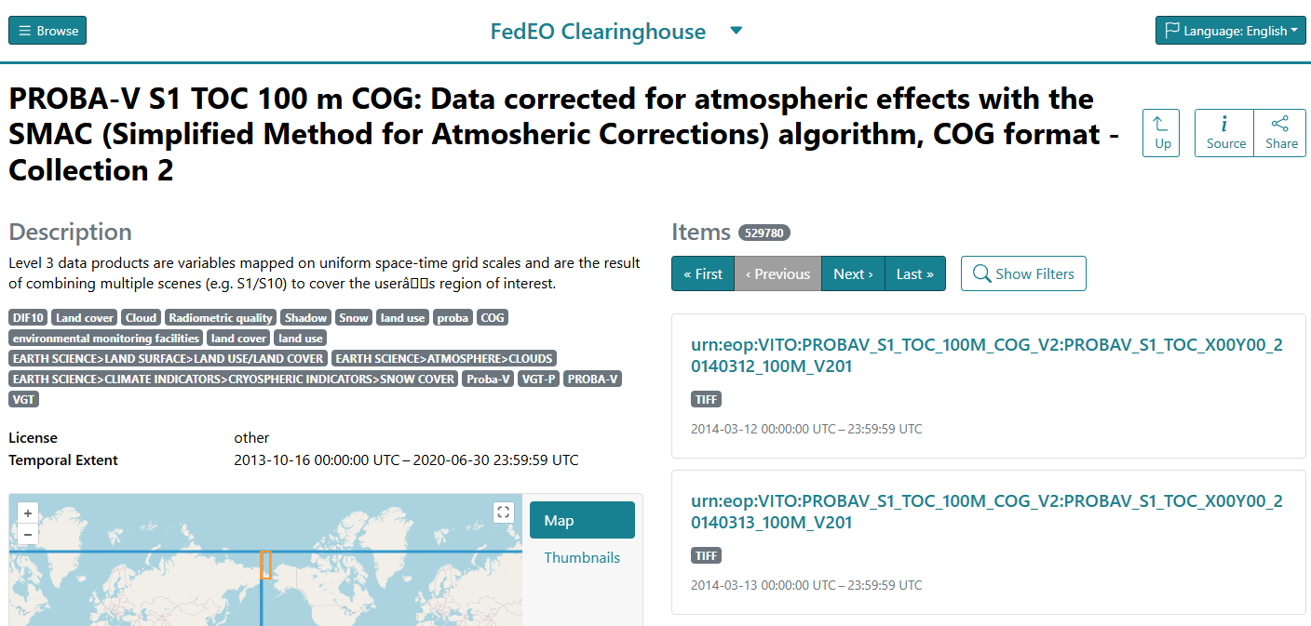
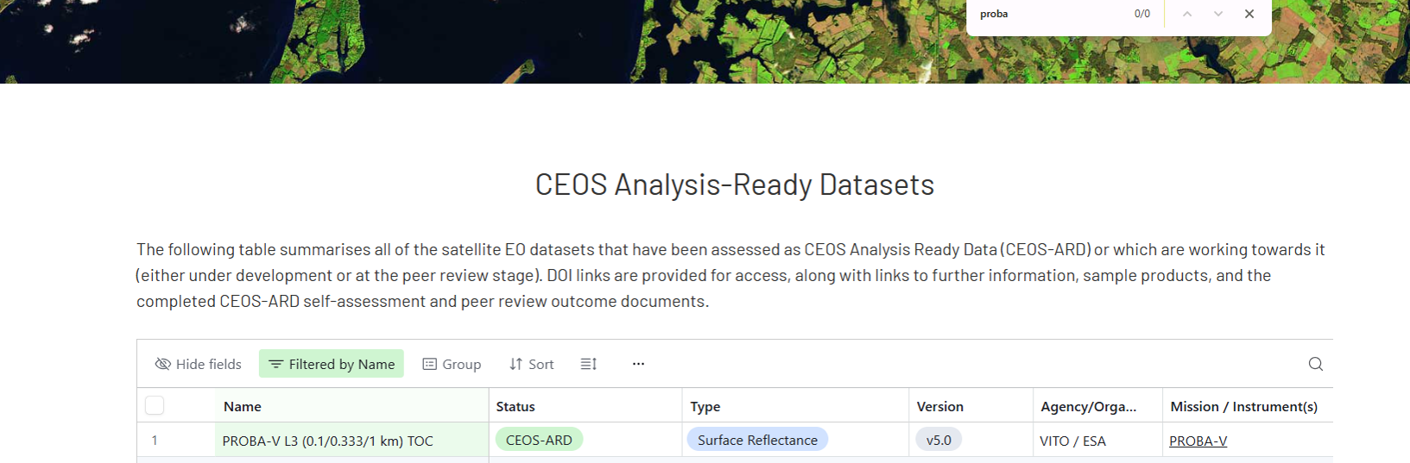
Example CEOS-ARD datasets in FedEO (2/3)
Example 2 – VITO:
  https://radiantearth.github.io/stac-browser/#/external/fedeo.ceos.org/collections/urn:eop:VITO:PROBAV_S1_TOC_100M_COG_V2?.language=en

Slide 6
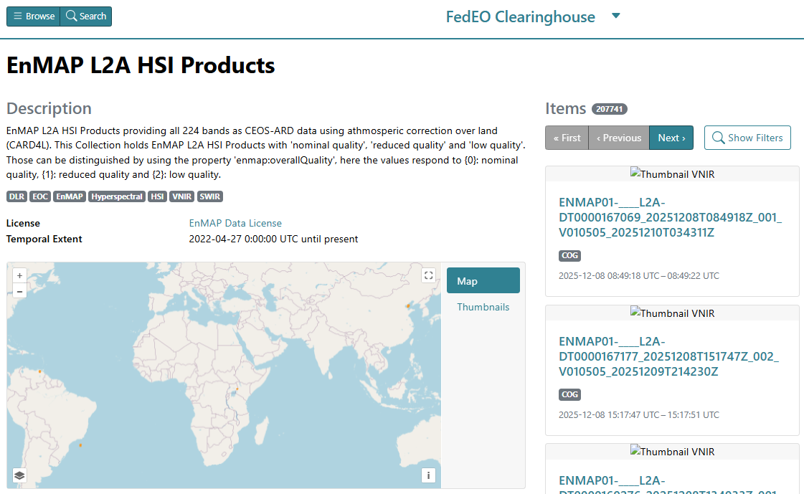
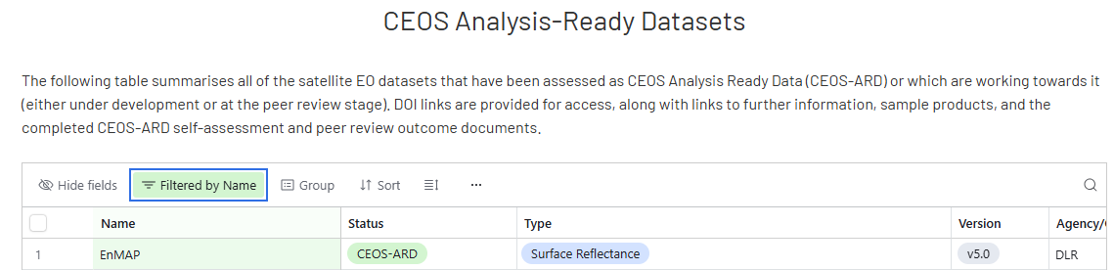

Example CEOS-ARD datasets in FedEO (3/3)
Example 3 – DLR:
  https://radiantearth.github.io/stac-browser/#/external/geo.spacebel.be/collections/ENMAP_HSI_L2A

Slide 7
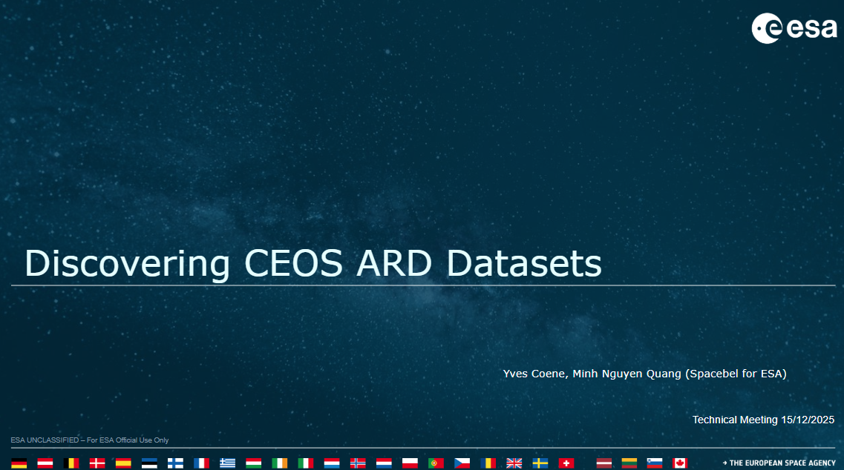
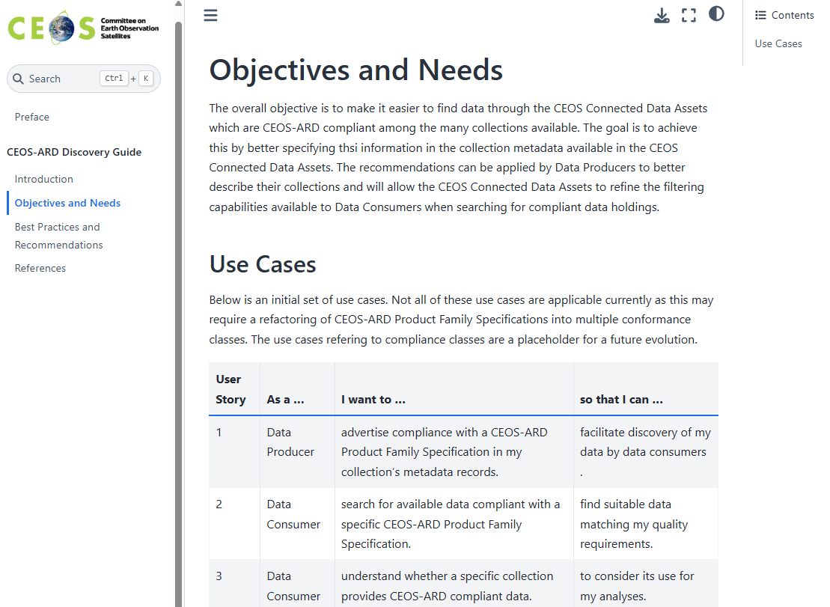
Collaboration and initial results
Initial meetings 15/12/2025 and 19/01/2026:
  Overview of issues to be tackled.
  Discussion various options proposed by DAIG (slides) to improve discoverability through CDA.
  Action: DAIG to prepare Guidance document for collection-level metadata for CEOS-ARD compliance.
Meeting 25/02/2026:
  Explain and discuss status of Draft guidance document
  Incomplete list of CEOS-ARD collections available via WGISS CDA
  Action: setup GitHub “Guidance to Enable Discoverability of Specialised Datasets” to host “Guidance document”.
WGISS-61 18/03/2026:
  Presentation of status at CEOS WGISS-61 (Dehradun)
Meeting 24/03/2026:
  Further actions related to CEOS URIs.

Slide 8
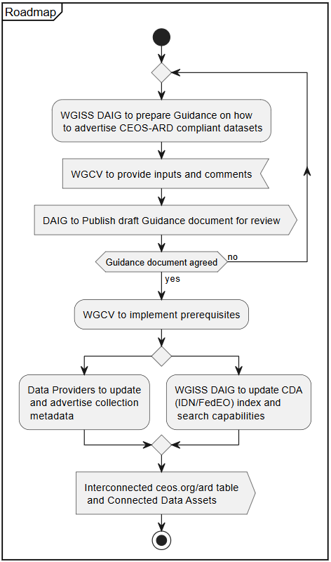
Stepwise approach
(1) WGISS DAIG to make recommendations on how to advertise CEOS-ARD compliance in collection metadata.
(2) WGISS and Working Group on Cal/Val (WGCV) to agree on recommendations
  May require actions by SEO and WGCV (e.g. prerequisites)
(3) Data Providers to updated their “favorite” collection metadata formats according to agreed recommendations
(4) Connected Data Assets (IDN, FedEO) to support recommendations:
  Include in collection metadata definition / harvesting processes
  Provide filtering capabilities in available (STAC) API
  Provide filtering capabilities in client applications.
(5) Connect ceos.org/ard datasets table to CDA endpoints.
Add flowchart (alptiop?)

Slide 9
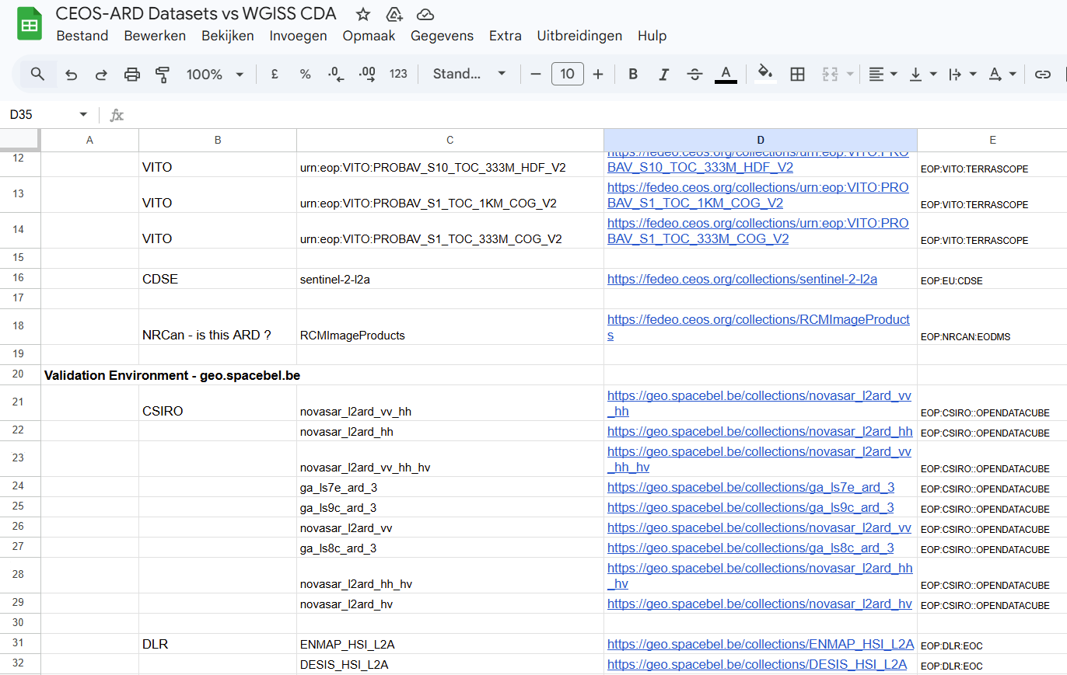
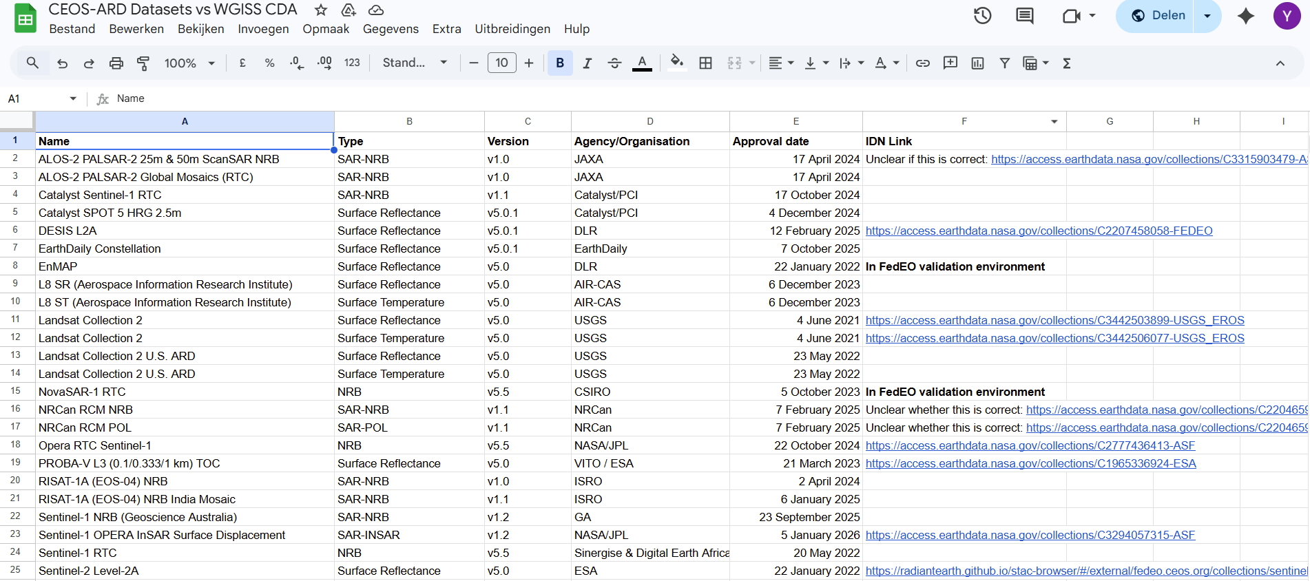

Result 1: Inventory of CEOS-ARD datasets in CDA
Collection of information is on-going. Preliminary Google sheet shared at https://docs.google.com/spreadsheets/d/1uCgp_XvMsl_B71-wSQY3zBV2lY8lF30cXiw3mdU8oZk/edit?gid=1265398649#gid=1265398649
To be consolidated.
Eventually to be linked to ceos.org/ard datasets table.

Slide 10
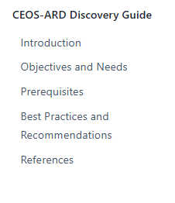
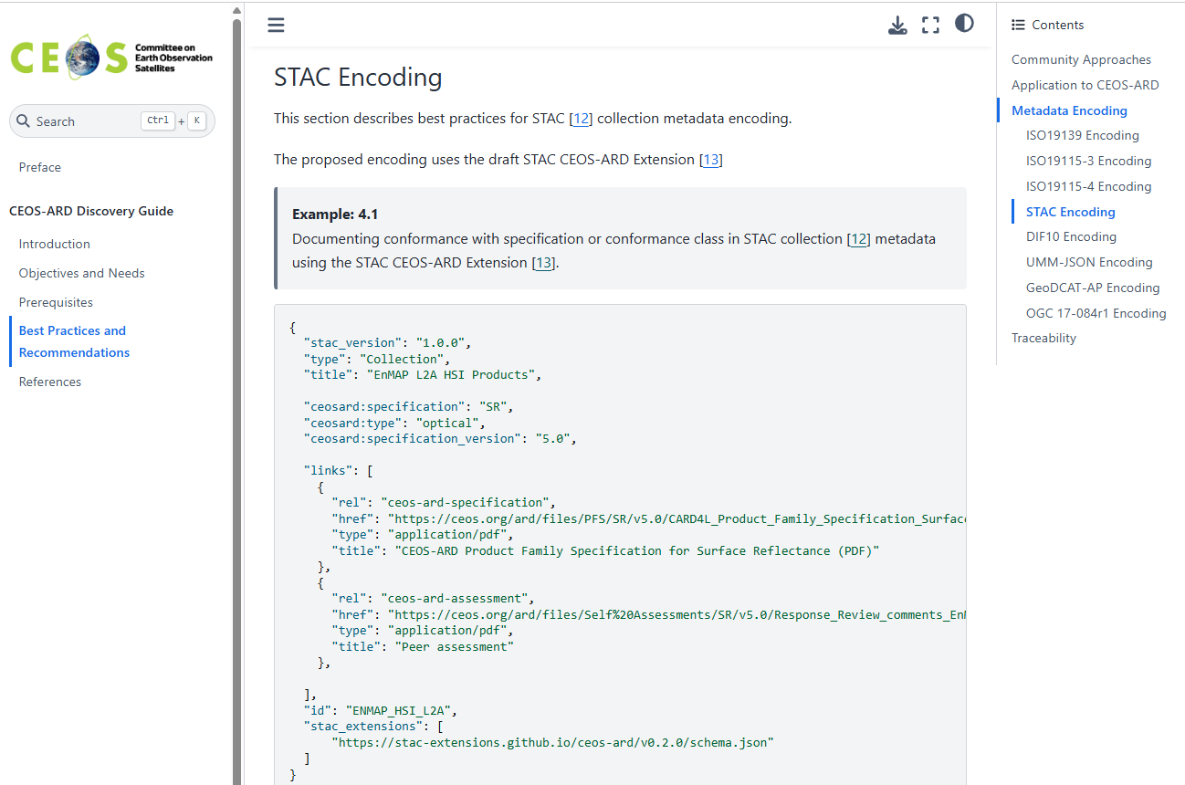
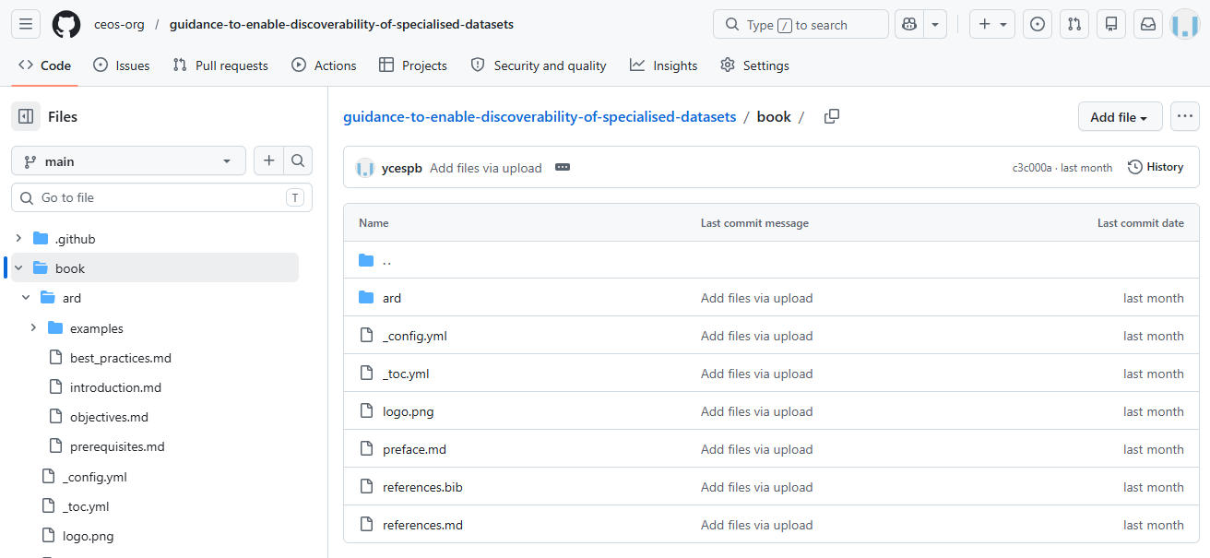
Result 2: “Guide to Enable Discoverability of Datasets”
Approach:
  Is hosted in https://github.com/ceos-org/guidance-to-enable-
  discoverability-of-specialised-datasets repository.
  Rendered in HTML documentation as
Status:
  Draft version to collect feedback and to be consolidated.
Notes:
https://github.com/ceos-org/guidance-to-enable-discoverability-of-specialised-datasets/tree/main/book
https://ceos-org.github.io/guidance-to-enable-discoverability-of-specialised-datasets/preface.html

Slide 11


Result 2: Guide - Introduction
Purpose:
  Best Practices for the encoding of metadata for CEOS-ARD Collections to facilitate their discovery through the CEOS Connected Data Assets.
Approach:
  Metadata neutral. Recommendations for multiple metadata format encodings.
  Reuse proven approaches used by other communities for expressing conformance with data specifications as part of (ISO) Quality metadata:
    INSPIRE: to express partial or conformance with respect to the INSPIRE Data Specifications e.g. “Land Cover”, “Orthoimagery”
    DGIWG: to express partial or conformance with respect to its Data Product Specifications, e.g. “Defence Gridded Elevation Data Product”, “Defence Orthoimagery Product” or “Elevation Surface Mode”.

Slide 12
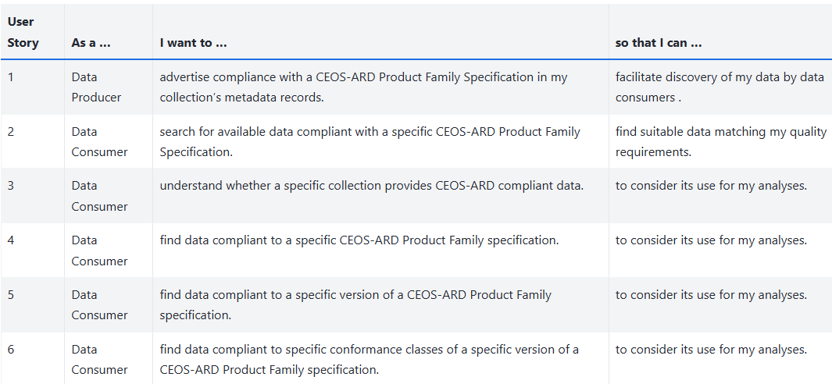
Guide – Objectives and Needs
Proposed content:
  Summary of objectives and supported use cases: Data Producer / Data Consumer
  Some use-cases are forward-looking and not yet possible, e.g. expressing partial compliance versus conformance classes.

Slide 13
Guide – Prerequisites
(1) Requirements for citations – Provides examples from OGC which can be removed once CEOS-ARD equivalents are agreed/known (appear in recommendations).
  Specification title
  Version
  External identifier (URI)
  Conformance class name
  Conformance class identifier (URI)
(2) Requirements for controlled keywords (concepts) – Provides example/model used by INSPIRE (SKOS) which can be published as a single (RDF) file.
  Keyword title (skos:prefLabel) e.g. “Surface Reflectance”
  Keyword URI (concept URI) e.g. https://ceos.org/ard/metadata-codelists/PFS/SR
  Keyword URI (concept URI) e.g. https://ceos.org/ard/metadata-codelists/PFS/SR/5.0
  Scheme URI (skos:inScheme) e.g. https://ceos.org/ard/metadata-codelists/PFS

Slide 14
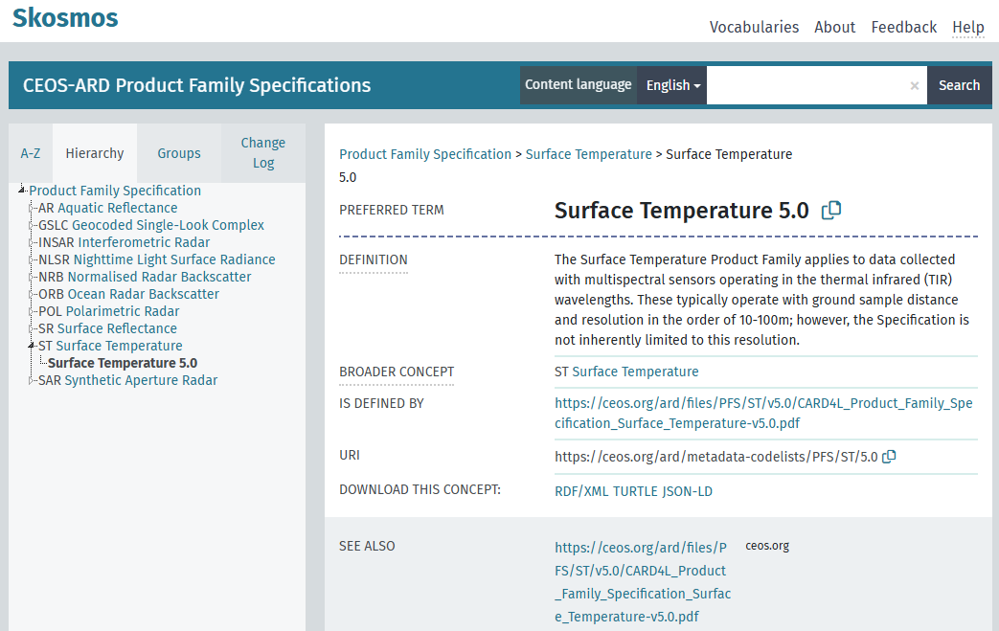
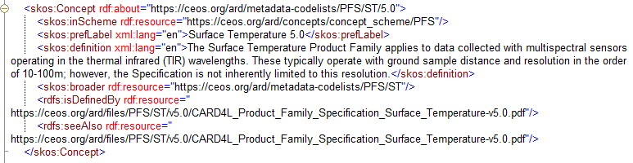
Guide – Prerequisites
Definition of URI for CEOS-ARD keywords / concepts underway (since WGISS-61)
  Update of list of URI is expected to become part of the approval process for a new or updated PFS.
  To be resolvable and in ceos.org domain (Action SEO)
  Maintained in well-known format (W3C SKOS)
Example definition:

Slide 15
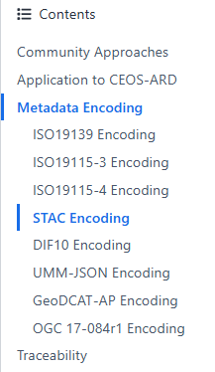




Guide – Best Practices and Recommendations
Activity just started. Preliminary draft to be consolidated in next period.
To cover various metadata encodings:
  ISO 19139(-2) (XML)
  ISO 19115-3 / ISO 19157-2 (XML)
  ISO 19115-4 (JSON)
  STAC (JSON)
  OGC 17-084r1 (JSON)
  GeoDCAT-AP
  DIF-10
  UMM-JSON
Should include:
  Inline examples
  Requirements/
  recommendations
  Example files
  (for download)

Slide 16
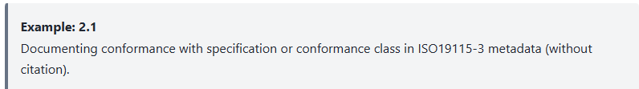
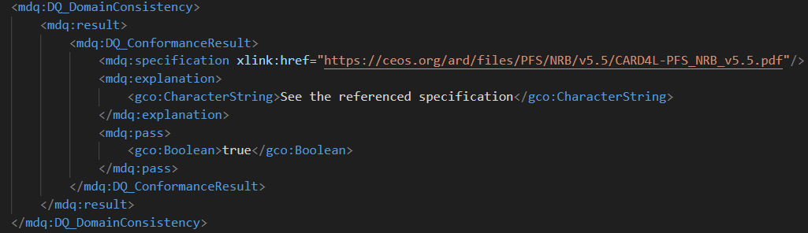
ISO19115-3 Encoding (1/4)

Slide 17

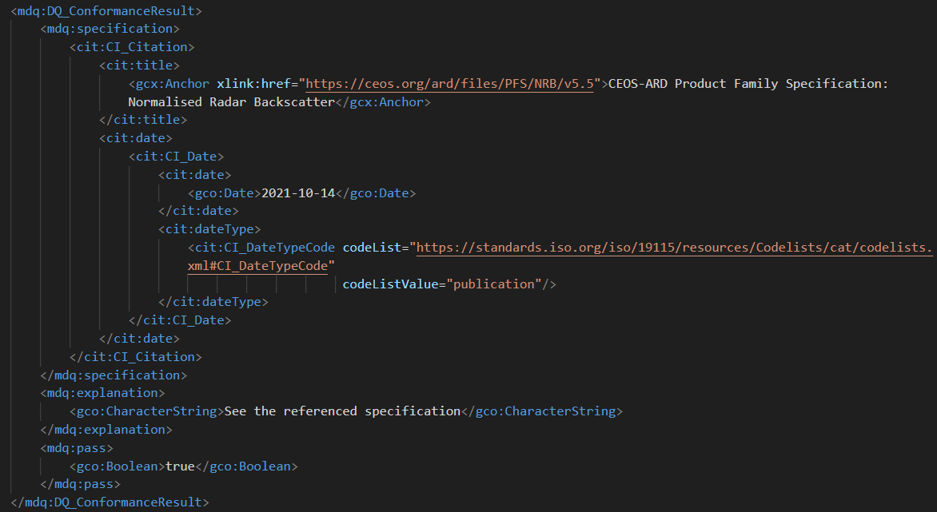
ISO19115-3 Encoding (2/4)

Slide 18
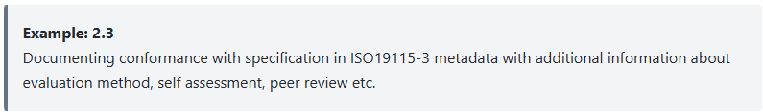
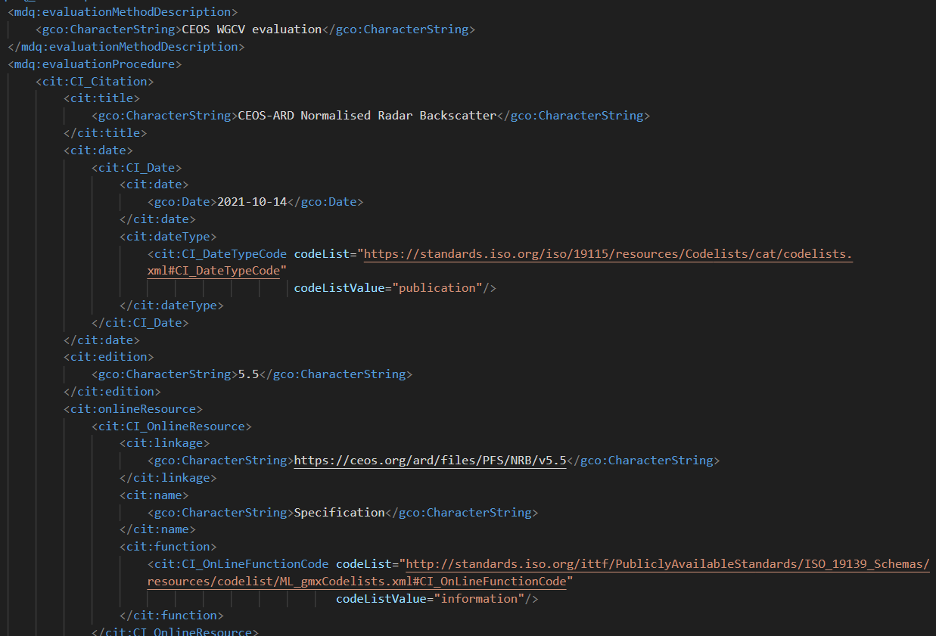
E.g. ISO19115-3 Encoding (3/4)

Slide 19

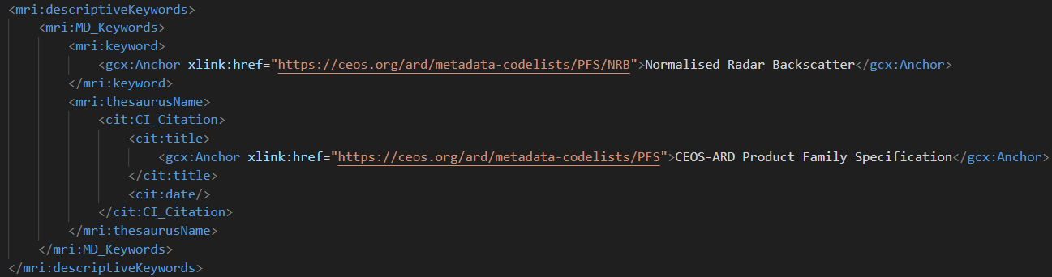
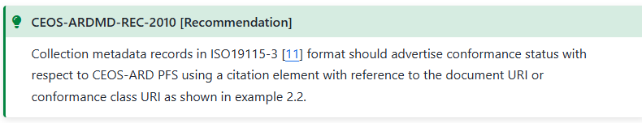
E.g. ISO19115-3 Encoding (4/4)

Slide 20
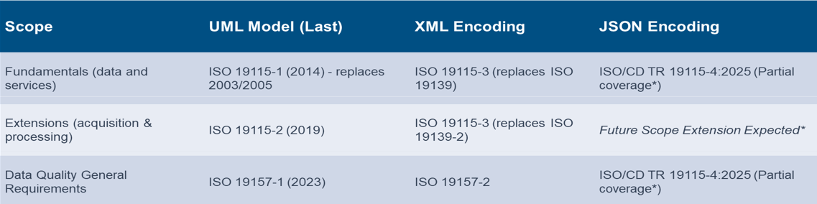
Guide – Metadata Encoding
Overview of related ISO standards: XML / JSON

Slide 21
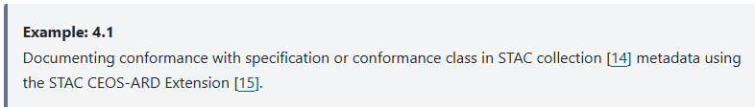
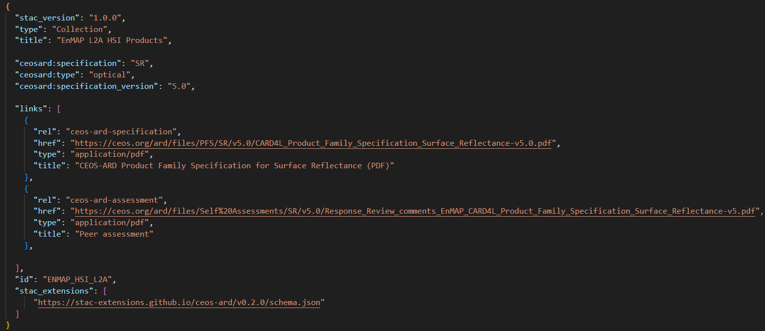
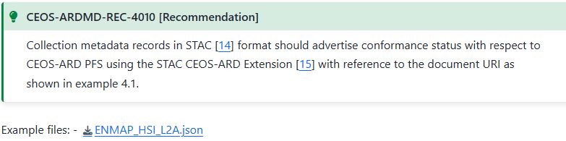
E.g. STAC Encoding (1/1)

Slide 22
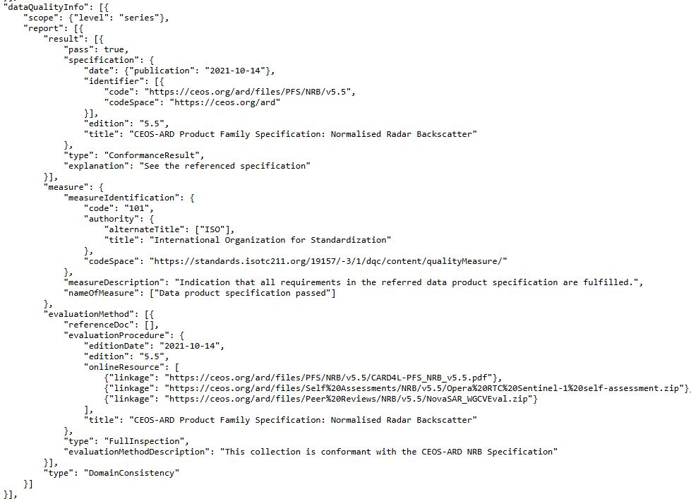
E.g. ISO19115-4 Encoding (1/1)
OGC Testbed-21 DQ4IPT (OGC 26-005):
  Draft ISO19115-4, i.e. JSON encoding of ISO19157-1 and ISO19115-1 (subsets).
  Measures from ISO19157-3 registry (OGC Rainbow)
  Include ISO19115-4 Data Quality object inside STAC collections and STAC items via draft STAC Extensions.
NovaSAR CEOS-ARD example
  https://radiantearth.github.io/stac-browser/#/external/emc.spacebel.be/collections/novasar_l2ard_hh_hv?.asset=asset-metadata_iso_19115_4

Slide 23
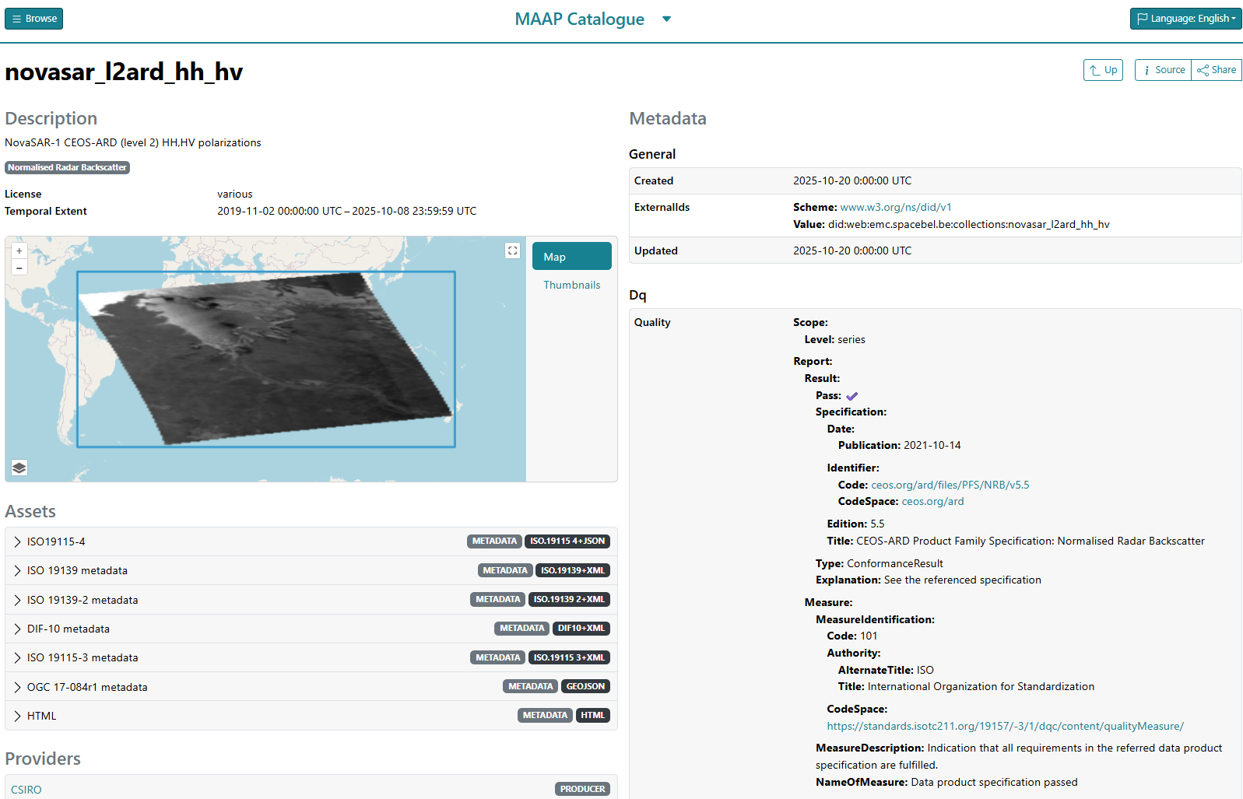

OGC Testbed-21 DQ4IPT

Slide 24
Outline
Introduction
Guide to Enable Discoverability of Datasets
Proof of concept (Improved discoverability and accessibility)
Conclusion

Slide 25

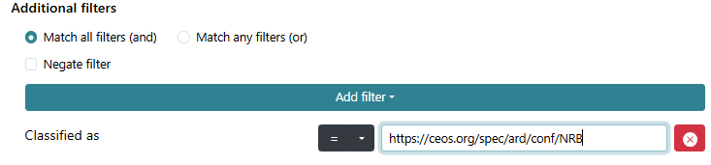
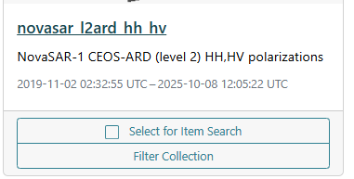
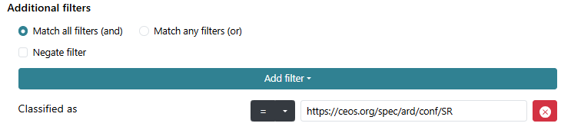
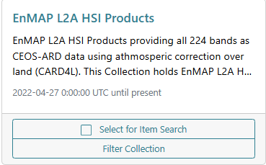
Improved description and discoverability (STAC)
Expected outcome:
  Improved descriptions of CEOS-ARD compliant CDA collections in collection metadata.
  Improved discoverability via additional search capabilities
FedEO Proof-of-Concept (STAC API, STAC Collection Search Extension):
  Exploiting keywords (Themes STAC Extension)
  Exploiting CEOS-ARD STAC Extension

Slide 26
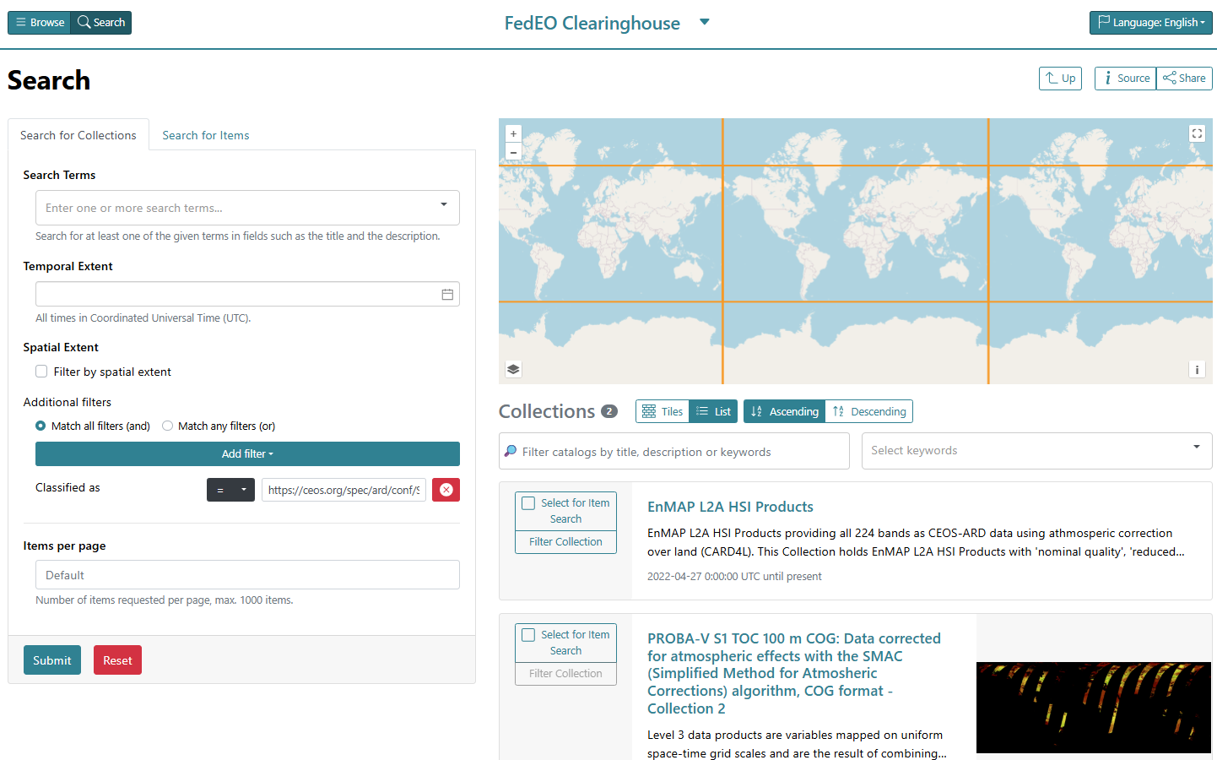
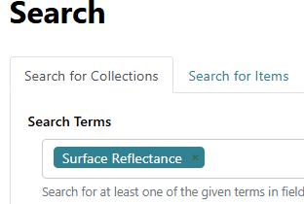
Discovery exploiting STAC “themes” extension
FedEO STAC API – “SR” search
Queryable “specification” or “theme” could be advertised as well.
Text search does not provide accurate results
Precise search (e.g. by conformance “uri”).

Slide 27
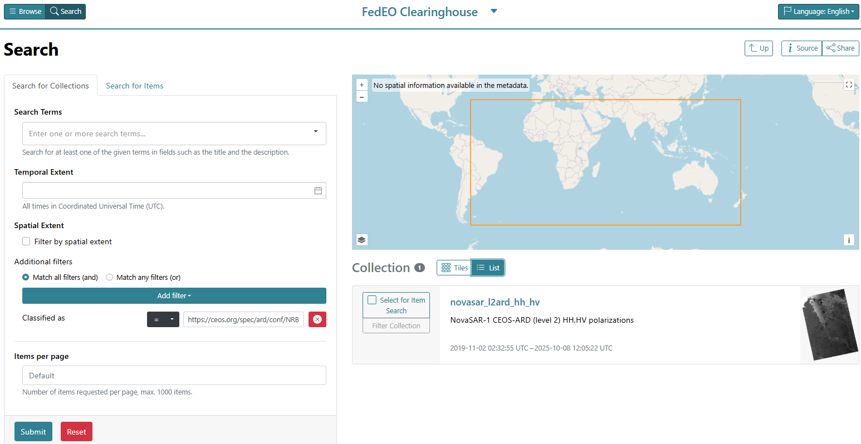
Discovery exploiting STAC “themes” extension
FedEO STAC API – “NRB” search

Slide 28
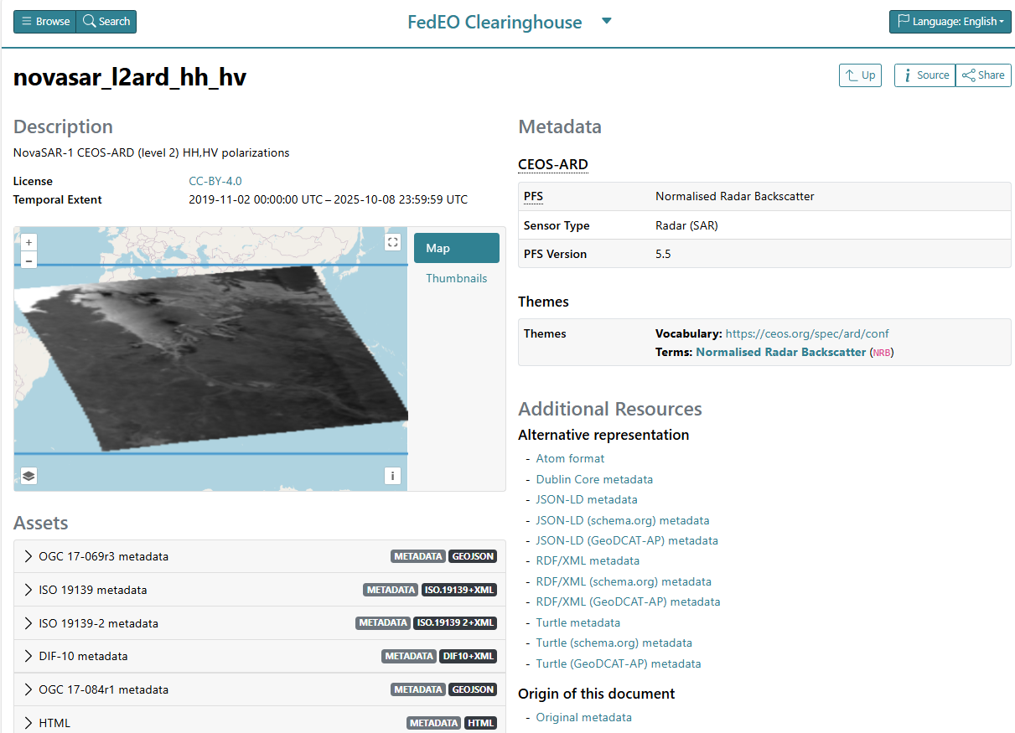
Datasets with CEOS-ARD STAC Extension
CSIRO
VITO (Proba-V)
CSIRO
CSIRO

Slide 29
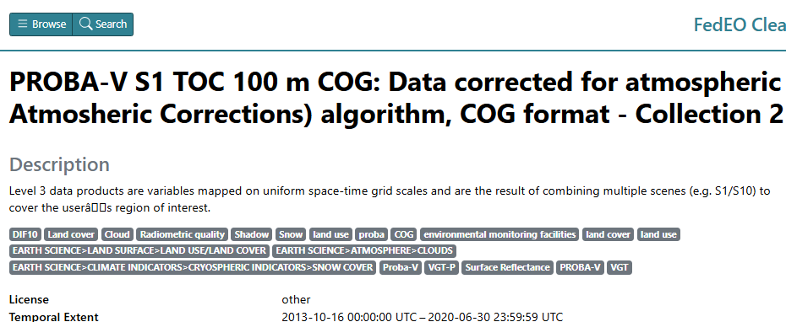
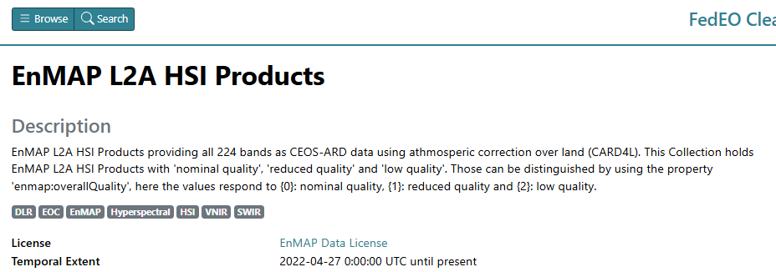
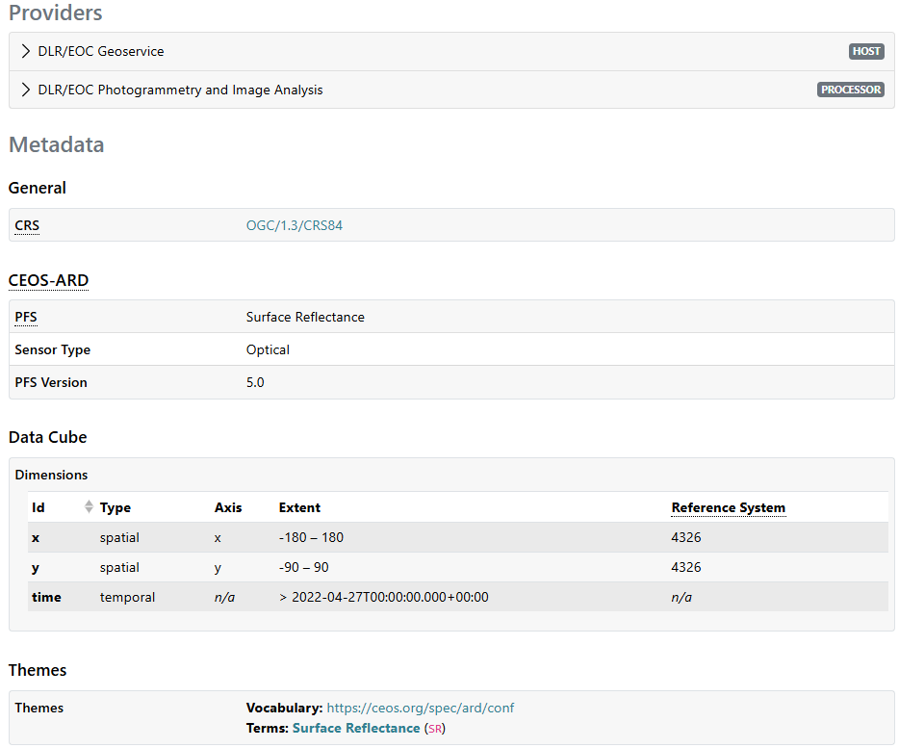
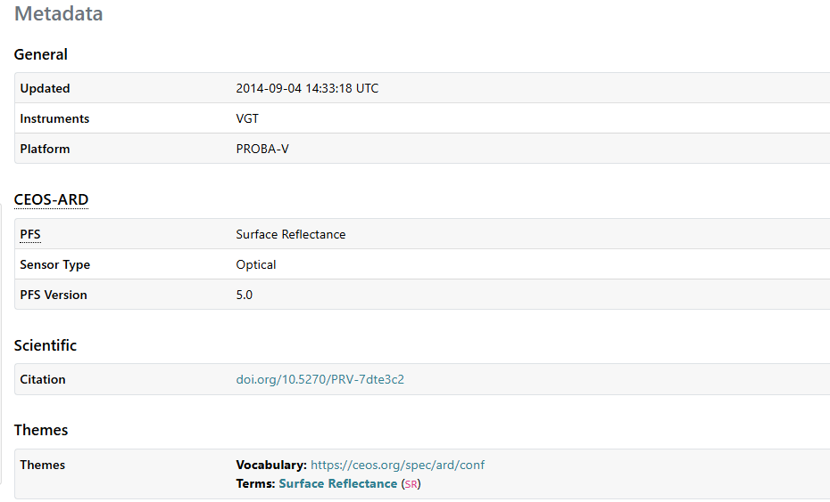
VITO
DLR
Notes:
Examples at:
https://radiantearth.github.io/stac-browser/#/external/geo.spacebel.be/collections/urn:eop:VITO:PROBAV_S1_TOC_100M_COG_V2_?.language=en
https://radiantearth.github.io/stac-browser/#/external/geo.spacebel.be/collections/ENMAP_HSI_L2A_?.language=en

Slide 30
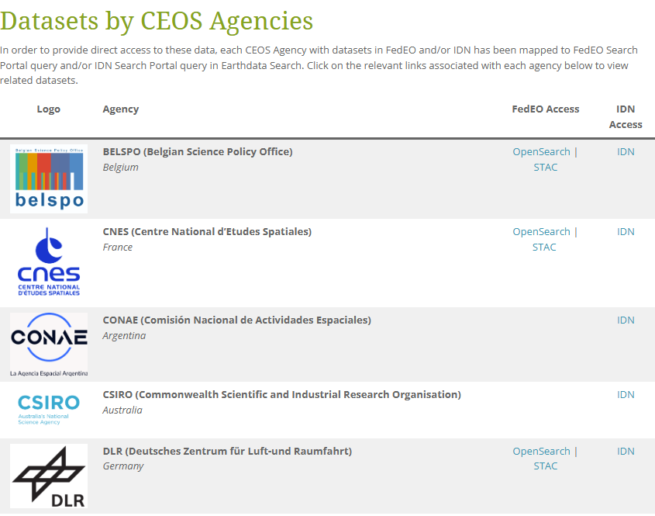
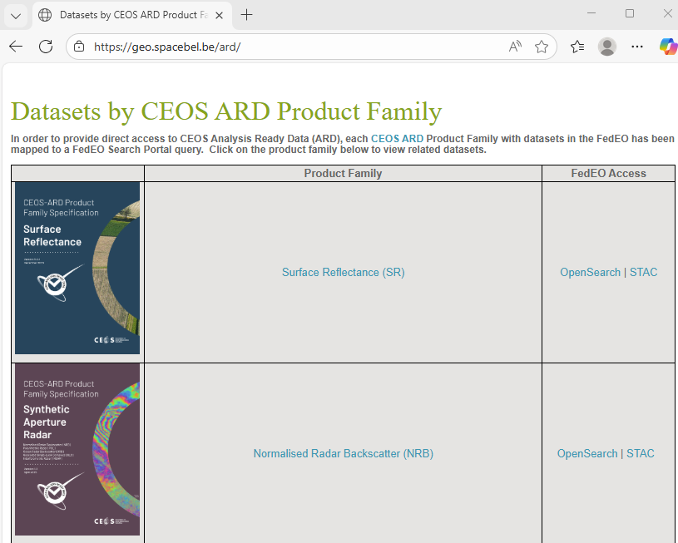
Consistent and interconnected CEOS-ARD access points
Connect access points to ceos.org/ard dataset table
  Deep links available to individual collections (See current spreadsheet) can be added to current ceos.org/ard dataset table.
  Overview page can open list of collections of a CEOS-ARD Product Family (similar to collections per Agency)

Slide 31
Conclusion
Collaboration WGISS DAIG, CEOS Working Group on Cal/Val (WGCV) / CEOS-ARD Oversight group and SEO Team ongoing.
Roadmap proposed.
Preliminary version of “Guide to Enable Discoverability of Datasets” available on CEOS WGISS GitHub to facilitate its elaboration. Contributions / feedback are welcome.
(Resolvable) keyword URI mechanism is being defined.
Update of list of (CEOS-ARD) URI is expected to become part of the approval process for a new or updated PFS.
Once agreed, Data Providers and Connected Data Assets (CDA) can update assets accordingly to achieve consistent endpoints and interconnect the ceos.org/ard dataset table and CDA endpoints.

Slide 32

Contact: yves.coene@spacebel.be

