Slide 1
GEOGLAM Update
Alyssa Whitcraft | GEOGLAM Programme Scientist
CEOS LSI-VC
16 September 2026
Reston, VA
LSI-VC-20 | Reston, VA | 14-16 Sep 2026

Slide 2

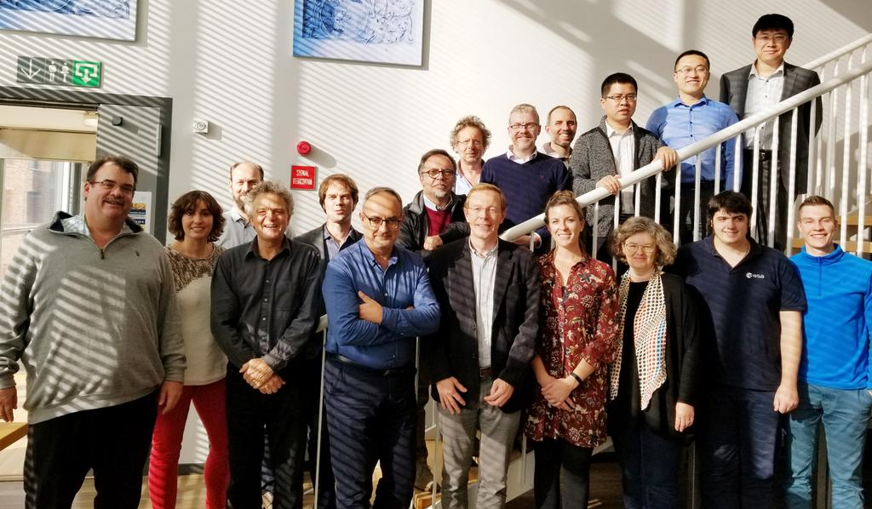
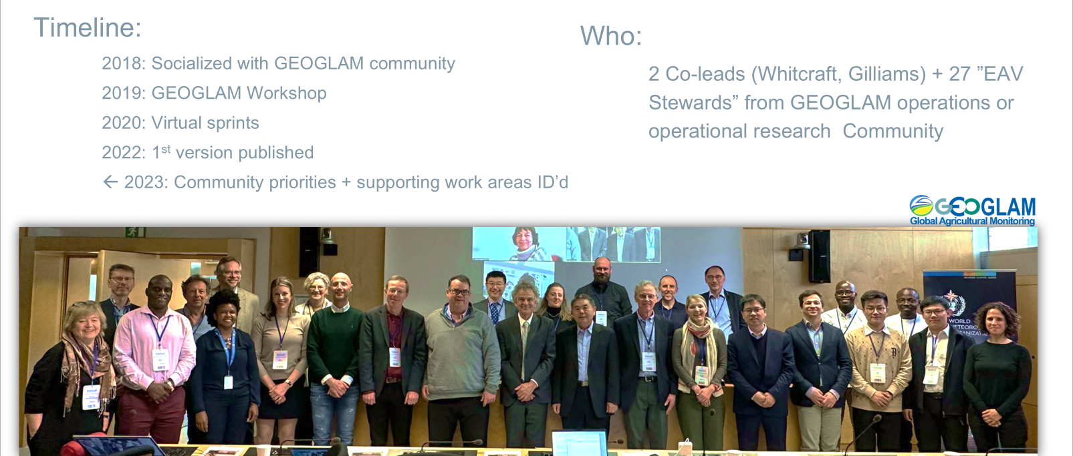
GEOGLAM EAVs
Ongoing, community-based process
First Meeting of the GEOGLAM EAV Working Group
23-24 October 2019 | UCL
EAV Workshop, JRC Ispra, May 13-15, 2025
EAV session during GEOGLAM ExCom of 2023 | Geneva
LSI-VC-20 | Reston, VA | 14-16 Sep 2026

Slide 3
Main Points
Alyssa (and NASA) are steadfast in their commitments to GEOGLAM!
  ”Chaser” and “finish-line” support for the EAV stock-take is needed, to be supervised by Alyssa & Sven
CEOS is a valuable partner in the EAV Stocktake
  The ask is finite:
    What have each agency done as relevant to the EAVs (products and tools – past, present, planned)?
ET was in the first phase of EAVs, and we are coordinating with CEOS LPV ET
  Meeting still planned for November 4-6, 2026 in Rome…
  Exact details and scope in flux
The MIM Database does not currently include the majority of agricultural variables
  Our hope is to have the results of the stock-take populate MIM
Opportunities for CEOS-GEOGLAM partnership are broader and ongoing…
  Current focus = stock take
  Momentum around ET
Open question re: AFOLU
LSI-VC-20 | Reston, VA | 14-16 Sep 2026

Slide 4
EAVs: Progress
1. EC-funded consultant
2. Evapotranspiration (example)
(Appendix)
From NASA Acres for farmers on their steering committee
  List (single slide)
  Table – summarizing by EAV what is available
  1 slide per EAV (ET example included)
LSI-VC-20 | Reston, VA | 14-16 Sep 2026

Slide 5

Updates: EAV Stocktake & Gap Analysis
Phase 1 & Phase 2
GEOGLAM portion presented at Plenary-39:
Improved framework
Definition, requirements, inventory, and preliminary gap analysis for 5 variables
CEOS Role to Complete Phase 1
Agency input (CEOS-39-21):
  Add missing stocktake info for Phase 1 EAVs
    Missing satellites, products, etc.
  Get input on priorities
Status:
CEOS agencies with confirmed interest→
  There are MANY others on the mailing list…
GA
ESA
ISRO
CSIRO
SANSA
CONAE
NASA
EC/JRC
INPE
NOAA
UKSA
USGS
JAXA
CSA kicked it to AAFC
Great news:
  European Commission is supporting a 40-day consultancy:
    Completing Phase 1
    Improving public content on EAVs (inc. website)
    Phase 2 plan → prioritize, plan, recruit participants
Notes:
❖I'll provide updates:
▪- WGCV + GEOGLAM ET Meeting... had to be postponed to ~October from the planned June date because of Copernicus LMS General Assembly being rescheduled to the week we were planning, but UN FAO is going to host and we have a solid agenda.
▪- European Commission will fund a consultant to help us get through Phase 1 of the EAVs and develop a plan / start Phase 2 of the EAVs.
▪- Show briefly that I developed some materials to teach people how to fill in the EAV table and the consultant (if ready in time), or Sven or I, can set up times with them to walk them through it - so that the CEOS people can do their part in the Phase 1 EAVs
❖- On that latter point, I need to take a look at the GEOGLAM Subgroup membership list (Matt, have you been maintaining a list other than this, I see it was updated in September but not since Plenary) and see which organizations are on it vs. who has responded to the stocktake so far.
❖- Based on that, Julie suggested that I "ask for help instead of an action and then let NASA offer an intervention" because even though I asked for an action at Plenary, "because no one championed it it didn't get captured it in the official minutes/actions". I was confused by this because we DO have an action on the record... but because it she said this just now during the big NASA prep call and I wasn't planning to request a specific action, I didn't feel that was appropriate to dig in further with her.
❖- The "help" she recommended I ask for is showing who has not yet responded to the action that I think should (i.e. who may have science or satellites that are relevant to the Phase 1 EAVs), and let NASA and/or others intervene.

Slide 6
ToR for European Commission Supported
Expert Consultant for EAVs – mid-way through
Description | Activities
Consolidated and Cleaned EAV Inventory | Cleaned and harmonised EAV tables Traceability to workshop outcomes and previous EAV versions
Validated EAV Definitions and Phase 1 Framework and summary report | Refined technical definitions for priority EAVs Documented feedback from EAV stewards and CEOS contributors
Presentation package for Input to CEOS–GEOGLAM governance | Final versions of all Phase 1 EAV tables and definitions Prepare and deliver slide deck outlining inventory and framework Review and and provide updated content for an improved EAV website to reflect revised definitions Provide recommendations on improving accessibility and clarity of EAV materials for different user communities (e.g. policy, early warning, farming).
Prioritisation and Options Document | Clear prioritisation criteria (policy relevance, technical readiness, community demand, CEOS alignment) Prioritised shortlist of EAVs for Phase 2 Recommended Phase 2 approach/implementation plan
LSI-VC-20 | Reston, VA | 14-16 Sep 2026
Notes:
Note 🡪 we need to see what the consultant can do to review what went well and what didn’t

Slide 7
Nov 2025
Apr 2026
Nov 2026
Apr 2027
Plenary-39
Actions:
Agencies Add to Stocktake for 1st 5 Variables
Backburner:
CEOS MIM Ag Component Database Design Scoping
SIT-41
Interim Update::
- EAV Consultancy
- Planned Onboarding of new Subgroup Members
Requests
Continue Plenary-39-21 action
Agencies: please identify accountable/lead points of contact
Agencies: please respond to and collaborate with EAV Consultant
SIT-TW-41 / Plenary-40
Milestones:
- Updated EAV website
- Onboarding and engagement of Subgroup members (see appendix)
Documents
- Full Phase 1 Report (with CEOS input)
- Phase 2 Prioritisation Plan
Actions
Agencies: participate in Phase 2
CEOS SEO: co-develop conceptual design of Ag-MIM
SIT-42
Milestones:
- Possible 1st ET Workshop (current plan 4-6 Nov)
- Phase 2 Progress
- Ag-MIM Design + Phase 1 implementation
Actions
- Cross-community effort on ET?
Plan / Execute ET Workshop
(Oct or Nov 2026)
Design & Populate Ag-MIM
Legend
Boxes = Events
Arrows = Work
Hire EAV Consultant
Onboard New Subgroup Members
Asynchronous Work on Phase 2
Def’s + Req’s for Other Variables
GEOGLAM
CEOS/Agencies
LSI-VC-20 | Reston, VA | 14-16 Sep 2026
Shared
Notes:
Documents:
- Phase 2 Report
- Agency feedback on level of interest in remaining EAVs
Report:
- EAV Req’s
- Agency Foci for next phase of EAV Stocktake
Action:
Agencies continue Stocktake based on their foci
WG Cal-Val Workshop “Green-light”

Slide 8
REQUIREMENTS
EAV Progress: Phase 1 included Actual Evapotranspiration
EAV: Actual Evapotranspiration
EAV Steward: | Jippe Hoogeveen (primary), Radoslaw Guzinski, Steven Wonink, Agnieszka Soszynska, Forrest Melton (as needed)
Broad Use: | Agromet and Water Management
Example Use Cases or Decisions: | Regional water accounting, drought impact assessment, water producitivity assessments, yield monitoring, surface and groundwater management at local to regional scales, irrigation water management and precision agriculture, estimation of root zone soil moisture, water rights administration, rangeland condition and productivity, vegetation water stress and wildfire risk assessments
Requirements: | Temporal |  | Spatial |  | Accuracy |  | Latency
 | Threshold | Goal | Threshold | Goal | Threshold | Goal | Threshold | Goal
 | 10 days | Daily | 300 | 10 | Rigorous accuracy assessment completed according to best practices that need to be established | Mean absolute error: Growing season / annual: +/- 10%; Monthly: +/-15; Daily: +/- 25; Bias error: < 10% at all timesteps | 10 day | 1 day
LSI-VC-20 | Reston, VA | 14-16 Sep 2026

Slide 9
STOCKTAKE & GAP ANALYSIS: MISSIONS
EAV Progress: Phase 1 included Actual Evapotranspiration
EAV: Actual Evapotranspiration
EAV Steward: | Jippe Hoogeveen (primary), Radoslaw Guzinski, Steven Wonink, Agnieszka Soszynska, Forrest Melton (as needed)
Broad Use: | Agromet and Water Management
List | Requirements & Performance
 | Temporal |  | Spatial |  | Accuracy |  | Latency |  | Availability
 | Characteristic | Performance | Characteristic | Performance | Characteristic | Performance | Characteristic | Performance | Characteristic | Performance
Sentinel 2 | 5 day | Threshold | 10-20 m | Goal |  | Not Yet Analyzed | 24 hours | Threshold |  | Not Yet Analyzed
Sentinel 3 | Daily | Goal | 300-1000 m | Threshold |  | Not Yet Analyzed | 3 hours (NRT) | Goal |  | Not Yet Analyzed
Landsat 5/7/8/9 | 8-16 day | Threshold | 30-100 m | Threshold | L9 LST -> bias of 0.44 K; RMSE of 1.98 K | Threshold | 1-10 days | Threshold | Freely and publicly available | Goal
Suomi NPP / VIIRS | Daily | Goal | 375-750 m | Not Met | LST bias of < 0.5 K; RMSE of ~1.5 K | Threshold | 1 day | Goal | Freely and publicly available | Goal
Terra & Aqua / MODIS (historic) | Daily | Threshold | 250-1000 m | Threshold | LST RMSE of ~1.0 K | Threshold | 1 -8 day | Goal | Freely and publicly available | Goal
ECOSTRESS | Variable | Threshold | 70 m | Threshold | LST bias of ~ -1.0 K; RMSE of ~2 K | Threshold | 1 day | Goal | Freely and publicly available | Goal
SDG Sat (China) | Monthly | Not Met | 30 m | Threshold
First Detection (China) | Monthly | Not Met | ?
FI3 (China) | Daily | Goal | 30-1000 m | Threshold
GCOM (JAXA) | 2 days | Threshold | ?
Trishna | 2-3 days | Threshold | 57-90 m | Threshold | LST Goal RMSE of 0.7 K @300K | Not Yet Analyzed | 12 hours on selected products | Goal | Future mission | Not Yet Analyzed
SBG | < 16 days | Not Met | 30-60 m | Threshold | LST RMSE of < 1.0 K | Threshold | < 3 days | Threshold | Future mission | Not Yet Analyzed
LSTM | 2 days | Threshold | 50 m | Threshold | 15% [mm/day] |  | 6-12 hours on LST |  | Future mission | Not Yet Analyzed
Landsat NEXT | 6 day | Threshold | 10-60 m | Goal | LST <= Landsat 9 | Not Yet Analyzed | < 3 days | Threshold | Future mission | Not Yet Analyzed
LSI-VC-20 | Reston, VA | 14-16 Sep 2026

Slide 10
STOCKTAKE & GAP ANALYSIS: PRODUCTS
EAV Progress: Phase 1 included Actual Evapotranspiration
EAV: Actual Evapotranspiration
EAV Steward: | Jippe Hoogeveen (primary), Radoslaw Guzinski, Steven Wonink, Agnieszka Soszynska, Forrest Melton (as needed)
Broad Use: | Agromet and Water Management
List | Requirements & Performance
 | Definition |  | Temporal |  | Spatial |  | Accuracy |  | Latency |  | Method Transferrability and Scalability |  | Availability
 | Consistent with Consensus Definition? | Reconcilable to Consensus Definition? | Characteristic | Performance | Characteristic | Performance | Characteristic | Performance | Characteristic | Performance | Characteristic | Performance | Product? Pipeline? | Where to Access
Copernicus LMS ETa (Dec 2025) (TSEB and WaPOR ET Look) | Yes | N/A | 10 days | Threshold | 300 m (Global) | Threshold | TBD | Not Yet Analyzed | 2 days | Threshold | Open source | Goal | Product | Copernicus data space ecosystem
FAO WAPOR (ET Look) | Yes | N/A | 10 days | Threshold | 300m (Global) / 100m (Africa and Middle East) / 20 m (Local) | Threshold | TBD | Not Yet Analyzed | 3 days | Threshold | Open source | Goal | Product | https://www.fao.org/in-action/remote-sensing-for-water-productivity/en
OpenET ETa (6 models; US + Brazil only at present) | Yes | N/A | Daily / monthly | Threshold | 30 m | Threshold | For croplands: Bias error: < 10% at all timescales RMSE: Annual: +/- 11% Monthly: +/- 17% Daily: +/- 24% | Threshold | 1-10 days | Threshold | Open source | Goal | Product | https://openetdata.org
ECOSTRESS ETa (PT-JPL, DisALEXI) | Yes | N/A | Daily at variable interval | Threshold | 70 m | Threshold | In progress for Collection 2 | Not Yet Analyzed | ~10 days | Threshold | Open source | Goal | Product | https://lpdaac.usgs.gov/data/get-started-data/collection-overview/missions/ecostress-overview/
LSI-VC-20 | Reston, VA | 14-16 Sep 2026

Slide 11
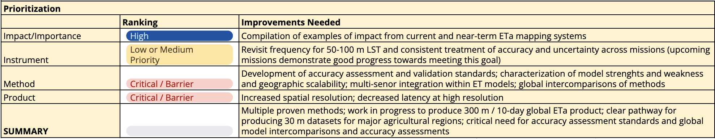
STOCKTAKE & GAP ANALYSIS: PRIORITIZATION
EAV Progress: Phase 1 included Actual Evapotranspiration
EAV: Actual Evapotranspiration
EAV Steward: | Jippe Hoogeveen (primary), Radoslaw Guzinski, Steven Wonink, Agnieszka Soszynska, Forrest Melton (as needed)
Broad Use: | Agromet and Water Management
LSI-VC-20 | Reston, VA | 14-16 Sep 2026

Slide 12
Cross-Community & Cross-Thematic Effort on ET
Cross-walking our ag-community requirements with the water community
Cross-community (ag, water users; CEOS LPV ET) efforts on:
  identifying where 30 m vs. 300 m products for ET are valuable for understanding water use/demand and managing water resources
  ensembling and intercomparison of different approaches to ET
  harmonization of underlying thermal observations including collaborative effort on validation/accuracy assessment
    this is an expansion of the in-planning GEOGLAM meeting on good practices for validation of ET products... in that we don't just write what makes a validation robust, but we actually then have the community do it.
At CEOS SIT in April 2026, share:
  clear set of requirements spanning multiple* uses.
  assessment of current multi-source EO capability for ET, including looking at future missions (inspired by the MIM)
  a workplan that leads to an ask, which would be implementing #2
LSI-VC-20 | Reston, VA | 14-16 Sep 2026

Slide 13
Questions
Does framing the EAV effort within CEOS as presented for ET resonate?
  Links to Resilience Theme
  Links to Water Theme
Who from different agencies would like to scope?
Does the AFOLU effort need more/new engagement from GEOGLAM?
Is there value in convening semi-regular GEOGLAM Subgroup meetings (as we did when it was the AHWG)?
LSI-VC-20 | Reston, VA | 14-16 Sep 2026

Slide 14
Appendix
Table of Contents:
Envisioned CEOS <> GEOGLAM Interactions
(excerpted) NASA Acres-prepared materials for farmer audience re: EAVs
  Simplified, based on GEOGLAM structure
GEOGLAM EAV “How-To”
LSI-VC-20 | Reston, VA | 14-16 Sep 2026

Slide 15
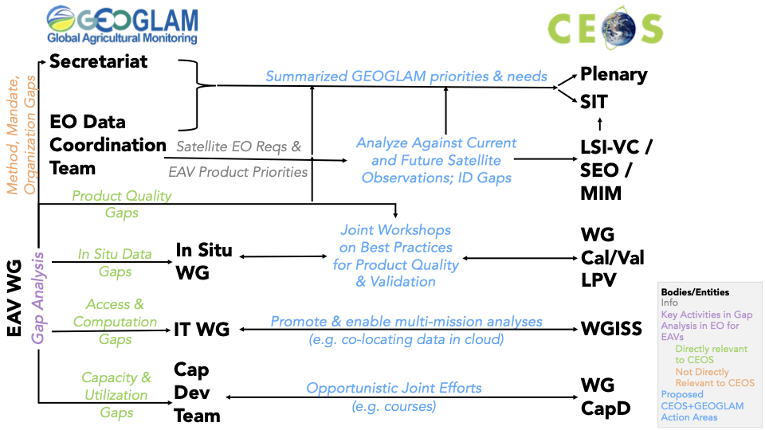
A sketch of logical GEOGLAM-CEOS interactions

Slide 16
List of Essential Agriculture Variables
Prepared by NASA Acres for farmers/ranchers
Cropland Map
Field Boundaries
Agroforestry Map
Rangeland/Pasture Map
Crop Yield Estimate
Crop Quality (protein, soil, starch... or grading)
Crop Condition
Rangeland/Pasture Condition
Rangeland/Pasture Forage Quality
Crop Type Maps
Crop Type Area / Planted Area
Seasonal Fallow Map
Usual or Reference Crop Calendars
Current Crop Stage
Cover Crop Use Map
Cover Crop Functional Type Map
Cover Crop Performance (Biomass, N, C, etc.)
Tillage Detection Map
Tillage Intensity Map
Structural Conservation Management
Pest and Disease Detection
Pest and Disease Risk
Crop Nutrient Status
Soil Carbon Stocks
Soil Carbon Change
Greenhouse Gas Emissions/Capture
Surface Roughness Map
Residue Cover Map
Fractional Ground Cover Map
Reference Evapotranspiration
Actual Evapotranspiration
Surface Water Availability
Surface Soil Moisture
Root Zone Soil Moisture
Irrigated Cropland Map
Precipitation
Soil type
Soil Fertility
Soil Temperature
Water Productivity
Aboveground Agricultural Biomass
Air temperature
Land surface temp
Runoff
Slope
Accumulated Growing Degree Days

Slide 17
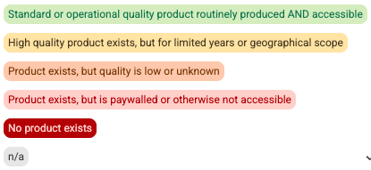
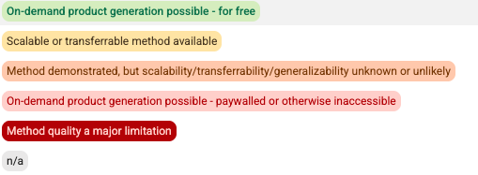
Summary Table of EAVs
Prepared by NASA Acres for farmers/ranchers
For Each Variable:
NASA Acres Experts
Status of a Product
  At County level
  At Field or Sub-field level
  Summary Comments
Status of a Method
  At County level
  At Field or Sub-field level
  Summary comments

Slide 18
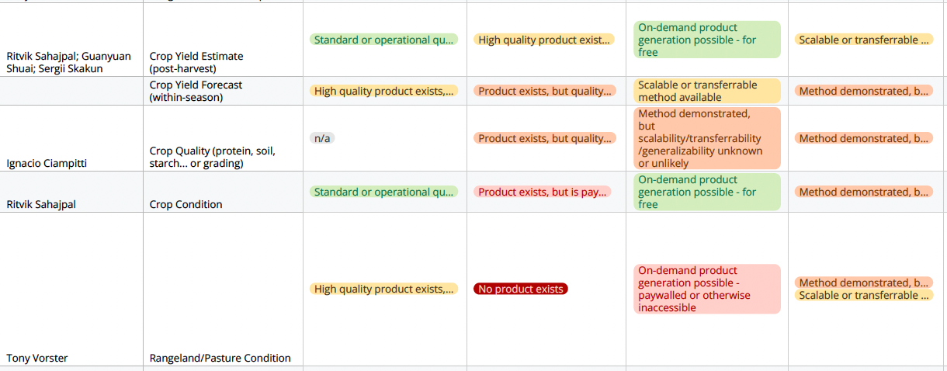
PRODUCT
METHOD
EXCERPT 🡪
Prepared by
NASA Acres for
farmers/ranchers

Slide 19

Evapotranspiration
Sub-variables: Actual; Reference; Potential (?)
Remotely Sensed Definition(s)
Actual ET (ETa): water actually evaporated from soil and transpired by vegetation under current conditions and stress.
Reference ET (ET0, FAO): ET from a standardized well-watered 0.12 m grass surface (atmospheric demand).
Potential ET: maximum ET given unlimited water.
Relevant Observations
Landsat thermal (30/100 m) + optical drive field-scale ETa since 1982; MODIS/VIIRS/ECOSTRESS add frequency; ET0 from weather/reanalysis. Thermal continuity (Landsat Next) is key. Outlook good.
Ground data required
Eddy-covariance flux towers and lysimeters for calibration and validation.
Available Methods & Products
NASA Acres → Yun Yang (Cornell): ET / reference-ET ratio and anomaly for irrigation water use, Lower Mississippi (field); 3 m ET for NY vineyards (sub-field).
NASA Acres → Lin Yan (MSU) & Yun Yang (Cornell): impacts of field size on ET.
OpenET → field-scale (30 m) ETa for the contiguous US, ensemble of 6 models (SSEBop, SIMS, DisALEXI, geeSEBAL, PT-JPL, eeMETRIC), daily/monthly/annual, free; ~15.8 mm/month error at cropland sites (R²≈0.9).
ECOSTRESS → high-resolution ET from the ISS. gridMET / RefET → reference ET.
Prepared by NASA Acres for farmers/ranchers
 | Sub-field | Field | County
Update Frequency | Daily & Monthly | Daily & Monthly | Daily & Monthly
Availability | Restricted & free products | Free product (OpenET) | Free product (OpenET)
Crops Covered | All | All (best annual crops) | All
Quality | Emerging | Good | Good
Extent | CONUS | Field, CONUS | CONUS
Notes:
Options:
Update Frequency → Daily, Weekly, Monthly, Post-season
Availability → Method only; Free product; For purchase
Crops covered → e.g. corn, soy, all
Quality → leave blank if you don’t know; or say “variable” or “not documented” or “good” “medium” and “low”
Extent (method or product) → Counties, states, national; or, maybe it’s available in Ukraine but hey, it exists
Product available now → ID years, can add links below table
Options:
Relevant observations → (past (how far can we go back), present, planned (near-term outlook))
Options:
For “Examples” - prioritize NASA Acres. Provide PI name, describe product (when, where, which crops, how often, etc.), image/map if possible, link to project name if possible
Then add other examples that cover the US
Then, if something truly amazing only exists outside the US, show that to show possibility

Slide 20
EAVs How-To
What & Why We’re Doing EAVs
and
How to fill in EAV tables

Slide 21

GEOGLAM EAVs 2.0 Steps >> Objectives
Effort kicked off in early 2025
Starting point: Establish a unified and authoritative framework for documenting EAVs
1. Agree upon a list and definitions:
  Use-agnostic
2. Characterize product requirements by use
  Temporal, spatial, latency, accuracy by use
3. Take stock (inventory)
  List 🡪 Methods, projects, pipelines/systems, and satellite instruments satellite instruments
  What is actually being used
4. Identify gaps
  Simply, this ”inventory - requirements = gaps" ...
  But not all gaps are equally important, closeable, etc.
5. Prioritize what to do next...
Phase 1 (2025) 🡪
Executed and refined Steps 2-4 of the Framework for for 5 variables:
      Crop type
      Crop yield
      Field boundaries
      Cover crop
      Actual ET
Notes:
not all gaps matter to the same degree, not all gaps are closeable in the near-term, not all gaps will require the same level of effort, different parties are responsible for different gaps (e.g. GEOGLAM issuing standards/guidance vs. seeking donor support vs. asking CEOS, etc.), and there are many ways to strategize for gaps (mitigation vs. closure, for example). A framework for prioritization will need to be a separate activity, and one for the ExCom.

Slide 22
Description of next slide
Convergent
Single set of scale and use-independent List and Definitions for all EAVs
  Plus related information like suggested typologies, hierarchies, measurement specifications (e.g. depth, height), and good-practices for accuracy assessment of those EAVs;
Divergent
Multiple sets of requirements, inventory (result of the inventory), gap analysis, and prioritisation for:
  scale- and “broad-use” dependent input EAVs (input EAVs describe weather, environmental, hydrological, biophysical, geophysical, etc. variables that are generally not sufficient on their own for decision support, but which are the invaluable inputs into the decision-relevant “agriculture information EAVs”);
  highly user-specific agriculture information EAVs.
Convergent
Cross-use prioritisation
  Distillation of most important interventions (observations, methods, EAV production) that can cut across multiple uses for a given EAV
  Community R&D agenda
  Observations
  Funding, etc.

Slide 23




SINGLE SET FOR ALL USES
Reduce Complexity
Create Consistency
DISTINCT SETS FOR EACH USE
Representative of breadth of applications
Allows unpacking of sources of gaps
PRIORITISATION
Identifying most important gaps that can support the most improvement
for each use and
distilled for the most uses
Use 1
Product Requirements
“Threshold” and “Goal” Spatial, Spectral, Temporal, Accuracy, Latency
Inventory - Products
List & Specifications of Past, Current, & Planned Products
Gap Analysis - Products
Performance of Products vs. Threshold & Goal Requirements
EAV Name
Definition
Units
Guidance: Typologies, Hierarchies, Accuracy Assessment etc.
Correspondence with Other EVs
Per Use Priorities
Inventory - Missions
List & Specifications of Past, Current, & Planned Missions
Gap Analysis - Missions
Performance of Missions vs. Threshold & Goal Requirements
Distilled Priorities
Use …n
Product Requirements
“Threshold” and “Goal” Spatial, Spectral, Temporal, Accuracy, Latency
Inventory - Products
List & Specifications of Past, Current, & Planned Products
Gap Analysis - Products
Performance of Products vs. Threshold & Goal Requirements
Per Use Priorities
Inventory - Missions
List & Specifications of Past, Current, & Planned Missions
Gap Analysis - Missions
Performance of Missions vs. Threshold & Goal Requirements
Whitcraft et al.
Notes:
Points:
Single set = consensus
Multiple sets for uses = a realistic picture of how EO data are used
But at the end, we narrow and distill down
Missions piece is where we really need agency help - products are good too

Slide 24
GEOGLAM EAV Audiences &
What to Show Them
Audience for GEOGLAM’s EAV Efforts | What GEOGLAM wants from them | What they want to know from GEOGLAM’s EAV efforts | What GEOGLAM EAV WG shows them
Funders / donors | Money for innovation research and in-situ data collection | What agriculture decision makers need (products, training, and underpinning materials) in order to achieve a desired impact | Constrained/time-limited funding ask which clearly link to impact that can be achieved from the innovation/in-situ data collection research in terms of human and environmental benefit.
Agriculture decision-makers | To serve them - which justifies the entirety of agriculture monitoring | Which decision-relevant, satellite-derived agriculture information products are available to them, where to find them, and how to use them | A list of the agriculture information products. Where the decision-makers are also funders, we show them the above as well.
Agriculture information product generators | Common definitions for the agriculture information products that agriculture decision-makers need | GEOGLAM itself - we want to collectively benefit from our varied perspective and expertise facilitated through the convening power of GEOGLAM. | The framework and clear boundaries/guidance for their efforts
Bio/geo/physical and hydrological product generators | Basic variables that are necessary for the agriculture information product generators to create the decision-relevant products | Which "input EAVs" to produce and with which specifications | The list of measurements and their requirements.
CEOS / Agencies | Suitable satellite observations | Spatial, spectral, temporal requirements that have a clear tie to what the agriculture decision-makers need. | Spectral, spatial, temporal, radiometric, accuracy, continuity, and latency requirements, with an indication of what concrete improvements will be achieved through their provision of satellites with the specified requirements.

Slide 25
The EAV Framework (simplified + example)
Step 1: Start with a well-defined decision support need
Decision Support Need
Example: Measure winter cover crop performance to support adaptive management of environmental benefits, inform farmer decision making, and provide input to models to estimate ecosystem services

Slide 26
The EAV Framework (simplified + example)
Step 2: Identify the ag information EAVs that would answer the need, as well as the supporting input EAVs that support those ag information EAVs
Decision Support Need
Example: Measure winter cover crop performance to support adaptive management of environmental benefits, inform farmer decision making, and provide input to models to estimate ecosystem services
Ag Information Essential Agriculture Variables (More Directly Support Info or Decision Need) | Variable Number | 1 | 2 | 3 | 4
 | Variable Name | Seasonal Cover Crop Presence/Absence | Seasonal Cover Crop Performance | Cover Crop Functional Type (cereal, legume, brassica) | Dynamic Cropland Management Calendar
Input EAVs --> support the derivation of the Ag Information EAVs | Variable Name | Fractional Ground Cover | Aboveground Biomass | N content | Forage Quality Carbon Traits | Emergence date | Termination date
 | Ag Info EAVs Supported (use Variable Number) | 1, 2 | 1, 2 | 2, 3 | 2, 3 | 1, 4 | 1, 3, 4
 | Why this Variable? | Increasing fractional ground cover is highly correlated with reduction of soil erosion | Aboveground biomass indicates cover crop growth and can be used as a proxy for ecosystem services | Nitrogen content of cover crops is inversely correlated with N leaching, and influences N availability to following summer crop | Carbon traits (cellulose, lignin, carbohydrates) affect plant decomposition and N release to the following summer crop | Emergence date (if identified) can be used to identify fields with cover crop presence and identify how they fit in with the management rotational cycle | Termination date (if identified) can be used to validate field practices and confirm cover crops were not taken to harvest

Slide 27
The EAV Framework (simplified + example)
Step 2: Identify the ag information EAVs that would answer the need, as well as the supporting input EAVs that support those ag information EAVs
Decision Support Need
Example: Measure winter cover crop performance to support adaptive management of environmental benefits, inform farmer decision making, and provide input to models to estimate ecosystem services
Ag Information Essential Agriculture Variables (More Directly Support Info or Decision Need) | Variable Number | 1 | 2 | 3 | 4
 | Variable Name | Seasonal Cover Crop Presence/Absence | Seasonal Cover Crop Performance | Cover Crop Functional Type (cereal, legume, brassica) | Dynamic Cropland Management Calendar
Input EAVs --> support the derivation of the Ag Information EAVs | Variable Name | Fractional Ground Cover | Aboveground Biomass | N content | Forage Quality Carbon Traits | Emergence date | Termination date
 | Ag Info EAVs Supported (use Variable Number) | 1, 2 | 1, 2 | 2, 3 | 2, 3 | 1, 4 | 1, 3, 4
 | Why this Variable? | Increasing fractional ground cover is highly correlated with reduction of soil erosion | Aboveground biomass indicates cover crop growth and can be used as a proxy for ecosystem services | Nitrogen content of cover crops is inversely correlated with N leaching, and influences N availability to following summer crop | Carbon traits (cellulose, lignin, carbohydrates) affect plant decomposition and N release to the following summer crop | Emergence date (if identified) can be used to identify fields with cover crop presence and identify how they fit in with the management rotational cycle | Termination date (if identified) can be used to validate field practices and confirm cover crops were not taken to harvest
I won’t address input EAVs in this slide deck, but wanted to show that this is how we get closer to comprehensive measurement across multiple uses (e.g. Fractional Ground Cover supports Seasonal Cover Crop Presence/Absence and Seasonal Cover Crop Performance; it also supports Rangeland Condition!)
Note that whether you analyze the input EAVs before or after the ag info EAVs depends on the case.

Slide 28
The EAV Framework (simplified + example)
Step 3: Evaluate/diverge from previously developed “Consensus Definitions” for each ag info EAV; articulate requirements for the product
Decision Support Need
Example: Measure winter cover crop performance to support adaptive management of environmental benefits, inform farmer decision making, and provide input to models to estimate ecosystem services
Ag Information Essential Agriculture Variables (More Directly Support Info or Decision Need) | Variable Number | 1 | 2 | 3 | 4
 | Variable Name | Seasonal Cover Crop Presence/Absence | Seasonal Cover Crop Performance | Cover Crop Functional Type (cereal, legume, brassica) | Dynamic Cropland Management Calendar
Ag Information EAV | Seasonal Cover Crop Presence/Absence
Consensus Definition: | Cropland on which plants are seeded specifically to reduce the loss of soil, nutrients and plant protection products during the winter or other periods when the land would otherwise be bare and susceptible to losses. The seeded crop must reach a vegetative state to be labeled as using a seasonal cover crop. This is differentiated from Seasonal Fallow by the purposeful seeding and cultivation of a crop.
If using a revised definition, what is it and how to reconcile with Consensus Def? | Seasonal green cover can be separated into 1) environmental cover including weeds and crops, 2) agricultural cover including planted crops and cover crops, and 3) incentive cover crops that are planted for environmental benefit and not taken to harvest. It is important to distinguish these three categories of seasonal green vegetation: only the third category represents Seasonal Cover Crop Presence/Absence
Requirements: | Temporal |  | Spatial |  |  | Accuracy |  | Latency
 | Threshold | Goal | Threshold | Goal |  | Threshold | Goal | Threshold | Goal
 | annual | seasonal between each cash crop | Watershed/county | field-specific |  | At least 75% of seasonal cover crop fields successfully identified | At least 90% of seasonal cover crop fields successfully identified | annual by August | within season to support winter verification

Slide 29
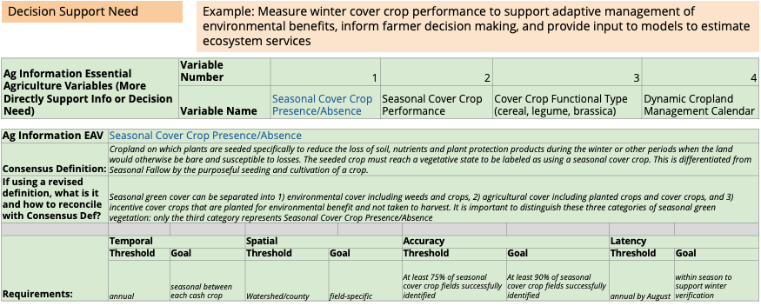
The EAV Framework (simplified)
Step 4: Take stock of existing relevant methods, products, pipelines for that EAV, assessed for relevant characteristics
Note: It’s getting a little too messy for a slide to show the example now…
Relevant Methods, Products, and Product Pipelines | Ag Info EAV: Seasonal Cover Crop Presence/Absence
List | Characteristics & Performance (relative to requirements)
 | Temporal |  | Spatial |  | Accuracy |  | Latency |  | Method Transferability and Scalability
 | Characteristic | Performance | Characteristic | Performance | Characteristic | Performance | Characteristic | Performance | Characteristic | Performance
Relevant Satellite Sensors | Ag Info EAV: Seasonal Cover Crop Presence/Absence
List | Characteristics & Performance (relative to requirements)
 | Temporal |  | Spatial |  | Spectral |  | Accuracy |  | Latency
 | Characteristic | Performance | Characteristic | Performance | Characteristic | Performance | Characteristic | Performance | Characteristic | Performance

Slide 30
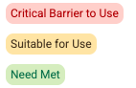
The EAV Framework (simplified)
Step 4: Compare the inventory of products, methods, and pipelines against the requirements to assess performance
Relevant Methods, Products, and Product Pipelines | Ag Info EAV: Seasonal Cover Crop Presence/Absence
List | Characteristics & Performance (relative to requirements)
 | Temporal |  | Spatial |  | Accuracy |  | Latency |  | Method Transferability and Scalability
 | Characteristic | Performance | Characteristic | Performance | Characteristic | Performance | Characteristic | Performance | Characteristic | Performance
Relevant Satellite Sensors | Ag Info EAV: Seasonal Cover Crop Presence/Absence
List | Characteristics & Performance (relative to requirements)
 | Temporal |  | Spatial |  | Spectral |  | Accuracy |  | Latency
 | Characteristic | Performance | Characteristic | Performance | Characteristic | Performance | Characteristic | Performance | Characteristic | Performance

Slide 31
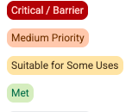
The EAV Framework (simplified)
Step 5: Assess the most important priorities for this Ag Info Variable to be useful for the defined decision support need.
Prioritization
 | Ranking | Improvements Needed (e.g. geographic extent, openness/availability, scalability/transferability, continuity, cost, operational vs. on-demand, accuracy/quality, documentation... etc.)
Satellite Sensor
Method
Products and Pipelines
In situ data
Ag Info EAV Status Summary:

Slide 32
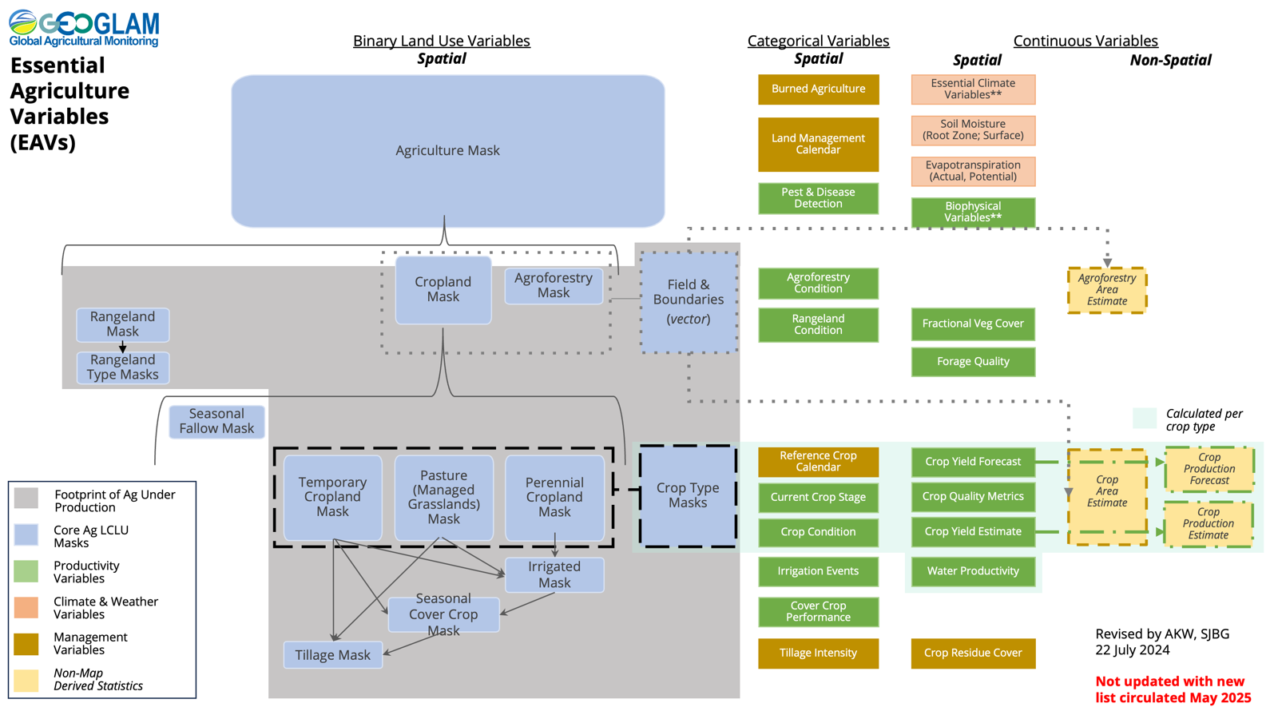
The EAV Framework (simplified)
Then:
Step 6: Do Steps 1-5 for all Ag Info EAVs related to that use
Step 7: Once all Ag Info EAVs have been documented, identify common Input EAVs across other Ag Info EAVs
  Recall the case where “Fractional Ground Cover” was called out in both Cover Crop and Rangeland Condition – we need to still create consensus definitions AND reduce complexity in identifying the product requirements to reduce inefficiencies of having too many minute, niche needs and instead strive to compromise to meet the majority of needs.
Step 8: Convene interested participants to do Steps 1-5 for Input EAVs
Step 9: As needed to reach a single consensus definition per EAV, reconvene participants to resolve any differences in definitions:
  For Ag Info EAVs across distinct uses
  For Input EAVs across different uses
At the end, we should have something like this (one row per variable)
EAV | Definition | Typology, Category, and/or Hierarchy Guidance | Measurement Units | Type of Measurement | Mapping Extent
Soil Temperature | Soil temperature at different depths. | The standard depths for soil temperature measurements are 5, 10, 20, 50 and 100 cm below the surface. | Degrees C (?) | Spatial, continuous | Agriculture Mask
Notes:
Step 6:

Slide 33
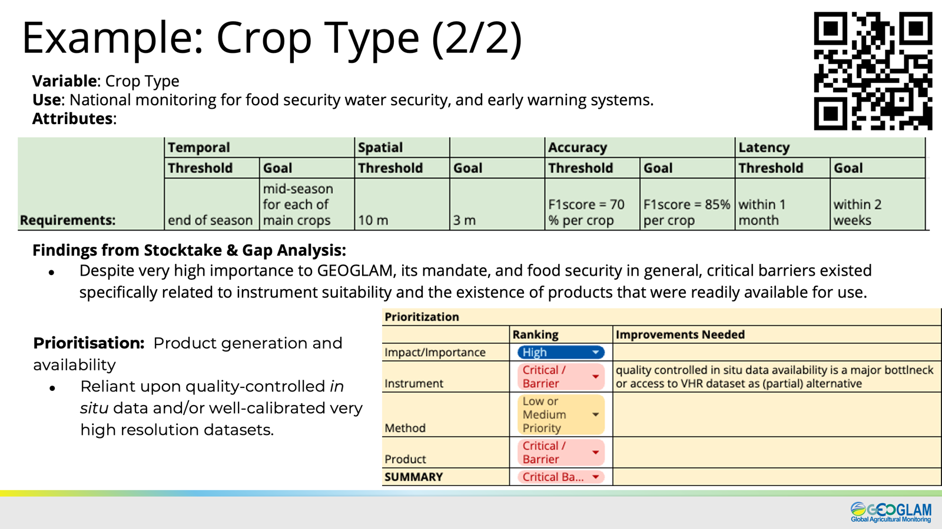
The EAV Framework (simplified)
Then:
Do Steps 1-5 for all Ag Info EAVs related to that use
Once all Ag Info EAVs have been documented, identify common Input EAVs across other Ag Info EAVs
  Recall the case where “Fractional Ground Cover” was called out in both Cover Crop and Rangeland Condition – we need to still create consensus definitions AND reduce complexity in identifying the product requirements to reduce inefficiencies of having too many minute, niche needs and instead strive to compromise to meet the majority of needs.
Convene interested participants to do Steps 1-5 for Input EAVs
As needed to reach a single consensus definition per EAV, reconvene participants to resolve any differences in definitions:
  For Ag Info EAVs across distinct uses
  For Input EAVs across different uses
At the end, we should have something like this (one row per variable)
Reconvene each EAV’s participants to distill top priorities
for that variables and/or for that use 🡪

