Slide 1
Sentinel-2 status as relevant to CARD4L* discussion
Bianca Hoersch, Sentinel-2 Mission Manager
Ferran Gascon, Sentinel-2 Data Quality Manager
Enrico Cadau, Sentinel-2 Data Quality & Mission Management
LSI-VC#3 meeting, 20 Mar 2017, Esrin
*CEOS Analysis Ready Data for Land

Slide 2
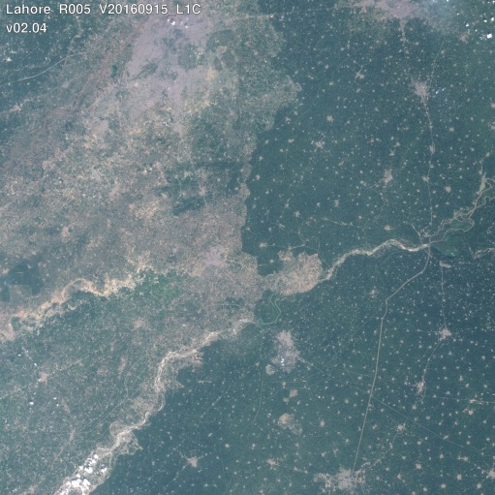
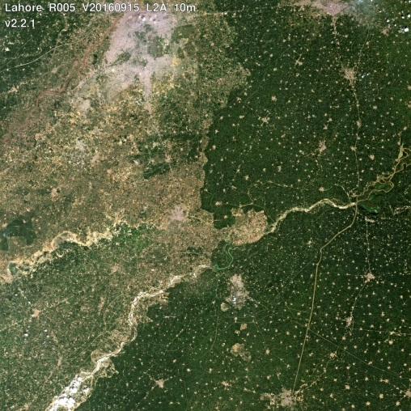
Sentinel-2 Products
Name | High-level Description | Production | Volume
Level-1C | Top-of-Atmosphere reflectances in cartographic geometry | Systematic | ˜500 MB (each 100x100km²)
Level-2A | Bottom-of-Atmosphere reflectances in cartographic geometry | On user side* (using Sen2Cor processor**) | ˜600 MB (each 100x100km²)
*: ESA plans a systematic global production of L2A.
**: http://step.esa.int/main/third-party-plugins-2/sen2cor

Slide 3

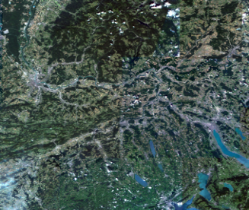


L1C Product Format
Fulfilling the CARD4L requirements
Manifest
XML
Metadata
GML - JPEG2000
XML
XML
Metadata,
Image data,
Auxiliary data,
Quality Indicators data
QC check reports
GRANULE
GRANULE 1
XML/GML
S2 PRODUCT
XML
DATASTRIP
DATASTRIP 1
Metadata,
Quality Indicators Data
QC check reports
AUXILIARY DATA (optional)
Processing parameters, IERS bulletin,…
Relevant Info: “https://sentinel.esa.int/web/sentinel/news/-/article/minor-update-to-the-sentinel-2-level-1c-product-format-change-psd-14--1”

Slide 4
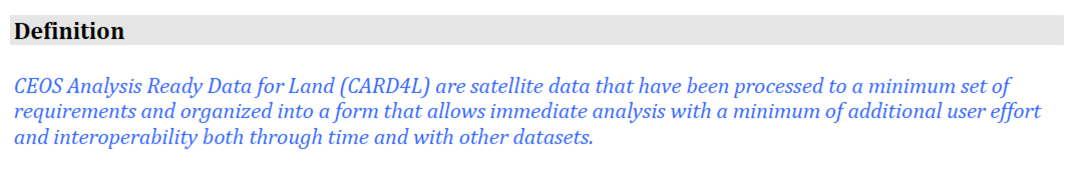
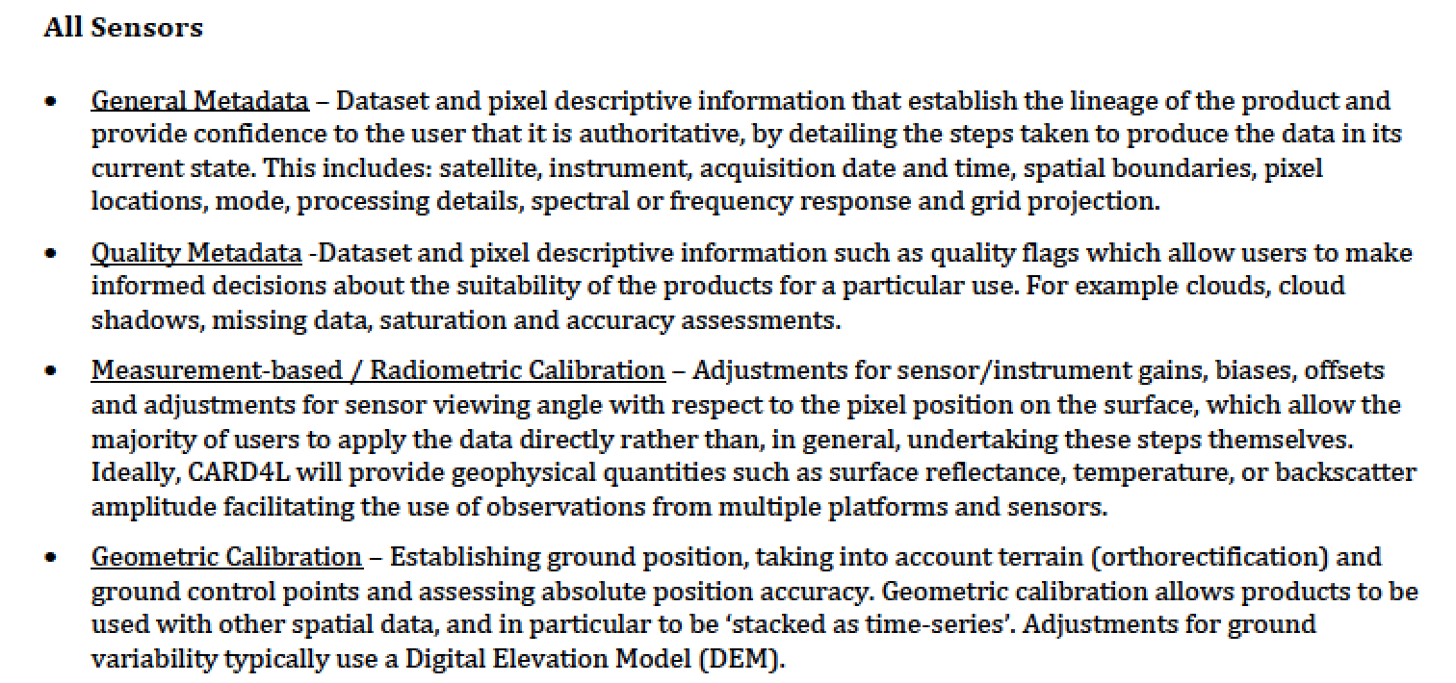
CARD4L definition (high-level)

Slide 5
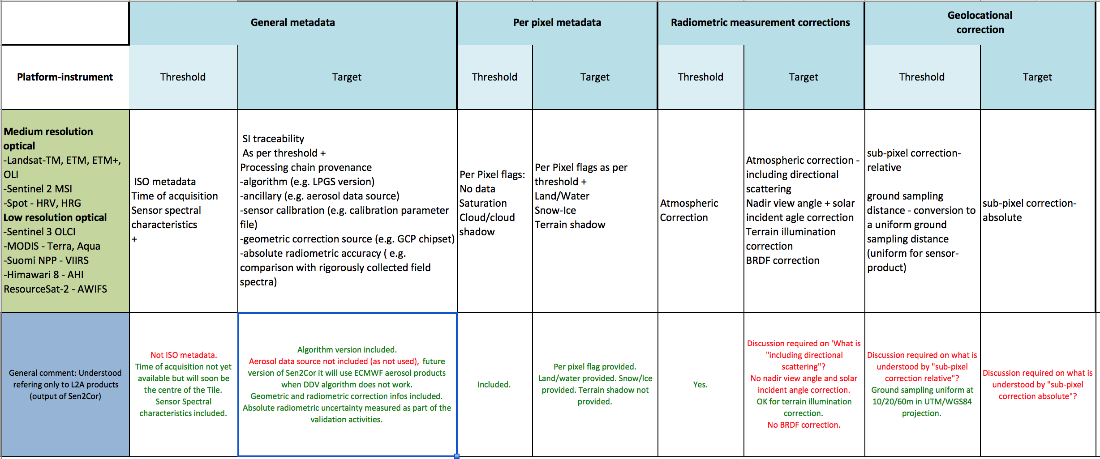
Comparison S2 products versus CARD4L specs
Not far from being compliant with all CARD4L specs

Slide 6
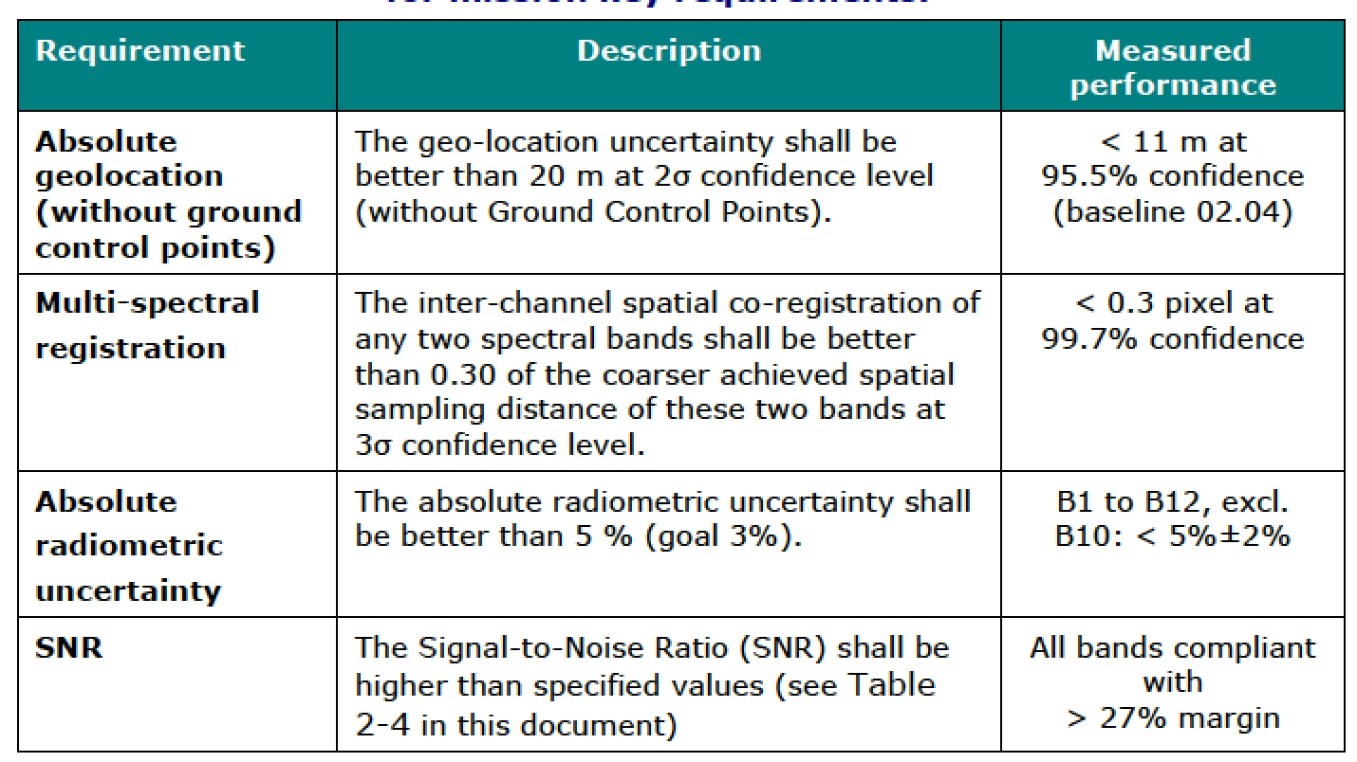
L1C Product Data Quality
BEST in its resolution class
Fore more details on products quality status and validation, see
http://esaconferencebureau.com/2016-events/16c20/presentations

Slide 7
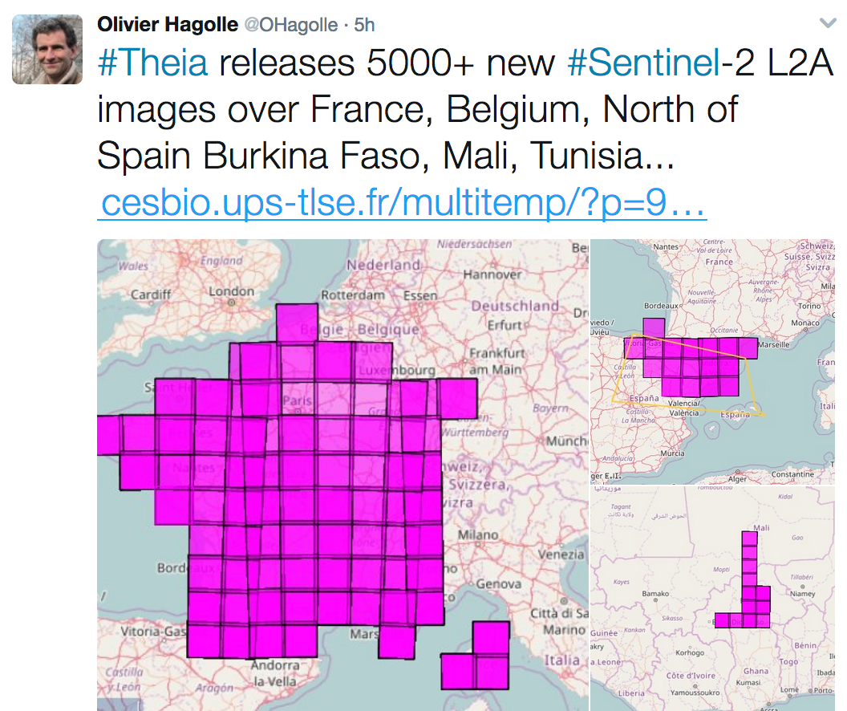
Sentinel-2 – progressing towards Surface Reflectance (L2A)
State of the art: no other HR mission produces globally surface reflectance, current approaches are
  on-demand production e.g. Landsat
  – plans to move to systematic?
  regional production e.g. PEPs/TEIA (France)
  and others
Sentinel-2 production of L2A will increase the data
volume by 120%
ESA Pre-operational Pilot project: systematic regional production Europe (see next slide)
Feasibility study: assessment of best European algorithm for systematic global production
ACIXs: International algorithm comparison

Slide 8
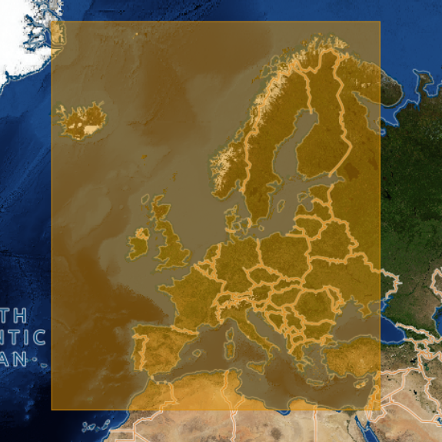
L2A Production Pilot Project ‘Europe’
The Sen2Cor processor (version 2.3.0) has been integrated in the ESA-RSS environment
It generates daily up to 300GB of L2A products data (~600 Tiles per Day).
L2A products will be made available in Q1/2017 through http://scihub.esa.int
Products granularity of L2A will be the same of L1C available on SciHub.
L2A product format is aligned with the new compact naming convention.
Notes:
The following algorithms are being assessed by a group of experts:
BC by Brockmann Consult
MAJA (MACCS ATCOR Joint Algorithm) by CNES-DLR
SCAPE-M by GFZ Potsdam
Sen2Cor by DLR-TPZ

Slide 9
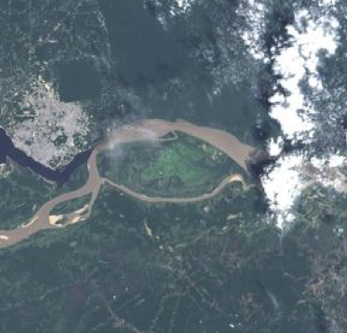
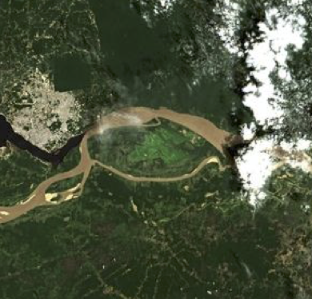
Feasibility: L2A Evaluation for Operational Production
ESA is evaluating a set of atmospheric correction algorithms for the operational production.
The following algorithms are being assessed by a group of experts:
  BC by Brockmann Consult
  MAJA (MACCS ATCOR Joint Algorithm) by CNES-DLR
  SCAPE-M by GFZ Potsdam
  Sen2Cor by DLR-TPZ
  Conclusion expected by July 2017

Slide 10



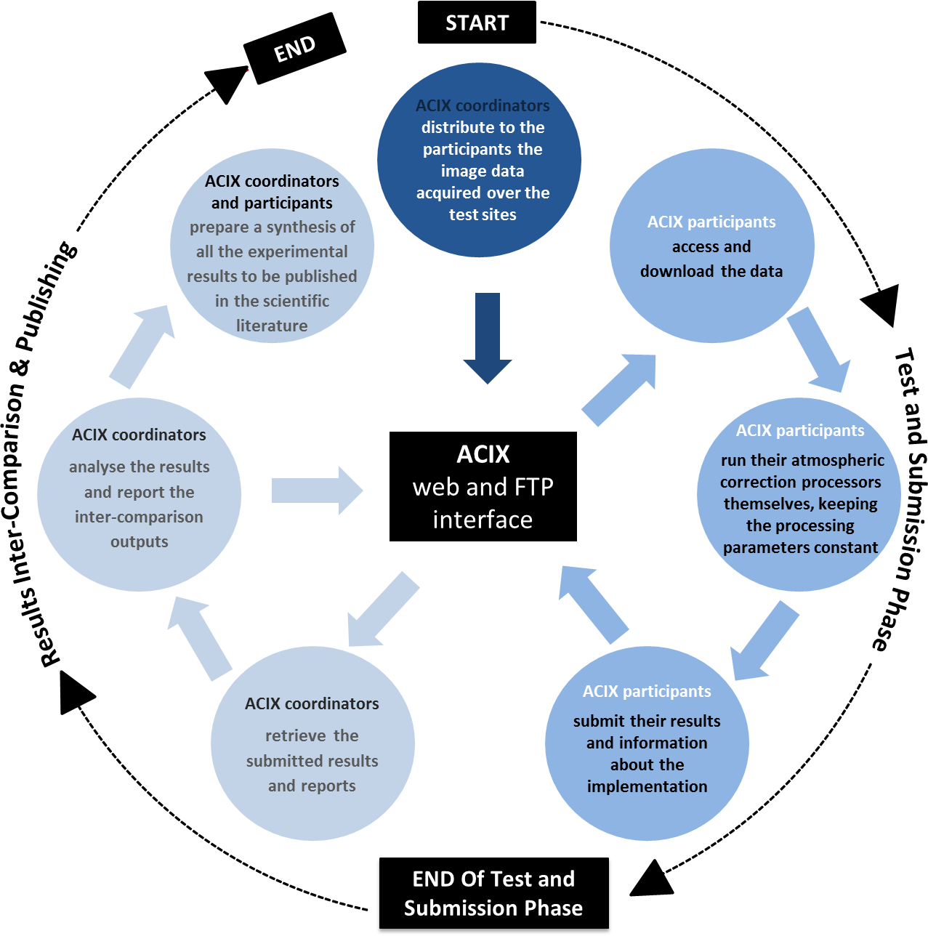
ACIX
In the framework of CEOS, ESA and NASA are co-organizing an inter-comparison of atmospheric correction algorithms for high-resolution optical missions, in particular S2 and Landsat-8:
  ACIX (Atmospheric Correction Intercomparison eXercise)
  https://earth.esa.int/web/sppa/meetings-workshops/acix
14 algorithms participating:
  ACOLITE (Royal Belgian Institute for Natural Sciences), ATCOR (DLR), BC (BC), FLAASH (Spectral Sciences), GA-PABT (Geoscience Australia), GRASP (LOA), Ind-prepro (Trier University), LAC (ACRI), L8SR (NASA), MACCS (CNES), Sen2Cor (DLR-TPZ), SMACAA (South Dakota State University), OPERA (VITO), SCAPE-M (GFZ).
ACIX will bring metrics on how different algorithms compare.

Slide 11
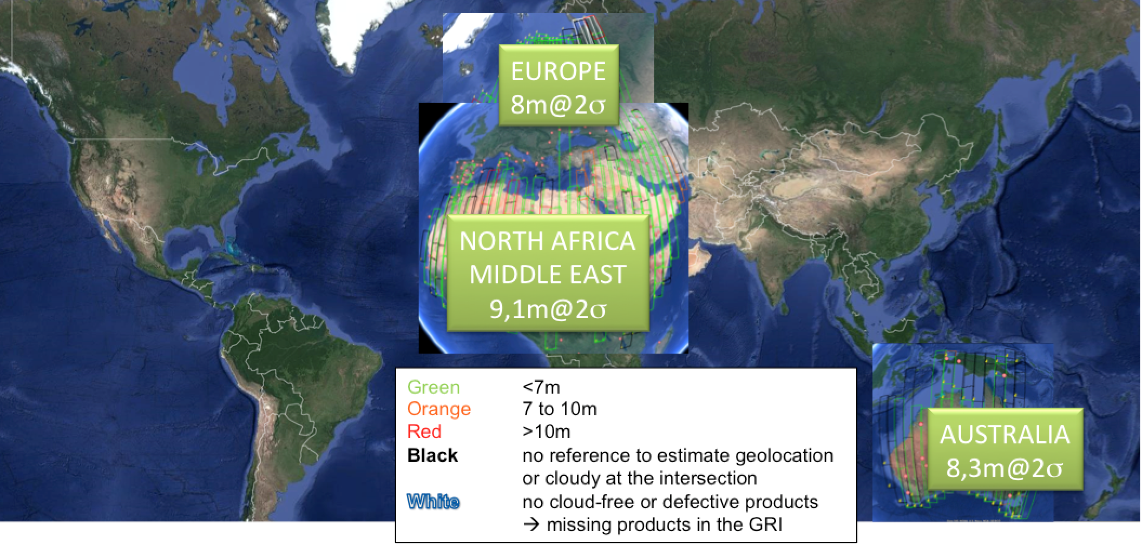
Sentinel-2 Products Foreseen Evolutions
Level-1C
  New compact naming convention. DONE
  Refining using Global Reference Image (GRI). 2018
  Inclusion of sensing time associated to each Tile. 2017
  Updated cloud masks calculation. 2017
  Provision of raster quality and cloud masks (under evaluation). 2017

Slide 12
Sentinel-2 Products Foreseen Evolutions
Level-2A
  New compact naming convention (aligned with L1C).
  Usage of AOT auxiliary data from ECMWF.
  Improvement of cirrus correction.
  Simplification of Sen2Cor processor installation process.

Slide 13
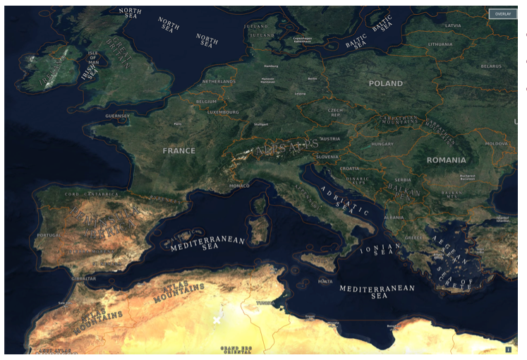
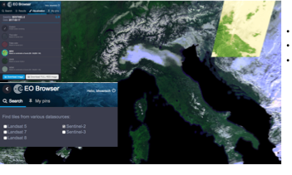
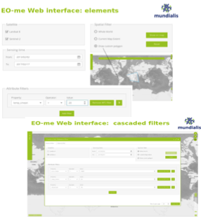
Some Portals, Visualisation tools &
Webmapping external services with focus on Sentinel-2
A number of commercial entities are actively redistributing Sentinel-2 products and offering advanced data visualisation capabilities
European
EOX: S2Maps, Europe 4-months mosaic from summer 2016
http://S2maps.eu
Sinergise: EO Browser, combing Sentinel-2 with Landsat and Proba-V data on-demand:
http://apps.sentinel-hub.com/eo-browser/
Sinergise: Sentinel playground, different indices and S2 bands rendering on the fly, with clouds and time definition
http://apps.sentinel-hub.com/sentinel-playground/
Mundialis: Eome, Data Analytics & filtering tool for Sentinel-2 and Landsat by e.g. cloud and bio/climate/geophysical baseline maps
http://eome.mundialis.de/eome/client/index.html
Non-European
Descarteslab: mosaics of Landsat-8, Sentinel-1 and Sentinel-2 (red-edge bands only)
https://maps.descarteslabs.com/
PlanetScope: Planetscope data, Rapideye, Sentinel-2, Landsat-8
https://www.planet.com/explorer/
LSI-VC: Assessment of what is offered in tools?

Slide 14
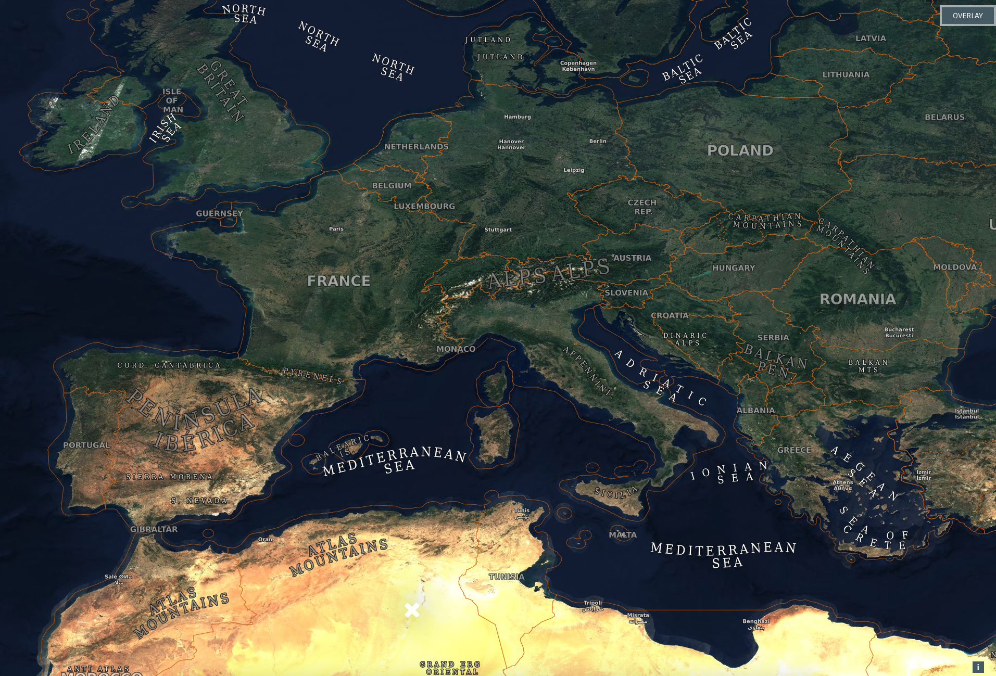

S2Maps– Sentinel Europe ‘summer 2016’ mosaic for WMS
4 months of data
Cloudfree mosaic
Creative Commons
Austria
Notes:
You can get a personal demo of the application at XYZ.

Slide 15
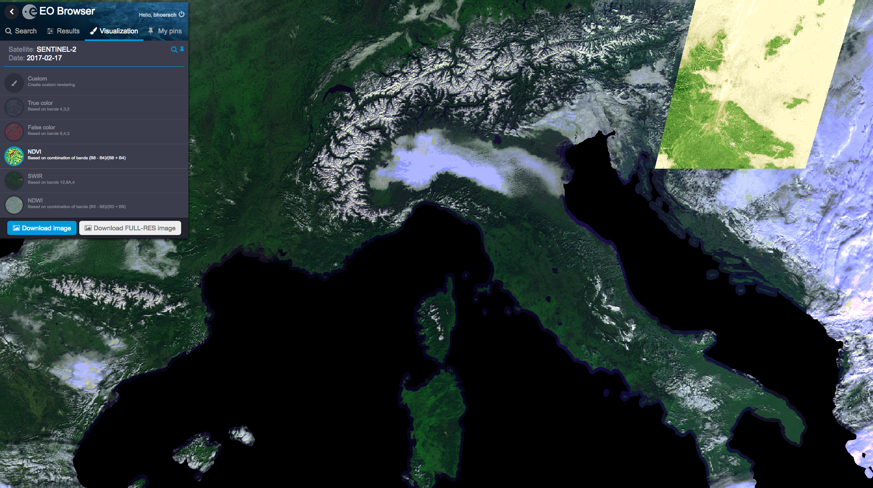
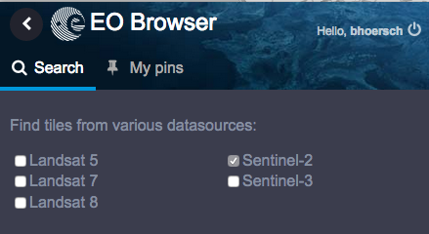

EO Browser – Sentinel, Landsat et al. data in one place
Compare data
Custom indices
Bring data to platforms
Complete archive of Sentinel-2
ESA archive Landsat 5,7,8
Proba-V products
Sentinel-3
ENVISAT coming soon
Slovenia
Notes:
EO Browser is a new tool, which makes it possible to browse and compare full resolution Sentinel, Landsat and other data. You simply go to an area of interest, select the date and inspect the resulting data from different sources. There are several visualizations available – true color, false color, NDVI, etc or you can do your own combination of bands. Visual comparison tool makes it possible to observe changes in the land from 1984 onward.
If you need these data in your own platform, you can either export them as GeoTiff or include them using web services.
You can get a personal demo of the application at XYZ.

Slide 16
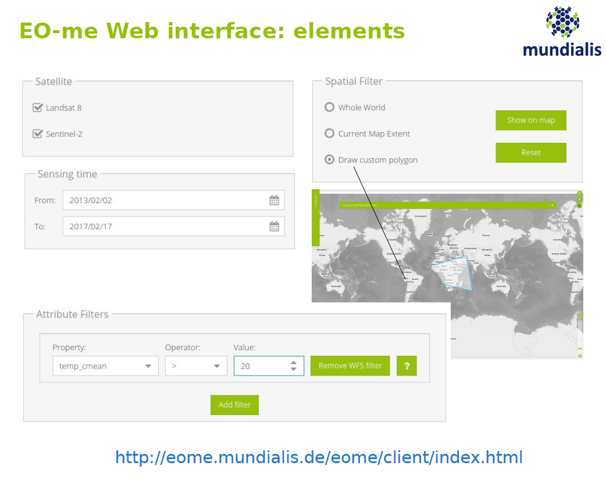
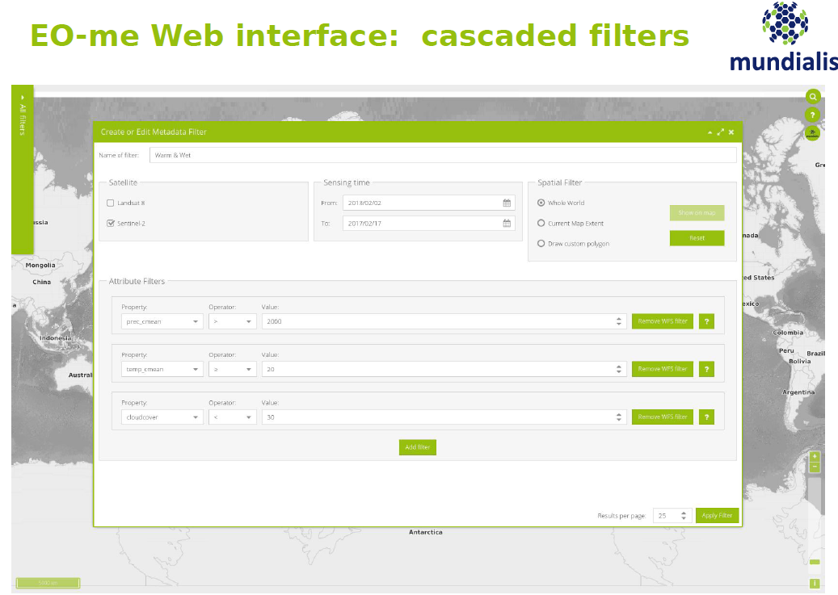

EOme– Sentinel-2, Landsat-8 & data filters
Filter data by metadata
Filter data by underlying base maps (climate, soils etc.)
Germany

Slide 17
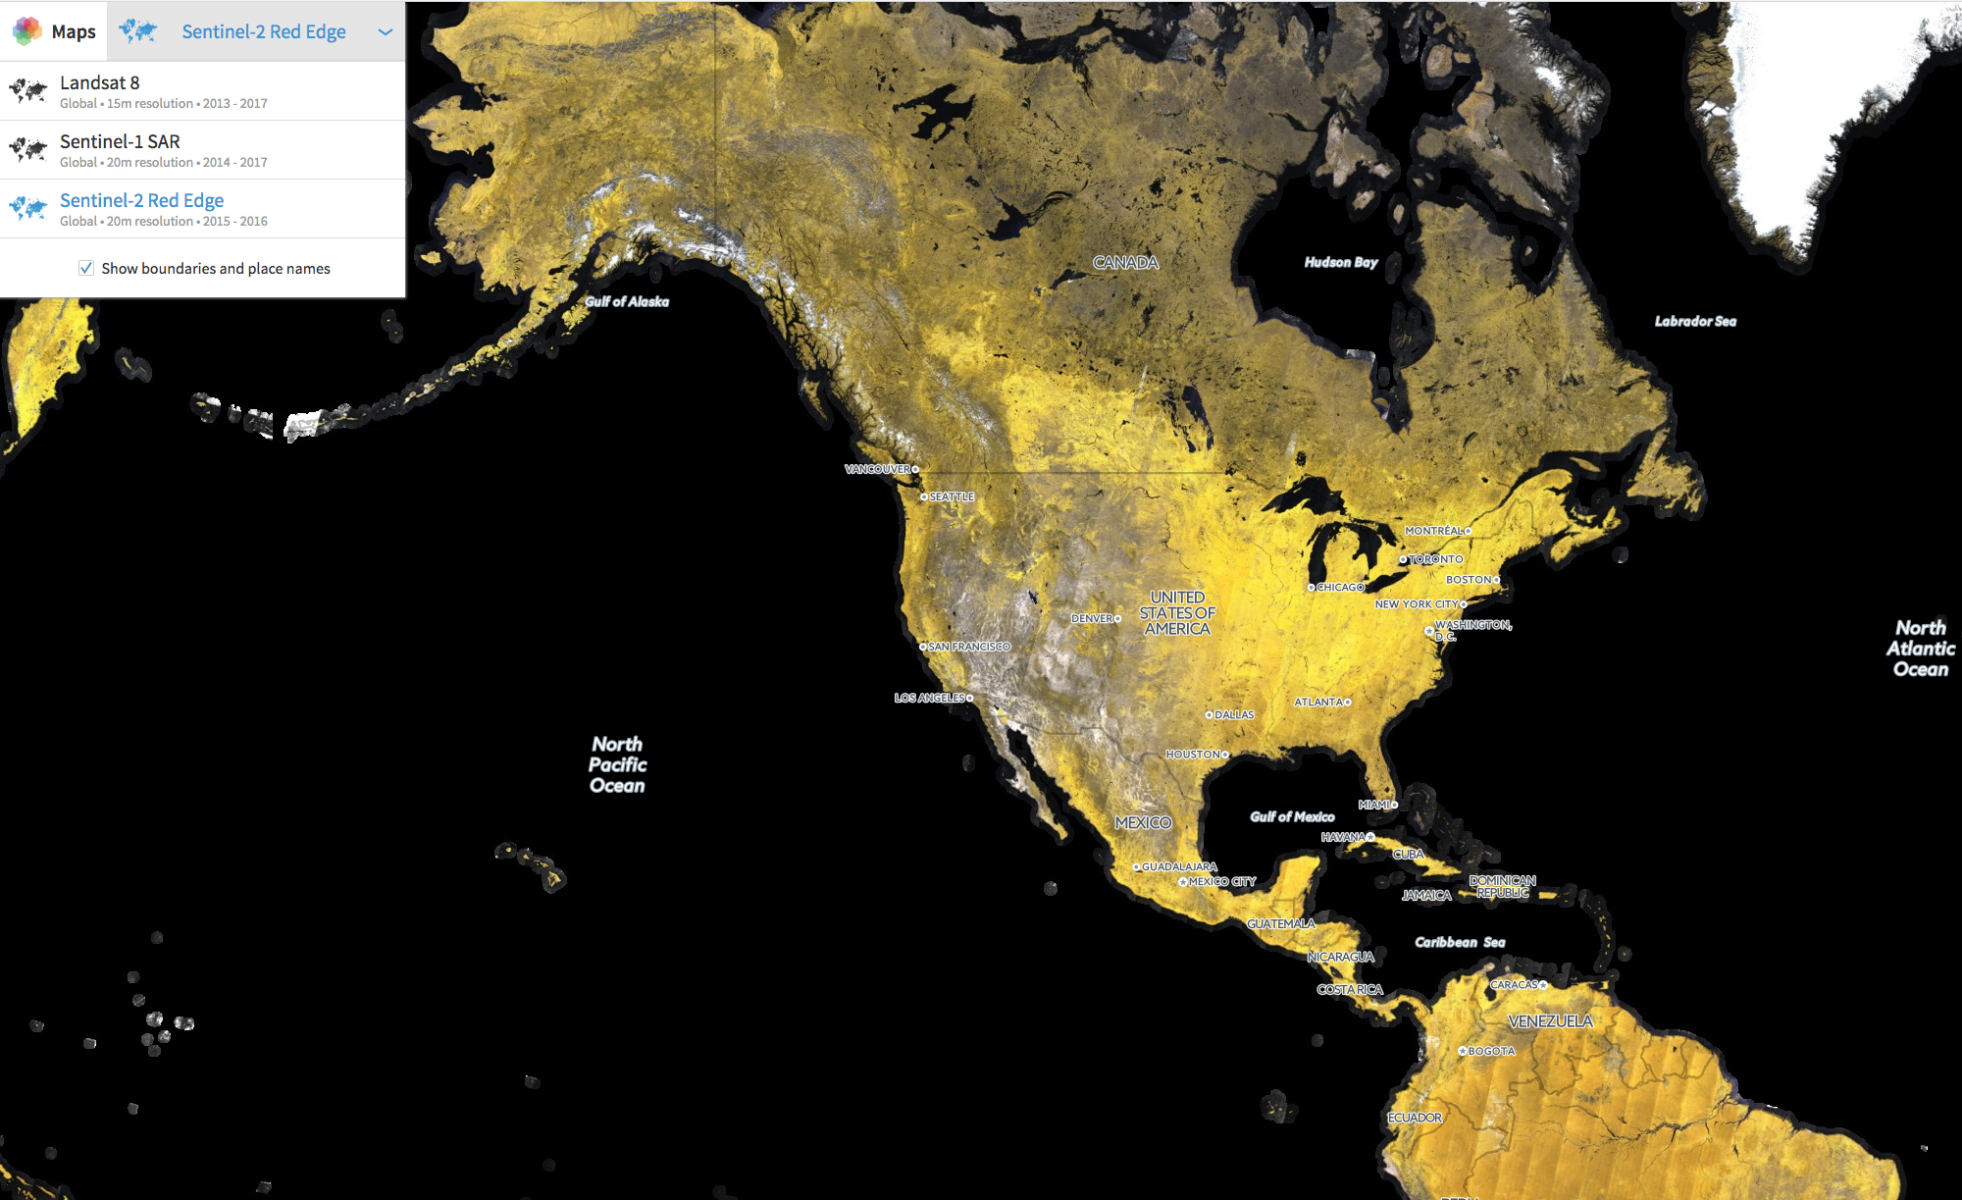

Descartes Labs: Sentinel-2 red edge, Landsat-8, Sentinel-1
Red-edge only
Global mosaics
USA

Slide 18
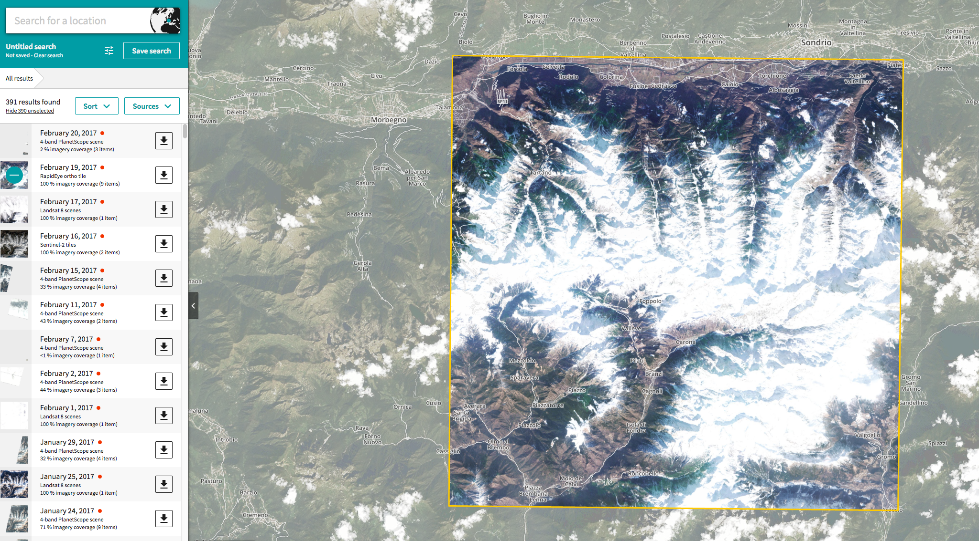

Planet Explorer: combines Planetscope, Rapideye, Sentinel-2 and Landsat
USA

Slide 19
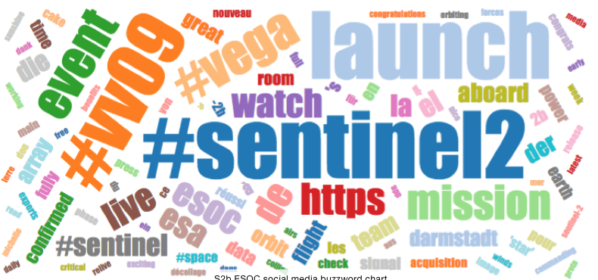
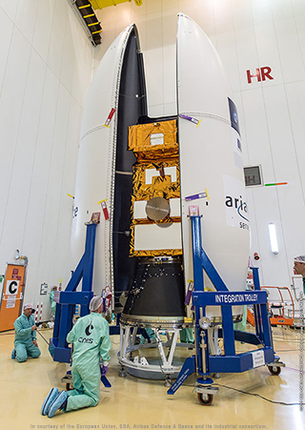
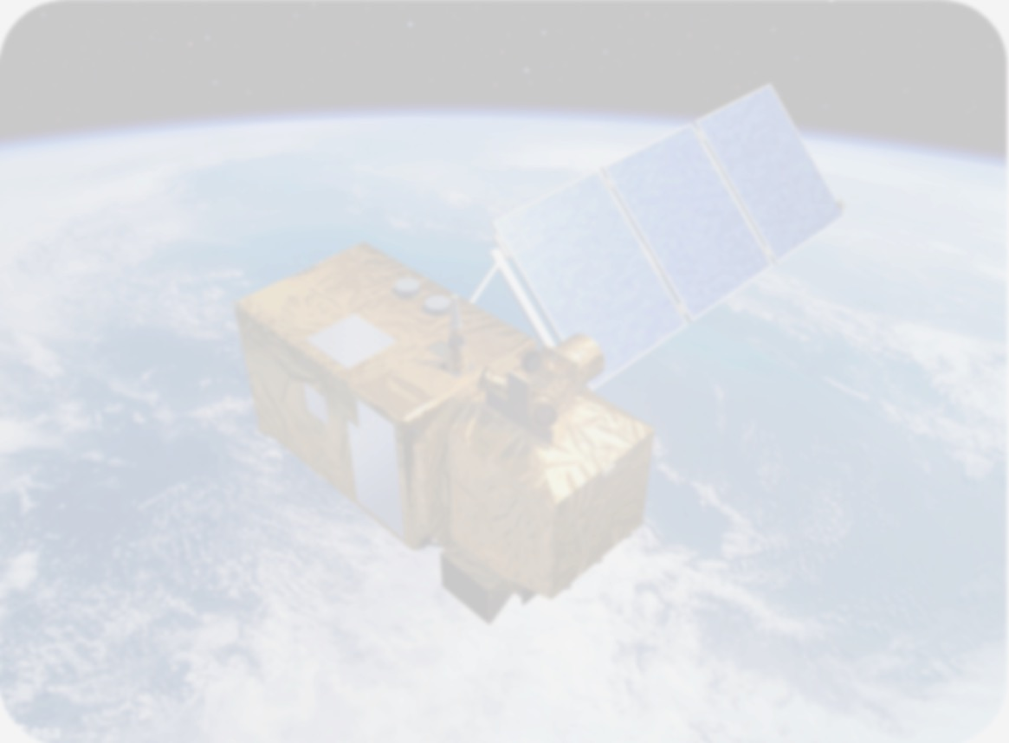
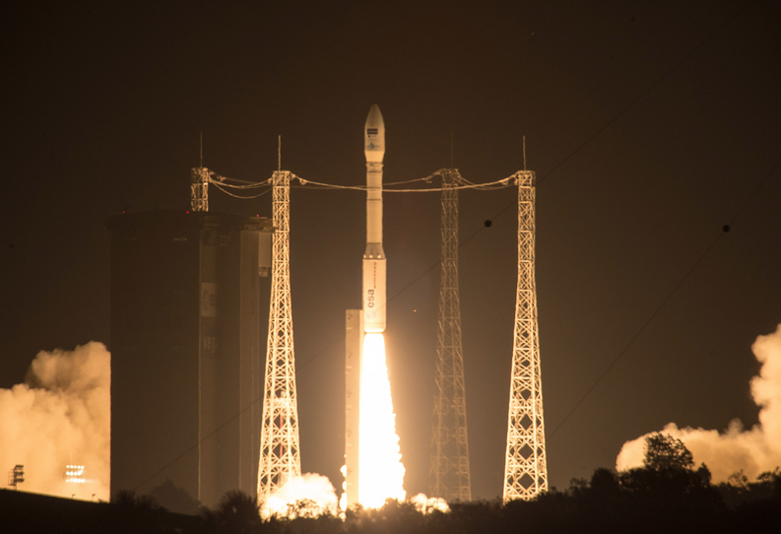
Sentinel-2: we have twins!
#Sentinel2Go: 15,000 messages on Twitter, Facebook, Instagram, etc. were posted in 48 hrs and ~ 20 million people were reached all over the world
Doubling the information/acquisition capacity
Increase chances of cloud-free imagery globally
Capture fast processes that require < weekly mapping e.g.
  Agricultural growth periods
  Deforestation rates
  Glacier & Sea Ice dynamics
  Coastal & inland water quality
  Emergencies
Improved interoperability/fusion capacity with other missions (Sentinels, Landsat-8/-9, Proba-V) due to higher revisit/more temporal overlap

Slide 20
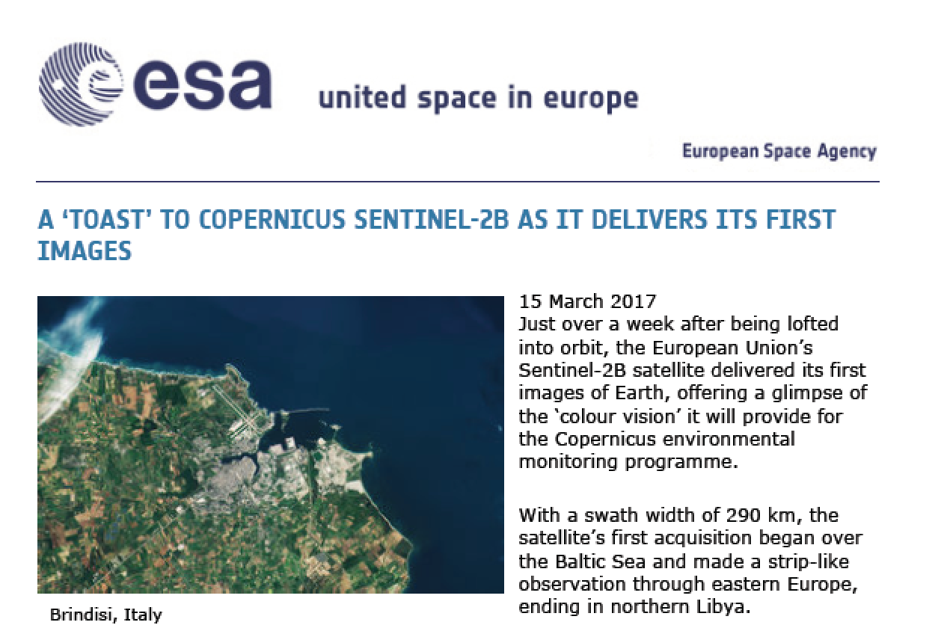
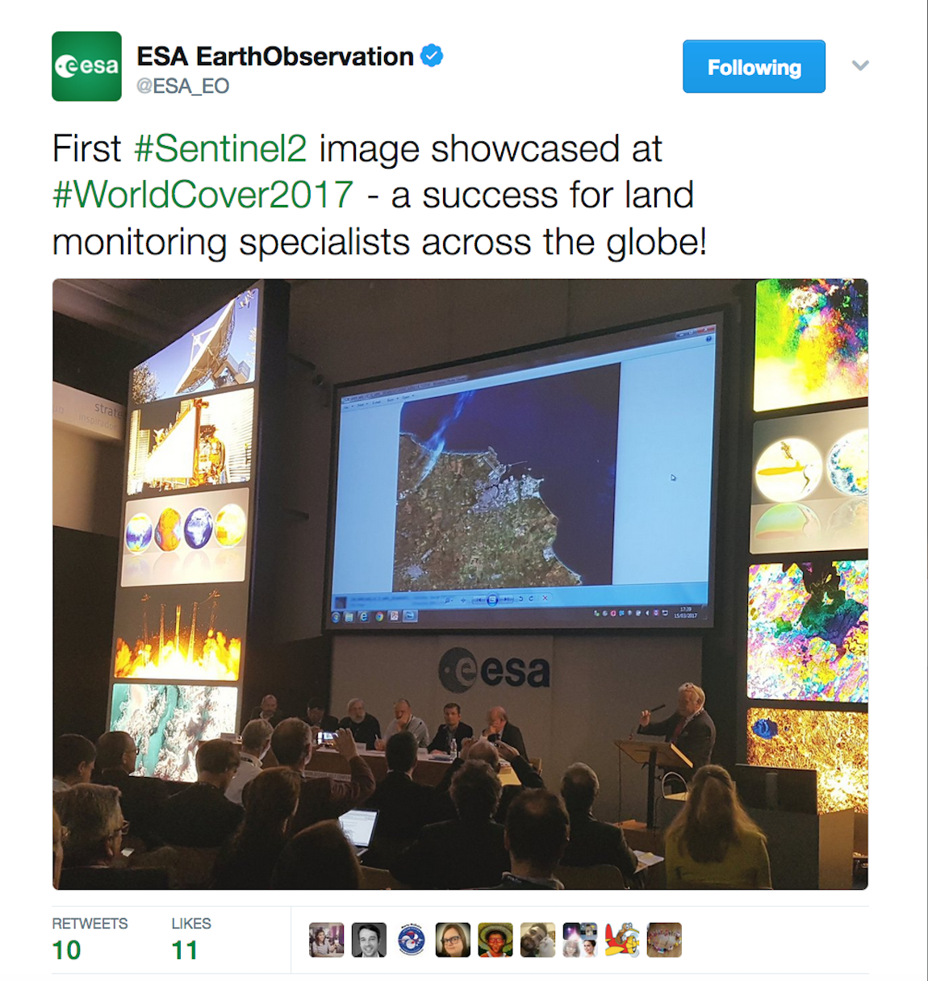
S2B opens its eyes

Slide 21
Sentinel-2 Mission Operations Phases
The Sentinel-2 full mission exploitation capability is based on the routine operation of the 2-satellites constellation.
In-orbit Commissioning Review (IOCR)
Routine Operation Readiness Review (RORR)
S2B
Operational qualification
S2 Full Operational Capacity
S2A Routine Operations
S2A Operational qualification
S2A Space Segment Commissioning
S2B Space Segment Commiss.
S2A-Launch
23 Jun ‘15
S2A IOCR
L+4m
Oct’15
S2A RORR
Jul’16
S2B FAR
Nov’16
S2B Launch
6 Mar’17
S2B IOCR
L+3m
Jun ‘17
S2 RORR
IOCR + 4m
Oct ‘17

Slide 22
Next steps
Q1/2017: Start dissemination of data from L2A Europe Pilot (using SEN2COR)
Q2/2017: 2nd workshop ACIX for comparison metrics across 14 algorithms
Q3/2017: Results from feasibility study L2A best European algorithm
Q4/2017: Gradual increase of ‘Europe’ pilot to global production, not yet authorised by EC
Q4/2017: end of ramp-up Phase of S2B, full constellation operational (=3 PB/y including L1C+L2A)
Q1/2018: Validated Global Reference Image (GRI): best geometric quality globally (<0.3 pixels @3 sigma multi-temporal)
2018: start of GRI-based production for S2A and S2B
2018: move from SEN2COR towards operational L2A processor for global production
2018: evolving DEM? Further S2-L8 harmonisation/interoperability
2018: start major reprocessing exercise of all S2A/S2B archived data with GRI and operational L2A processor (archive size ~5PB!)
Sentinel-2 is moving towards an optimised global radiometry and geometry. Combined with the approach of exploitation platforms this will allow
“immediate analysis with a minimum of additional user effort and interoperability both through time and with other datasets”.

