Slide 1
Copernicus Data Access DIAS Introduction
7 September 2017, ESRIN

Slide 2
DIAS Context : Data distribution
Sentinels operations are progressing nominally towards full capacity

Slide 3
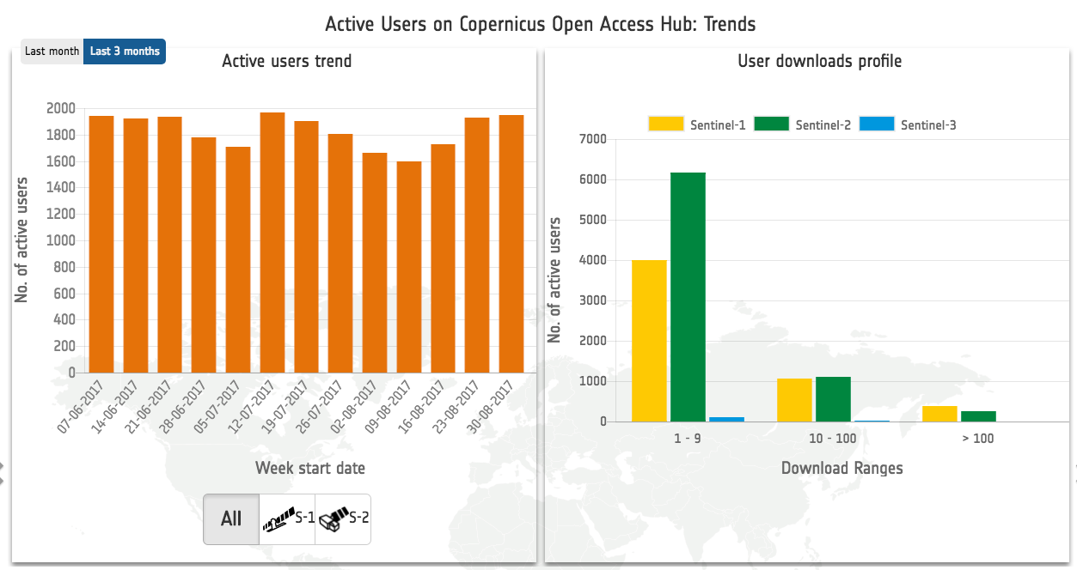
User community
Solid user community, with a regular growth

Slide 4
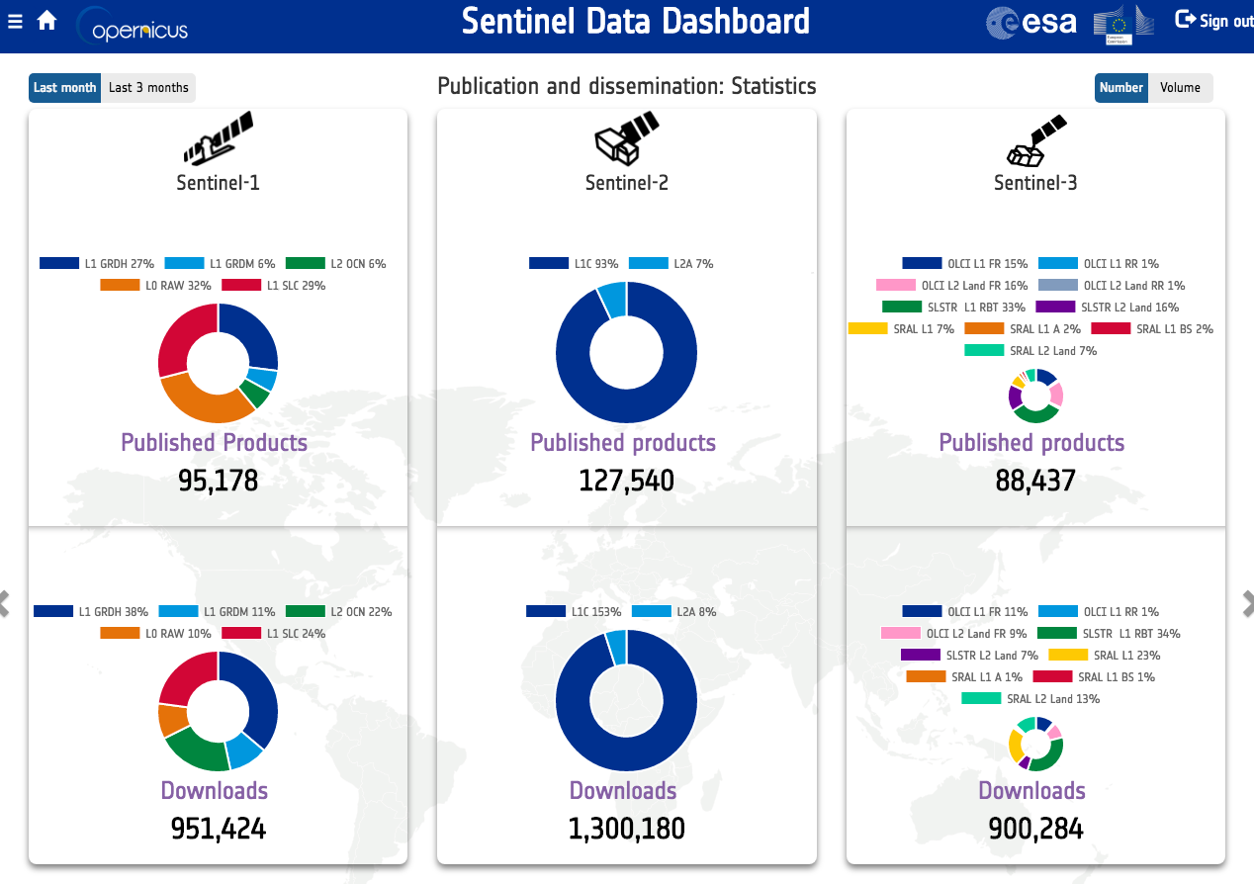
Data offer
Large data offer

Slide 5
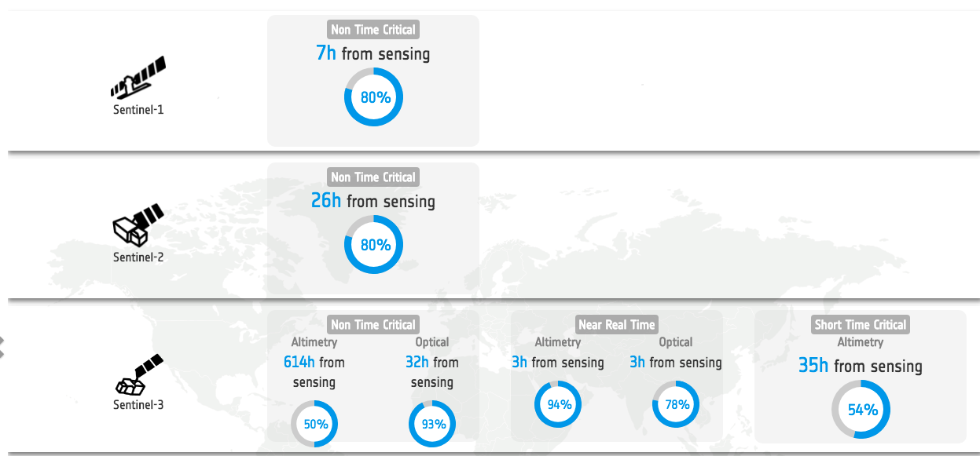
Data timeliness
Fast release

Slide 6
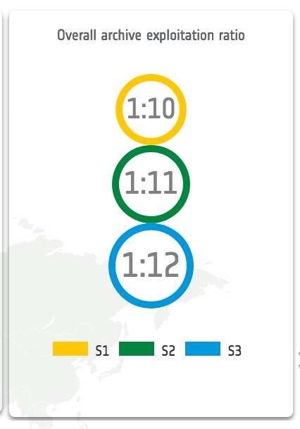
Exploitation ratio
Impressive Exploitation ratio
(Number of products downloaded : Number of products in the archive)

Slide 7
Copernicus Distribution
In 3 years of operations, the Copernicus programme has put in place a solid distribution system complemented by a solid network of Europeans and International partners offering mirror sites
This is not enough!
Don’t move the data!

Slide 8
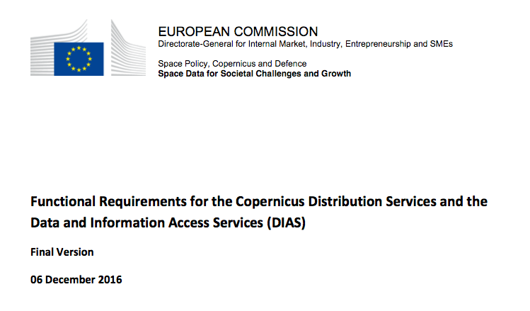
Data and Information Access Services
A way forward has been identified for improved data and information access that combines augmented distribution capabilities with data and information access services (DIAS) and captured into European Commission functional requirements
Functional Requirements for the Copernicus Distribution Services and the Data and Information Access Services (DIAS), Final Version, 06 December 2016
ESA Industry Information day: 20 December 2016
ESA Procurement initiated in January 2016

Slide 9
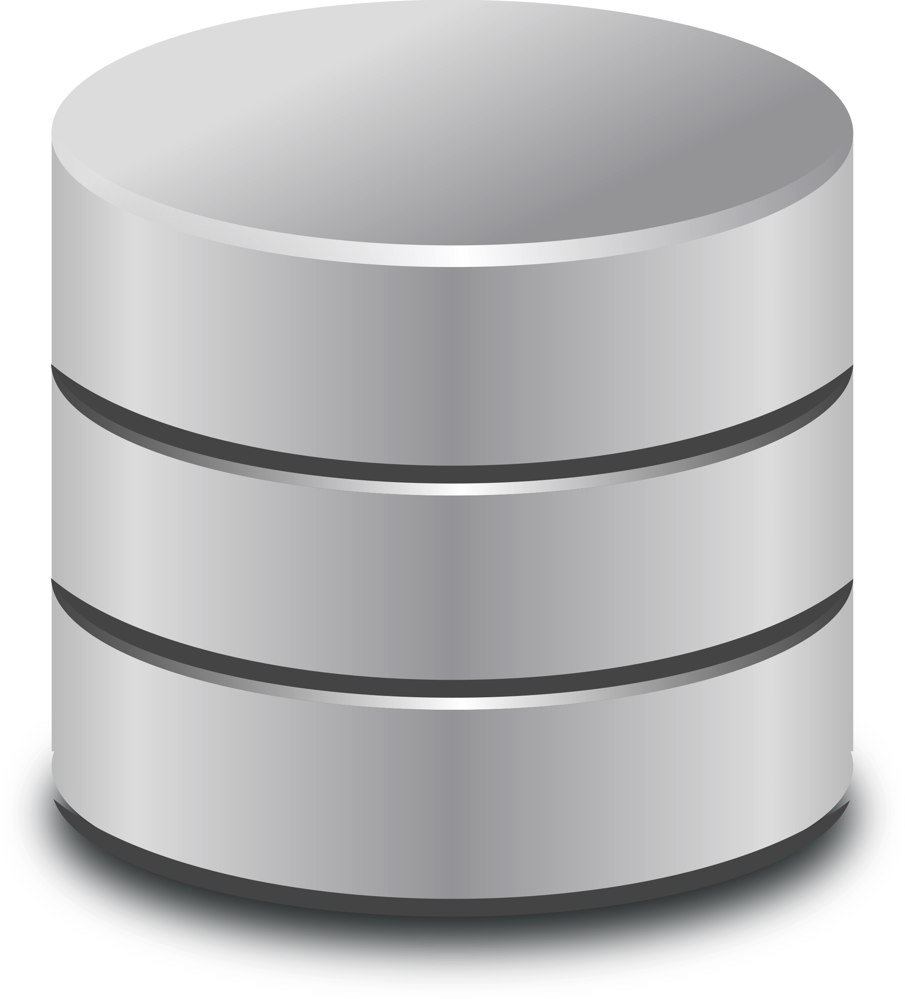
DIAS overview
End user: User of the third-parties services
Front
office service
Front
office service
Front
office service
Third-party
funded
Front
office service
Front
office service
Front
office service
Front
office service
Third-Party
Copernicus DIAS interfaces
DIAS
funded
Copernicus DIAS Storage
DIAS Consortium

Slide 10
Operational Scenarios Actors
DIAS: Roles
DIAS Consortium: Ensure availability of Sentinels data and Services information to accommodate third party services and data. Responsible for the provision of the underlying IT infrastructure and provider of IT resources to third parties.
Third-parties: Service providers who autonomously negotiate with DIAS IT provider(s) for infrastructure and services to be deployed
End user: Any user accessing a front-office service supported by the DIAS framework

Slide 11
DIAS: scenario
4 – OPERATE
Third Party operates own service for own users community
Sizing the service scalability according to own needs
Possibility to operate and manage the service autonomously, including management of access to service results
3 – GET ACCESS TO THIRD PARTY DATA
Third-party negotiates data and interfaces with another Third-Party service provider.
Direct interface between Third-Parties.
Third Party interfaces and Services
2 – CONFIGURE
Third Party interfaces and Services
Third Party Service developer configures own environment (processors, select Sentinels collections, deploy own user interface…).
1 – PROCURE
Third Party Service developer procures IT environment and associated DIAS services
Copernicus DIAS Storage
DIAS Consortium

Slide 12
Copernicus DIAS
DIAS (Data and information access services) : An industrial framework to enable and foster Copernicus data exploitation
Several providers have been selected and negotiations are progressing
Services should open beginning 2018

Slide 13
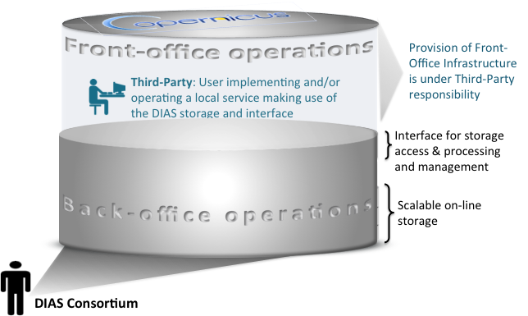
Copernicus DIAS – ESA Implementation Approach
ESA detailed implementation approach presented at the Copernicus IGS Task Force meeting on 6 October 2016

