Slide 1
Status Report about ALOS-2 PALSAR-2 ARD JJ-FAST Version
Toshio Okumura (RESTEC), Shin-ichi Sobue (JAXA), Takeo Tadono (JAXA)
21st February 2018

Slide 2
Overview of the Dataset
ALOS-2 PALSAR-2 ARD JJ-FAST Version is a dataset which is provided by JAXA (Japan Aerospace Exploration Agency) through the JJ-FAST (JICA-JAXA Forest Early Warning system in the Tropics). The product provided by JJ-FAST is different from JAXA’s standard product. For detail information about JJ-FAST, please see “http://www.eorc.jaxa.jp/jjfast/”.
The dataset is ScanSAR dual polarization mode. The dataset consists of 5 files which are HH polarization imagery, HV polarization imagery, local incidence angle imagery, mask information imagery and meta-information file.
Noteworthy is that the dataset is divided into 1 degree tile from a data processed for each path (strip) obtained by ALOS-2 PALSAR-2, whereas the standard product is provided in a scene based on a orbit and frame.
And the dataset is Ortho-rectified/slope-corrected amplitude image (γ0).

Slide 3
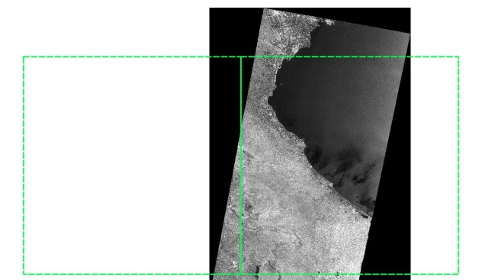
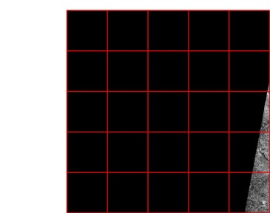
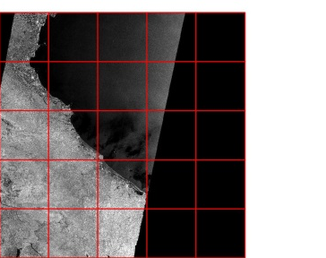
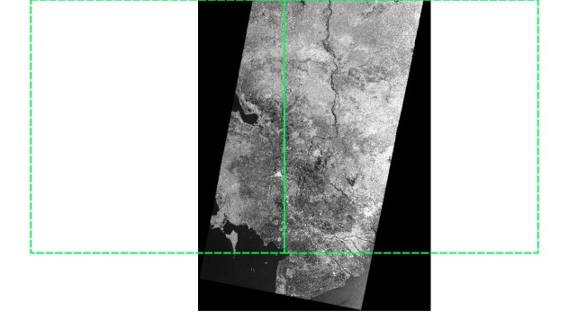
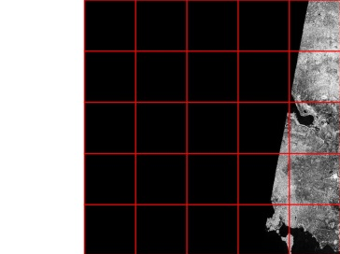
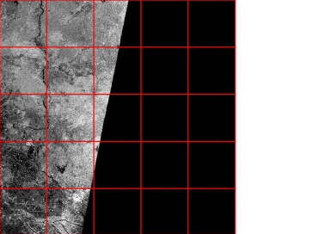
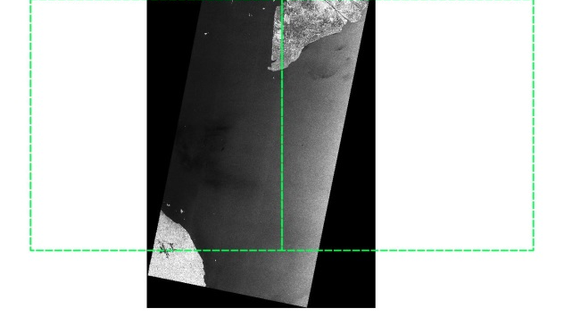
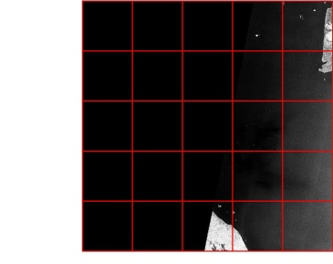
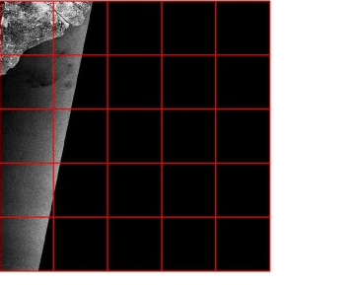
Overview of the Dataset
Sample image of JJ-FAST product
RSP035
N20
N15
N10
5deg
1deg
E100
E105
At first path processed imagery is divided into 5 degree tile.
Then the 5 degree tile is divided into 1 degree tile.

Slide 4
Dataset specification
Map projection | Latitude/Longitude
Datum+Ellipsoid | ITRF97 + GRS80
Data unit (one tile) | 1deg. grid in latitude-longitude
Number of pixels for one tile | 2250 pixels x 2250 lines
Size of one pixel | 1.6 arcsec (approx. 50m)
Data size | 42MB/tile
Content | 1. backscattering coefficient for each polarization (HH and HV) 2. Local incidence angle 3. Processing mask information 4. catalog file (meta-information)
Original SAR data | PALSAR-2 ScanSAR (Dual Pol.)
Pre-Processing | Radiometric calibration, Ortho-rectified/slope-corrected amplitude image (γ0)
DEM for processing | SRTM-1
SAR algorithm | Sigma-SAR

Slide 5
File name & Format
Data list | File name | Format Data type
Backscattering cofficient (HH pol) | LLLLLLL_YYMMDD_sl_HH.tif | GeoTiff 16bit-unsigned
Backscattering cofficient (HV pol) | LLLLLLL_YYMMDD_sl_HV.tif | GeoTiff 16bit-unsigned
Local incidence angle | LLLLLLL_YYMMDD_linci.tif | GeoTiff 8bit –unsigned
Processing mask information | LLLLLLL_YYMMDD_MASK.tif | GeoTiff 8bit –unsigned
catalog file | LLLLLLL_YYMMDD.json | json ascii
LLLLLLL: latitude/longitude of the upper left corner of the tile
e.g. latitude 0 degree north, longitude 100 degrees east: LLLLLLL = "N00E100"
YYMMDD: observation year + month + date of the original SAR image
e.g., 2017-Jan-1st : YYMMDD = "170101"

Slide 6
Content of data
Backscattering coefficient
Data are stored as digital number (DN) in unsigned 16bit. The DN values can be converted to gamma naught values in decibel unit (dB) using the following equation:
where, CF is a calibration factor, and <> is the ensemble averaging. The CF value is “-83.0 dB”.
*Where, no data is 1.
Local incidence angle
It is the angle between the radar direction and zenith. Pixel value is local incidence angle.
*Where, no data is 1.
Processing mask information
value | Category
0 | Land
1 | No data
3 | Ocean / Water
150 | Shadowing
255 | Lay over

Slide 7
Meta data (1/2)
Tag | Description
product | Path or Tile
obs_date | Observation date
polarization | Types of polarization
rsp | Number of Path
cycle | Observation cycle
obs_mode | Observation Mode
off-nadir_angle | Off-nadir angle [deg]
satellite_direction | Orbit Direction D: Descending A: Ascending
look_side | Observation Direction L: Left looking R: Right looking

Slide 8
Meta data (2/2)
Tag | Description
replay_id | Downlink ID
version | Software release and revision number
DEM | Digital Elevation Model
upper_left_latitude | Upper left latitude
upper_left_longitude | Upper left longitude
pixel | Number of pixels
line | Number of lines
provider | "JAXA"
satellite | "ALOS-2"
instrument | "PALSAR-2"
calibration_equation | Equation for converting DN to dB
calibration_factor(CF1) | Calibration Factor for the calibration equation
calibration_info_url | URL about the calibration equation

Slide 9
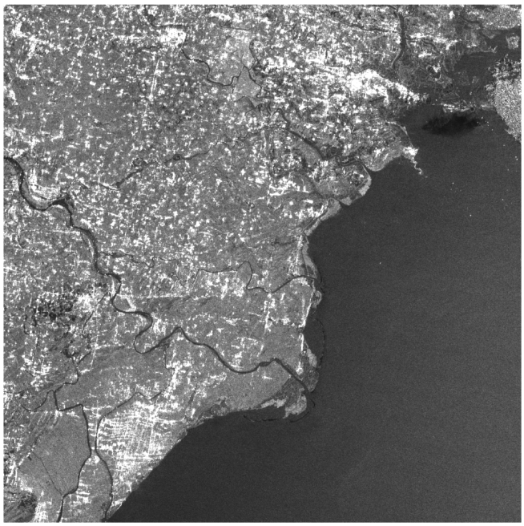
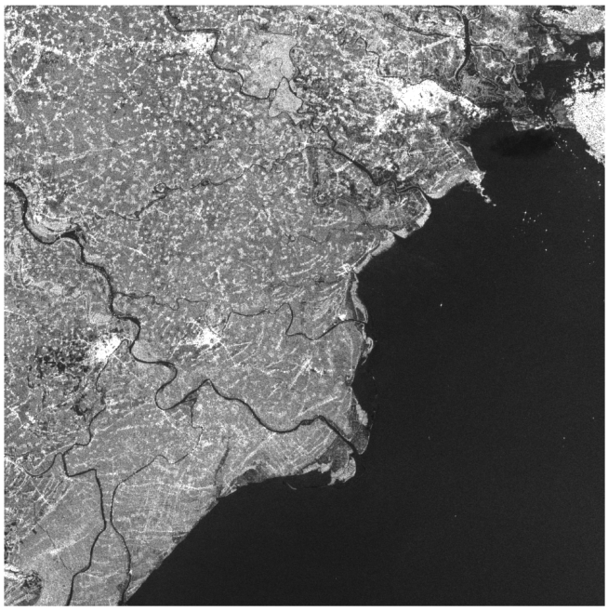
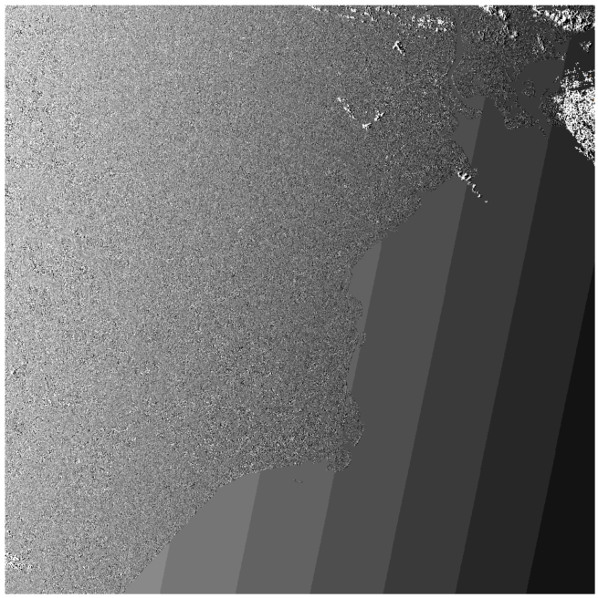
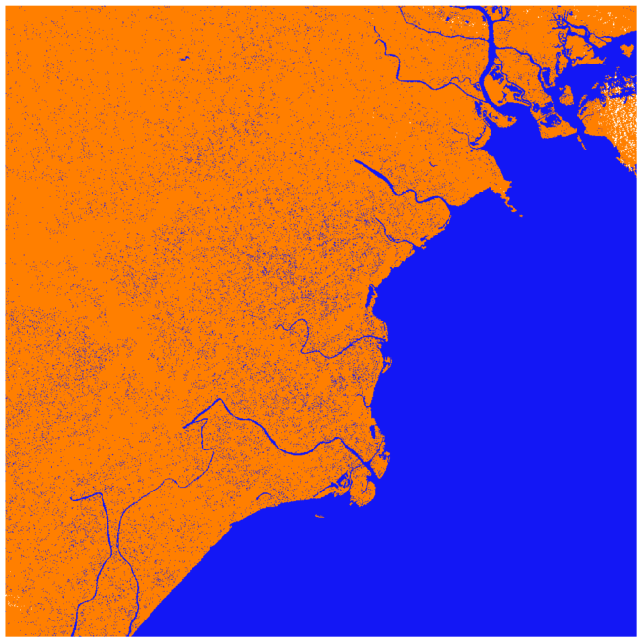
Sample data
N21E106_20170104_C065_RSP036_sl_HH.tif
N21E106_20170104_C065_RSP036_sl_HV.tif
N21E106_20170104_C065_RSP036_linci.tif
N21E106_20170104_C065_RSP036_MASK.tif

Slide 10
Sample data
“N21E106_20170104_C065_RSP036.json”
{
"file_name": "N21E106_WBD349_D_R_RSP036_20170104_065_SARD000000144663-00014_RSP036_N25D",
"product": "Tile",
"obs_date": "20170104",
"polarization": "HH+HV",
"rsp": 36,
"cycle": 65,
"obs_mode": "WBD",
"off-nadir_angle": 34.9,
"satellite_direction": "D",
"look_side": "R",
"replay_id": "SARD000000144663-00014",
"version": "2.0.0",
"DEM": "SRTM1",
"upper_left_latitude": 21,
"upper_left_longitude": 106,
"pixel": 2250,
"line": 2250,
"provider": "image courtesy of Japan Aerospace Exploration Agency",
"satellite": "ALOS-2",
"instrument": "PALSAR-2",
"calibration_equation": "gamma naught(dB) = 10.0*log10(DN^2) + CF1",
"calibration_factor(CF1)": -83.0,
"calibration_info_url": "http://www.eorc.jaxa.jp/ALOS-2/en/calval/calval_index.htm"
}

Slide 11
Prototype and Trial
JAXA has already prototyped the dataset and provided it to 2 countries which are Vietnam and Indonesia based on a MOU between 2 agencies.
The provided dataset was taken from cycle 62 started from November 2016.
JAXA is implementing a data transfer tool on the counter part’s server in order to transfer the dataset automatically.
For Vietnam, JAXA is implementing a rice detection tool on the Vietnam data cube.

Slide 12
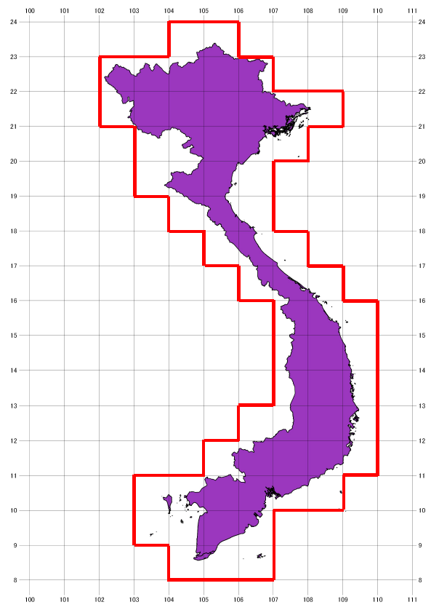
Prototype and Trial

Slide 13
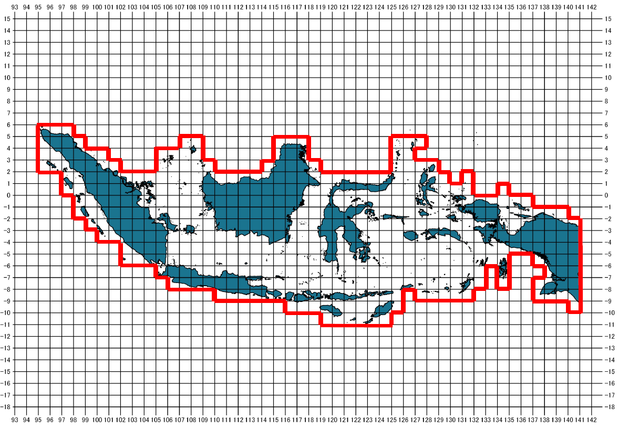
Prototype and Trial

Slide 14
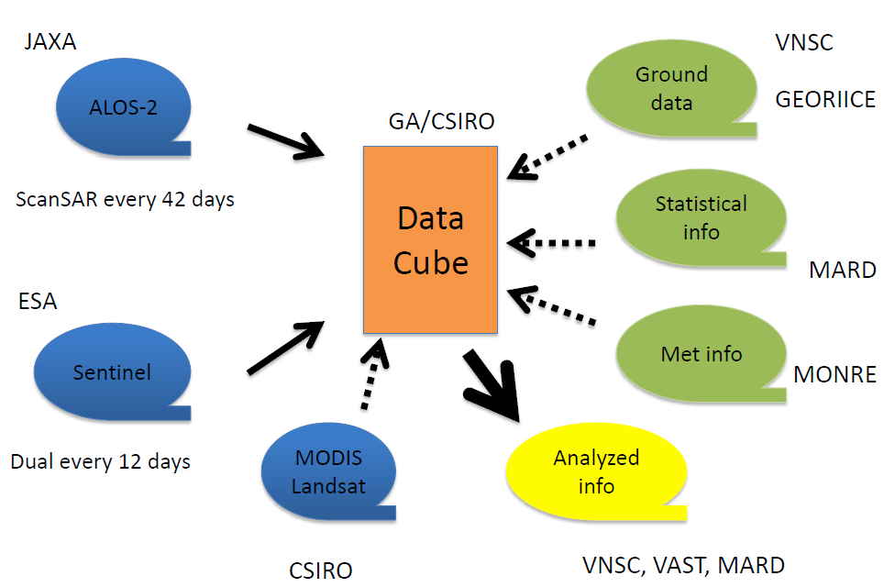
Prototype and Trial
Vietnam Data Cube scheme
under the MOU contracted with VNSC

Slide 15
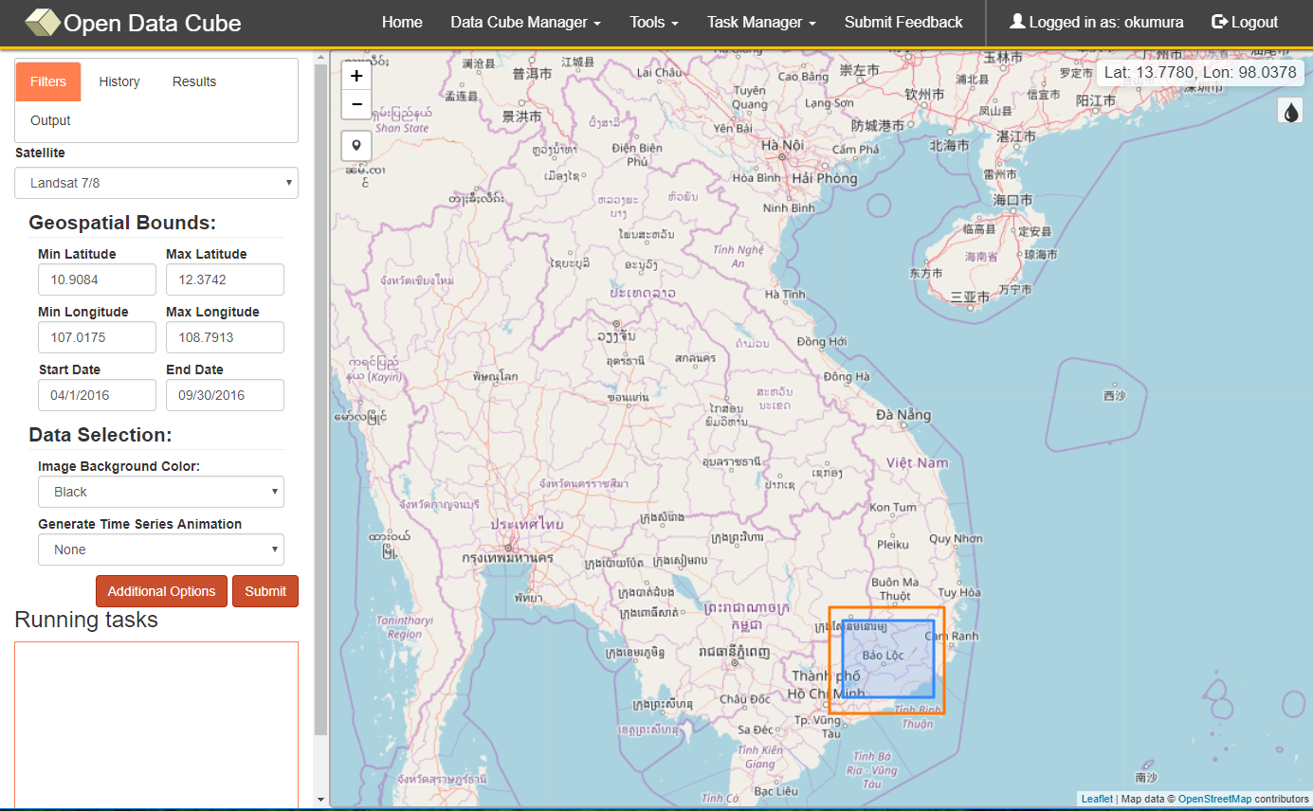
Prototype and Trial
ALOS-2 PALSAR-2
This picture is for illustration purpose

Slide 16
Summary of ARD status
JAXA has designed the ARD for ALOS-2 PALSAR-2 JJ-FAST Version.
JAXA has prototyped the ARD and provided it to Vietnam and Indonesia under the MOU.
JAXA provides not only the dataset but also rice detection tool for Vietnam data cube.

