Slide 1
Status Report on ARD Usage
LSI-VC Meeting
February 21, 2018 (14:30)
Tokyo, Japan
Brian Killough
CEOS Systems Engineering Office
NASA Langley Research Center

Slide 2
Moving toward ARD
Analysis Ready Data (ARD) is no longer a desire of global users, but is now becoming a requirement and an expectation
If we want our satellite data to get into the hands of more global users, we MUST give them ARD and make the effort
If we only give them unprocessed (Level-1) data, we are restricting our potential users to scientists and commercial entities with the resources and knowledge to handle the data
If we do not supply ARD, we also risk the use of non-ARD data being used for decision-making in inappropriate ways
All of the current CEOS-sponsored data cubes are using ARD.
CEOS, through the LSI-VC, is making great strides in the development of ARD definitions and guidelines and the world is taking notice!

Slide 3
Optical ARD Progress
Landsat
USGS is moving toward a new ”tile based” system that will produce non-overlapping ARD for easier analysis and ingestion into data cubes.
USGS has completed ARD processing for the CONUS USA. They are still processing the rest of the globe with plans for completion in late 2018.
Sentinel-2
ESA-EC is still evaluating a number of atmospheric correction algorithms. We do not believe they have chosen a single version.
The Data Cube project has been reluctant to build S2 data cubes for countries due to the complexity of producing ARD.
The Swiss Data Cube team is using S2 ARD in their data cube and completed processing with the Sen2Cor algorithm (Sentinel Toolbox).
The U.K. Catapult team has developed an open source processing method based on ARCSI that is being used for their Wales and U.K. Data Cubes.

Slide 4
Radar ARD Progress
Sentinel-1
ESA/EC does not currently produce simple ARD (gamma nought intensity) from GRD data products. Due to the large file sizes (1GB each), this is a huge burden for common users.
The production of ARD for SLC data (includes phase content) may never be possible due to its complexity and choices in processing.
Google Earth Engine has created ARD from GRD data and provides gamma-nought intensity to its users. The SEO has recently developed a script (with support from Google) that will generate a GeoTIFF export and then a data cube from these data holdings. This is currently the fastest method to achieve S1 data cubes for global users.
ALOS
JAXA only produces annual PALSAR mosaics (25 meter) ARD products, which do NOT support time series analyses or algorithm validation.
JAXA is currently funding PALSAR ARD studies ...good news
Many data cubes users have expressed the desire for L-band archive data to conduct time series analyses change detection and to validate algorithms at specific times. If such data was available, even at 30-meter scale, it would be a significant global impact.

Slide 5
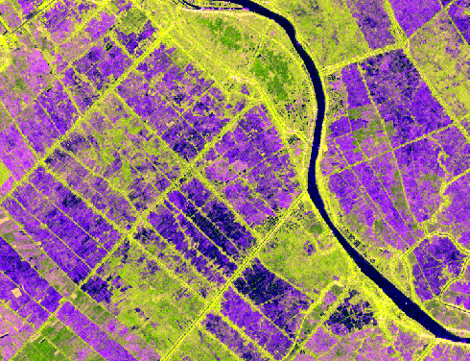
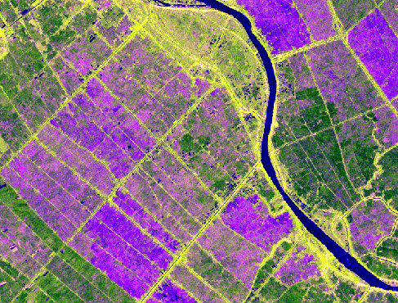
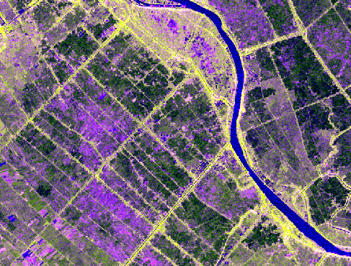
An Giang Province – Southern Vietnam
Rice crop region near Bassac River
Sentinel-1 Median Mosaic
RGB: VV – VH – VV/VH
May 2017 – Top Left
June 2017 – Top Right
July 2017 – Bottom Left
* Generated from Google Earth Engine dataset and then analyzed in QGIS

Slide 6
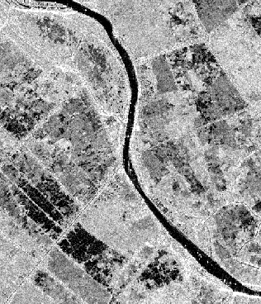
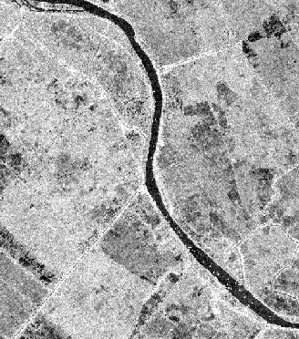
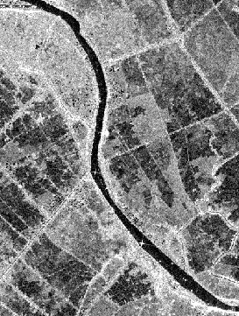
Layer 1
Layer 11
Layer 21
An Giang Province – Southern Vietnam
Rice crop region near Bassac River
Sentinel-1 Multi-Layer GeoTIFF
May to July 2017 – Gray-scale image of VV band
* Generated from Google Earth Engine and then analyzed in QGIS

Slide 7
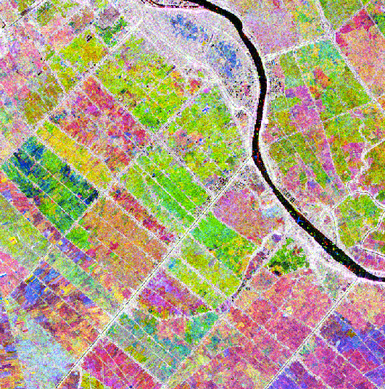
An Giang Province – Southern Vietnam
Rice crop region near Bassac River
Sentinel-1 C-Band Radar Time series composite of VV-band for May to July 2017
* Generated from Google Earth Engine and then analyzed in QGIS. It is expected these products will be available in a Data Cube format in the future.
RGB image: Red=May (Layer 1), Green=June(Layer 11), Blue=July (Layer 21)
* The variations in color are consistent with rice crop planting dates. Red areas are earlier plantings (May) and Green/Blue areas are later plantings (June/July). White areas indicate non-rice.

Slide 8
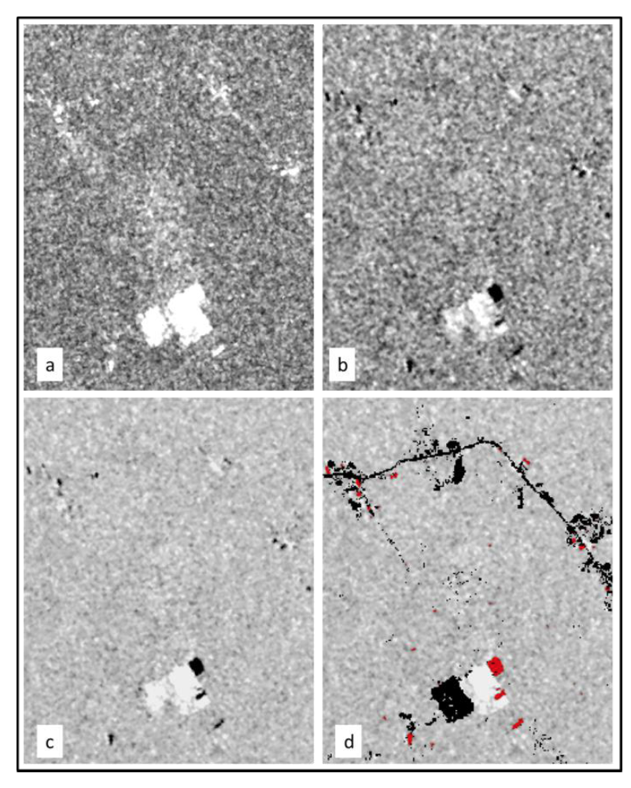
Radar Time Series Forest/Land Change (Deutscher Algorithm)
A new method to find forest/land disturbance using radar time series. Calculations are based on the dual-pol coefficient of variation and backscatter trend.
Sentinel-1 Example (left)
(a) Mean coefficient of variation (VV and VH) of entire time series
(b) Backscatter trend: (Mean of first 3 images) – (Mean of last 3 images)
(c) Product of (a)*(b)
(d) Disturbance results using a threshold value. RED = deforestation, BLACK = non-forest areas removed using GFW mask
Comments: Vegetation loss (black) and vegetation gain (white) are easily delineated in figure (c). A forest mask was applied to (d) to detect only forest loss (red).
Under Evaluation ...

