Slide 1
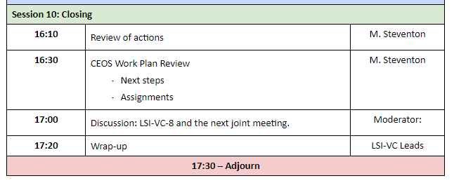
CEOS 2019-2021 Work Plan LSI-VC Deliverables
Session 10: CEOS WP Review

Slide 2
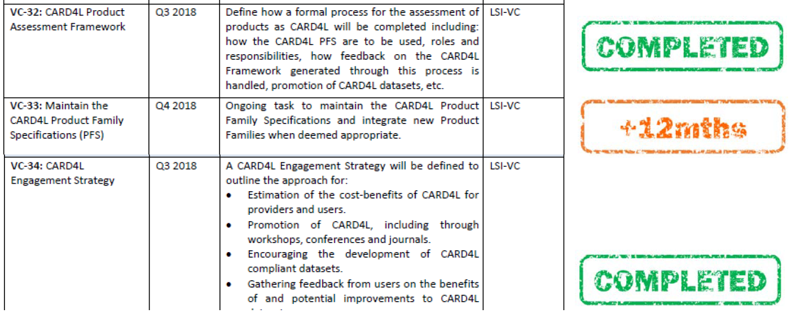
LSI-VC CEOS WP 2018-2020 deliverables

Slide 3
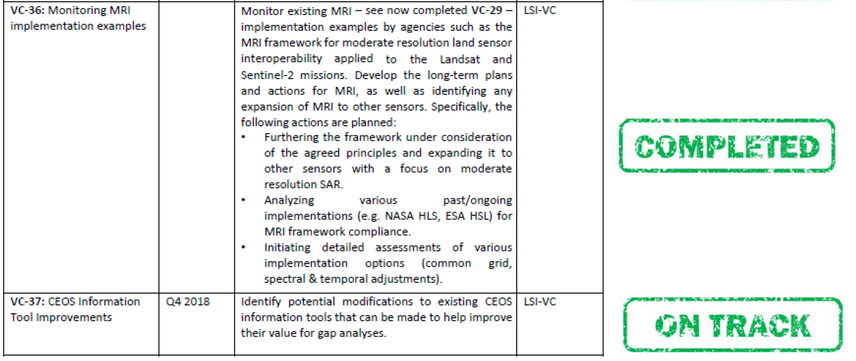
LSI-VC CEOS WP 2018-2020 deliverables

Slide 4
LSI-VC CEOS WP 2018-2020 deliverables
8 deliverables (VC-30, VC-31, VC-32, VC-33, VC-34, VC-36, VC-37, FDA-7)
4 Completed (VC-32, VC-34, VC-36, FDA-7)
1 On track (VC-37)
3 +12 months (VC-30, VC-31, VC-33)
4 deliverables carried through to 2019-2021 WP (VC-30, VC-31, VC-33, VC-37)

Slide 5
Current State of LSI-VC inputs to CEOS WP 2019-2021
VC-30 | Interoperability case study for Landsat and Sentinel-2 | Open | 2017 | 2020-Q4 | While a specific case study is formulated, this task/deliverable will include regular reporting of the outputs of the ESA-USGS bilateral discussions and work around Landsat and Sentinel-2 interoperability. | LSI-VC
VC-31 | Evaluate CARD4L among target user communities, via: – Pilot activities (e.g., with SDCG for GFOI, GEOGLAM) | Open | 2018 | 2019-Q4 | Trial production, supply, and application of CARD4L are central to the development of robust Product Family Specifications and demonstration of the value of these datasets. Pilot activities are also important outreach and promotion opportunities. The CARD4L survey provides a formal opportunity for current and potential users to input to the continual refinement of the CARD4L Specifications. This task will leverage existing CEOS involvement and relationships in the forestry and agriculture domains. | LSI-VC, SDCG-GFOI, CEOS-GEOGLAM AHWG
VC-33 | Complete Annual Update of the CARD4L Product Family Specifications | Open | 2017 | 2019-Q1 | The CARD4L Product Family Specifications are intended to be living documents, updated on an annual basis at the occasion of the first LSI-VC team meeting of the calendar year. In addition, new PFS are expected to periodically join the CARD4L portfolio. This task captures the ongoing effort of the LSI-VC in these regards. | LSI-VC | Andreia Siqueira
VC-37 | CEOS Information Tool Improvements | Open | 2018 | 2019-Q4 | Modify the CEOS MIM database to allow complex queries and gap analyses through the addition of an API. Develop a prototype online user interface using an API connected to the MIM. | LSI-VC, SEO | Brian Killough

Slide 6
Current State of LSI-VC inputs to CEOS WP 2019-2021
VC-26 | Pilot approaches to conducting integrated assessments of gaps/opportunities in mission measurements | Open | 2019 | 2020-Q4 | LSI-VC will utlize the GEOGLAM updated requirements report to asses potential gaps in current operational instruments in fulfilling measurements needed by the community. This task will only commence following the completion of VC-37. | LSI-VC and SEO with GEOGLAM
 | Formally define the term ‘interoperable’ in the context of the Moderate Resolution Interoperability (MRI) Initiative | Open | 2019 | 2019-Q2 | There is a broad spectrum of definitions of ‘interoperable’. An agreed and documented formal definition is needed before further work can be done on VC-30. | LSI-VC | Steve Labahn
 | Complete Initial CARD4L Product Assessments | Open | 2019 | 2019-Q4 | LSI-VC and WGCV have agreed a process for the assessment of data products as CARD4L. There are two components to this process: a self-assessment against the CARD4L PFS by the data provider, and secondly, a peer review undertaken by WGCV in collaboration with LSI-VC. This task captures the ongoing effort of the WGCV and LSI-VC. | LSI-VC, WGCV | Andreia Siqueira

Slide 7
Current State of LSI-VC inputs to CEOS WP 2019-2021
 | Pursue CEOS ARD promotion, including via continuation and expansion of the CARD4L survey | Open | 2018 | 2019-Q4 | LSI-VC will undertake a number of tasks regarding the promotion of CARD4L, including: 1. Develop an information pack capturing the key value of CARD4L, using the CARD4L information notes as a basis. 2. Communicate actively with the commercial sector using the information pack and networks including UK Catapult, DIAS providers, and EARSC. 3. Increase communication with remote sensing agencies, scientists, and commercial providers through the ESA Living Planet Symposium, IGARSS, the ESA Ground Segment Coordination Body (GSCB), and other forums such as the World Geospatial Forum. 4. Act on the suggestions from the CARD4L survey. 5. Promote datasets via the CEOS ARD website (i.e., the CARD4L stocktake) and also through the relevant WGISS systems (e.g., Connected Data Assets (CDA)). | LSI-VC, WGISS | Adam Lewis
 | Open-source library for surface reflectance product generation | Open | 2019 | 2020-Q4 | Publish an open-source software library for the generation of CARD4L surface reflectance products. The main focus will be on sen2like/HLS type processing modules. Any agency can contribute to the library, and it could potentially be open to private sector contributions. | LSI-VC | Ferran Gascon

Slide 8
Current State of LSI-VC inputs to CEOS WP 2019-2021
Four continuing deliverables:
VC-30: (lead person?) Interoperability case study for Landsat and Sentinel-2
VC-31: (lead person?) Evaluate CARD4L among target user communities, via: – Pilot activities (e.g., with SDCG for GFOI, GEOGLAM)
VC-33: (Andreia) Complete Annual Update of the CARD4L Product Family Specifications
VC-37: (Brian) CEOS Information Tool Improvements

Slide 9
Current State of LSI-VC inputs to CEOS WP 2019-2021
Five new deliverables:
Pilot approaches to conducting integrated assessments of gaps/opportunities in mission measurements (lead person?)
Formally define the term ‘interoperable’ in the context of the Moderate Resolution Interoperability (MRI) Initiative (Steve L)
Complete Initial CARD4L Product Assessments (Andreia)
Pursue CEOS ARD promotion, including via continuation and expansion of the CARD4L survey (Adam)
Open-source library for surface reflectance product generation (Ferran)

Slide 10
Other WP issues/decisions for LSI-VC
AGRI-12
Can AGRI-12 be included as a deliverable on “LSI-VC and CEOS AHWG on GEOGLAM”?
AGRI-12: | Characterize requirements and describe work plan for developing long-term interoperable moderate resolution surface reflectance (or NDVI) | Open | 2019 | 2020-Q1 | A work plan will be established by LSI-VC and CEOS AHWG on GEOGLAM. This is not a task to develop the dataset itself! A requirement across multiple vegetation monitoring communities is long-term NDVI time series. With the data deluge resulting from Sentinel-2 and Landsat-8, there are ample opportunities to move this method into the moderate resolution domain. To maximize value, it should be made interoperable with historical observations in the 250-1000m resolution time series.

Slide 11
Summary of LSI-VC CEOS WP input required ASAP
Confirm deliverable status as described in this slideset
Provide lead person names for VC-30, VC-31, “Pilot approaches … gaps/opportunities”
State LSI-VC position on AGRI-12 as proposed by GEOGLAM Ad-hoc WG

