Slide 1
SR Self Assessment for CARD4L - Geoscience Australia
Medhavy Thankappan
Contributors: Lan-Wei Wang, Simon Oliver, Josh Sixsmith, Imam Alam, Passang Dorji, Alex Vincent, Jeremy Hooke, Andreia Siqueira

Slide 2
SR self assessment against CARD4L
Self assessment of surface reflectance products derived from Landsat and Sentinel-2 done at GA (October 2018)
Report of compliance / non-compliance against threshold and target CARD4L specifications for Landsat and Sentinel-2 prepared
Feedback provided to LSI-VC about experience with the process, description of the metadata parameters and need for examples in some cases, along with self assessment outcomes.
Sought feedback about CARD4L specifications for SR from WGCV membership and received written feedback from N Fox on potential improvements (TBD at WGCV plenary in July)

Slide 3
Self assessment outcome for Landsat SR

Slide 4
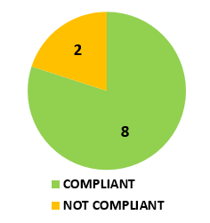
THRESHOLD Specifications on “General Metadata”
# | Item | Threshold | Comments
1.1 | Traceability | Not required
1.2 | Metadata machine readability | YES
1.3 | Data Collection Time | YES
1.4 | Geographical area | YES | Current metadata document contains a polygon detailing the valid metadata extents
1.5 | Coordinate reference system | YES
1.6 | Map Projection | YES
1.7 | Geometric correction methods | Not required
1.8 | Geometric accuracy of the data | Not required
1.9 | Instrument | YES
1.10 | Spectral bands | NOT compliant | Requirement: The central wavelength for each band for which data is included is identified in the metadata, expressed in SI units Can spectral response details be added into CEOS Missions, Instruments and Measurements Database?
1.11 | Sensor Calibration | Not required
1.12 | Radiometric Accuracy | Not required
1.13 | Algorithms | YES
1.14 | Ancillary data | YES
1.15 | Processing chain provenance | Not required
1.16 | Data access | NOT compliant | Requirement: The metadata identifies the location from where the product can be retrieved, expressed as a DOI. Our metadata does not identify the location from where the product can be retrieved, DOI-linked or otherwise.
1.17 | Overall Data quality | Not required
7 Not required
8/10 COMPLIANT
2/10 NOT COMPLIANT

Slide 5
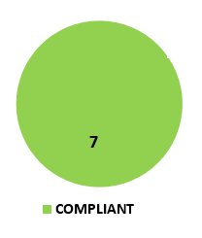
THRESHOLD Specifications on “Per-pixel Metadata”
# | Item | Threshold
2.1 | Metadata machine readability | YES
2.2 | No data | YES
2.3 | Incomplete testing | YES
2.4 | Saturation | YES
2.5 | Cloud | YES
2.6 | Cloud Shadow | YES
2.7 | Land/Water mask | Not required
2.8 | Snow/ice mask | Not required
2.9 | Terrain Shadow Mask | Not required
2.10 | Terrain occlusion | Not required
2.11 | Illumination and viewing geometry | YES
2.12 | Aerosol optical depth parameters | Not required
5 Not required
7/7 COMPLIANT

Slide 6
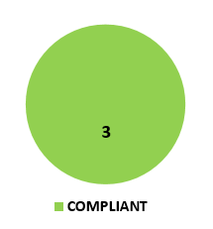
THRESHOLD Specifications on “Radiometric and Atmospheric corrections”
3 Not required
# | Item | Threshold | Comments
3.1 | Measurement | YES
3.2 | Measurement uncertainty | Not required
3.3 | Measurement Normalization | Not required
3.4 | Directional Atmospheric Scattering | YES
3.5 | Water vapour corrections | YES
3.6 | Ozone Correction | Not required
3/3 COMPLIANT

Slide 7
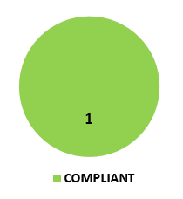
THRESHOLD Specifications on “Geometric corrections”
# | Item | Threshold | Comments
4.1 | Geometric correction | YES | Sub-pixel accuracy is achieved through the use of available GQA record
1/1 COMPLIANT

Slide 8
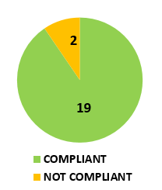
Landsat SR: THRESHOLD specifications - summary
“General Metadata”:
8/10
“Per-pixel metadata”:
7/7
“Radiometric and atmospheric corrections”:
3/3
“Geometric corrections”:
1/1

Slide 9
TARGET Specifications on “General Metadata”
# | Item | Target/Desired | Comments
1.1 | Traceability | NO
1.2 | Metadata machine readability | NO
1.3 | Data Collection Time | YES
1.4 | Geographical area | YES
1.5 | Coordinate reference system | YES
1.6 | Map Projection | YES
1.7 | Geometric correction methods | NO | Metadata includes ancillary data set such as elevation model(s), but DOI is not used.
1.8 | Geometric accuracy of the data | YES
1.9 | Instrument | NO | No CEOS MIM database reference at this time
1.10 | Spectral bands | NO | Can spectral response details be added into CEOS MIM database
1.11 | Sensor Calibration | NO
1.12 | Radiometric Accuracy | NO
1.13 | Algorithms | YES
1.14 | Ancillary data | YES
1.15 | Processing chain provenance | NO
1.16 | Data access | NO
1.17 | Overall Data quality | YES

Slide 10
TARGET Specifications on:
“Per-pixel Metadata”
“Radiometric and Atmospheric corrections”
# | Item | Target/Desired
2.1 | Metadata machine readability | NO
2.2 | No data | YES
2.3 | Incomplete testing | YES
2.4 | Saturation | NO
2.5 | Cloud | NO
2.6 | Cloud Shadow | NO
2.7 | Land/Water mask | NO
2.8 | Snow/ice mask | NO
2.9 | Terrain Shadow Mask | YES
2.10 | Terrain occlusion | YES
2.11 | Illumination and viewing geometry | YES
2.12 | Aerosol optical depth parameters | YES
# | Item | Target/Desired | Comments
3.1 | Measurement | NO
3.2 | Measurement uncertainty | NO
3.3 | Measurement Normalization | YES
3.4 | Directional Atmospheric Scattering | YES
3.5 | Water vapour corrections | YES
3.6 | Ozone Correction | YES
“Geometric Correction”
# | Item | Target/Desired
4.1 | Geometric correction | YES

Slide 11
Landsat SR: TARGET specifications - summary
“General Metadata”:
9/17
“Per-pixel metadata”:
6/12
“Radiometric and atmospheric corrections”:
4/6
“Geometric corrections”:
1/1

Slide 12
Self assessment outcome for Seninel-2 SR

Slide 13
THRESHOLD Specifications on “General Metadata”
# | Item | Threshold | Comments
1.1 | Traceability | Not required
1.2 | Metadata machine readability | YES
1.3 | Data Collection Time | YES
1.4 | Geographical area | YES | Current metadata document contains a polygon detailing the valid metadata extents
1.5 | Coordinate reference system | YES
1.6 | Map Projection | YES
1.7 | Geometric correction methods | Not required
1.8 | Geometric accuracy of the data | Not required
1.9 | Instrument | YES
1.10 | Spectral bands | NOT compliant | Requirement: The central wavelength for each band for which data is included is identified in the metadata, expressed in SI units Can spectral response details be added into CEOS Missions, Instruments and Measurements Database?
1.11 | Sensor Calibration | Not required
1.12 | Radiometric Accuracy | Not required
1.13 | Algorithms | YES
1.14 | Ancillary data | YES
1.15 | Processing chain provenance | Not required
1.16 | Data access | NOT compliant | Requirement: The metadata identifies the location from where the product can be retrieved, expressed as a DOI. Our metadata does not identify the location from where the product can be retrieved, DOI-linked or otherwise.
1.17 | Overall Data quality | Not required
7 Not required
8/10 COMPLIANT
2/10 NOT COMPLIANT

Slide 14
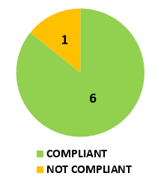
THRESHOLD Specifications on “Per-pixel Metadata”
# | Item | Threshold
2.1 | Metadata machine readability | YES
2.2 | No data | YES
2.3 | Incomplete testing | YES
2.4 | Saturation | NO
2.5 | Cloud | YES
2.6 | Cloud Shadow | YES
2.7 | Land/Water mask | Not required
2.8 | Snow/ice mask | Not required
2.9 | Terrain Shadow Mask | Not required
2.10 | Terrain occlusion | Not required
2.11 | Illumination and viewing geometry | YES
2.12 | Aerosol optical depth parameters | Not required
5 Not required
6/7 COMPLIANT
1/7 NOT COMPLIANT

Slide 15
THRESHOLD Specifications on “Radiometric and Atmospheric corrections”
3 Not required
# | Item | Threshold | Comments
3.1 | Measurement | YES
3.2 | Measurement uncertainty | Not required
3.3 | Measurement Normalization | Not required
3.4 | Directional Atmospheric Scattering | YES
3.5 | Water vapour corrections | YES
3.6 | Ozone Correction | Not required
3/3 COMPLIANT

Slide 16
THRESHOLD Specifications on “Geometric corrections”
# | Item | Threshold | Comments
4.1 | Geometric correction | YES | Sub-pixel accuracy is achieved through the use of available GQA record
1/1 COMPLIANT

Slide 17
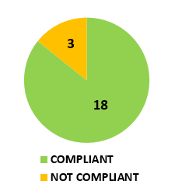
Sentinel-2 SR: THRESHOLD specifications - summary
“General Metadata”:
8/10
“Per-pixel metadata”:
6/7
“Radiometric and atmospheric corrections”:
3/3
“Geometric corrections”:
1/1

Slide 18
TARGET Specifications on “General Metadata”
# | Item | Target/Desired | Comments
1.1 | Traceability | NO
1.2 | Metadata machine readability | NO
1.3 | Data Collection Time | YES
1.4 | Geographical area | YES
1.5 | Coordinate reference system | YES
1.6 | Map Projection | YES
1.7 | Geometric correction methods | NO | Metadata includes ancillary data set such as elevation model(s), but DOI is not used.
1.8 | Geometric accuracy of the data | YES
1.9 | Instrument | NO | No CEOS MIM database reference at this time
1.10 | Spectral bands | NO | Can spectral response details be added into CEOS MIM database
1.11 | Sensor Calibration | NO
1.12 | Radiometric Accuracy | NO
1.13 | Algorithms | YES
1.14 | Ancillary data | YES
1.15 | Processing chain provenance | NO
1.16 | Data access | NO
1.17 | Overall Data quality | YES

Slide 19
TARGET Specifications on:
“Per-pixel Metadata”
“Radiometric and Atmospheric corrections”
# | Item | Target/Desired
2.1 | Metadata machine readability | NO
2.2 | No data | YES
2.3 | Incomplete testing | YES
2.4 | Saturation | NO
2.5 | Cloud | NO
2.6 | Cloud Shadow | NO
2.7 | Land/Water mask | NO
2.8 | Snow/ice mask | NO
2.9 | Terrain Shadow Mask | YES
2.10 | Terrain occlusion | YES
2.11 | Illumination and viewing geometry | YES
2.12 | Aerosol optical depth parameters | YES
# | Item | Target/Desired | Comments
3.1 | Measurement | NO
3.2 | Measurement uncertainty | NO
3.3 | Measurement Normalization | YES
3.4 | Directional Atmospheric Scattering | YES
3.5 | Water vapour corrections | YES
3.6 | Ozone Correction | YES
“Geometric Correction”
# | Item | Target/Desired
4.1 | Geometric correction | YES

Slide 20
Sentinel-2 SR: TARGET specifications - summary
“General Metadata”:
9/17
“Per-pixel metadata”:
6/12
“Radiometric and atmospheric corrections”:
4/6
“Geometric corrections”:
1/1

Slide 21
Thank you

