Slide 1
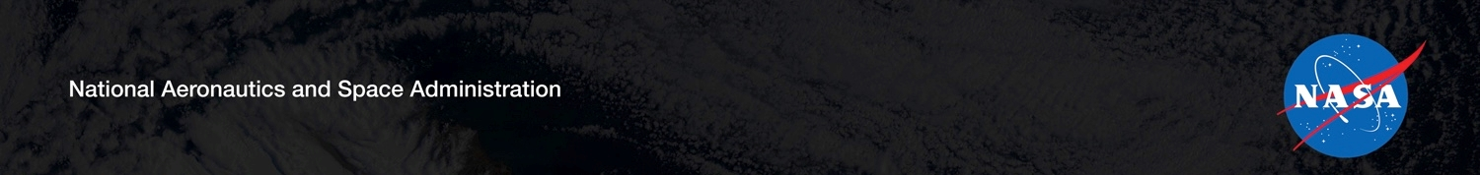
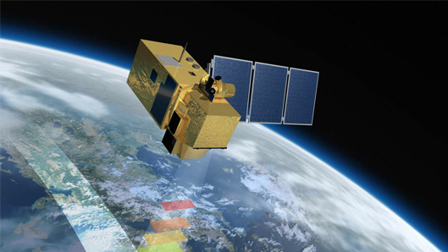
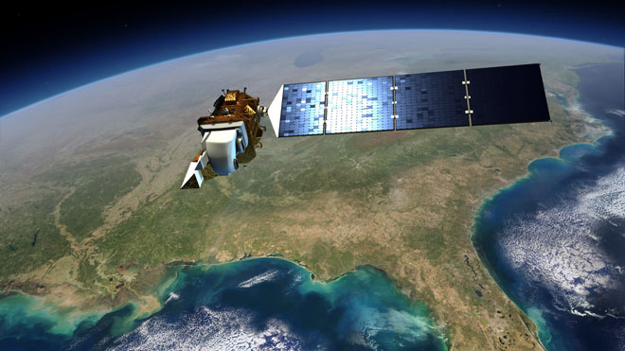
Future US Land Imaging
Jeffrey Masek, NASA GSFC
Harmonized Landsat/Sentinel-2 (HLS) Update
Jeffrey Masek¹, Junchang Ju², Jean-Claude Roger², Sergii Skakun², Belen Franch², Chris Justice²
(1) NASA GSFC, (2) Univ. of Maryland
NASA Agency Update – CEOS LSI-VC-2
July 20-22, 2016
Dave Jarrett, NASA HQ
Jeff Masek, NASA GSFC
Presentation contains modified Copernicus Sentinel data (2015-18) processed by ESA

Slide 2
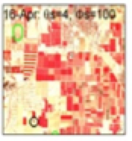
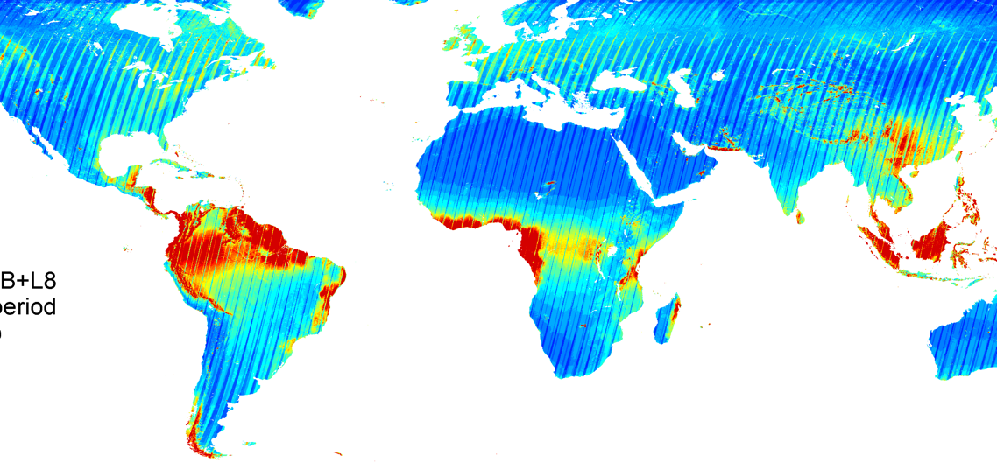
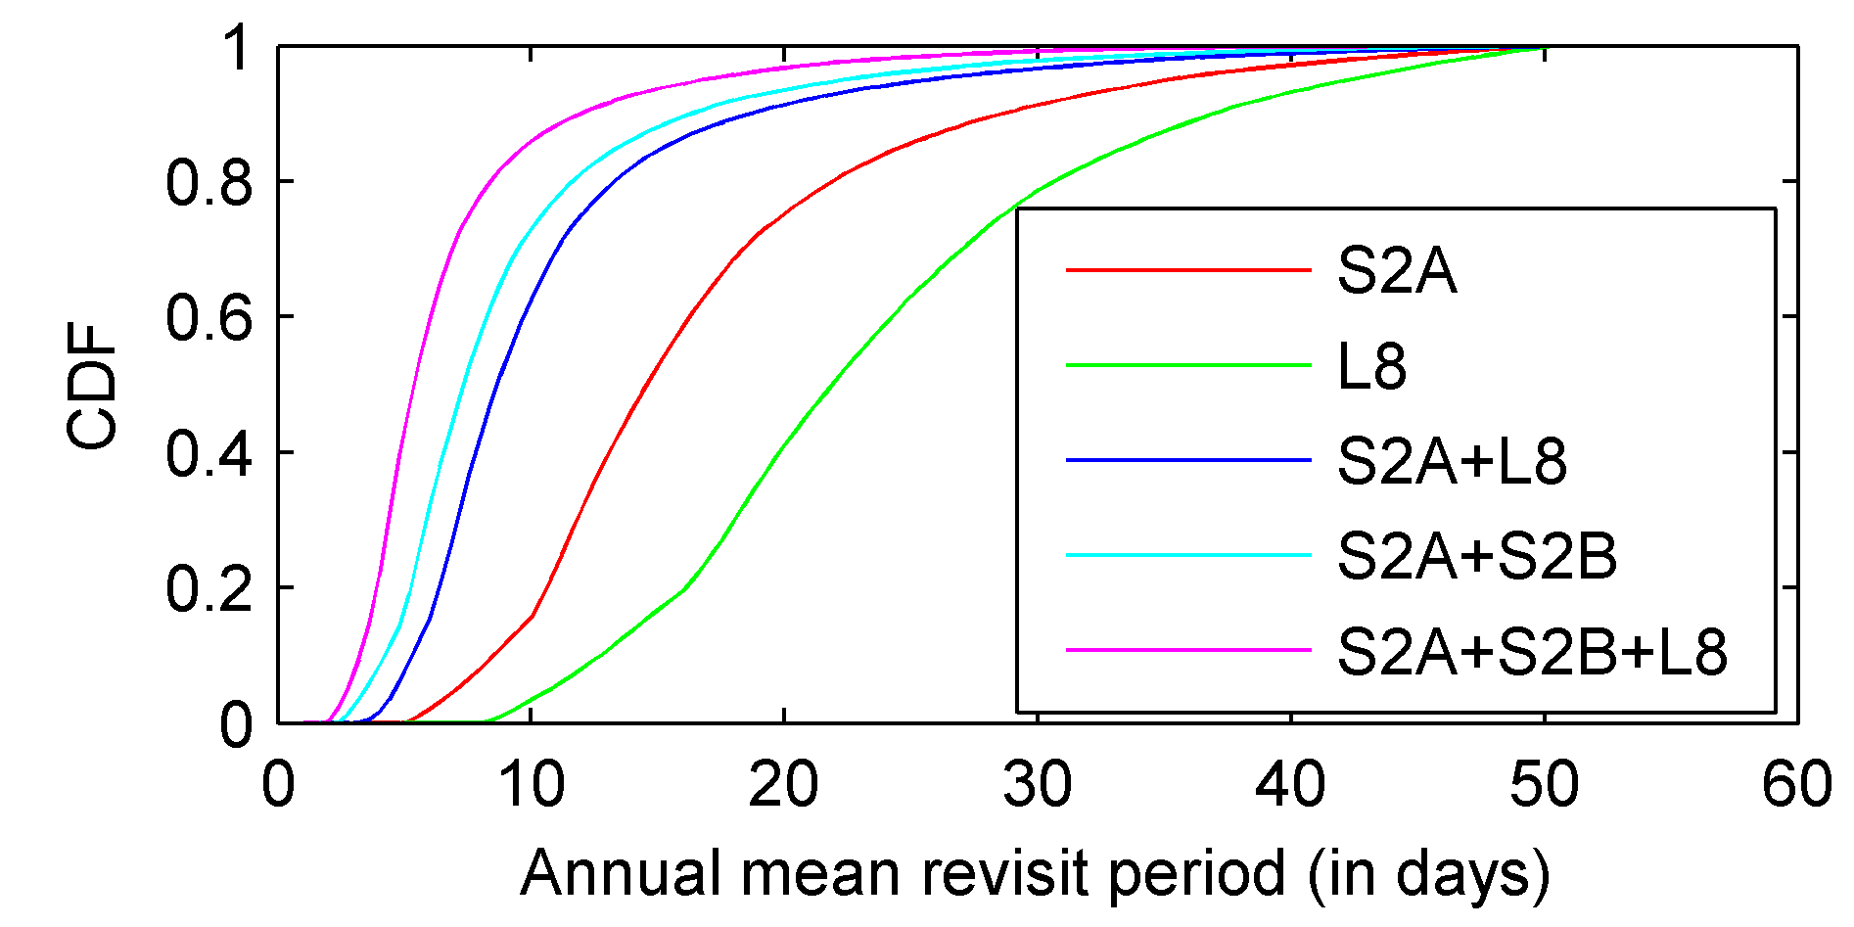
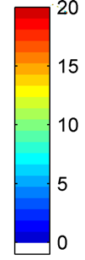
Harmonized Landsat Sentinel-2 (HLS) Project
Merging Sentinel-2 and Landsat data streams can provide 2-3 day global coverage
Goal is “seamless” near-daily 30m surface reflectance record including atmospheric corrections, spectral and BRDF adjustments, regridding
Project initiated in 2012 as collaboration among NASA GSFC, UMD, NASA Ames
Prototype for a multi-sensor Analysis Ready Data product
Potential Revisit using
different Virtual Constellations
S2A+S2B+L8 Mean Revisit period (in days)
Cloud free

Slide 3
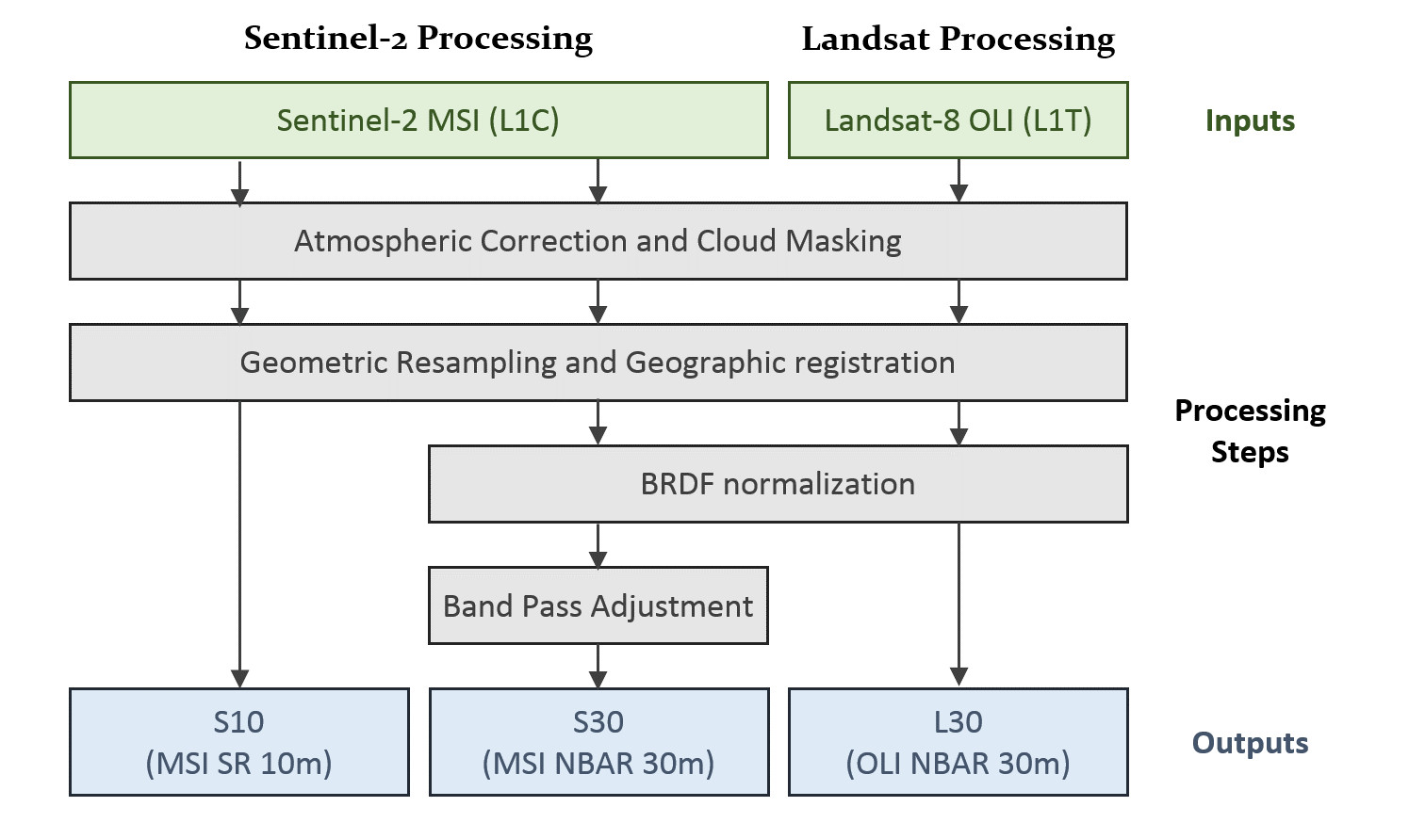
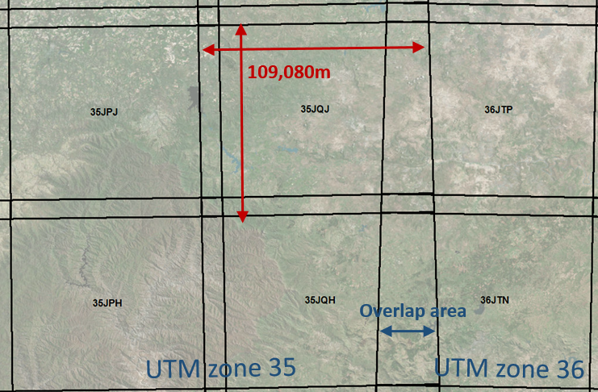
HLS Main specs and Algorithm Flow
All 3 products are aligned on the MGRS S2 Tiles system following UTM zones
S10 (from Sentinel-2)
Spatial: 10m, 20m, 60m
Spectral Bands: All MSI
NBAR: No
S30 (from Sentinel-2)
Spatial: 30m
Spectral Bands: OLI-like + MSI Red Edge
NBAR: Yes
L30 (from Landsat 8)
Spatial: 30m
Spectral Bands: All OLI
NBAR: Yes
Atmospheric Correction | LaSRC/6S approach (image-based aerosol) | Vermote et al. (2016)
BRDF normalization | C-factor technique with the global constant coefficients | Roy et al. (2016)
Spectral bandpass | Linear regression using global training set from EO-1 Hyperion | Claverie et al., (in review)
Cloud/shadow mask | Landsat 8: output from LaSRC; Sentinel-2: Boston University Fmask algorithm | Vermote et al. (2016); Zhu et al. (2015)
Geographic registration | AROP: automated registration and orthorectification package | Gao et al. (2009)

Slide 4
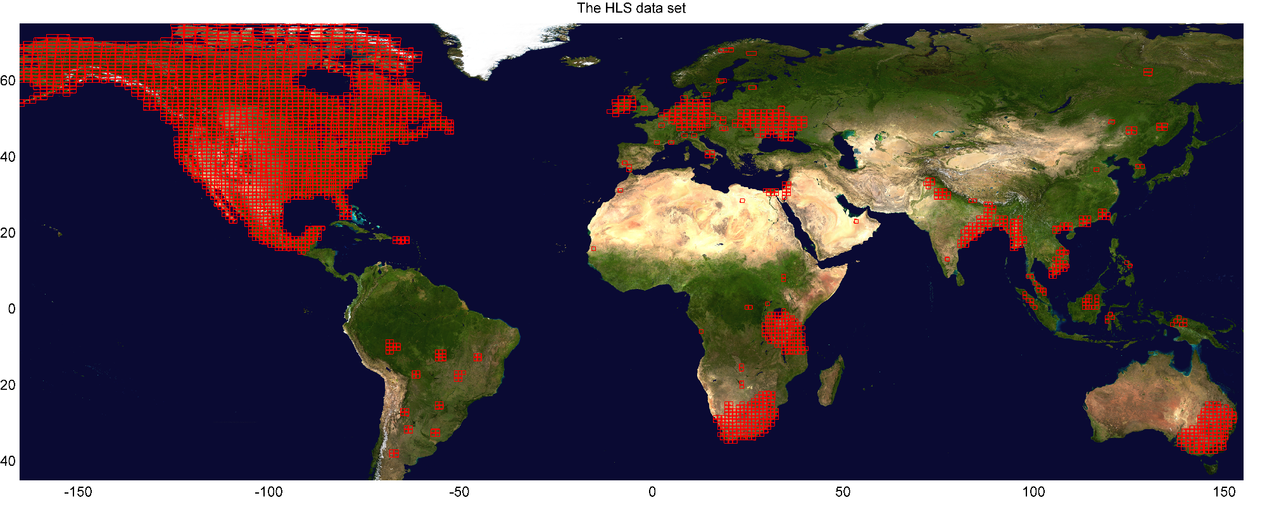
HLS (v1.4) Data Set (released Nov 2018)
Landsat-8 data set: 1,100k products From Mar-2013 to Present (135 TB)
Sentinel-2 data set: 420k products From Jun-2015 to Present (60 + 274 TB)
105 Global Test Sites (3904 MGRS tiles)
>37 million sq. km2 (~25% global land)
< 7 day latency

Slide 5

Cloud Processing Approach: AWS & AMCE
Initially HLS was processed via NASA Ames NEX computing cluster
With Version 1.4, HLS has migrated to Amazon Web Services (AWS) via NASA Earth Sciences Technology Office (ESTO) AIST Managed Cloud Environment (AMCE)

Slide 6
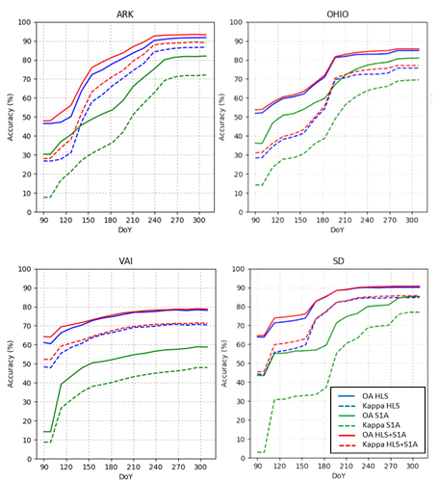
HLS Application to Crop Type Mapping
Torbick, N., X. Huang, B. Ziniti, D. Johnson, J. Masek, and M. Reba, Fusion of Moderate Resolution Earth Observations for Operational Crop Type Monitoring, Remote Sensing, 10, 2018.
Compared crop type maps generated using three satellite time series:
  Sentinel-1a SAR
  HLS optical
  S1a + HLS
Training data from USDA Cropland Data Layer using Random Forests classifier
HLS optical time series consistently perform better than Sentinel-1 SAR time series

Slide 7

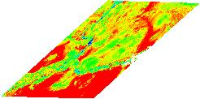
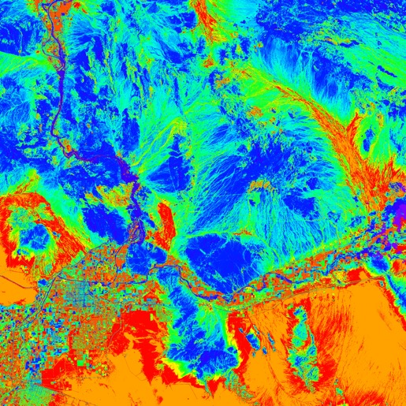
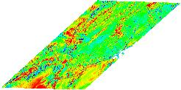
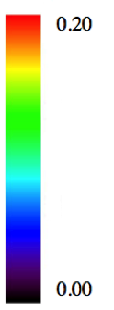
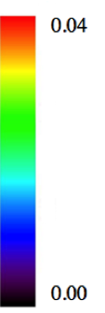
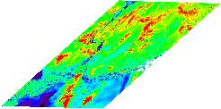
New BRDF and Albedo Retrieval (Belen Franch, UMD)
MODIS BRDF
(1000m spatial resolution)
VJB method (Vermote et al., 2009)
HLS classification
(30m spatial resolution)
Unsupervised using all bands
INPUTS
Red band
HLS
0.3
k0
k2
0.25
0.08
k1
Convert to sinusoidal projection
Franch, B., Vermote, E. F., and Claverie, M. (2014). Intercomparison of landsat albedo retrieval techniques and evaluation against in situ measurements across the US SURFRAD network. Remote Sens. Environ. 152, 627–637. doi: 10.1016/j.rse.2014.07.019

Slide 8
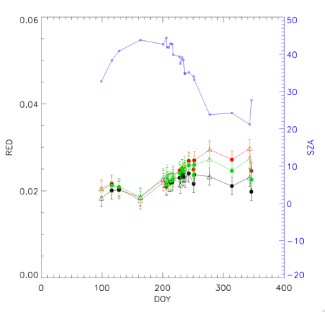
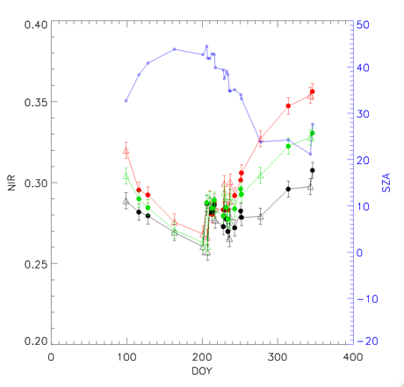
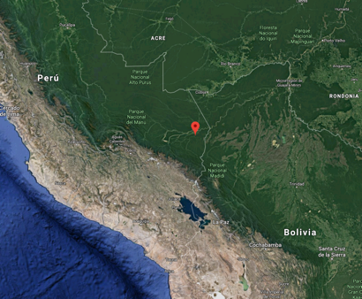
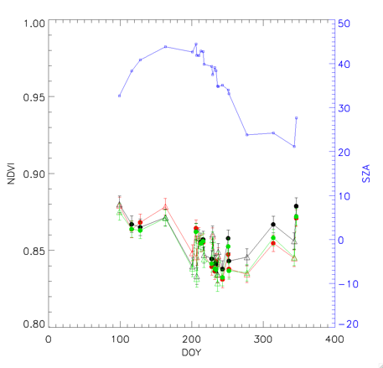
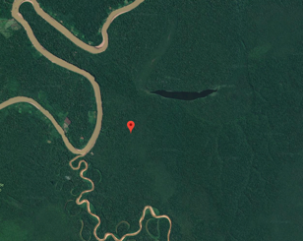
RESULTS
Surface Reflectance Normalization. Homogeneous Amazon site
Red: non-corrected
Green: current HLS BRDF correction
Black: Proposed BRDF correction
CV (%) | RED | NIR | NDVI
Non corrected | 11.4 | 8.3 | 1.6
Current HLS BRDF correction | 9.3 | 6.0 | 1.6
Proposed BRDF correction | 7.6 | 4.5 | 1.6

Slide 9
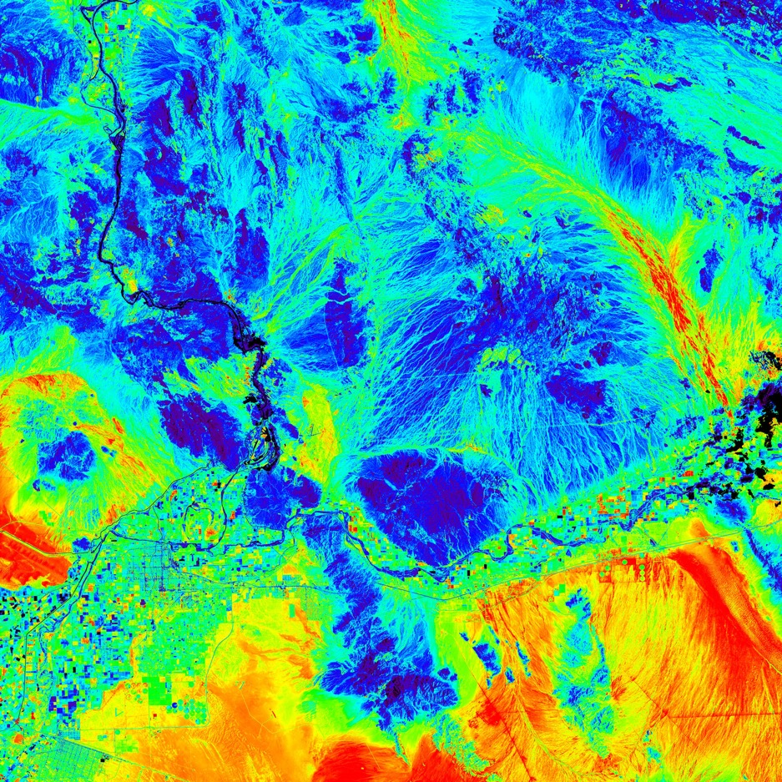
Surface albedo at HLS spatial resolution
HLS Broadband Blue Sky Albedo
0.33
0.10
Yuma 06/20/2017

Slide 10
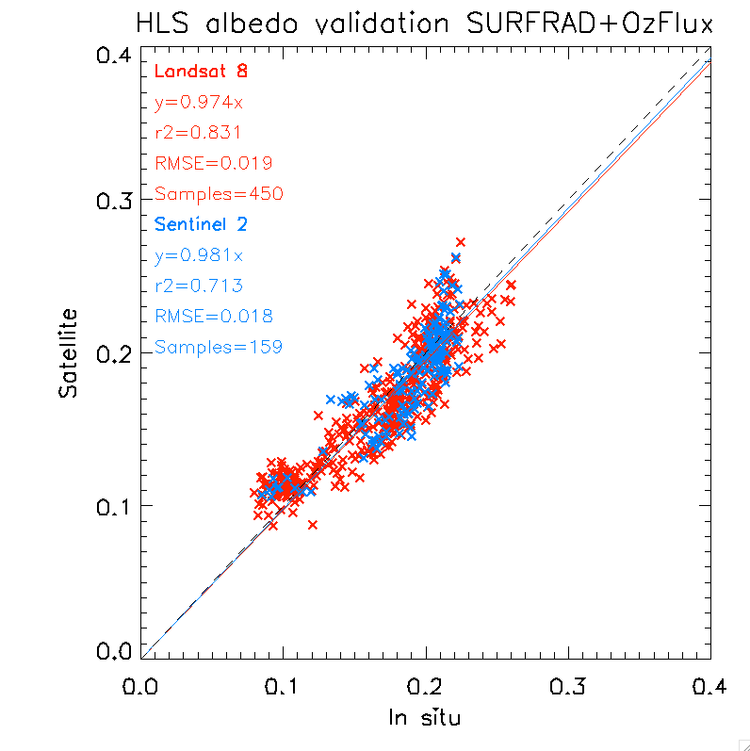
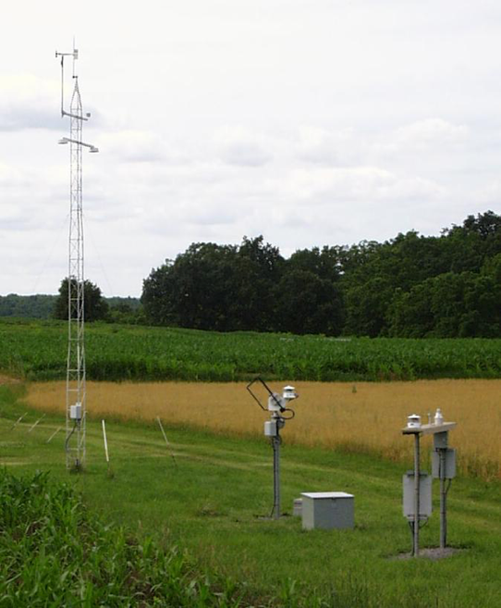
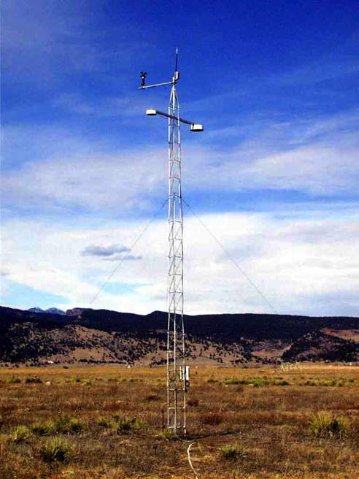
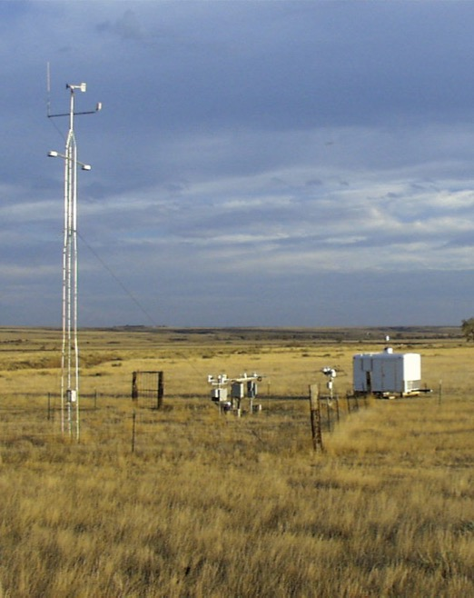
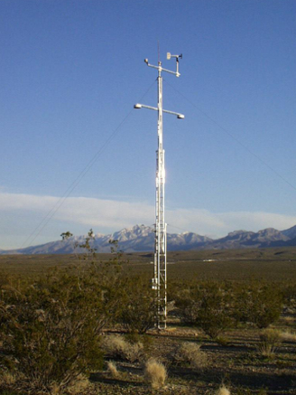
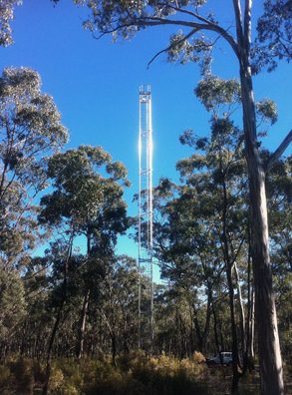
Albedo Estimation from HLS (Belen Franch, UMD)
Convert HLS directional reflectance to hemispheric albedo via spectral unmixing and application of MODIS BRDF kernels
Validation using US SURFRAD and Australia OZFLUX albedometer data
US
SURFRAD
Australia
OZFLUX

Slide 11
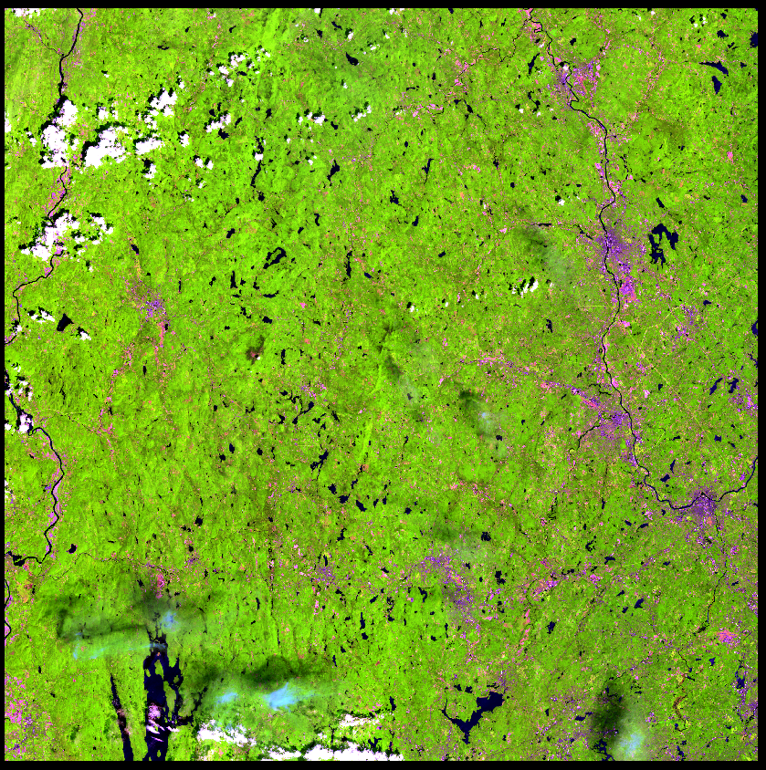
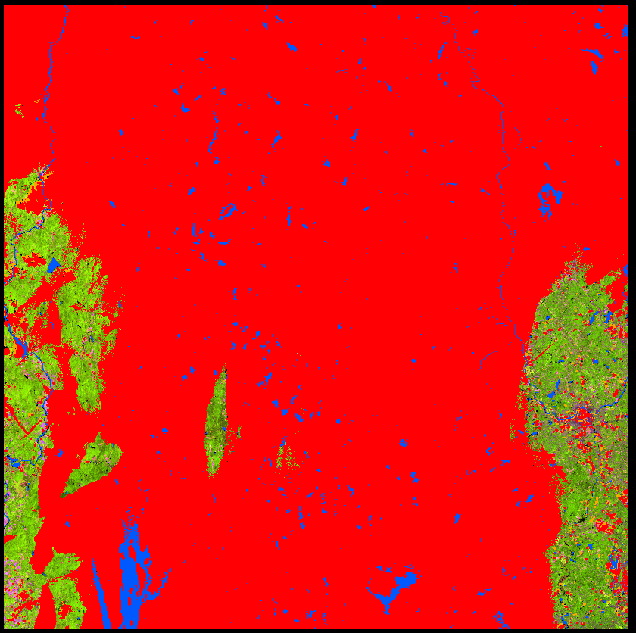
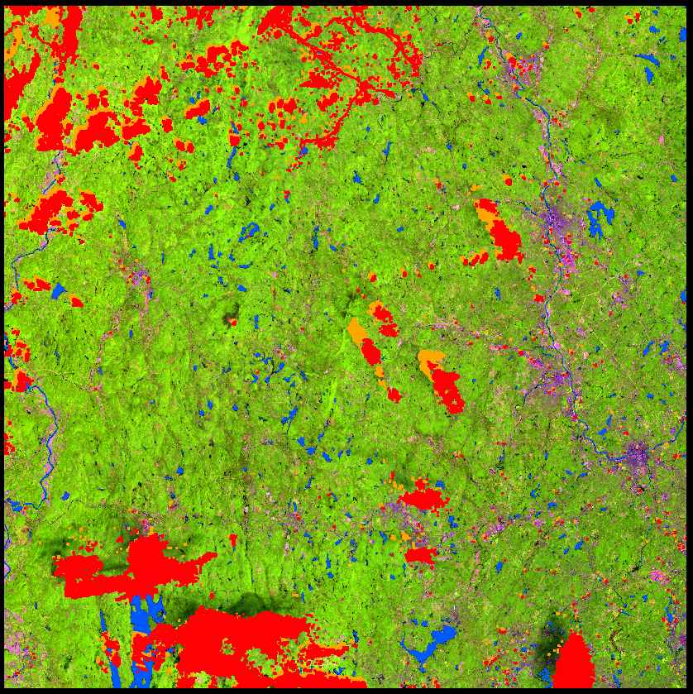
HLS S30 Cloud Mask Error (v1.4)
HLS.S30.18TYN.2018163.3
5/4/3 Composite
V1.4 QA flags
Fmask 4.0
Shadow
Cloud
Snow
Courtesy D. Bolton, Boston U.

Slide 12
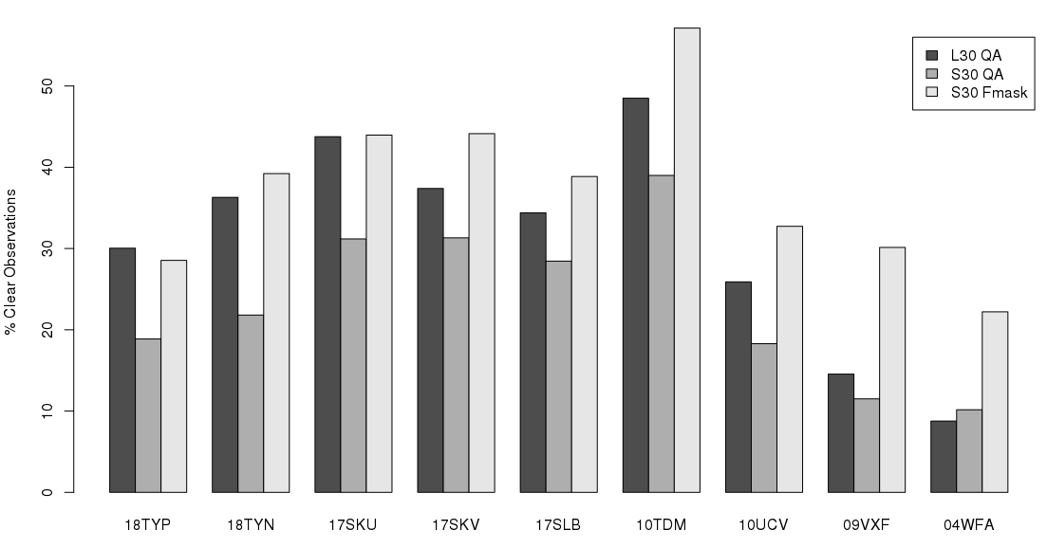
% Clear observations 2016-2018 (Calculated for full tile area)
Higher % clear observations for S30 Fmask (typically more in line with L30 QA). But in some cases, S30 Fmask is much higher than L30 QA. Need to investigate why. I suspect it has to do with snow (09VXF and 04WFA are both high latitude)

Slide 13
HLS Evolution
Now developing version 1.5
  Improved BRDF approach
    View angle and solar angle normalization via Franch (2014, 2018) approach
    Option for view angle ONLY via Roy et al (2016) fixed coefficients
  Fixing cloud mask issues – investigating Fmask 4.0 algorithm of Zhu
  Targeting end-2019
NASA Earth Science Data Systems planning to support global HLS implementation beginning in 2020
  Product need documented by Interagency Satellite Needs Working Group
  Processing will migrate to USG data system – exact location TBD

Slide 14
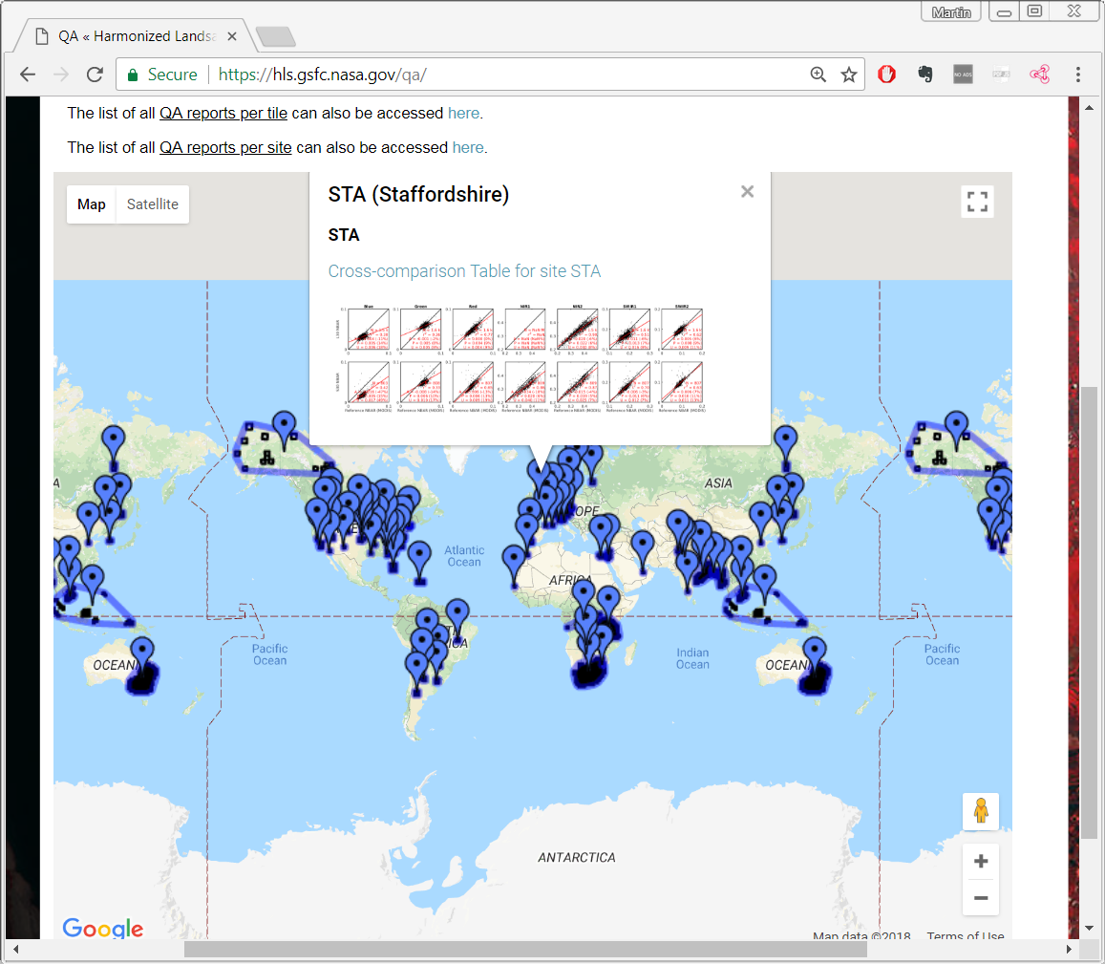
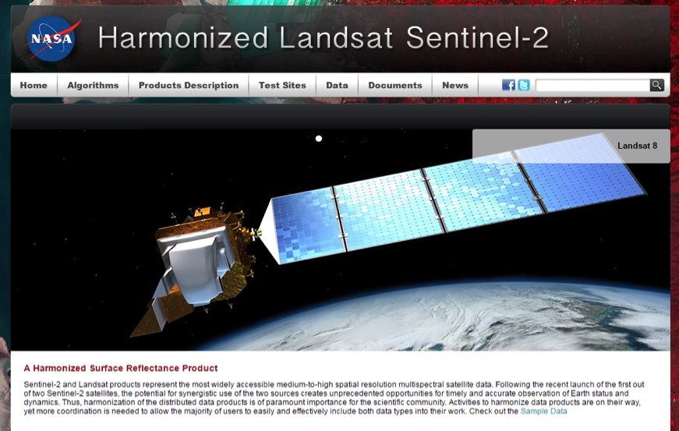
Website and Public Interface
https://hls.gsfc.nasa.gov
Public access
S30, L30 data available (via HTTPS)
QA, Product documentation
Products also available via S3 storage for AWS users

Slide 15
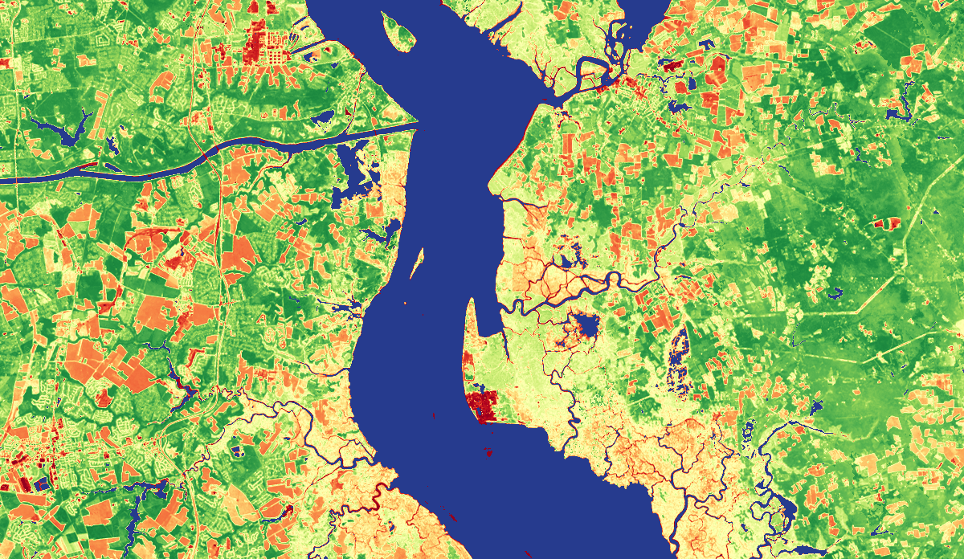
Thank You
Delaware / New Jersey

