Slide 1



LSI-VC MRI
Landsat-S2 ARD Interoperability Working Group
F. Gascon & S. Labahn
15 Feb 2019, VNSC, Hanoi, Vietnam
Notes:
15 min
Friday 10:50

Slide 2

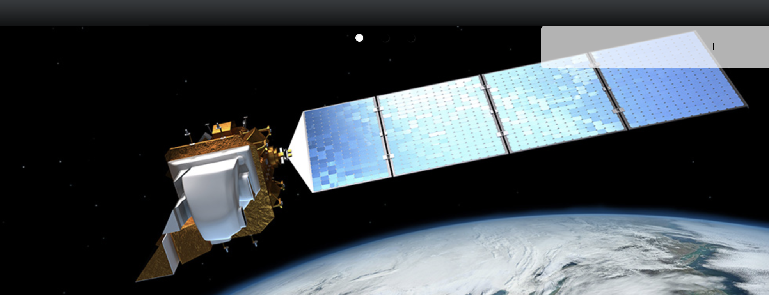
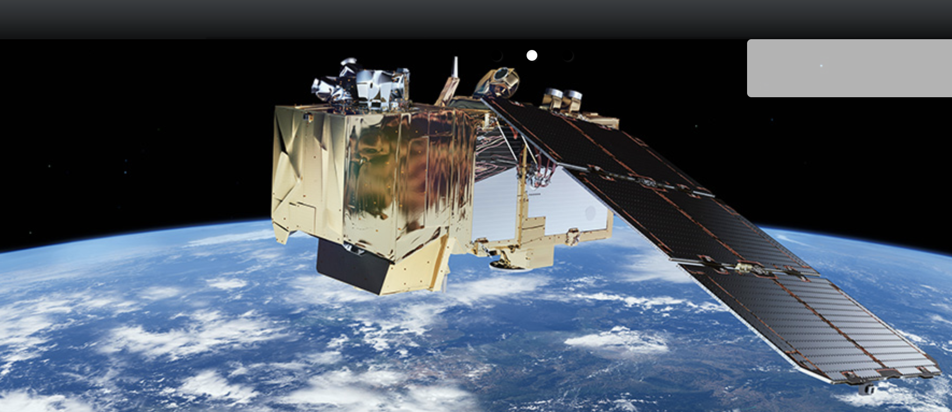
Landsat-S2 ARD Interoperability
Landsat/Sentinel-2 Interoperability (as MRI Framework case study)
Terminology
Geometric
Radiometric Top-of-Atmosphere (TOA)
Radiometric Bottom-of-Atmosphere (BOA)

Slide 3
Terminology
Draft 5 of the Terminology document being discussed.
  Analysis Ready Data (ARD)
  Interoperable Products
  Harmonised Products
  Fused Products
  CEOS ARD for Land (CARD4L) Products
Main discrepancy on the definition of Harmonised / Fused terms.
Plan to share with LSI-VC and finalise during Q1 2019.

Slide 4
Terminology (draft)
Analysis Ready Data (ARD)
  An Analysis Ready Data (ARD) product is generated from raw data and processed so that it can be used directly without the need for further processing to be applied by users.
  This definition is intentionally broad to cover a large range of processing levels and possibilities. There is, however, a minimum processing requirement to be an ARD-compliant product: the data must be processed to a geo-referenced projection to enable the position identification within the data product. Beyond this minimum requirement, additional levels of geometric and radiometric processing may be applied to further prepare the data for analysis, reducing the amount of pre-processing for an end user.
Interoperable Products
  Interoperable Products refers to a set of two or more ARD products which are sufficiently documented to enable processing across a continuum of geometric and/or radiometric standards to permit direct quantitative comparison.
  This definition is intentionally broad and covers a large range of processing levels and possibilities, but is constrained at one extreme by a minimum processing requirement for an ARD product: that the data is geometrically processed to a geo-referenced projection to enable the identification of the position of the acquired data.

Slide 5
Terminology (draft)
Harmonised Products
  Harmonised Products refers to a set of two or more interoperable products, which have been processed to common geometric and/or radiometric levels to enable direct comparison between the products.
Fused Product
  A Fused Product is a derived, irreversible data product produced by merging two or more fully interoperable products.
CEOS ARD for Land (CARD4L) Products
  CEOS Analysis Ready Data for Land (CARD4L) products are a subset of all ARD products and have been processed to a specified minimum set of requirements and organized into a form that allows immediate analysis with a minimum of additional user effort and interoperability both through time and with other datasets. As a standard, CARD4L represents the initial state from which basic dataset harmonization can be implemented for increasingly interoperable products.

Slide 6
Geometric
Landsat and Sentinel-2 use the same map projection (UTM) although the treatment at zone boundaries is not consistent. The S2 tiling scheme allows for representing the data in multiple zones at boundaries.
The Landsat GLS geometric reference is being harmonized with the S2 GRI. This should improve registration accuracy considerably.
The sampling/gridding strategy has (at least) two aspects:
  Common sample locations –unless Landsat adopts the S2 sampling grid, interoperability will require interpolation.
  Consistent pixel area representation/spatial response –spatial normalization will be required in any case but the details will depend upon the sample alignment.
Plan to develop a set of pixel aggregation weights to synthesize OLI pixels from MSI pixels for 3 situations, and evaluate accuracy:
  Option 1) Retain current pixel grids;
  Option 2) Change Landsat to 10m/20m S2 sampling grid;
  Option 3) Retain 15m/30m sampling but change to corner aligned grid.

Slide 7
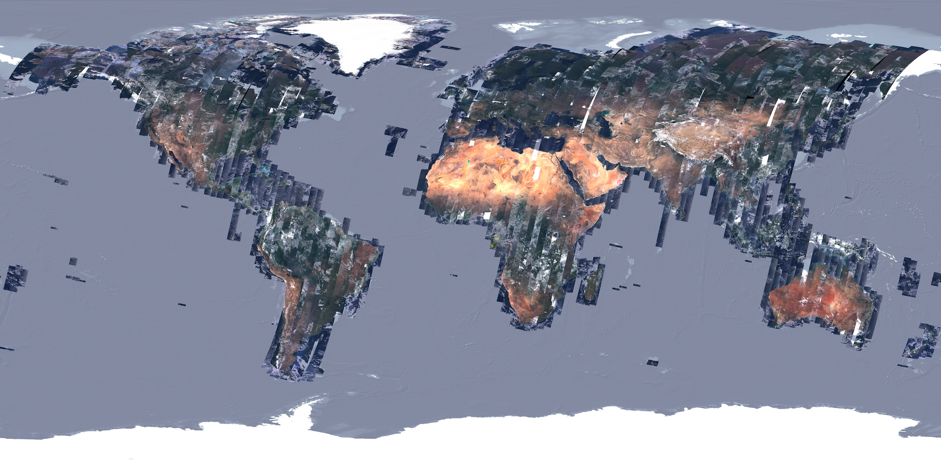
Geometric / GCPs
Sentinel-2 Global Reference Images (GRI) – RGB quicklook

Slide 8
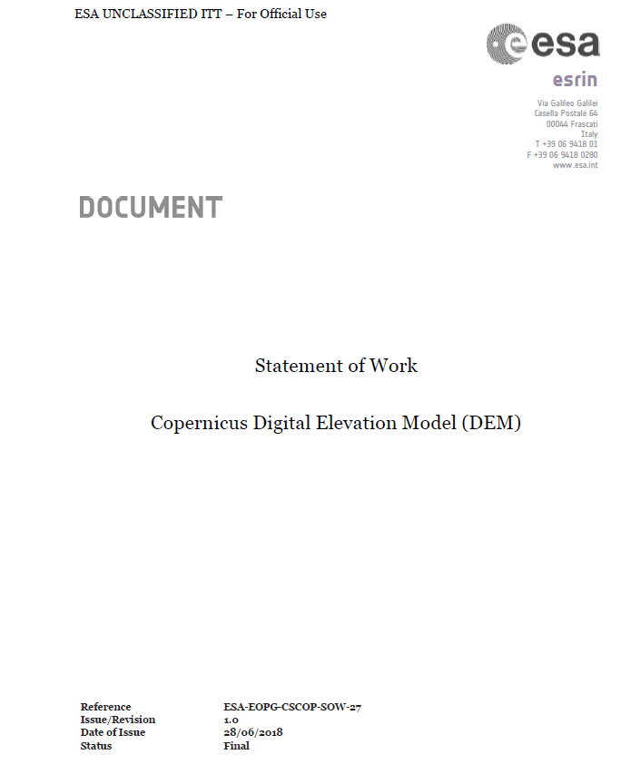
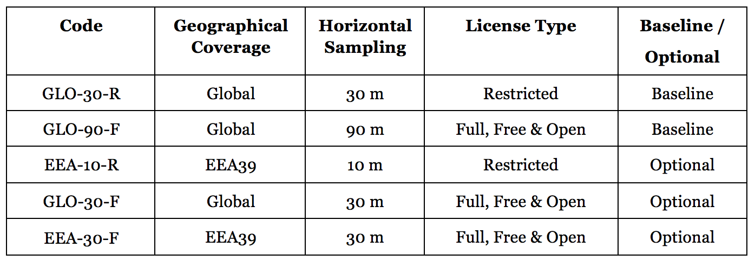
Geometric / DEM
Copernicus DEM – Available by mid-2019.
DEMIX (DEM Intercomparison eXercise) will be organised.
USGS participating in discussions with ESA regarding exercising options for high-quality, redistributable global DEM.

Slide 9
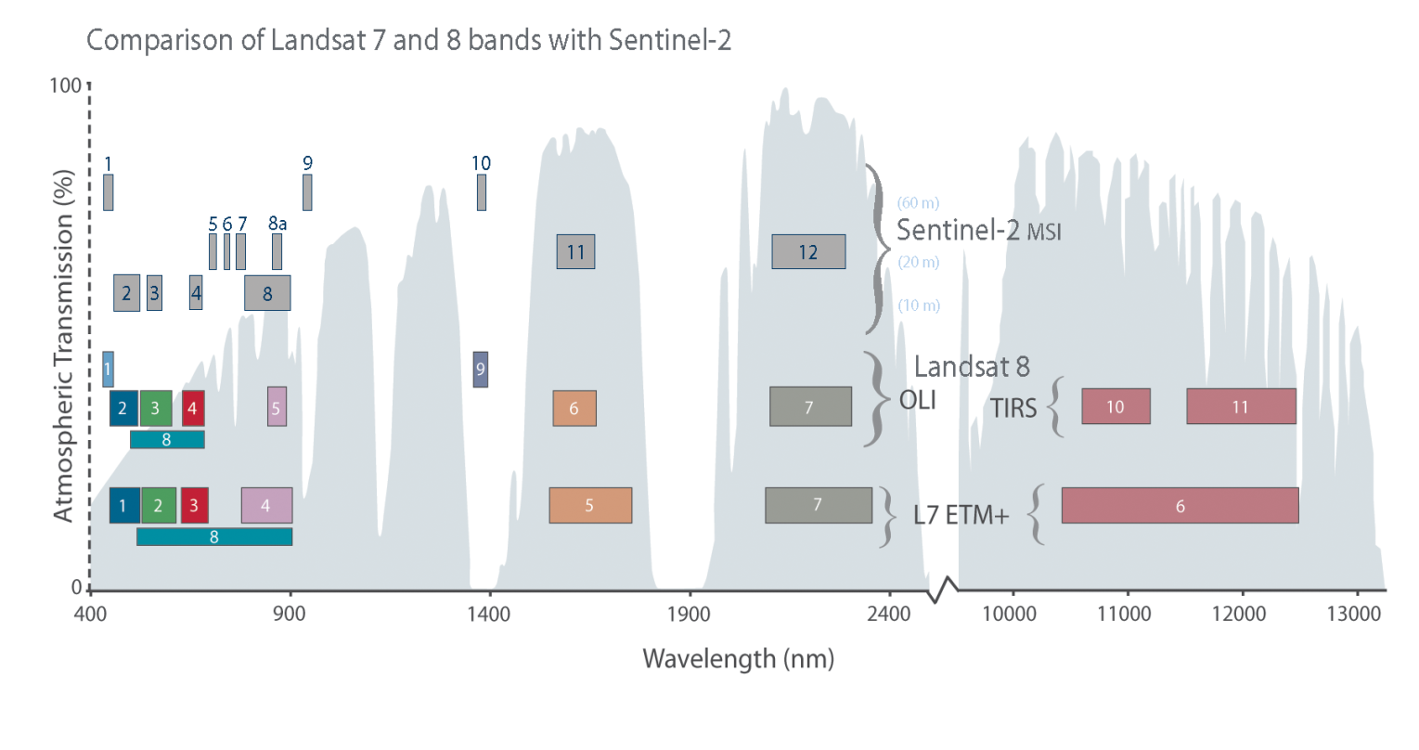
Radiometric

Slide 10
Radiometric TOA
Inter-comparison of Landsat-S2 TOA measurements submitted for publication:
  “An inter-comparison exercise of Sentinel-2 radiometric validations assessed by independent expert groups”
  Co-authors: Nicolas Lamquin, Véronique Bruniquel (ACRI-ST), Ferran Gasco (ESA), Emma Wooliams, Javier Gorrono (NPL), Yves Govaerts, Vincent Leroy (Rayference), Vincent Lonjou (CNES), Julia Barsi (NASA GSFC), Jeffrey Czapla-Myers (University of Arizona), Bahjat Alhammoud (ARGANS), Joel McCorkel (NASA GSFC), Dennis Helder (South Dakota State University/USGS), Bruno Lafrance (CS), Sebastien Clerc (ACRI-ST), Susanne Kratzer (Stockholm University), Brent Holben (NASA GSFC).
Biases measured between Landsat-8/OLI, Sentinel-2A/MSI and Sentinel-2B/MSI, but no inter-calibration foreseen given the magnitude of the biases measured.

Slide 11
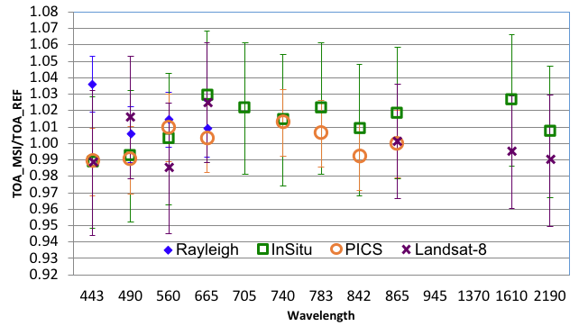
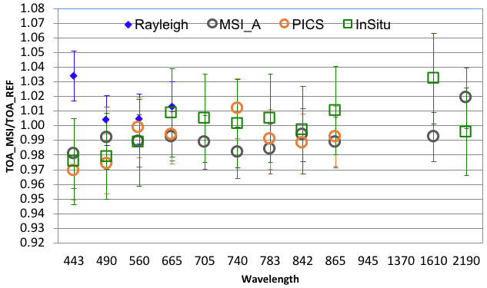
Radiometric TOA
S2A
S2B
[nm]
[nm]
Plots show the ratio of MSI measurements over reference values.
Error bars indicate the validation method uncertainty.
Notes:
The absolute radiometric calibration relies on the on-board solar diffuser. However, this calibration is validated by using several methods:
Rayleigh method is a so-called vicarious method, that means that the equivalent TOA radiance is computed for a known surface reflectance and atmosphere, in this case over stable oceanic regions, far from land so to ensure a purely maritime aerosol model [Rayleigh scattering can accurately be calculated based on the surface pressure and viewing angles][low concentration of phytoplankton and sediment] [low wind speed, less than 5 m/s] [low aerosol content] [6 Cal/Val sites were selected]
Comparison with in-situ data; that means comparison with the TOA normalized reflectance [reconstructed by the University of Arizona] using ground and atmosphere radiometric measurements provided by NASA (Landsat Cal/Val Team) via ESA as part of the ESA-NASA agreement over the Radiometric Calibration Test Site [Railroad Valley Playa site] [the dataset has been specifically generated for the spectral bands of S2A using hyperspectral reference profiles of the site]
Measurement over well characterized, temporally stable desert areas (Pseudo-Invariant Calibration Sites or PICS) [for this sites we have built a reference BRDF model using TOA measurements from MERIS than propagated to the surface using an inverse Radiative Transfer simulation. Therefore we have a database of BOA measurements with various acquisition geometries, i.e. Sun and viewing zenith angles, and relative azimuth angle. Then, the TOA measurement is simulated by using the BRDF model, the observation geometry, ozone and WV content from the European Centre for Medium-range for Weather Forecasts, and constant AOT is assumed]
Comparison with other sensors (Landsat-8 OLI and S2A for S2B case) [near-simultaneous TOA reflectance measurements made under similar observational geometries, over the same natural target. [The comparison is done over three desert sites: Algeria-3, Libya-4 and Railroad Valley Playa]
A small systematic difference in radiometry is observed between S2A and S2B: S2A is brighter (measured reflectance is higher) than S2B by about 1%. This difference is currently under study.
B9 Water vapour
B10 cirrus
For Band B10 direct validation is not possible

Slide 12

Radiometric BOA
ACIX (Atmospheric Correction Inter-Comparison eXercise) co-organised by ESA and NASA in CEOS/WGCV.
Results from first ACIX exercise published in Remote Sensing MDPI:
  “Atmospheric Correction Inter-Comparison Exercise”
  Co-authors: Georgia Doxani (ESA), Eric Vermote (NASA), Jean-Claude Roger (University of Maryland), Ferran Gascon (ESA), et al.
ACIX II being organised, and extended to Cloud Masking with CMIX.
  https://earth.esa.int/web/sppa/meetings-workshops/hosted-and-co-sponsored-meetings/acix-ii-cmix

Slide 13
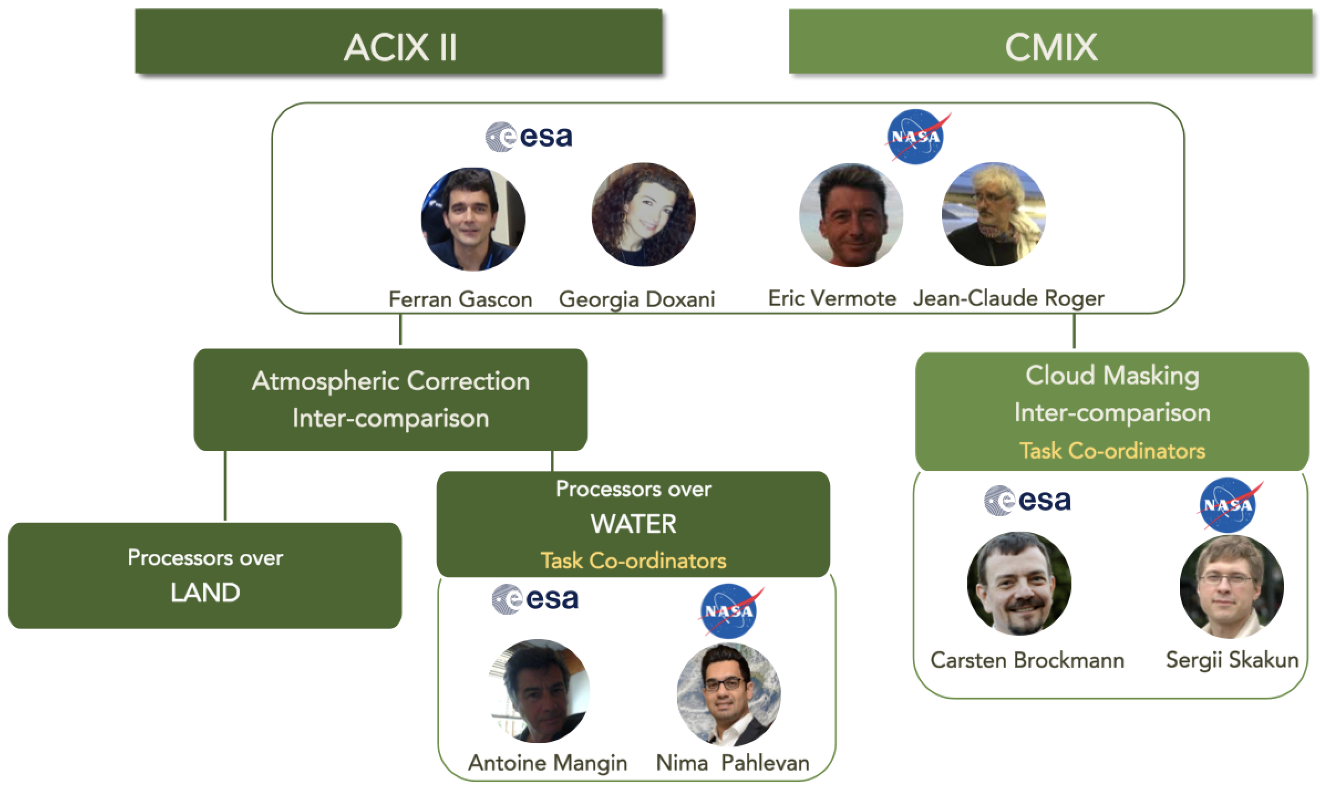
Radiometric BOA

Slide 14
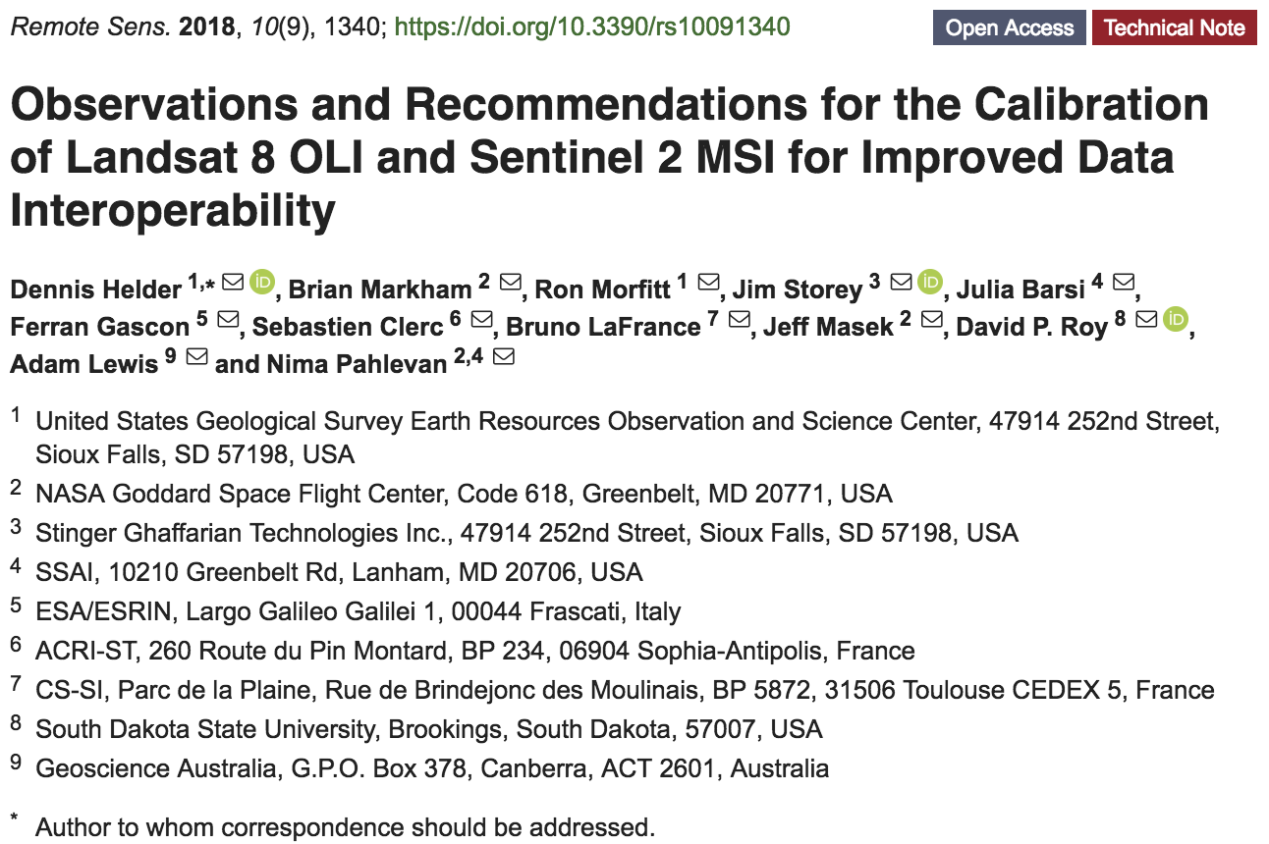
Landsat-S2 ARD Interoperability
  https://www.mdpi.com/2072-4292/10/9/1340

Slide 15
MRI New Activity Proposals
From ESA:
Landsat/Sentinel-2 Harmonised/Fused ARD Products
  Cooperation on algorithms.
  Open source library of harmonisation/fusion SW (sen2like, HLS,...).
  Prototype/Demonstration productions.
  Test case with GEOGLAM and GFOI.
Assess practical usability of Discrete Global Grid Systems (DGGS).
From USGS:
Beyond current GRI/DEM focus, would like to see global Landsat (Collection 2)/S-2 Level-2 data easily, persistently availability in architectures that allow deep time-series analysis and other analytics.
Consider making HLS operational.

Slide 16
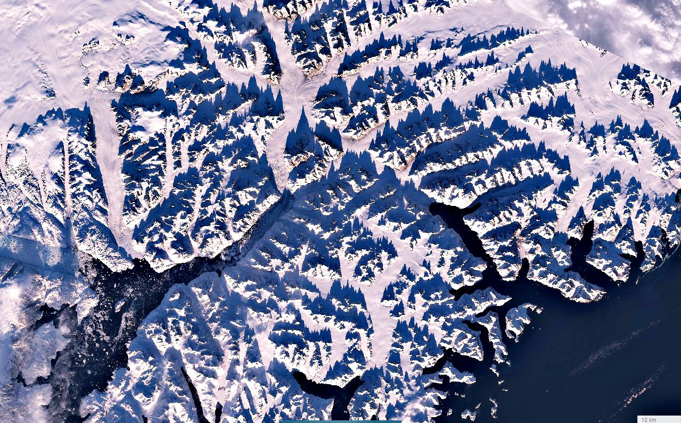
Greenland
Many thanks you for your attention!

