Slide 1
Synthetic Aperture Radar PFSs Status (+ LiDAR) Ake Rosenqvist (soloEO) for JAXA , Takeo Tadono (JAXA) Nuno Miranda (ESA), Bruce Chapman (NASA JPL) Andreia Siqueira (GA), Medhavy Thankappan (GA), Marco Lavalle (JPL), Francois Charbonneau (NRCan), Zheng-Shu Zhou (CSIRO) LSI-VC-8, Anchorage, AK, Sept 4-6, 2019
Committee on Earth Observation Satellites

Slide 2
CARD4L
LiDAR
LiDAR – measurements of vegetation canopy structure and height. GEDI and ICESat-2 launched in 2018 + MOLI targeted for 2022. Proposal to develop CARD4L for LiDAR well received by mission teams.
Oct 2019: Launching new CARD4L subgroup on LiDAR
Group members representing 3 spaceborne LiDAR missions + science users
Laura Duncanson (UMD/NASA GSFC) - GEDI
John Armston (UMD/NASA GSFC) – GEDI
Lola Fatoyinbo (UMD/NASA GSFC) – GEDI
Amy Neuenschwander (U Texas) – ICESat-2
Rei Mitsuhashi (JAXA) - MOLI
Peter Scarth (U Queensland) – advanced science user
Paul Montesano (NASA GSFC) – advanced science user
Richard Lucas (U Aberystwyth) – advanced science user
Ake Rosenqvist/Takeo Tadono (JAXA) – coordinator & layman user guinea pig
Gregory Stensaas, Jeffrey Daniels (USGS)
+ Suggestions for other relevant contributors welcome

Slide 3
CARD4L
Synthetic Aperture Radar
CARD4L subgroup on SAR
Bruce Chapman (JPL) - NISAR
Nuno Miranda (ESA) – Sentinel-1
Medhavy Thankappan (GA)
Marco Lavalle (JPL) - NISAR
Zheng-Shu Zhou (CSIRO) – NovaSAR-AU
François Charbonneau (NRCan) – (RADARSAT/RCM)
Danilo Dadamia (CONAE) – SAOCOM
Takeo Tadono (JAXA) – ALOS/ALOS-2/ALOS-4
Ake Rosenqvist (JAXA) – ALOS/ALOS-2/ALOS-4
Franz Meyer, Kirk Hogenson (ASF)
Andrew Davidson (Ag-Canada)
Good mission representation although participation from ASI, CSA and DLR would be desired.
8 time zones from Alaska to Canberra - Challenge to find viable telecon time slots

Slide 4
CARD4L
Synthetic Aperture Radar PFSs
Key focus for group:
Product Family Specification (PFS) development and alignment
Sample Products for each PFS
Metadata file specifications
Four SAR PFSs:
Normalised Radar Backscatter (NRB)
Polarimetric Radar (PR)
Polarimetric decomposition
Polarimetric covariance matrix
Geocoded SLC (GSLC)
Interferometric Radar (InSAR)
Geocoded interferograms (wrapped / unwrapped)
InSAR coherence

Slide 5
CARD4L
Synthetic Aperture Radar
1. PSF development

Slide 6
CARD4L
Synthetic Aperture Radar PFSs
Normalised Radar Backscatter (NRB)
Leads/contributors: N. Miranda (ESA), B. Chapman (JPL), A. Siqueira (GA), A. Rosenqvist (JAXA)
Radiometrically Terrain Corrected (RTC) ortho-rectified backscatter product in γ⁰.
v1.0 endorsed @ LSI-VC-7
2019/Q4 revision
v2.0 for endorsment @ LSI-VC-9

Slide 7
CARD4L
Synthetic Aperture Radar PFSs
Polarimetric Radar (PR)
Leads: F. Charbonneau (NRCan), M. Lavalle (JPL) & Z-S Zhou (CSIRO)
PR development in focus the past months.
(Tentatively) merging the PD and COV products into a single PSF, Polarimetric Radar (PR)
Polarimetric decomposition (PD)
Polarimetric covariance matrix (COV)
Revision of metadata structure – likely to be used for all SAR PFSs (including NRB v2)
Target for endorsment @ LSI-VC-9

Slide 8
CARD4L
Synthetic Aperture Radar PFSs
Geocoded Single-Look Complex (GSLC)
Lead: B. Chapman (JPL) and H. Zebker (Stanford U)
Geocoding SAR data already at SLC level simplifies generation of interferograms.
Zero Draft based on NISAR NASA SDS Product Description Document (Agram & Buckley, 2018), and NISAR NASA SDS Algorithm Theoretical Basis Document (Agram, Lavelle & Buckley, 2017).

Slide 9
CARD4L
Synthetic Aperture Radar PFSs
Interferometric Products (InSAR)
Lead: M. Thankappan & GA team
A suite of three products generated by InSAR processing of two SLC images captured of the same geographic area at different times.
Limited feedback on CARD4L draft from WGCV and InSAR community
Sept 2019: Decision to move forward (Medhavy comments)

Slide 10
CARD4L
Synthetic Aperture Radar
2. Sample products
Surat Basin (QLD/Australia):
Sentinel-1, ALOS-2 PALSAR-2
Vancouver (Canada)
RADARSAT-2, ALOS-2 PALSAR-2
Sakurajima volcano (Japan)
ALOS-2 PALSAR-2, Sentinel-1
Riau (Indonesia)
ALOS-2 PALSAR-2, Sentinel-1

Slide 11
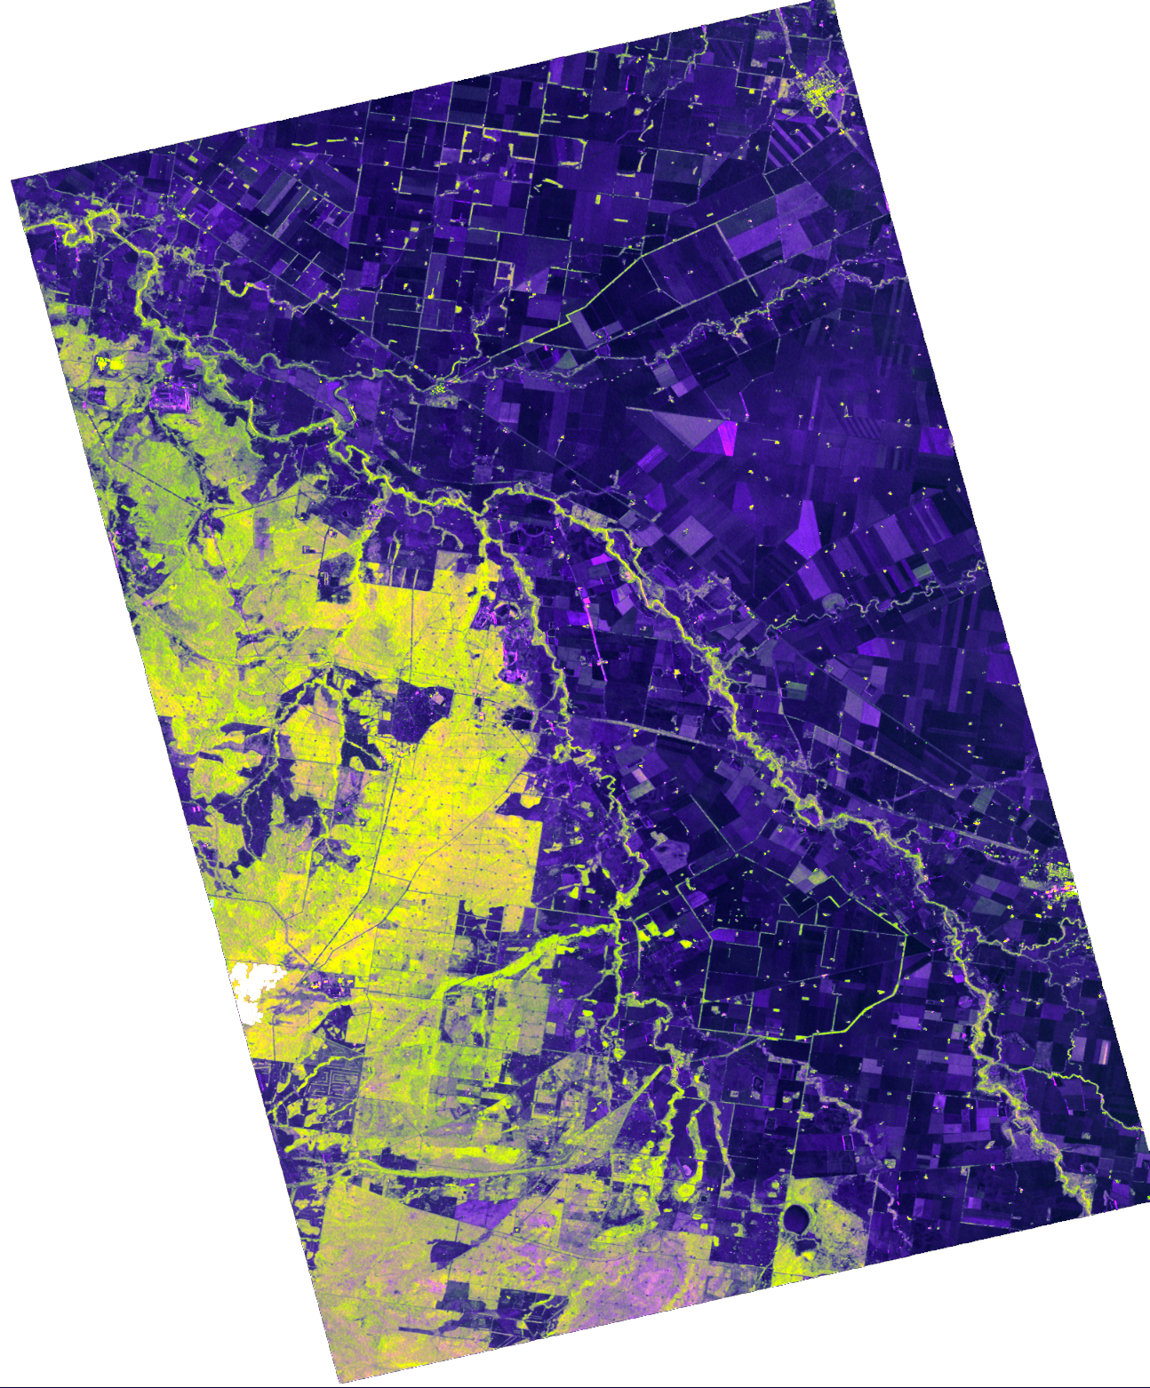
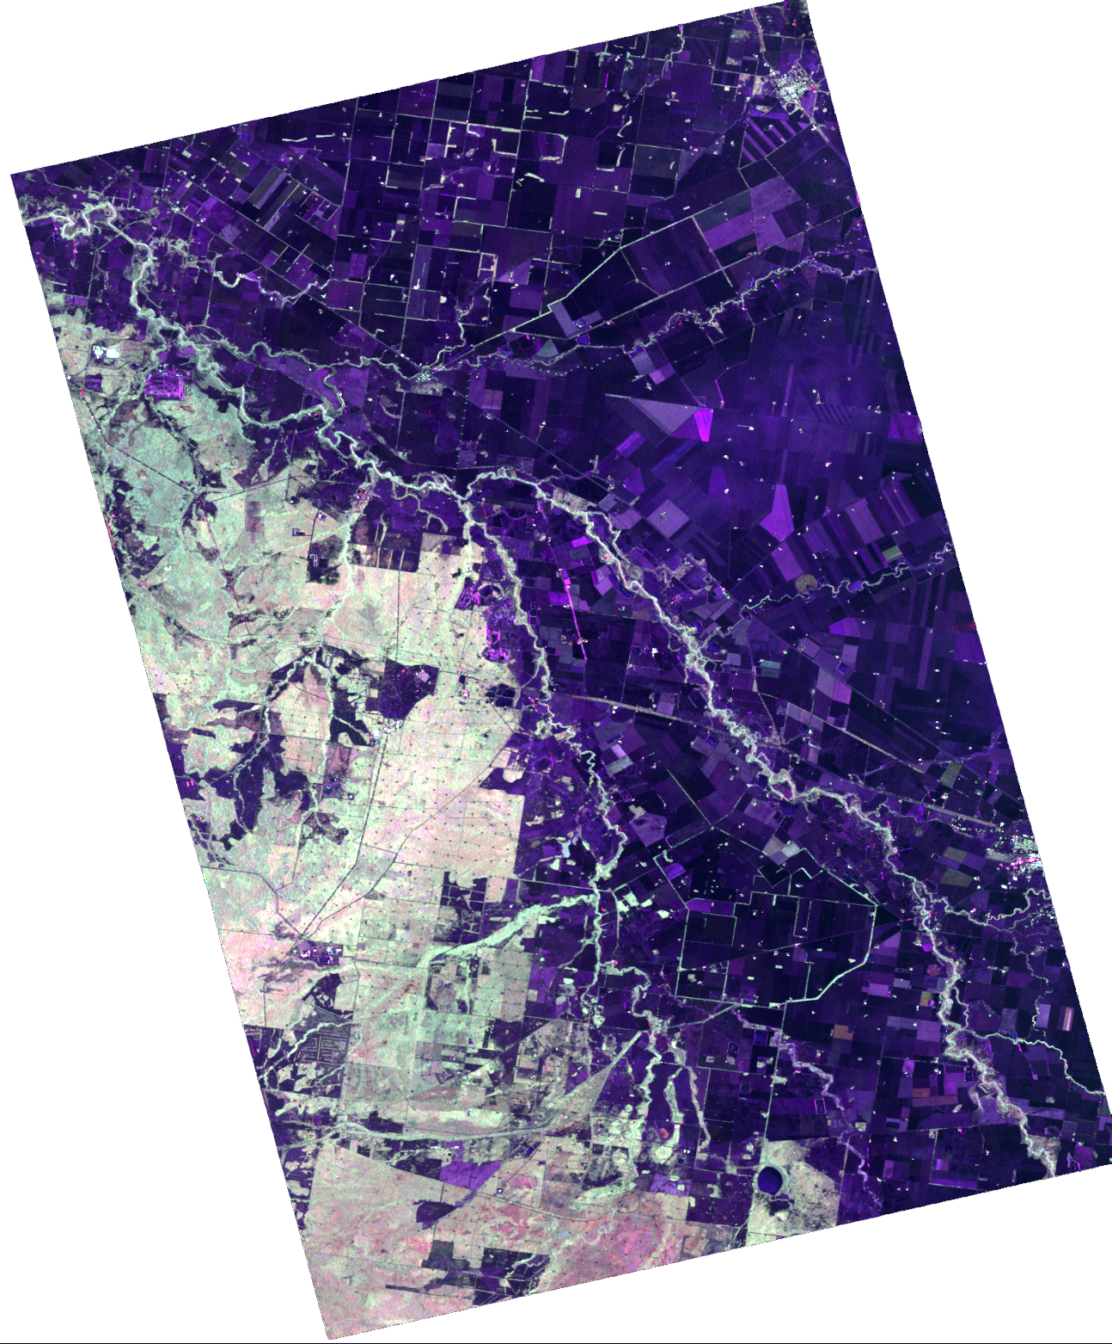
CARD4L SAR
Sample products
ALOS-2 PALSAR-2
Data: JAXA
Proc: Z-S Zhou (CSIRO)
Normalised Radar Backscatter (NRB)
PALSAR-2 Dual-pol NRB
PALSAR-2 Quad-pol NRB
R: HH
G: HV
B: HH/HV
R: HH
G: HV
B: VV
Surat Basin (QLD/AU) Agriculture

Slide 12
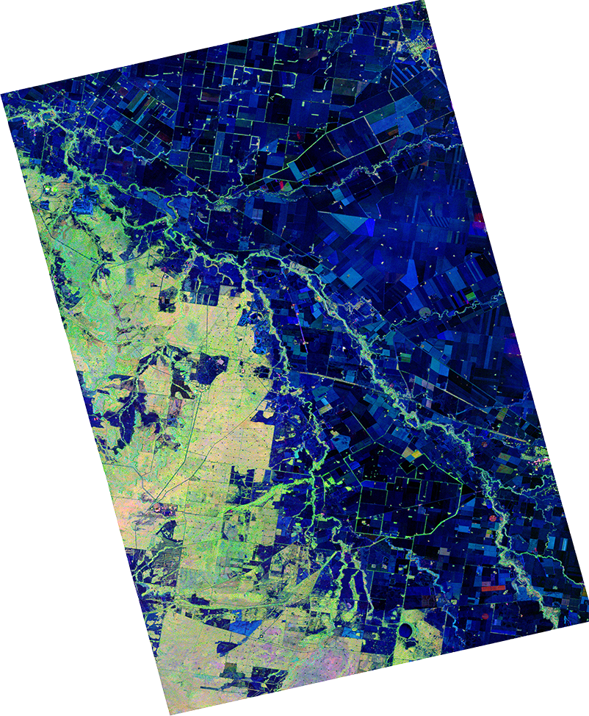
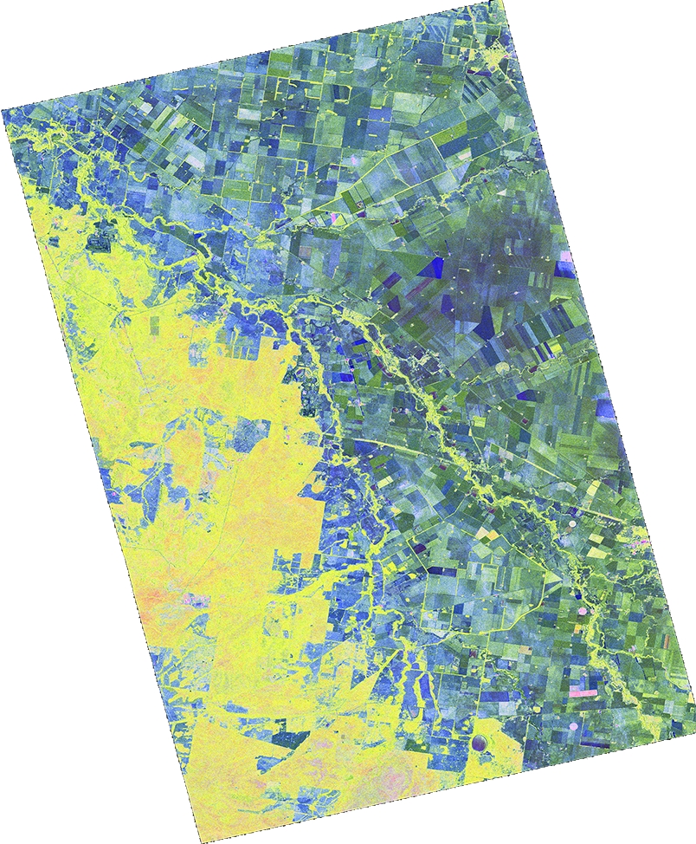
CARD4L SAR
Sample products
ALOS-2 PALSAR-2
Data: JAXA
Proc: Z-S Zhou (CSIRO)
Polarimetric Decomposition (PD)
Yamaguchi decomposition (Quad-pol)
H-A-α decomposition (Quad-pol)
R: α angle
G: H – Entrophy (disorder)
B: A - Anisotrophy (directional dependence)
R: Double-bounce
G: Volume
B: Surface

Slide 13
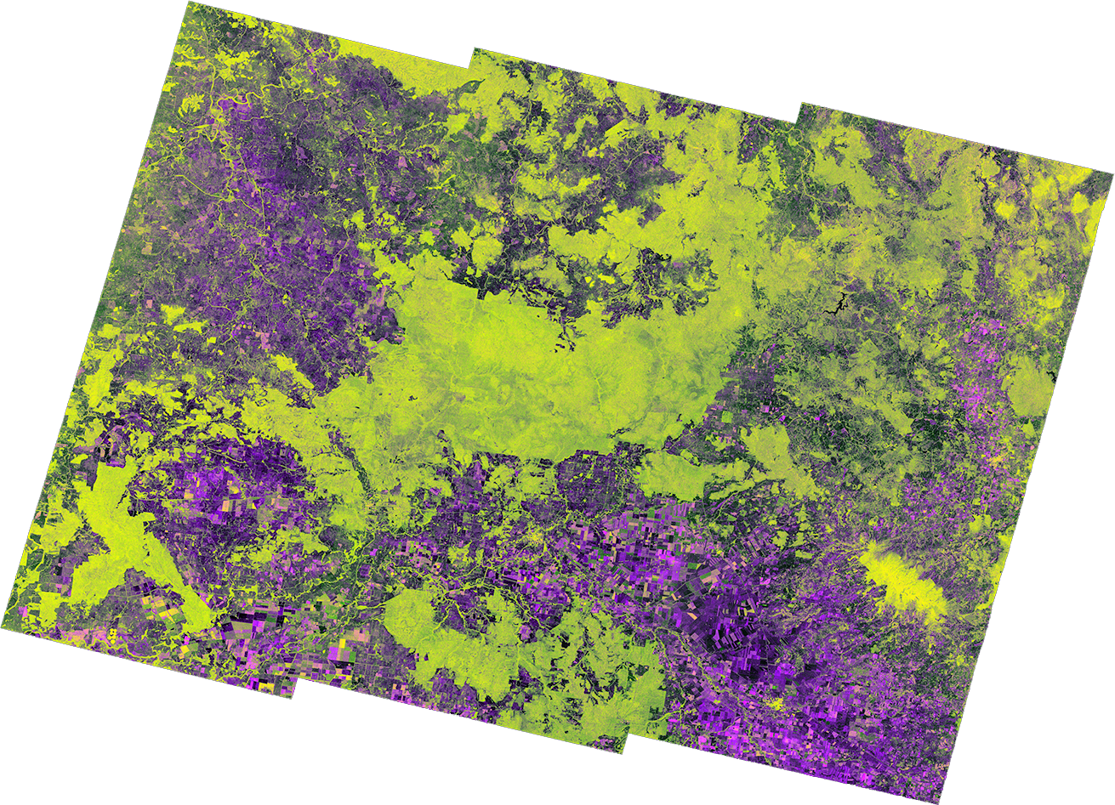
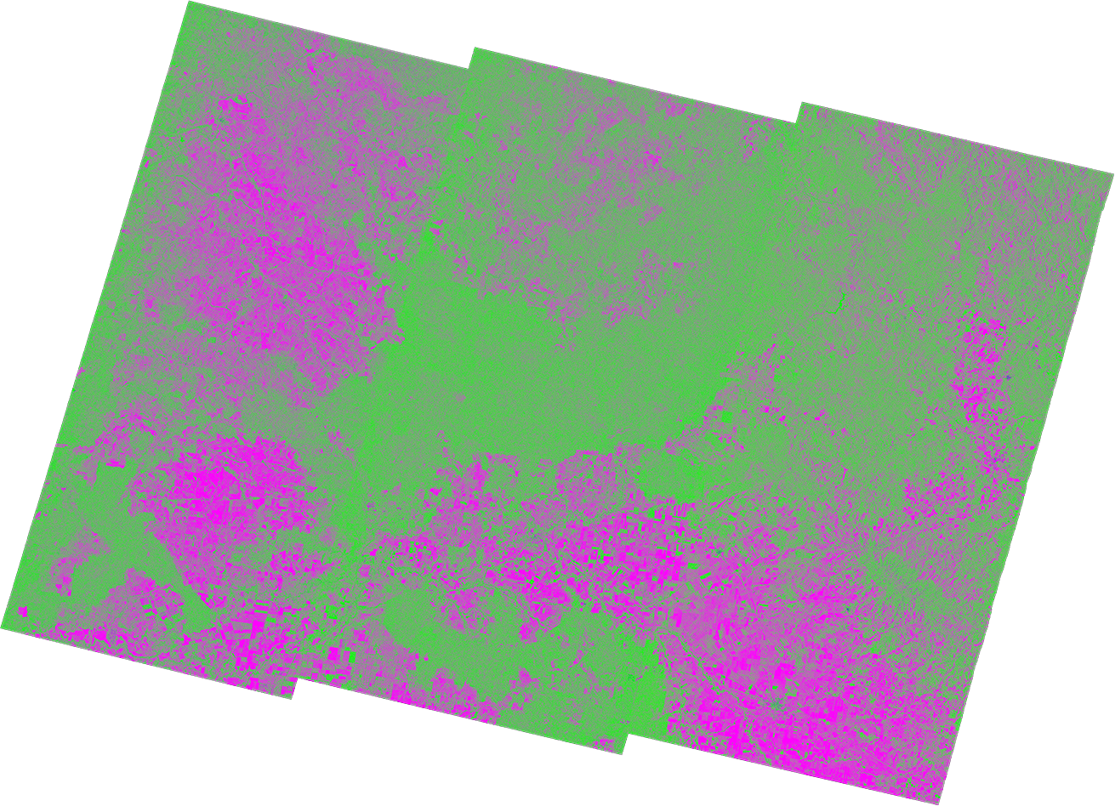
CARD4L SAR
Sample products
Sentinel-1
Data: ESA
Proc: Z-S Zhou (CSIRO)
NRB & PD
Sentinel-1 Dual-pol
Normalised Radar Backscatter
Sentinel-1 Dual-pol
H-A-α decomposition
R: VV
G: VH
B: VV/VH
R: α angle
G: H – Entrophy (disorder)
B: A - Anisotrophy (directional dependence)
Surat Basin (QLD/AU) Agriculture

Slide 14
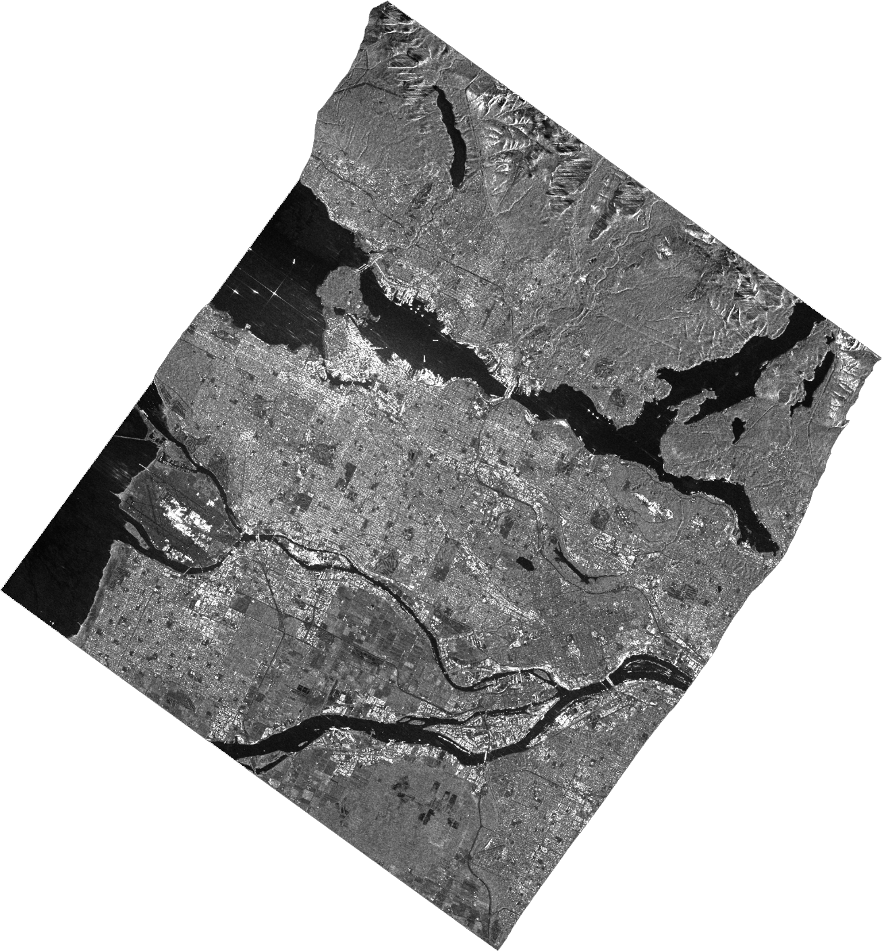
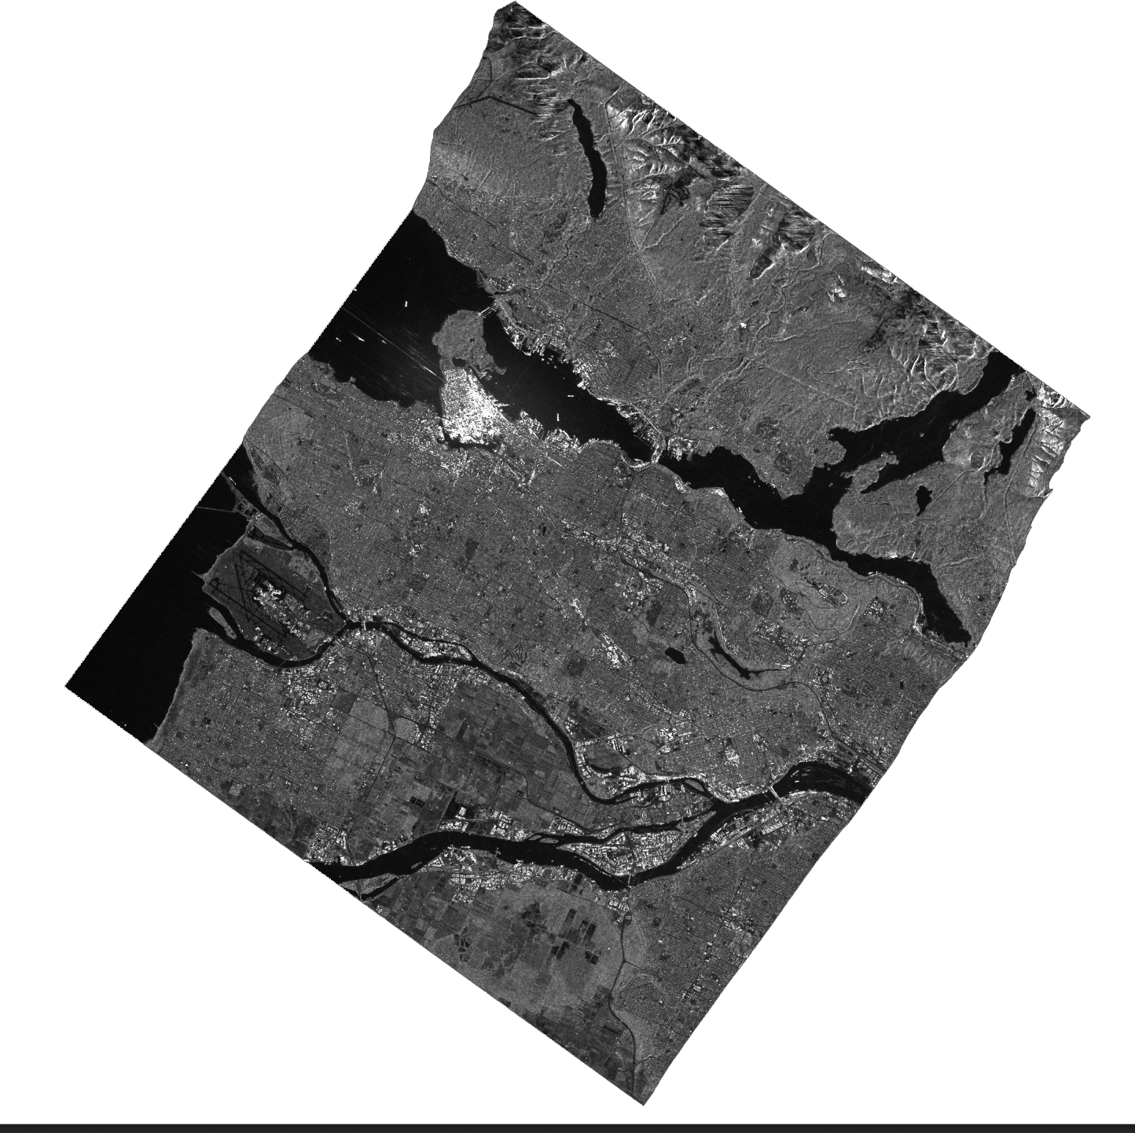
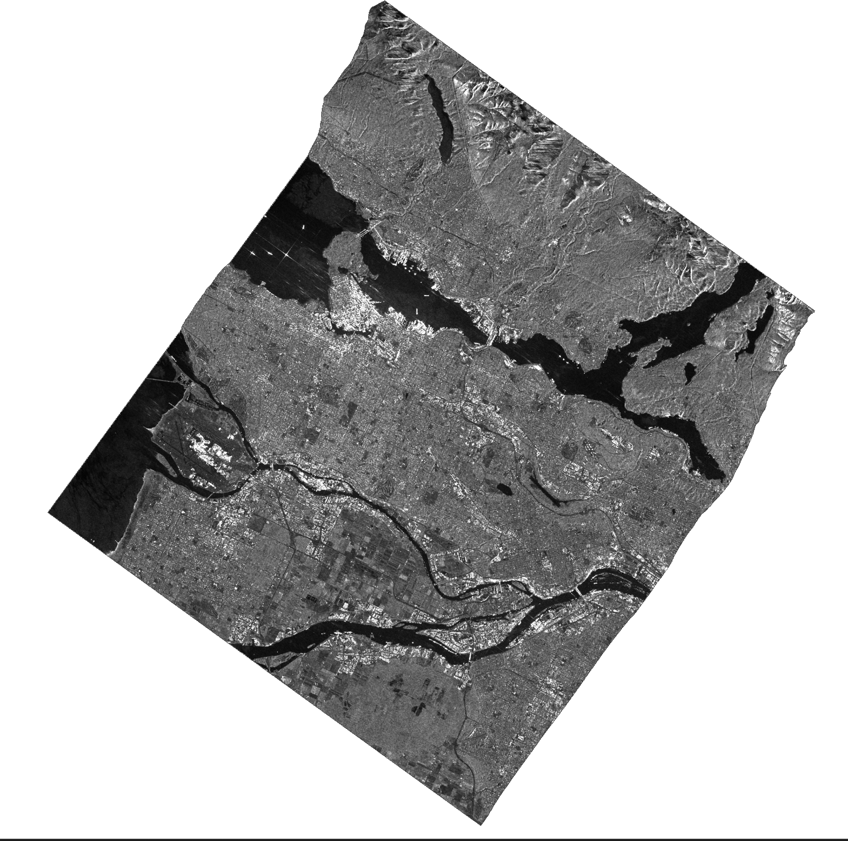
CARD4L SAR
Sample products
RADARSAT-2
Data: CSA
Proc: F. Charbonneau (NRCan)
Polarimetric Covariance Matrix
Vancouver, Canada
Matrix element (1,1)
REAL
HH amplitude
Matrix element (2,2)
REAL
HV amplitude
Matrix element (3,3)
REAL
VV amplitude
Matrix elements (1,2) (1,3) & (2,3)
COMPLEX (2 images each)
Polarimetric phase

Slide 15
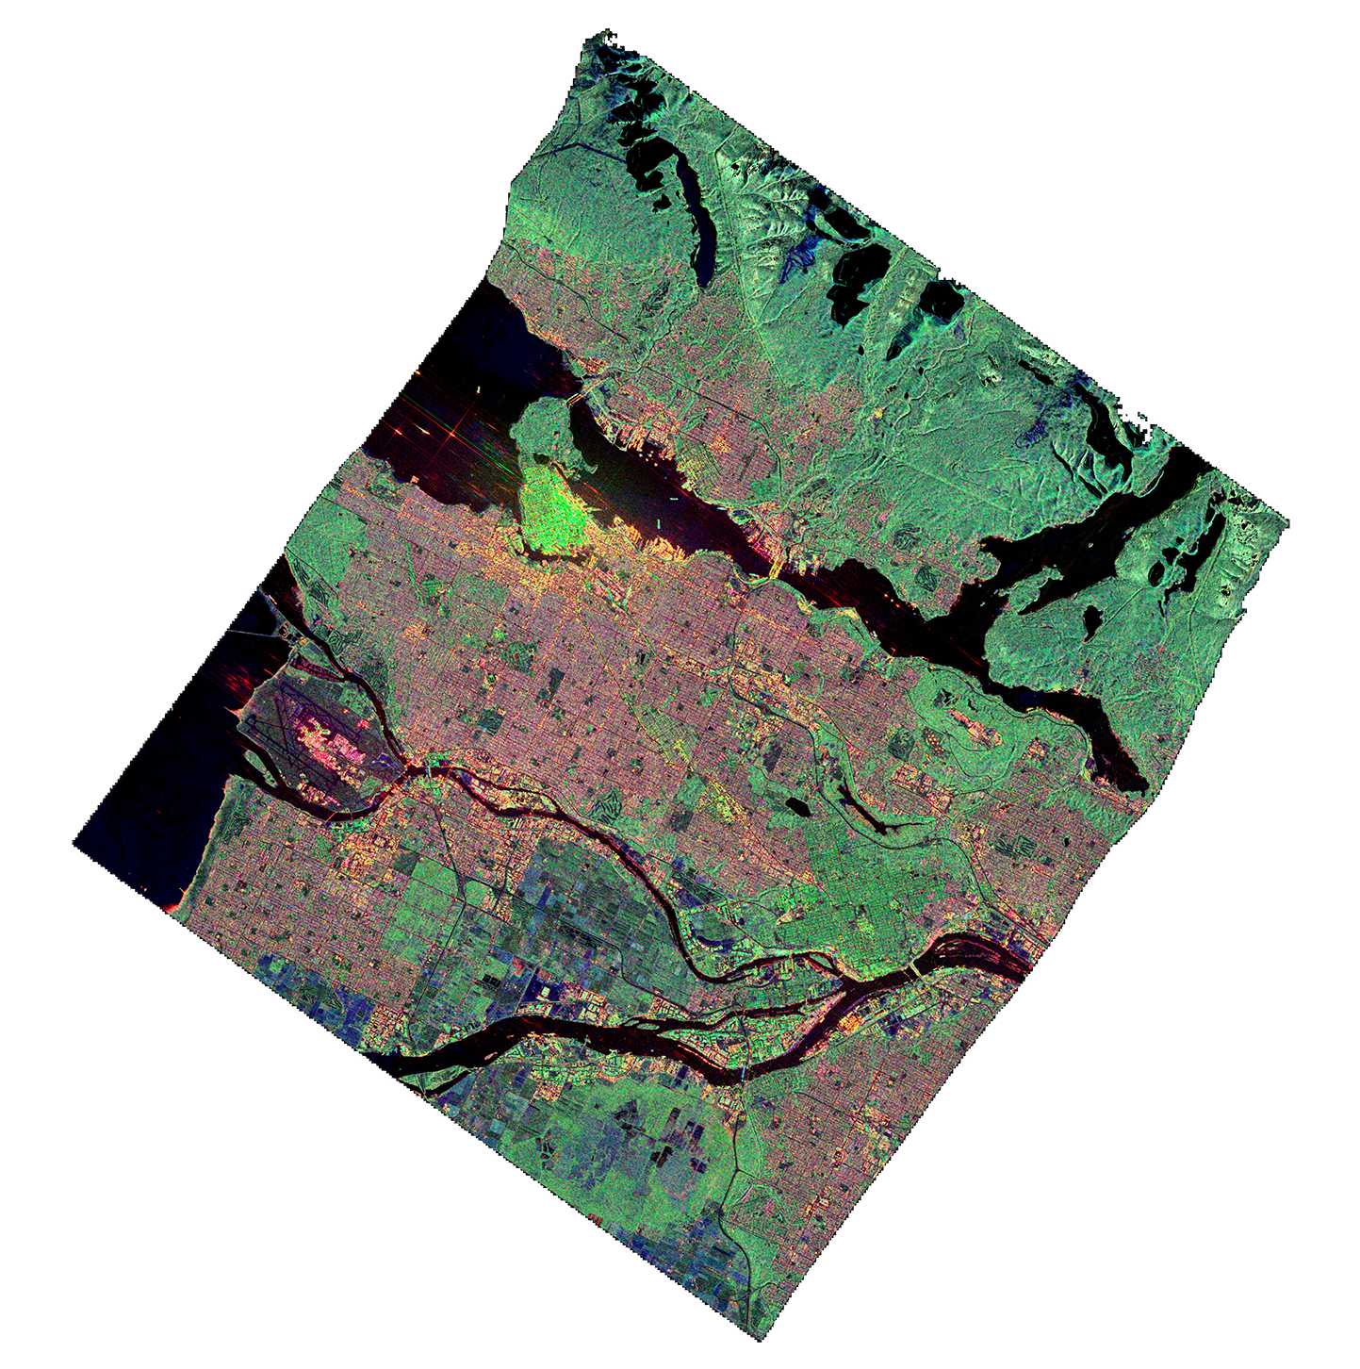
CARD4L SAR
Sample products
RADARSAT-2
Data: CSA
Proc: F. Charbonneau (NRCan)
Polarimetric Decomposition
Yamaguchi decomposition (Quad-pol)
Matrix element (2,2)
REAL
HV amplitude
Vancouver, Canada

Slide 16
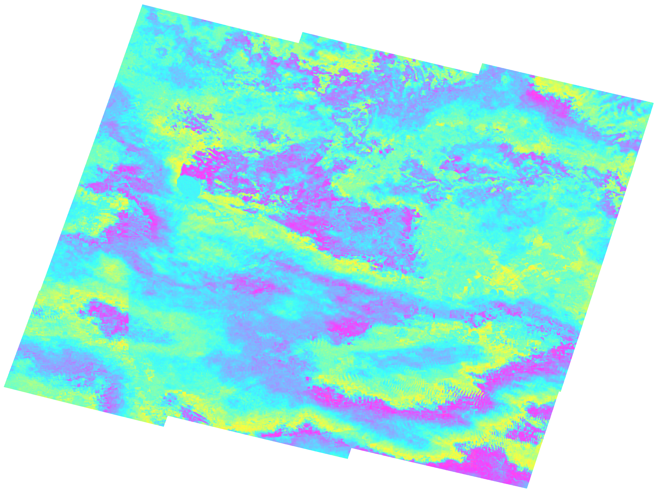
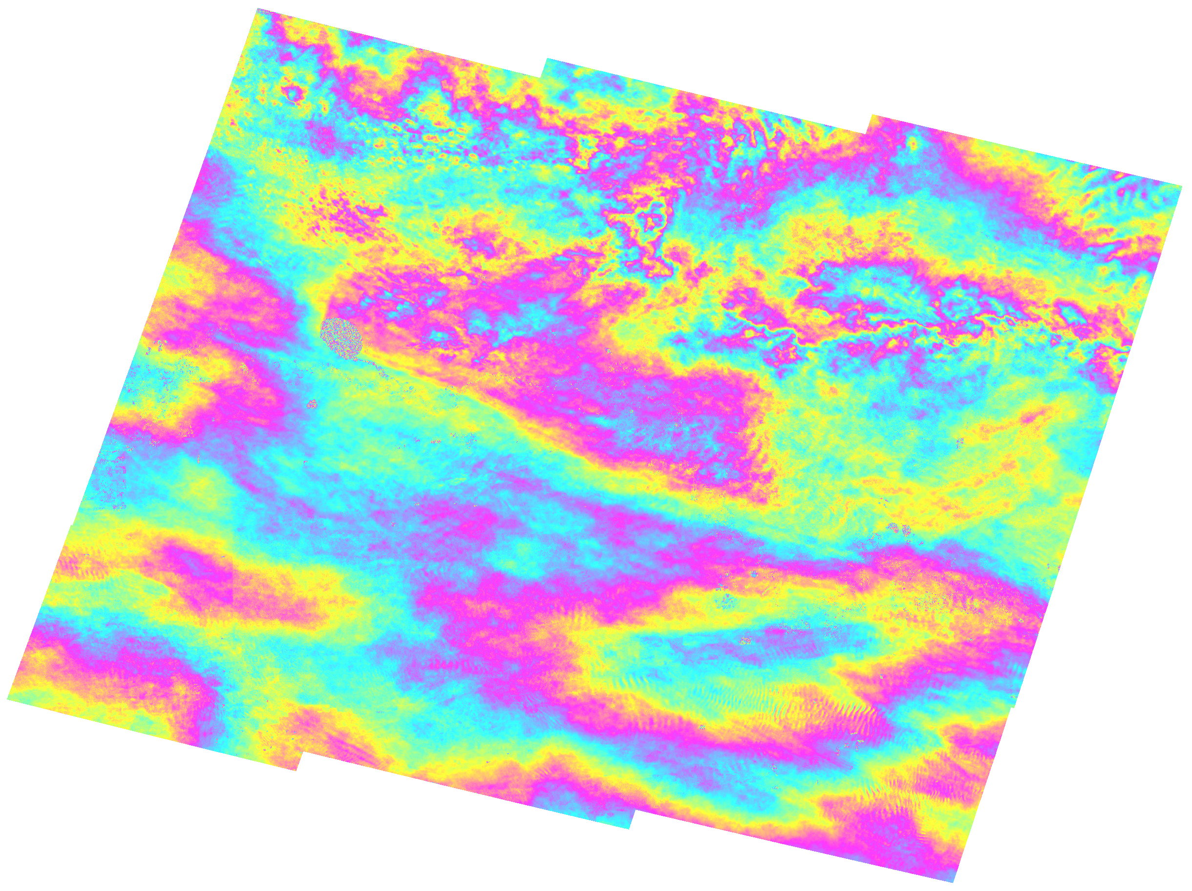
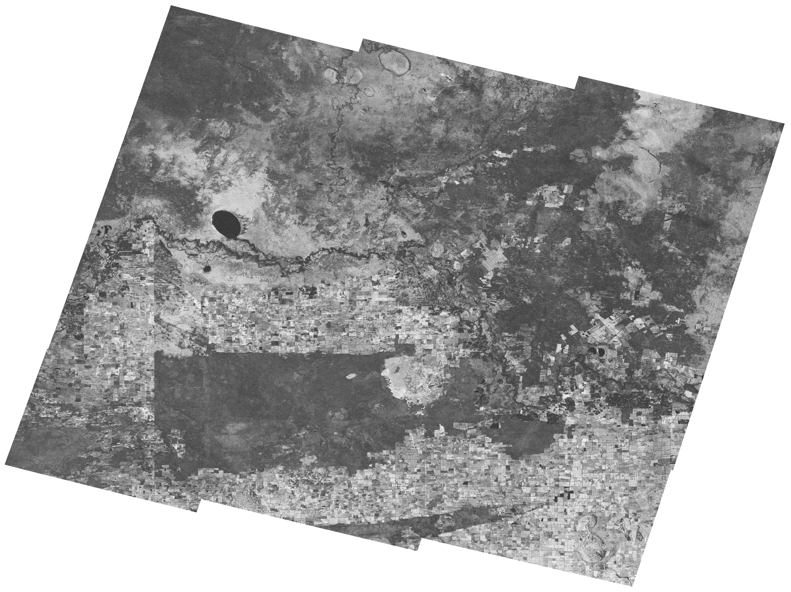
Discussion topics
Sentinel-1
Data: ESA
Proc: M. Thankappan (GA)
Interferometric SAR products
Wrapped interferograms
Studying large deformation events e.g. earthquakes
Time series analysis, using Persistent Scatterer algorithms
Unwrapped interferograms
Time series analysis, using DInSAR-SBAS algorithms
Interferometric coherence
Change detection, land-cover applications

Slide 17
CARD4L
Synthetic Aperture Radar
3. Meta data

Slide 18
Discussion topics
PSF alignment
between SAR PSFs (ongoing)
between optical & SAR? (feasible? SR and ST already endorsed )
CARD4L compliance
Full vs partial compliance
Alternative: address “difficult” parameters in annual revision cycle? (e.g. by moving from threshold to target?)
Meta data
Prescriptive vs free (different opinions also within SAR wg)
Harmonisation of parameter naming (similar to what is currently led by IEEE)
Prescribed format
for self-assessment? (to ease WGCV review)
for sample products made available on CARD4L www?
SAR PFSs still on a “theoretical level”. Self assessment and sample dataset generation expected to reveal detailed feedback that should be incorporated in annual revision cycle.

