Slide 1

CARD4L Products & Assessments
JAXA GLOBAL SAR MOSAICS
Takeo Tadono (JAXA)
Ake Rosenqvist (soloEO) for JAXA
LSI-VC-8, Anchorage, AK, Sept 4-6, 2019
Committee on Earth Observation Satellites

Slide 2
JAXA plans for CARD4L:
Normalised Radar Backscatter (NRB)
  25m ALOS PALSAR/ALOS-2 PALSAR-2 mosaics
    Global coverage (2007-2010; 2015-2018+)
    Derived from 10m/20m Fine Beam data
    Self-assessment ongoing
  50m PALSAR-2 ScanSAR
    Regional coverage (pan-tropical + selected global regions)
    1x1 deg tiles (non-mosaicked)
  ALOS PALSAR (FBS, FBD, POL, ScanSAR)
    Scene-based, Full resolution
    Full archive (2006-2011)
    JAXA to release CARD4L format conversion software

Slide 3
JAXA Global SAR Mosaics –
Candidate for CARD4L Normalised Radar Backscatter
• ALOS-2 PALSAR-2: 2015, 2016, 2017 (2018)
• ALOS PALSAR: 2007, 2008, 2009, 2010
• JERS-1 SAR: 1996
• Global coverage at 25 m pixel spacing, provided in 1°x1° tiles
• Publicly available free of charge at
https://www.eorc.jaxa.jp/ALOS/en/palsar_fnf/fnf_index.htm

Slide 4
JAXA Global SAR Mosaics –
Image and Meta data
Global SAR mosaic datasets image/data layers:
• Radar backscatter (γº ) – HH polarisation
• Radar backscatter (γº ) – HV polarisation
• Local incidence angle
• Observation date image
• Mask image (layover, shadowing, no-data, water)

Slide 5
JAXA Global SAR Mosaics –
Self-assessment for CARD4L NRB (v1.0)
1 – Radiometric corrections
CARD4L specs:
The requirements for radiometric corrections must be met for all pixels and must lead to normalised measurement(s) of backscatter intensity.
γº_{HH}
γº_{HV}
JAXA product compliance:
Radiometric Terrain Correction (RTC) has been undertaken to eliminate incidence angle and topographic effects on the backscatter measurements to render γº using a peer-reviewed algorithm. The backscatter values are given as (2 byte UINT) linear amplitude.
All three sensors (JERS-1 SAR, PALSAR and PALSAR-2) have been subject to absolute calibration (using corner reflectors and radar transponders) and γº can be calculated with the standard formula for amplitude data: γº = 10 * log₁₀(DN²) + K
The global SAR mosaics conform with the CARD4L TARGET requirements for radiometric corrections.

Slide 6
JAXA Global SAR Mosaics –
Self-assessment for CARD4L NRB (v1.0)
2 – Geometric corrections
CARD4L specs:
Relevant metadata relating to geometric accuracy and geometric correction must be provided,
Absolute geolocation at sub-pixel accuracy is required.
γº_{HH}
γº_{HV}
JAXA product compliance:
The global SAR mosaics are ortho-rectified using a peer-reviewed algorithm, utilizing SRTM Digital Elevation Model. (JERS-1 & ALOS-1: SRTM-90, ALOS-2: SRTM-30) In high-latitude regions (>60°N and S), a public open 3-arcsec global DEM is used.
The global SAR mosaics are NOT compliant with parameter a) (≤0.2 pix RMSE pub-pixel accuracy ), and meets the THRESHOLD requirements for parameters b) and c) (DEM quality and consistency; Gridding/sampling frame consistency)

Slide 7
JAXA Global SAR Mosaics –
Self-assessment for CARD4L NRB (v1.0)
3 – General Metadata
CARD4L specs:
The CARD4L NRB specification for general metadata are records describing a distributed collection of pixels that must be contiguous in space and time.
The general metadata should allow the user to assess the overall suitability of the dataset.
Traceability
Metadata machine readability
Data collection time
Geographical area
Coordinate reference system
Map projection
Geometric correction
Geometric accuracy
Instrument
Acquisition parameters
Processing parameters
Sensor calibration
Radiometric accuracy
Algorithms
Ancillary data
Processing chain provenance
Data access
Overall data quality
Performance Indicators
JAXA product compliance:
The SAR mosaics meet
THRESHOLD requirements in seven instances
TARGET in nine instances
Unknown, not applicable or non-compliance in three instances

Slide 8
JAXA Global SAR Mosaics –
Self-assessment for CARD4L NRB (v1.0)
4 – Per-pixel Metadata
CARD4L specs:
The per-pixel metadata specifications apply to each pixel, provided in a single record relevant to all pixels, or separately for each pixel.
JAXA product compliance:
Per-pixel metadata are provided as image data, with pixel-to-pixel correspondence with the backscatter image data. These include local incidence angle, observation date and data masks for layover, shadowing and no-data.
The SAR mosaics meet
THRESHOLD requirements in one instance
TARGET in four instances
unknown, not applicable or non-compliance in four instances.
Local incidence angle Observation date
Mask (shadow, layover, no-data)
1. Metadata machine
readability
2. No data
3. Layover
4. Shadow
5. Local Incidence Angle
6. Global Incidence Angle
7. Digital Elevation Model
8. Noise Equivalent Sigma-0
9. Number of Looks

Slide 9
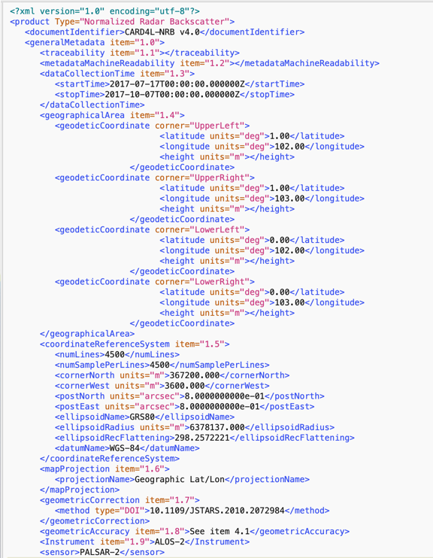
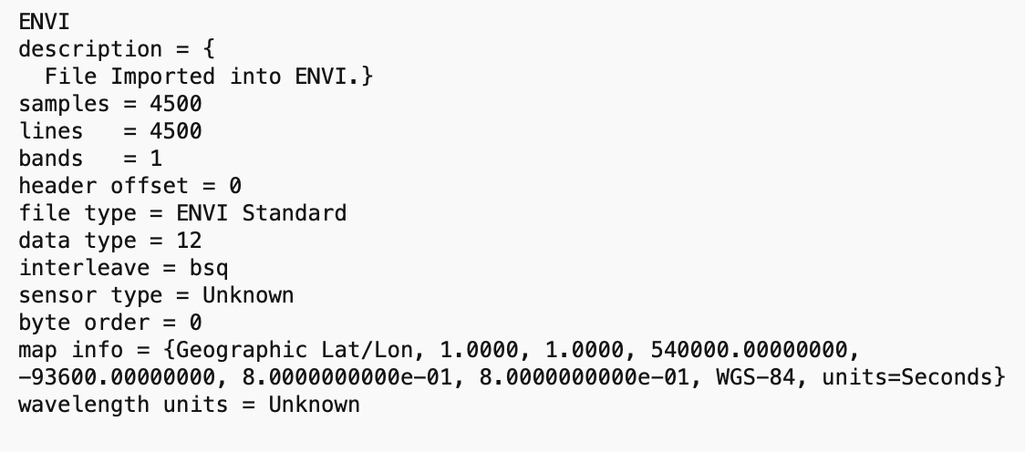
JAXA Global SAR Mosaics –
Self-assessment for CARD4L NRB (v1.0)
Standardised representation of Metadata
JAXA Global mosaic metadata to be modified to conform with the (suggested) CARD4L metadata file format
→
Current
Proposed new

Slide 10
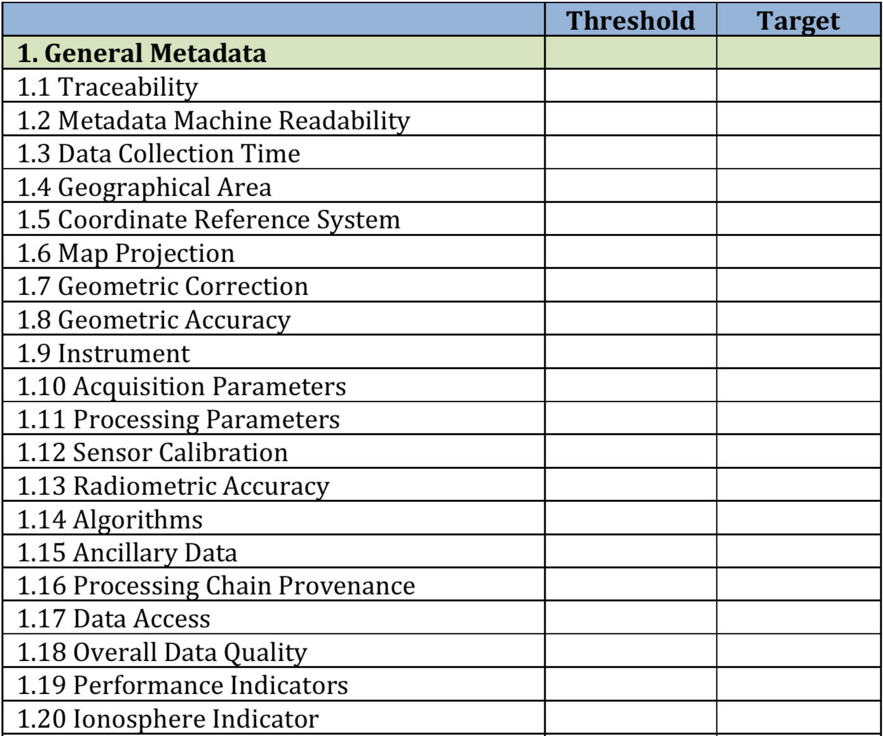
JAXA Global SAR Mosaics –
Self-assessment for CARD4L NRB (v1.0)
YES
YES
NO
YES
YES
YES
YES
NO
YES
YES
YES
YES
NO
YES
YES
YES
YES
YES
YES
NO

Slide 11
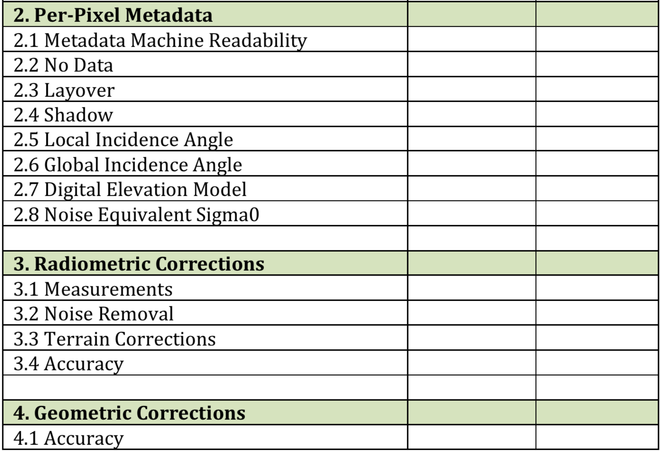
JAXA Global SAR Mosaics –
Self-assessment for CARD4L NRB (v1.0)
YES
YES
YES
YES
YES
NO
NO (N/A)
NO
NO
2.9 Number of Looks
YES
N/A
YES
YES
NO

Slide 12
JAXA Global SAR Mosaics –
Self-assessment for CARD4L NRB (v1.0)
Summary
JAXA’s Global SAR Mosaic products currently NOT FULLY COMPLIANT with CARD4L NRB (v1.0) specs
Actions:
Processing of 2018 Global Mosaic with revised SAR processing software underway to address errors affecting the Geometric Accuracy
Re-processing of historical (2007-2017) Global Mosaic products
Global mosaic metadata to be complemented and/or modified to conform with the (new) CARD4L file formats being developed by the CARD4L SAR group.
Aim to have at least 2018 Global Mosaic product fully compliant with CARD4L NRB (v2.0←) by LSI-VC-9.

